Slide 1
GROUP 8 · DATA SCIENCE CAPSTONE
Fraud Detection
Do relationships between transactions help us catch fraud?
Alia AlGhamdi · Lujain Alqarni · Nada Aljaafari · Remas Almutairi
Notes:
Introduce the team and the question. Fraud is often coordinated: several transactions sharing a card, address or device. Our project asks whether using those relationships improves detection compared with looking at each transaction alone.

Slide 2
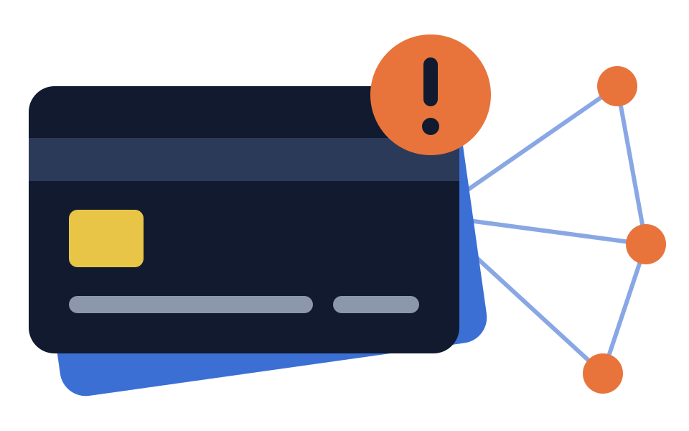
1 · PROBLEM
Fraud often hides in groups
A fraudster may reuse one card, address or device many times. Each transaction can look normal on its own, but together they form a pattern.
Our question
Our hypothesis
Change from proposal
Do relationships between transactions improve fraud detection compared with transaction-level machine learning?
Relationship features will reveal coordinated fraud that single-transaction features miss.
We tried GraphSAGE and RGCN, but neither beat XGBoost, so we compare XGBoost with a neural network (ANN).
Fraud Detection · Group 8
2
Notes:
State the business problem: coordinated fraud that looks normal one transaction at a time. Be upfront that the proposal planned graph neural networks (GraphSAGE, RGCN); we tried both, but neither performed better than XGBoost, so the final comparison uses an ANN, which runs on the same features and split.

Slide 3
2 · DATA
IEEE-CIS: real e-commerce transactions from Vesta
590,540
434
3.5%
76%
labelled transactions
columns after merging two tables
are fraud (20,663 cases)
have no identity record
Transaction table (394 columns: amount, product, card, address, email, anonymised C, D, M, V features) joined to the identity table (41 columns: device details) on TransactionID, with a left join so no transaction is lost.
Fraud Detection · Group 8
3
Notes:
The dataset is the IEEE-CIS Fraud Detection competition data from Kaggle. Two tables joined on TransactionID. The key numbers: 3.5% fraud, so the classes are very imbalanced, and 76% of transactions have no identity data, so missing values are everywhere.

Slide 4
3 · ANALYSIS
Fraud rates vary 5× by product and device
Always predicting "not fraud" would score 96.5% accuracy, so we rank models by Average Precision, not accuracy.
Fraud rate per group · 590,540 transactions
4
Notes:
Main EDA findings. Product C and mobile devices have fraud rates three to five times the average. Credit cards are nearly three times riskier than debit. Transactions with no device info have the lowest rate, so missingness itself carries signal. Amount alone separates poorly (median $75 fraud vs $68.50 legitimate). These are associations, not causes.

Slide 5
4 · APPROACH
A pipeline built to avoid leakage
Step 1
Step 2
Step 3
Step 4
Time-based split
Preprocessing
Baseline XGBoost
Fraud network
Oldest 80% train, newest 20% validate
Learned from training data only
423 transaction features
Explore how fraud connects
Step 5
Step 6
Step 7
Historical features
Compare 4 models
Final model
5 label-free 24-hour counts
XGBoost vs ANN, with and without
Threshold choice and SHAP
Fraud Detection · Group 8
5
Notes:
Walk through the pipeline. The key design choice is the time-based split: a random split would let the model learn from later fraud when predicting earlier fraud. Every preprocessing step (dropping 9 columns over 95% empty, category encoding, medians and scaling for the ANN) was learned from the training period only. Class imbalance was handled with a weight of 27.5 on fraud rather than resampling.

Slide 6
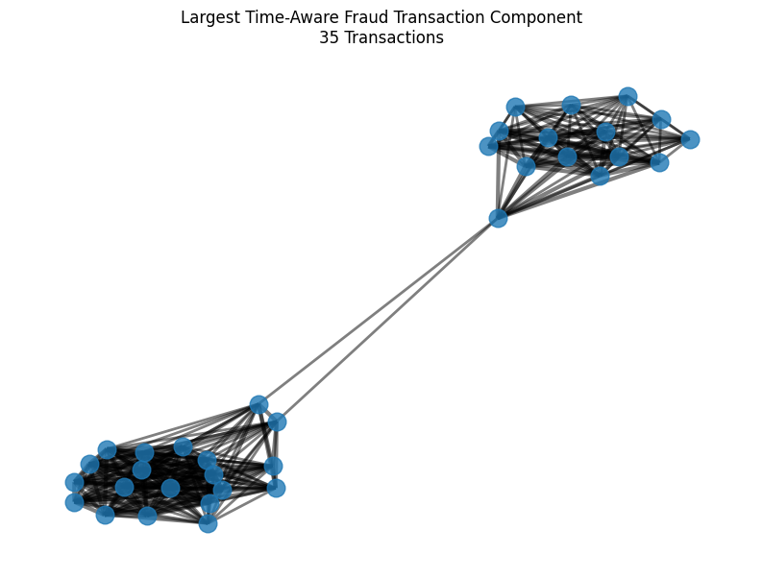
5 · FRAUD NETWORK
35 linked frauds: one card, 73 hours
Link rule: two fraudulent transactions connect when they share a card and an address within 24 hours.
7,519
71%
separate groups
of links also share email or device
This largest group spent $6,305 in two bursts, consistent with one actor returning.
Exploratory only: this graph uses the fraud labels, so feeding it to the model would leak the answer.
12,922 fraud transactions with card and address
6
Notes:
We tested linking rules first. Single attributes like email domain linked too broadly. Card plus address was a good balance, and the 24-hour window made links meaningful. The network has 12,922 nodes, 12,226 edges and 7,519 components. The biggest has 35 transactions on one card, one address and one email domain, across 3 devices over 73 hours. Stress that this graph is exploratory because it uses labels.

Slide 7
6 · FEATURE ENGINEERING
Five label-free relationship features
For each transaction: how many earlier transactions in the last 24 hours shared the same identifier? The fraud label is never used.
Feature | Shares the same… | With a match
card1_prev_count_24h | card | 78.4%
addr1_prev_count_24h | address | 88.7%
email_prev_count_24h | email domain | 83.7%
device_prev_count_24h | device | 17.8%
card_addr_prev_count_24h | card and address | 49.5%
24-hour look-back
Fraud Detection · Group 8
7
Notes:
This is how we used relationships safely. The proposal mentioned neighbourhood fraud density, but counting known fraud would leak the label. So instead we count how busy each identifier was in the past 24 hours. Only past transactions count, which is exactly the information available when a real transaction arrives.

Slide 8
7 · MODELS
XGBoost versus a neural network
XGBoost
Neural network (ANN)
300 trees, depth 6, learning rate 0.05
80% row and column sampling
Handles missing values natively
Fraud weighted 27.5×
Dense layers 256 → 128 → 64
Batch normalisation and dropout
Median fill and standard scaling
Early stopping, fraud weighted 27.5×
Same split, same metrics, same class weight. The only difference inside each pair is the five historical features. We also tried GraphSAGE and RGCN; neither beat XGBoost.
Fraud Detection · Group 8
8
Notes:
XGBoost is the standard strong model for tabular data and was our proposal baseline. The ANN is the deep learning comparison. We also tried GraphSAGE and RGCN from the proposal; neither performed better than XGBoost, so they are not in the final notebook. Keeping everything identical except the five features means any change in score comes from the features.

Slide 9
8 · COMPARISON
XGBoost wins; new features add a little
Features for XGBoost: +0.0017 AP. For the ANN: ROC-AUC up 0.011 but AP down 0.011. XGBoost leads the ANN by about 0.07 AP.
Validation period: newest 118,108 transactions
9
Notes:
We rank by Average Precision because it measures how well fraud rises to the top of the list. ROC-AUC can look strong even with many false alerts. XGBoost beats the ANN clearly; the ANN validation PR-AUC jumped between epochs, a sign of unstable training. The historical features helped XGBoost only slightly.

Slide 10
9 · FINAL MODEL
XGBoost + historical features
0.521
0.909
74%
Average Precision
ROC-AUC
of fraud caught
About 15× a random guess (0.034)
Best of all four models
3,014 of 4,064 at threshold 0.50
Why this one: highest scores, fast to train, handles missing data, and explainable with SHAP. Plain XGBoost is a close, simpler alternative.
10
Notes:
Click to reveal each number. AP 0.521 versus 0.034 for random, ROC-AUC 0.909, and at the default 0.50 threshold it catches 74% of fraud. Be honest that the gain over plain XGBoost is small. The most complex model, the ANN, was not the best.

Slide 11
9 · FINAL MODEL
The alert threshold is a business decision
Threshold | Caught | Missed | False alerts
0.30 | 3,546 | 518 | 25,511
0.50 (default) | 3,014 | 1,050 | 11,108
0.70 | 2,350 | 1,714 | 3,948
0.80 | 1,938 | 2,126 | 1,796
Must stop most fraud → 0.30–0.50
Needs a larger team to review alerts.
Small review team → 0.70–0.80
65–85% fewer false alerts, about half of fraud missed.
4,064 frauds in the validation period
11
Notes:
The model gives a probability; the threshold turns it into an alert. Lower thresholds catch more fraud but flood the team with false alerts. At 0.50, only about 1 in 5 alerts is real fraud. Accuracy at 0.50 is 89.7%, but that mostly reflects the legitimate majority.

Slide 12
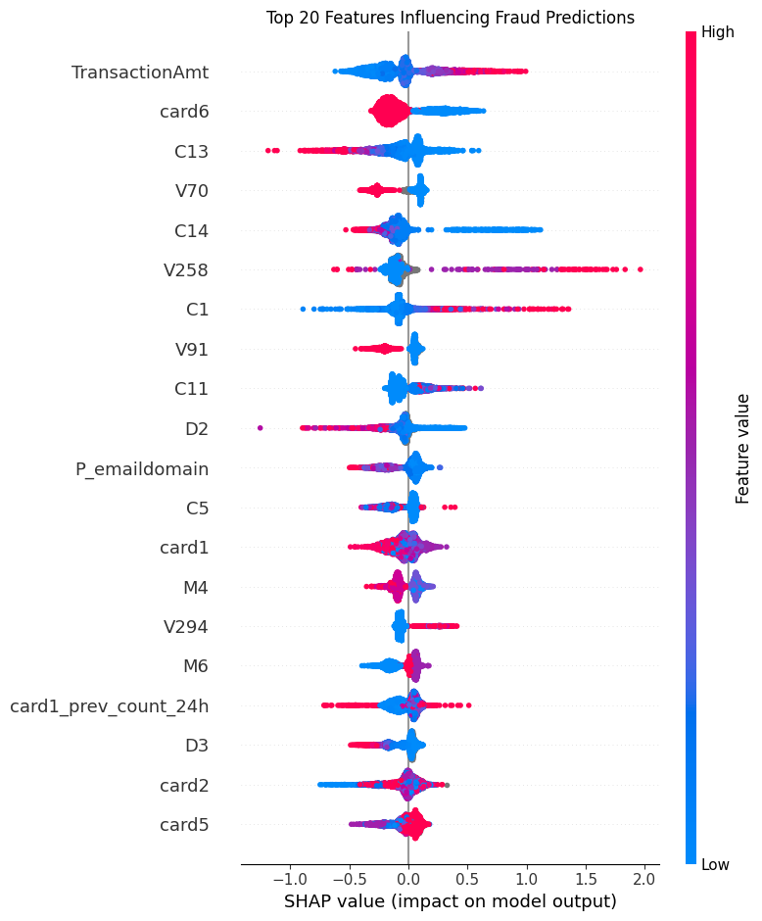
10 · INSIGHTS
What drives the predictions
1. Transaction amount
The strongest driver; higher amounts tend to raise the fraud score.
2. Card type
Matches the EDA: credit cards have almost 3× the fraud rate of debit.
Anonymised C and V features
Fill most of the top 10, but their meaning is hidden.
Our card count ranks 17th of 428
The best historical feature. The model uses it as a supporting signal, not a main driver.
SHAP on 5,000 validation transactions
12
Notes:
Each dot is a transaction; right means pushed toward fraud; red means a high feature value. Amount and card type lead. Among our five features, card count ranks 17th, then address 36th, email 56th, device 61st, card plus address 82nd. Their effect is non-linear.

Slide 13
11 · DASHBOARD
MAKĀMIN | مكامن : from score to evidence
A Streamlit investigation dashboard over 5,000 validation transactions. Pick a transaction, then follow three steps.
1 · Prediction
2 · Explanation
3 · Relationships
Risk score
Top 10 SHAP reasons
24-hour network
Final XGBoost score and decision at the 0.50 reference threshold.
What pushes this transaction toward or away from fraud.
Earlier transactions sharing card, address, email or device.
Demo tool: a link is context for an investigator, not proof of fraud
13
Notes:
MAKĀMIN (مكامن, "Uncovering Hidden Fraud Patterns") takes the 5,000 validation transactions that have SHAP explanations. For a selected transaction it shows the risk score and decision at 0.50, the ten strongest SHAP reasons, and an interactive network of earlier transactions from the previous 24 hours that share its card, address, email domain or device. Future transactions are never used, and fraud labels are added only after links are found. Built with Streamlit, Plotly and PyVis; runs from Kaggle through a temporary link for the demo. If possible, show the live dashboard here.

Slide 14
12 · CHECKING OUR RESULTS
Leakage-aware, but the feature gain is within noise
✓
Done right
!
Watch out
Tested on future transactions only
Preprocessing learned from training data
Features use past data, never labels
Notebook check confirms time order
Labelled network kept out of the model
AP instead of accuracy for 3.5% fraud
ANN early stopping watched validation data
One split, one run: +0.0017 may be noise
XGBoost training scores not recorded
ANN validation score unstable across epochs
Fraud Detection · Group 8
14
Notes:
We designed against leakage from the start. The honest caveats: the ANN used validation PR-AUC for early stopping, so its score is slightly optimistic; the threshold table also used validation data. With one split and one run, the small gain from our features may not hold. Recording XGBoost training scores would show the overfitting gap.

Slide 15
13 · LIMITATIONS AND NEXT STEPS
What limits the results, and what comes next
Limitations
Future work
GNN experiments not in the final notebook
Many top features are anonymised
Card and address are not true customer IDs
Little hyperparameter tuning; CPU only
Real fraud labels arrive late
Revisit GNNs with a richer entity graph
Time-based cross-validation + final test set
Tune XGBoost, report training scores
Stronger customer identifiers
Cost-based threshold; host MAKĀMIN permanently
Fraud Detection · Group 8
15
Notes:
We tried GraphSAGE and RGCN and neither beat XGBoost, but those runs are not in the final notebook, so we cannot show their scores. A stronger customer ID, for example card plus address plus account start date, would make the relationship features sharper.

Slide 16
14 · CONCLUSION
Our hypothesis is partly supported
1
Coordinated fraud is real: up to 35 fraudulent transactions share one card and address.
2
Relationship features are safe and used by the model, but add only a little on top of XGBoost.
3
The most complex models were not the best: XGBoost beat the ANN, GraphSAGE and RGCN, catching 74% of fraud.
Fraud Detection · Group 8
16
Notes:
Click to reveal each takeaway. Relationships exist and can be used without leakage, but a strong tabular model already captures most of the signal. MAKĀMIN shows how an investigator could use the score, its reasons and the related transactions together. Even the graph neural networks we tried did not beat XGBoost.

Slide 17
Thank you
Questions?
Alia AlGhamdi · Lujain Alqarni · Nada Aljaafari · Remas Almutairi
Data: IEEE-CIS Fraud Detection (Kaggle, 2019)
Notes:
Likely questions: Why not GNNs? Why AP instead of accuracy? How do you know there is no leakage? Why weighting instead of SMOTE? Why is the gain from the features so small?

