Slide 1
Session 02
ERD Digaram

Slide 2

Objectives
What is ERD?
ERD elements?
Steps in Building ERD
What is Normalization?
Normalization steps

Slide 3
What Is an ERD?
A picture showing the information created, stored, and used by a business system.
Entities generally represent similar kinds of information
Lines drawn between entities show relationships among the data
High level business rules are also shown

Slide 4

Using the ERD to Show Business Rules
Business rules are constraints that are followed when the system is in operation.
ERD symbols can show when one instance of an entity must exist for an instance of another to exist
  A doctor must exist before appointments for the doctor can be made

Slide 5
Using the ERD to Show Business Rules
ERD symbols can show when one instance of an entity can be related to only one or many instances of another entity
  One doctor can have many patients; each patient may have only one primary doctor
ERD symbols show when the existence of an entity instance is optional for a related entity instance
  A patient may or may not have insurance coverage

Slide 6
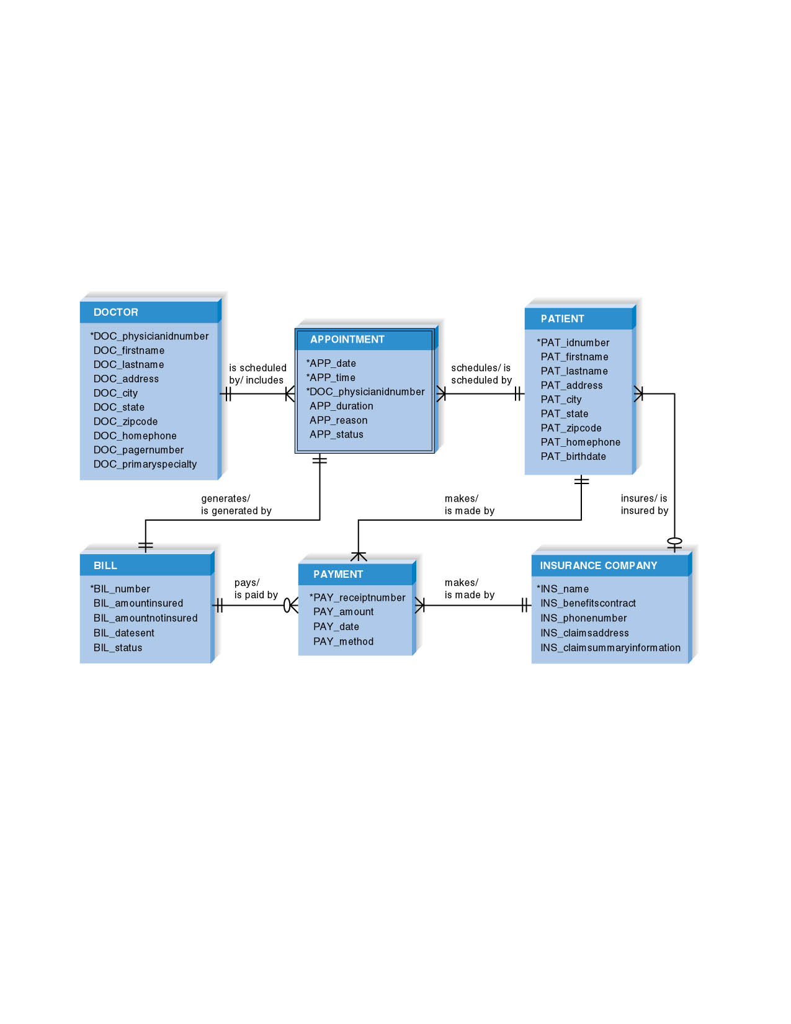
An ERD Example

Slide 7
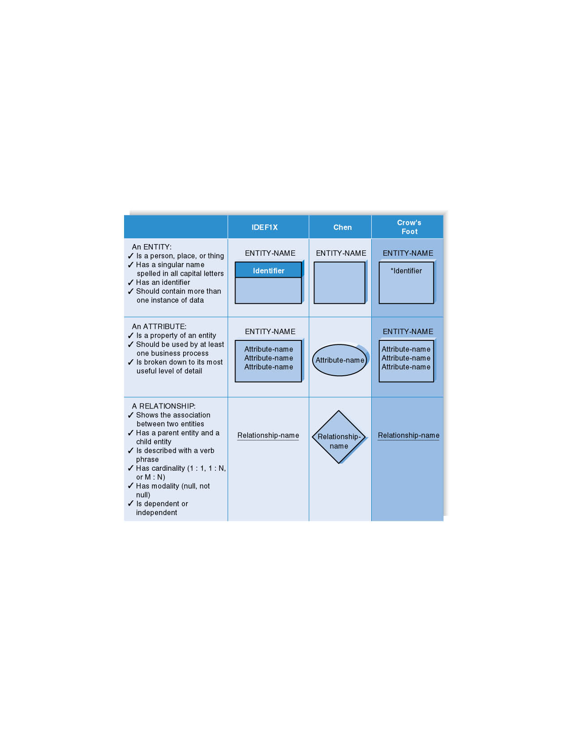
ERD Elements

Slide 8
Entity
A person, place, event, or thing about which data is collected
Must be multiple occurrences to be an entity
  Example: If a firm has only one warehouse, the warehouse is not an entity. However, if the firm has several warehouses, the warehouse could be an entity if the firm wants to store data about each warehouse instance.

Slide 9
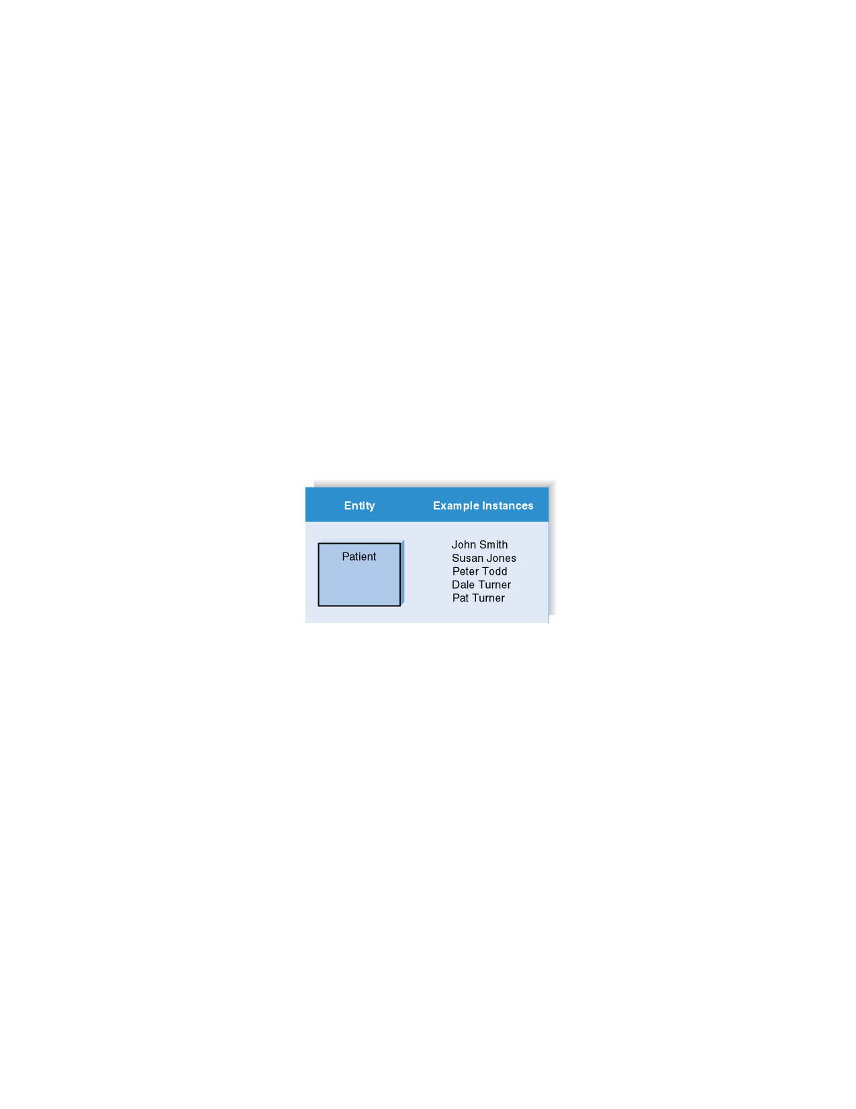
Entities and Instances

Slide 10
Attributes
Information captured about an entity
Only those used by the organization should be included in the model
Attribute names are nouns
Sometimes entity name is added at the beginning of the attribute name for clarity

Slide 11
Identifiers
One or more attributes can serve as the entity identifier, uniquely identifying each entity instance
Concatenated identifier consists of several attributes
An identifier may be ‘artificial,’ such as creating an ID number
Identifiers may not be developed until the Design Phase

Slide 12
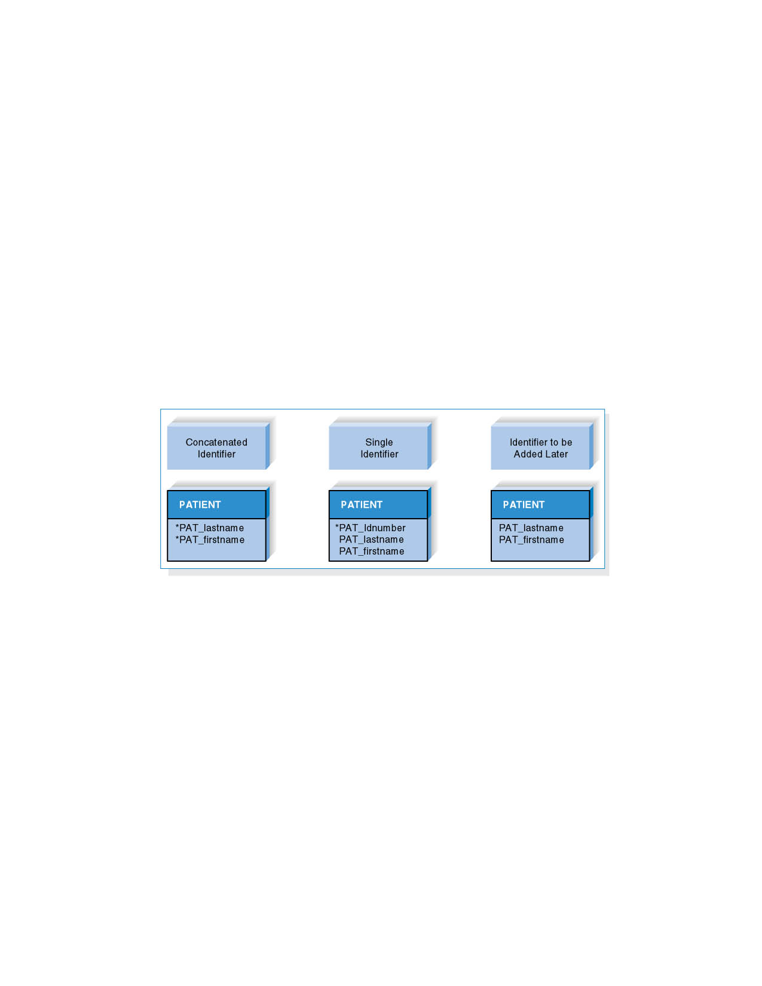
Choices for Identifiers

Slide 13
Relationships
Associations between entities
The first entity in the relationship is the parent entity; the second entity in the relationship is the child entity
Relationships should have active verb names
Relationships go in both directions

Slide 14

Cardinality
Cardinality
  refers to the number of times instances in one entity can be related to instances in another entity
    One instance in an entity refers to one and only one instance in the related entity (1:1)
    One instance in an entity refers to one or more instances in the related entity (1:N)
    One or more instances in an entity refer to one or more instances in the related entity (M:N)

Slide 15
Modality
Modality
  Refers to whether or not an instance of a child entity can exist without a related instance in the parent entity
    Not Null means that an instance in the related entity must exist for an instance in another entity to be valid
    Null means that no instance in the related entity is necessary for an instance in another entity to be valid

Slide 16
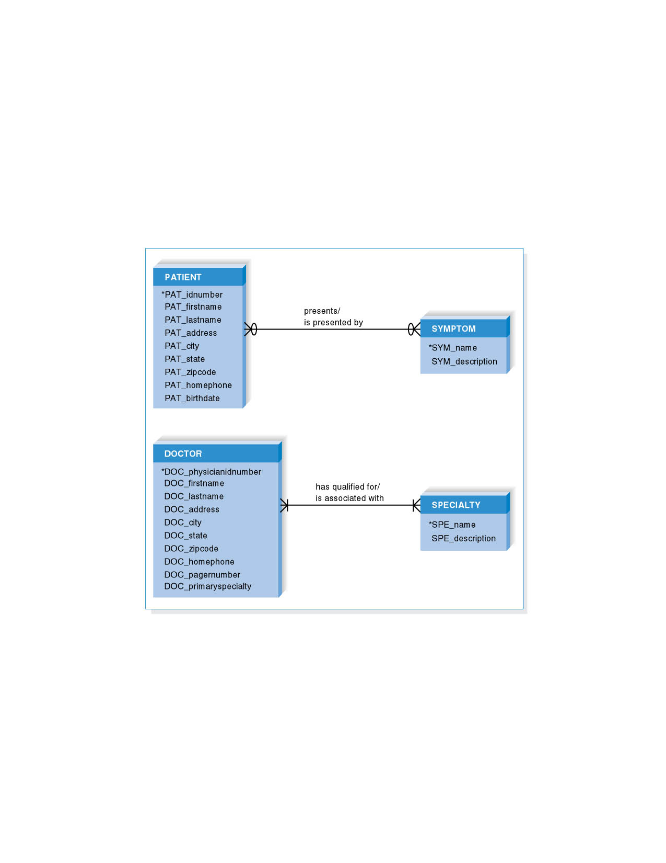
M : N Relationships

Slide 17
BUILDING AN ENTITY-RELATIONSHIP DIAGRAM (ERD)

Slide 18
ERD Basics
Drawing the ERD is an iterative process of trial and revision
ERDs can become quite complex

Slide 19
Steps in Building ERDs
Identify the entities
Add attributes and assign identifiers
Identify relationships

Slide 20
Identify the Entities
Identify major categories of information
  If available, check the process models for data stores, external entities, and data flows
  Check the major inputs and outputs from the use cases
Verify that there is more than one instance of the entity that occurs in the system

Slide 21
Add Attributes and Assign Identifiers
Identify attributes of the entity that are relevant to the system under development
  Check the process model repository entries for details on data flows and data stores
  Check the data requirements of the requirements definition
  Interview knowledgeable users
  Perform document analysis on existing forms and reports
Select the entity’s identifier

Slide 22
Identify Relationships
Start with an entity and identify all entities with which it shares relationships
Describe the relationship with the appropriate verb phrase
Determine the cardinality and modality by discussing the business rules with knowledgeable users

Slide 23
ERD Building Tips
Data stores of the DFD should correspond to entities
Only include entities with more than one instance of information
Don’t include entities associated with implementation of the system (they will be added later)

Slide 24
Advanced Syntax
Independent Entity
  Can exist without the help of another entity
  Identifiers created from the entity’s own attributes
  Attributes from other entities are not needed to uniquely identify instances of these entities
Dependent Entity
  Relationships when a child entity does require attributes from the parent entity to uniquely identify an instance

Slide 25
Advanced Syntax
Intersection Entity
  Exists in order to capture some information about the relationship that exists between two other entities. Typically, intersection entities are added to a data model to store information about two entities sharing an M : N relationship.

Slide 26
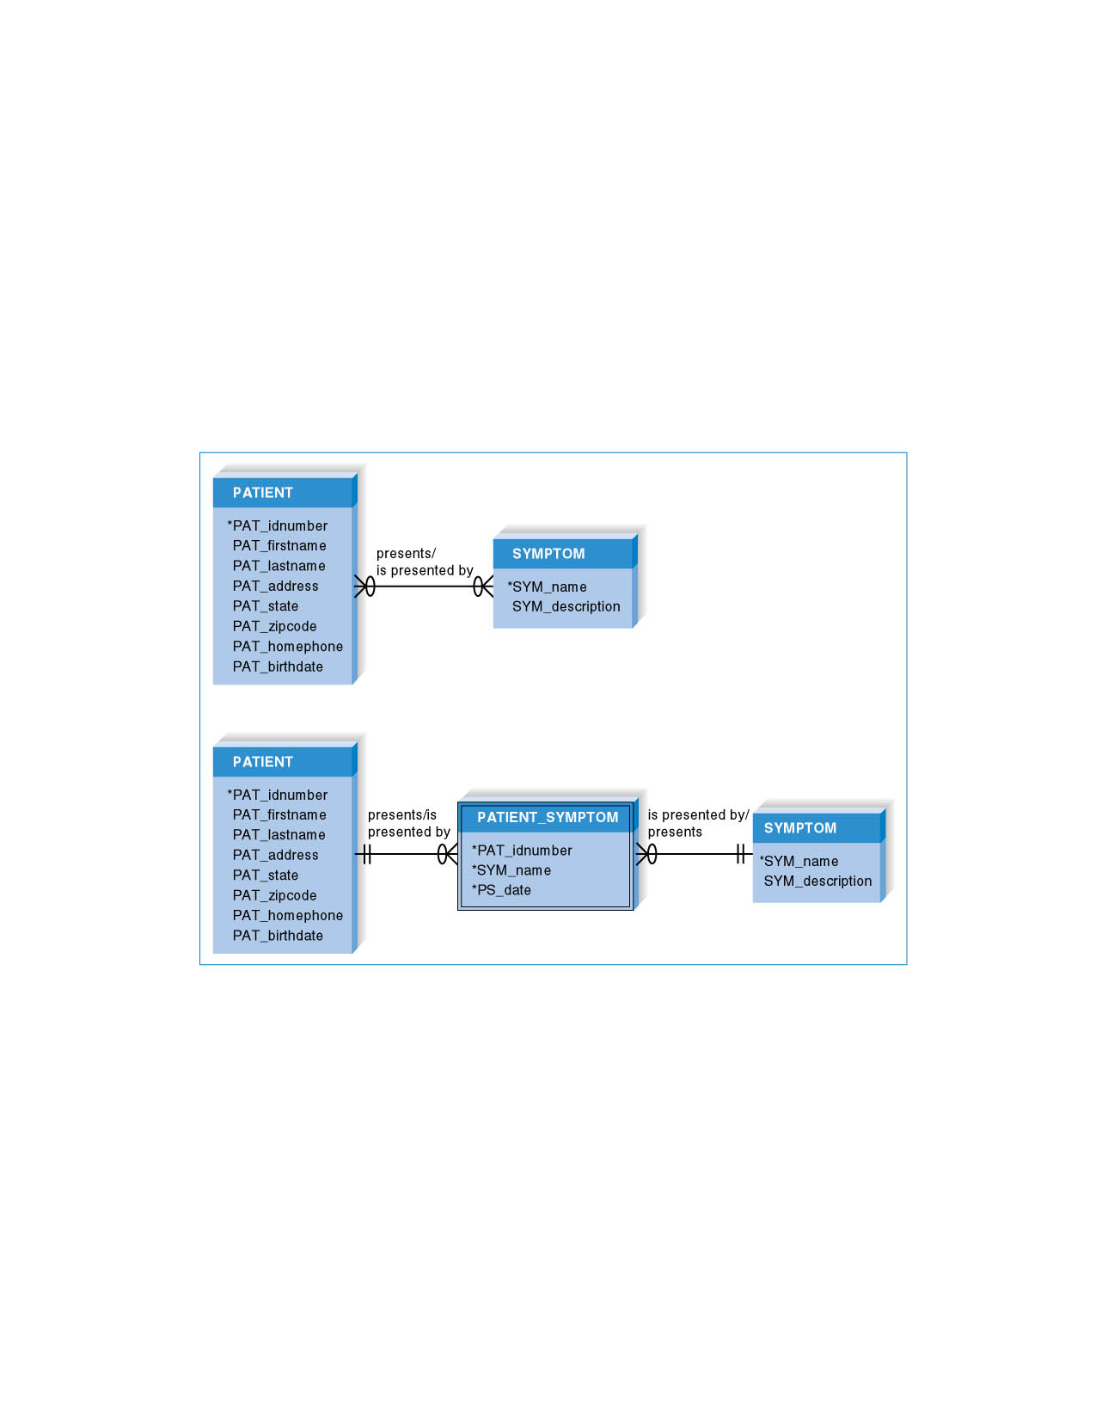
Advanced Syntax – Resolving an M : N Relationship

Slide 27
VALIDATING AN ERD

Slide 28
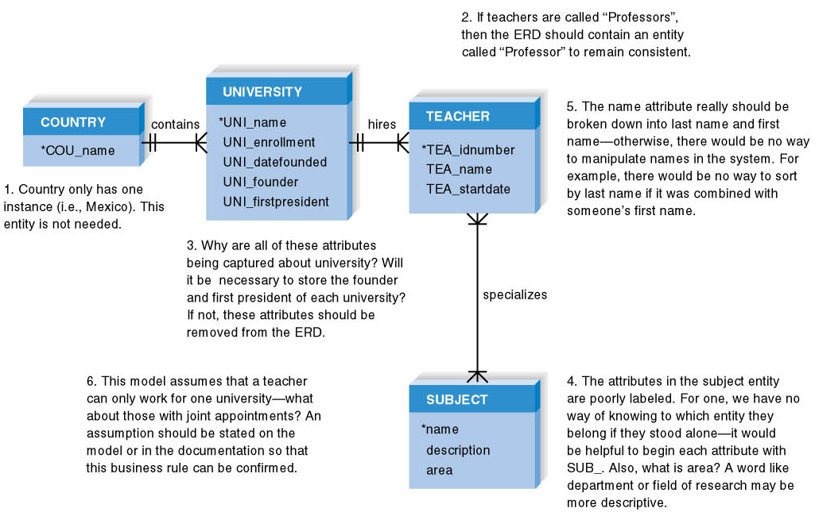
Design Modeling Guidelines Summary

Slide 29
Normalization
Technique used to validate data models
Series of rules applied to logical data model to improve its organization
Three normalization rules are common

Slide 30
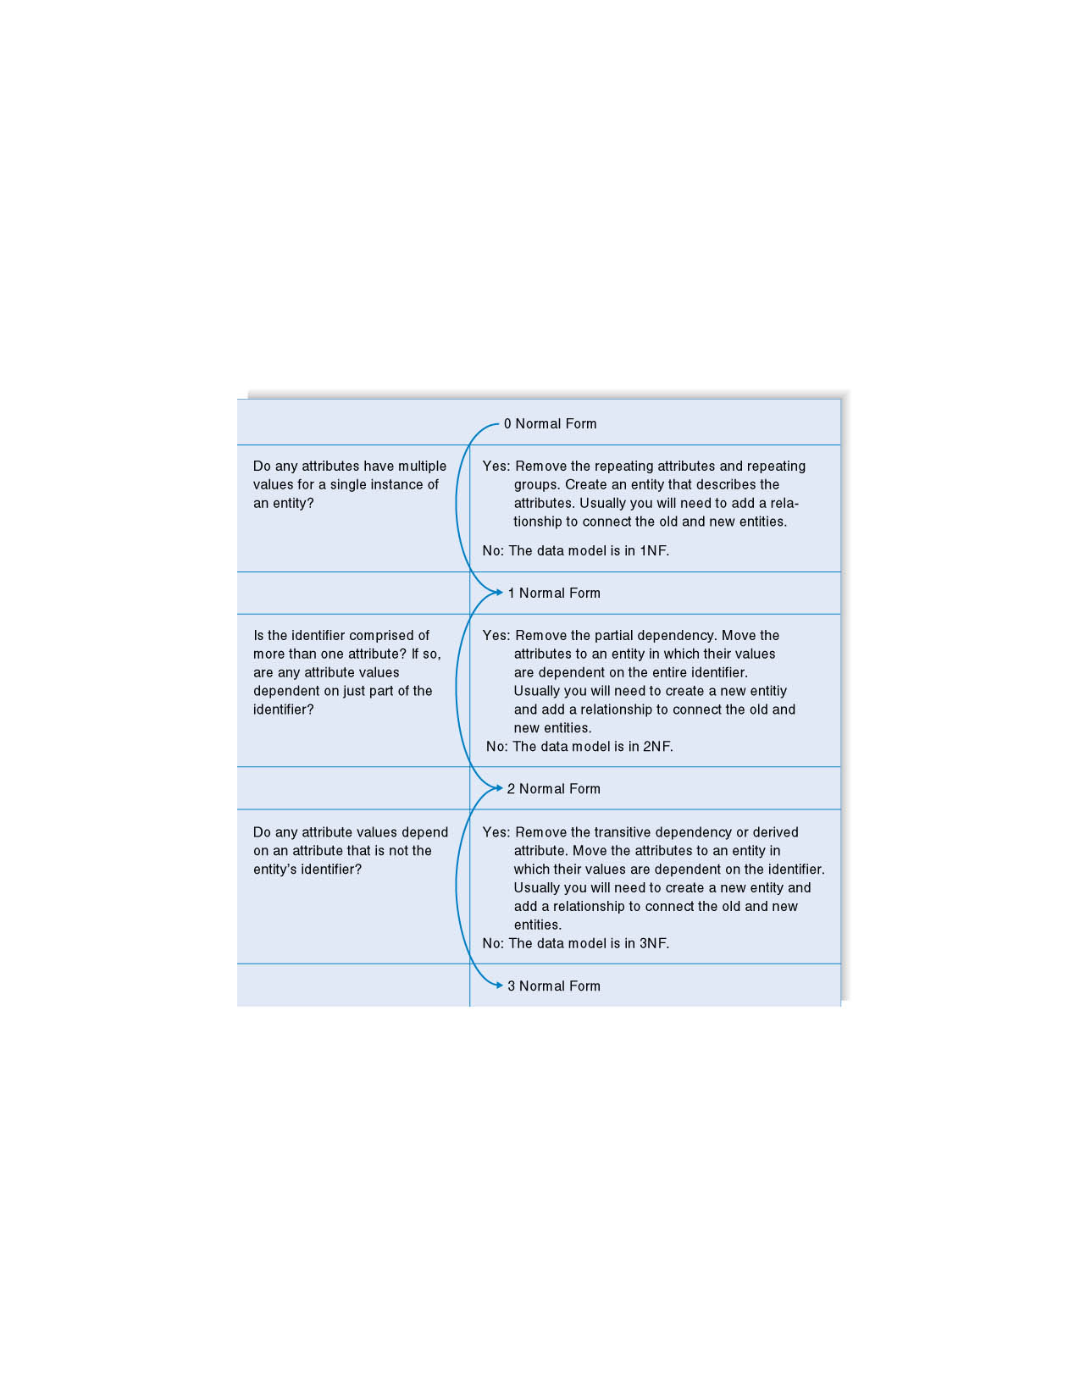
Normalization Steps

Slide 31
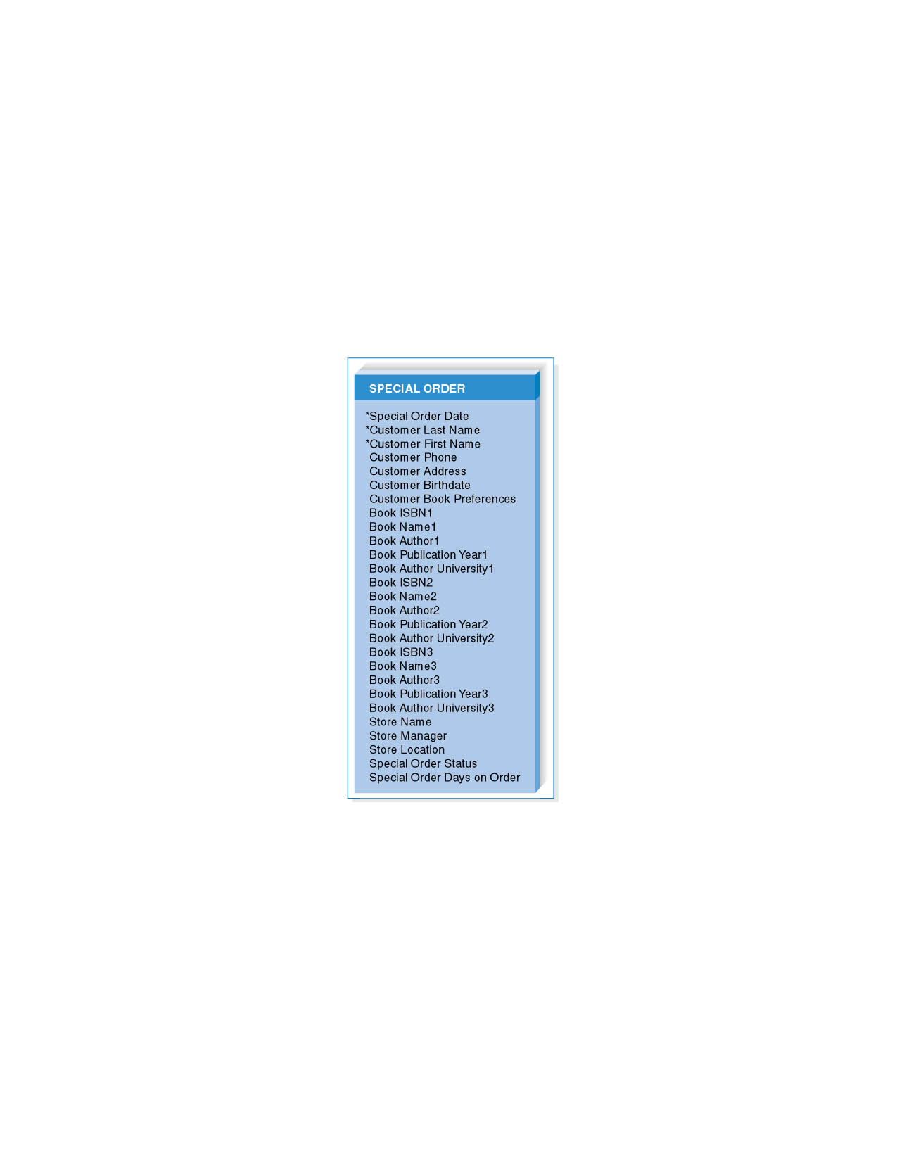
Unnormalized Entity
Begin with an entity from
the logical data model

Slide 32
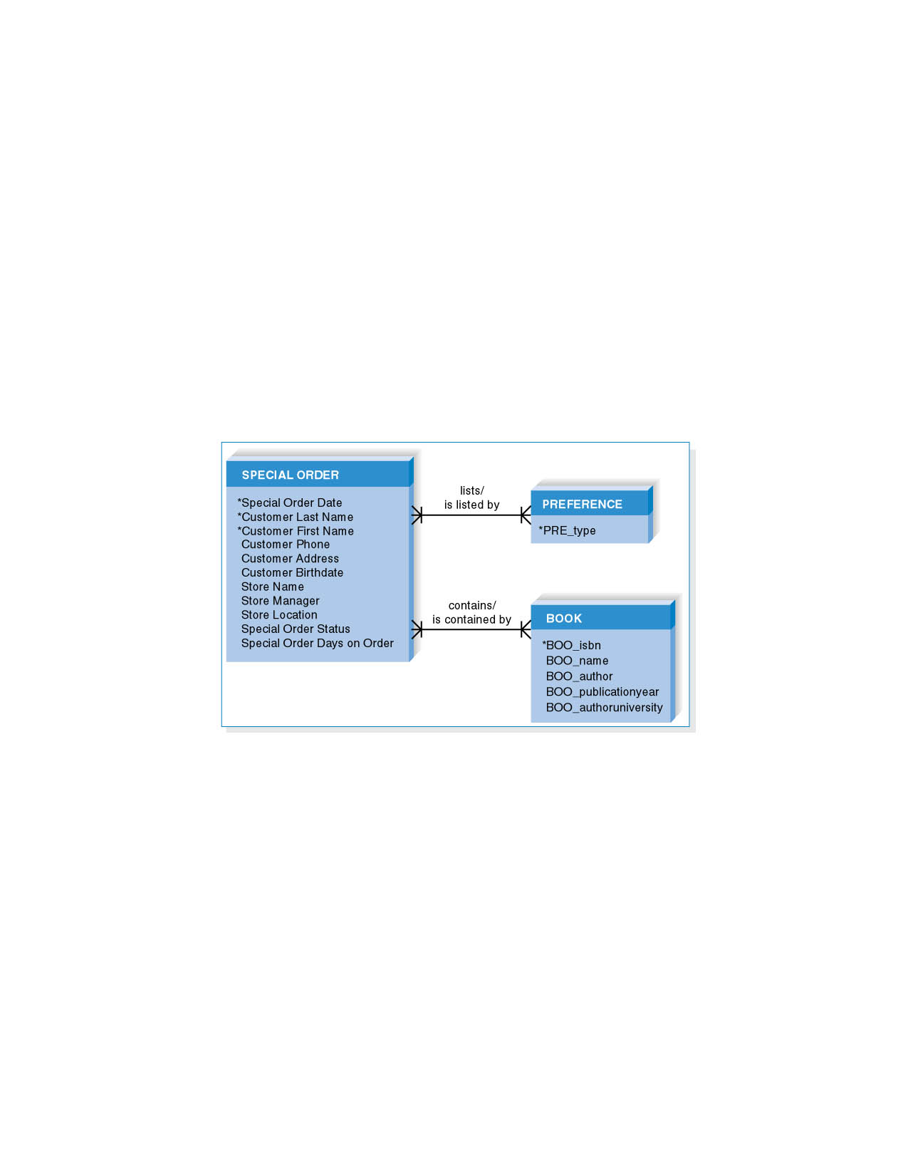
First Normal Form (1NF)
Look for repeating groups of attributes and remove them into separate entities

Slide 33
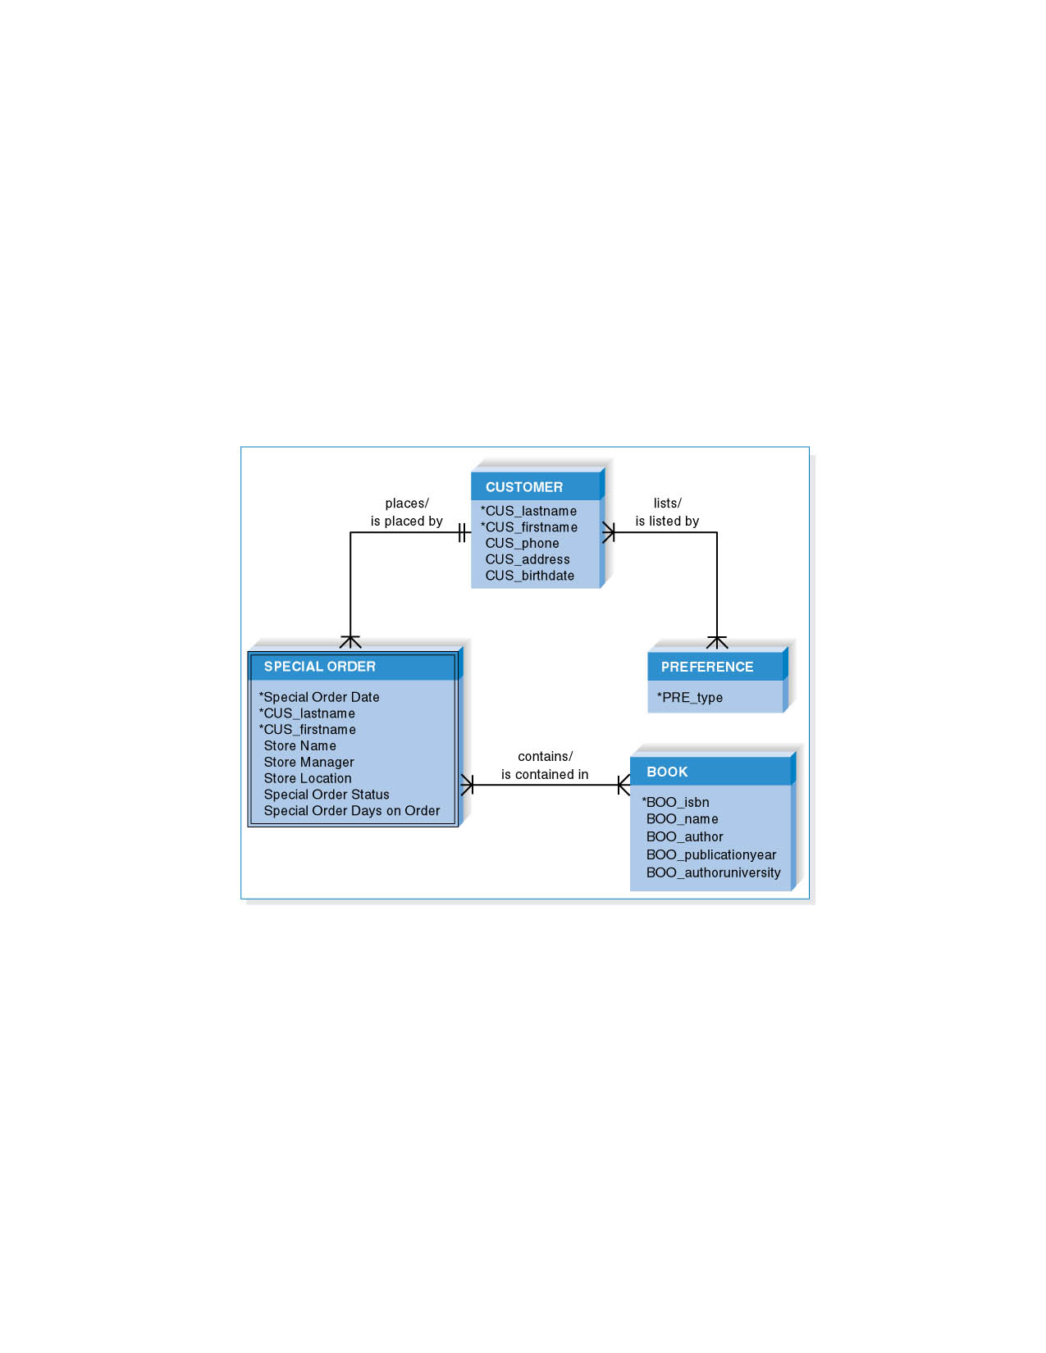
Second Normal Form (2NF)
If an entity has a concatenated identifier, look for attributes that
depend only on part of the identifier. If found, remove to new entity.

Slide 34
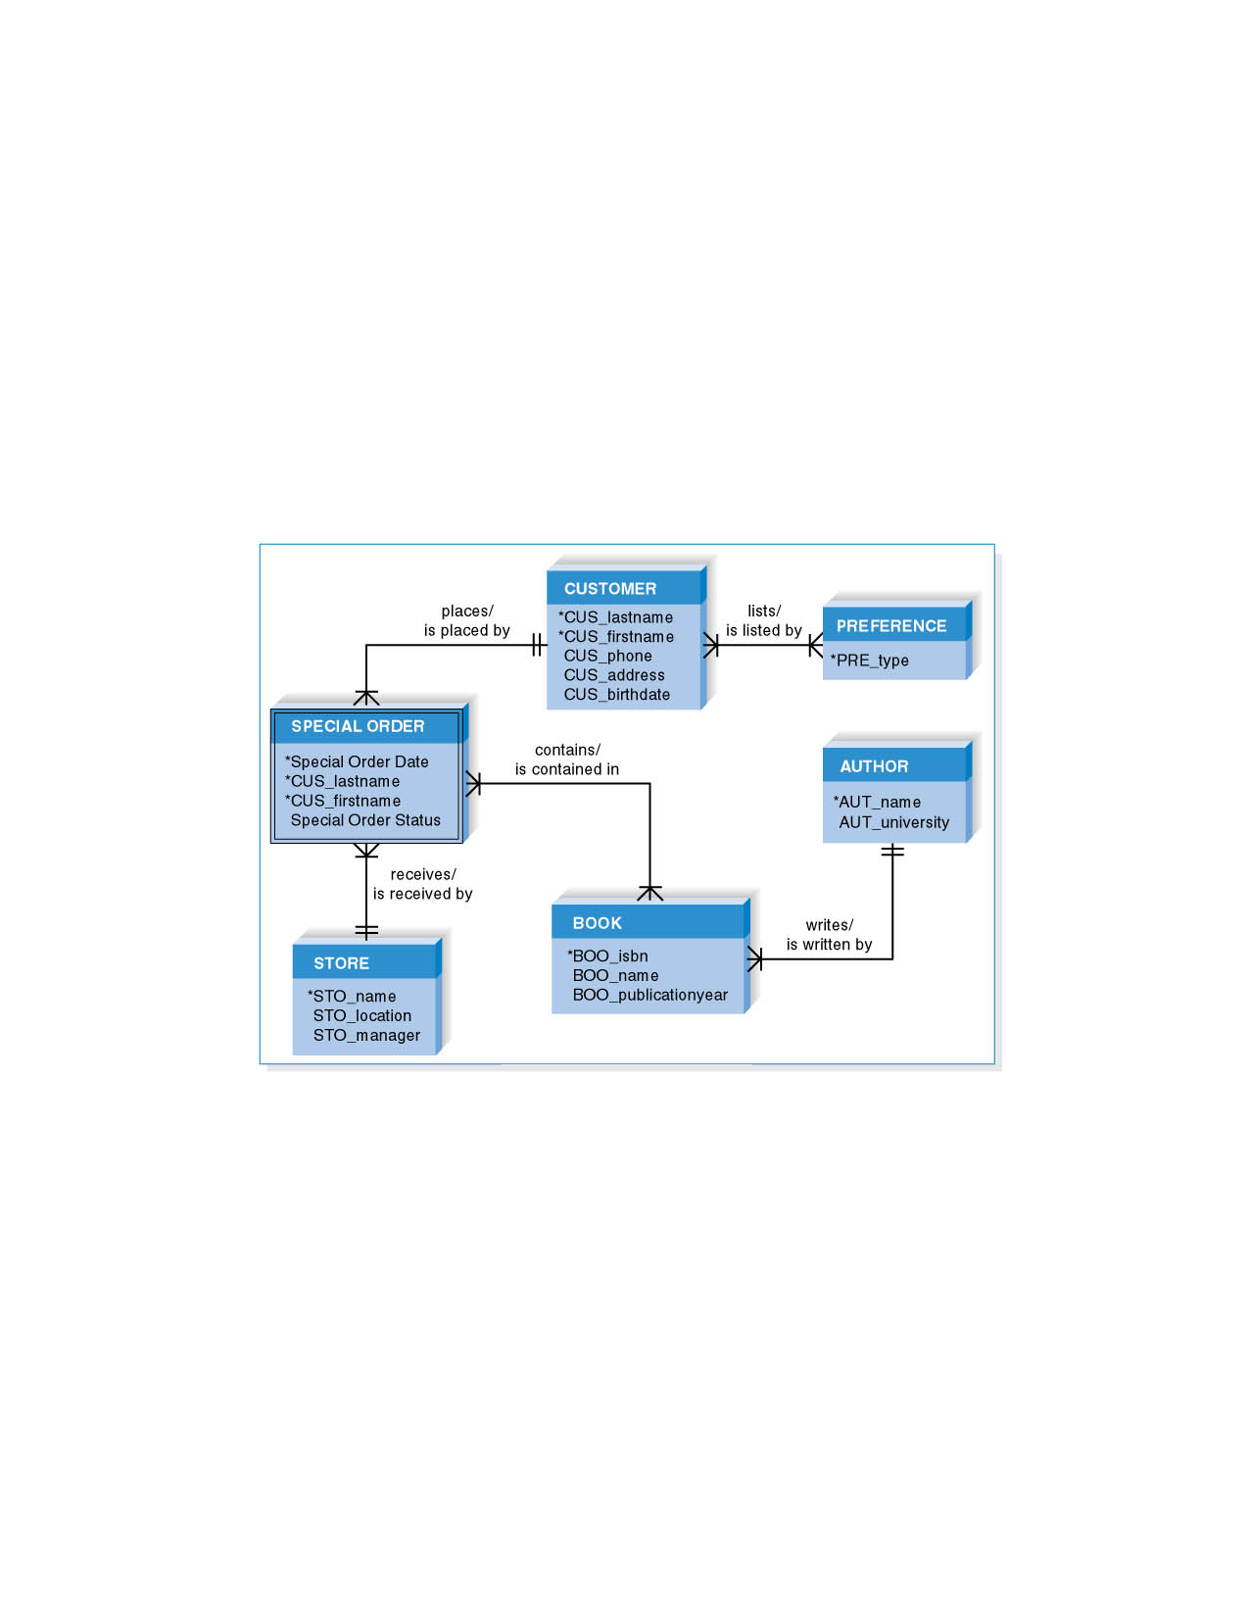
Third Normal Form (3NF)
Look for attributes that depend only on another non-identifying attribute.
If found, remove to new entity. Also remove any calculated attributes.

Slide 35
Balancing ERDs with DFDs
All analysis activities are interrelated
Process models contain two data components
  Data flows and data stores
The DFD data components need to balance the ERD’s data stores (entities) and data elements (attributes)
Many CASE tools provide features to check for imbalance
Check that all data stores and elements correspond between models
  Data that is not used is unnecessary
  Data that has been omitted results in an incomplete system
Do not follow thoughtlessly -- check that the models make sense!

Slide 36
Summary
The ERD is the most common technique for drawing data models. The building blocks of the ERD are:
  Entities describe people, places, or things
  Attributes capture information about the entity
  Relationships associate data across entities
Intersection, dependent, and independent entities must be recognized.
The ERD must be balanced with the DFD.

Slide 37
References and Reading
http://en.wikipedia.org/wiki/Data_flow_diagram
Systems Analysis and Design, Alan Dennis, Barbara Haley Wixom, and Roberta Roth
John Wiley & Sons, Inc.

