Slide 1
Session 01
Module 1: Introduction to eProject
Module 2: Structured System analysis and Design

Slide 2

Objectives
What is eProject?
eProject Objectives
Development Enviroment
What is SSADM?
What is DFD?
Elements of a DFD
Relationship among Levels of DFDs
Steps in Building DFDs

Slide 3
Module 1: Introduction to eProject

Slide 4
What is eProject?
“eProject is a step by step learning environment that closely simulates the classroom and lab based learning environment into actual implementation”
In eProjects, students have a chance to put all knowledge and skills together to build a software using key technologies (.NET and Java)

Slide 5
eProject Objectives
Practice iterative software development using key technologies
Collaborate in software development teams
Usage of tools and processes for software construction
Mentoring through e-mail support and face-to-face discussion.
Feel real life scenario and help to create complex and useful applications.
Enhance skills and add value

Slide 6

Development Environment
Frameworks
  J2EE 1.5 (s4)
IDEs
  NetBeans
Integrated Project Management Environment: http://pms.aptech.ac.vn
  Issues(Time, Bugs, Features) management
  Software Control Management: SVN
SVN Client: TortoiseSVN
Others

Slide 7
How are eProjects evaluated?
India
  I_Mark
Vietnam
  V_Mark
eProject Mark = 50% I_Mark + 50% V_Mark
Pass Condition: eProject Mark >= 40%

Slide 8
Module 2
Structured System Analysis and Design

Slide 9
What is SSADM?
Structured Systems Analysis and Design Methodology (SSADM) is a systems approach to the analysis and design of information systems.
SSADM was produced for the Central Computer and Telecommunications Agency (now Office of Government Commerce), a UK governmentoffice concerned with the use of technology in government, from 1980 onwards.

Slide 10
SSADM techniques
Logical Data Modelling – The data requirements of the system being designed are identified, modelled and documented. This data is separated into entities and relationships between these entities identified.
Data Flow Modelling(DFD) – Concerned with how the data moves around the information system.Examines processes, data stores, external entities and data flows.
Entity Behaviour Modelling – The identifying, modelling and document events with respect to the entities in the system and the order in which these events take place.

Slide 11
What is DFD?
A data-flow diagram (DFD) is a graphical representation of the "flow" of data through an information system. DFDs can also be used for the visualization of data processing (structured design).
On a DFD, data items flow from an external data source or an internal data store to an internal data store or an external data sink, via an internal process.
A DFD provides no information about the timing of processes, or about whether processes will operate in sequence or in parallel.

Slide 12
Elements of a DFD
Process
  An activity or function performed for a specific business reason
  Manual or computerized
Data flow
  A single piece of data or a logical collection of data
  Always starts or ends at a process

Slide 13
DFD Elements
Data Store
  A collection of data that is stored in some way
  Data flowing out is retrieved from the data store
  Data flowing in updates or is added to the data store
External entity
  A person, organization, or system that is external to the system but interacts with it.

Slide 14
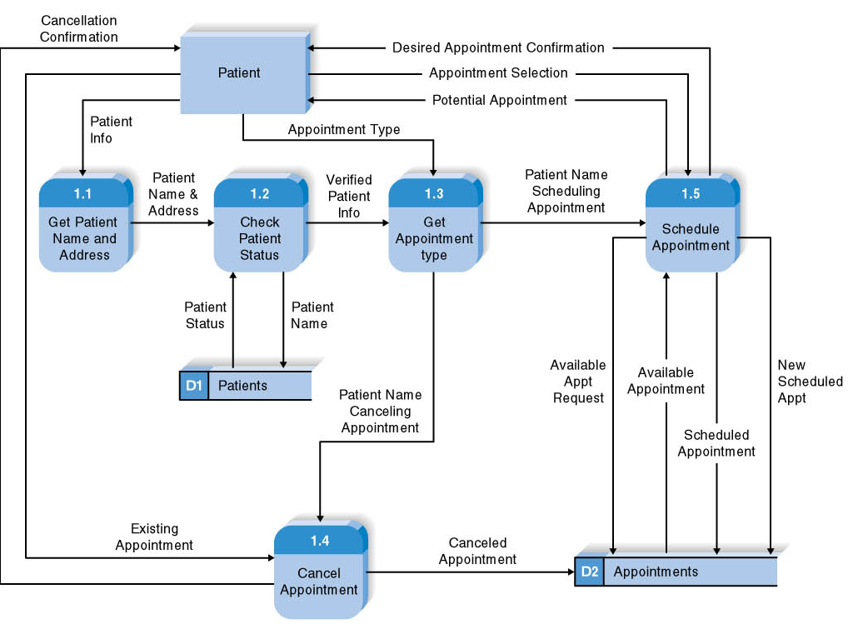
DFD Example

Slide 15
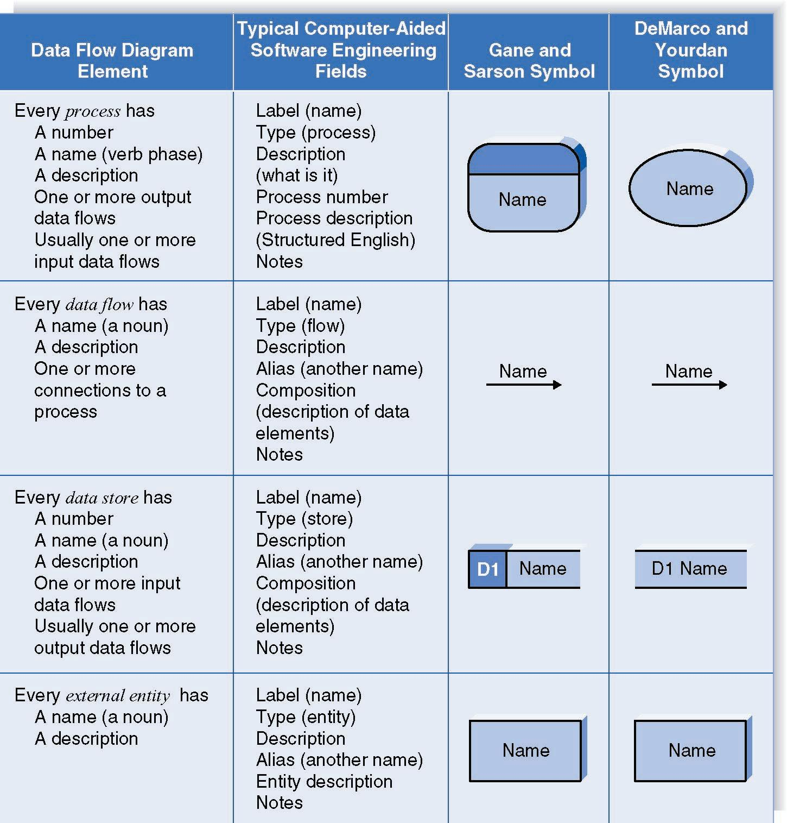
Naming and Drawing DFD Elements
Process
Data flow
Data store
External
entity

Slide 16
Using a DFD to Define Business Processes
Business processes are too complex to be shown on a single DFD
Decomposition is the process of representing the system in a hierarchy of DFD diagrams
  Child diagrams show a portion of the parent diagram in greater detail

Slide 17
Key Definition
Balancing involves insuring that information presented at one level of a DFD is accurately represented in the next level DFD.

Slide 18
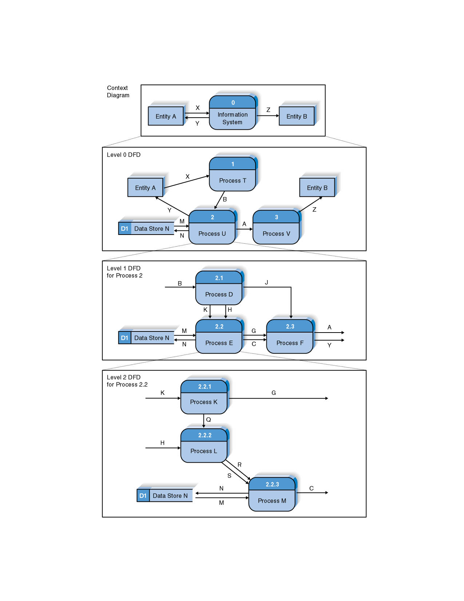
Relationship among Levels of DFDs
Context diagram
Level 0 diagram
Level 1 diagram
Level 2 diagram

Slide 19
Context Diagram
First DFD in every business process
Shows the context into which the business process fits
Shows the overall business process as just one process (process 0)
Shows all the external entities that receive information from or contribute information to the system

Slide 20
Level 0 Diagram
Shows all the major processes that comprise the overall system – the internal components of process 0
Shows how the major processes are interrelated by data flows
Shows external entities and the major processes with which they interact
Adds data stores

Slide 21
Level 1 Diagrams
Generally, one level 1 diagram is created for every major process on the level 0 diagram
Shows all the internal processes that comprise a single process on the level 0 diagram
Shows how information moves from and to each of these processes
If a parent process is decomposed into, for example, three child processes, these three child processes wholly and completely make up the parent process

Slide 22
Level 2 Diagrams
Shows all processes that comprise a single process on the level 1 diagram
Shows how information moves from and to each of these processes
Level 2 diagrams may not be needed for all level 1 processes
Correctly numbering each process helps the user understand where the process fits into the overall system

Slide 23
Steps in Building DFDs
Build the context diagram
Create DFD fragments for each use case
Organize DFD fragments into level 0 diagram
Decompose level 0 processes into level 1 diagrams as needed; decompose level 1 processes into level 2 diagrams as needed; etc.
Validate DFDs with user to ensure completeness and correctness

Slide 24
Creating the Context Diagram
Draw one process representing the entire system (process 0)
Find all inputs and outputs listed at the top of the use cases that come from or go to external entities; draw as data flows
Draw in external entities as the source or destination of the data flows

Slide 25
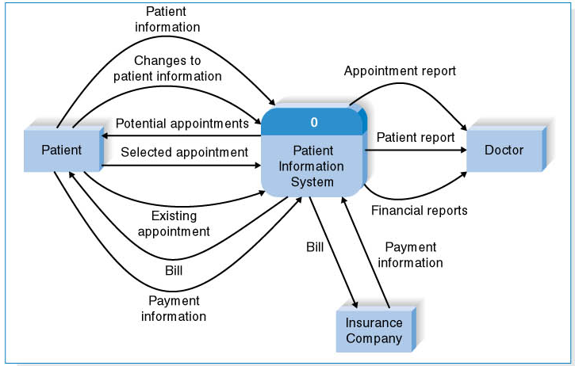
A Context Diagram Example

Slide 26
Creating DFD Fragments
Each use case is converted into one DFD fragment
Number the process the same as the use case number
Change process name into verb phrase
Design the processes from the viewpoint of the organization running the system

Slide 27
Creating DFD Fragments
Add data flows to show use of data stores as sources and destinations of data
Layouts typically place
  processes in the center
  inputs from the left
  outputs to the right
  stores beneath the processes

Slide 28
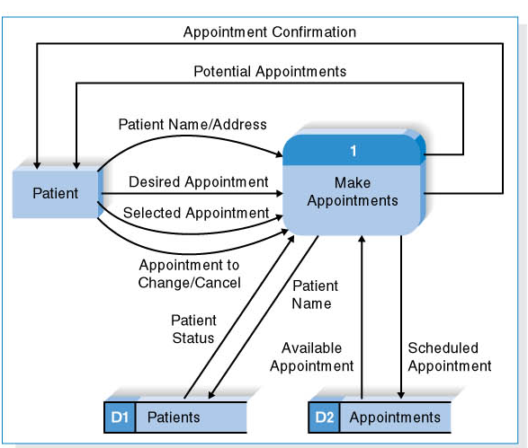
A DFD Fragment Example

Slide 29
Creating the Level 0 Diagram
Combine the set of DFD fragments into one diagram
Generally move from top to bottom, left to right
Minimize crossed lines
Iterate as needed
  DFDs are often drawn many times before being finished, even with very experienced systems analysts

Slide 30
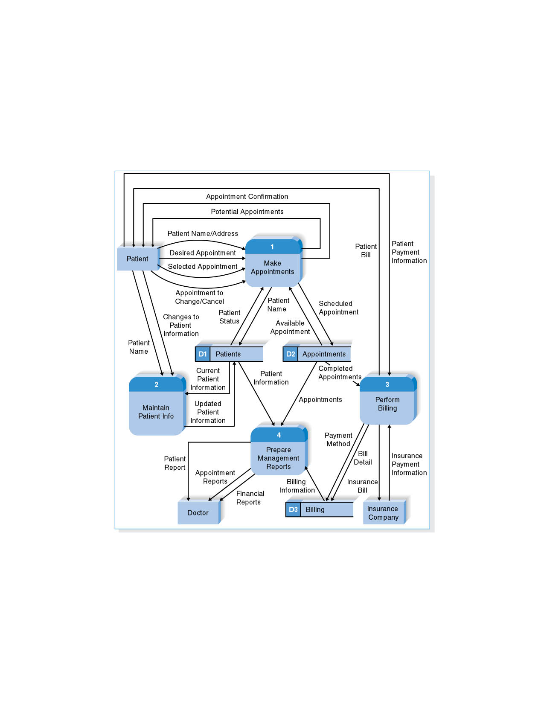
A Level 0 DFD Example

Slide 31
Creating Level 1 Diagrams (and Below)
Each use case is turned into its own DFD
Take the steps listed on the use case and depict each as a process on the level 1 DFD
Inputs and outputs listed on use case become data flows on DFD
Include sources and destinations of data flows to processes and stores within the DFD
May also include external entities for clarity

Slide 32
Creating Level 1 Diagrams (and Below)
When to stop decomposing DFDs?
  Ideally, a DFD has at least three processes and no more than seven to nine.

Slide 33
Validating the DFD
Syntax errors – diagram follows the rules
  Assure correct DFD structure
For each DFD:
Check each process for:
A unique name: action verb phrase; number; description
        At least one input data flow
        At least one output data flow
        Output data flow names usually different than
        input data flow names
        Between 3 and 7 processes per DFD

Slide 34
Validating the DFD
For each DFD:
Check each data flow for:
A unique name: noun; description
Connects to at least one process
Shown in only one direction (no two-headed arrows)
A minimum number of crossed lines
Check each data store for:
A unique name: noun; description
At least one input data flow
At least one output data flow
Check each external entity for:
A unique name: noun; description
At least one input or output data flow

Slide 35
Validating the DFD
Across DFDs:
Context Diagram:
Every set of DFDs must have one Context Diagram
Viewpoint:
There is a consistent viewpoint for the entire set of DFDs
Decomposition:
Every process is wholly and complete described by the
processes on its children DFDs
Balance:
Every data flow, data store, and external entity on a higher level
DFD is shown on the lower level DFD that decomposes it
No data stores or data flows appear on lower-lever DFDs that do
not appear on their parent DFD

Slide 36
Validating the DFD
Semantics errors – diagram conveys correct meaning
  Assure accuracy of DFD relative to actual/desired business processes
To verify correct representation, use
  User walkthroughs
  Role-play processes
Examine lowest level DFDs to ensure consistent decomposition
Examine names carefully to ensure consistent use of terms

Slide 37
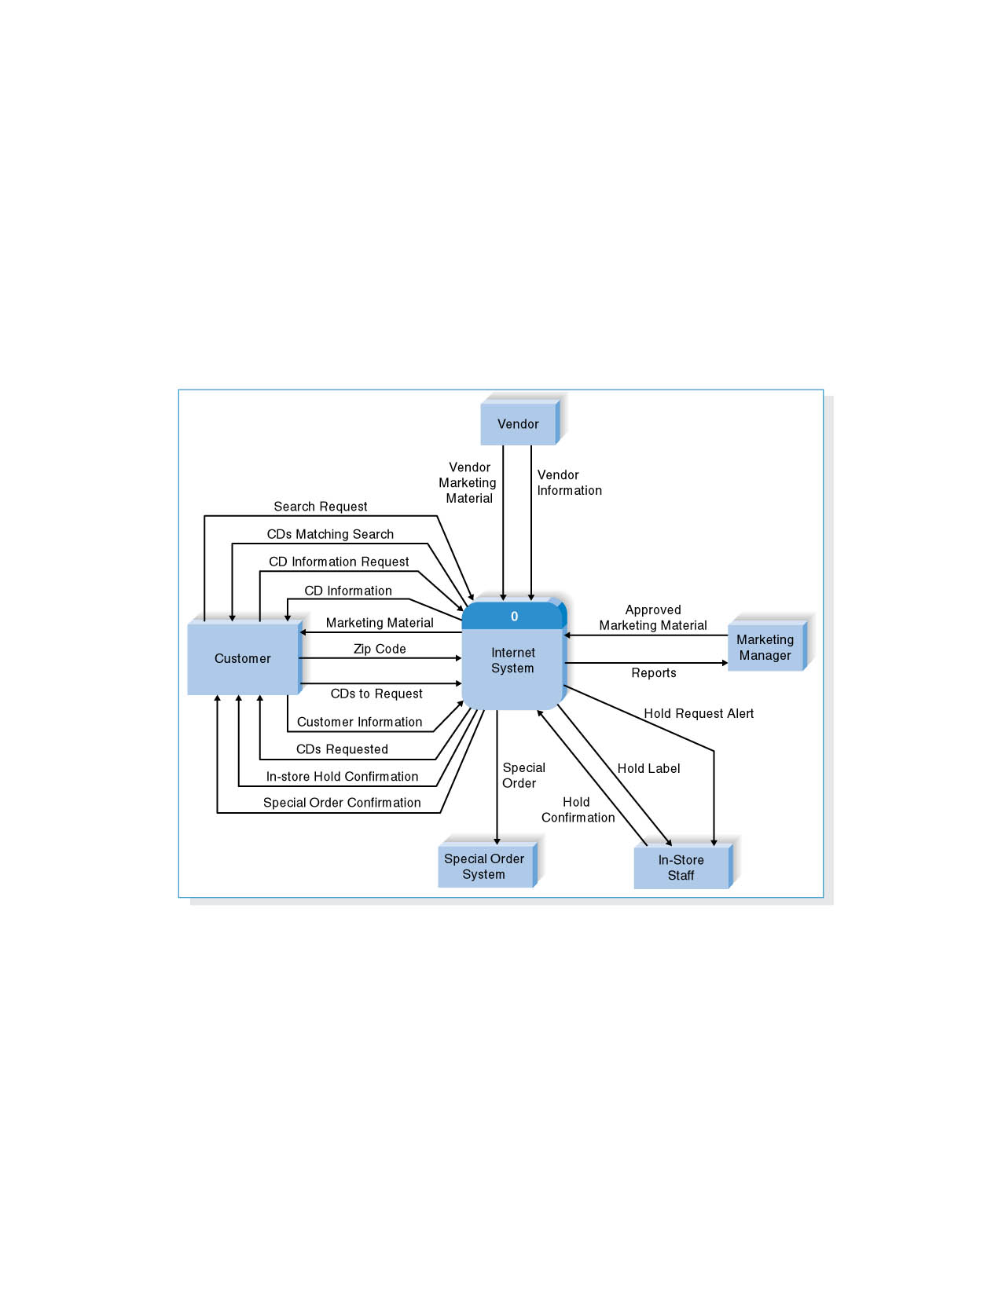
Context Diagram for CD Selections
Internet Sales System

Slide 38
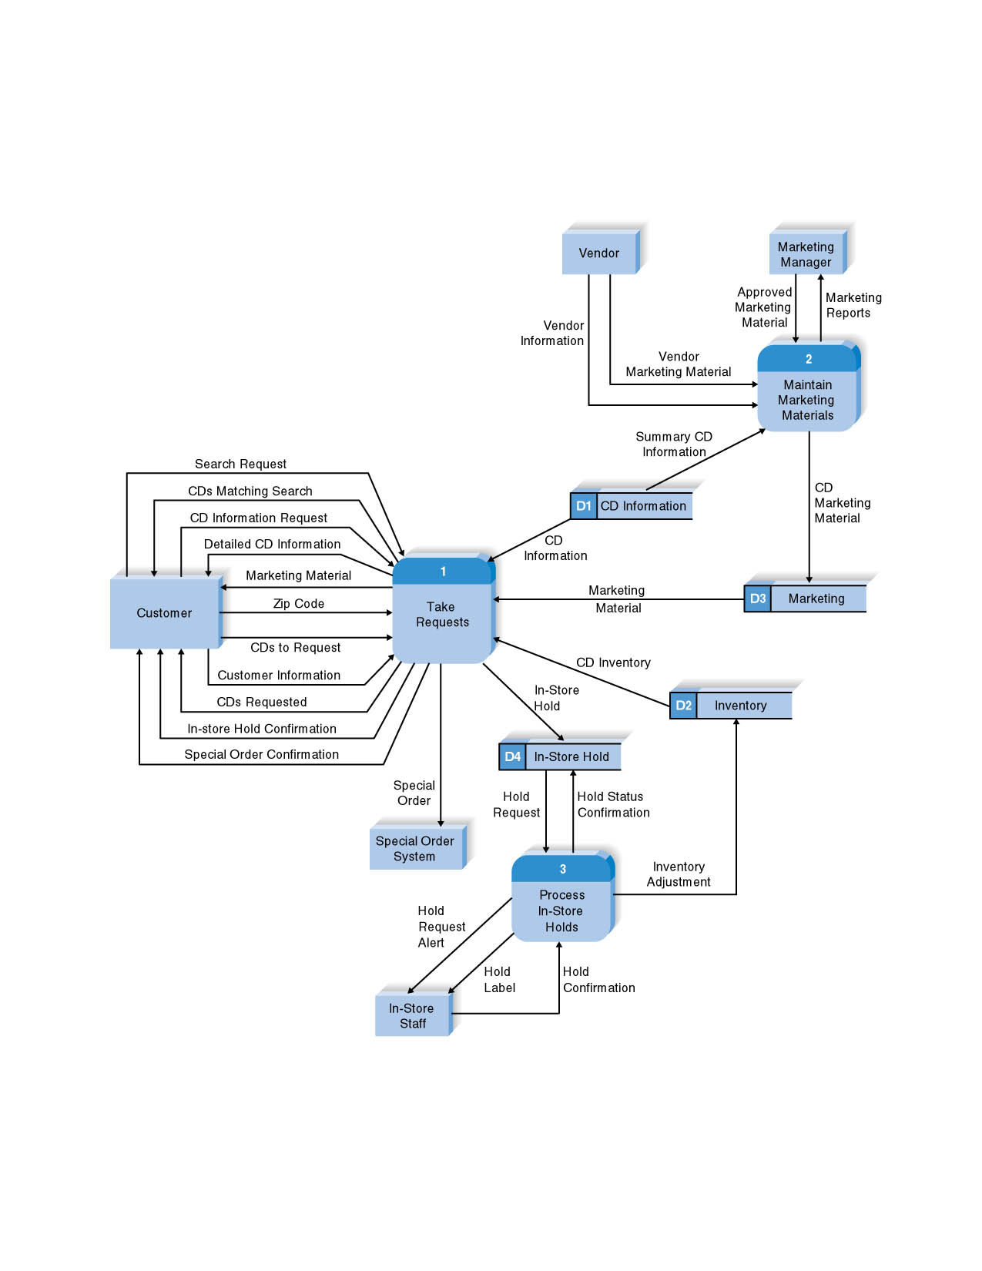
Level 0 DFD for CD Selections
Internet Sales System

Slide 39
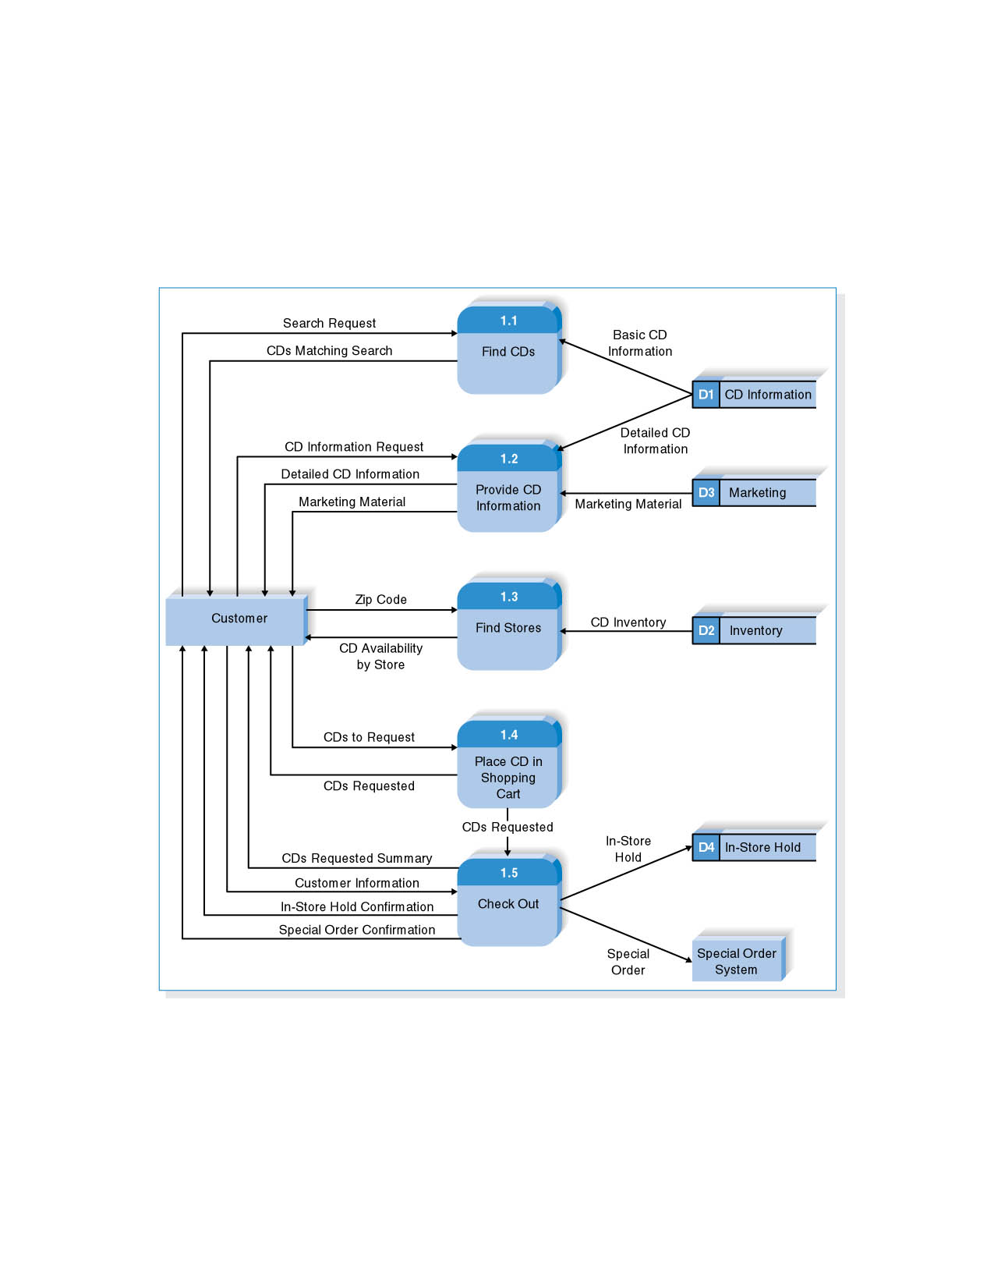
Level 1 DFD for CD Selections Process 1: Take Requests

Slide 40
Summary
The Data Flow Diagram (DFD) is an essential tool for creating formal descriptions of business processes.
Use cases record the input, transformation, and output of business processes and are the basis for process models.
Eliciting use cases and modeling business processes are critically important skills for the systems analyst to master.

Slide 41
References and Reading
http://en.wikipedia.org/wiki/Data_flow_diagram
Systems Analysis and Design, Alan Dennis, Barbara Haley Wixom, and Roberta Roth
John Wiley & Sons, Inc.

