Slide 1
Sketch
menubar
Video window
Captions window
Play/pause
Timebar

Slide 2
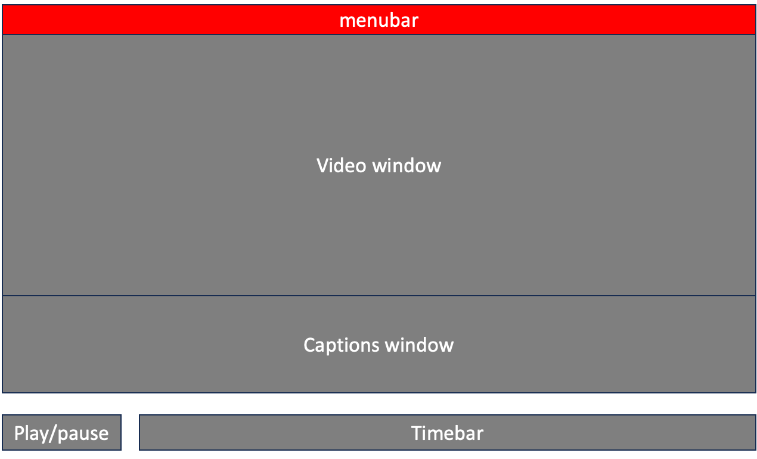
MenuBar
Sends info to:
State
Gets info from:
None (only direct user)
Select_audio
→ changes STATE
→ calls load_audio()

Slide 3
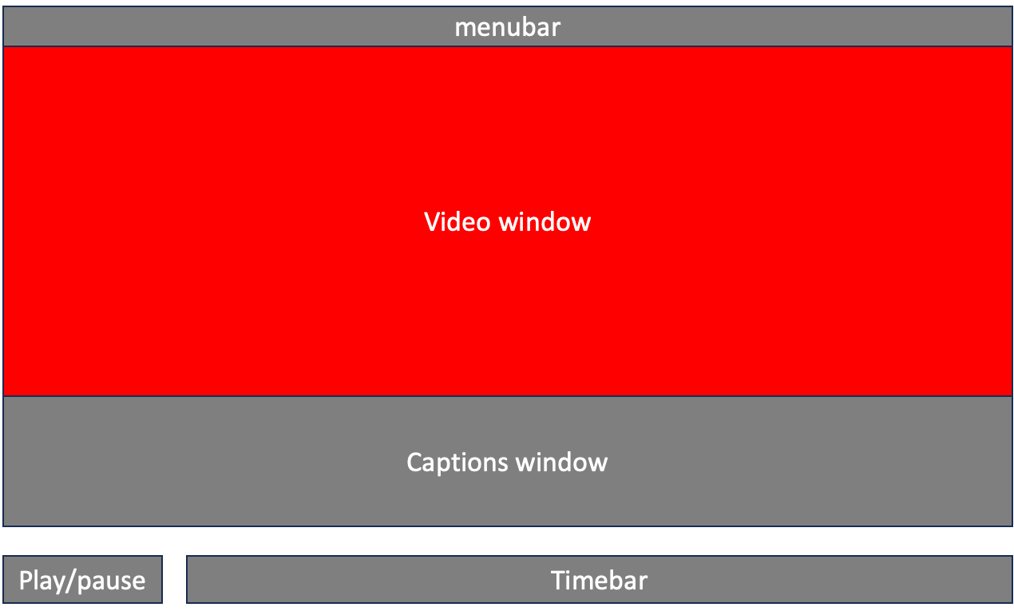
graphicsView
Gets info from:
Controller
Sends info to:
None

Slide 4
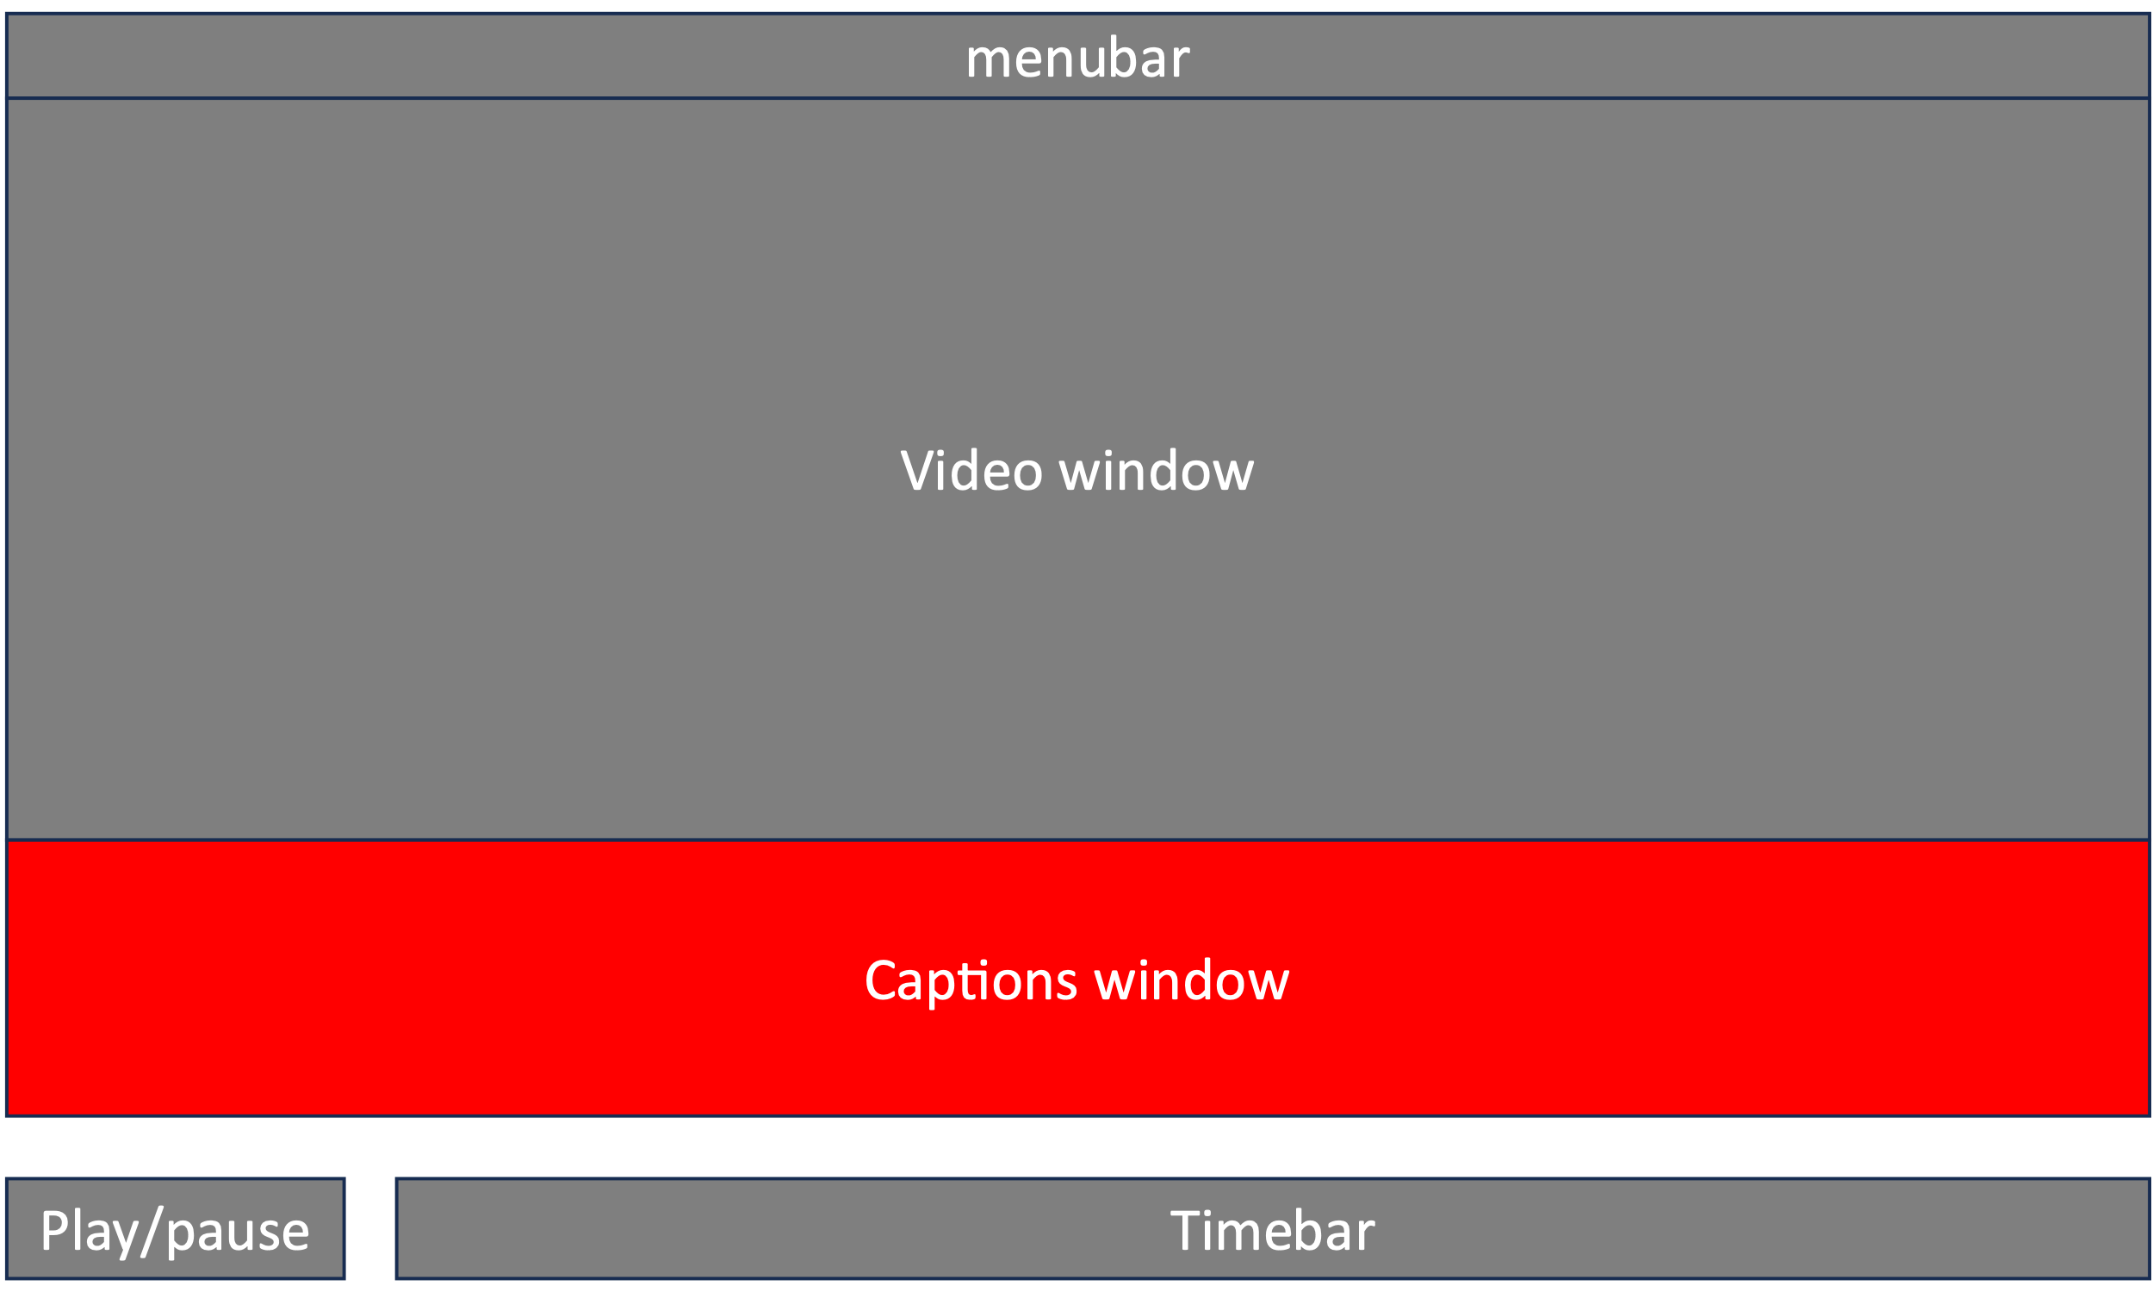
Gets info from:
Controller
Sends info to:
None

Slide 5
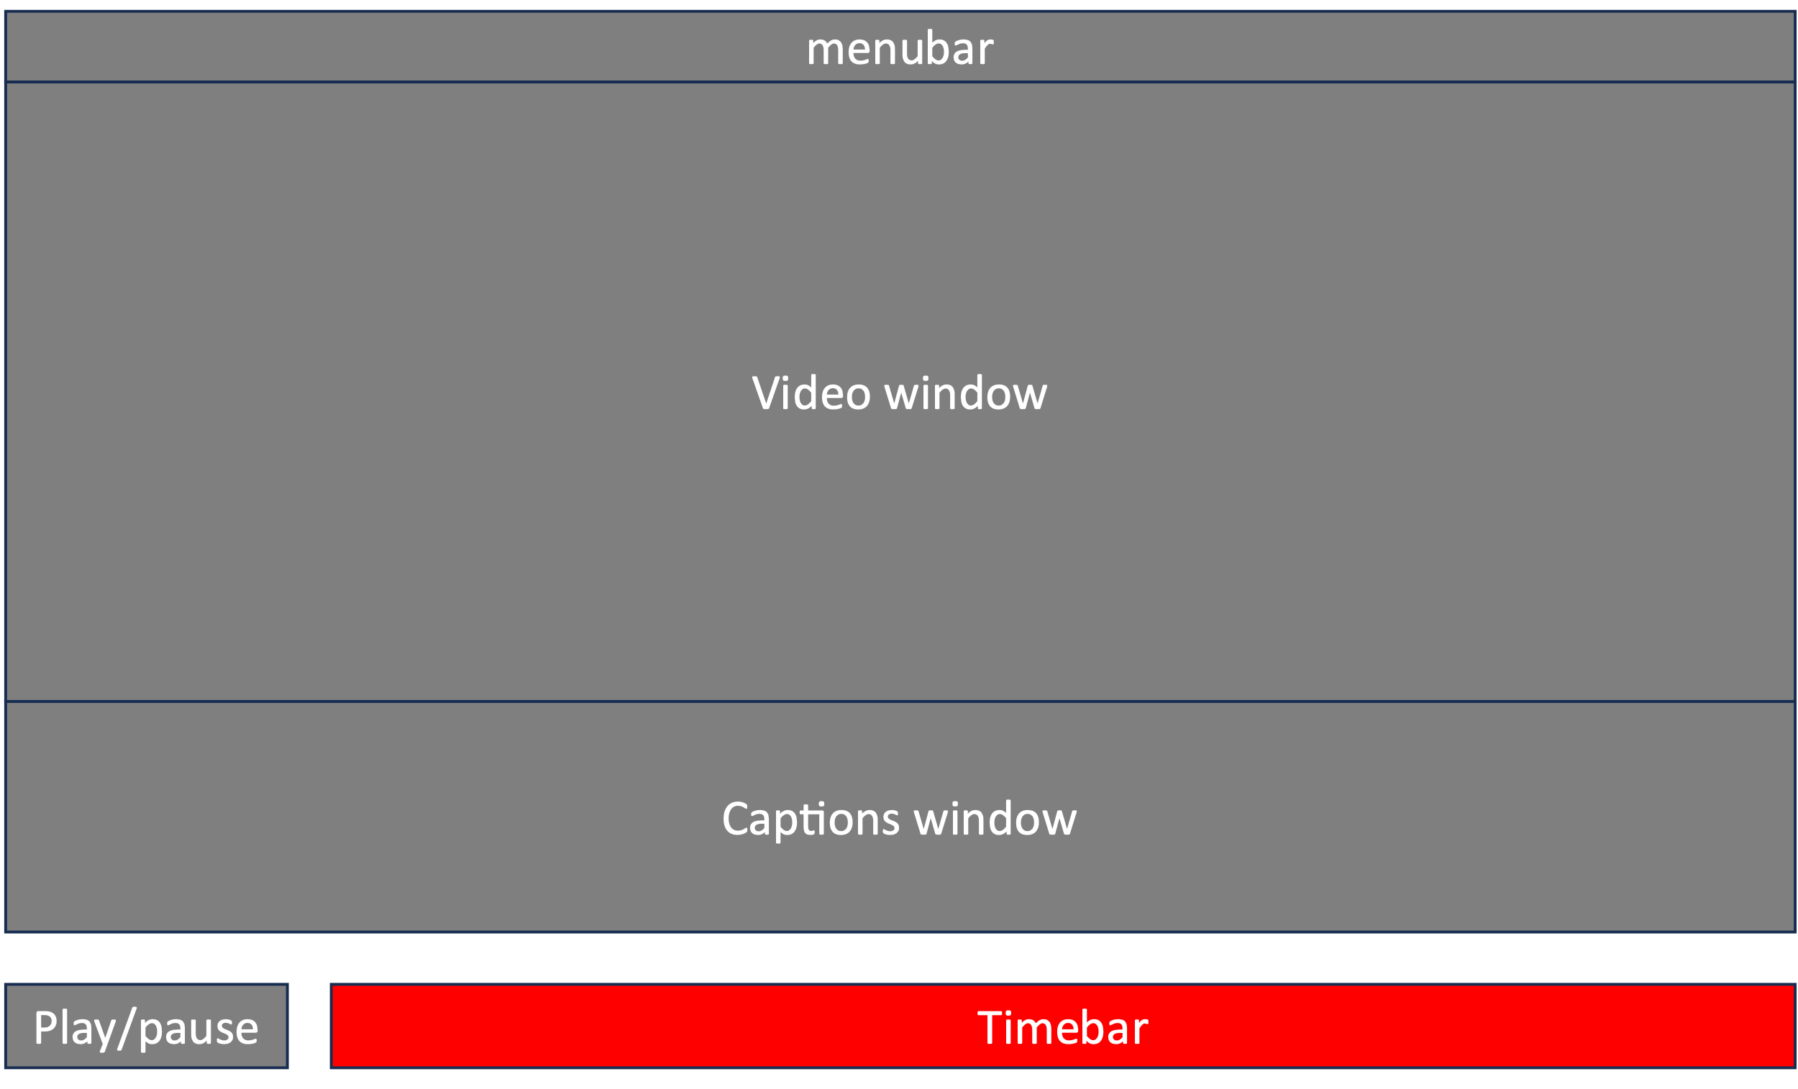
Gets info from:
controller

Slide 6
State
Contains:
Config = dict() with settings. Can be changed
Filepath = pathlib
Subtitle path = pathlib
Active time = time in ms
Modified by:

