Slide 1
Import Excel
Bus schedule
Gantt Chart
Performance Indicators
Bus specific schedule
Select bus specific schedule
Total idle time
Total material time
Lowest battery percentage
End battery percentage
Mean Leeway
3 hours
1.6 hours
22%
66%
12 min

Slide 2
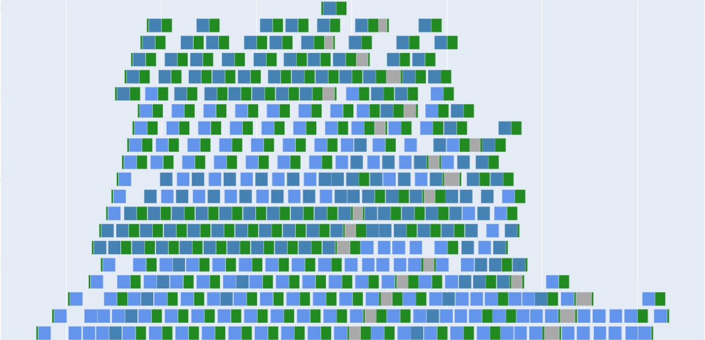
Upload Excel File
Excel file will be shown here
Bus 3
Bus 8
Bus 12
Battery % was to low at 2023-9-27 : 12.18.36.
Activities overlapped at 2023-9-27 : 16.44.09.
Bus spend to little time at charger.
Gantt chart
Performance indicators will be calculated and shown when all circulation have returned valid

