Slide 1

INTRODUCTION BASH SCRIPTS 2 & AWK
Presenter: Nguyen Le Thuy Lan
5th February, 2023

Slide 2
Outline
1. Data Streams
2. Function
3. Arguments
4. Case Statements
5. Scheduling Jobs
6. Backup Script
7. Introduction AWK

Slide 3
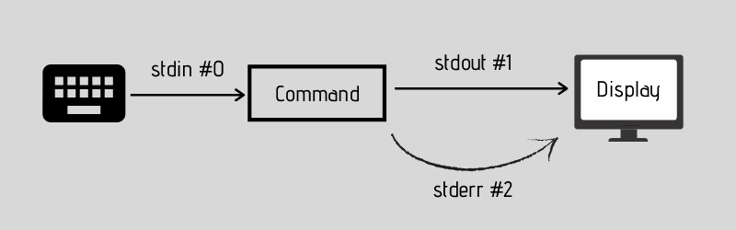
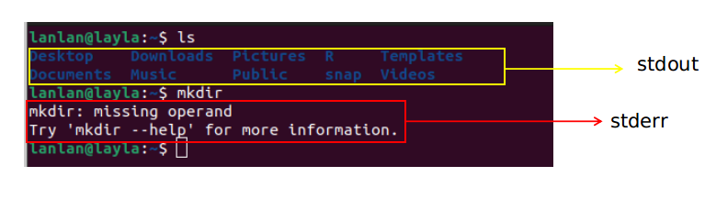
1. Data Streams
When you run a Linux command, there are three data streams that play a part in it:
- standard input (stdin)– usually the input from the keyboard.
- standard output (stdout) – displays the output from commands, usually to the terminal.
- standard error (stderr) – displays error output from commands. It is usually sent to the same output as standard output, but it can be redirected.

Slide 4
2. Function
Function is a reusable block of code. They are particularly useful if you have certain tasks which need to be performed several times. Instead of writing out the same code over and over you may write it once in a function then call that function every time.
There are two syntactical ways to define a function:
- The first way is to use the bash built-in keyword "function" followed by the name of the function. The block of code will be written inside curly braces {}
function function_name () {<commands>}
- The second way is to create a function without the keyword "function". Start with the function name followed by brackets.
function_name () {<commands>}
Notes:
Either of the above methods of specifying a function is valid. Both operate the same and there is no advantage or disadvantage to one over the other. It's really just personal preference.
In other programming languages it is common to have arguments passed to the function listed inside the brackets (). In Bash they are there only for decoration and you never put anything inside them.
The function definition ( the actual function itself) must appear in the script before any calls to the function.

Slide 5
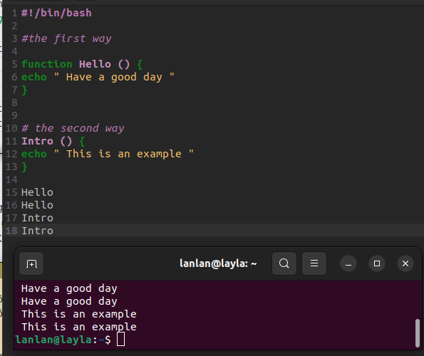

Slide 6
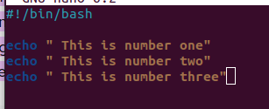



3. Arguments
Assuming you want create a script with the same commands to run things with fewer keystrokes. But sometimes you want to run it with different arguments. You need a way to provide and use arguments from the command line.

Slide 7
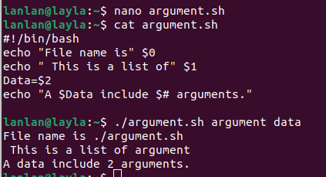
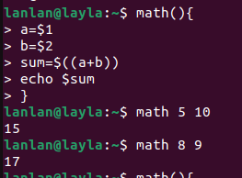
$0 :The filename of the current script.
$1 , $2 , .. $n : The n argument sent to the script
$# - To check count (number of arguments) in script.
combination of function and argument

Slide 8
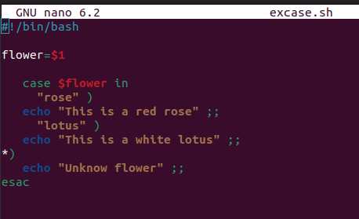

4. Case Statements
The case statement simplifies complex conditions with multiple different choices.
The basic syntax of the case...esac statement is to give an expression to evaluate and to execute several different statements based on the value of the expression.
case $variable in
pattern-1)
commands ; ;
pattern-2)
commands ; ;
pattern-N)
commands ; ;
*)
commands ; ;
esac

Slide 9
5. Scheduling Jobs
It is a system process that will automatically perform tasks as per the specific schedule.
at command
The 'at' command is a Linux command-line utility used to schedule a job for later execution. The utility reads commands from standard input and groups them into an at job, which executes only once.
Syntax: at [option] runtime
Some options with at
-f : Reads the job from the specified [file]
-l: Lists the user's pending jobs.
Obtain the job number by running the atq command first to list all pending jobs.
To remove scheduled at jobs, specify the -r option, or run the atrm command along with the job ID.

Slide 10
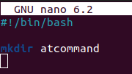
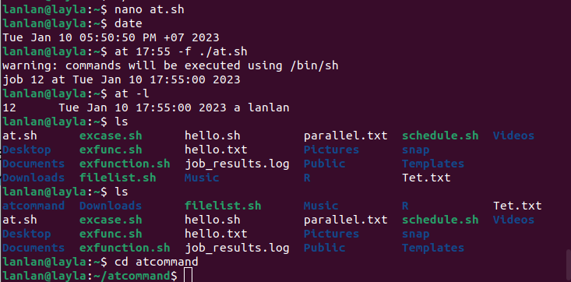

Slide 11
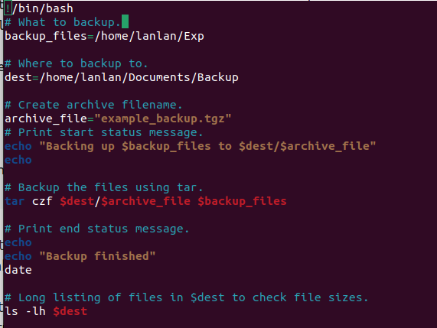
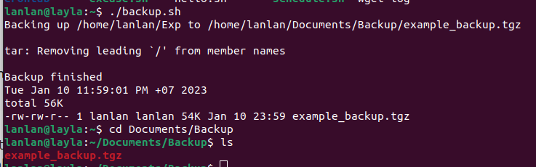
6. Backup Script
The backup script used to directories specified by compressing and storing them.
https://ubuntu.com/server/docs/backups-shell-scripts

Slide 12
7. AWK
The awk command is a Linux tool and programming language that allows users to process text files. It is especially helpful when the lines in a text files are in a record format, i.e, when each line (record) contains multiple fields separated by a delimiter. You can also write programming logic using awk even when there are no input files that needs to be processed.
Syntax: awk [options] 'selection _criteria {action }' input-file > output-file
WHAT CAN WE DO WITH AWK?
1. AWK Operations:
(a) Scans a file line by line
(b) Splits each input line into fields
(c) Compares input line/fields to pattern
(d) Performs action(s) on matched lines
2. Useful For:
(a) Transform data files
(b) Produce formatted reports
3. Programming Constructs:
(a) Format output lines
(b) Arithmetic and string operations
(c) Conditionals and loops

Slide 13
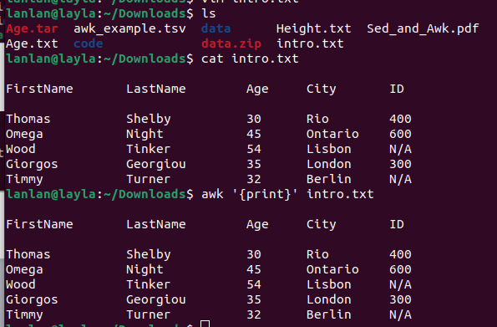

7.1 Simple manipulation with awk
Default behavior of Awk: By default Awk prints every line of data from the specified file
To output words that contain certain letters and print out words that match a pattern you specify, use the slashes //

Slide 14
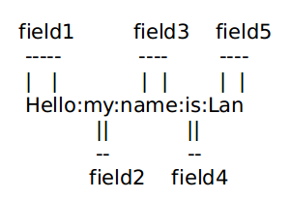

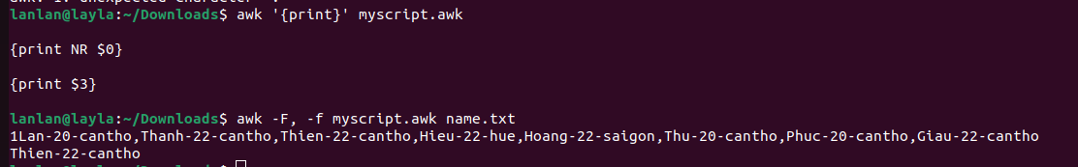
7.2 Options in awk
-F <value> - tells awk what field separator to use.
Ex: As you know the file /etc/passwd stores user account information.It's a plain text file and all fields are separated by a colon (:) symbol. How can I print the 6th field ?
-f <file> : To specify a file that contains awk script.

Slide 15
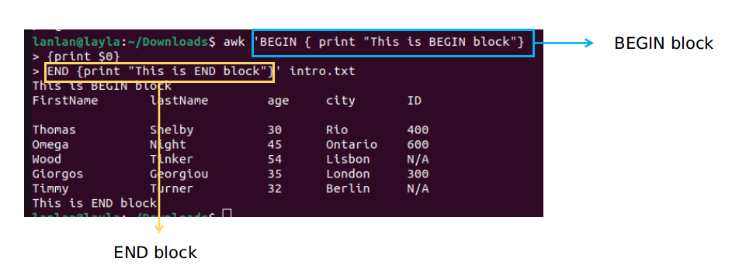
7.3 Awk Program Structure (BEGIN and END block)
BEGIN: To perform an action before data is processed
END: To perform an action after the data is processed

Slide 16
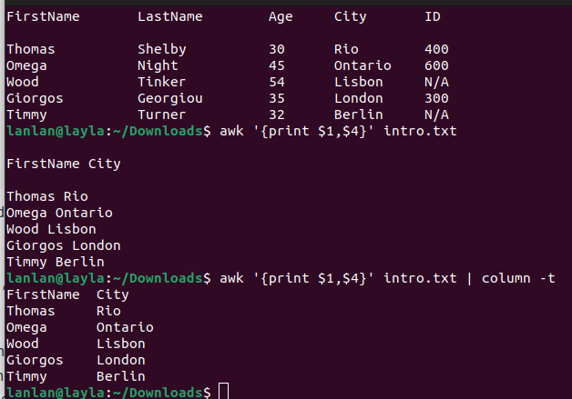
7.4 Built-In Variables in Awk
Splitting a Line Into Fields : For each record i.e line, the awk command splits the record delimited by whitespace character by default and stores it in the $n variables. If the line has 5 words, it will be stored in $1, $2, $3, $4 and $5 respectively. Also, $0 represents the whole line.

Slide 17
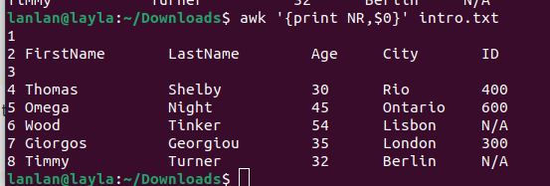

NR (Number of Records) number of row input.
Use of NR built-in variables (Display Line Number)
Another use of NR built-in variables (Display Line From 2 to 4)

Slide 18
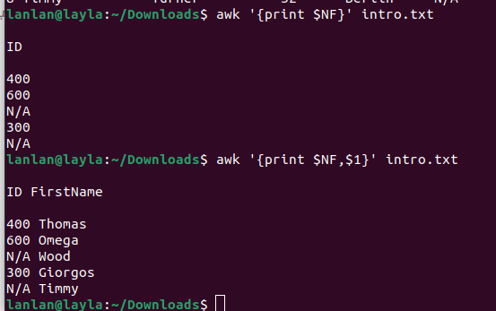
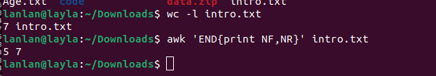
NF (Number of Fields) number of fields input record and displays the last field of the file.
Use of NF built-in variables (Display Last Field)
Awk is used to display the number of rows and fields of data

Slide 19
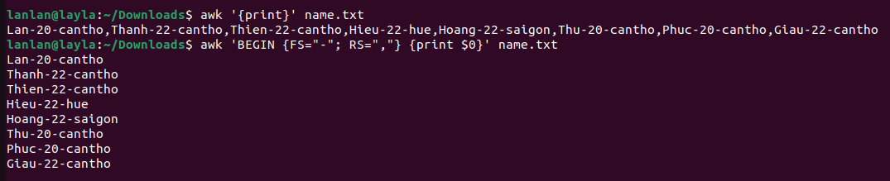
FS (Input field separator variable) Contains the character used to divide fields on the input line
RS (Record Separator variable) Stores the current record separator character. The default input line is the input record, which makes a newline the default record separator. The command is useful if the input is a comma-separated file (CSV).

Slide 20
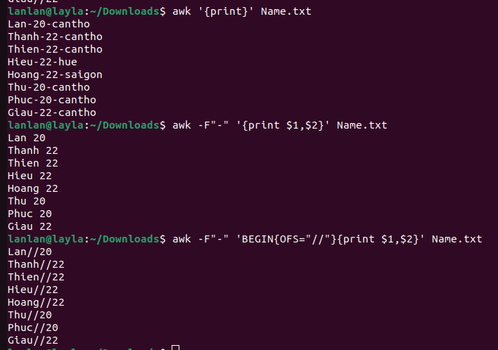
OFS: Output Field Separator Variable
Concatenator in the print statement “,” concatenates two parameters with a space which is the value of awk OFS by default.
So, Awk OFS value will be inserted between fields in the output as shown example.

Slide 21
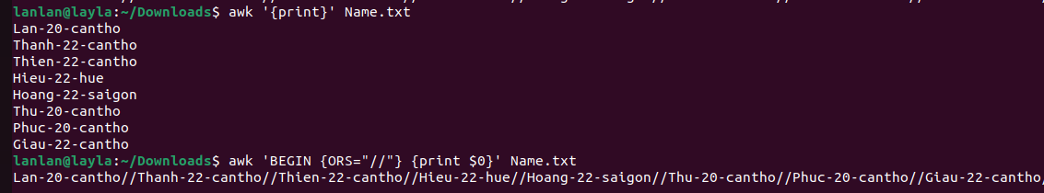
ORS: Output Record Separator Variable
ORS stores the output record separator, which separates the output lines when Awk prints them. The default is a newline character.

Slide 22
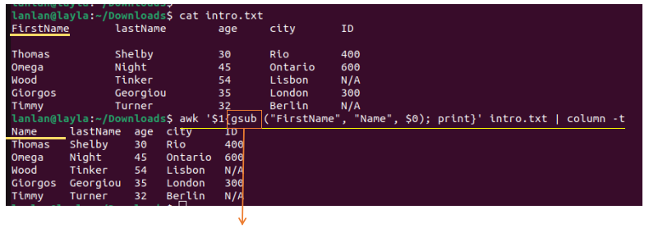
How to change field name with awk ?
gsub stands for global substitution. It replaces every occurrence of regex with the given string (sub).

Slide 23
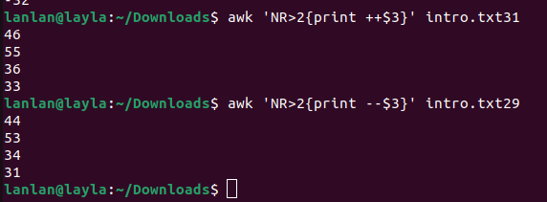
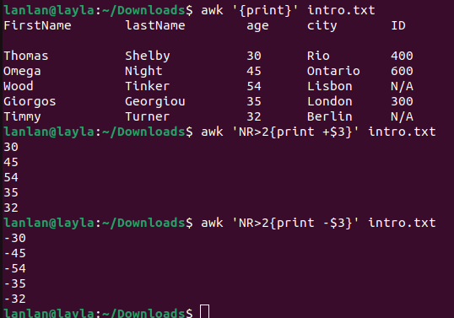
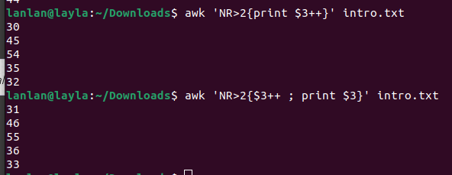
7.5 Unary Operators
+ : The number (returns the number itself)
- : Negate the number
++ : Auto Increment
-- : Auto Decrement
++ in the print statement the original value is printed
++ in a separate statement the resulting value is printed

Slide 24
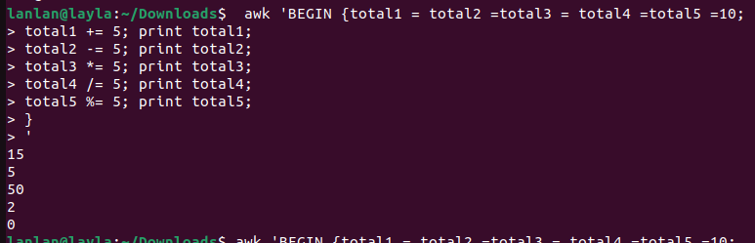
7.6 Assignment Operators
awk uses = as the assignment operator
"=" -Assignment
"+=" -Shortcut addition assignment
"-=" -Shortcut subtraction assignment
"*=" -Shortcut multiplication assignment
"/=" -Shortcut division assignment
"%=" -Shortcut modulo division assignment

Slide 25
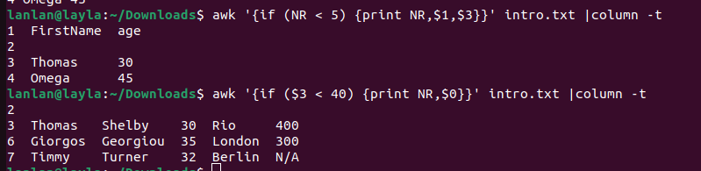
7.7 AWK Statements
Awk Simple If statement
The simple if statement tests a condition, and if the condition returns true, performs the corresponding action(s).
Syntax: awk '{if (condition) {statement} }' [input_file]

Slide 26
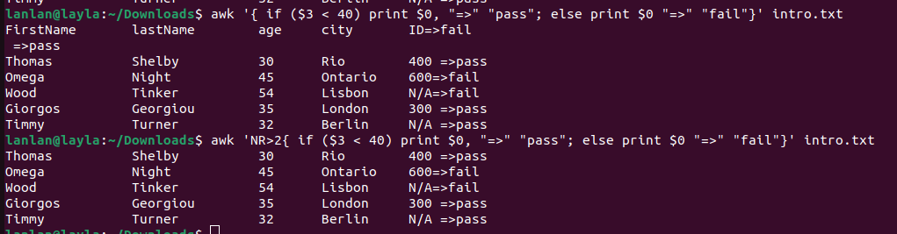
Awk If-Else statement
In the awk "If Else" statement you can also provide list of actions to perform if the condition is false. In the following syntax, if the condition is true statement 1 will be performed, if the condition is false statement 2 will be performed.
Syntax:
if (condition) {
statements
} else {
statements }

Slide 27
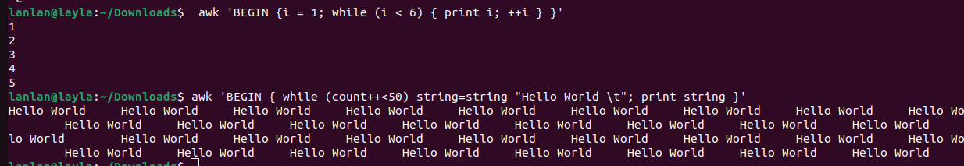
Awk While Loop
Awk while looping statements are used to perform a set of actions again and again in succession. Awk keeps executing a statement as long as the loop condition is true.

Slide 28
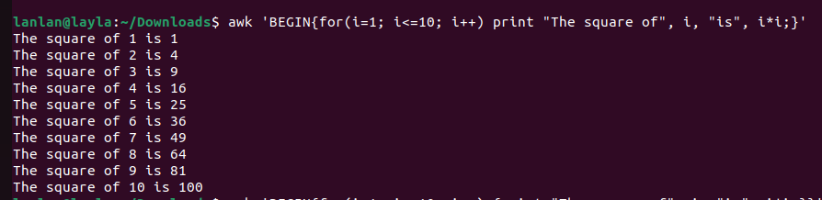
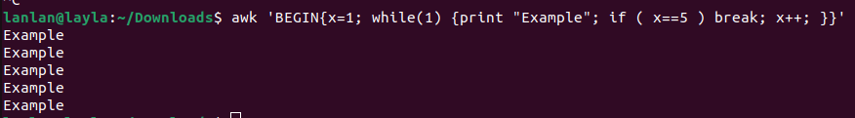
Awk For Loop
break statement

Slide 29
Classwork
Use data awk_example.tsv to make the following requests.
- Check the number of rows and columns in the data
- Displays the contents of the last line of the “Row.names” field and the total number of lines contained in that field “Row.names”
- Show first 10 lines of these field : Row.names, AveExpr and P.Value
- Change “Row.names” to “ProbesName” using awk
- Filter data with P.Value > 0.95
- Extract data from line 1 to line 1000 and save it to a new file

