Slide 1
Genome and File Formats
Phuc Loi Luu, PhD
Loi.lp@pacificinformatics.com.vn
5/8/2023

Slide 2
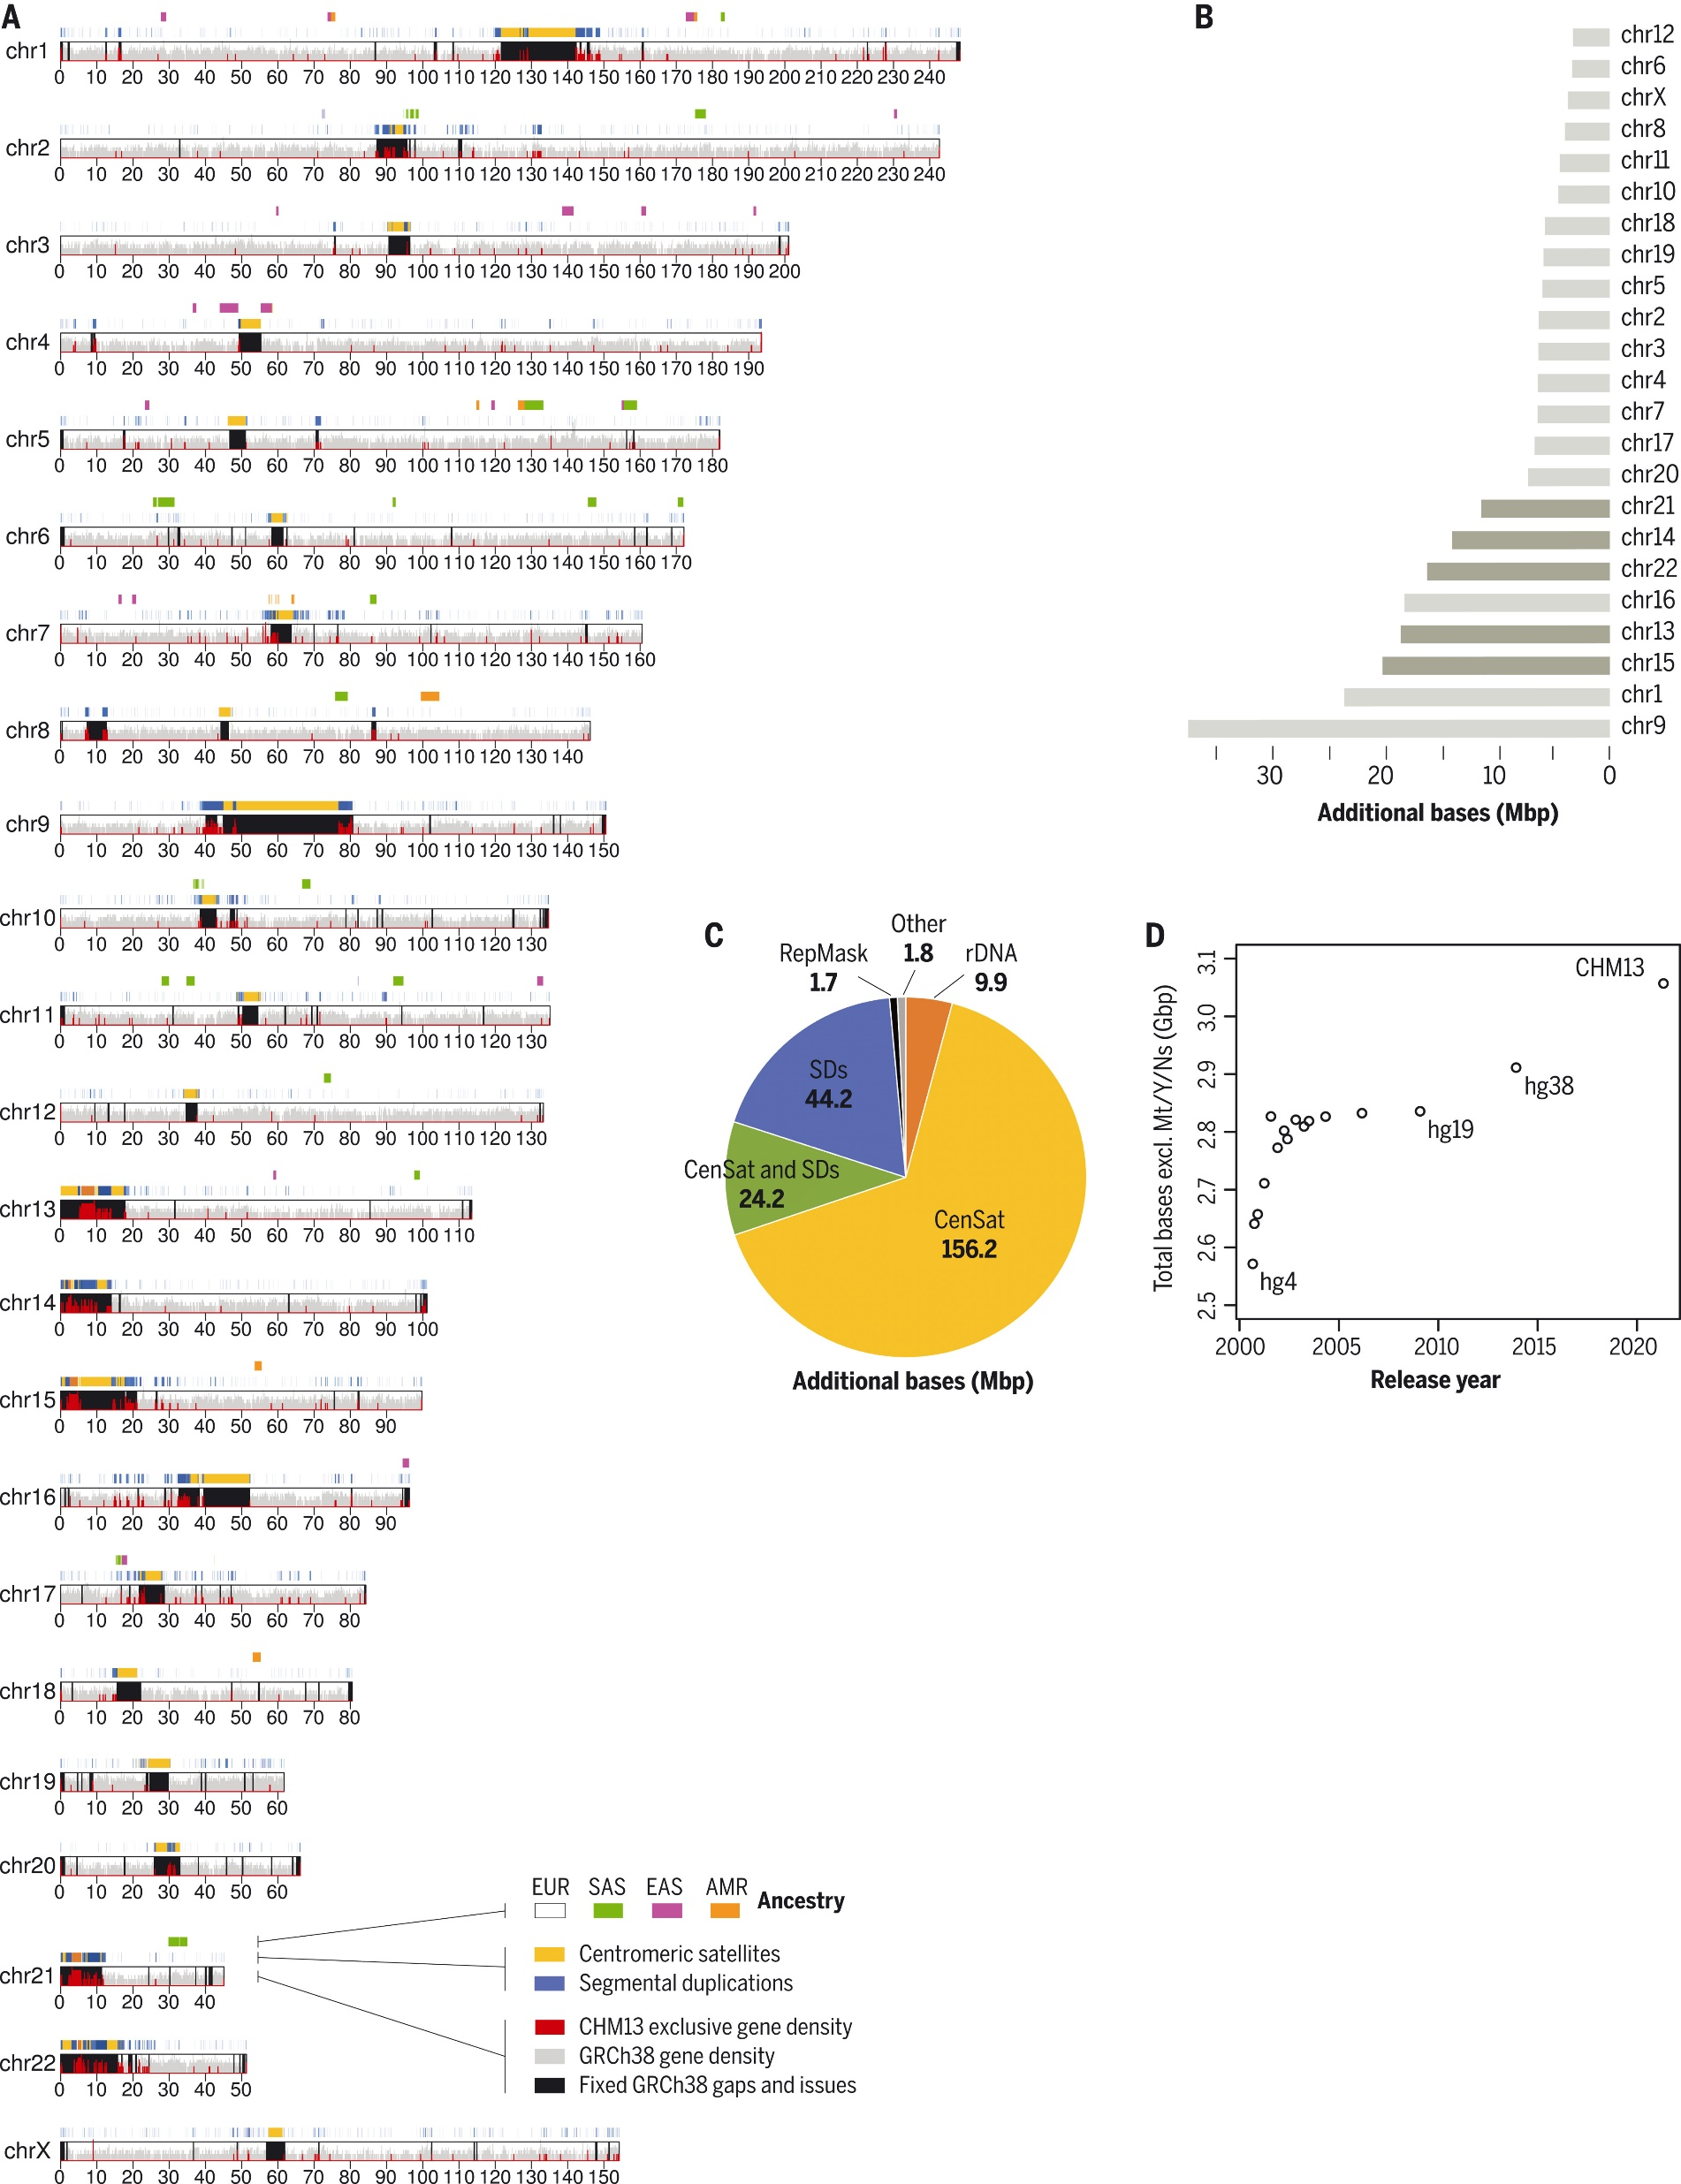
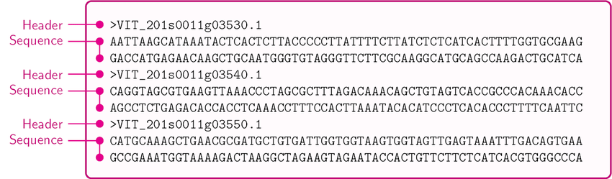
Human Reference genome
https://genome.ucsc.edu/
Fasta format
https://www.science.org/doi/10.1126/science.abj6987

Slide 3
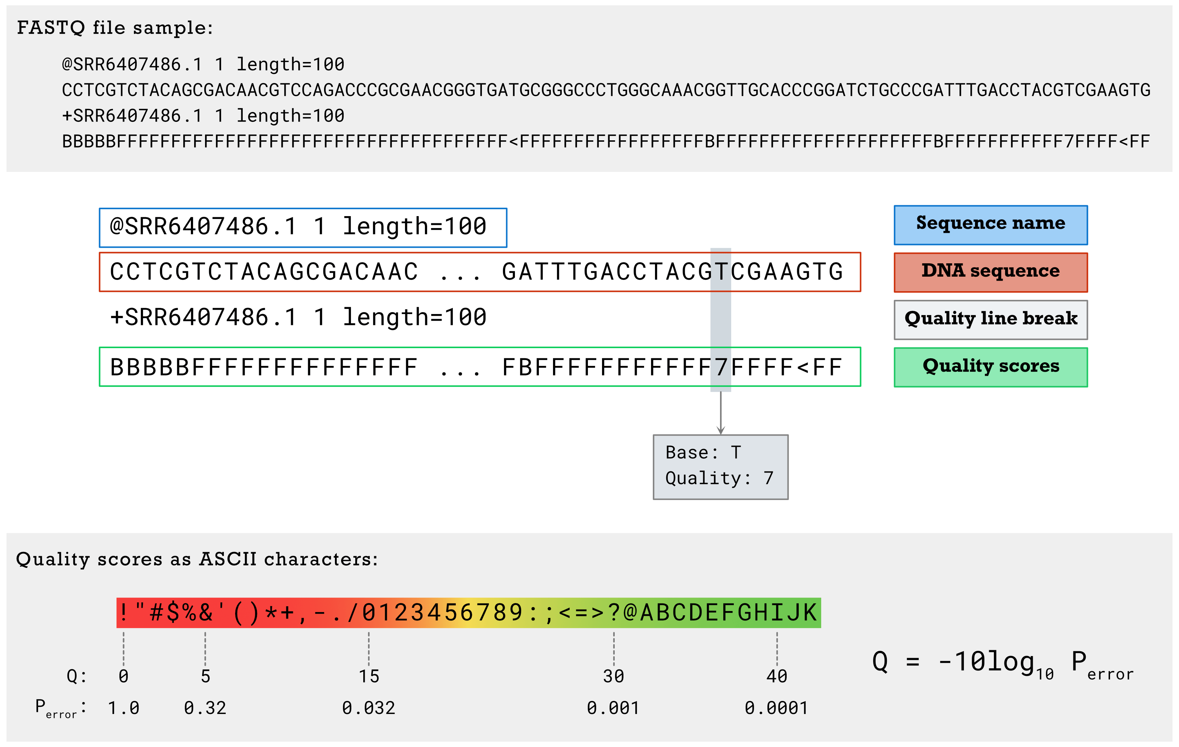
Fastq file

Slide 4
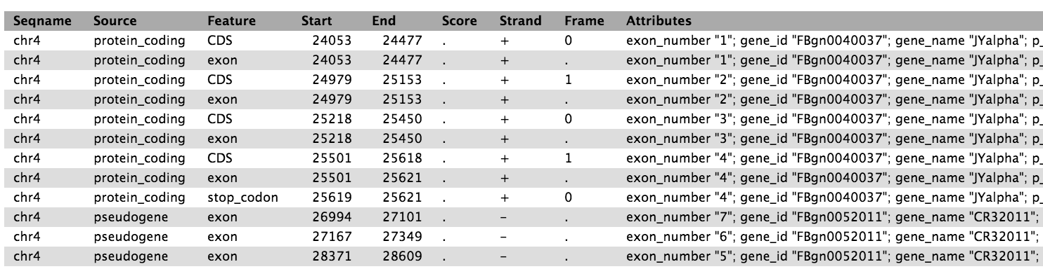
Human Gene Annotation
https://www.gencodegenes.org/
GTF format

Slide 5
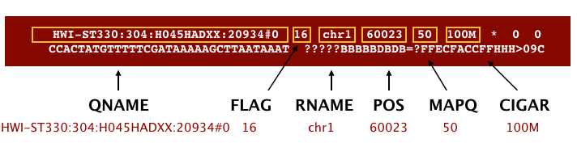
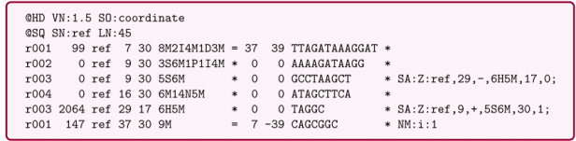
BAM Format

Slide 6
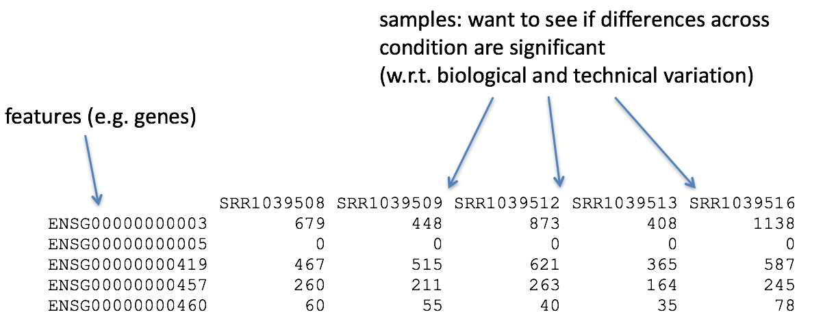
Gene expression count matrix

Slide 7
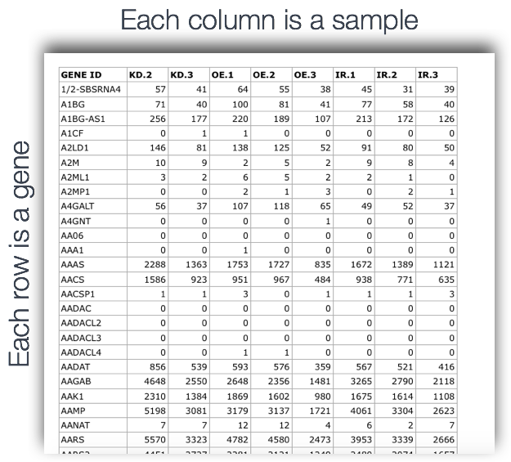
Gene expression count matrix (1)

Slide 8
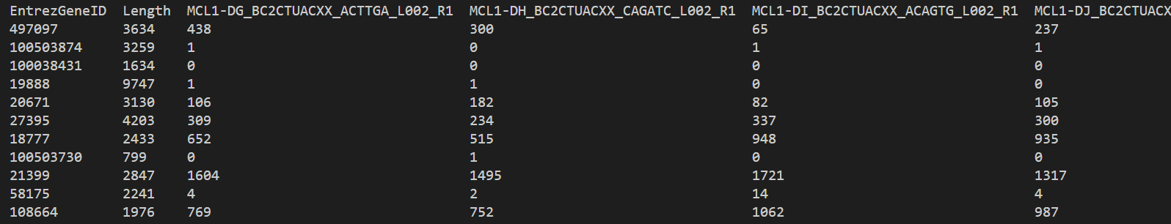
Gene expression count matrix (2)

Slide 9
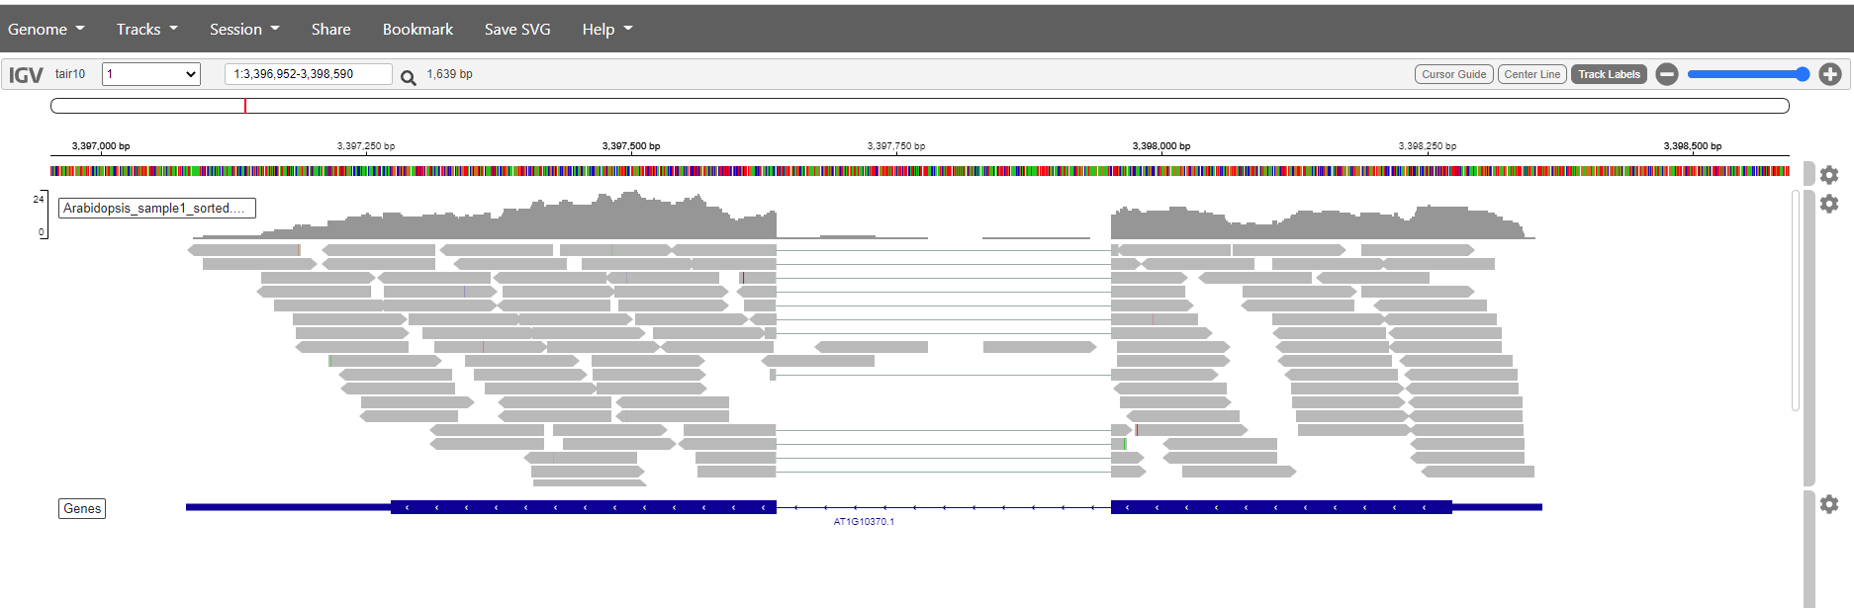
BAM in IGV (1)

Slide 10
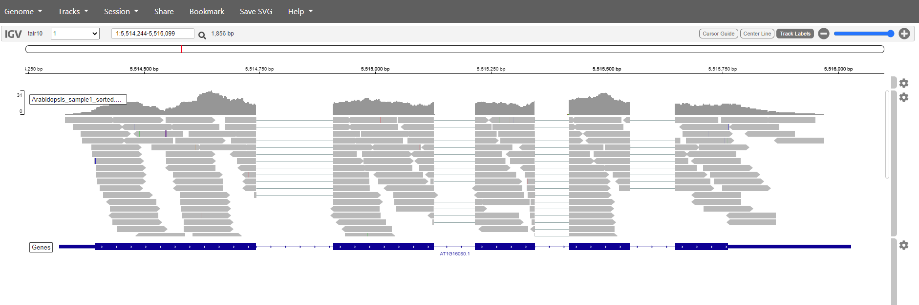
BAM in IGV (2)

Slide 11
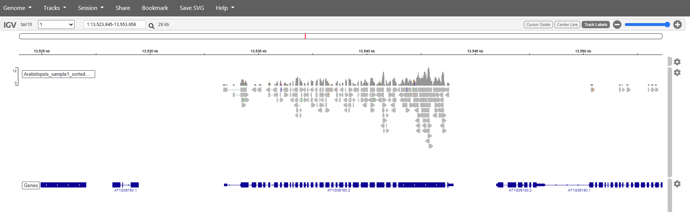
BAM in IGV (3)

