Slide 1

LINUX COMMAND LINE FOR BEGINNERS - INTRODUCTION
Presenter: Nguyen Duy Thanh
15th January, 2022
1

Slide 2
CONTENT OF PRESENTATION
1. Question: Why is learning the Linux command line important?
2. Overview
3. Navigation command
4. Manipulating Files And Directories
5. Redirection command
6. Command for Searching and Files Permissions
7. Processes Commad
2

Slide 3
1. Question: Why is learning the Linux command line important?
※ Using a web browser on Linux is not fundamentally different from using one on Windows, so what is the point?
- Linux is free, which is something you don’t get with Windows or Mac.
- We get to use the command line, in an environment that was designed for the command line => Fast, efficient and flexible
- Reproducible
- Memory
※ Example: You want to zip a folder then send it via FTP service to another place.
1. Open a zip utility app and zip that folder. Close zip utility app.
2. Open FTP app and send that zip files. Close that FTP app
Now, what if you need to zip many folder and send it via FTP?
3

Slide 4
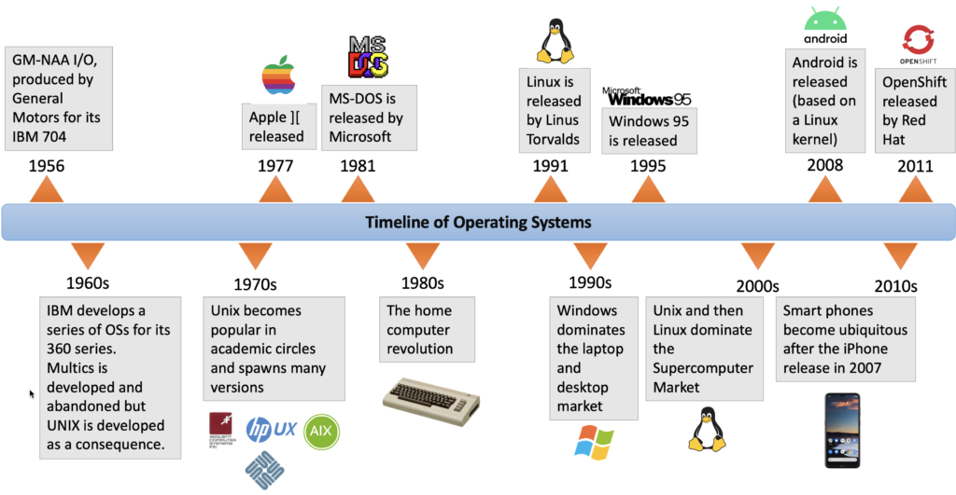
2. Overview
UNIX (1969) is a family of computer operating systems
Linux (1991) is a UNIX-like operating systems
Linux is not UNIX
(Source: Simon Barnes., 2021)
4

Slide 5
2. Overview
UNIX and LINUX
Ubuntu
Unix was created by Ken Thompson and Dennis Ritchie in 1969, Linux was written by a single man named Linus Trovald around 1991.
Linux comes in many varieties, which are called distributions: Fedora, Mint and Debian.
Linux
Fedora
Mint
Debian
5

Slide 6


2. Overview
UBUNTU INSTALLATION
Dual Boot Ubuntu Windows 10
https://phongvu.vn/cong-nghe/huong-dan-dual-boot-ubuntu-windows-10/
https://www.youtube.com/watch?v=q5m-h0d52I0&t=157s
For Windown symtems
Ubuntu
Terminal
6

Slide 7
2. Overview
https://learn.microsoft.com/en-us/windows/wsl/install-manual#step-4---download-the-linux-kernel-update-package
Ubuntu Skype Screen Sharing Not Working
Solution?
https://www.tutsmake.com/ubuntu-skype-screen-sharing-not-working/
How to install vietnamese on ubuntu?
https://truongtc.com/cai-dat-bo-go-tieng-viet-ibus-bamboo-tren-ubuntu/
7

Slide 8
2. Overview
Before diving into the world of linux command line, we need to learn two terms:
+ The Shell
+ Terminal
THE SHELL (CLI)
The shell is a program that takes keyboard commands and passes them to the operating system to carry out
TERMINAL
Terminal is a tool which you can use to pass your shell commands. This is a program that opens a window and lets you interact with the shell
8

Slide 9
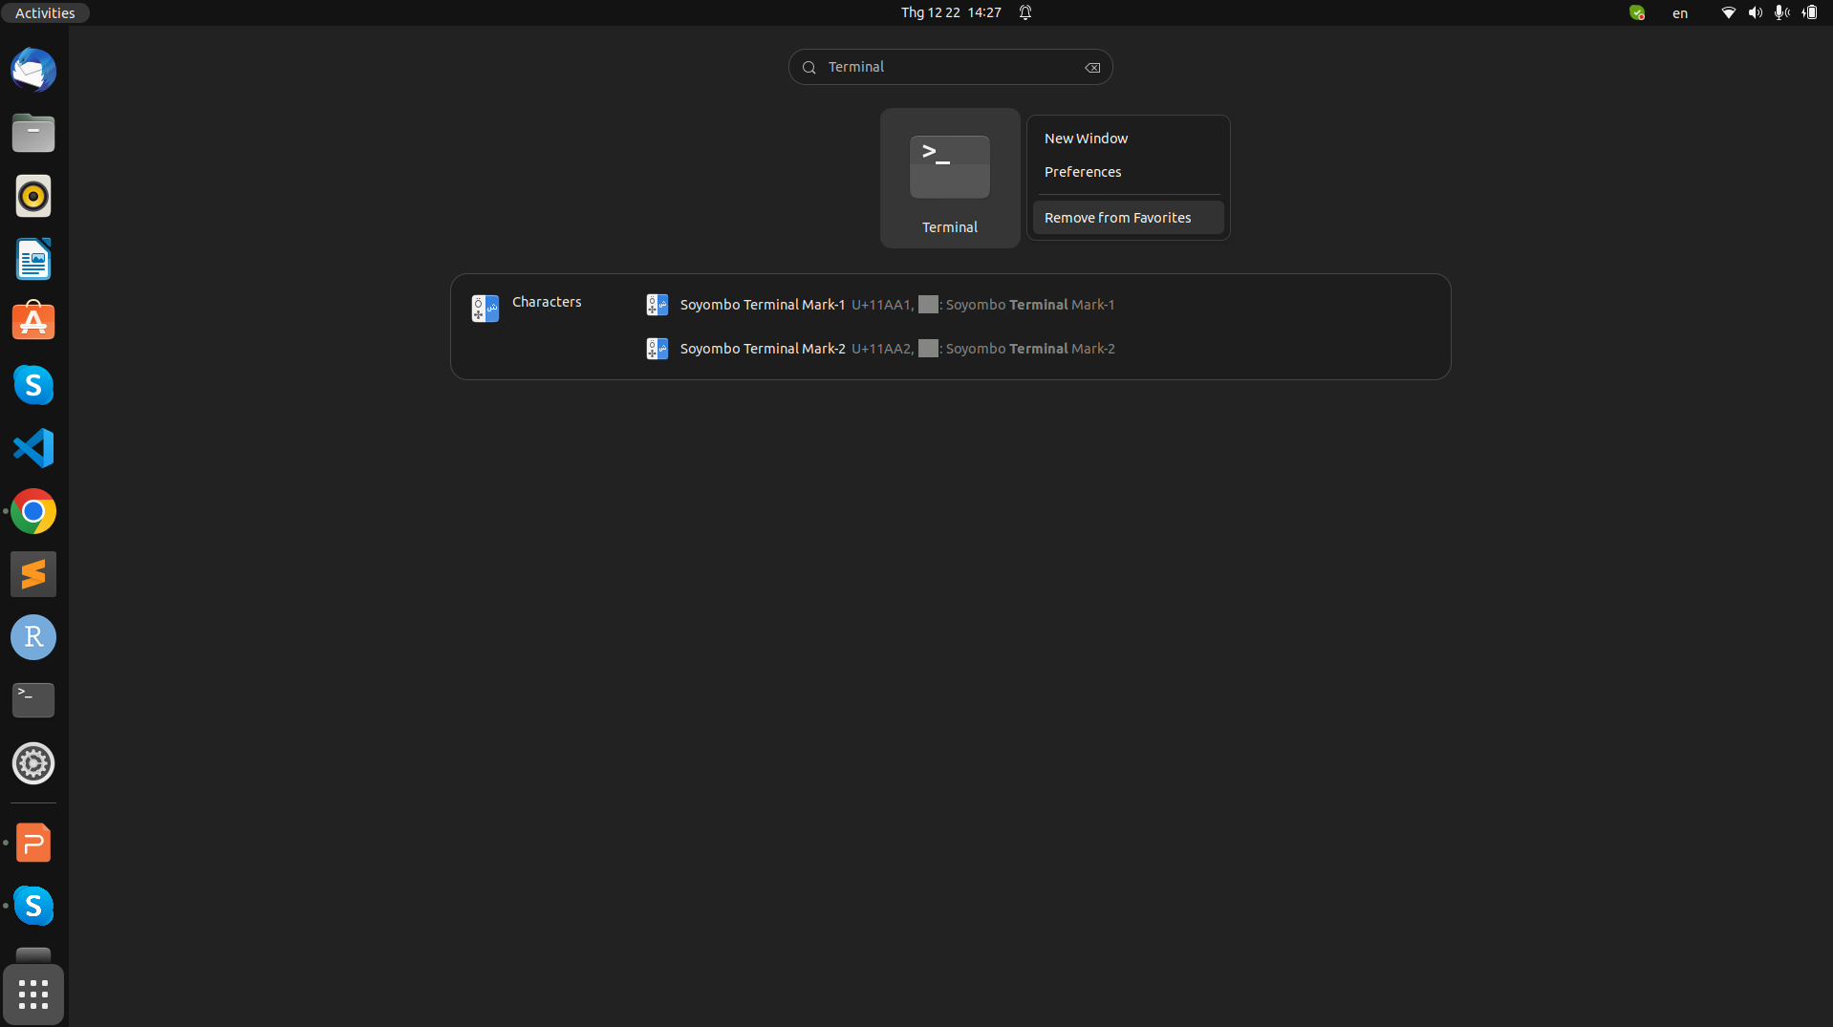
2. Overview
Open Terminal by in Options or Ctrl + Alt + T keys on the keyboard
File directory =>
App store =>
Menu app =>
9

Slide 10
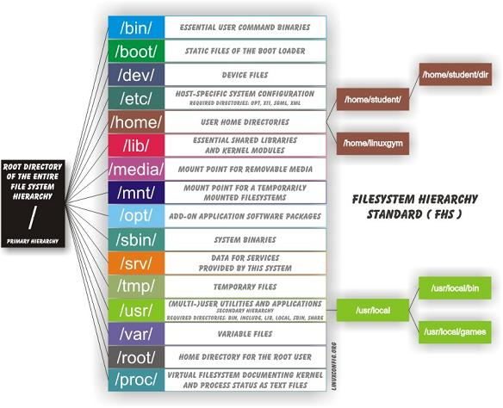
2. Overview
10

Slide 11
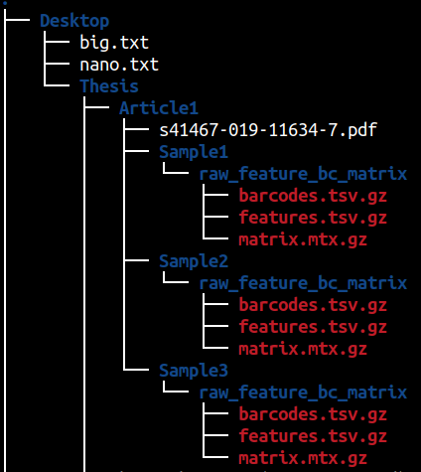
2. Overview
We need to understand what is a filesystem and how you know these filesystem work in Linux so like all other operating system?
The files on Linux system are arranged hierarchical directory structure which means that they are organized in a tree-like pattern
root folder start from this forward slash and then all the directories reside in this root folder
11

Slide 12
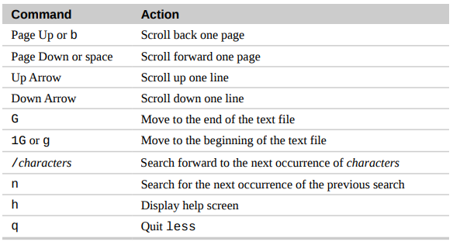
Exploring The System
2. Overview
less command
The less command is a program to view text files
less command syntax
less filename
less /home/thanhthanh/filename
How do I see the options?
man command
ex: man less
12

Slide 13
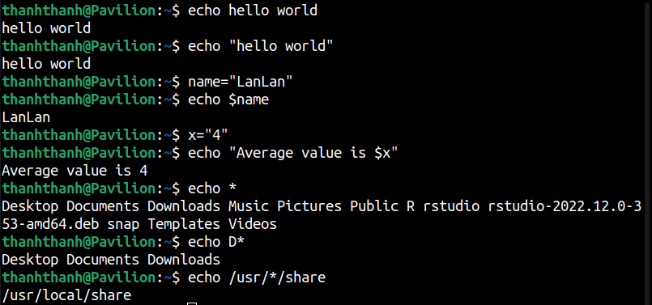
2. Overview
echo command
echo is a shell built-in that performs a very simple task. It prints out its text arguments on standard output
13

Slide 14
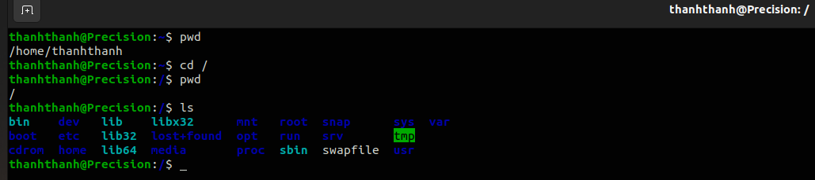
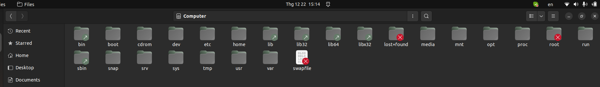
3. Navigation command
pwd command
pwd (print working directory) command shows you in which directory you are currently
14

Slide 15
3. Navigation command
cd command syntax: cd [dir]
cd command is going to land you in the current home directory
For example you want to go to somewhere:
cd / change to the root directory
cd .. it means we want to go to the parent directory of the current working
cd Documents change to the Documents directory
cd /home/thanhthanh/Documents/ change to the Documents directory by absolute path
15

Slide 16
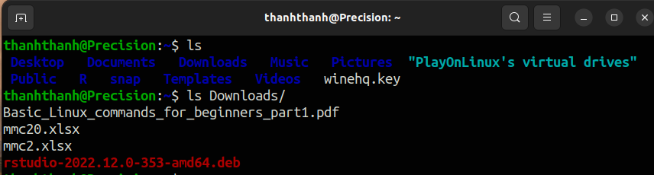
3. Navigation command
ls command
To list the files and directories in the current working directory
ls command syntax: ls [option] [fd]
16

Slide 17
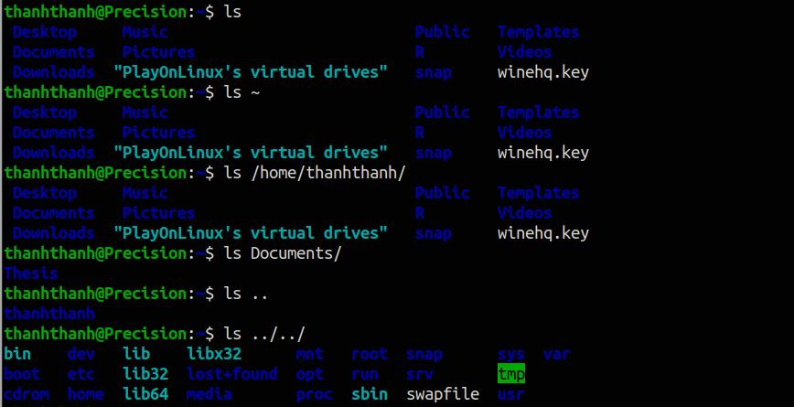
3. Navigation command
ls command with file and directory
home directory
Print out one step back directory structure
17

Slide 18
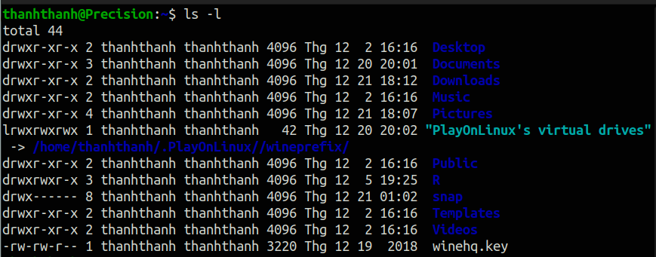
3. Navigation command
ls command with option
ls -l give you content in long format
Users
Others
- | - - - | - - - | - - -
Group
d - directory
r - read
w - write
x - execute
18

Slide 19
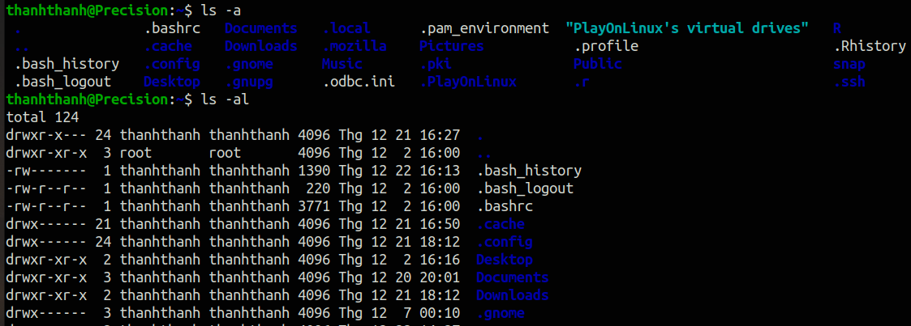
3. Navigation command
ls command with option
ls -a give you the hidden files
19

Slide 20
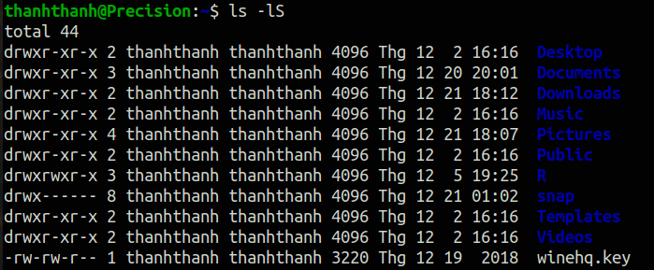
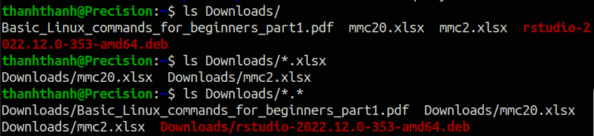
3. Navigation command
ls command with option
ls -lS will sort your directory by their size
20

Slide 21
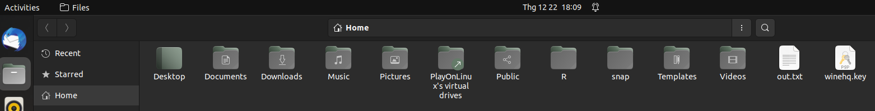
3. Navigation command
ls command with option
How to save results to a file?
The new file will be saved at the address we are working on
21

Slide 22
4. Manipulating Files And Directories
mkdir command
We can use mkdir command to create directories in Linux
Syntax with mkdir command:
mkdi52r image Creat a directory called image
mkdir image/picture Create a subdirectory inside this image directory
mkdir -p names/thanh
mkdir --parents names/thanh
mkdir --parents names/{thanh,lan,dat} Create multiple subdirectory
Creat a subdirectory for a directory that does not exist
22

Slide 23
4. Manipulating Files And Directories
rmdir and rm command
We can use rmdir and rm command to remove the directory or directory structures
Syntax with mkdir command: rmdir -options directory/rm -options directory
rmdir thanh Remove a directory thanh
rmdir -p names/thanh/lan/dat Remove a directory structures
rmdir -pv names/thanh/lan/dat Remove a directory structures and tell us
extended information
rm -r thanh Remove a directory thanh and subdirectory inside
23

Slide 24
4. Manipulating Files And Directories
cp command
We can use cp command to copies files or directories.
Syntax with cp command: cp options source destination
cp file1.txt file2.txt Copy a file1 into a new file called file2 and copy the content
cp file1.txt directory1 Copy a file1 to a directory1
cp file1.txt file2.txt directory2 Copy a multiple file to a directory2
How to transfer these two files to directory1 one but we already know that file1.txt is already existing inside the directory1?
cp -i file1.txt file2.txt directory1
24

Slide 25
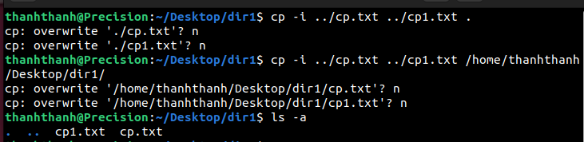
4. Manipulating Files And Directories
cp command
Copy a directory1 to directory3
25

Slide 26
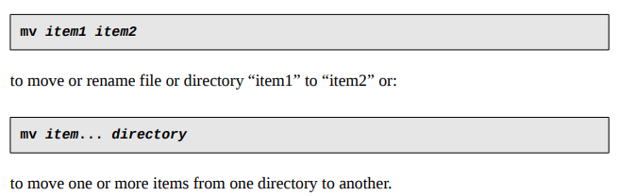
4. Manipulating Files And Directories
mv command
The mv command performs both file moving and file renaming, depending on how it is used. In either case, the original filename no longer exists after the operation. mv is used in much the same way as cp
Syntax with mv command: mv options source destination
26

Slide 27
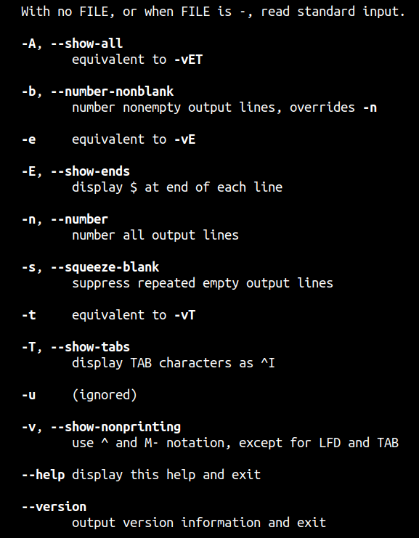
5. Redirection command
cat command
cat is one of the most frequently used command on linux it has three related function with regard to text files.
- Displaying the text
- Combining copies of text files
- Creating new text
Syntax: cat [option] [filename1 filename2 ....]
27
27

Slide 28

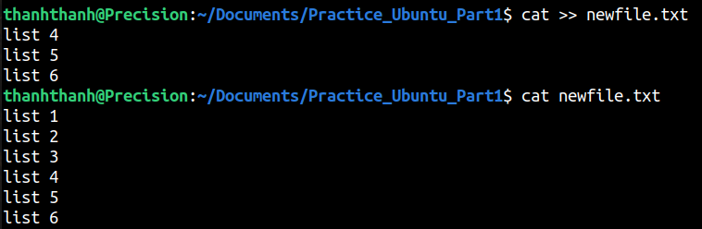
5. Redirection command
cat command
Redirection in Linux: redirection simply means capturing output from a file command or program and sending it as an input to another file command or program
Syntax: [output] > [file]
Syntax with cat command:
cat > [file] create a file and then transferring our you know stream to this file, now whatever you write here then this content will be written to the file
cat >> [file] appending to the existing content of a file
How to concaternate contents from file to another file?
28

Slide 29
6. Command for Searching & Files Permissions
touch command
touch command is the easiest way to create new empty files in Linux. It is also used to change the timestamps on existing files or directories.
touch command syntax
touch filename
nano command
nano is a small and friendly text editor and beside the text editing nano offers many extra features like an interactive, search or replace,...
29

Slide 30
6. Command for Searching & Files Permissions
sudo command
super user command allows you to execute some command with the superuser or perform some tasks most probably it will ask you for this super user privileges
sudo command syntax
sudo [option]
example: sudo apt-get update
sudo mkdir thanh (ex: root directory)
sudo -s
30

Slide 31
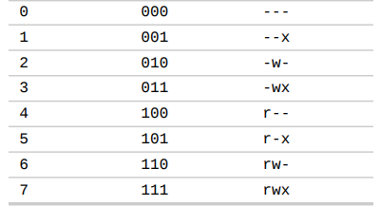
6. Command for Searching & Files Permissions
chmod command (chmod – Change File Mode)
To change the mode (permissions) of a file or directory
chmod supports two distinct ways of specifying mode changes: octal number representation, or symbolic representation.
chmod command syntax
chmod option filename1
31

Slide 32
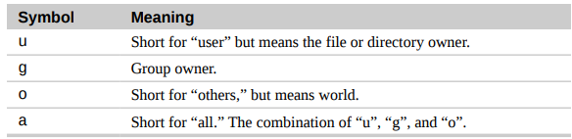
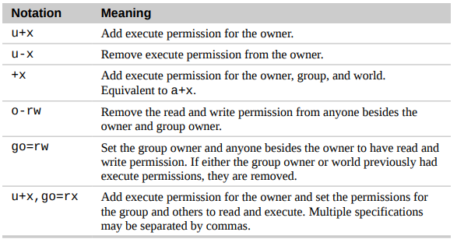
6. Command for Searching & Files Permissions
chmod command (chmod – Change File Mode)
32

Slide 33
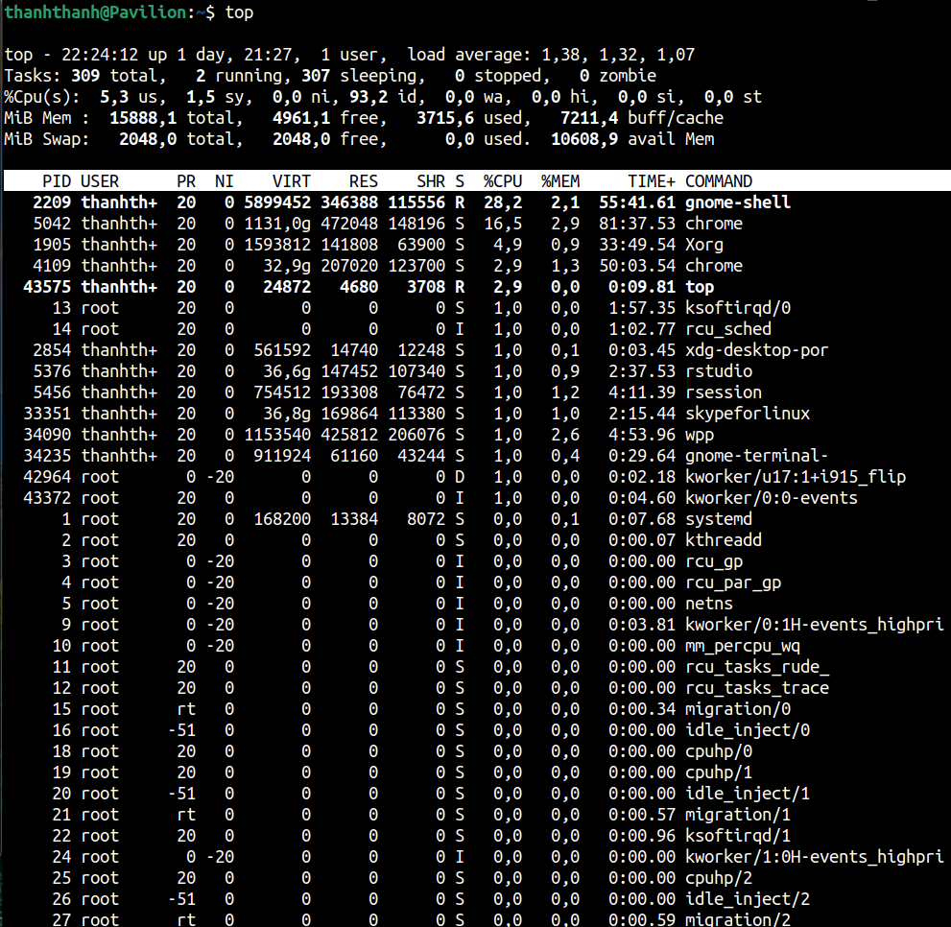
7. Processes Commad
top command
top command provides a dynamic real-time view of your running system
The time which is the current
Stands for process ID
The name of the program which is running currently
Key option in top
s Change time refreshing of the data
i Just filter out any idle processes
k Kill a process for
33

Slide 34
Summary
Command for Exploring The System
ls | List directory contents
less | View file contents
echo | Display a line of text
Navigation Command
ls | List directory contents
pwd | Print name of current working directory
cd | Change directory
34

Slide 35
Summary
Manipulating Files And Directories
cp | Copy files and directories
mv | Move/rename files and directories
mkdir | Create directories
rmdir/rm | Remove files and directories
Redirection Command
cat | Create, Concatenate files
Processes Commad
top | Display tasks
35

Slide 36
Summary
Command for Searching & Files Permissions
touch | Change file times
nano | Text editors
sudo | Execute a command as another user
chmod | Change File Mode
REFERENCE
https://wiki.lib.sun.ac.za/images/c/ca/TLCL-13.07.pdf
https://oit.ua.edu/wpcontent/uploads/2020/12/Linux_bash_cheat_sheet-1.pdf
https://www.youtube.com/watch?v=YHFzrakOas&list=PLS1QulWo1RIb9WVQGJ_vh-RQusbZgO_As&index=1
36

