Slide 1

Basic Linux command lines for beginners (p2)
Presenter: Nguyen Le Thuy Lan
29th January, 2023

Slide 2
Outline
1. Users and groups
2. Giving the information.
3. Text editor
4. Viewing Resources
5. Basic file manipulation
6. Compress and Extract Files
7. How to Run multiple Terminal Commands
8. Installing package

Slide 3
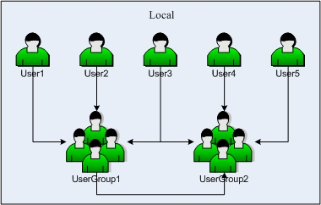


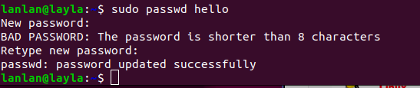
1. Users and Groups
useradd command
useradd is used to add user accounts to your system.
Syntax : useradd [options] [name_of_the_user]
Some options for useradd
To give a home directory path for new user: -m (--create-home)
To create a user with a specific login group: -g (--gid)
To create a user with a comment: -c (--comment)
To set a password of the new account: -p ( --password )
See more with useradd -h or useradd --help

Slide 4
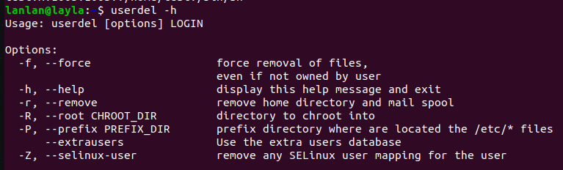
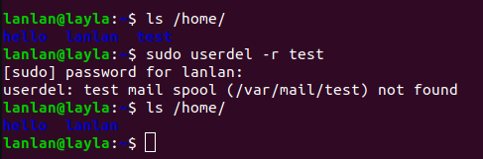
userdel command
The userdel command removes the user account and deleting all the entries which refer to the username LOGIN.
Syntax: userdel [options] LOGIN

Slide 5
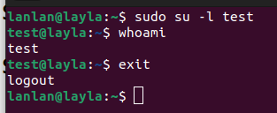
su command
'su' (short for substitute or switch user). Using 'su' is the simplest way to switch to the administrative account in the current login session.
The su command lets you switch the current user to any other user. If you need to run a command as a different (non-root) user, use the –l [username] option to specify the user account.
Linux prompt show a $, instead of the login name and path how to fix it
https://askubuntu.com/questions/388440/why-is-there-no-name-showing-at-the-command-line

Slide 6



Basic Group Management (groups, groupadd, groupdel)
A group is a collection of users. Groups make it easy to manage users with the same security and access privileges. A user can be part of different groups. Group information is held in the /etc/group file
groupadd command is used to create a new user group
tail /etc/group
The file shows group information in the following format
group_name : password : group-id : list-of-members

Slide 7

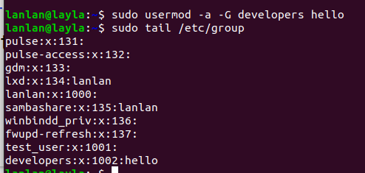

How to add an existing User to a Group
Set password for group
groupdel command is used to delete a existing group

Slide 8
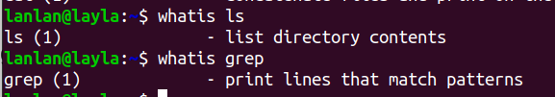
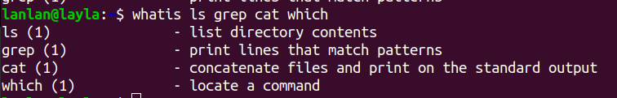
2. Giving the information
whatis command
“whatis” command is used to offer a one-line overview of command
Syntax: whatis [keyword]
If you want to know the details about multiple commands simultaneously, enter all the names as input

Slide 9
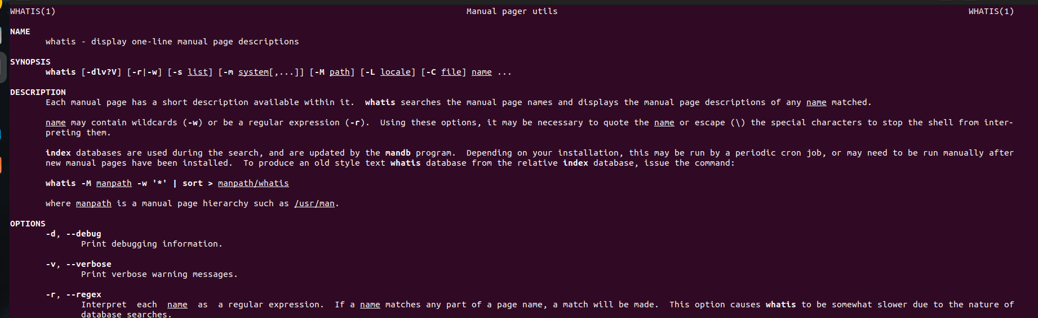
man command
‘man’ command in Linux is used to display the user manual of any command that we can run on the terminal
Syntax : man [COMMAND NAME]...
man -f [COMMAND NAME] = whatis [COMMAND NAME]
https://www.geeksforgeeks.org/man-command-in-linux-with-examples/

Slide 10

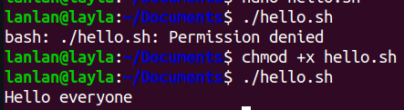

3. Text editor
Create a script in linux
Script used to make typescript or record all the terminal activities
1. Create file hello.sh
2. In order for the script to execute, we must grant it permission
First line put #! (shebang) and the location of bash
nano --> to save Ctrl+o (Enter); to exit Ctrl+x
or
exit existing files: Crtl+x (Exit) → y (Yes to save) → Enter)
Notes:
- Bash is a command processor that typically runs in a text window where the user types commands that cause actions. Bash can also read and execute commands from a file, called a shell script.
- The shebang directive is the first line in any Linux shell script. It starts with a character sequence consisting of a hash followed by an exclamation mark (#!). The presence of a shebang indicates that a file is executable. When the shebang line is missing, #!/bin/bash is the default shell used to execute the file.

Slide 11
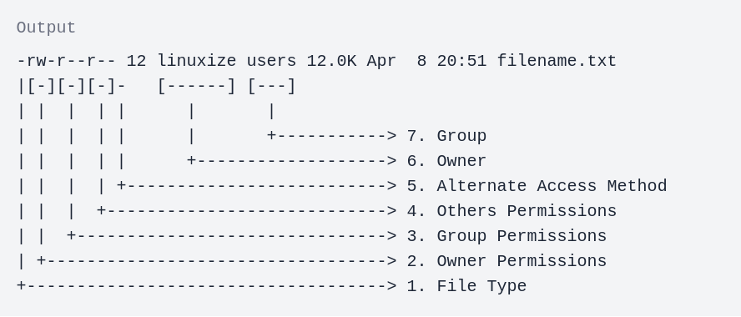
- In Linux, each file is associated with an owner and a group and assigned with permission access rights for three different classes of users:
The file owner.
The group members.
Others (everybody else).
- There are three file permissions types that apply to each class:
The read permission.
The write permission.
The execute permission.
https://www.digitalocean.com/community/tutorials/an-introduction-to-linux-permissions

Slide 12
vim command
‘vim’ is an editor to create or edit a text file using linux terminal.
Operating modes in vim editor:
- Command mode: by default, used to copy, paste, delete, or move text.
- Insert mode: To write the contents in the file, we must go to insert mode. Press ‘I’ to go to insert mode. If we want to go back to command mode, press the [Esc] key.
Syntax: vim [filename]
Step 1: Create a new file with ‘vim’ command
Step 2: Go to Insert Mode
Step 3: Write the content
Step 4: Save the file and exit from the editor: To save the file and exit from it, press the [Esc] key and the ‘:wq’.
Step 5: Check the data has been created successfully or not

Slide 13
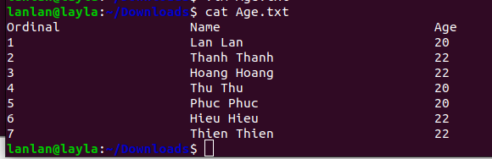
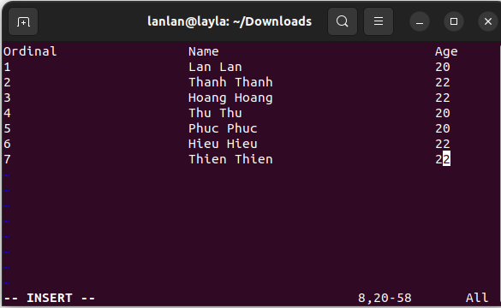
Step 1: Create a new file
Step 4: Save
Step 5: Check
Step 2: Go to Insert Mode
Step 3: Write the content
https://www.educba.com/vim-command-in-linux/

Slide 14
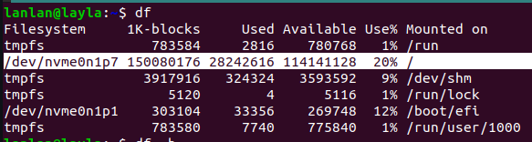
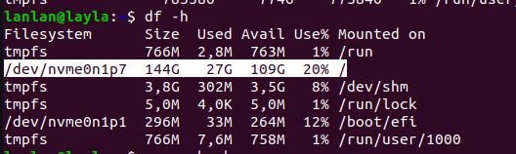
4. Viewing Resources
“df ” command report the amount of "available disk space" being used by your filesystem
So for making it "Human-readable" use "-h" flag with this command. Just write "df -h"

Slide 15
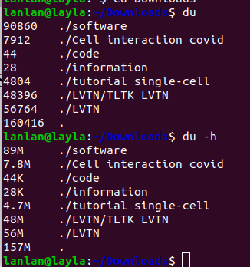
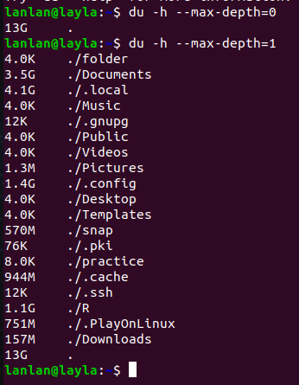
“du” command is used to estimate and display the disk space used by "files".

Slide 16

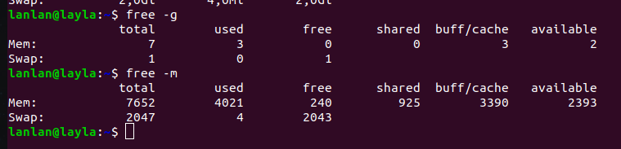
“free” command displays the total amount of free and used physical and swap memory in the system as well as the buffer memory
But this is also not human-readable so there are some flags. Which you can use with this free command and these flags are,
"-b" for byte.
"-k" for kilobyte.
"-m" for megabyte.
"-g" for gigabyte.
"-t" for terabyte.
Notes:
Shared, Buffer, and Cache fields identify memory being used for kernel/operating system needs. The buffer and cache are added together and the sum is listed under ‘buff/cache’.

Slide 17
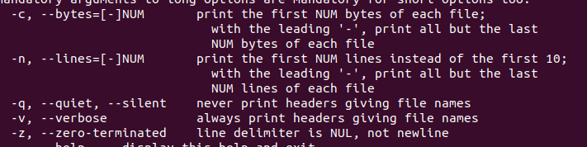
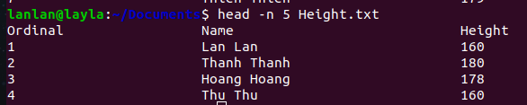
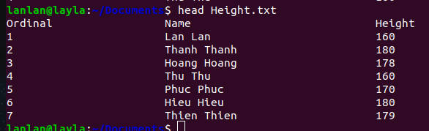
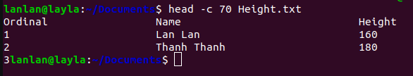
5. Basic file manipulation
Head and Tail Commands
‘head’ command, print the top 10 number of data of the given input.
Syntax: head [OPTION] [FILE]
‘-n’ option with 5 to print the first five lines
‘-c’ option with 70 to print the first 70 characters

Slide 18

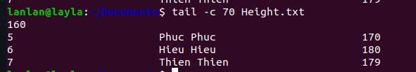
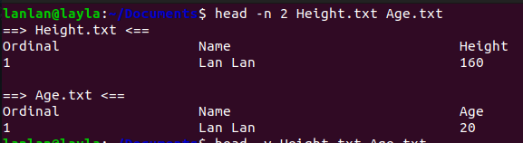
‘tail’ command reads the last 10 lines of the file.
‘-n’ option with 3 will display the last 3 lines
‘tail’ command with 70 to print the last 70 characters
Head & Tail Command with Multiple Files

Slide 19
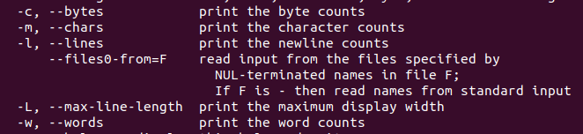
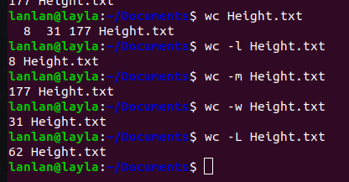
wc command
‘wc’ used to find out number of lines, word count and characters count in each file
Syntax: wc [OPTION] [FILE]

Slide 20
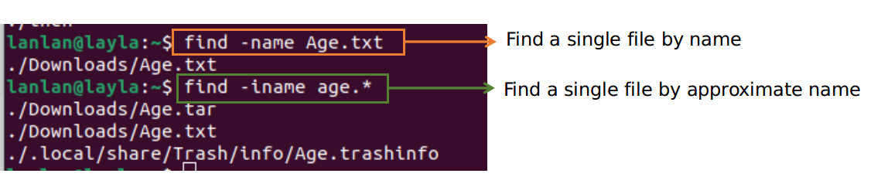
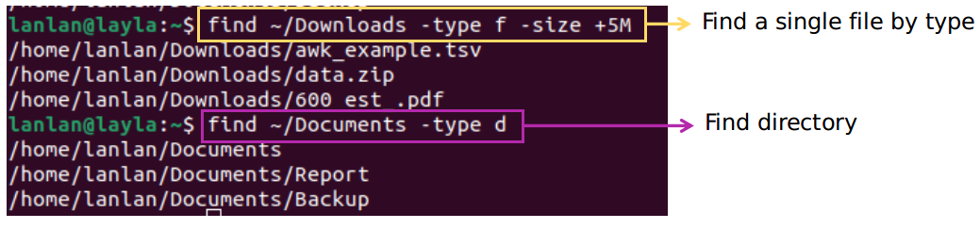
find command
‘find’ command is used to search for files or directories in a directory hierarchy
Syntax : find [path...] [options] [expression]
-name: Find a single file by name
-type: Find files based on their type

Slide 21


grep command
'grep' command used to search text and strings in a given file.
Syntax: grep [string] [filename(s)]
To print any line from a file
To search any line in multiple files

Slide 22
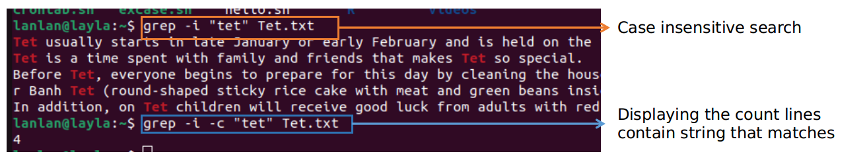
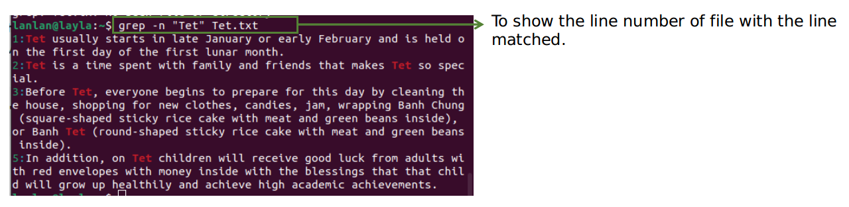
- grep commands are case sensitive, the terminal displays both uppercase and lowercase results. grep -i [xxx] *
- grep can display count of lines where it finds a match for your word. grep -c [xxx] *
Show line number while displaying the output using grep -n

Slide 23
6. Compress and Extract Files
‘tar’ command
‘tar’ command is used to compress a group of files into an archive. The command is also used to extract, maintain, or modify tar archives.
Syntax: tar [flags] [destinationFileName] [sourceFileName]
Some flags to customize the command input:
-c Create a new archive.
-z zip, tells tar command that creates tar file using gzip
-v Display progress in the terminal while creating the archive, also known as “verbose” mode. .
-f Archive file name.
-x Extract from a compressed file.

Slide 24
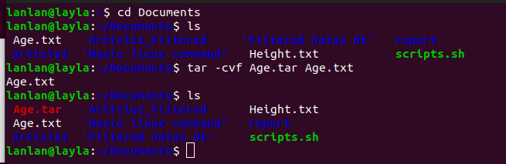
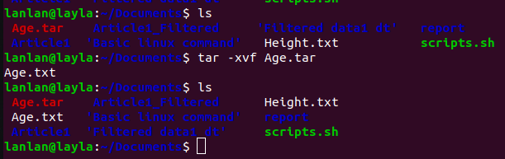
To compress file
To extract file

Slide 25
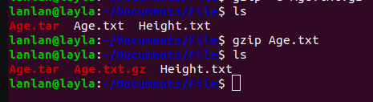

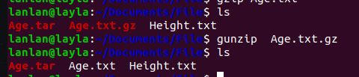
gzip command
‘gzip’ command compresses files. Each single file is compressed into a single file.
gzip [options] [file names]
To decompress a file: -d
One can unzip and open gz file using: gunzip [file.gz]

Slide 26
bc command
‘bc’ command is used for command line calculator. It is similar to basic calculator by using which we can do basic mathematical calculations.
Syntax: bc [option] [expression]
The ‘bc’ command supports the following features:
- Arithmetic operators
- Increment or Decrement operators
- Assignment operators
- Comparison or Relational operators
- Logical or Boolean operators
- Math functions
- Conditional statements
- Iterative statements

Slide 27
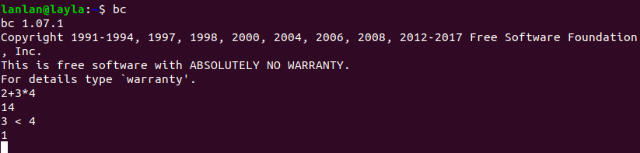
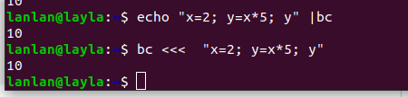
Ctrl + D or typing quit to exit
https://www.geeksforgeeks.org/bc-command-linux-examples/

Slide 28
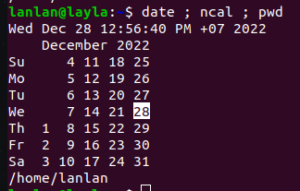
7. How to Run multiple Terminal Commands
When you need to run a bunch of terminal commands, you do it one-by-one. However, it turns out that there's a better way to do this, and it involves running multiple commands at once.
On Linux, there are three ways to run multiple commands in a terminal:
- The Semicolon (;) operator
- The Logical OR (||) operator
- The Logical AND (&&) operator
Using the Semicolon (;) Operator
Syntax: command A ; command B

Slide 29
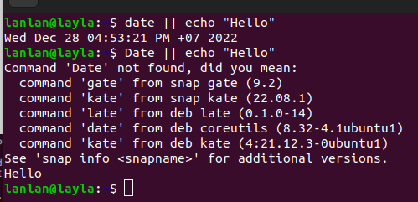
Using the OR (||) Operator
When you run two commands using the OR operator and it execute only one command between the two. For instance, command B will only execute if command A fails and command A runs successfully, command B won't execute.
Syntax: command A || command B

Slide 30
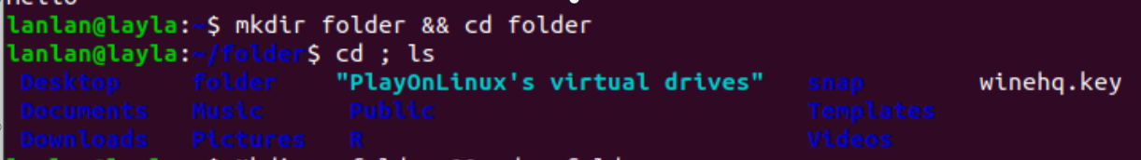
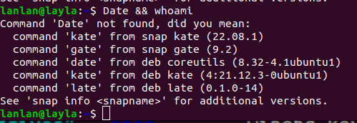
Using the AND (&&) Operator
With AND (&&) operator, the second command to only run if the first command is successful
Syntax: command A && command B

Slide 31
8. Installing package
apt-get is a command-line tool which helps in handling packages in Linux. Its main task is to retrieve the information and packages from the authenticated sources for installation, upgrade and removal of packages along with their dependencies. Here APT stands for the Advanced Packaging Tool.
Some Used Commands with -apt-get
- update: to perform an update before you upgrade or dist-upgrade.
apt-get update
- upgrade: used to install the latest versions of the packages currently installed
apt-get upgrade
- install: used to install or upgrade packages.
apt-get install [...PACKAGES]
- remove: used to remove package. It does not remove any configuration files created by the package.
apt-get remove [...PACKAGES]

Slide 32
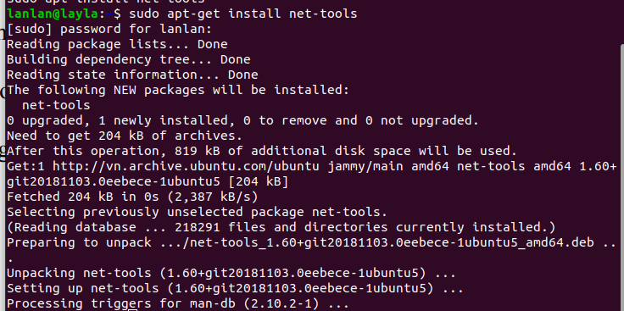
- purge: removes the packages, and also removes any configuration files related to the packages. apt-get purge [...PACKAGES]
- check: This command is used to update the package cache and checks for broken dependencies apt-get check
- download: This command is used to download the given binary package in the current directory. apt-get download [...PACKAGES]
see more with: apt-get -h

Slide 33
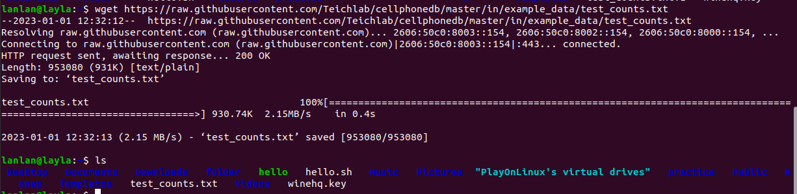
To get files and documents
wget command
- ‘wget’ stands for web get. The wget is a free non-interactive file downloader command. Non-interactive means it can work in background when user is not logged in. This allows user to get disconnected with the system while wget finish its work.
- It supports HTTP, HTTPS, and FTP protocols
Syntax: wget [options] [url]

Slide 34
some option use with 'wget'
- To save the downloaded file under a different name: wget -O [fileName] [URL]
- To resume a partially downloaded file: wget -c [URL]
- Download multiple files: wget -i [fileName] ( file name is a .txt and contain URLs)
- Downloading and save a File to a Specific Directory : wget -P [path] [URL]

Slide 35
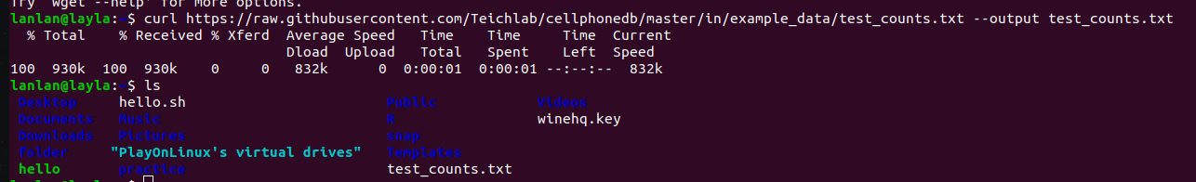
curl command
- ‘curl’ (short for "Client URL") is a command line tool that enables data transfer over various network protocol
- Using any of the supported protocols (HTTP, FTP, IMAP, POP3, SCP, SFTP, SMTP, TFTP, TELNET, LDAP, or FILE).
Syntax: curl [options] [URL...]

Slide 36

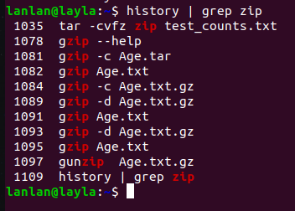
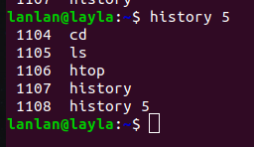
history command
‘history’ command is used to view the previously executed command
Basic syntax
This command can also be used along with grep
To show the limited number of commands that executed previously

Slide 37
Classwork
Let's create a folder 'NGS3' , in that folder please create a file script 'example.sh'. In that file list some command lines
- Download a file from URL
https://trituemedia.vn/uploads/file/Muon-kiep-nhan-sinh.pdf
- Use the search command to find out where the downloaded file is saved
- Compress the "NGS3" folder and move it to another folder (eg, move from Downloads to Documents )
- Grant permission and execute requests in "example.sh"

Slide 38
Homework
- Create 1 folder with name "homework" in Documents.
- In the directory "homework" create a script with the name "command.sh" containing the following commands:
(1) echo "10^2" | bc ; history | wc -l
(2) echo "var=10;var^2;var^3" | bc || date
(3) WGET https://trituemedia.vn/uploads/file/Muon-kiep-nhan-sinh.pdf && echo "var=10;--var" | bc
- Explain the lines of code in the script file
- Grant file script execution permission to user and execute this file
- Rename the script file from "command.sh" to "script.sh"
- Compress folder "homework" and then move that compressed file to the Downloads.

Slide 39
Summary
Command line | Function
Users and Groups
useradd | add user accounts to your system.
userdel | removes the user account
groupadd | create a new user group
groupdel | removes the user account
Giving the information
whatis | offer a one-line overview of command
man | manual of any command

Slide 40
Summary
Command line | Function
Text editor
nano | a small, free and friendly editor
vim | create or edit a text file
Viewing Resources
df | report the amount of "available disk space" being used by filesystem
du | estimate and display the disk space used by "files"
free | displays the total amount of physical and swap memory as well as the buffer memory

Slide 41
Summary
Command line | Function
Basic file manipulation
head | print the top 10 lines of data of the given input
tail | print the last 10 lines of the given input
wc | find out number of lines, word count and characters count in each file
find | used to search for files in a directory hierarchy
grep | used to search text and strings in a given file
Compress and Extract Files
tar | used to compress a group of files into an archive
gzip | compresses files

Slide 42
Command line | Function
Installing package
apt-get | install
To get files and documents
wget, curl | download file from URL
history | view the previously executed command
bc | calculator

