Slide 1

Introduction to basic Shell/Bash script
Nguyen Quang Khai
05/01/2025

Slide 2
Content
Overview
Variable
For loop
If else

Slide 3
1. Overview

Slide 4
What is a Bash script file?
#comment
Linux commands: ls, mkdir,..
for loop, if else, variables,..
A set of Bash language commands arranged to be executed in order
a blank text file
a Bash script file
(set of commands)

Slide 5




Why need Bash script?
Run the same set of commands many times.
Share “that set of commands” with others.

Slide 6
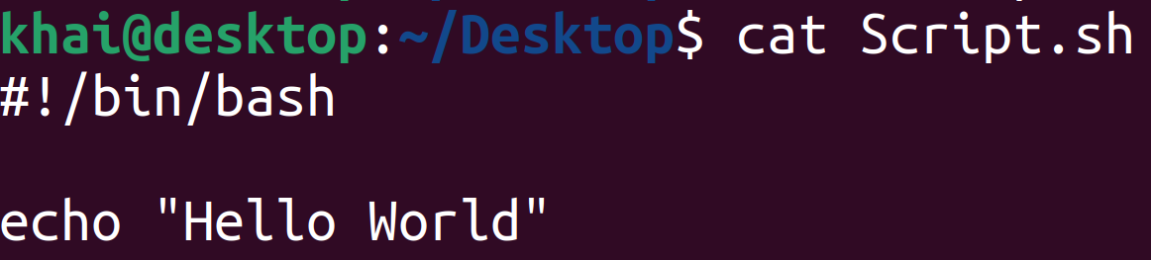
Run a Bash script file in the terminal
I have a Bash script file with content:
#! called Shebang (This line means that this script file will be executed by Bash.

Slide 7
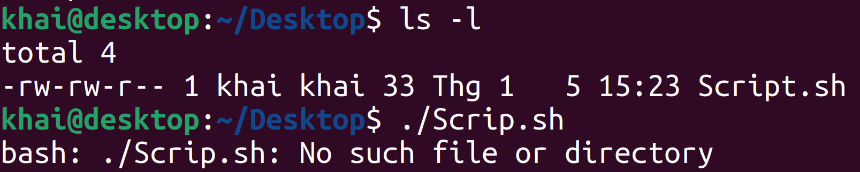
Run a Bash script file in the terminal
Run a Bash script file
The bash script file cannot be executed because it does not have the required permissions.

Slide 8
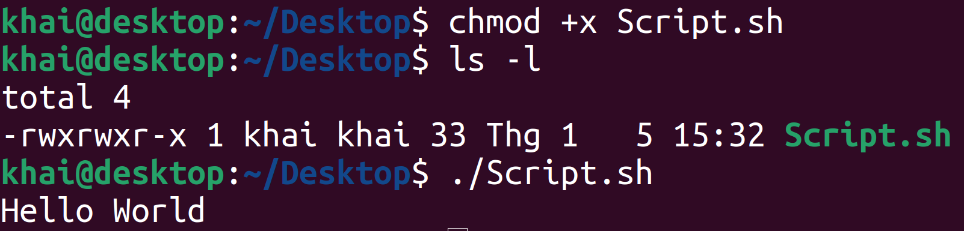

Run a Bash script file in the terminal
Grant execution permission to Bash script file using chmod command
Execution permission granted

Slide 9
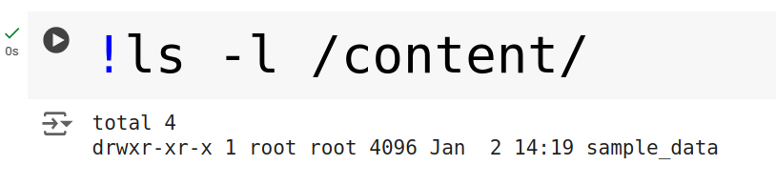
Run Bash script (or Linux commands) in Google Colab
1. Single line Bash script:
Place the ! right before command line
Bash script/Linux command line
Example 1:
Output

Slide 10
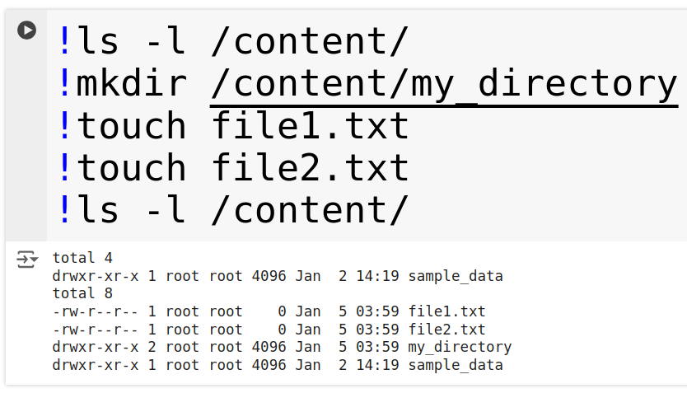
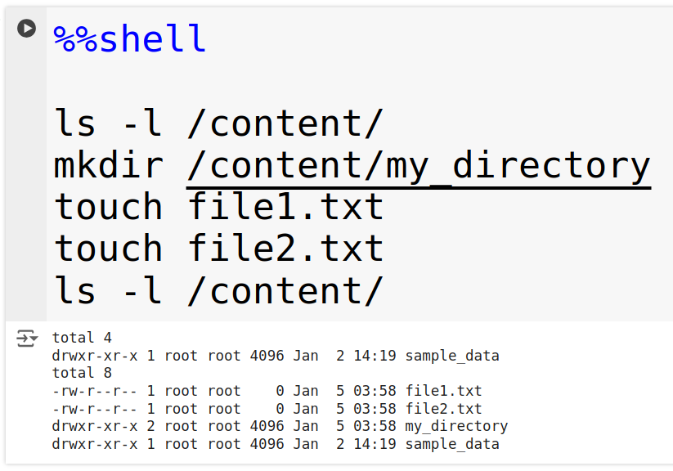
Run Bash script (or Linux commands) in Google Colab
2. Multiple line Bash script:
Example 2:
Example 3:
Should be like this
Save time when coding
Make code easy to read

Slide 11
2. Variable

Slide 12
2. Variables
Basic Syntax:
variable_name=value
Some rules:
If you want to name a variable with 2 or more words, there should be an underscore between the words.
Should contain letters, numbers, and underscores.
Cannot have spaces around =
(e.g., var = value is invalid).
Bash variables are case-sensitive (VAR and var are different).
Some rules:
String:
a word
multiple words with spaces between words: Place that string in quotes " "
A number
Output of a command: put that command in $( ):
variable_name=$(a command)
a directory path

Slide 13
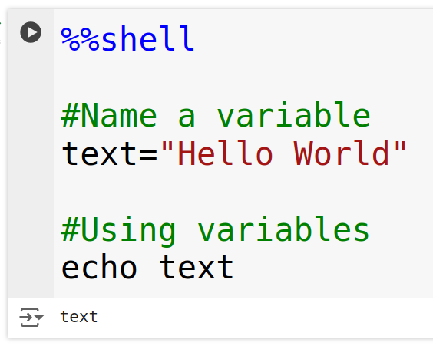
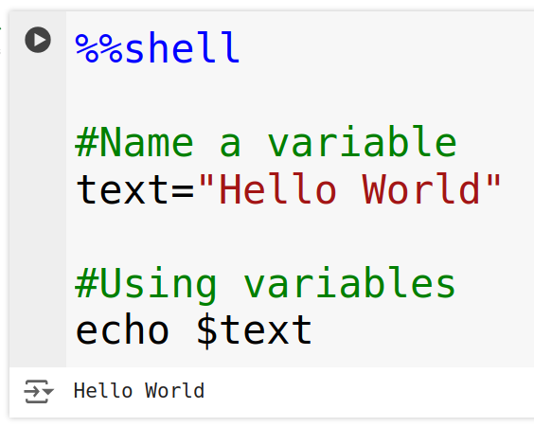
2. Variables
Example 4:
Example 5:
a comment (option): Put # at the beginning of the line to tell Bash to ignore this line
variable name
value
How to use a variable: Place the $ right before the variable name.

Slide 14
3. For loop

Slide 15
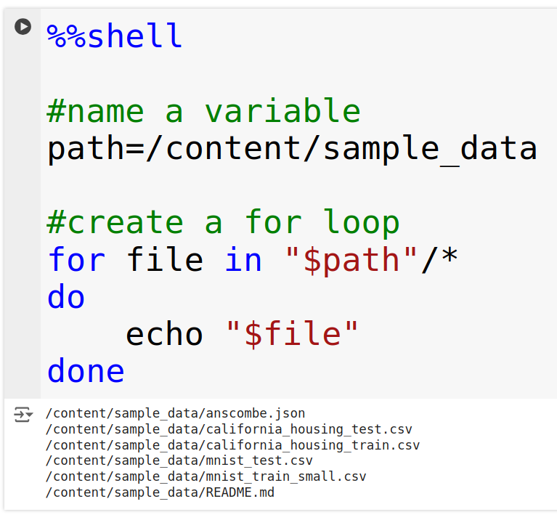
3. For loop
Example 6: Combine variable naming with a for loop
Syntax
for in
do
done
* means anything
a set
variable name for
each element in the set
(Can be changed)
Action to perform for each element
When all elements in the set are scanned, the "for loop" is stopped.

Slide 16
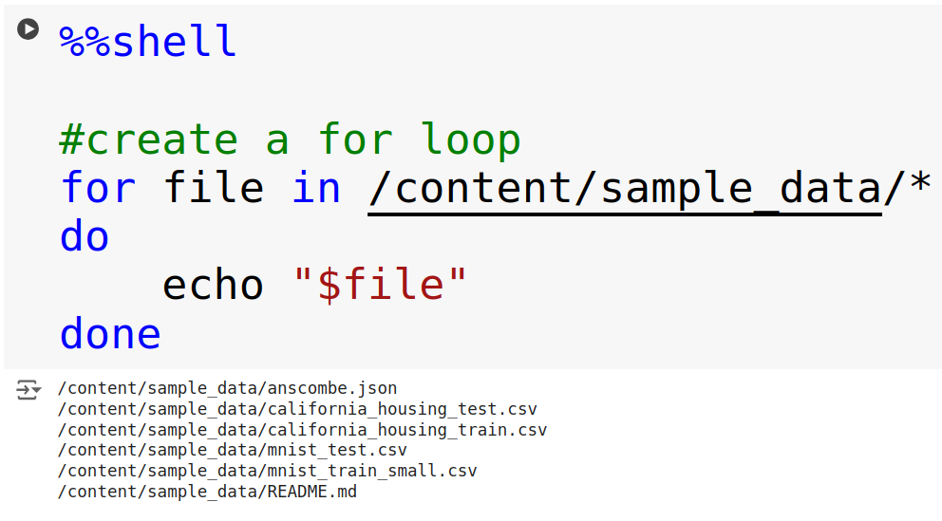
3. For loop
Example 6:
Example 7:
If the "path" variable is only used once in a Bash script,
it is not necessary to name the variable.

Slide 17
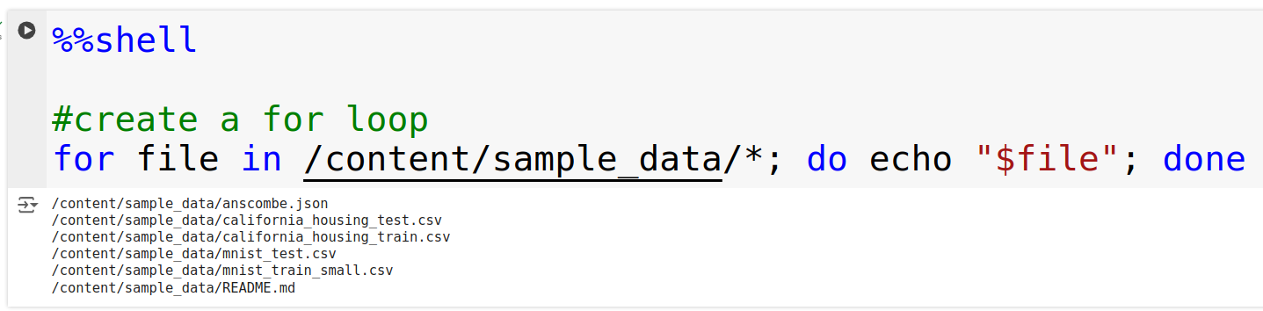
3. For loop
Example 7:
VS
When there are many commands, it will become a very long line of text → difficult to read
makes it easy to read quickly when there are many commands

Slide 18
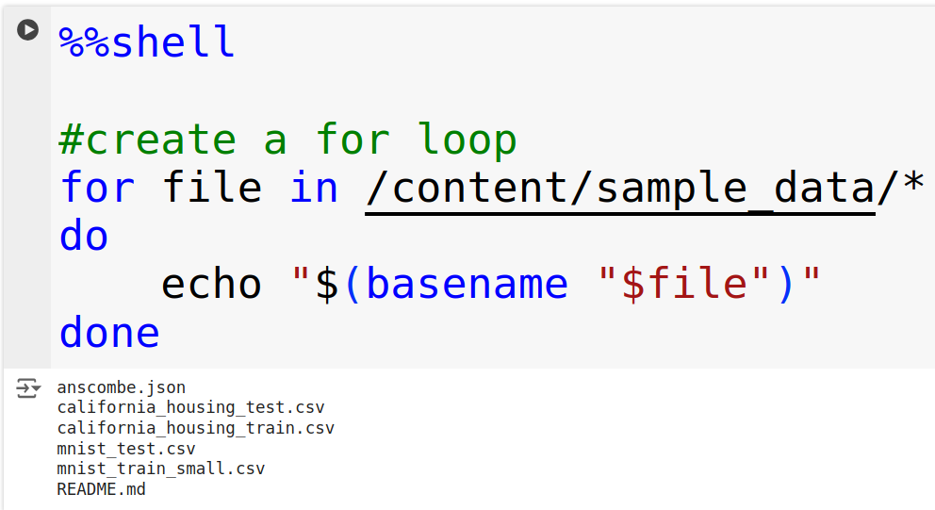
3. For loop
Example 7:
Example 8:
Use the basename command, if you want get just the file name without the path.

Slide 19
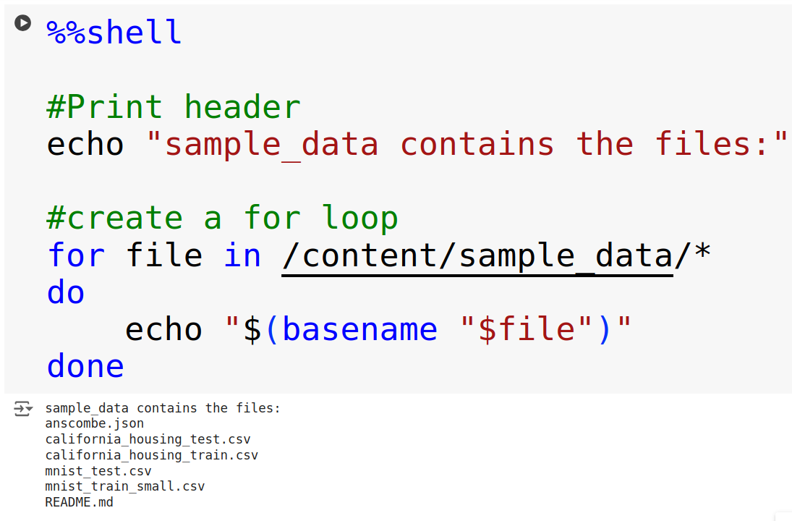
3. For loop
Example 9:
Example 8:
Print 1 header

Slide 20
4. If else

Slide 21
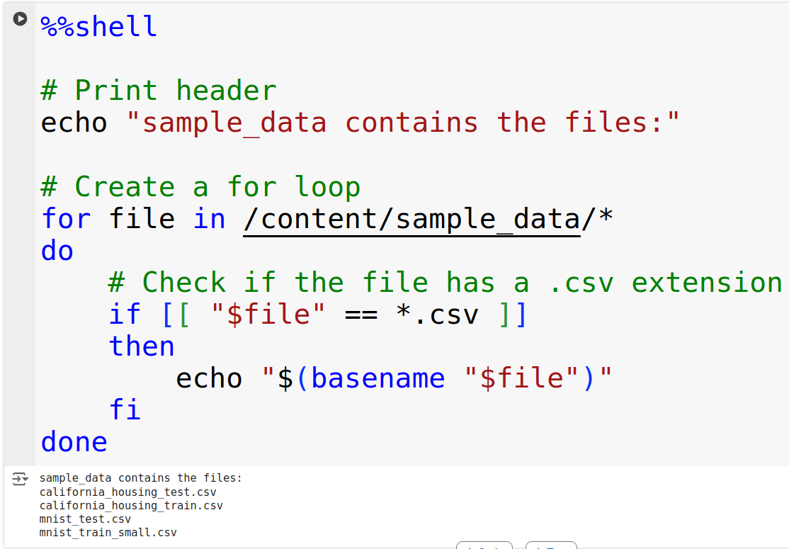
4. If else
Example 10: Combine if else in a for loop
Syntax
if
then
fi
condition

Slide 22
4. If else
[[ -z STRING ]] | empty string
[[ -n STRING ]] | not empty string
[[ STRING == STRING ]] | equal
[[ STRING != STRING ]] | not equal
[[ NUM -eq NUM ]] | equal
[[ NUM -ne NUM ]] | not equal
[[ NUM -lt NUM ]] | less than
[[ NUM -le NUM ]] | less than or equal
[[ NUM -gt NUM ]] | greater than
[[ NUM -ge NUM ]] | greater than or equal
[[ STRING =~ STRING ]] | regexp
(( NUM < NUM )) | numeric conditions

Slide 23
4. If else
[[ -e FILE ]] | exists
[[ -r FILE ]] | readable
[[ -h FILE ]] | symlink
[[ -d FILE ]] | directory
[[ -w FILE ]] | writable
[[ -s FILE ]] | size is > 0 byte
[[ -f FILE ]] | file
[[ -x FILE ]] | executable
[[ FILE1 -nt FILE2 ]] | i is more recent than 2
[[ FILE1 -ot FILE2 ]] | 2 is more recent than 1
[[ FILE1 -ge FILE2 ]] | same files
[[ ! EXPR ]] | not
[[ X && Y ]] | and
[[ X || Y ]] | or

Slide 24
Examples used in this presentation, Google Colab: https://colab.research.google.com/drive/1puSoJnupKsv64PhV8wasR2NTAPRK8LgU?usp=sharing
(For convenient code editing, in Google Colab: File → Save a copy in Drive)
For more about Bash script:
lecture 2, 3 in MGMA 2024 course: https://github.com/UeenHuynh/MGMA_2024

Slide 25
Thank you!

