Slide 1
R visualization
Basic plot
Hoang Son - 02.03.2025

Slide 2
Content
Import data into R
Data Visualization: Univariate Graphs, Bivariate Graphs
(bar chart, pie chart, histogram, density, dot chart, scatterplot)
Save plot in R

Slide 3
Import data into R
Directing input of data: c(), edit(data.frame())
Reading data from text, tsv file: read.table()
Reading data from excel file: read.csv() or
read_excel() - install.packages("readxl") / library("readxl")
Reading large data files in R: fread() - install.packages("data.table”)
Example: data <- read.csv("/home/son/Desktop/visualization/clinical.csv")

Slide 4
The Seven Stages of Visualizing Data
Acquire: Obtain the data, whether from a file on a disk or a source over a network.
Parse: Provide some structure for the data’s meaning, and order it into categories.
Filter: Remove all but the data of interest.
Mine: Apply methods from statistics or data mining as a way to discern patterns or
place the data in mathematical context.
Represent: Choose a basic visual model, such as a bar graph, list, or tree.
Refine: Improve the basic representation to make it clearer and more visually engaging.
Interact: Add methods for manipulating the data or controlling what features are visible.

Slide 5
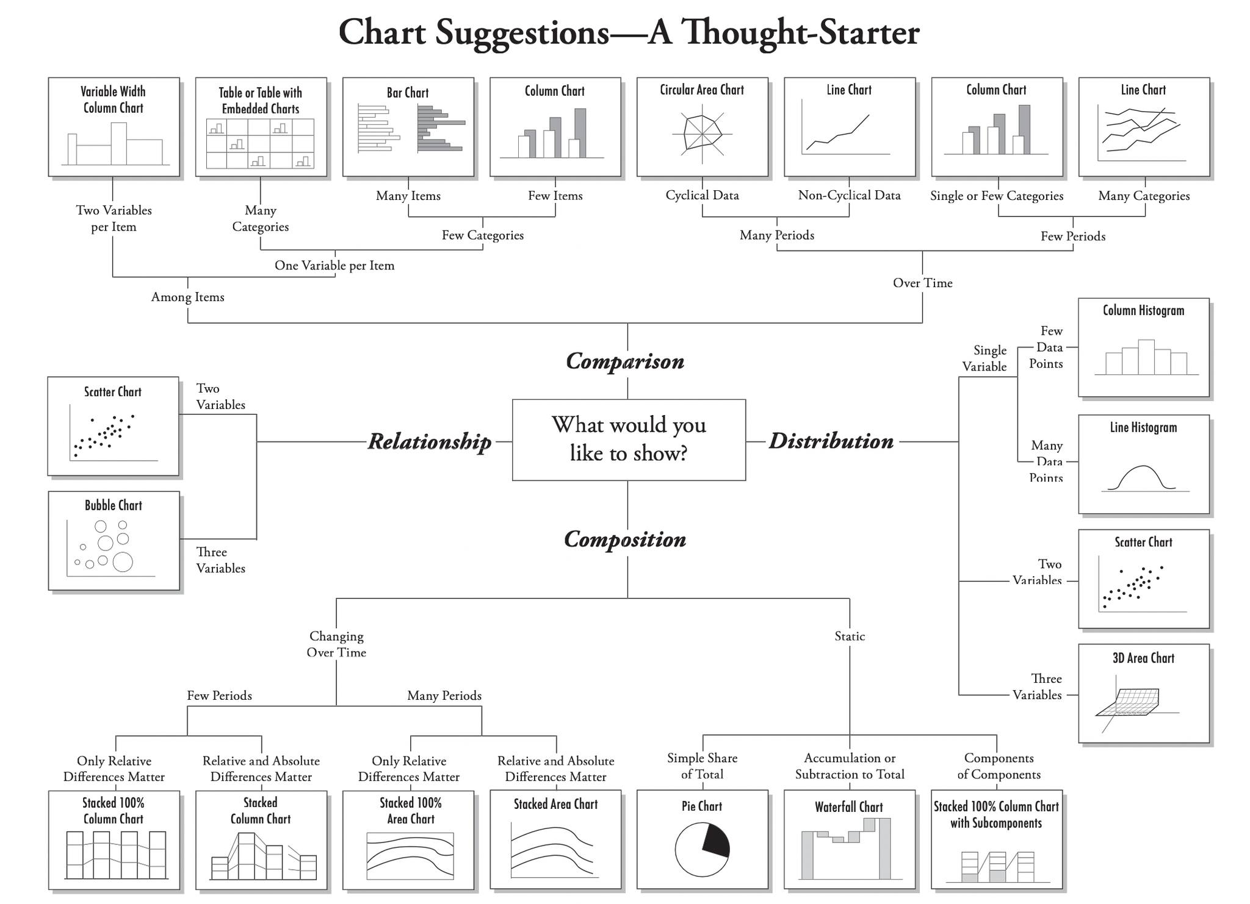
Data Visualization Best Practices
There are four basic presentation types that you can use to present your data:
Comparison
Composition
Distribution
Relationship

Slide 6
Data Visualization - R basic
Univariate Graphs
Bivariate Graphs

Slide 7
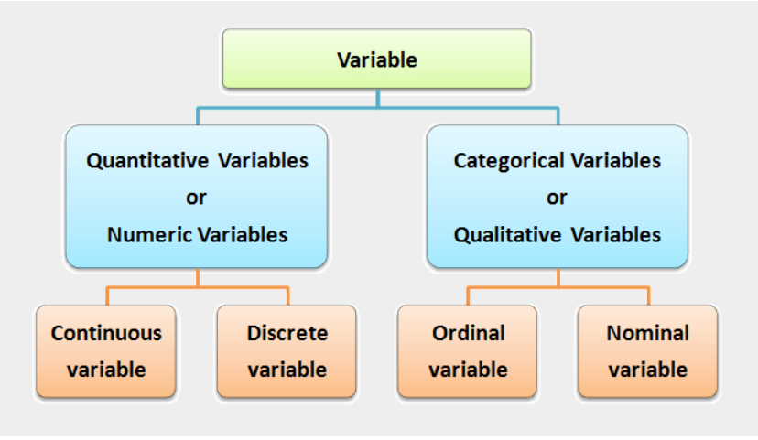
Categorical vs Quantitative

Slide 8
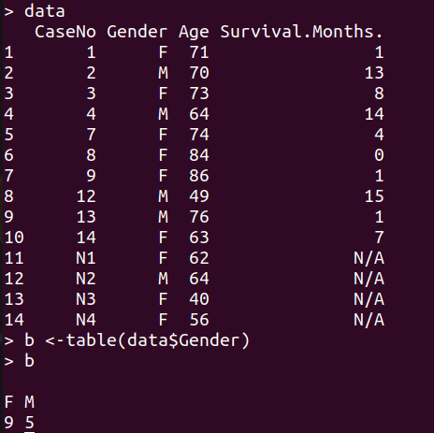
Categorical vs Quantitative
data <-read.csv("/home/son/Desktop/visualization/clinical.csv",header=TRUE)

Slide 9
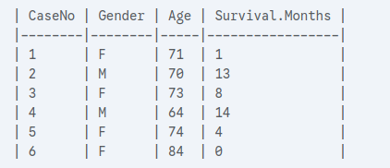
Univariate Graphs
Univariate graphs plot the distribution of data from a single variable.
The variable can be:
Categorical (e.g., race, sex): bar chart, pie chart
Quantitative (e.g., age, weight): histogram, density, dotchart

Slide 10
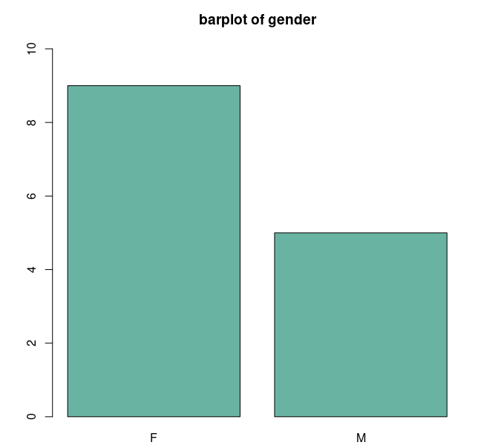
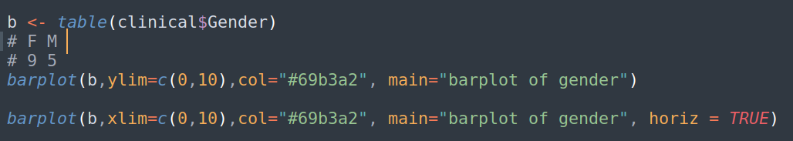
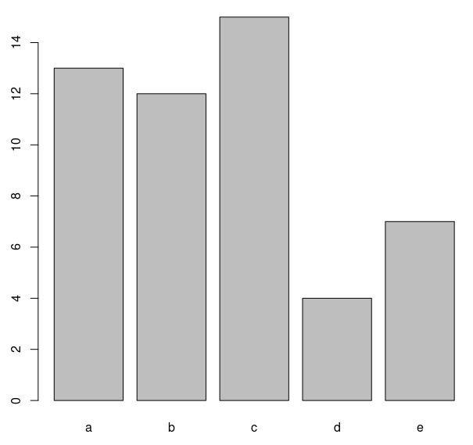
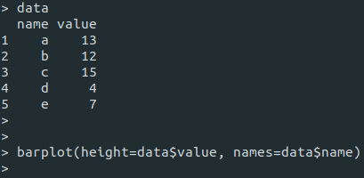
Bar chart
Colors in R http://www.sthda.com/english/wiki/colors-in-r
data

Slide 11
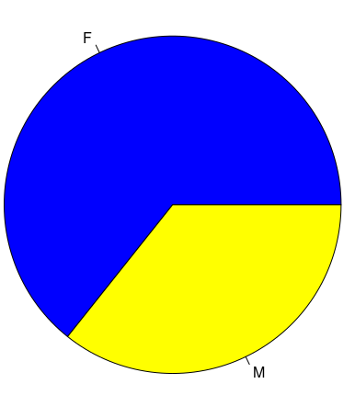
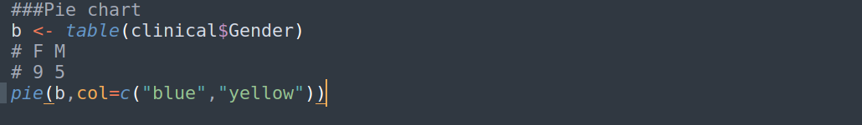
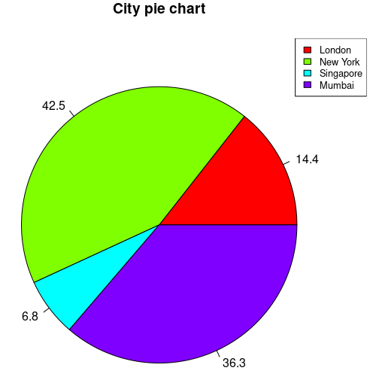
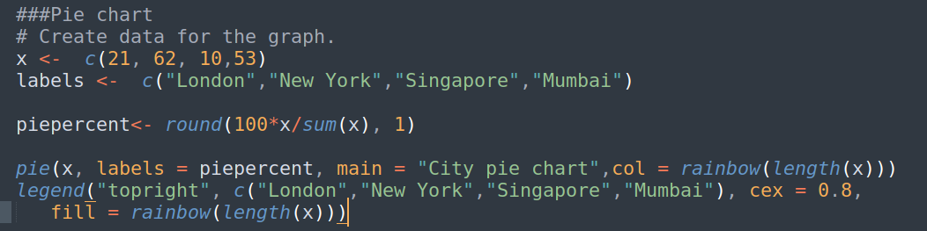
pie chart
https://r-graph-gallery.com/pie-plot.html

Slide 12
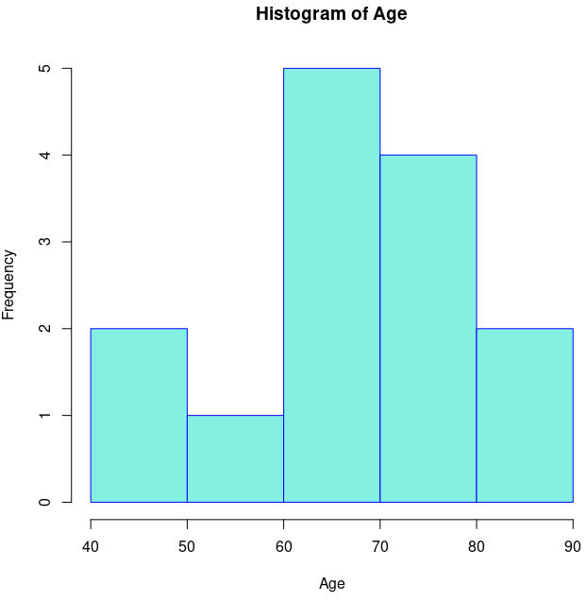
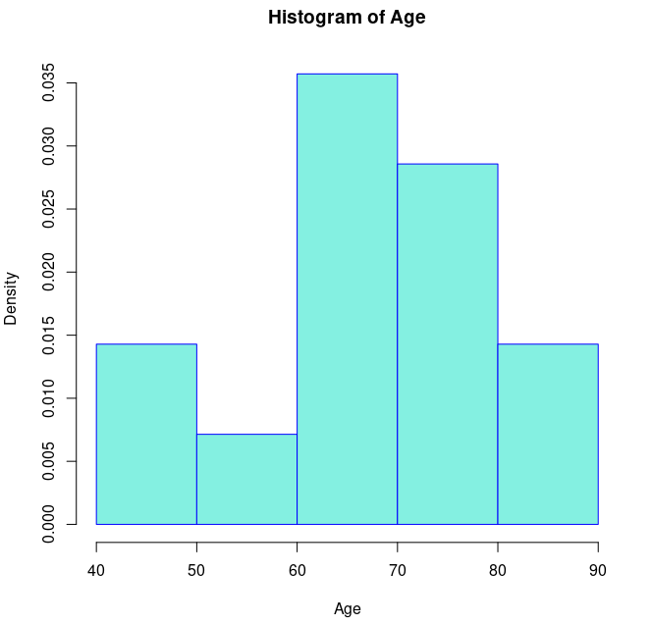
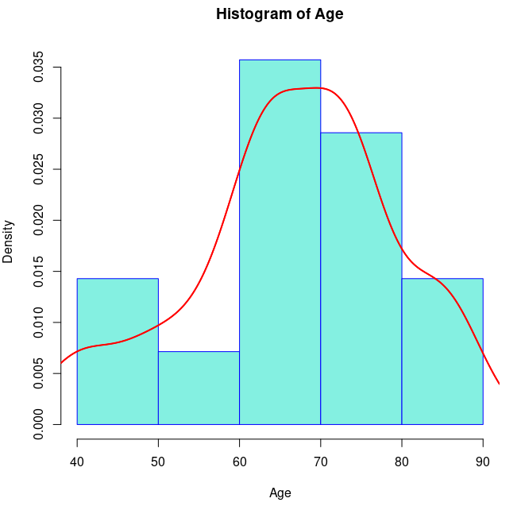
Histogram
hist (var, xlab, ylab, main, xlim, ylim, col, border, prob)
lines (density(var), col, lwd)
var: Variable
probability = T

Slide 13
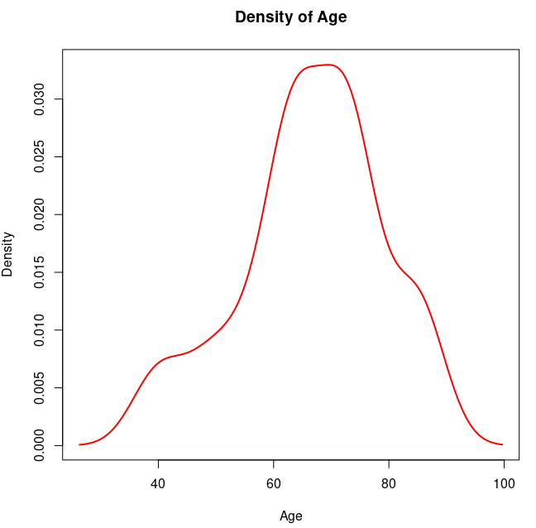
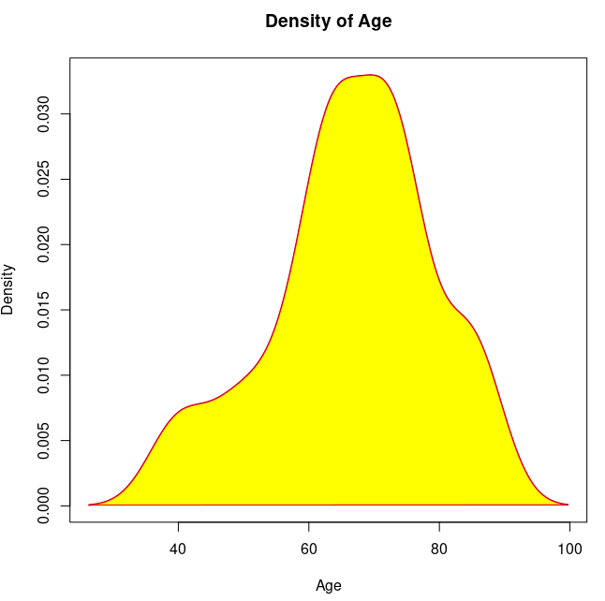
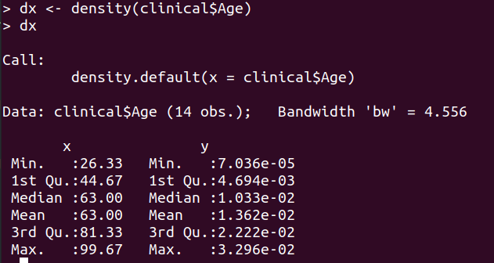
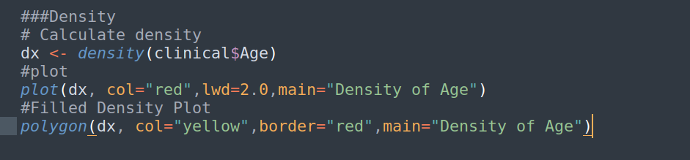
Density

Slide 14
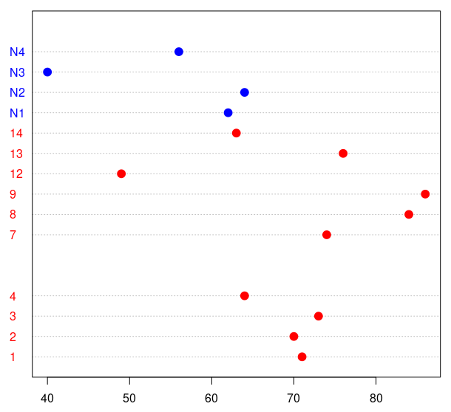
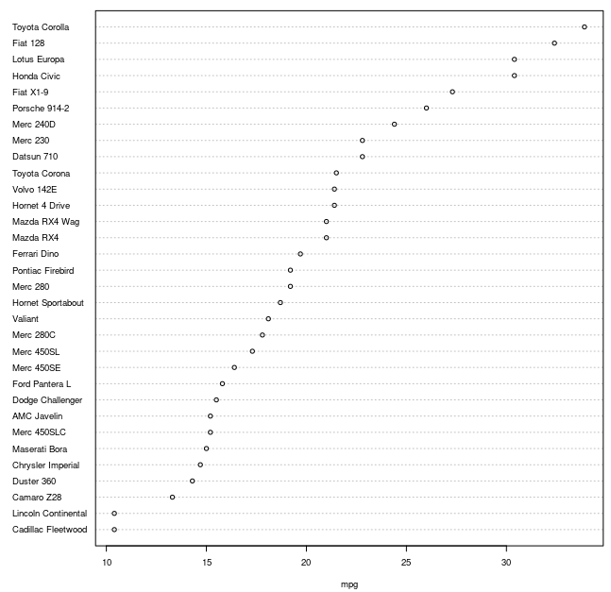
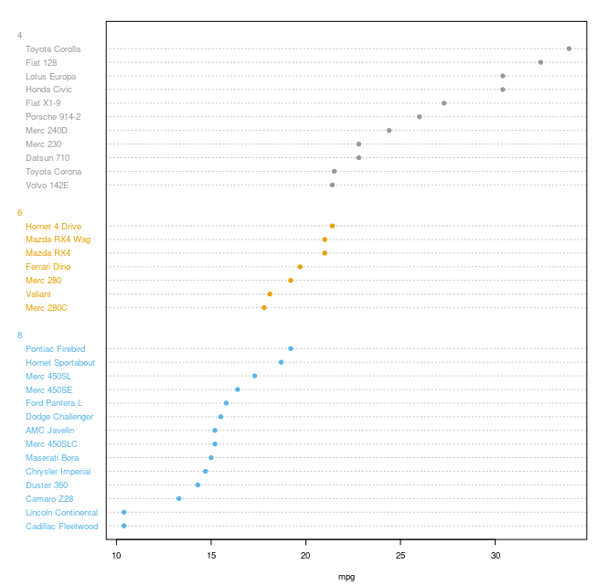
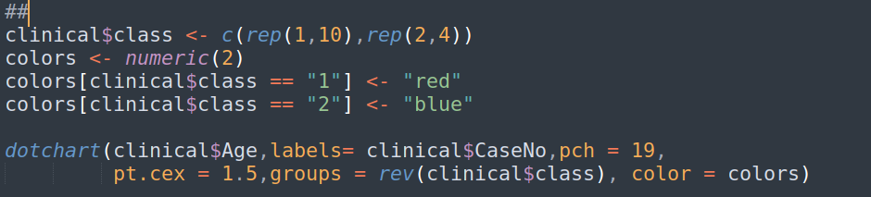
Dotchart

Slide 15
Bivariate Graphs
Bivariate graphs display the relationship between two variables
Categorical vs. Categorical: Stacked bar chart, Grouped bar chart, Segmented bar chart
Quantitative vs. Quantitative: Scatterplot, Line plot
Categorical vs. Quantitative: barplot, boxplot, violin plot

Slide 16
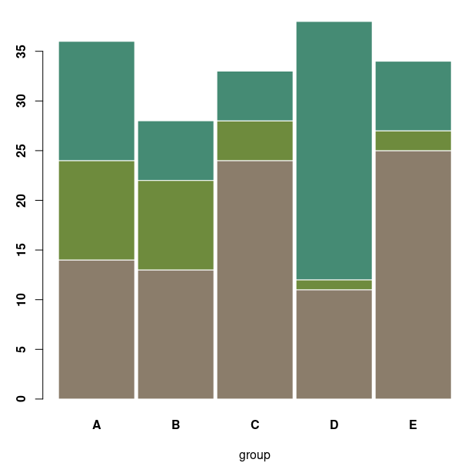
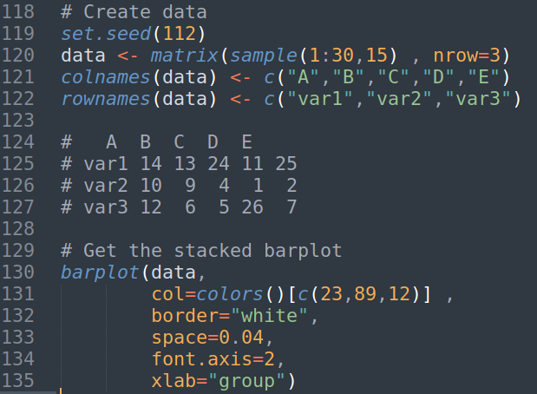
Grouped bar chart

Slide 17
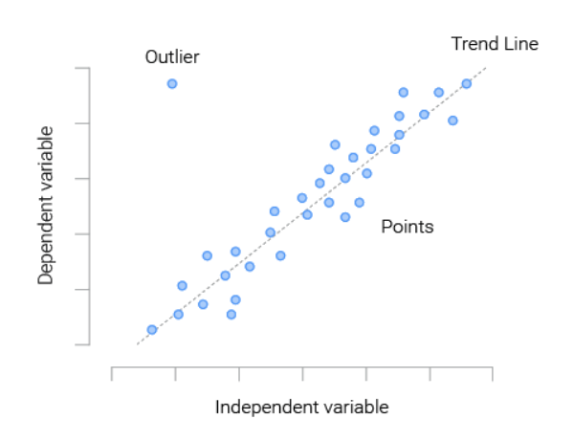
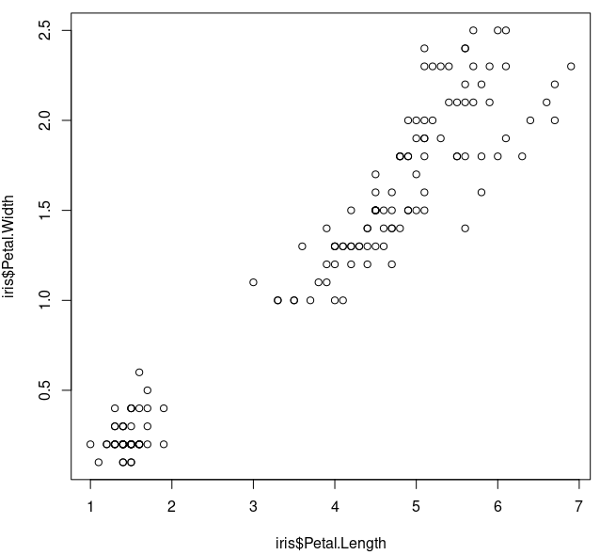
Scatterplot
plot (X ~ Y, xlab, ylab,…)
abline (lm(Y ~ X)) ----> Y = aX + b

Slide 18
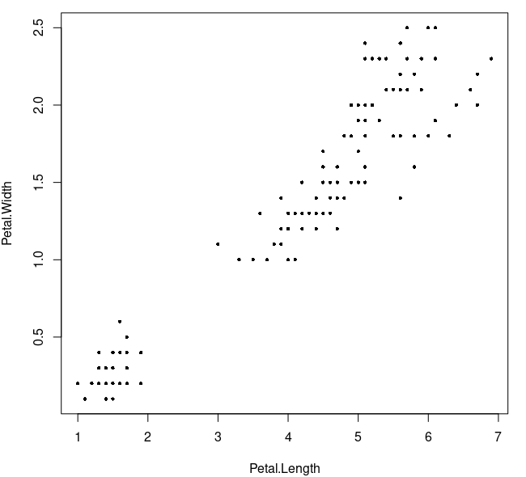
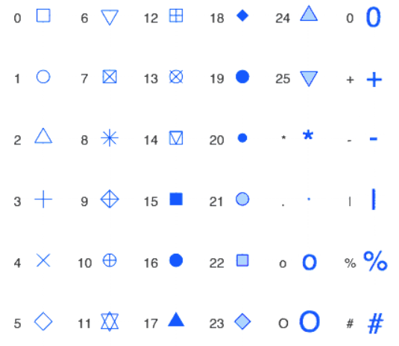
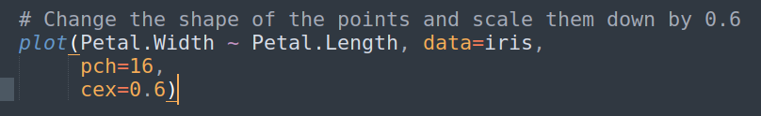
Scatterplot
pch (plotting character), cex (character expansion) argument

Slide 19
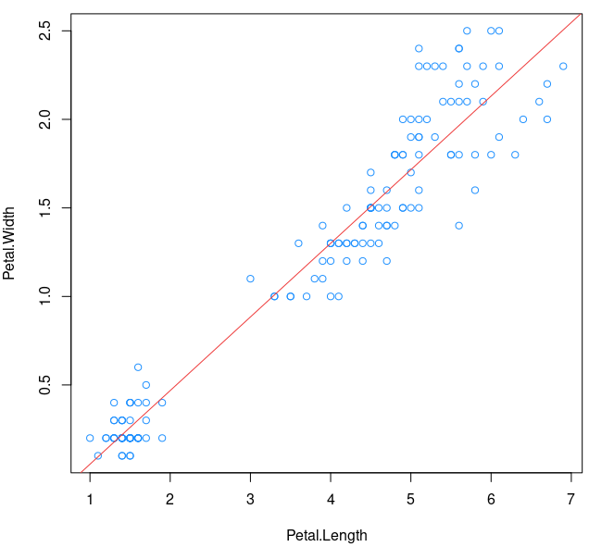
Scatterplot

Slide 20
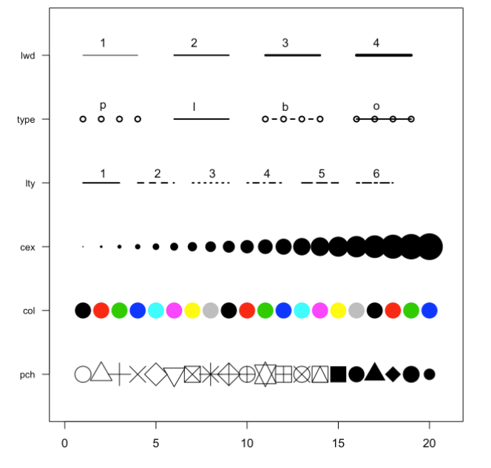
Few options to customize:
cex → shape size
lwd → line width
col → control colors
lty → line type
pch → marker shape
type → link between dots

Slide 21
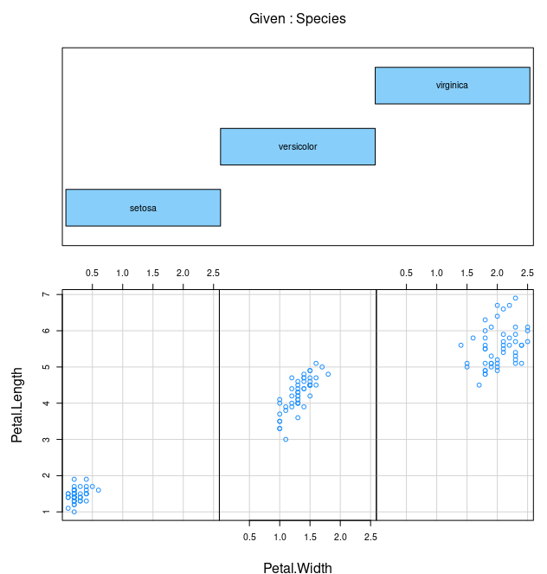
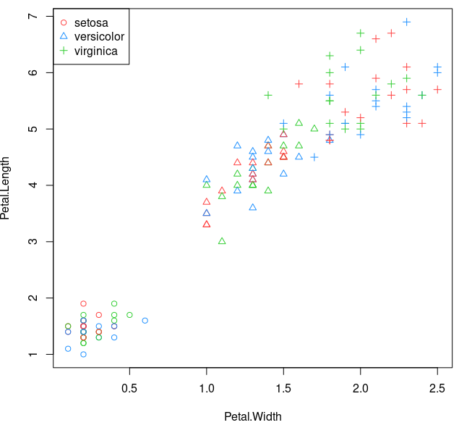
Scatterplot
coplot()

Slide 22
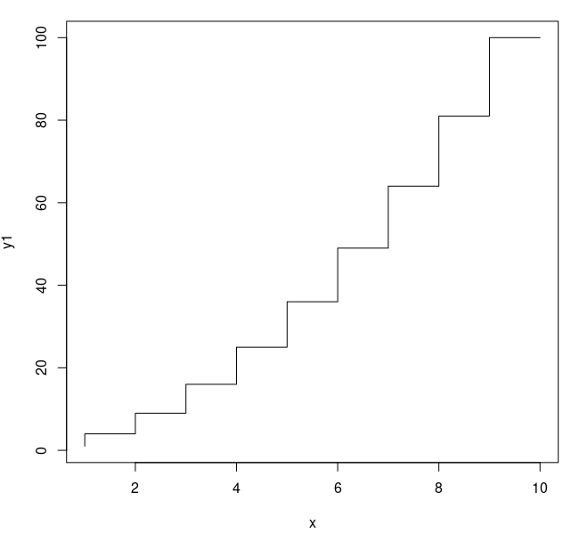
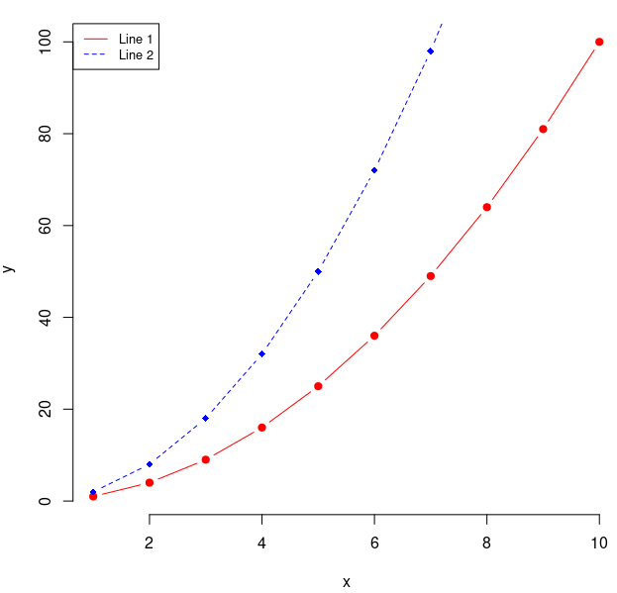
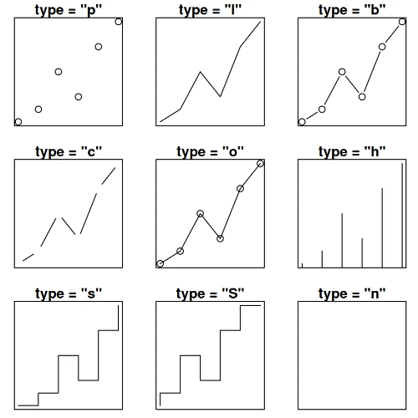
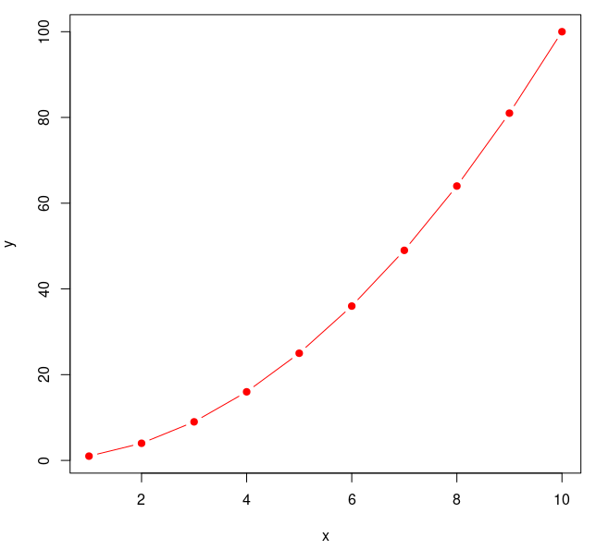
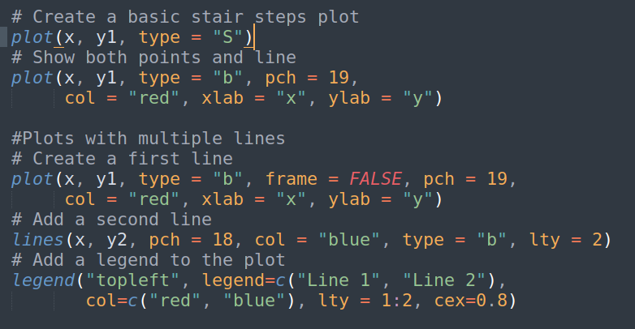
Line plot

Slide 23
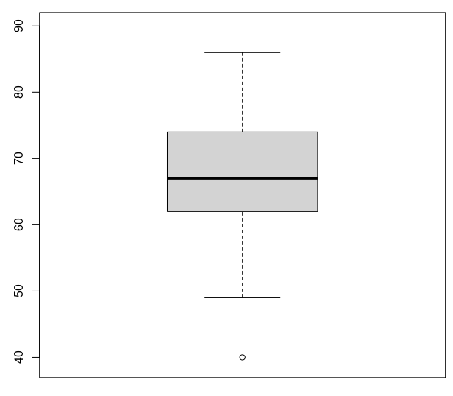
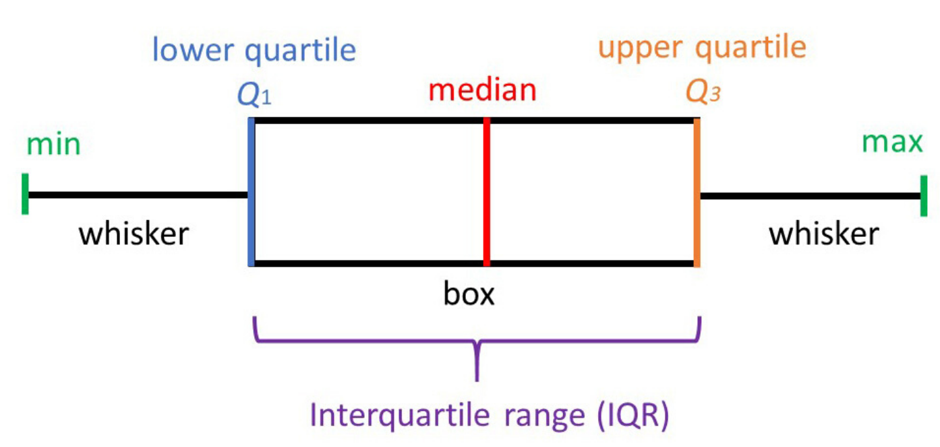

boxplot
Q1, Q3=?
Chi tiet

Slide 24
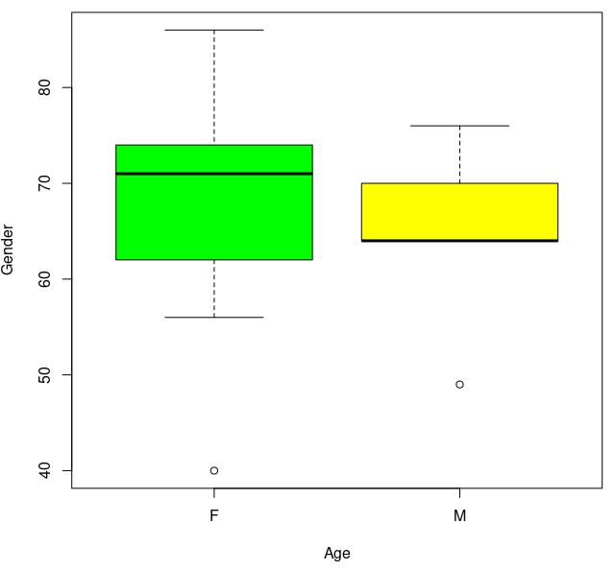
boxplot - Categorical vs. Quantitative
boxplot (var, xlab, ylab, main, border, col, xlim, ylim, horizontal)
boxplot ( var ~ group, xlab, v.v)

Slide 25
Univariate Graphs
Bivariate Graphs
Univariate graphs plot the distribution of data from a single variable.
The variable can be:
Categorical (e.g., race, sex): bar chart, pie chart
Quantitative (e.g., age, weight): histogram, density, dot chart
Bivariate graphs display the relationship between two variables
Categorical vs. Categorical: Stacked bar chart, Grouped bar chart, Segmented bar chart
Quantitative vs. Quantitative: Scatterplot, Line plot
Categorical vs. Quantitative: barplot, boxplot, violin plot

Slide 26
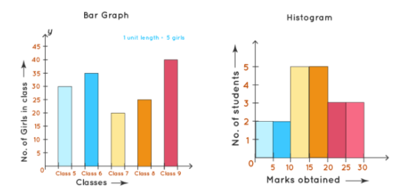
HISTOGRAM AND BARPLOT
Histogram | Barplot
Show distributions of variables | Compare variables
Quantitative (numerical) data (continuous) | Categorical data
Not make sense to rearrange | The bars can be rearranged
No space between the columns | Have space between the columns

Slide 27
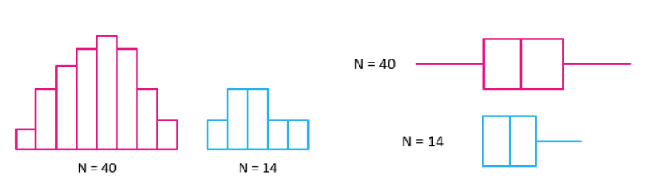
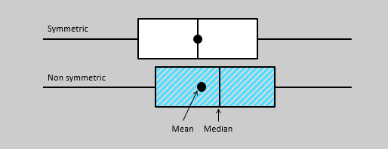
HISTOGRAM AND BOXPLOT
Histogram | Boxplot
probability distribution of a data | Comparing between several data sets. (distribution is symmetric or skewed)
Min, mean, max | Min, median, max and quartile
Although histograms are better in determining the underlying distribution of the data, box plots allow you to compare multiple data sets better than histograms as they are less detailed and take up less space.

Slide 28
Save plot in R
Save pdf: # Open a pdf file
pdf("/../name_plot.pdf")
#Create plot
#Close the pdf file
dev.off()
Save png/jpeg: #Open jpeg file
pdf("/../name_plot.jpeg")
#Create plot
#Close the pdf file
dev.off()

Slide 29
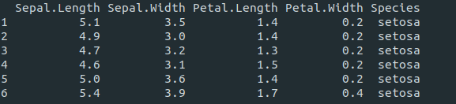
Example
Sepal.Length of 3 Species in iris data using boxplot

Slide 30
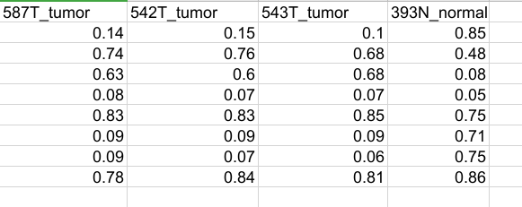
Example
Beta value of 4 samples and 8 probes (8 x 4)

