Slide 1
Basic Linux commands part 2

Slide 2
Contents
I. Working with text file.
1. Search and filter.
2. Input/output redirection.
II. Some other commands
3. Download file.
4. File permission.
5. Compress and decompress.

Slide 3
1. Search and filter

Slide 4
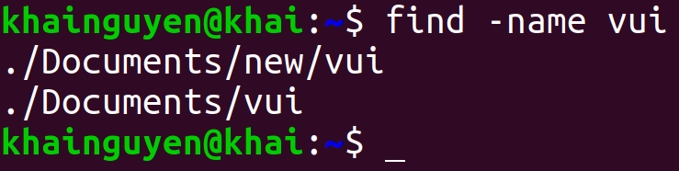
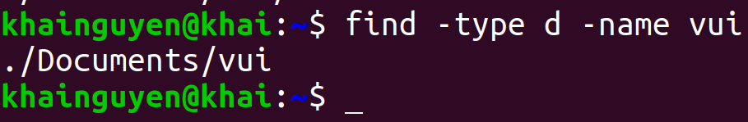
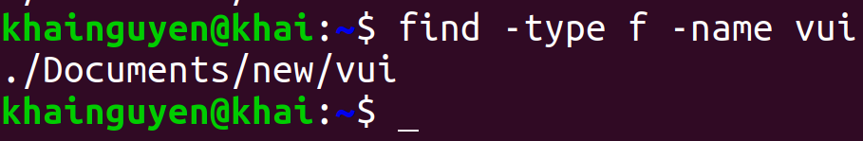
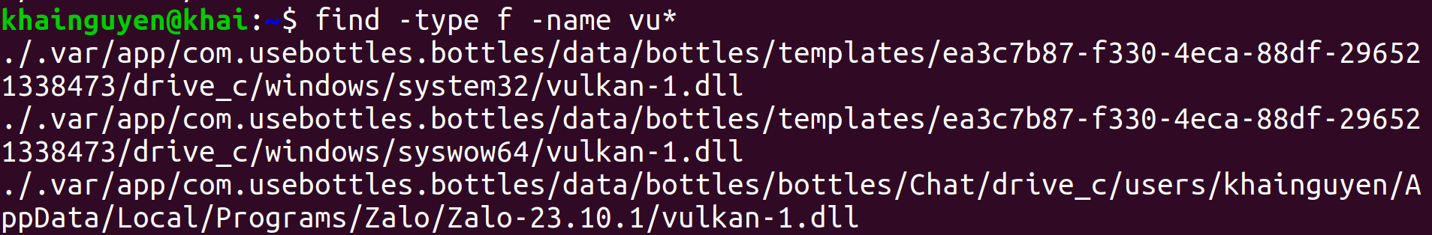
Search and filter
find command: search for files or directories in a directory
Search for files and directories named "vui", with -name option:
Search for directories named "vui", with -type option, d means directory:
Search for files named "vui", with -type option, f means file:
don't remember the file name clearly, but there is "vu" at the beginning of the name:

Slide 5
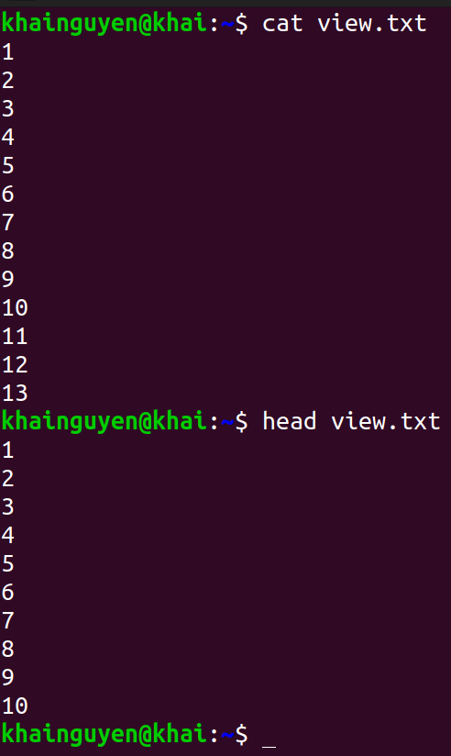
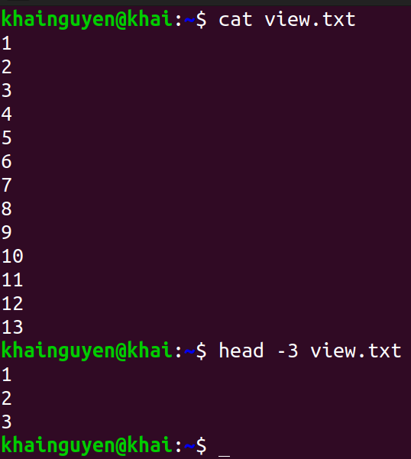
Search and filter
head command: prints the first few lines in the file
Default: prints the first 10 lines in the file:
print the first #number lines instead of the first 10

Slide 6
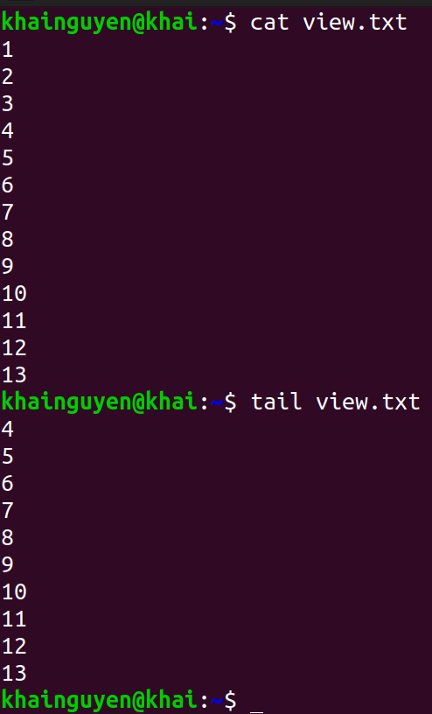
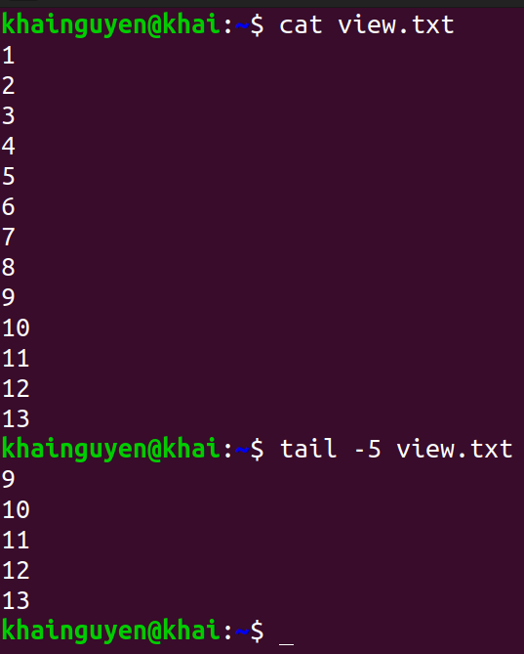
Search and filter
tail command: prints the last few lines in the file
Default: prints the last 10 lines in the file:
print the last #number lines instead of the last 10

Slide 7
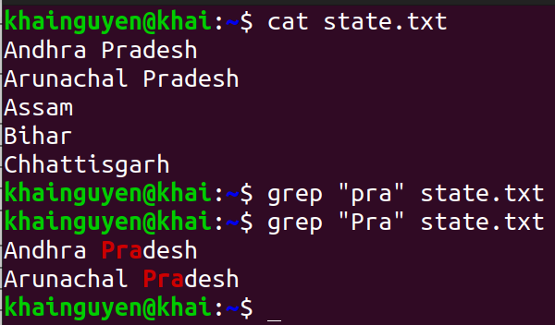
Search and filter
grep command: print lines that match patterns
Default: case-sensitive

Slide 8
2. input/output redirection

Slide 9
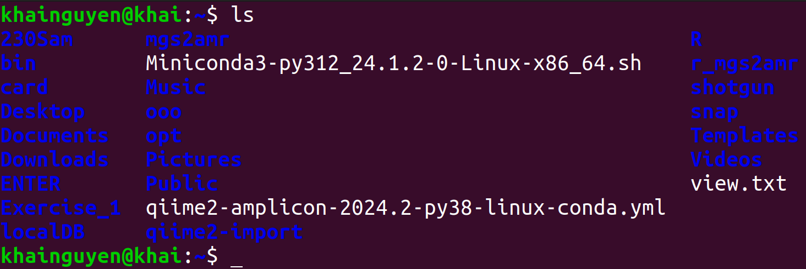
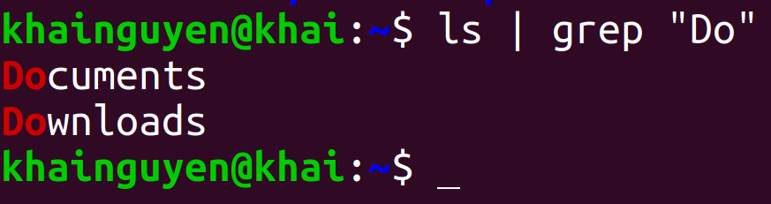
input/output redirection
Piping
Pipe is formed using the vertical dash |
A | B | output of command A will be input of B command.
A | B | C output of command A will be input of B command, output of command B will be input of C command.
The pipe is used to combine two or more commands.
Example:
ls | grep “Do"
ls's output
grep's input
grep's output

Slide 10
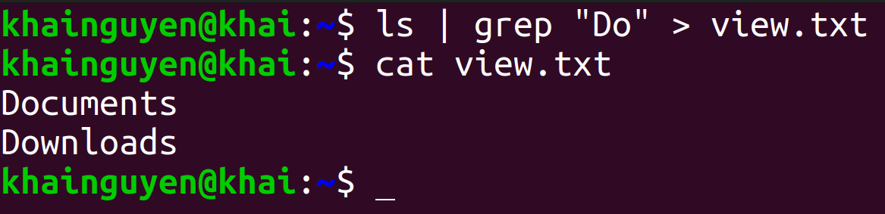
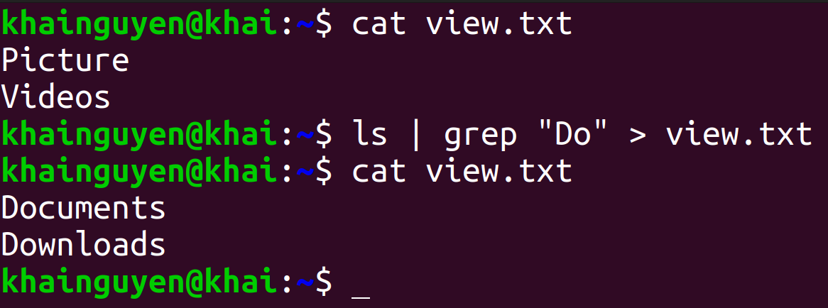
input/output redirection
Output redirection: The ">" character
To redirect output to a file
If the view.txt file already exists, its content will be overwritten

Slide 11
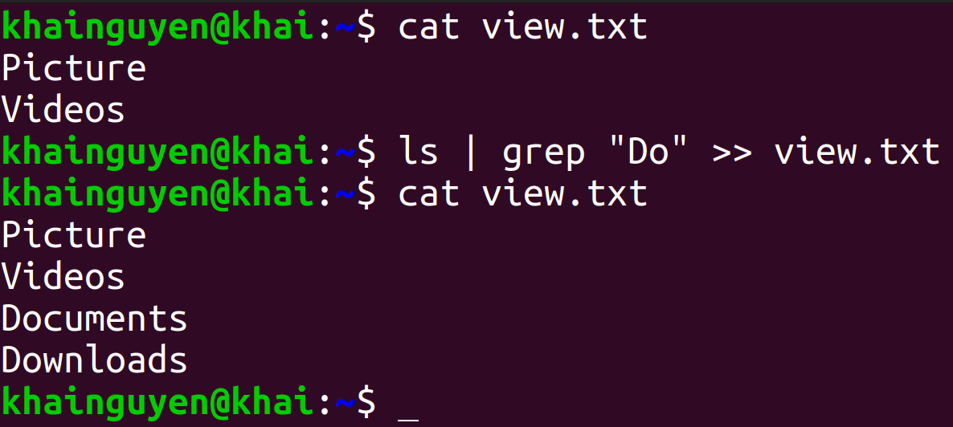
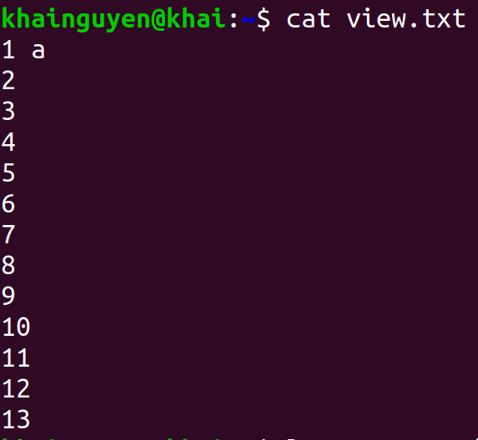

input/output redirection
If you do not want the content to be overwritten, use the ">>" character
Input redirection: The "<" character

Slide 12
3. Download file

Slide 13
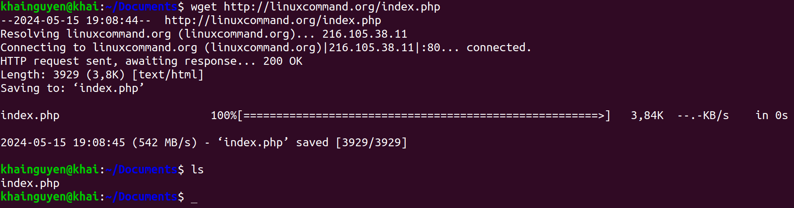
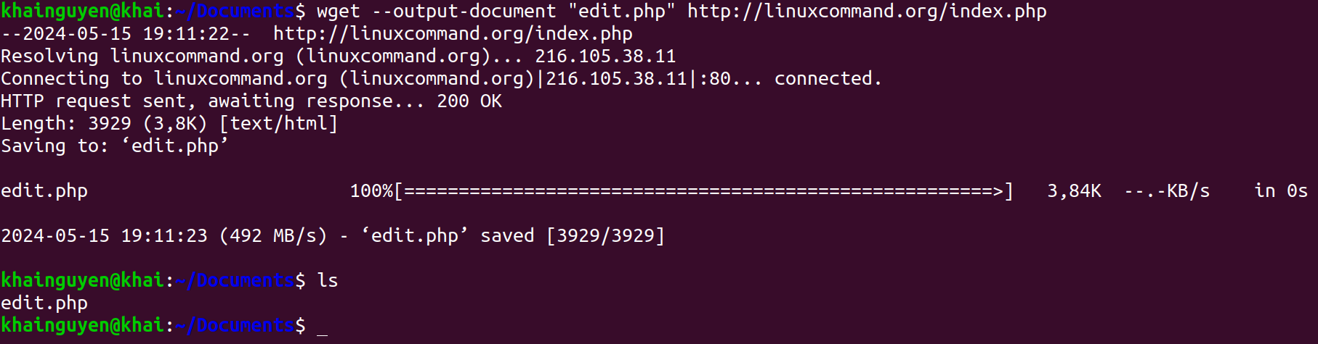
Download file
wget command: Downloader
Default: Download file from a URL
--output-document option: download file from URL, with a different name

Slide 14
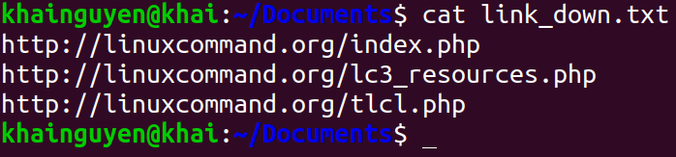
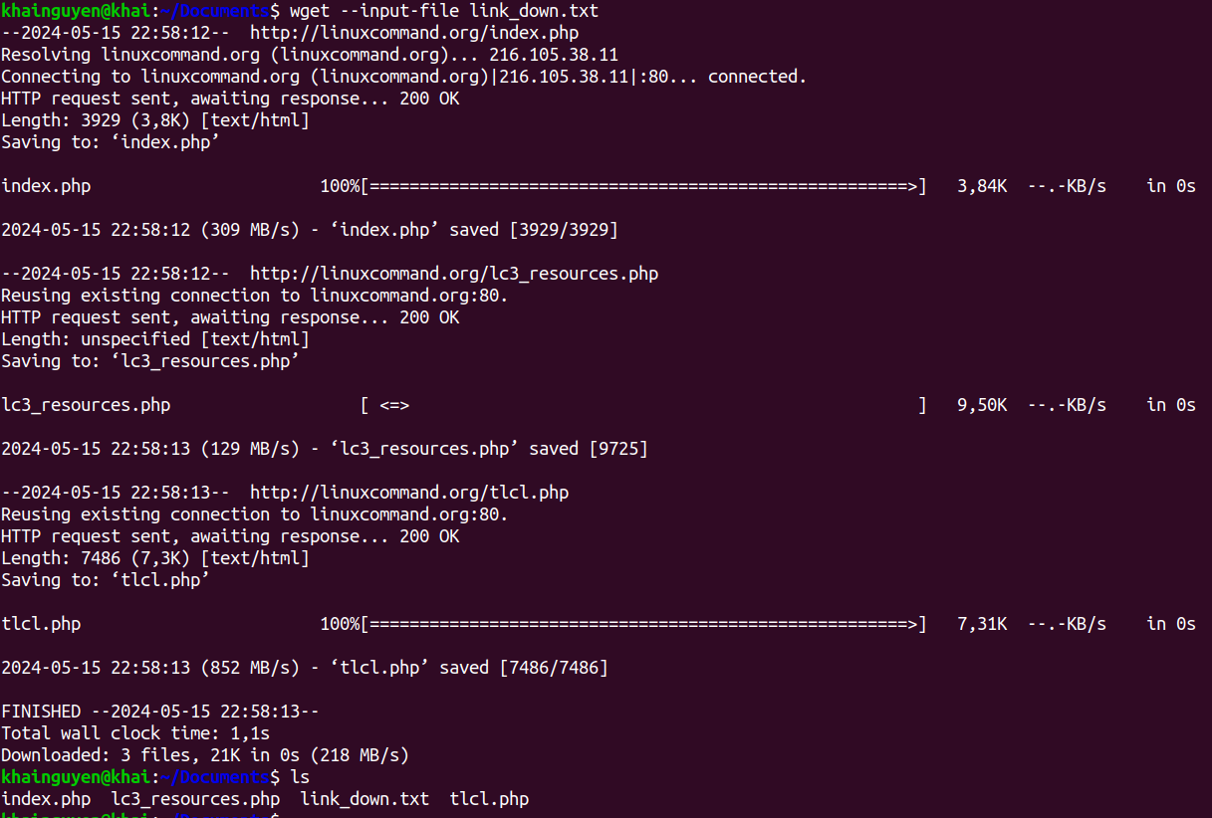
Download file
--input-file option: download from multiple URL
1. Create a text file containing URLs, each line includes a URL, use: nano.
2. wget --input-file link_down.txt

Slide 15
4. File permission

Slide 16
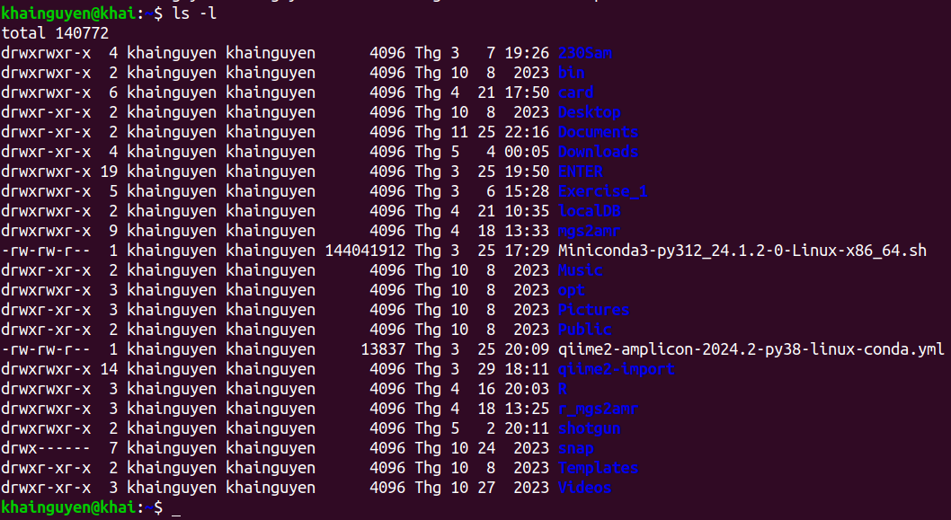
When run: ls -l
user (or owner)
permission
other
permission
Owner of file
(user_name)
user group
group
permission
snap directory
- User permission: read (yes), write (yes), execute (yes).
- Group permission: read (no), write (no), execute (no).
- Other permission: read (no), write (no, execute(no).
Meaning of r, w, x, -:
r = readable
w = writeable
x = executable
- = denied
Templates directory
- User permission: read (yes), write (yes), execute (yes).
- Group permission: read (yes), write (no), execute (yes).
- Other permission: read (yes), write (no), execute (yes).

Slide 17
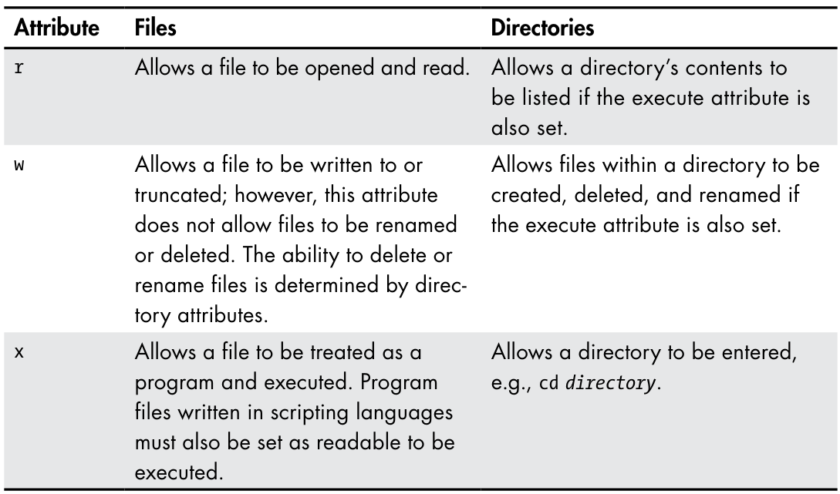
Permission Attributes
https://shorturl.at/prOPY

Slide 18

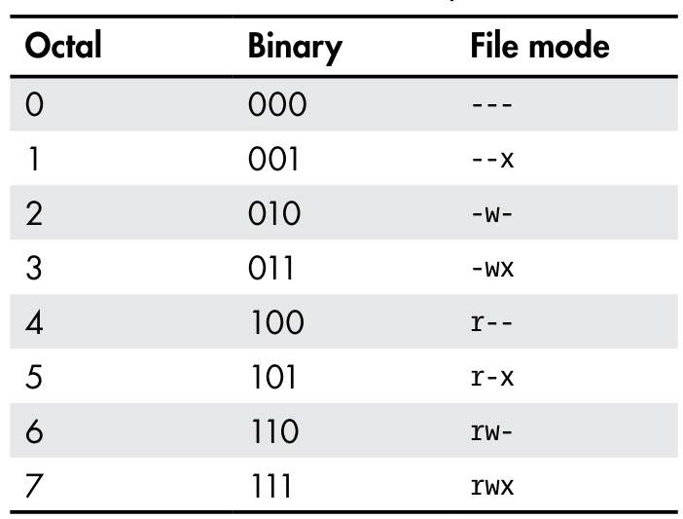
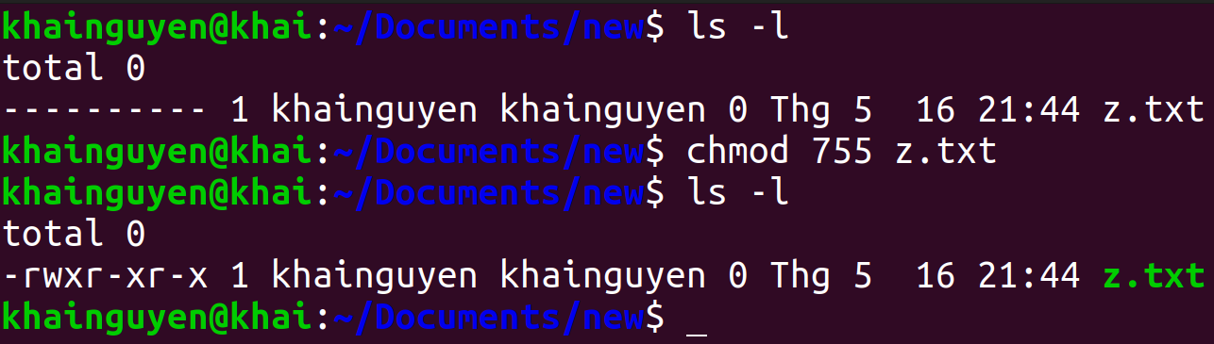
chmod: Change File Mode
To change the mode (permissions) of a file or directory, use the chmod command.
chmod supports two distinct ways of specifying mode changes:
1. Octal number representation
rwx
(user)
r-x
(group)
r-x
(other)
File Modes in Binary and Octal
https://shorturl.at/prOPY

Slide 19
5. Compress and decompress

Slide 20
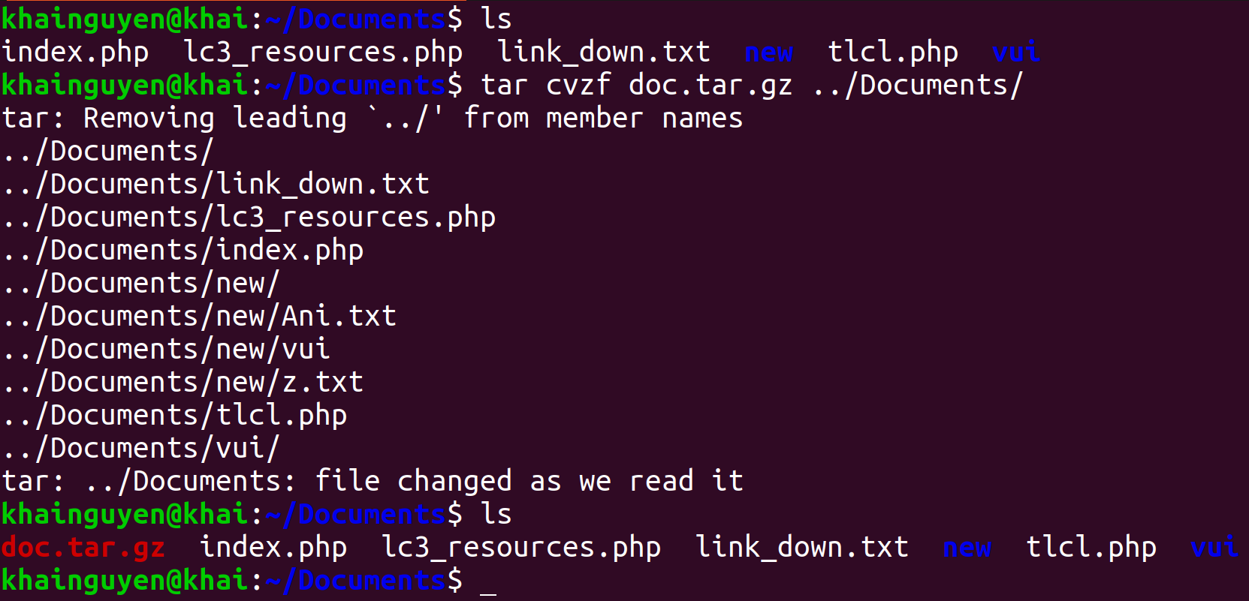
Compress and decompress
tar command: compress and decompress
Compress all files and directories in the “Documents" directory to a compressed file named “doc.tar.gz"
-c --create: create a new archive file
-z, --gzip: Using gzip to compress
-f or --file: compressed file name
-v or --verbose: Verbosely list files processed
The four options "-c -v -z -f" can be written as "cvzf"

Slide 21
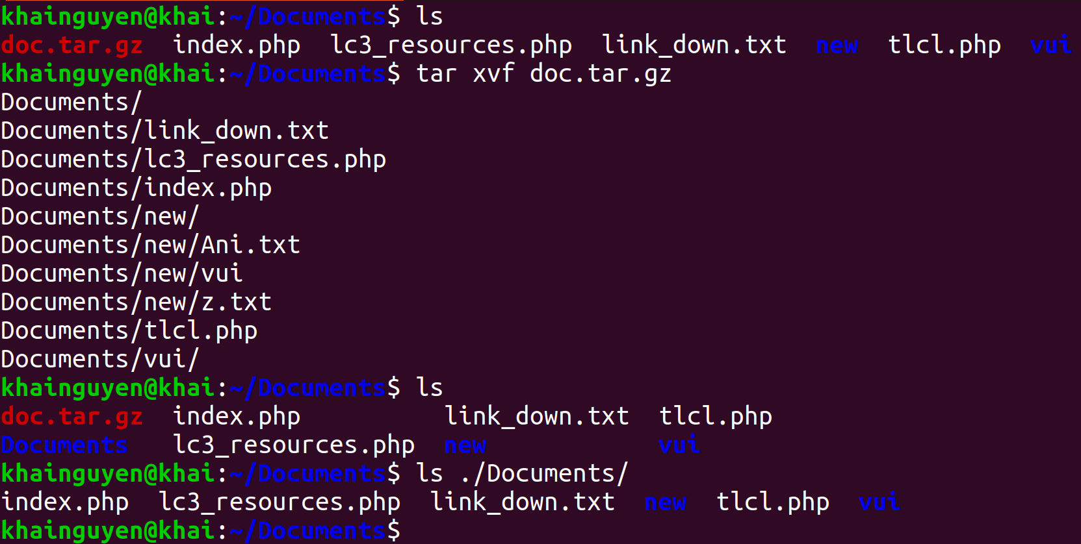
Compress and decompress
Decompress a compressed file named “doc.tar.gz"
-x, --extract: Extract files from an archive.

Slide 22
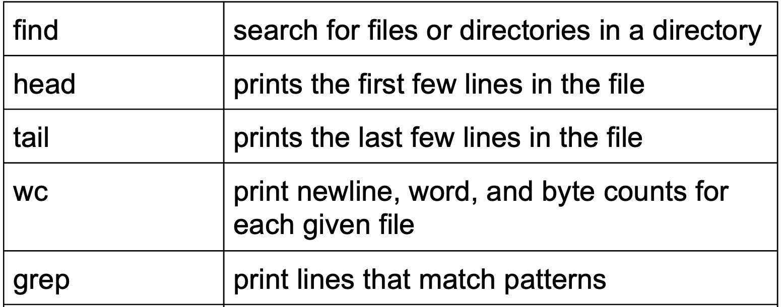
Summary

Slide 23
Summary
| | pipe
“>”, “>>” | output redirection
“<” | input redirection
wget | download file from <link>
chmod | Change File Mode
tar | compress and decompress

