Slide 1
XAI
Báo cáo tiến độ 11/11/2025

Slide 2
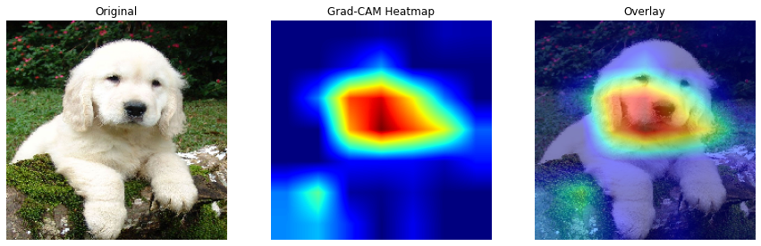
Grad-CAM
Gradient-weighted Class Activation Mapping

Slide 3
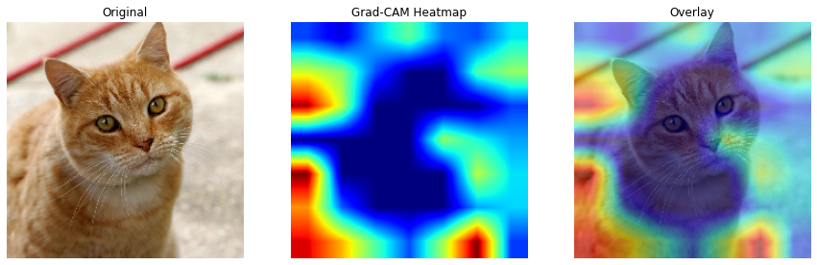
GRAD-CAM

Slide 4
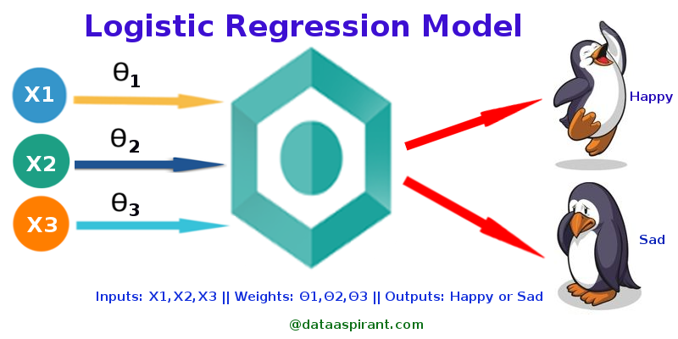
SHAP-Logistic Regression

Slide 5
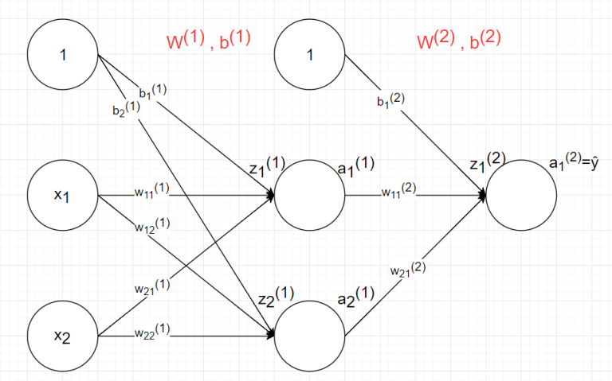
GRAD-CAM

Slide 6
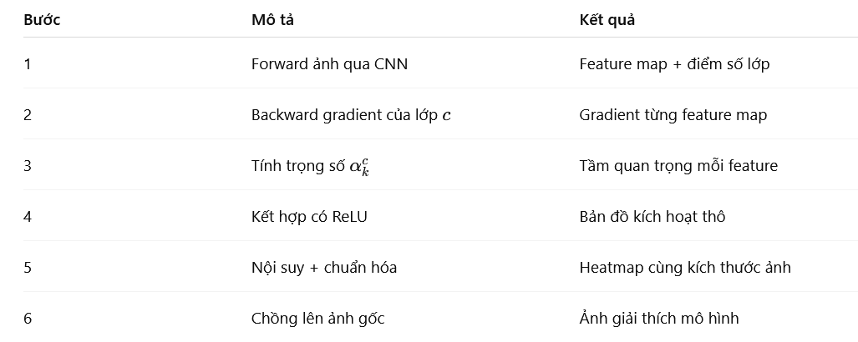
GRAD-CAM

Slide 7
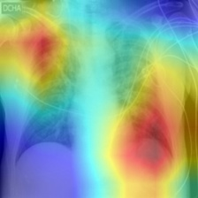
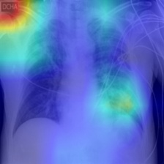
GRAD - CAM

