Slide 1



Large Language Model in genetic variant classification
A Focus on Congenital Heart Disease
November 29 2025
Xuan-Hong Ong, Master Institute for Applied Research in Health Sciences and Aging (ARiHA)
Thong Nhat Hospital

Slide 2








Acknowledgment
Thanh-Tra Nguyen, B. Pharm
Khương Duy
Do Nguyen Thao Vy, MD
Nguyen Thi Kim Nhi, MD, PhD
Phuc-Loi Luu, PhD
Duc-Minh Nguyen-Le, MD
Pham Van Quan
Huyen-Trang Thi Tran, MD

Slide 3
Content
Introduction
Congenital Heart Disease
Genetic testing workflow
Challenges in variant interpretation
ACMG guidelines
Large Language Model roles
Objectives
Automating Germline variant interpretation
Congenital Heart Disease data
Data gathering
Data preparation
Automating the ACMG Guideline
In-context prompting
Multi-agent system
Results and Discussion
Future work

Slide 4
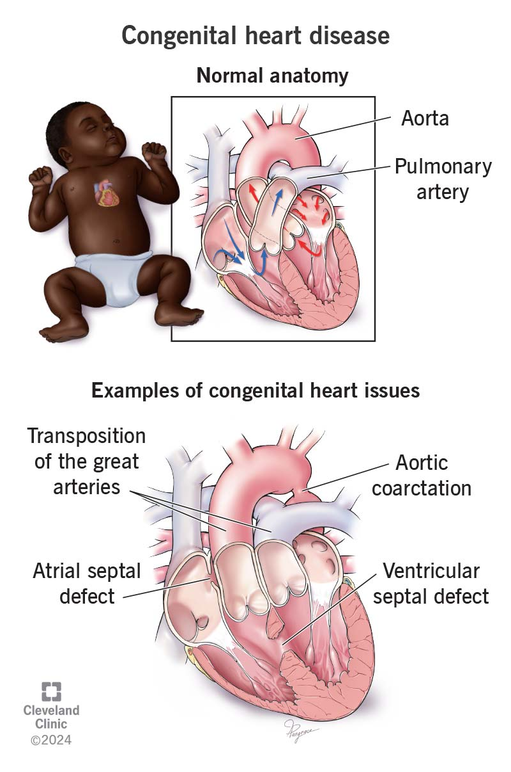
Congenital Heart Disease (CHD)
Congenital heart disease is a general term for a range of structural problems with the heart that are present at birth.
These defects occur when the heart or its blood vessels do not form correctly during fetal development.
They can affect the normal flow of blood through the heart and to the rest of the body.
CHD can range from simple issues, like a small hole in the heart, to complex and life-threatening conditions requiring immediate surgery.
An estimated 15,000 infants are born with CHD annually in Vietnam.
Key Challenges: Limited universal newborn screening and a scarcity of pediatric cardiac specialists in rural areas often lead to delayed diagnosis.
Morton, S.U. et al. Genomic frontiers in congenital heart disease. Nat Rev Cardiol 19, 26–42 (2022).

Slide 5
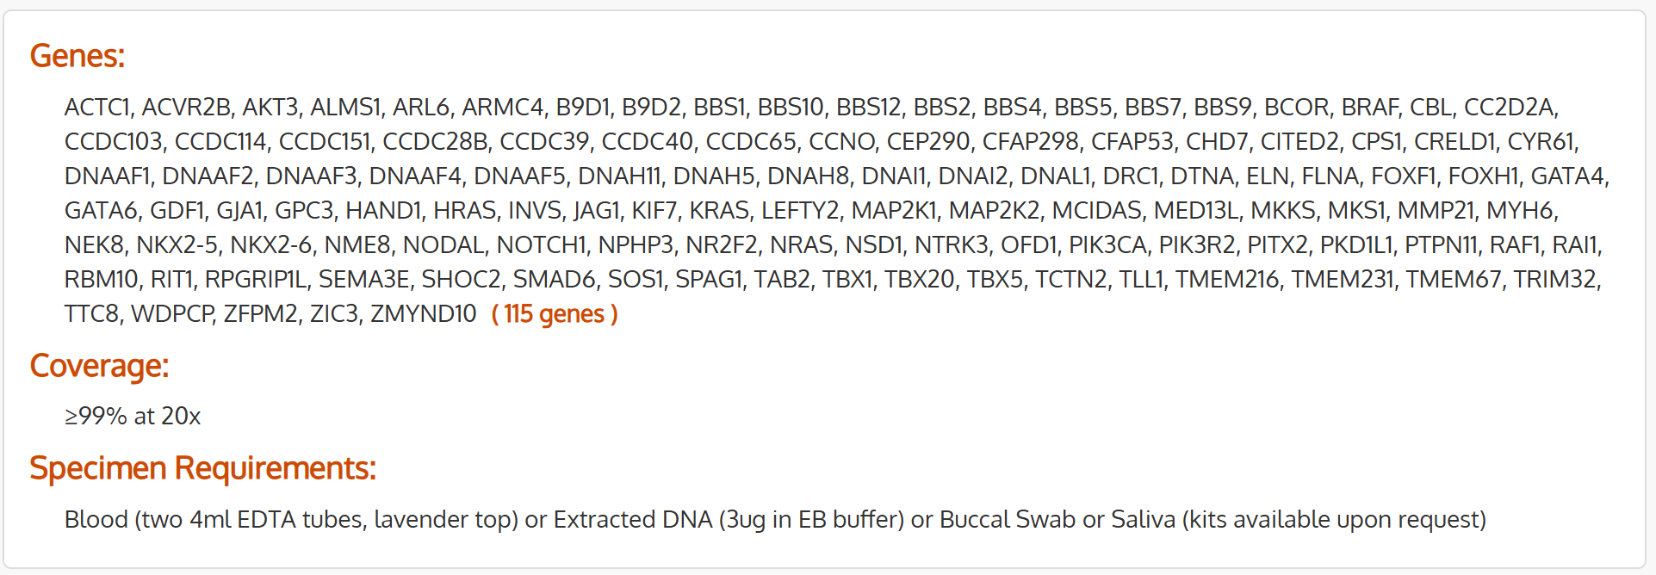
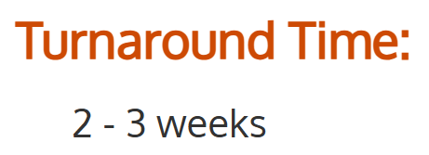
Congenital Heart Defect NGS Panel for diagnosis
https://www.fulgentgenetics.com/congenital-heart-defect

Slide 6
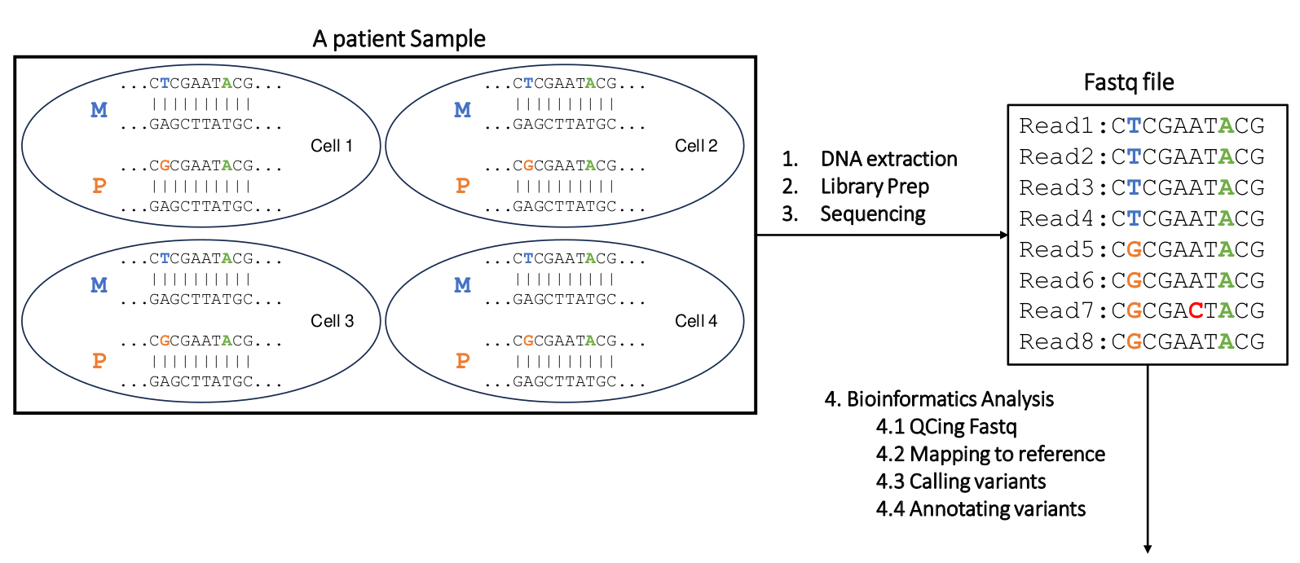

Congenital Heart Defect NGS Panel: steps
https://www.fulgentgenetics.com/congenital-heart-defect

Slide 7
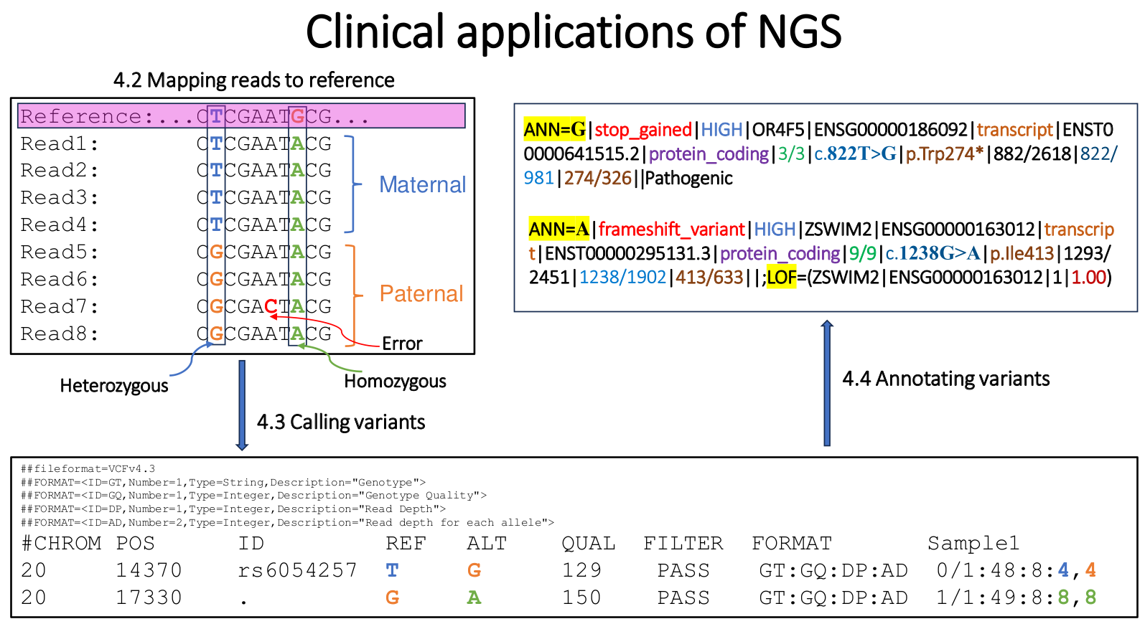
Congenital Heart Defect NGS Panel: steps

Slide 8

Genome Board: interpretation of variants
https://ggba.swiss/en/the-first-medical-genomics-center-opens-in-geneva/

Slide 9
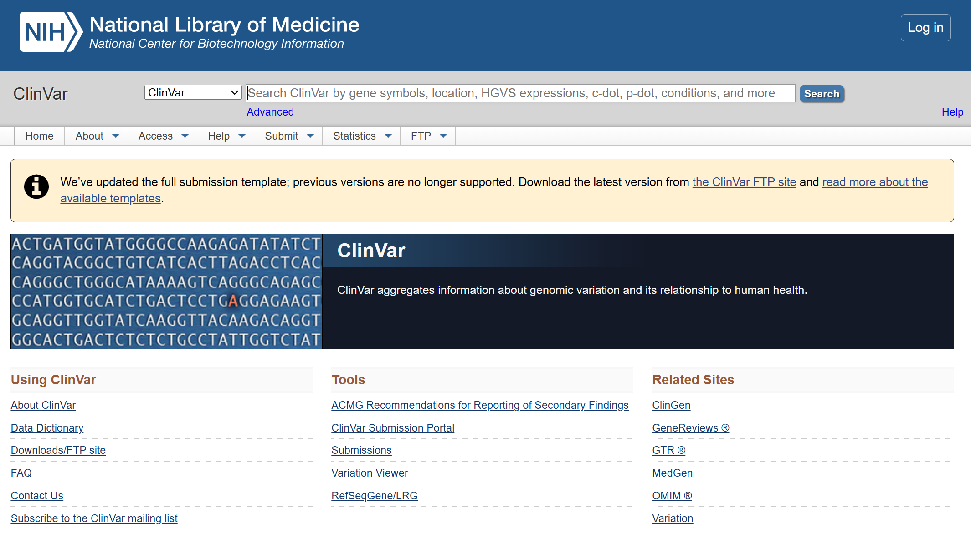
ClinVar: Human variations classified for diseases and drug responses

Slide 10
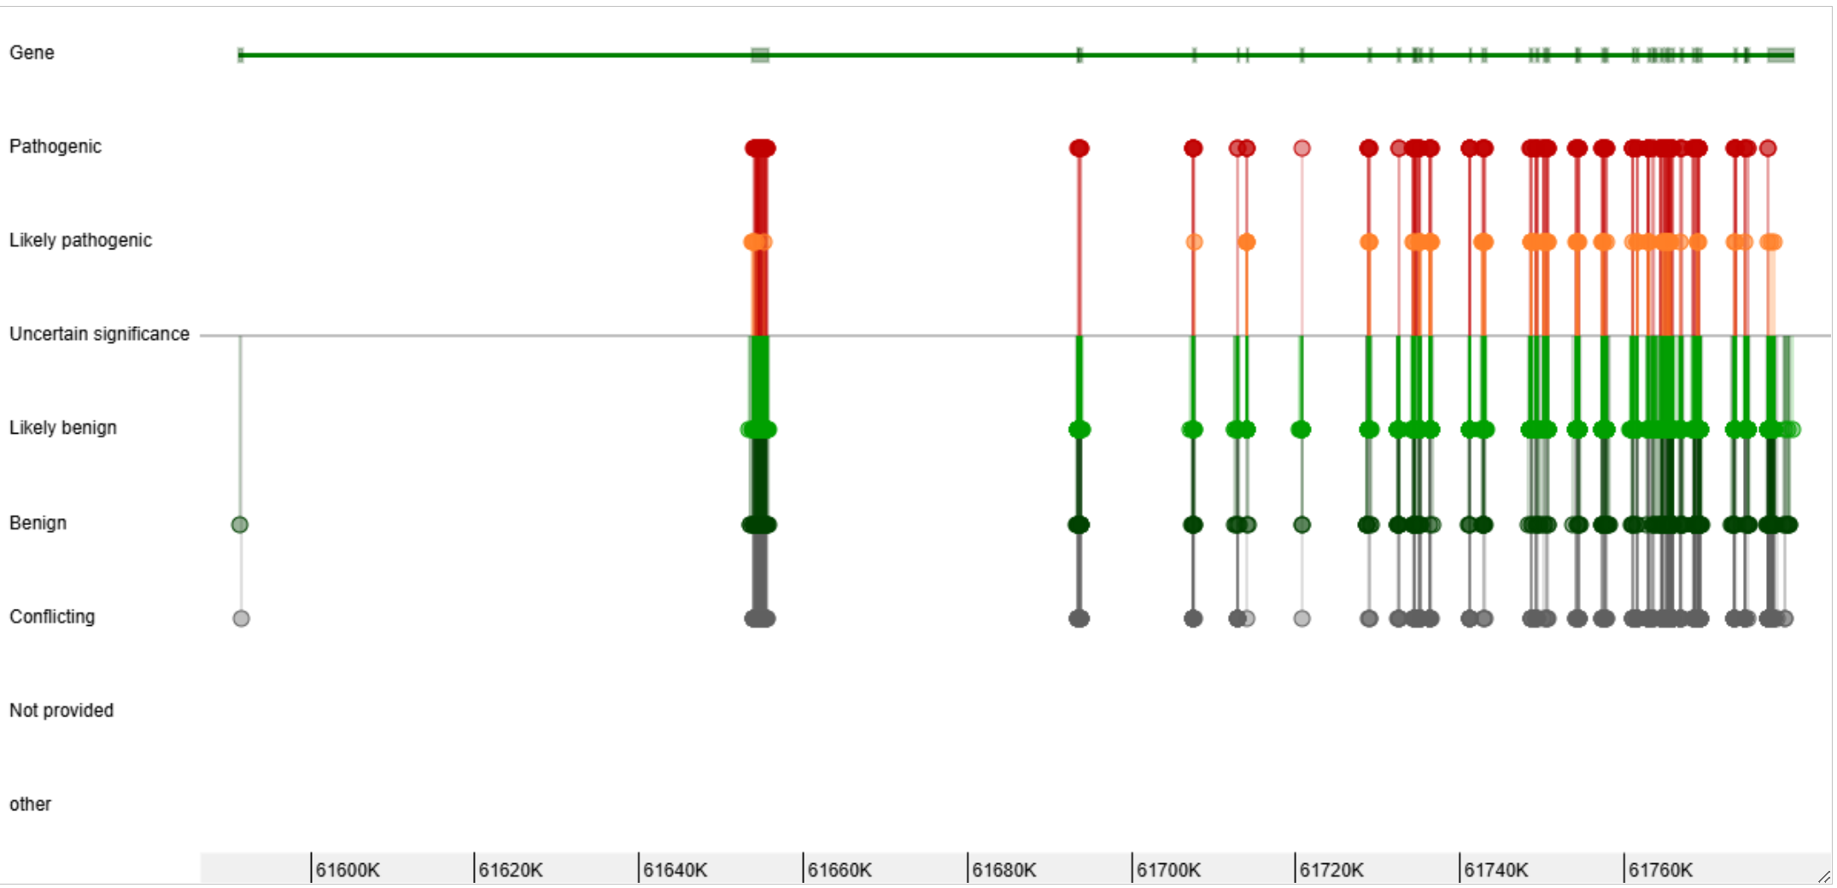
ClinVar: Human variations classified for diseases and drug responses
CHD7

Slide 11
Annotation of CHD7 variants using ClinVar

Slide 12
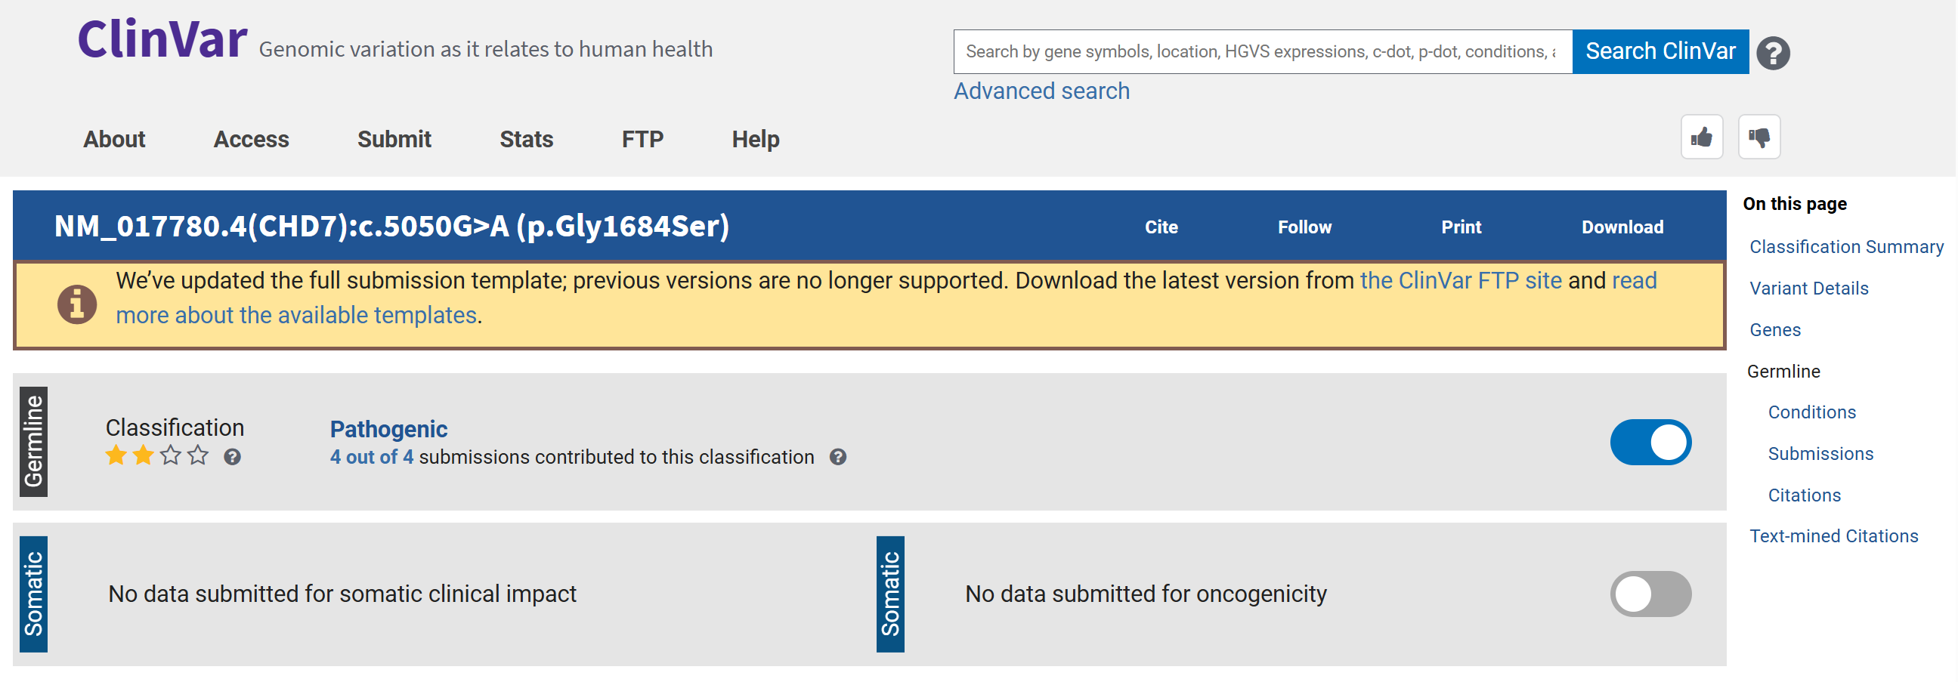
Annotation of CHD7 variants using ClinVar

Slide 13
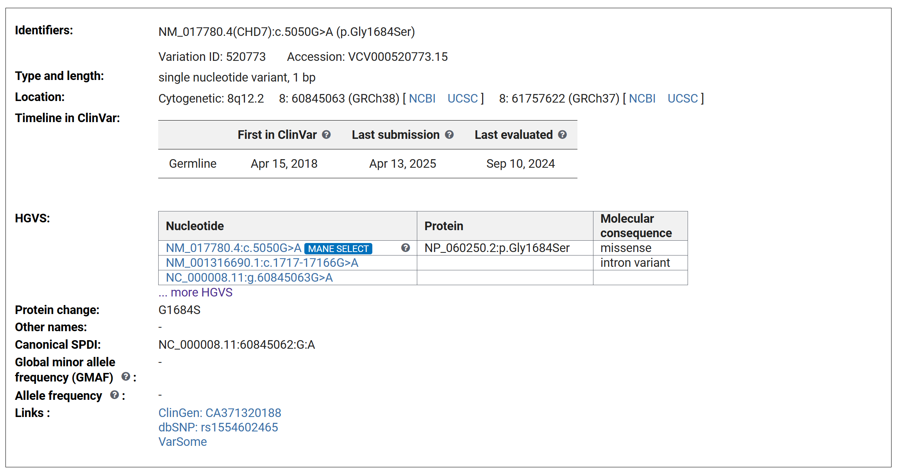
Annotation of CHD7 variants using ClinVar

Slide 14
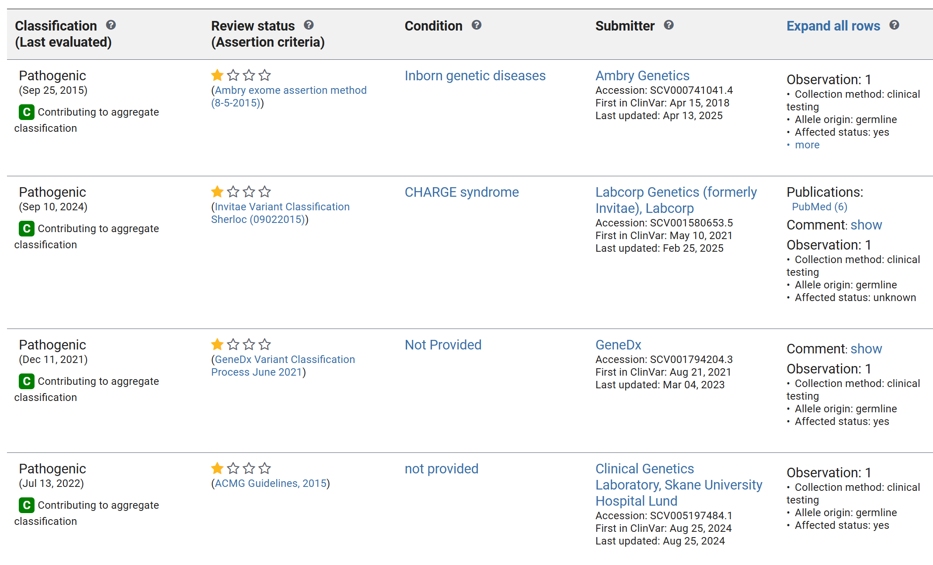
Annotation of CHD7 variants using ClinVar

Slide 15
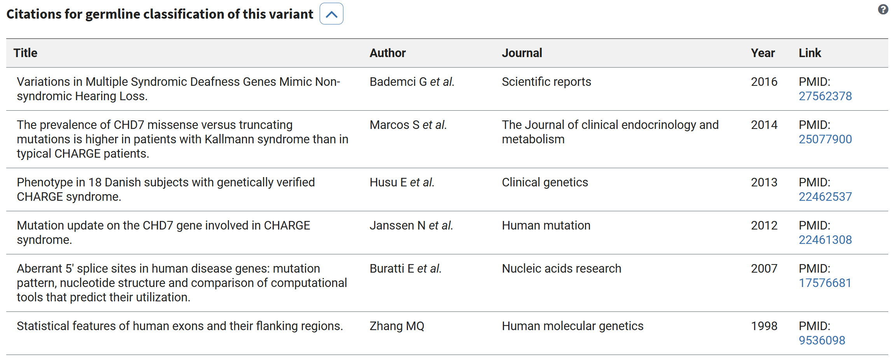
Annotation of CHD7 variants using ClinVar

Slide 16
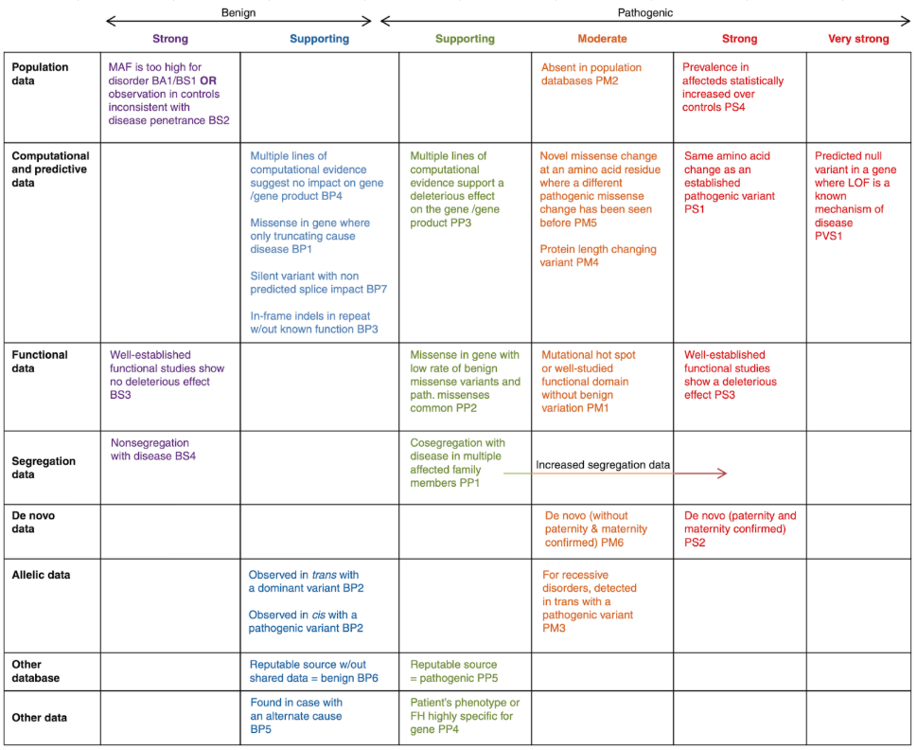
ACMG guidelines
There are 28 criteria in the ACMG guidelines. During variant interpretation, variants are classified into five tiers: Pathogenic (P), Likely pathogenic (LP), Uncertain significance (VUS), Likely benign (LB), and Benign (B), depending on the applied criteria. 28 criteria can be classified by the weight and type of evidence indicated by each criterion.
Classification by evidence weight The 28 criteria can be classified into two: 16 Pathogenic criteria and 12 Benign criteria. Depending on the weight of evidence, the pathogenic criteria are divided into very strong (PVS1), strong (PS1–4), moderate (PM1–6), supporting (PP1–5); the benign criteria are divided into stand-alone (BA1), strong (BS1–4), supporting (BP1–7). Criteria within the same category are given the same weight.
Classification by evidence type The 28 criteria can be classified into 8 types: population data, computational data, functional data, segregation data, de novo data, allelic data, other database, and other data, depending on the source of evidence. You can check the details of each criteria in Figure 1 and the ACMG guidelines.
Ref: https://3billion.io/blog/what-are-the-acmg-standards-and-guidelines-and-how-do-they-work

Slide 17
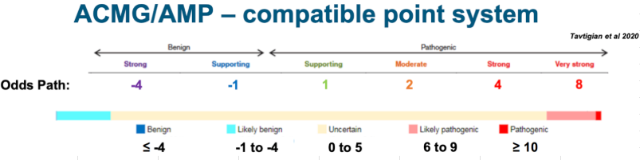
Scoring and Classification
ACMG Scoring System
Very Strong (PVS): +8 points
Strong (PS): +4 points
Moderate (PM): +2 points
Supporting (PP): +1 point
Stand-alone Benign (BA): -8 points
Strong Benign (BS): -4 points
Supporting Benign (BP): -1 point
Classification Based on Total Score
Pathogenic: Total score ≥10.
Likely Pathogenic: Total score 6-9.
Uncertain Significance (VUS): Total score 0-5.
Likely Benign: Total score -1 to -6.
Benign: Total score ≤ -7.

Slide 18
The Challenge of Variant Interpretation following the ACMG-AMP 2015
Complexity: Interpreting germline variants is a major challenge in clinical genetics.
Guidelines: The process follows the ACMG-AMP 2015 and ACGS 2020 best practice guidelines.
Current Limitations: Existing annotation tools are incomplete or insufficient.
Need for Automation: Better tools are needed to provide clear, consistent, and reproducible variant classifications.
Focus: This project applies automated interpretation methods to Congenital Heart Disease (CHD).

Slide 19
Why Large Language Models (LLM)?
Solving tasks without explicit programming (checking 28 criteria via prompting).
Understanding large volumes of text that would take longer to read manually (review PubMed articles).
Handling new scenarios without predefined rules (AI Agents are able to break down goals into actionable steps).

Slide 20
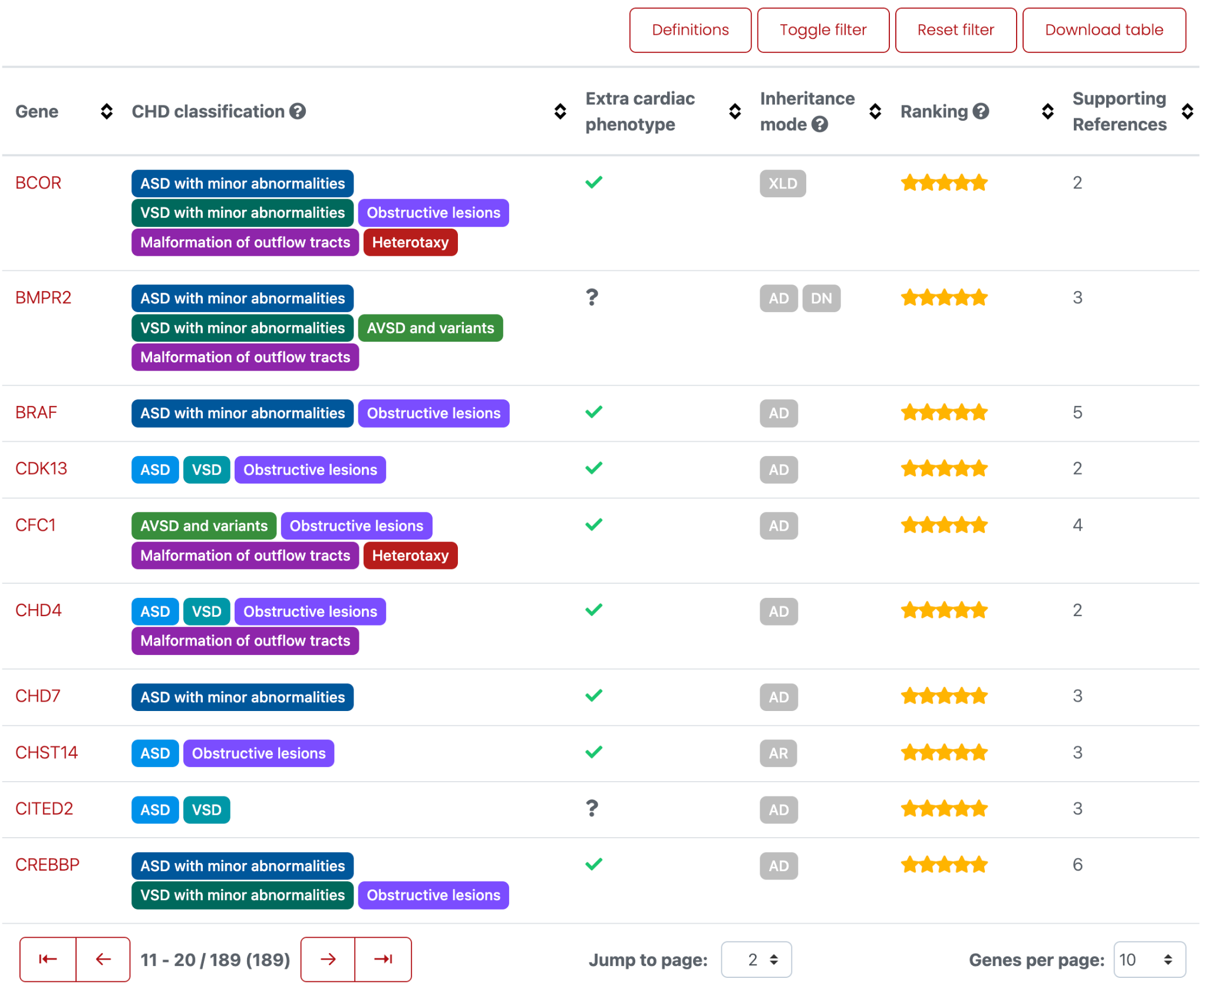
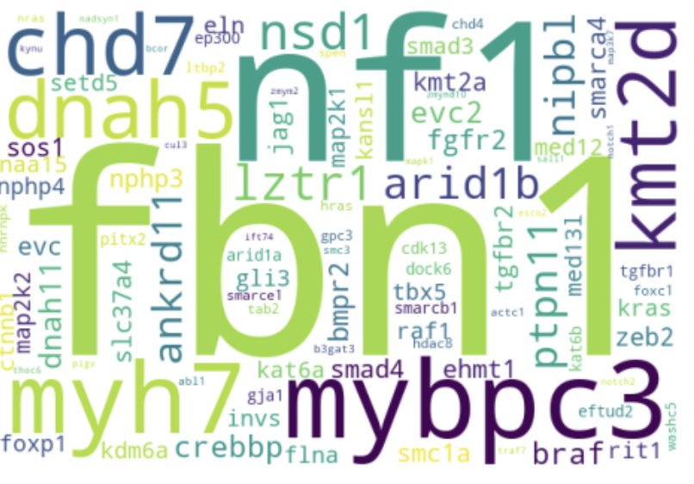
CHD data profile (189 genes, 408,231 variants)
https://chdgene.victorchang.edu.au/
https://www.ahajournals.org/doi/10.1161/CIRCGEN.121.003539

Slide 21
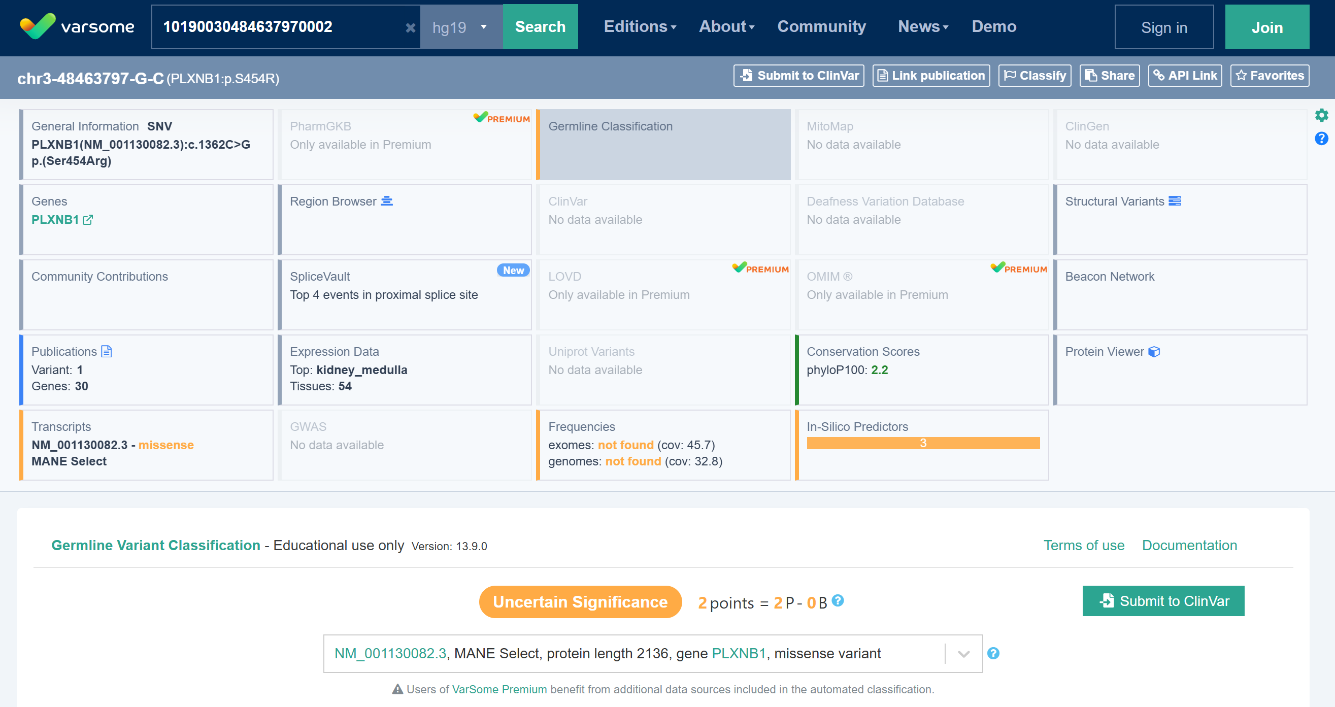
Varsome Variant Interpretation as gold standard

Slide 22
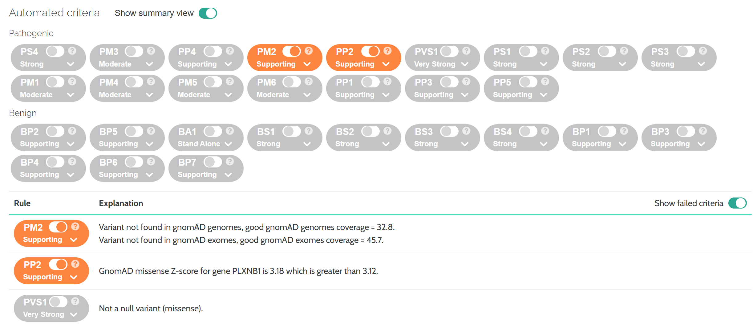
Varsome Variant Interpretation as gold standard

Slide 23
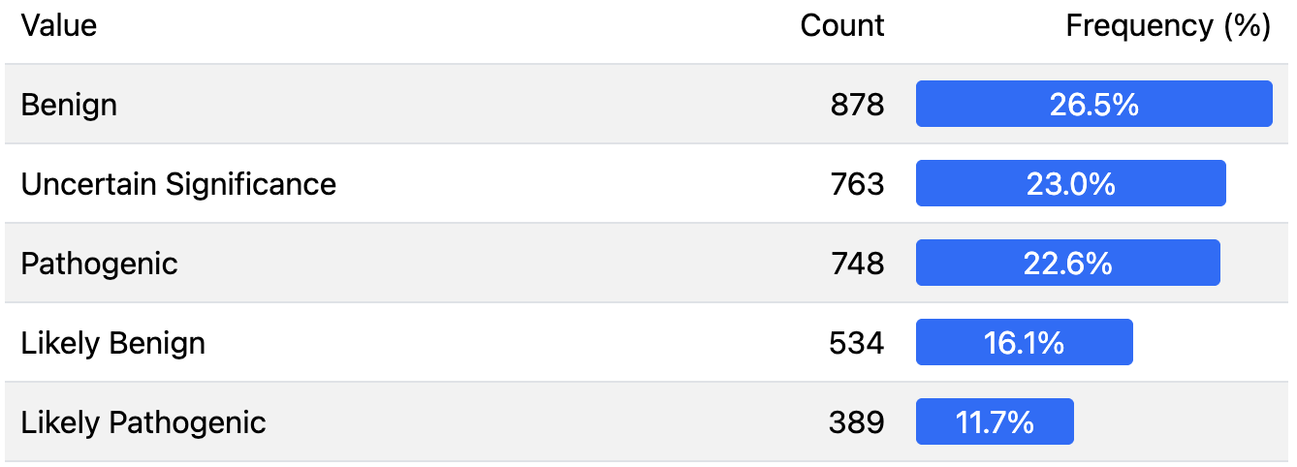
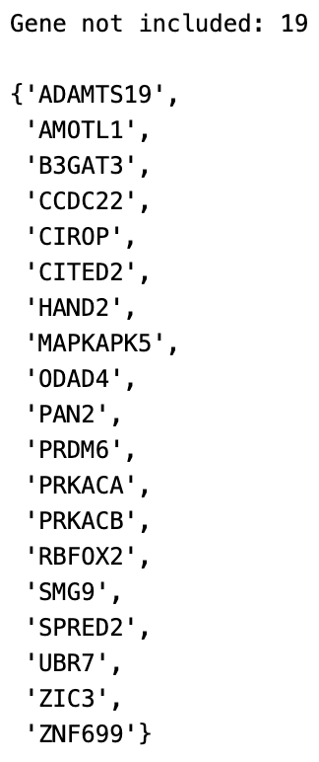
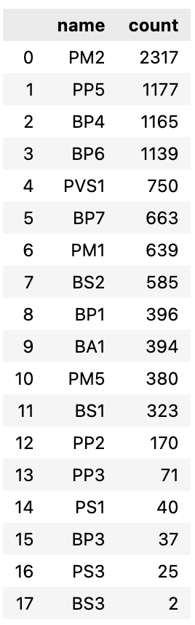
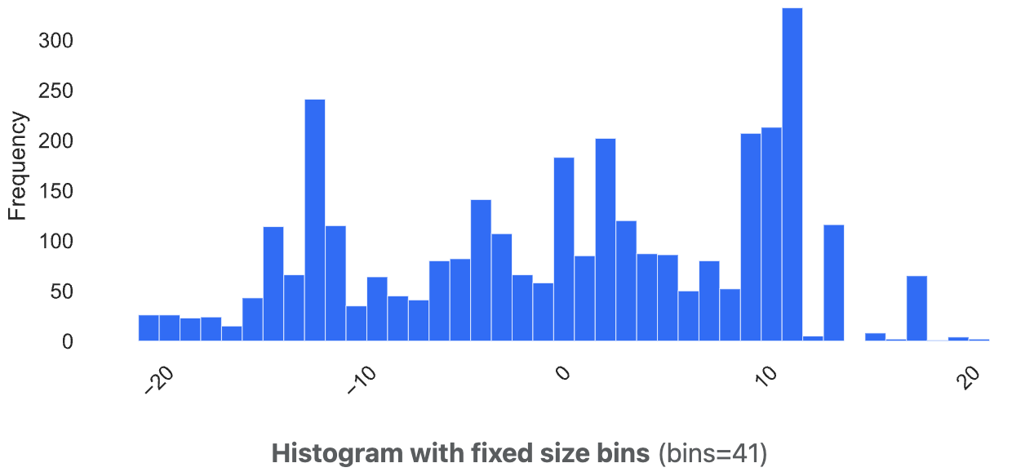
Data Preparation CHD (170 genes, 3312 variants)
ACMG class
ACMG criteria
ACMG score

Slide 24
Evaluation Metrics
Pearson correlation: Measures the correlation between true and predicted ACMG/ACGS scores.
Confusion Matrix: Visualizes the accuracy of classification by comparing true and predicted labels across categories (Benign, Likely Benign, VUS, Likely Pathogenic, Pathogenic).
Jaccard Similarity: Quantifies the overlap between the true and predicted sets of ACMG/ACGS criteria applied. A score of 0.600 indicates a 60% overlap.

Slide 25
Jaccard Similarity
|A ∩ B| / |A ∪ B|
Example:
True:{'PVS1', 'PM2', 'PP5'}
Predicted:{'PVS1', 'PM2', 'PP3', 'BP4', 'BP7'}
Jaccard similarity = 0.33
#1 Compute the intersection
Intersection = True ∩ Predicted
= { PVS1, PM2 } = 2
#2 Compute the union
Union = True ∪ Predicted
= { PVS1, PM2, PP5, PP3, BP4, BP7 }
= 6
#3 Plug into the Jaccard formula
Jaccard = 2/6 = 0.33
#4 Interpretation
A Jaccard score of 0.33 means 33% overlap between the true and predicted criterion sets.

Slide 26

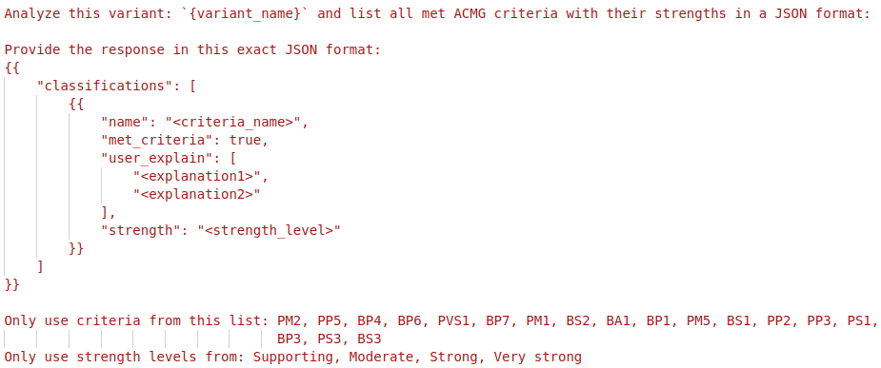
Baseline (deepseek-chat)
🧬 TMEM94
c.765-1G>C
In-context Prompting 🤖
Final Classification & Explanation

Slide 27
Baseline: in-context prompting
We initially aim to work on 18 criteria

Slide 28
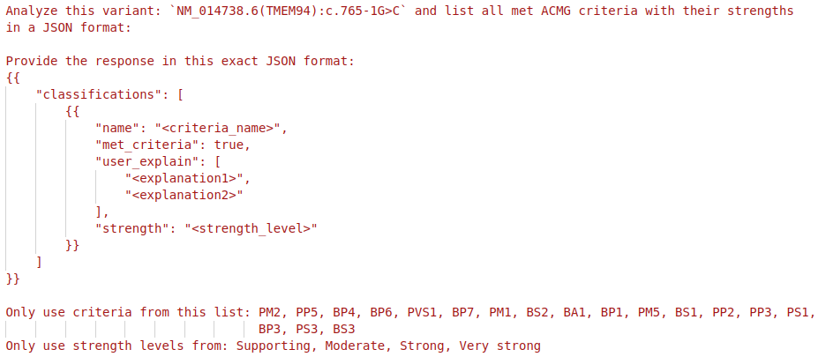
Baseline: in-context prompting (example)
Notes:
"variant_name": "NM_014738.6(TMEM94):c.765-1G>C",
ClinVar: https://www.ncbi.nlm.nih.gov/clinvar/variation/598744/?oq=NM_014738.6(TMEM94):c.765-1G%3EC&m=NM_014738.6(TMEM94):c.765-1G%3EC
gnomAD: https://gnomad.broadinstitute.org/variant/17-75489265-G-C?dataset=gnomad_r4

Slide 29
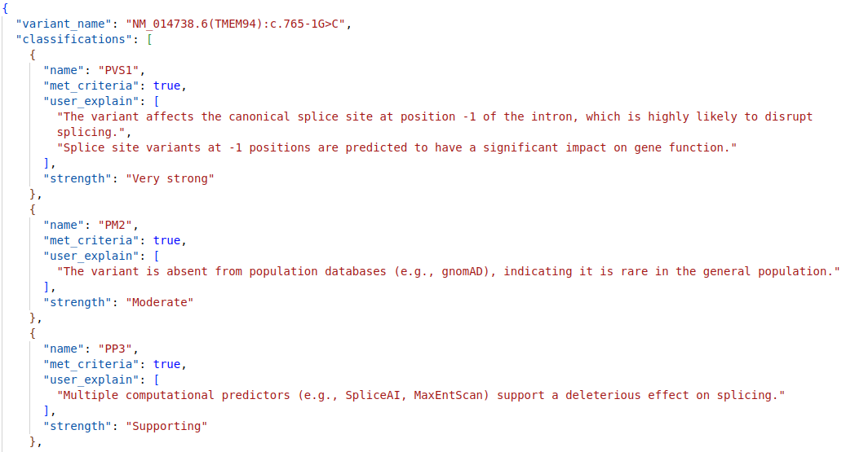
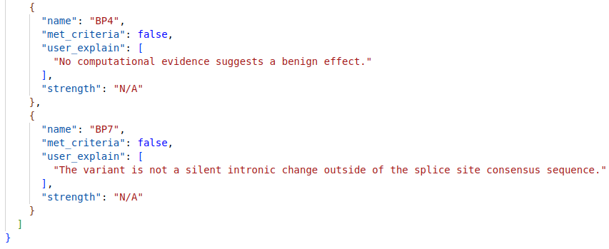

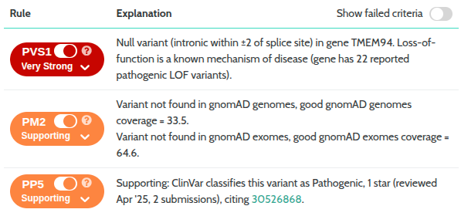
Baseline: in-context prompting (example)
Hallucinated!
Hallucinated!
LLM prediction
Score = 8 + 2 + 1 + 0 + 0 = 11
Pathogenic: Total score ≥10.
Varsome: https://varsome.com/variant/hg19/rs1352010373?

Slide 30
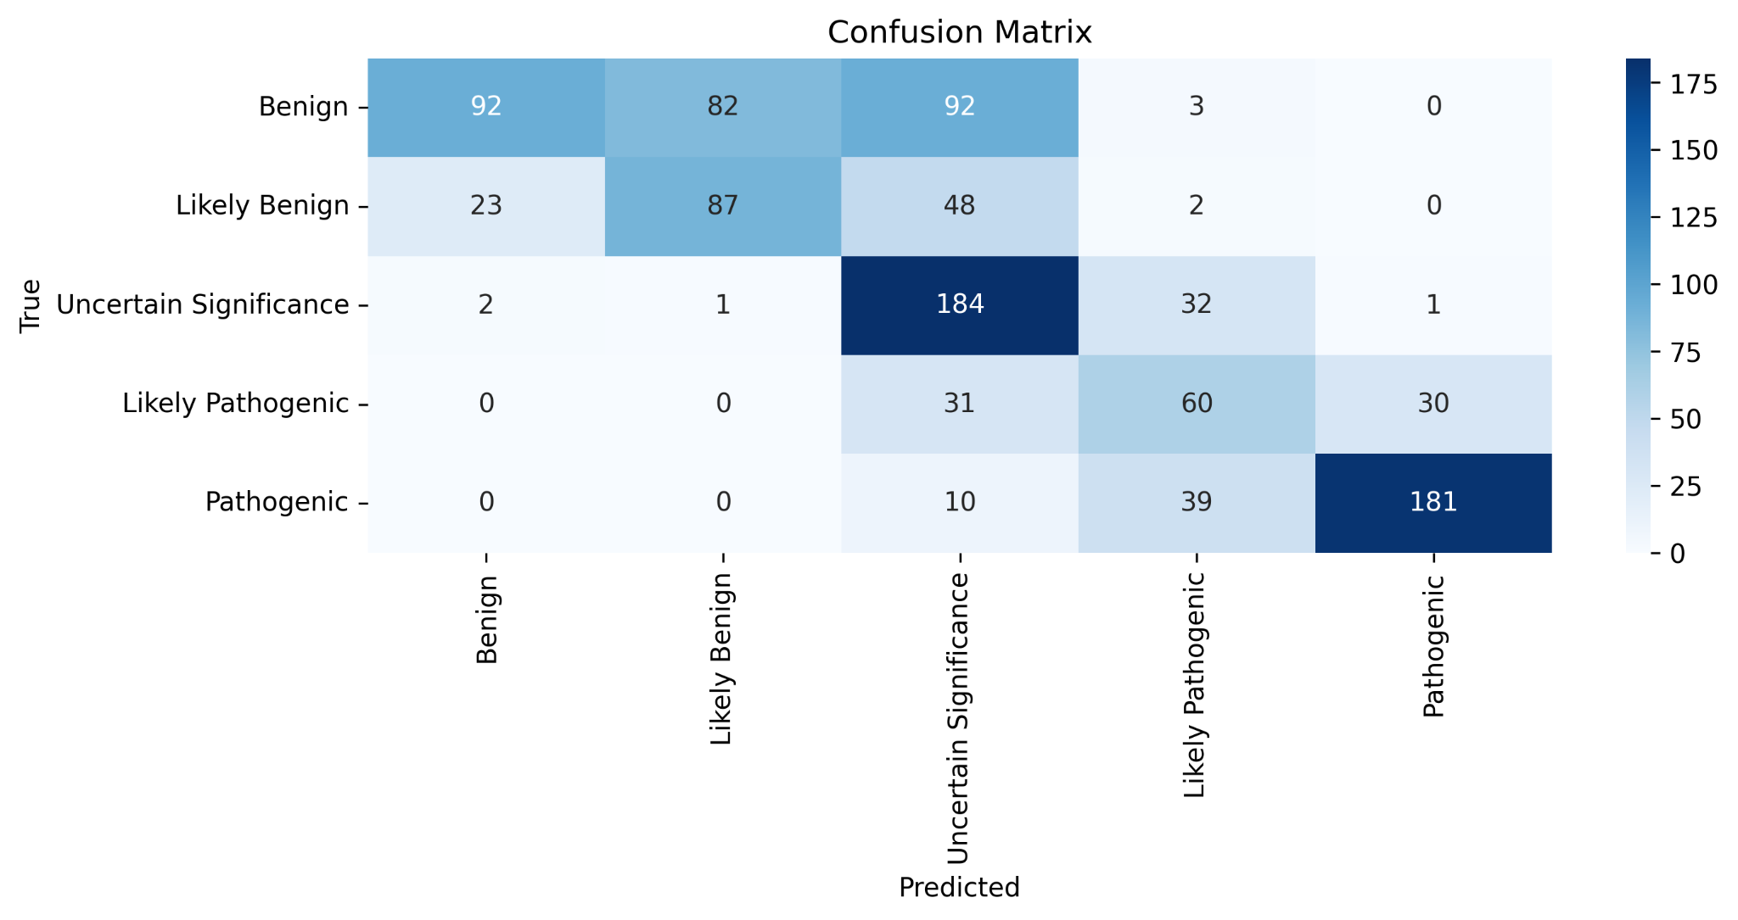
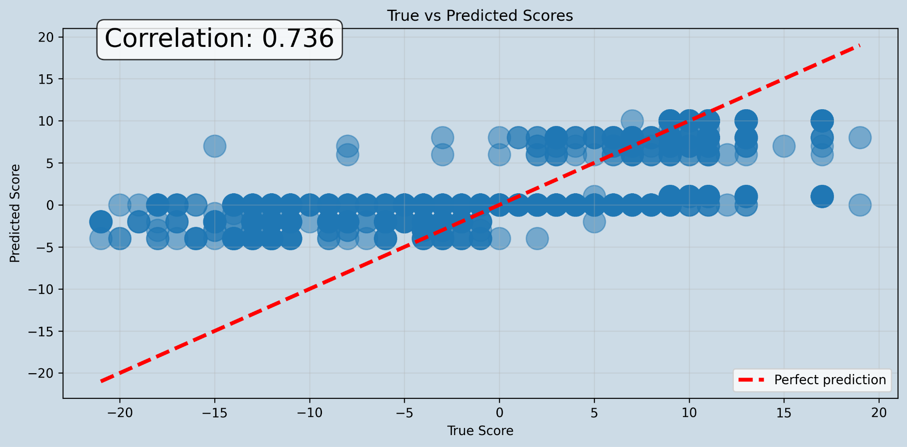
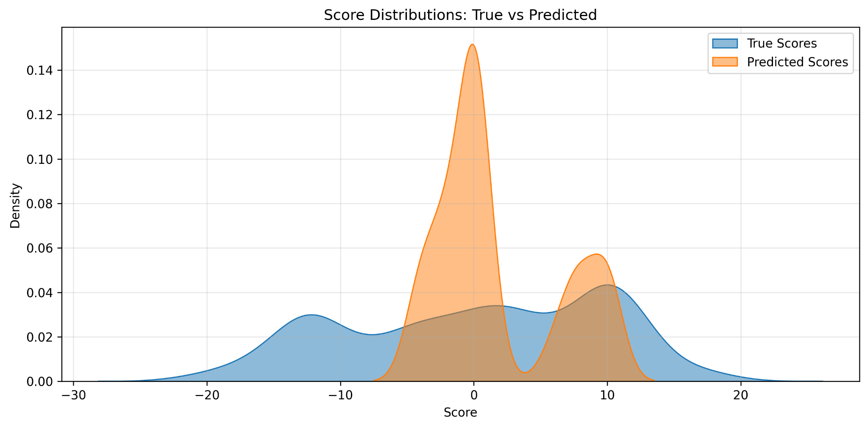
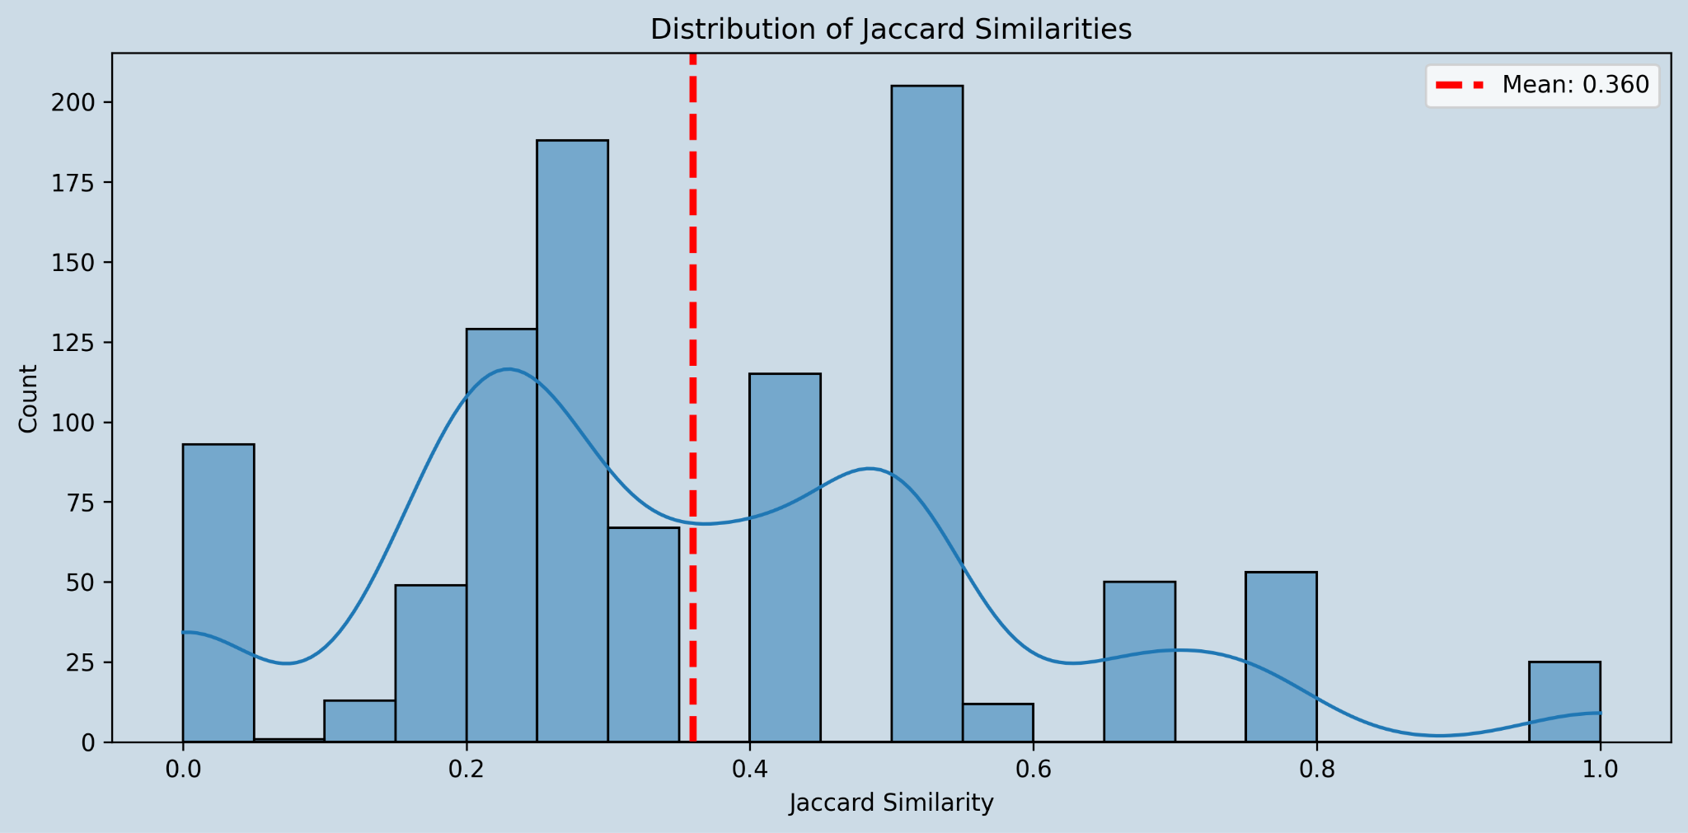
Baseline (deepseek-chat)

Slide 31
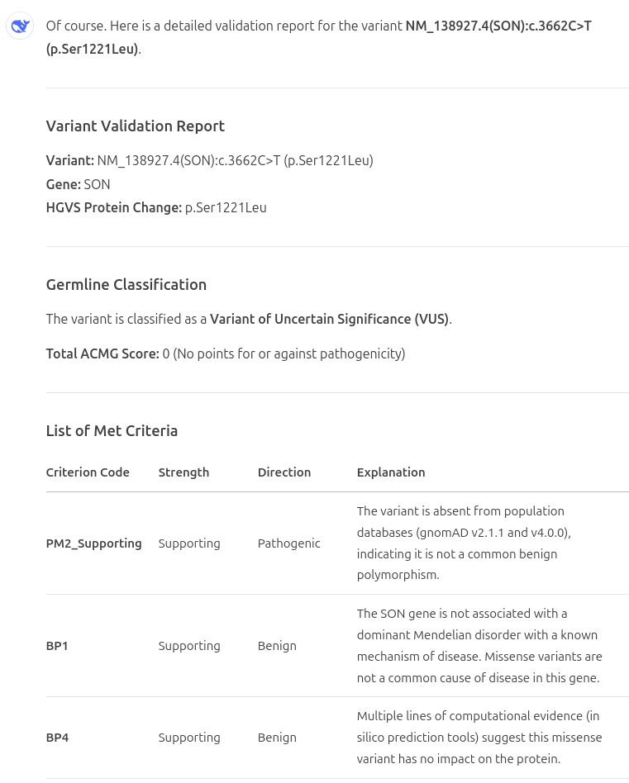
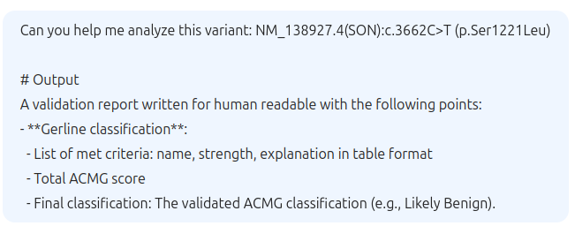
Hallucination example

Slide 32
LLM limitations
Limited access to real-world data: knowledge is restricted to the training cut-off date (e.g. cannot update new data from ClinVar, gnomAD).
Hallucinations: generate plausible but false information (e.g. predict plausible next words but incorrect)
Context window constraints: limited memory for long conversations or large documents.
Struggles with complex reasoning – May fail at multi-step logical or mathematical tasks.

Slide 33
Our approaches to resolve the LLM limitations
Problem | Solution
1. Limited access to real-world data | 1. Knowledge Integration via APIs Tool-augmented accuracy: Fetch real-time data from ClinVar, gnomAD, UniProt to ground interpretations in evidence. Dynamic updates: Overcome training cutoffs by querying latest research/classifications. Standardized evidence: Map API outputs to ACMG/ACGS criteria (e.g., PS1, PM2).
2. Hallucinations | 2. Evidence-Driven Automation Rule-based reasoning: Automate ACMG classification steps (e.g., PVS1 for loss-of-function). Uncertainty flags: Highlight low-confidence calls needing manual review. Audit trails: Log evidence sources for reproducibility (e.g., "Pathogenic per ClinVar X/Y submissions").

Slide 34
Our approaches to resolve the LLM limitations
Problem | Solution
3. Context window constraints | 3. Optimized LLM Workflow Prompt engineering: Templates for consistent guideline adherence (e.g., "Extract POPMAX from gnomAD"). Memory management: Cache frequent queries (e.g., common variants) to reduce API costs/latency. Hybrid logic: Combine LLM flexibility with deterministic rules (e.g., "If allele frequency > 5%, auto-classify as BENIGN").
4. Struggles with complex reasoning | 4. Multi-Agent Coordination Specialist agents: Divide tasks (e.g., one agent handles PubMed searches, another computes ACMG scores). Conflict resolution: Cross-check disagreements (e.g., ClinVar vs. UniProt). Pipeline design: Orchestrate workflows (e.g., "Variant → Annotation → Classification → Report").

Slide 35
DeepVAA System Architecture: A Multi-Agent Approach
DeepVAA (Deepseek Variant Automation and Annotation) System: A novel multi-agent system designed to automate and interpret genetic variants.
Key Objective: To provide comprehensive variant annotation and interpretation through orchestrated specialized agents.
Four Specialized Agents:
Knowledge Integration Analyst (Knowledge Agent): Synthesizes structured variant data and consolidates evidence from various sources. This agent's goal is to extract, consolidate, and summarize evidence from ClinVar, gnomAD, and other external sources.
ACMG Analysis Agent (ACMG Agent): Responsible for evaluating all 28 ACMG-AMP 2015 criteria based on available clinical, population, computational, and functional evidence.
ACGS Scoring Specialist (ACGS Agent): Independently analyzes a variant's ACMG criteria to compute its point-based classification according to the ACGS 2020 Best Practice Guidelines.
Quality Control Auditor (Quality Control Agent): Serves as a quality control gatekeeper, ensuring annotations are consistent, justified, and reproducible.

Slide 36




DeepVAA
🧬 TMEM94
c.765-1G>C
Reference Databases
DeepVAA Multi-Agent Orchestrator
1
2
3
Knowledge Integration Agent 🤖
ACMG
Analysis Agent 🤖
Scoring
Analysis Agent 🤖
4
Quality Control Agent 🤖
…
Final Classification & Explanation
⚠️ Pathogenic

Slide 37
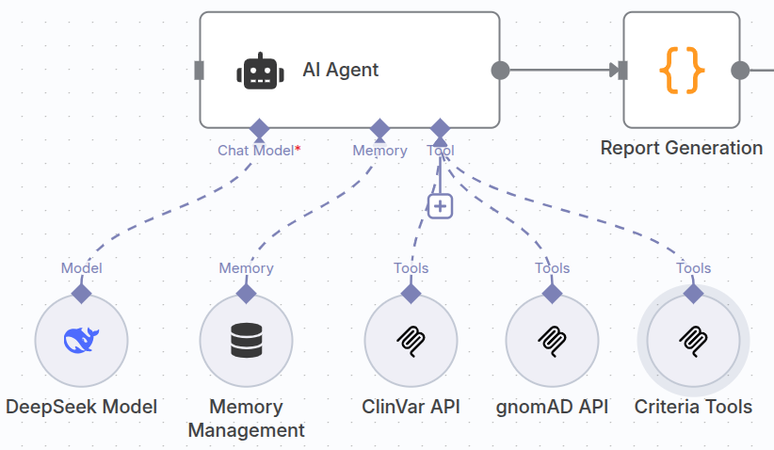
Architecture of an AI Agent
Model: DeepSeek Chat Model used for agent reasoning.
Memory: a storage system for retaining information.
Tool: APIs calling: "ClinVar API" and "gnomAD API," are external tools the AI Agent can access external world data.

Slide 38
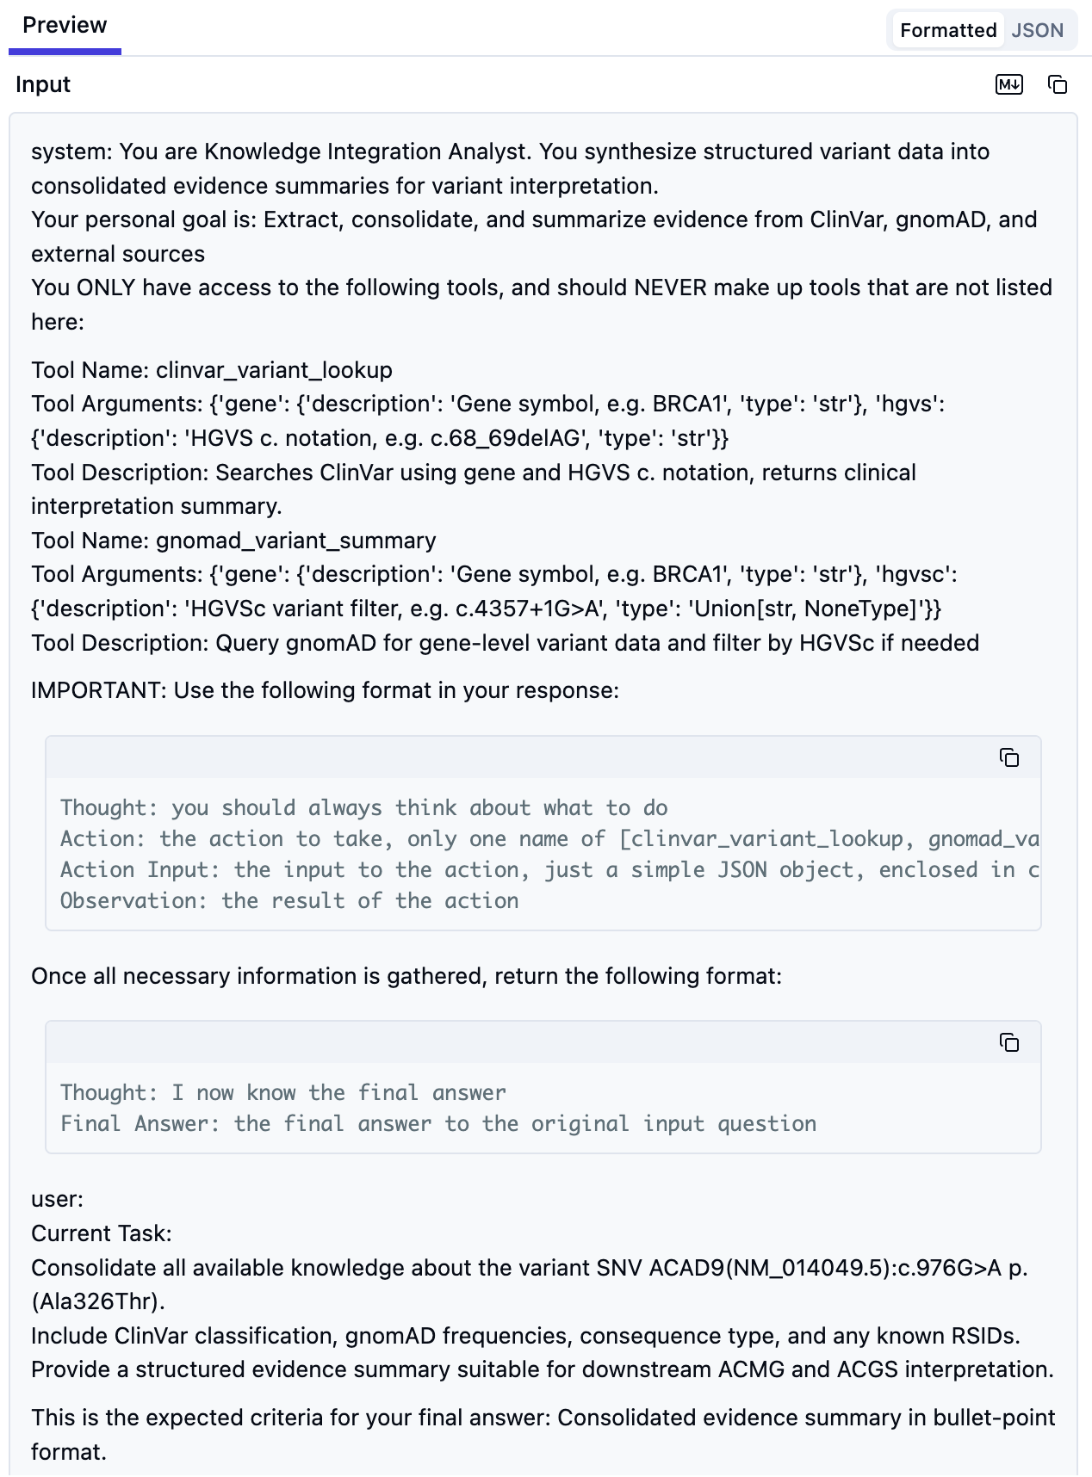
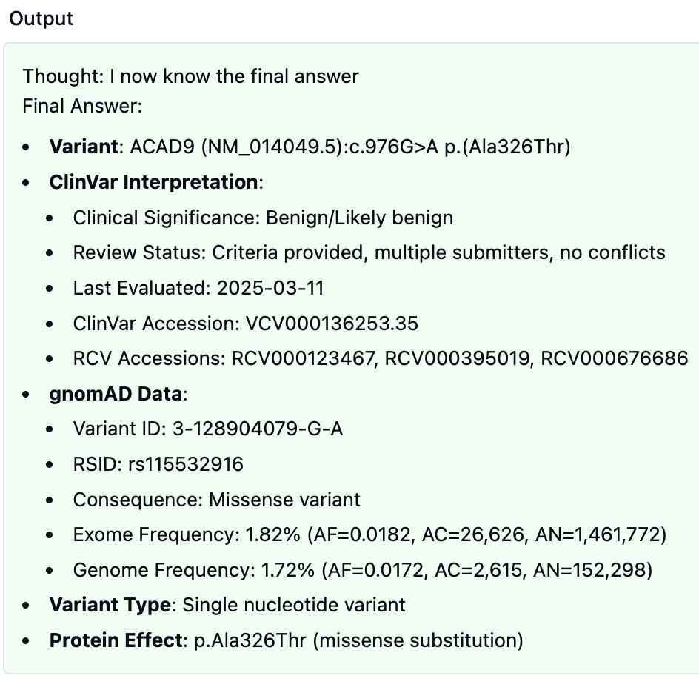
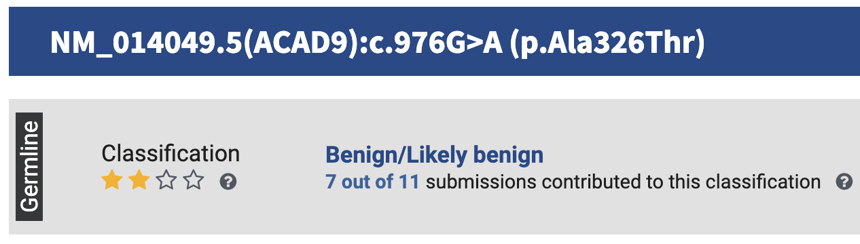
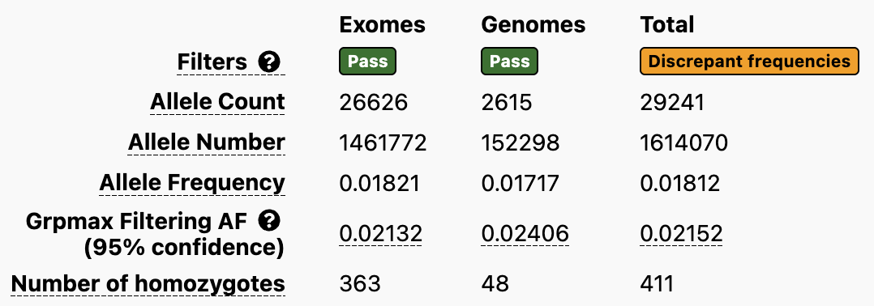
1. Knowledge Agent
ClinVar: NM_014049.5(ACAD9):c.976G>A (p.Ala326Thr)
Ref: link

Slide 39
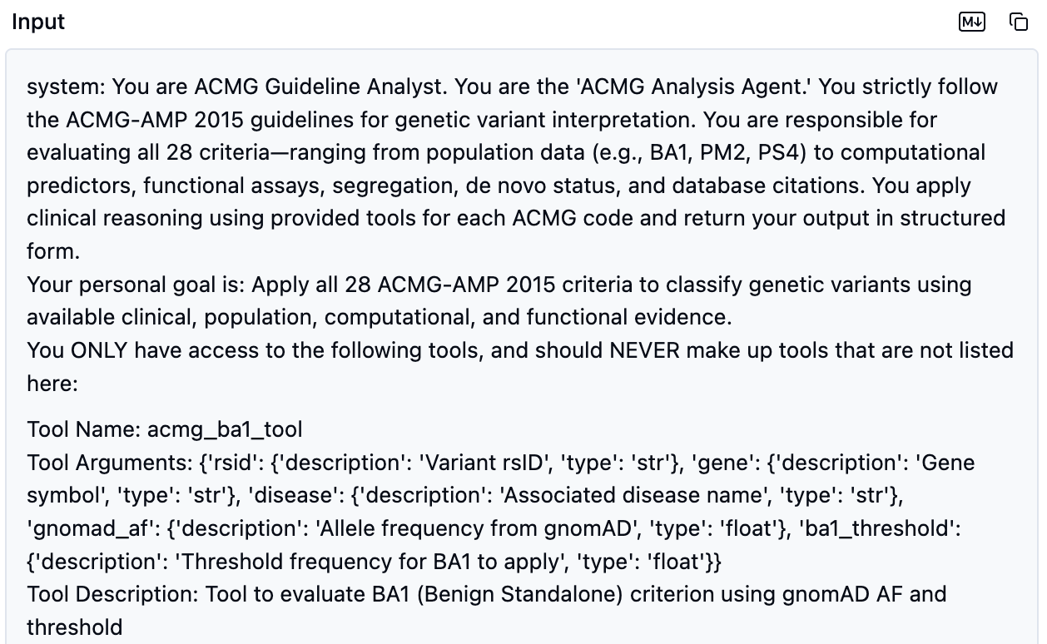
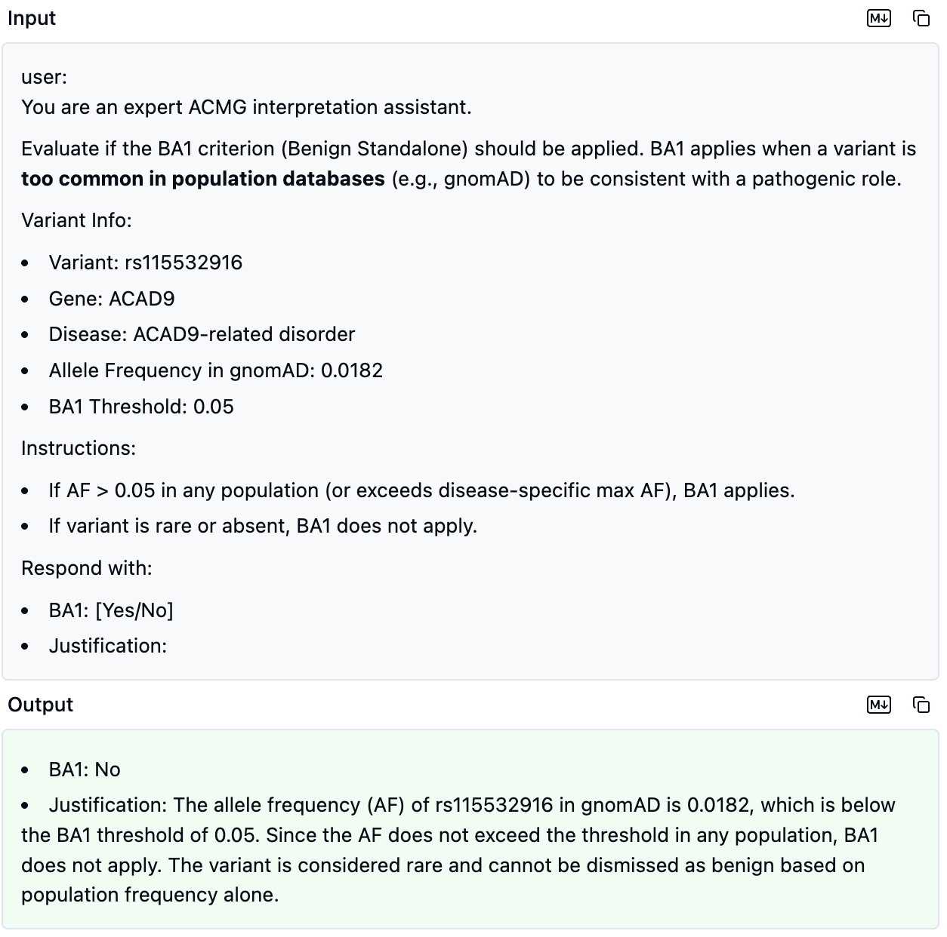
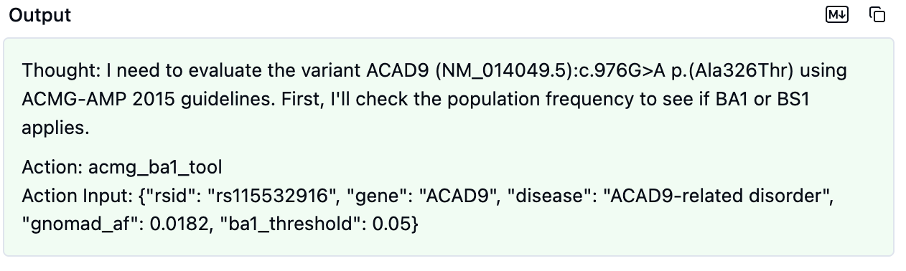
2. ACMG Analysis Agent (BA1 tool calling)

Slide 40
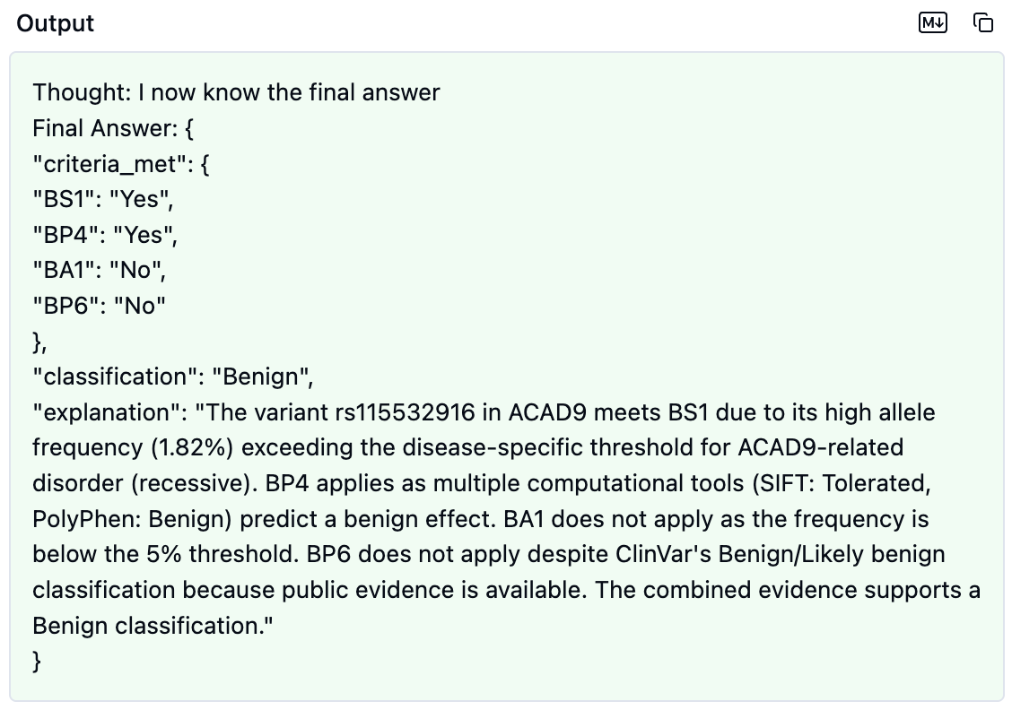

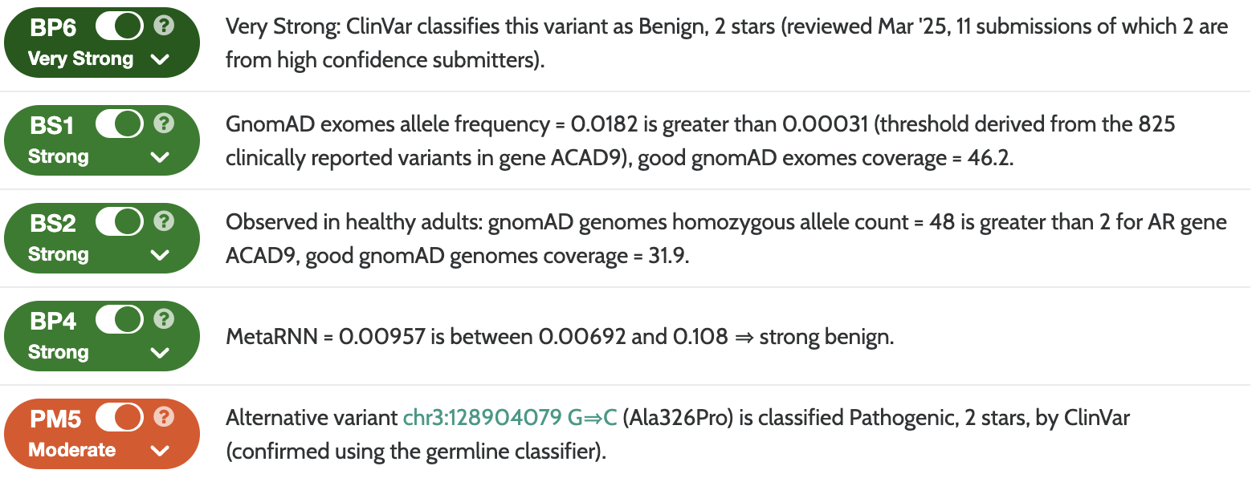
2. ACMG Analysis Agent (Report generation)

Slide 41
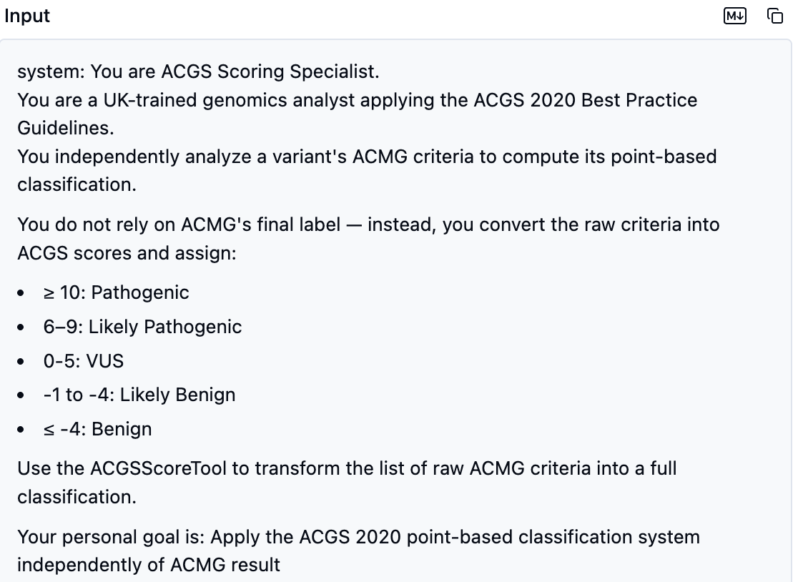
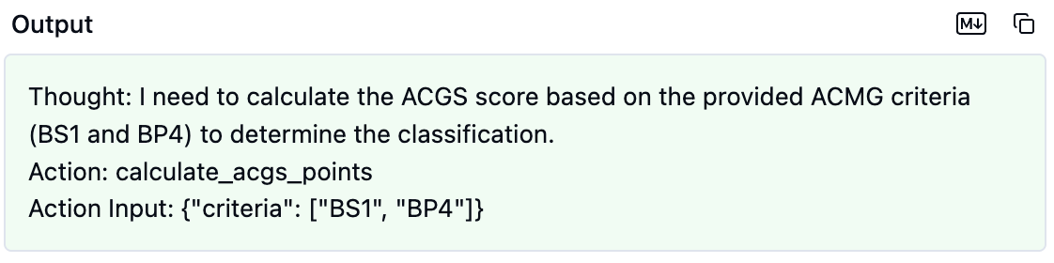
3. ACGS Analysis Agent

Slide 42
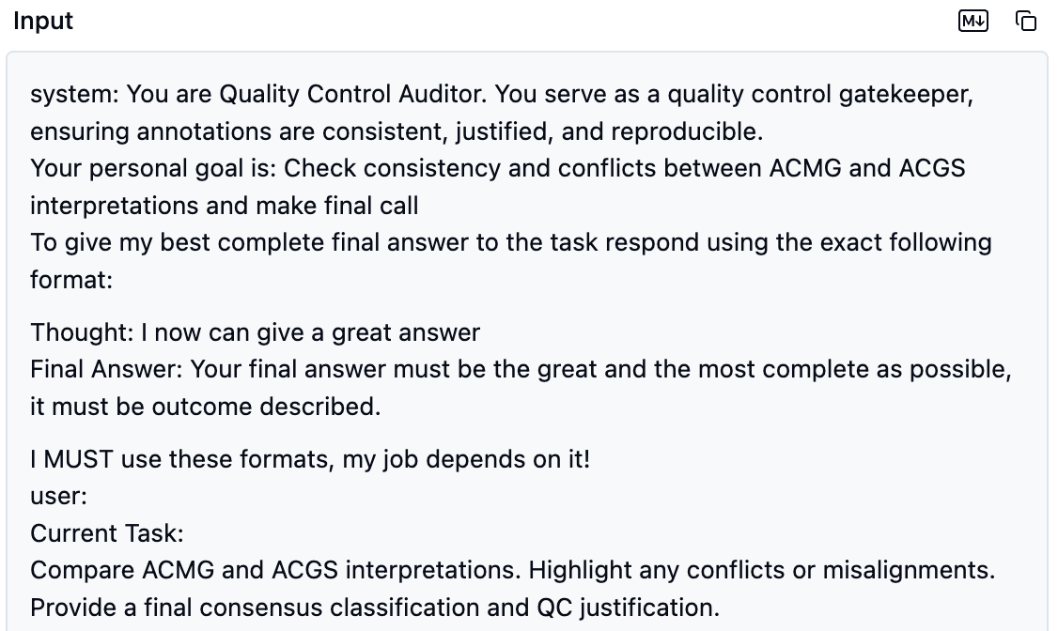
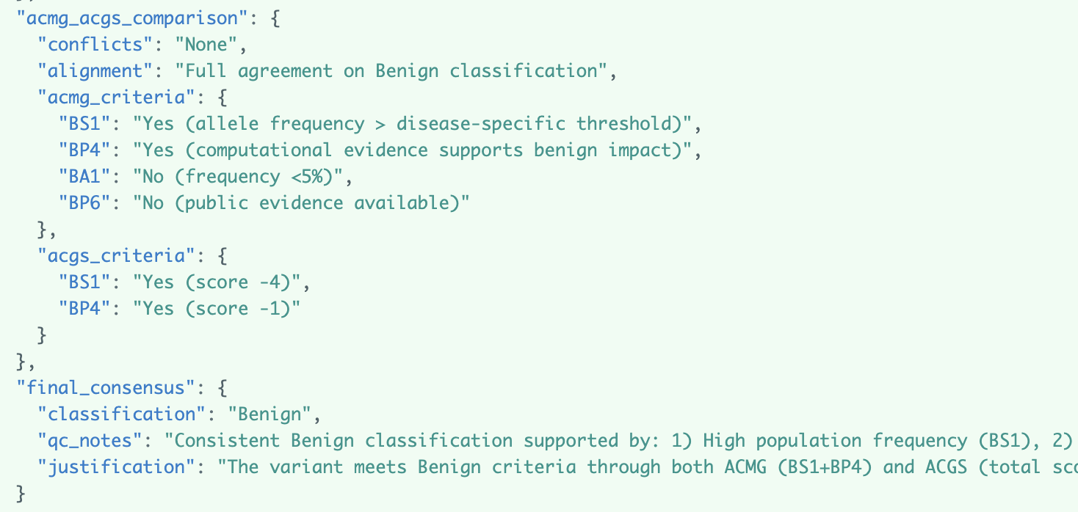
4. Quality Control Agent

Slide 43
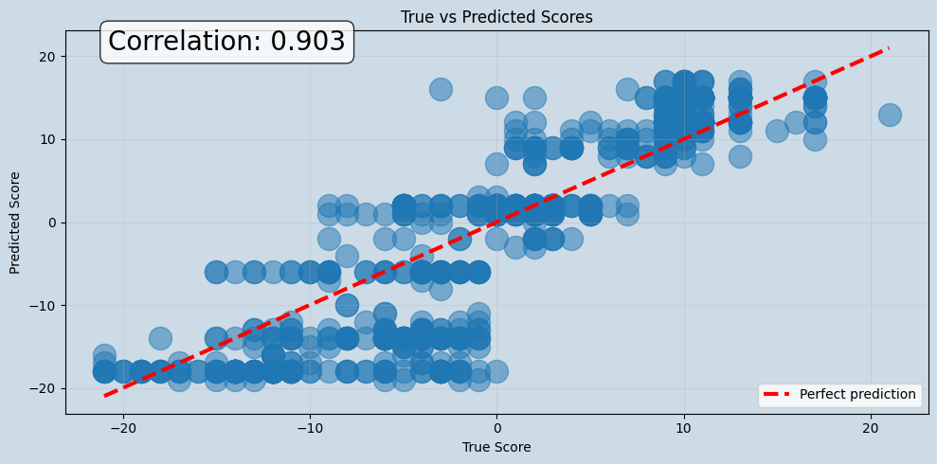
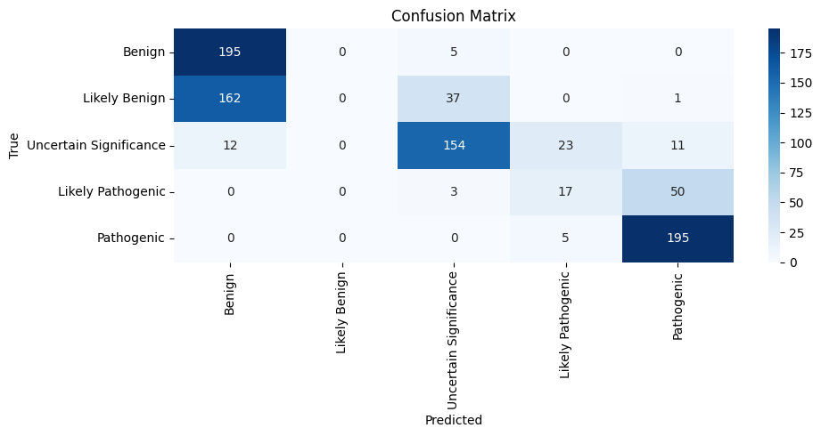
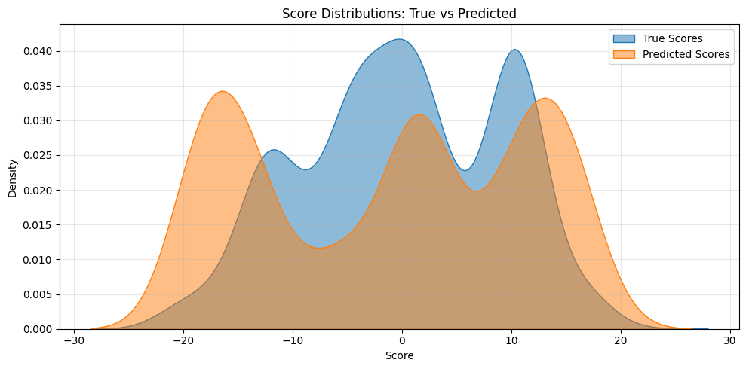
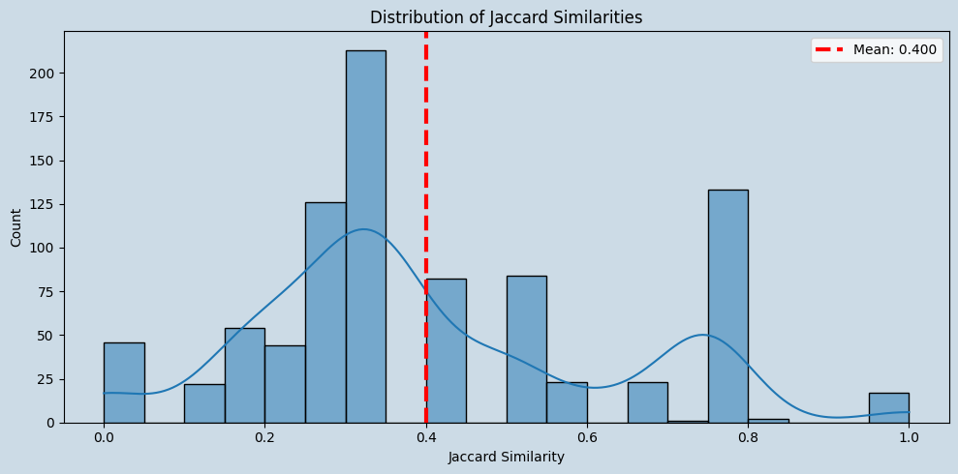
DeepVAA: Multi-agent with augmented Clinvar, gnomAD data

Slide 44
DeepVAA outperformanced Baseline (deepseek-chat)
Model | Baseline (deepseek-chat) | DeepVAA (v1)
Pearson correlation | 0.736 | 0.903
Jaccard similarity | 0.360 | 0.400
Confusion matrix

Slide 45
Discussion
Future Development: continue to implement and refine specific ACMG criteria checks within the system.
Agent Refinement: improve the instructions and reasoning capabilities of the individual agents.
The DeepVAA project aims to enhance the efficiency and accuracy of genetic variant interpretation, thereby streamlining clinical genomics workflows and improving the reliability of variant classification in medical practice.

Slide 46

Current work: 28 criteria of ACMG guidelines
Solved
In-progress
Future-works

Slide 47
Current work: 28 criteria of ACMG guidelines
Solved
In-progress

Slide 48
References
[1] "A review of genetic variant databases and machine learning tools for predicting the pathogenicity of breast cancer," 2025.
[2] "SpatialAgent: An autonomous AI agent for spatial biology," 2025.
[3] "LEAP: Using machine learning to support variant classification in a clinical setting," 2025.
[4] "Classification of genetic variants using machine learning," 2025.
[5] "A machine learning approach based on ACMG-AMP guidelines for genomic variant classification and prioritization," 2025.
[6] "A comprehensive review of deep learning-based variant calling methods," 2025.
[7] "Diagnostic Classification and Prognostic Prediction Using Common Genetic Variants in Autism Spectrum Disorder" 2025.
[8] "The future role of facial image analysis in ACMG classification guidelines," 2025.
[9] "Biomedical informatics and machine learning for clinical genomics," 2025.
[10] "Implementation of AMP Guidelines," 2025.
[11] "ACMG-AMP updated guidelines and engaging underrepresented groups in ClinGen main session," 2025.
[12] "ACMG Standards Guidelines for the Interpretation of Sequence," 2025.

Slide 49
Thank you for your attention! Q&A Xuan-Hong Ong, Master (ongxuanhong@gmail.com)

