Slide 1
XAI

Slide 2
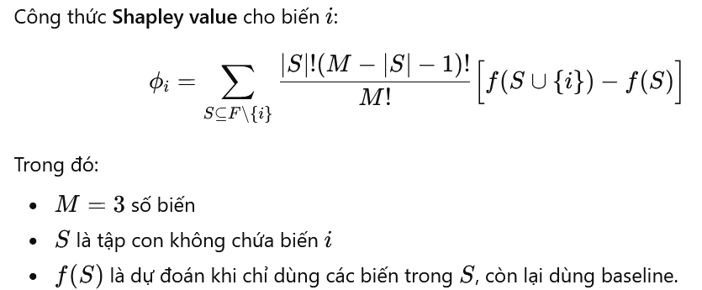
SHAP

Slide 3
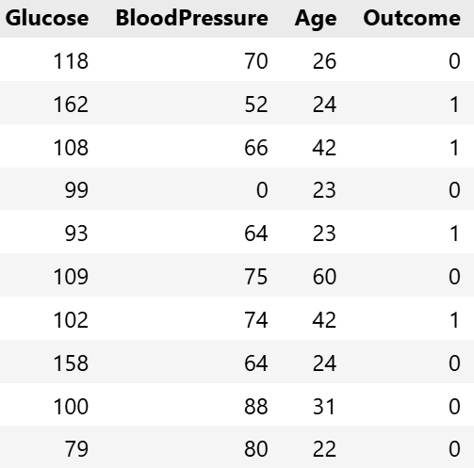
SHAP Kernel

Slide 4

SHAP Kernel

Slide 5

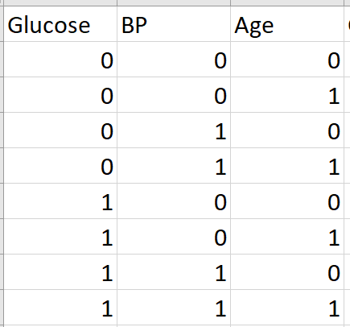
SHAP Kernel

Slide 6
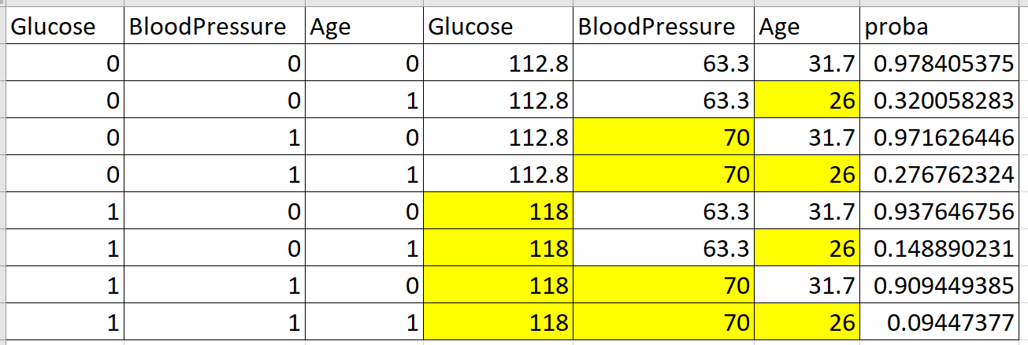
SHAP Kernel

Slide 7
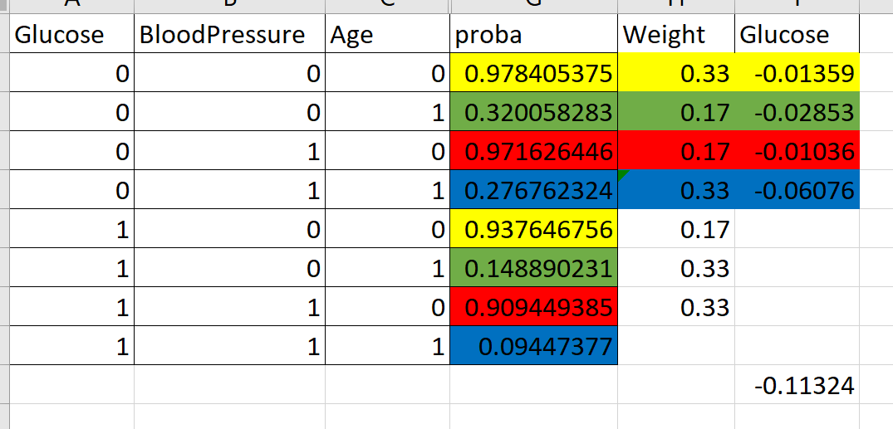
SHAP Kernel

Slide 8
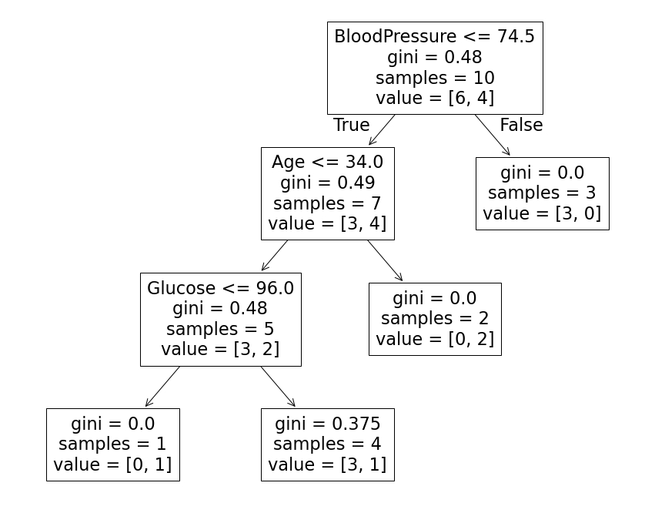
Feature Importance

Slide 9

Feature Importance

Slide 10
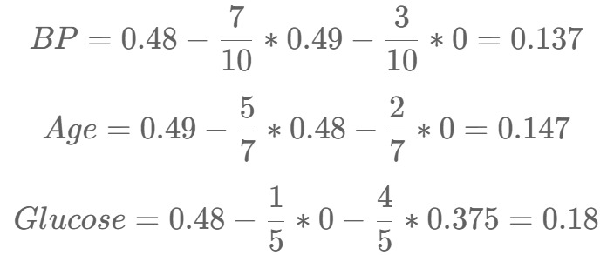


Feature Importance

Slide 11
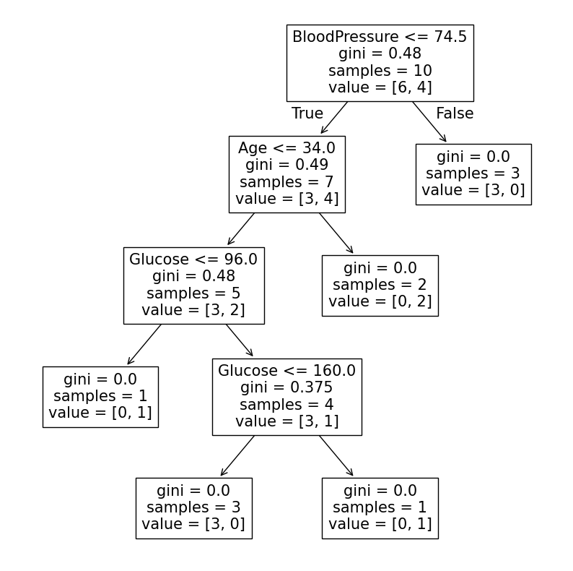
Feature Importance

Slide 12
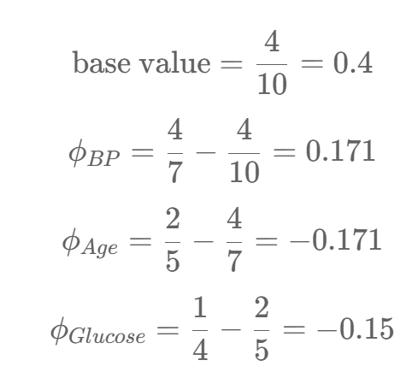
Tree SHAP

