Slide 1
Feature Selection with Filter Methods
Nov 08 2025
Giảng viên: TS. Lưu Phúc Lợi
Email: Luu.p.loi@googlemail.com
Zalo: 0901802182

Slide 2
Content
  Recap of Covariance and Correlation
  Coefficient correlation filter methods: Principle and Process
  Advantage and limitation
  Practice

Slide 3
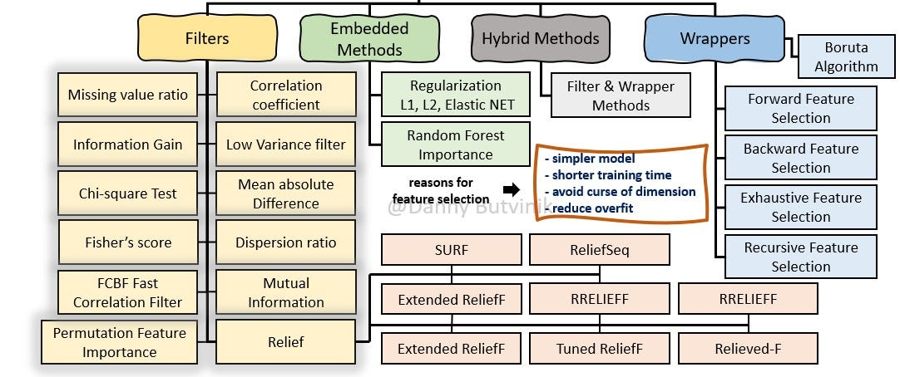
Supervised Feature Selection: Filter Methods
https://medium.com/analytics-vidhya/feature-selection-extended-overview-b58f1d524c1c

Slide 4
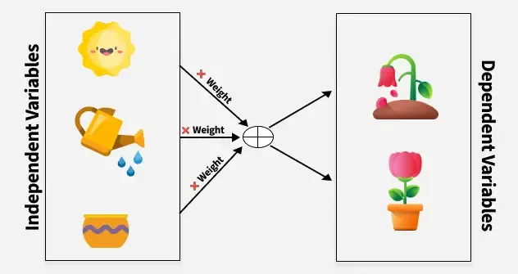
Relationship between Independent and dependent variables
https://www.geeksforgeeks.org/engineering-mathematics/mathematics-covariance-and-correlation/

Slide 5
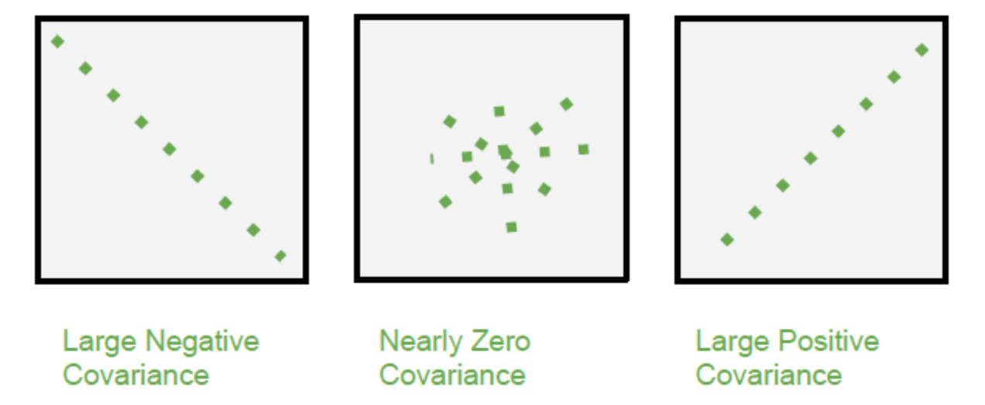
Covariance
It can take any value between - infinity to +infinity, where the negative value represents the negative relationship whereas a positive value represents the positive relationship.
It is used for the linear relationship between variables.
It gives the direction of relationship between variables.

Slide 6
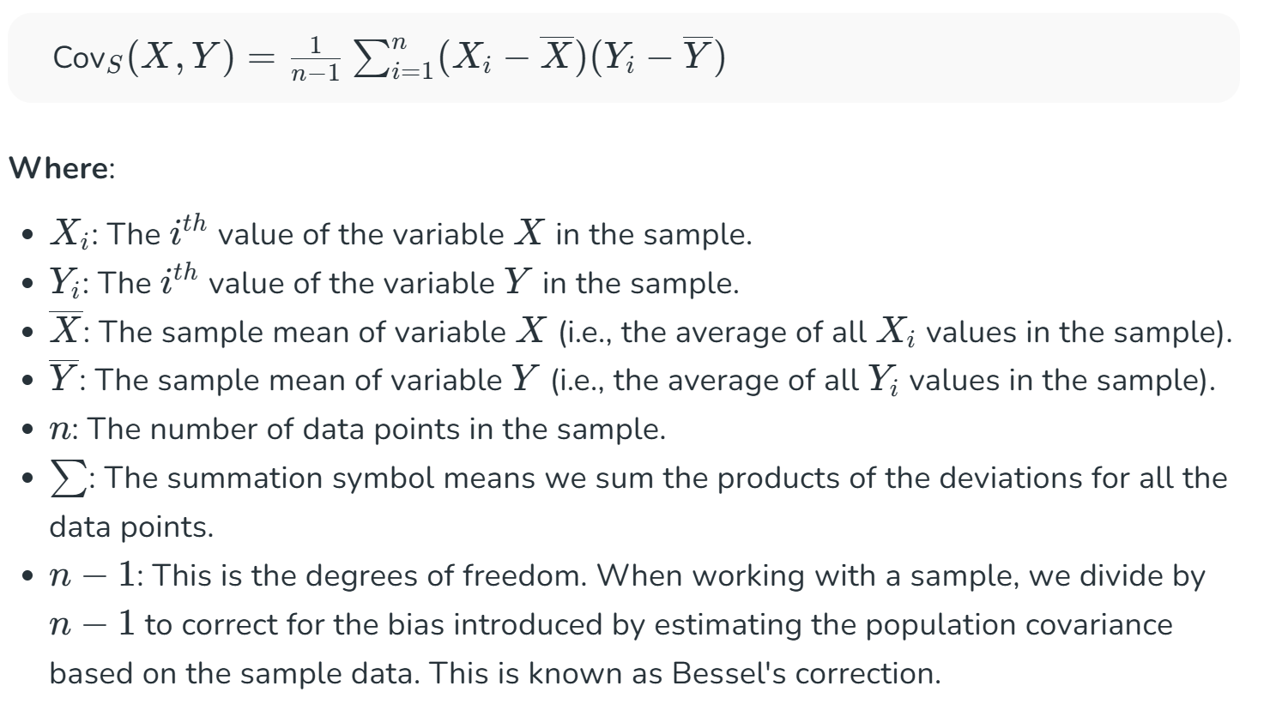
Sample Covariance

Slide 7
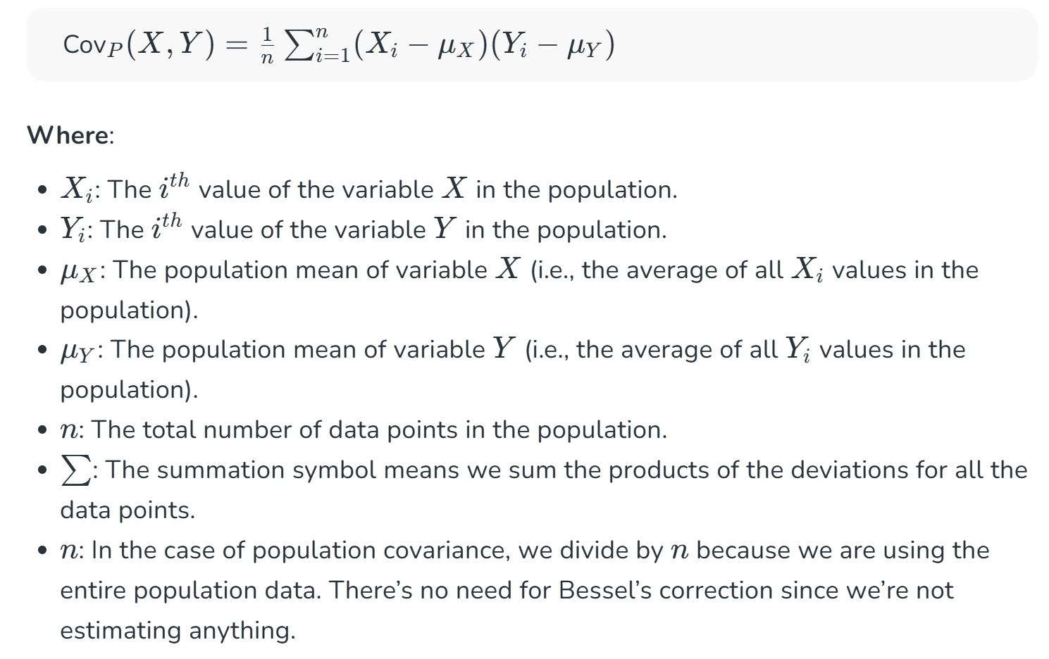
Population Covariance

Slide 8
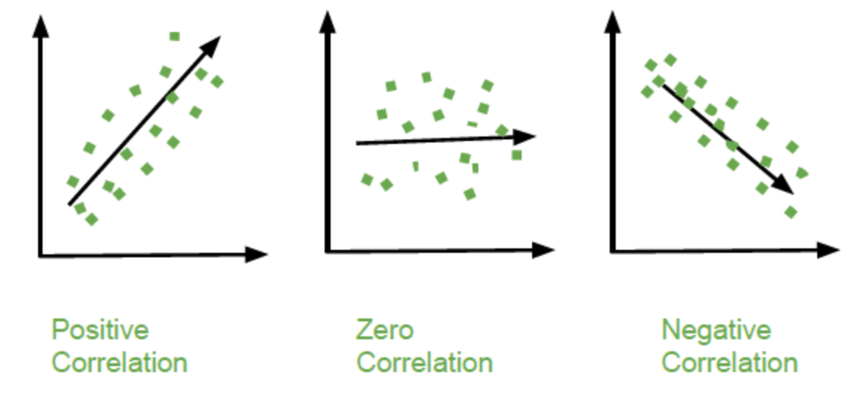
Correlation
Correlation is a standardized measure of the strength and direction of the linear relationship between two variables. It is derived from covariance and ranges between -1 and 1. Unlike covariance, which only indicates the direction of the relationship, correlation provides a standardized measure.
Positive Correlation (close to +1): As one variable increases, the other variable also tends to increase.
Negative Correlation (close to -1): As one variable increases, the other variable tends to decrease.
Zero Correlation: There is no linear relationship between the variables.

Slide 9
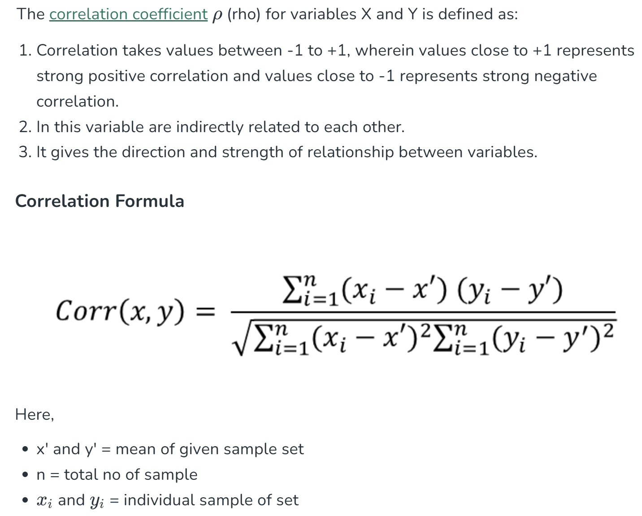
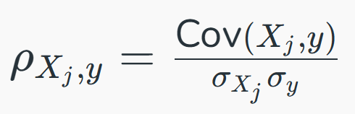
Correlation Coefficient ρ

Slide 10
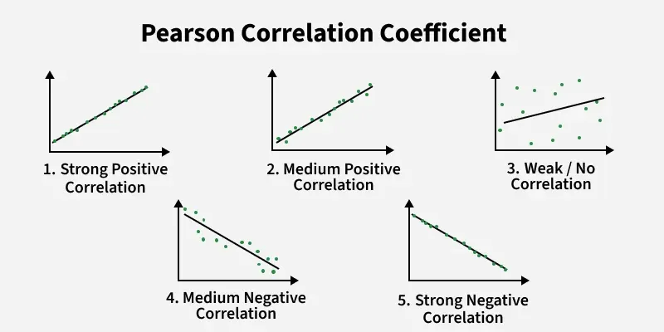
Pearson Correlation Coefficient

Slide 11
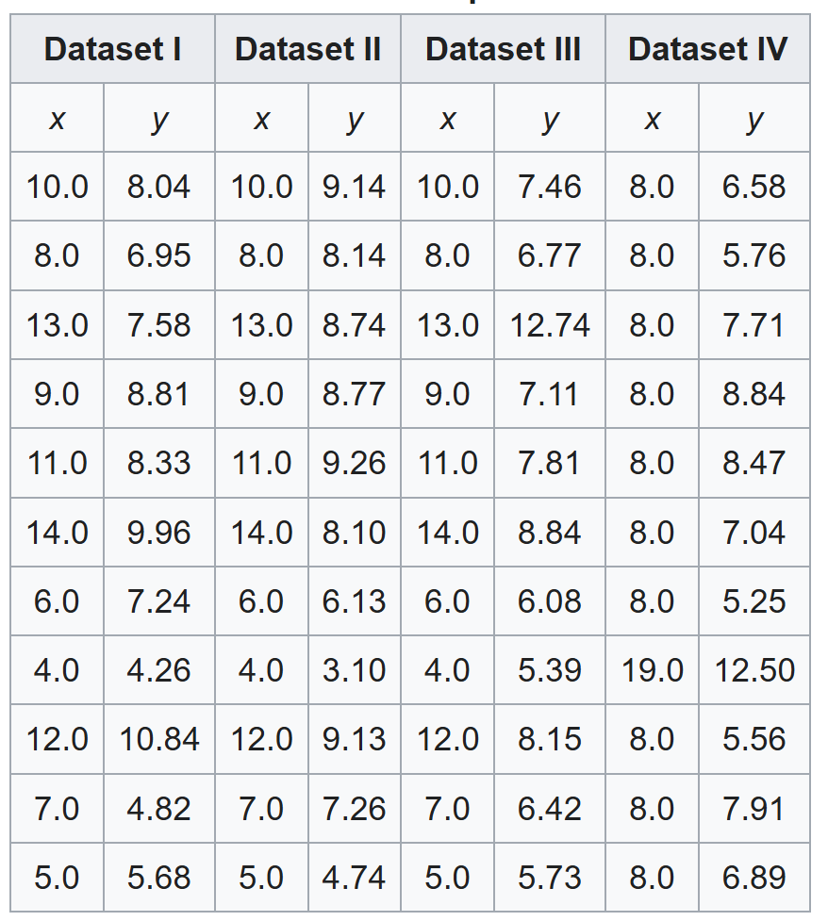
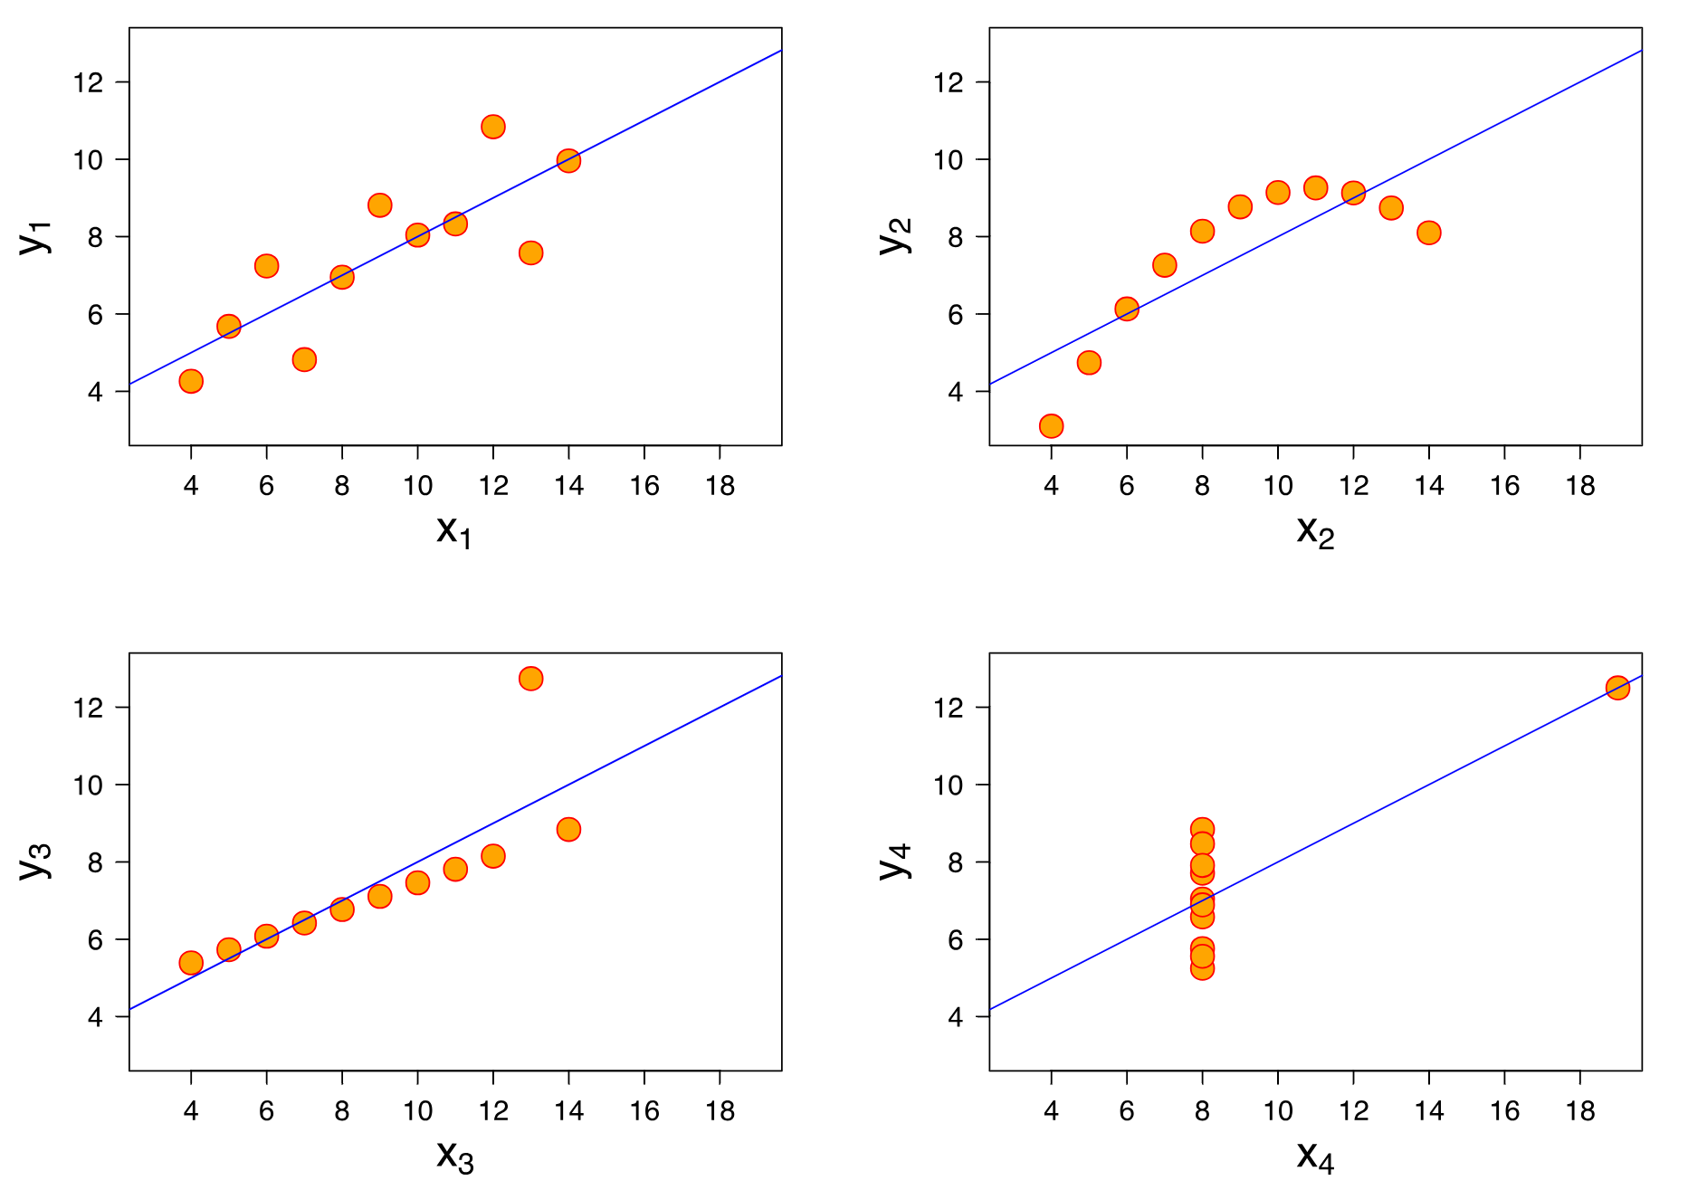
Anscombe's quartet
https://en.wikipedia.org/wiki/Anscombe%27s_quartet

Slide 12
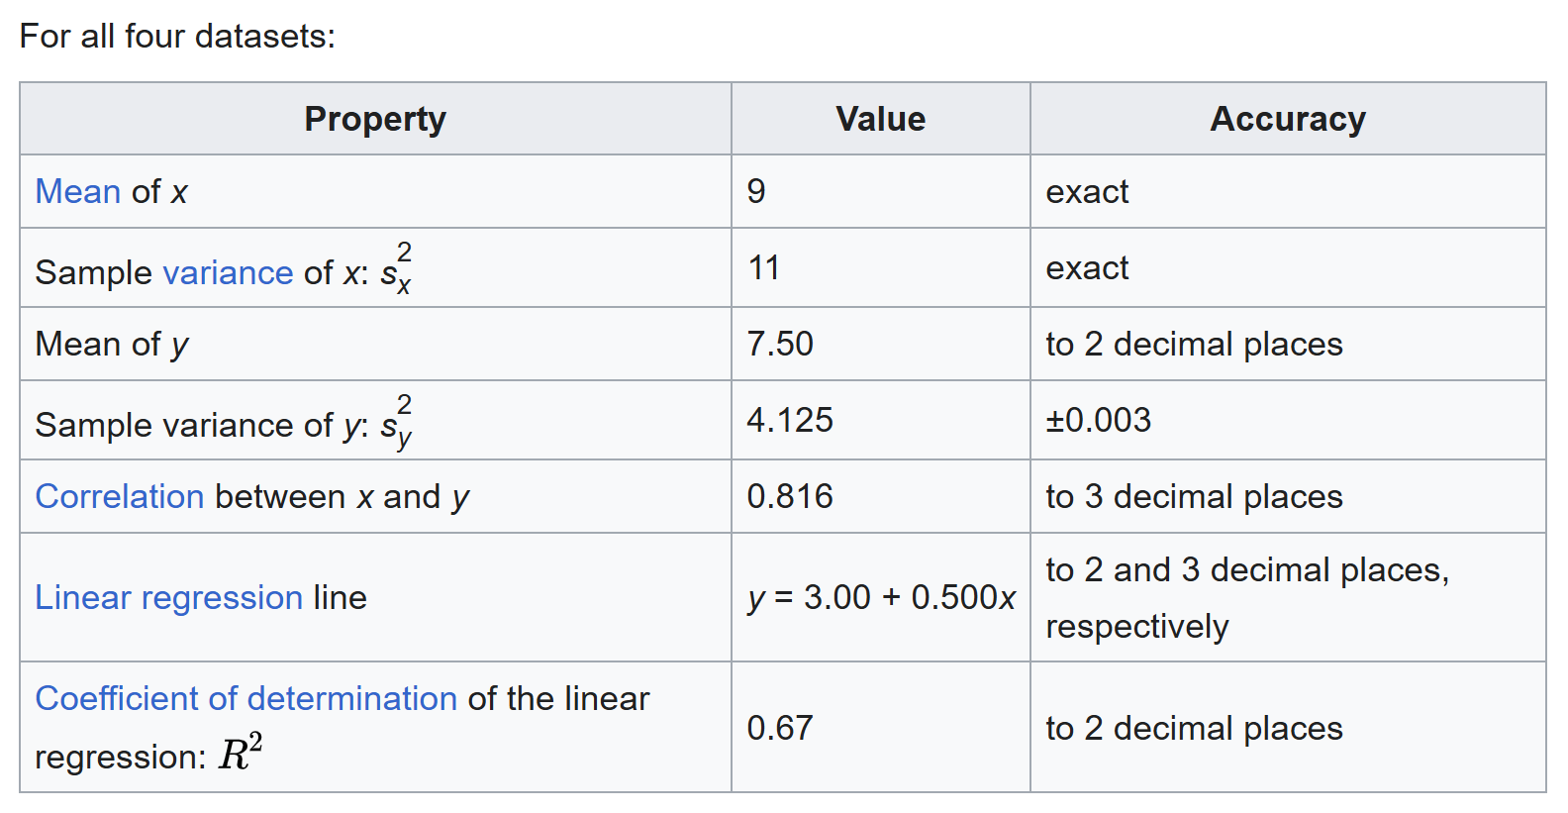
Anscombe's quartet
https://en.wikipedia.org/wiki/Anscombe%27s_quartet

Slide 13
Relationship between Independent and dependent variables
Features
Targets
Or
Response variables
https://www.geeksforgeeks.org/engineering-mathematics/mathematics-covariance-and-correlation/

Slide 14
Coefficient correlation filter methods
Core Principles
Relevance to Target Variable: Features with a strong correlation (positive or negative) to the target variable are considered more relevant and informative for predicting the outcome.
Minimizing Redundancy (Multicollinearity): Highly correlated features among themselves (multicollinearity) can introduce redundancy and potentially hinder model performance. One of the highly correlated features should be removed to reduce this redundancy.

Slide 15
Coefficient correlation filter methods
Calculate Correlation Coefficients
Feature-to-Target Correlation: Calculate the correlation coefficient between each individual feature and the target variable. Pearson correlation is commonly used for continuous variables, while other measures like Spearman correlation or Chi-squared can be used for other data types.
Feature-to-Feature Correlation: Calculate the correlation coefficient between all pairs of features to identify multicollinearity.

Slide 16
Coefficient correlation filter methods
Rank and Select Features (Relevance)
Features are ranked based on the absolute value of their correlation with the target variable.
A threshold can be set, and features exceeding this threshold are selected.

Slide 17
Coefficient correlation filter methods
Address Multicollinearity (Redundancy)
If two or more features are highly correlated with each other, and also with the target variable, a decision is made to remove one of them.
A common strategy is to keep the feature with the higher correlation to the target variable and remove the others

Slide 18
Coefficient correlation filter methods
import pandas as pd
from sklearn.datasets
import make_regression
# Create a synthetic dataset
X, y = make_regression(n_samples=100, n_features=10, random_state=42)
df = pd.DataFrame(X, columns=[f'feature_{i}' for i in range(10)])
df['target'] = y
# Calculate Pearson correlation between features and target
correlations = df.corr()['target'].abs().sort_values(ascending=False)
print("Feature-to-Target Correlations:\n", correlations)
# Select features with a correlation above a threshold (e.g., 0.5)
selected_features_target = correlations[correlations > 0.5].index.tolist()
print("\nSelected features based on target correlation:", selected_features_target)
# Calculate feature-to-feature correlations to address multicollinearity
feature_corr_matrix = df[selected_features_target].corr().abs()
print("\nFeature-to-Feature Correlation Matrix:\n", feature_corr_matrix)
# Example of removing redundant features (manual for demonstration)
# If feature_1 and feature_2 are highly correlated, and feature_1 has higher target correlation, keep feature_1.
# This step often involves a more systematic approach in practice.

Slide 19
Coefficient correlation filter methods
Advantages
  Computational Efficiency: Filter methods are generally faster than wrapper or embedded methods as they don't involve training and evaluating a model repeatedly.
  Generality: They can be applied independently of the chosen machine learning algorithm.
  Interpretability: Correlation coefficients provide a clear understanding of the relationships between variables.
Limitations
  Ignores Feature Interactions: Filter methods do not inherently consider interactions between features, which might be crucial for model performance.
  Suboptimal Feature Subsets: The selected feature subset might not be optimal for a specific learning algorithm, as the selection is independent of the model.

Slide 20
Practice
https://www.datacamp.com/tutorial/tutorial-lasso-ridge-regression
https://medium.com/@agrawalsam1997/feature-selection-using-lasso-regression-10f49c973f08
https://www.blog.trainindata.com/lasso-feature-selection-with-python/

Slide 21
What’s next?
https://medium.com/analytics-vidhya/feature-selection-extended-overview-b58f1d524c1c

Slide 22
Xin chân thành cảm ơn!
Luu Phuc Loi, PhD
Zalo: 0901802182
luu.p.loi@googlemail.com

