Slide 1
XAI

Slide 2
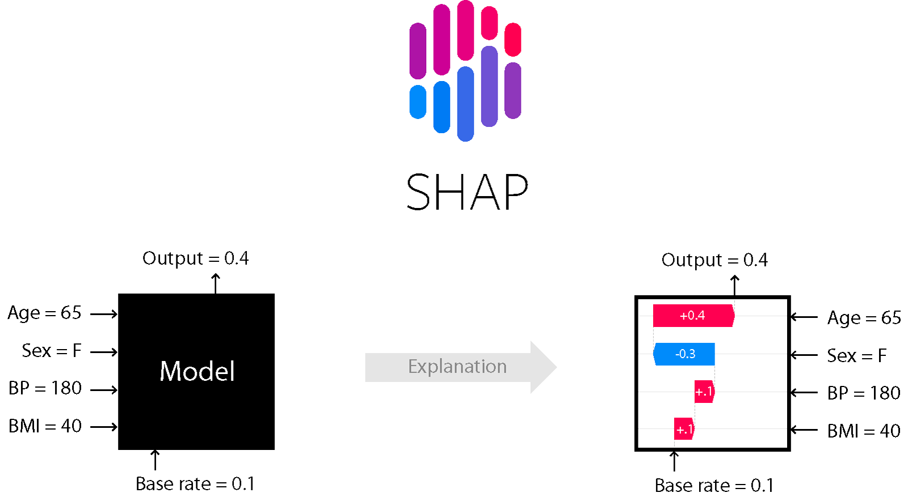
SHAP
SHapley Additive exPlanations

Slide 3
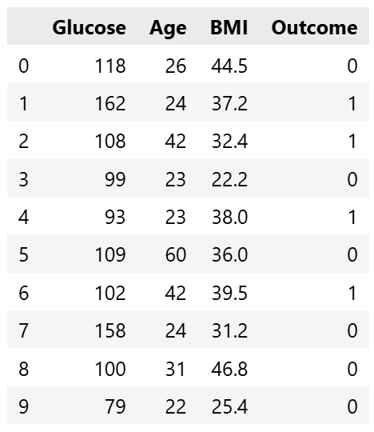
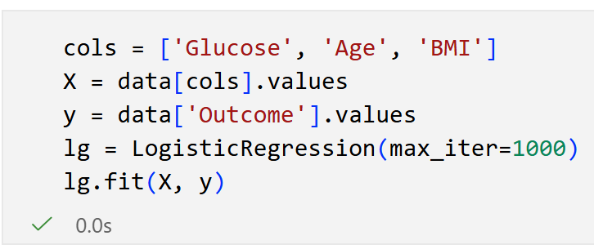
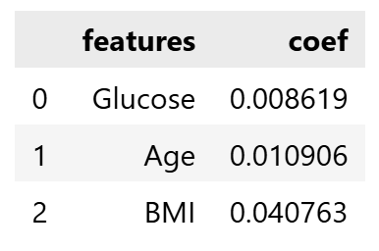
LinearExplainer

Slide 4
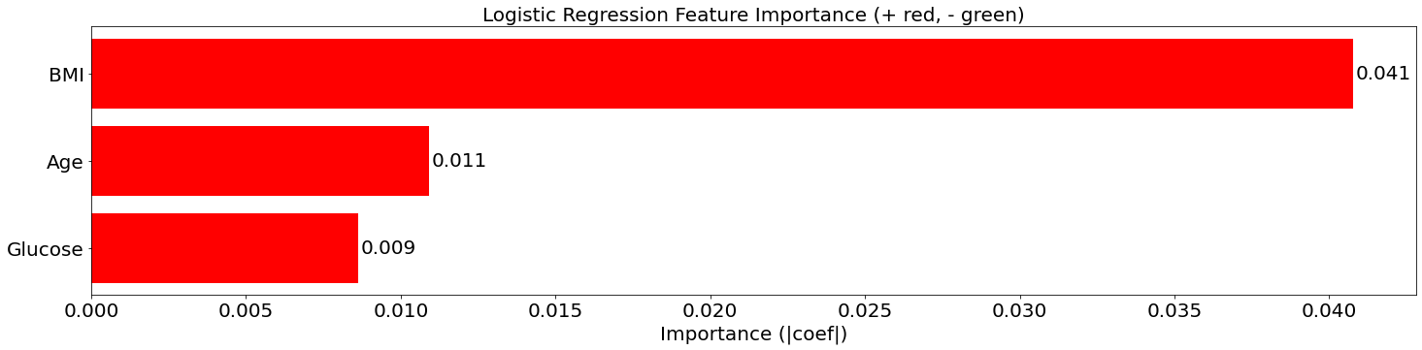
Linear Explainer

Slide 5
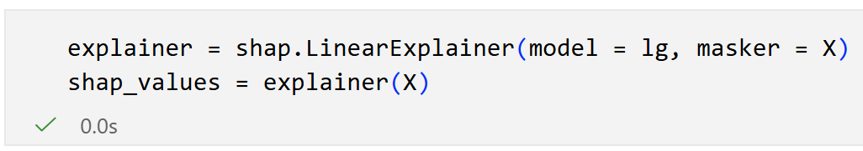
Linear Explainer

Slide 6
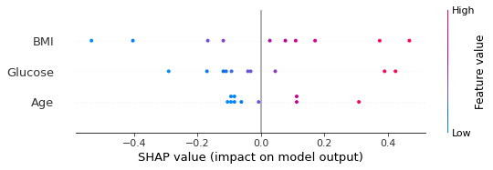
Beeswarm Plot

Slide 7
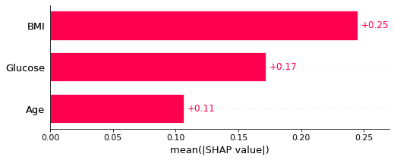
Summary Plot

Slide 8
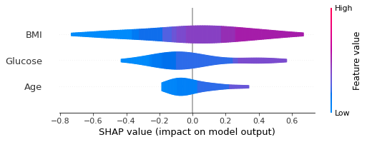
Violin plot

Slide 9
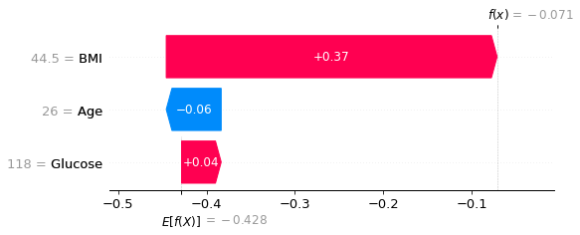
Waterfall Plot
shap.plots.waterfall(shap_values[0])

Slide 10
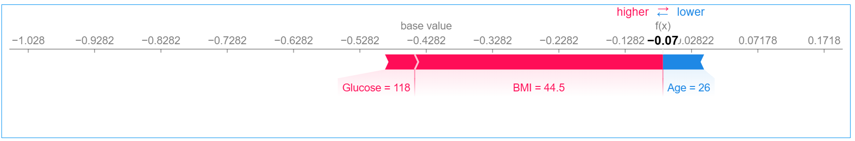
Force Plot
shap.plots.force(shap_values[0])

Slide 11
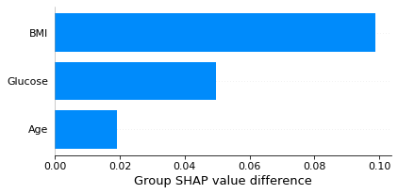
Difference Group Plot
masked = data['Outcome'] == 1
masked = masked.values
shap.plots.group_difference(shap_values = shap_values.values, group_mask = masked,
feature_names = cols)

