Slide 1
Autocorrelation and Moran’I
Nov 21 2025
Giảng viên: TS. Lưu Phúc Lợi
Email: Luu.p.loi@googlemail.com
Zalo: 0901802182

Slide 2
Content
What is Spatial Autocorrelation?
What is Moran’I?
How to compute Moran’I?
Applications of Autocorrelation
Practice

Slide 3
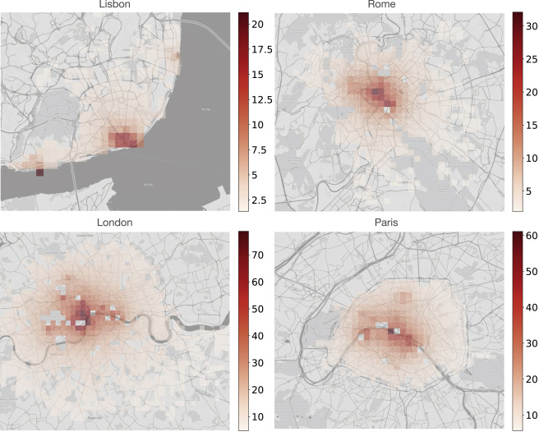
Comment on the plot
The Fig. presents heatmaps for mean values of attr_index.
The maps show the concentration of attractions in the city centre: in general, the listings in central areas have a higher accessibility of attractions; while further from the centre, the index values decline.
Attraction index in selected cities
https://www.sciencedirect.com/science/article/pii/S0261517721000388

Slide 4
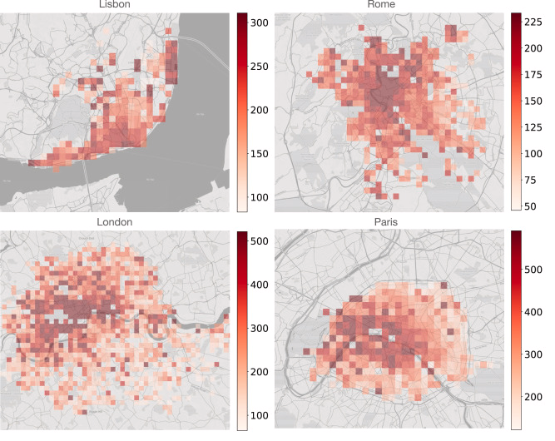
Comment on the linked plots
Attraction index in selected cities
Mean Airbnb prices (in EUR).

Slide 5
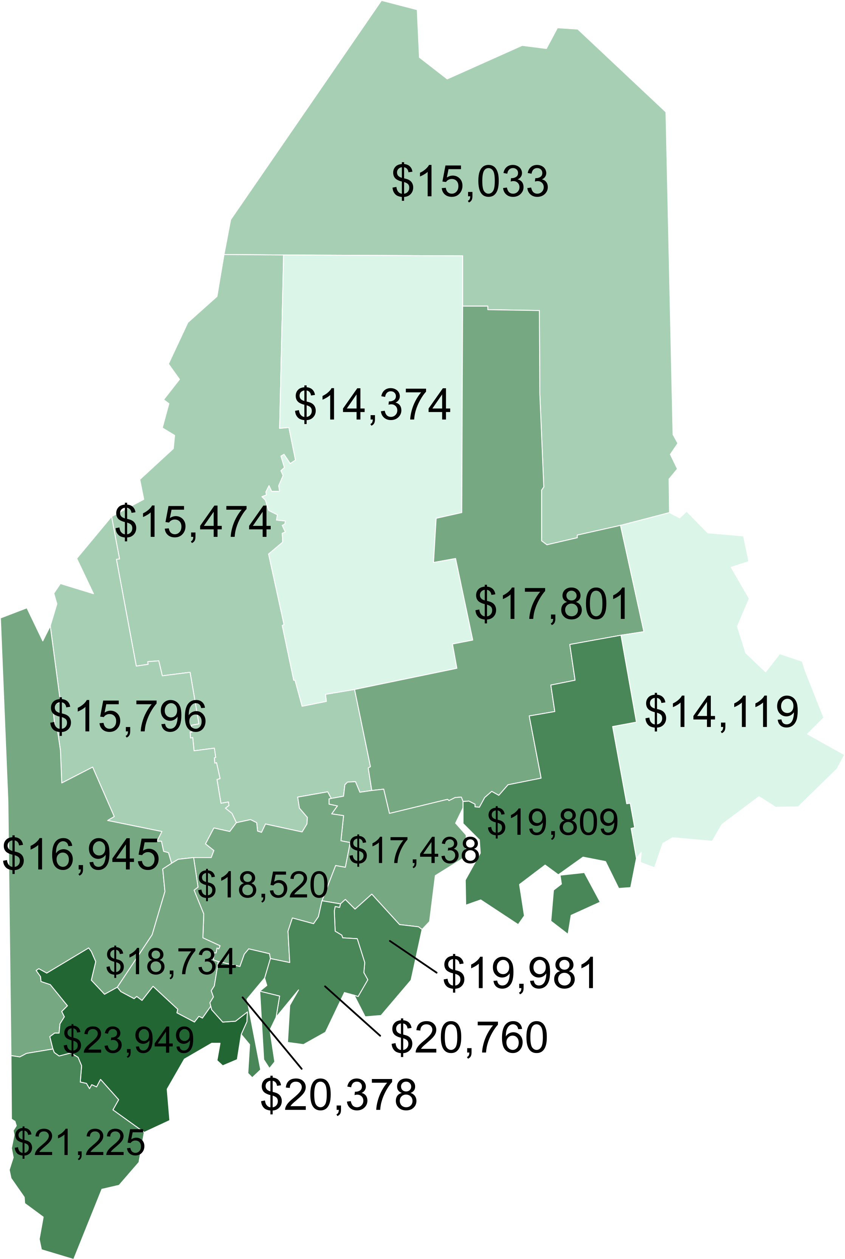
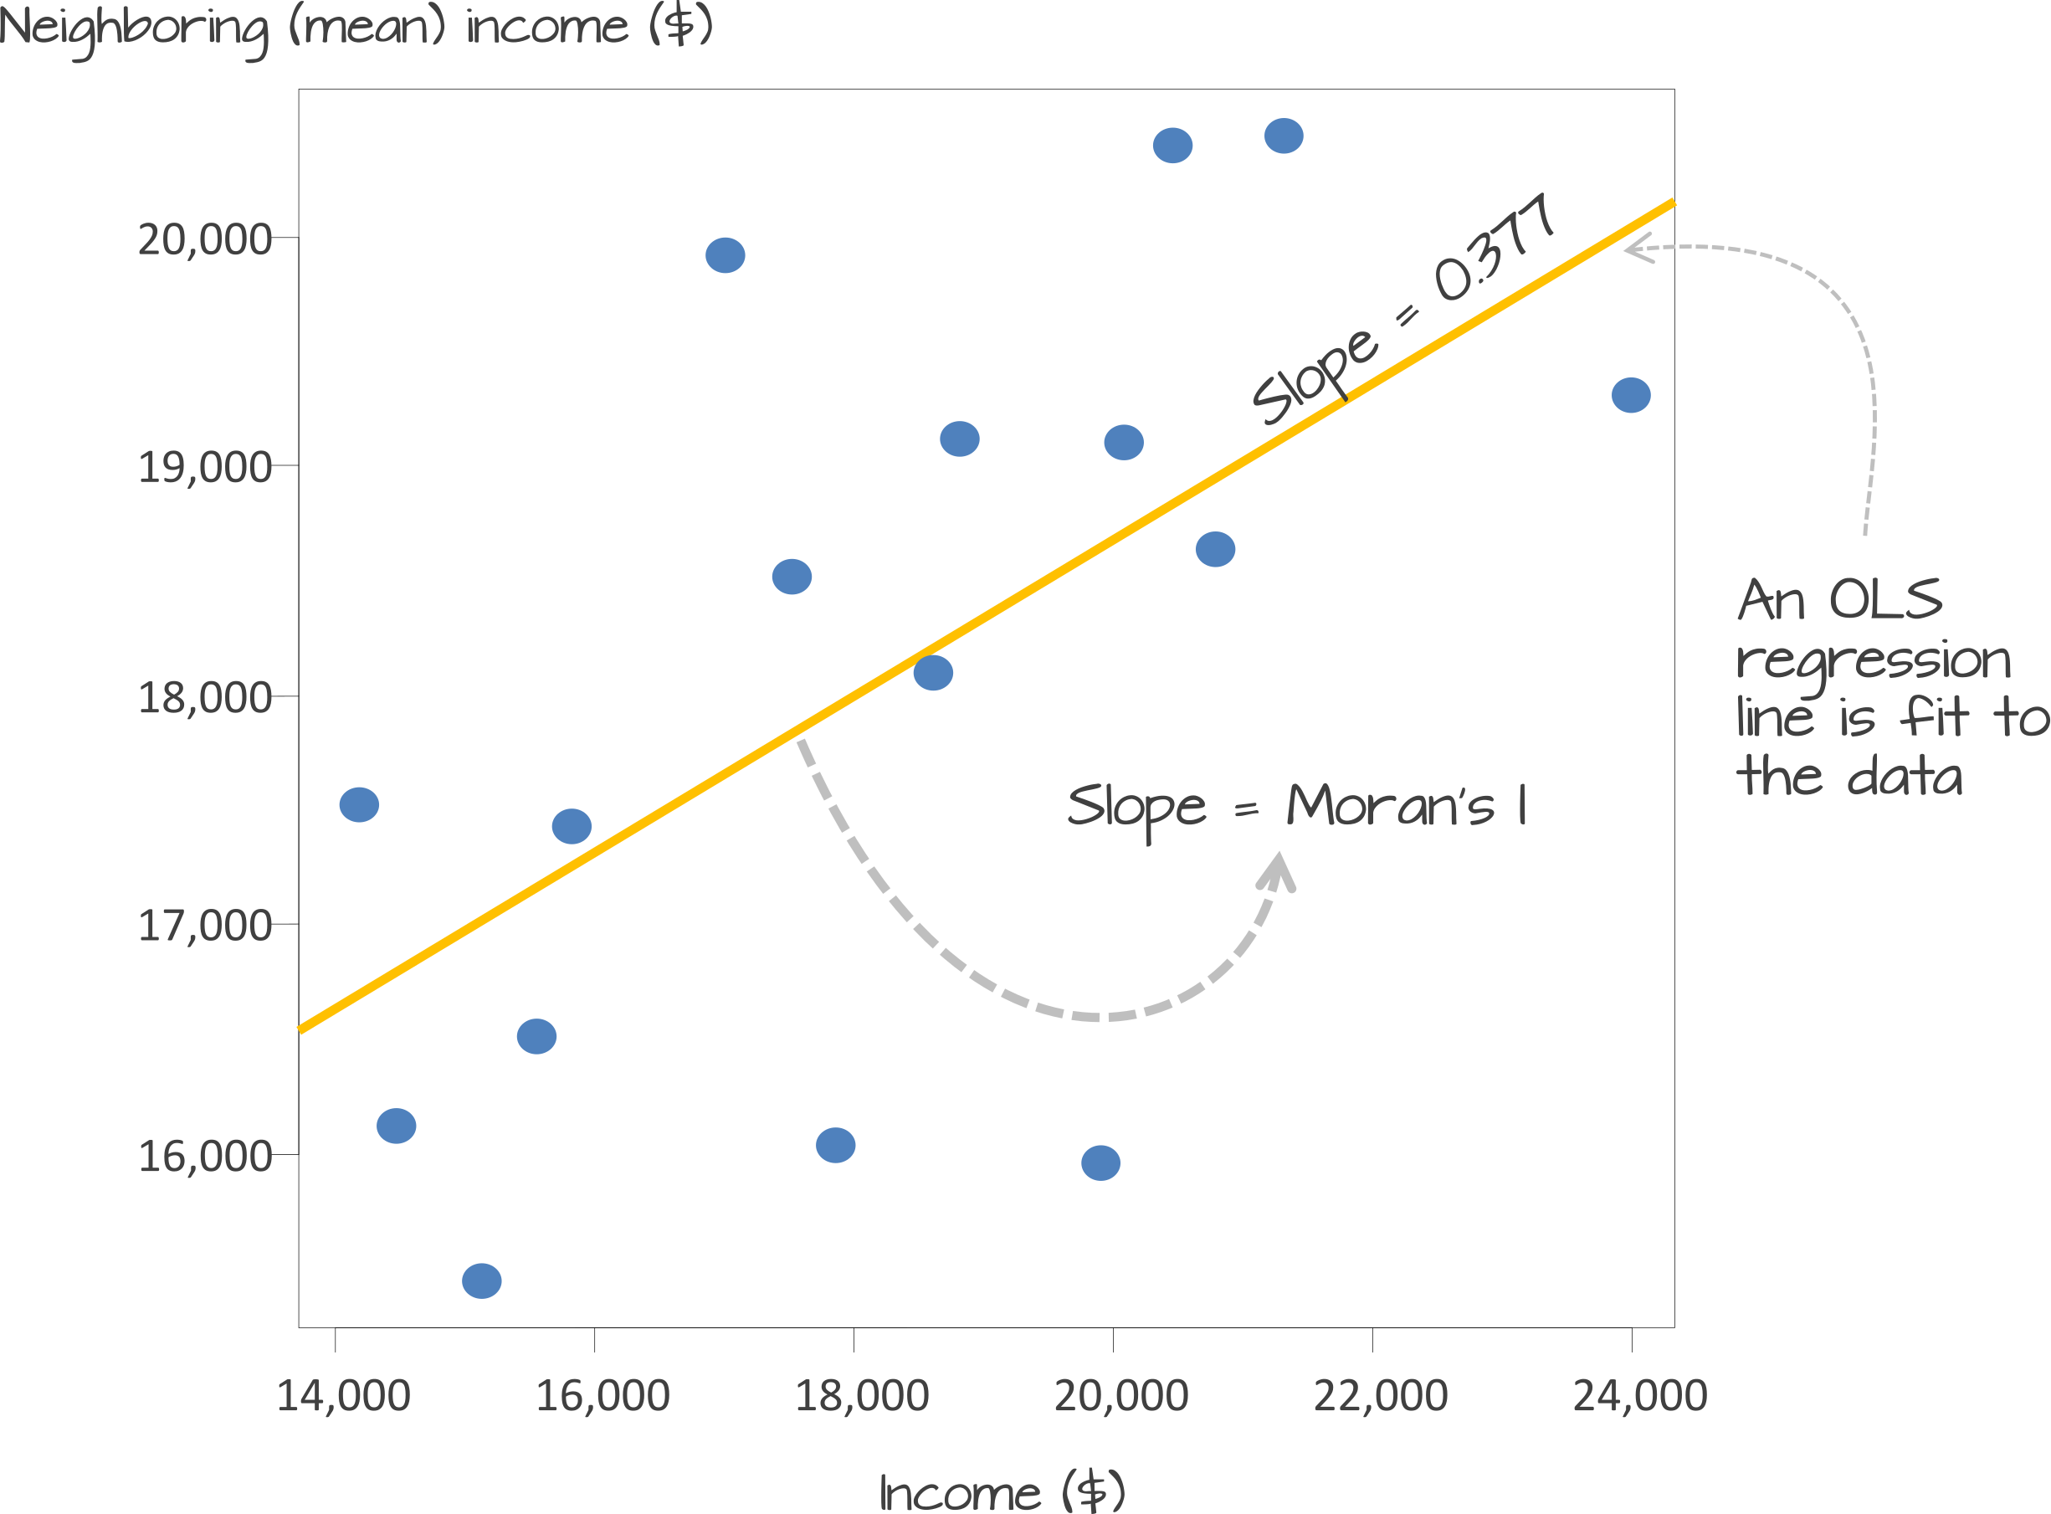
How to quantify autocorrelation? (The Moran’s I)

Slide 6
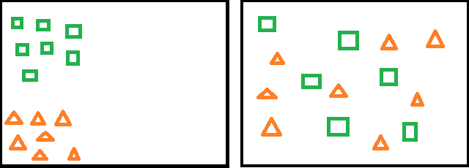
Comment on the below plots

Slide 7
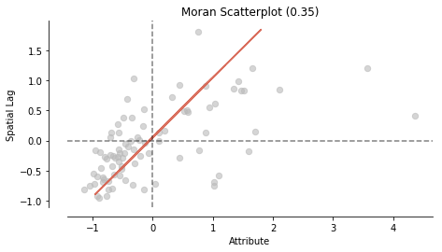
Understanding the Moran’s I plot

Slide 8
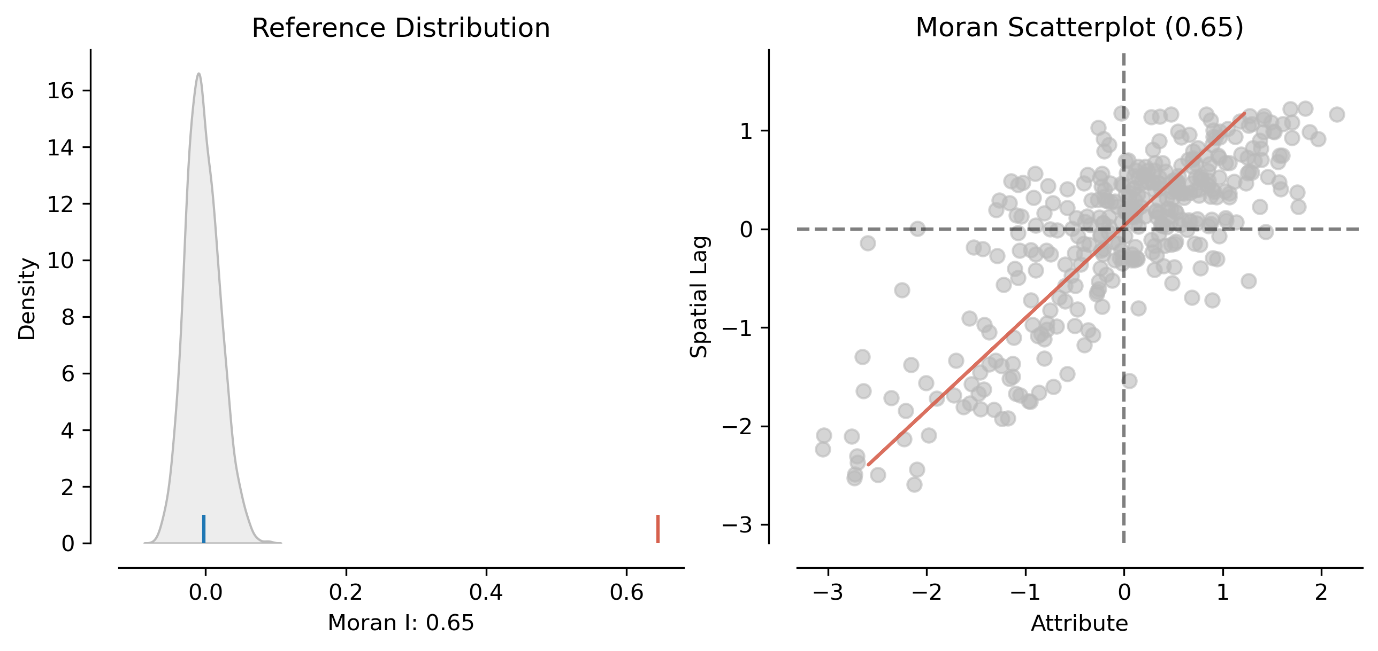
Practice
https://geographicdata.science/book/notebooks/06_spatial_autocorrelation.html

Slide 9
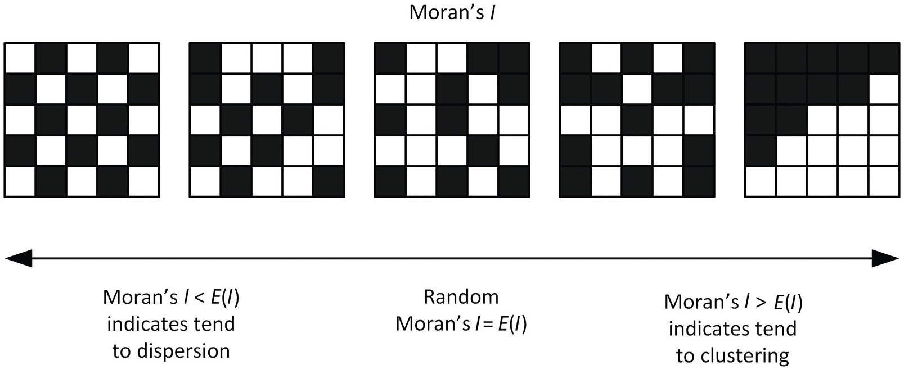
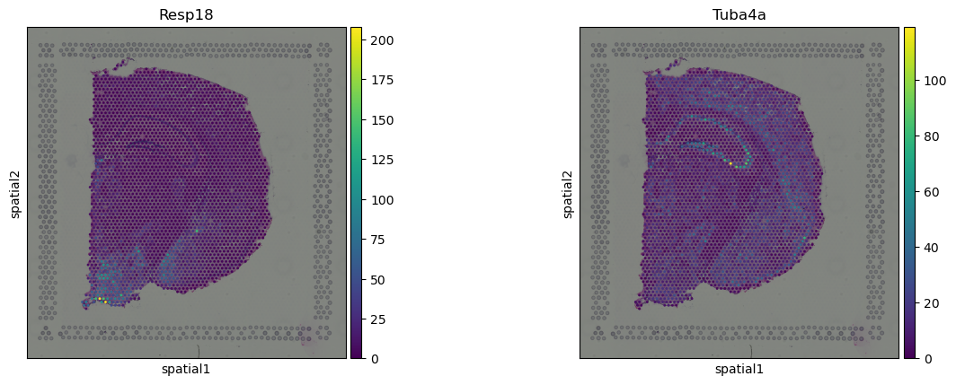
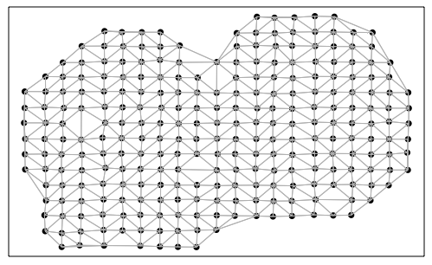
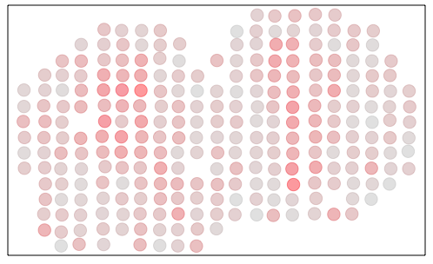
https://jef.works/blog/2024/08/29/the-many-ways-to-detect-svgs-using-moransI/

Slide 10
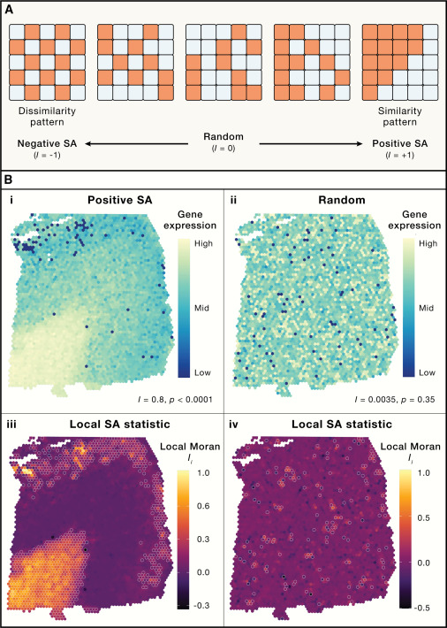
Spatial autocorrelation highlights regions of statistical similarity in gene-wise expression
(A) A simulated example of spatial autocorrelation (SA) for binary data associated with Moran’s I statistics. The leftmost panel shows perfect dispersion or dissimilarity, corresponding to a Moran’s I of −1. The center panel shows a random spatial distribution, corresponding to Moran’s I of 0. The rightmost panel shows perfect spatial autocorrelation, clustering, or similarity, corresponding to a Moran’s I of +1.
(B) Examples of SA from tissue measurements of gene expression. (i) Positive SA (I = 0.8): notice how high values cluster in one corner of the tissue while low values are highly localized. (ii) The same observations but randomly distributed over space (I ≈ 0). (iii) The local Moran’s Ii (LISA) for the variable in (i). Here, the local statistic provides a more detailed representation of SA over space, revealing locations with high SA. Significant locations (p < 0.05) are highlighted with a white border. (iv) The local significance of the local Moran’s Ii (LISA) in (ii). Significant locations (p < 0.05) are highlighted with a white border.
https://www.cell.com/cell/fulltext/S0092-8674(23)01219-9

Slide 11
Example applications
The following are example applications of the tool:
Identify an appropriate neighborhood distance for a variety of spatial analysis methods by finding the distance where spatial autocorrelation is strongest.
Measure broad trends in ethnic or racial segregation over time—is segregation increasing or decreasing?
Summarize the diffusion of an idea, disease, or trend over space and time—is the idea, disease, or trend remaining isolated and concentrated, or spreading and becoming more diffuse?
https://pro.arcgis.com/en/pro-app/latest/tool-reference/spatial-statistics/h-how-spatial-autocorrelation-moran-s-i-spatial-st.htm

Slide 12
Xin chân thành cảm ơn!
Luu Phuc Loi, PhD
Zalo: 0901802182
luu.p.loi@googlemail.com

