Slide 1
ChIP-seq for Histone modifications, Transcription Factor Binding Sides, ChromHMM, DNAaseI Hypersensitivity And ATAC-seq Analysis
April 18 2026
Phuc-Loi Luu, PhD

Slide 2
Content
Dnase-seq for Chromatin Accessibility and TF footprints
ATAC-seq
ChIP-seq for Histone modifications and TFBSs & ChromHMM
Reading the output of ChIP-Seq and ATAC-seq

Slide 3
Dnase-seq for Chromatin Accessibility and TF footprints

Slide 4
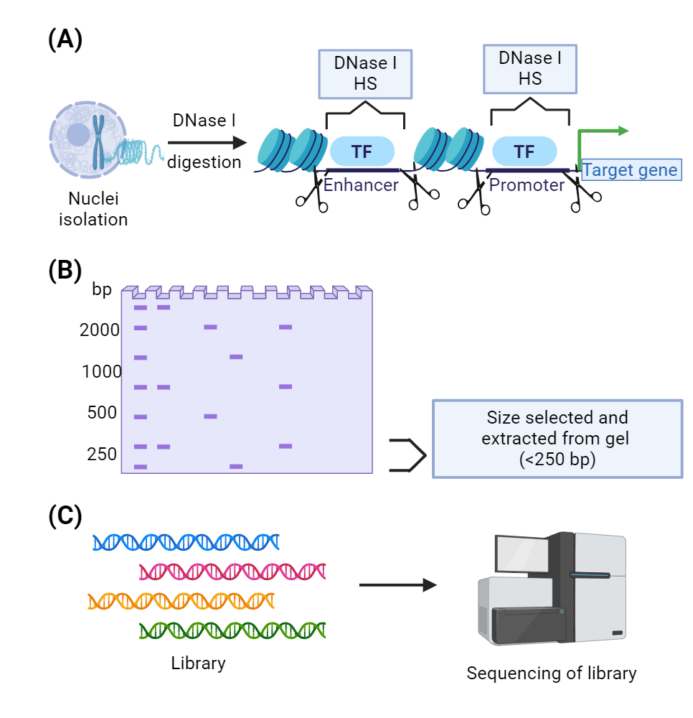
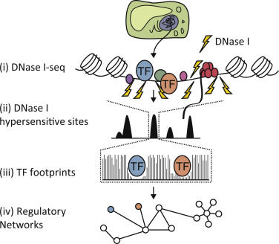
https://www.biorender.com/template/dnase-seq
https://www.sciencedirect.com/science/article/pii/S2214662815000122

Slide 5
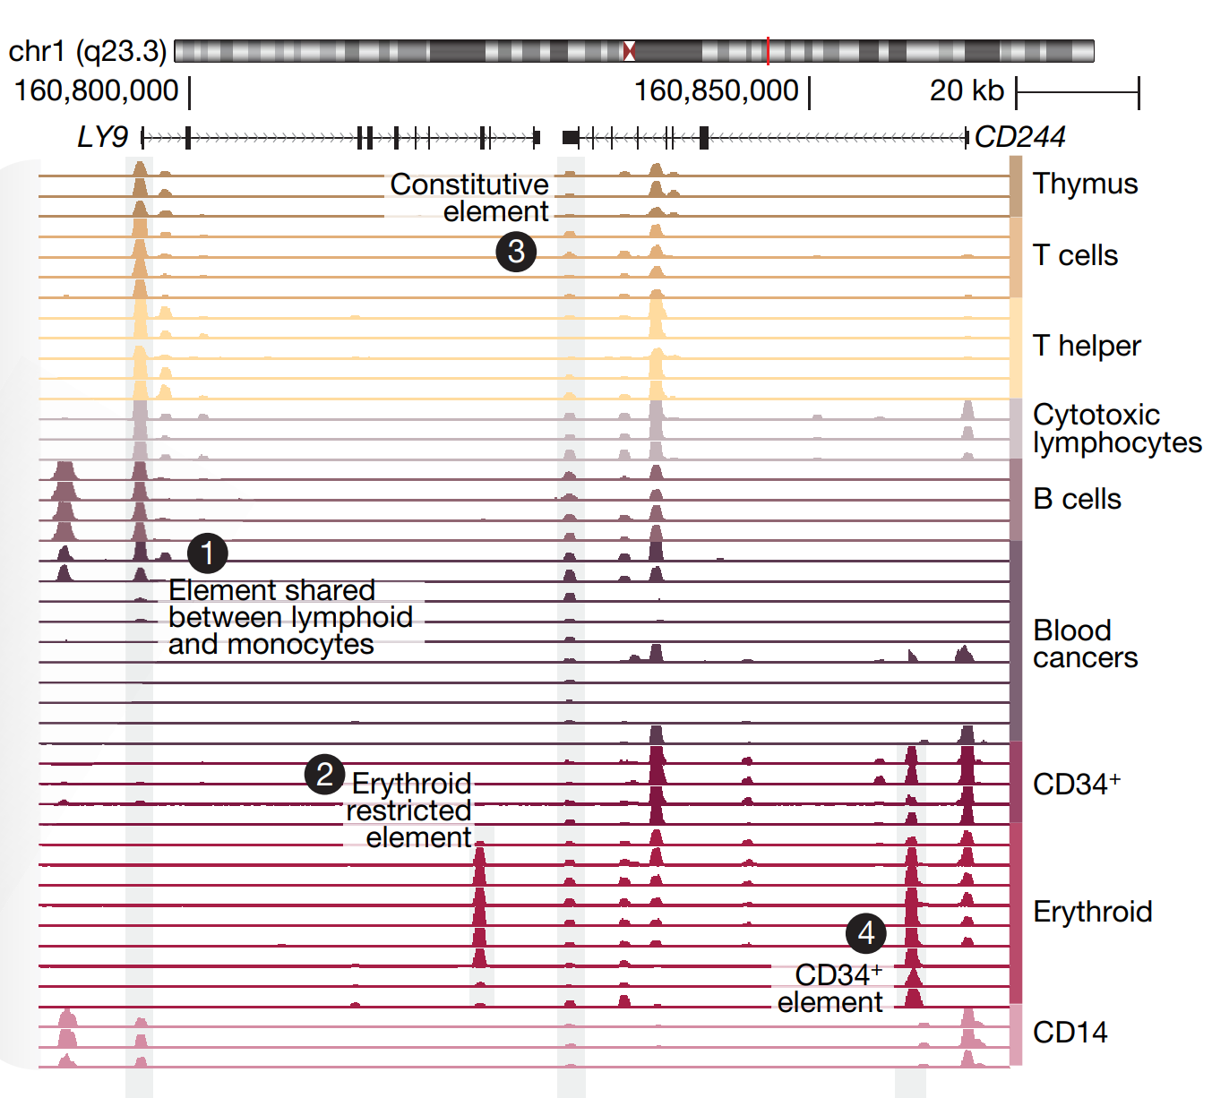
https://doi.org/10.1038/s41586-020-2559-3

Slide 6
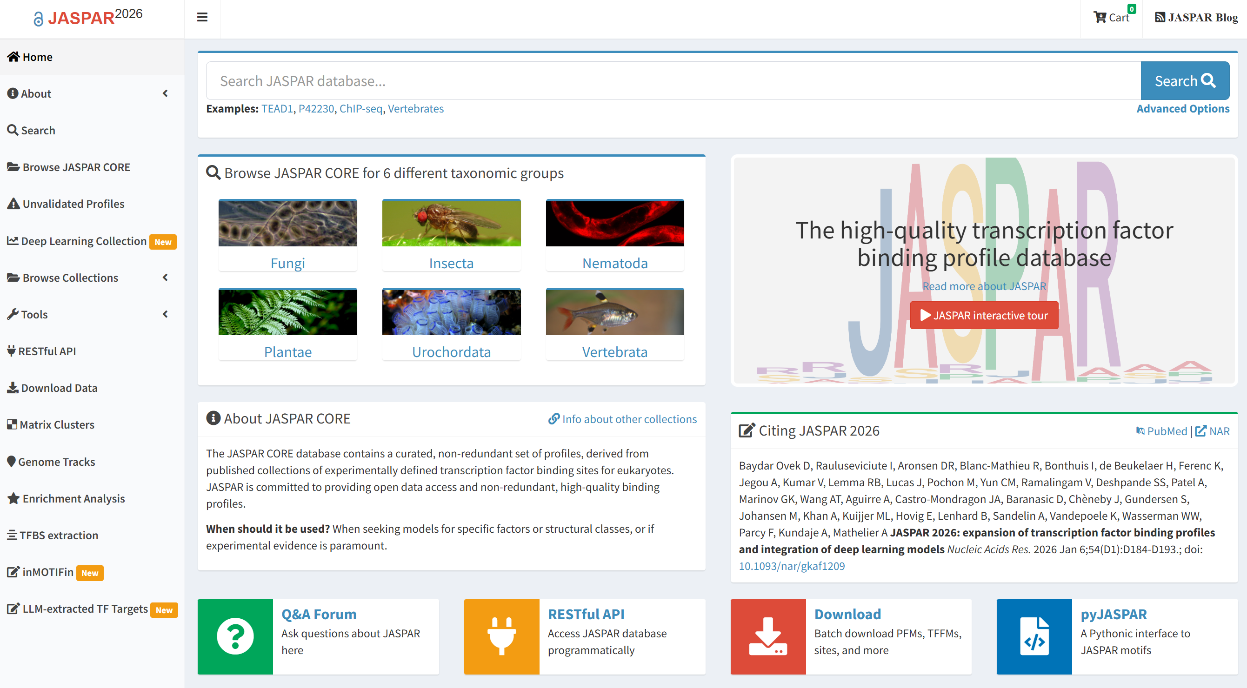
https://jaspar.elixir.no/

Slide 7
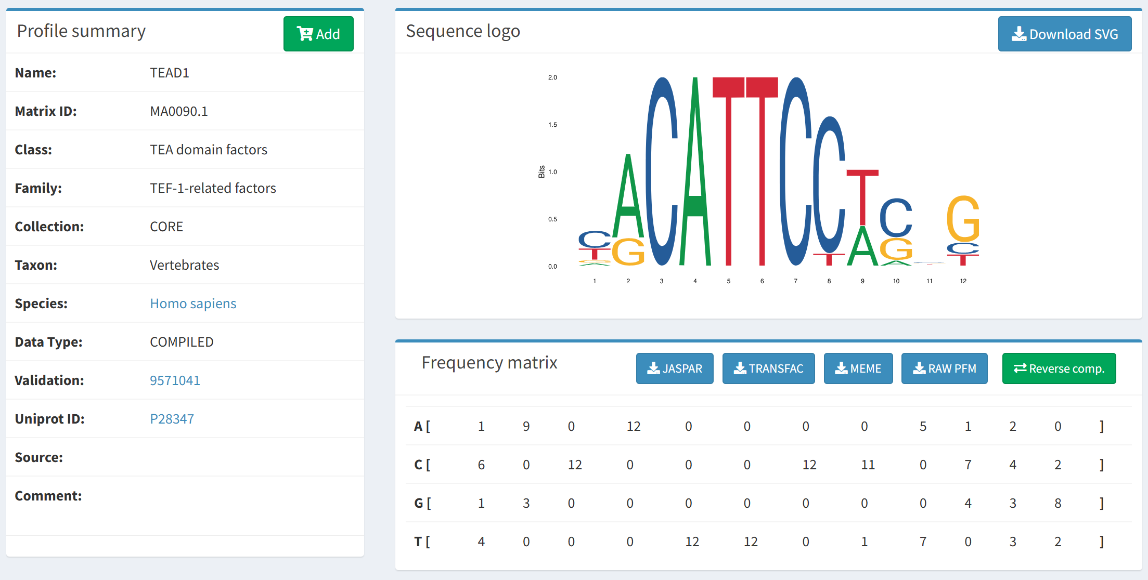
https://jaspar.elixir.no/matrix/MA0090.1/

Slide 8
ATAC-seq

Slide 9
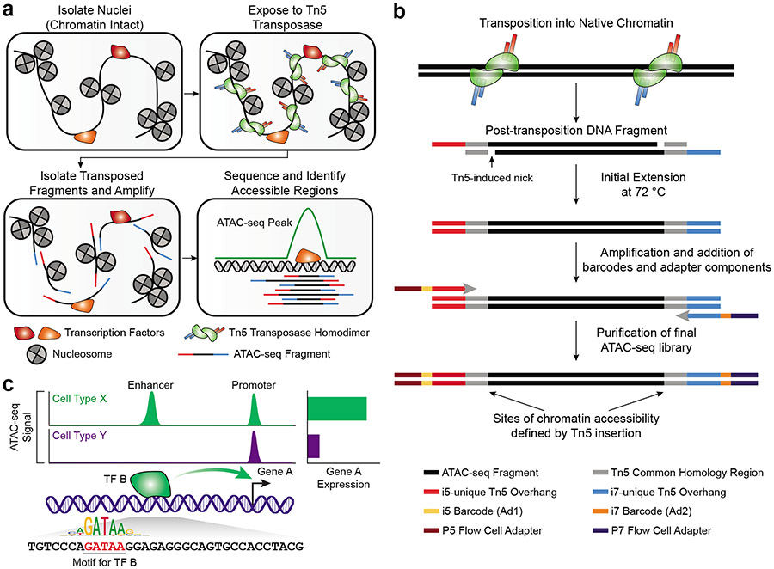
ATAC-seq
https://pubmed.ncbi.nlm.nih.gov/35478247/

Slide 10
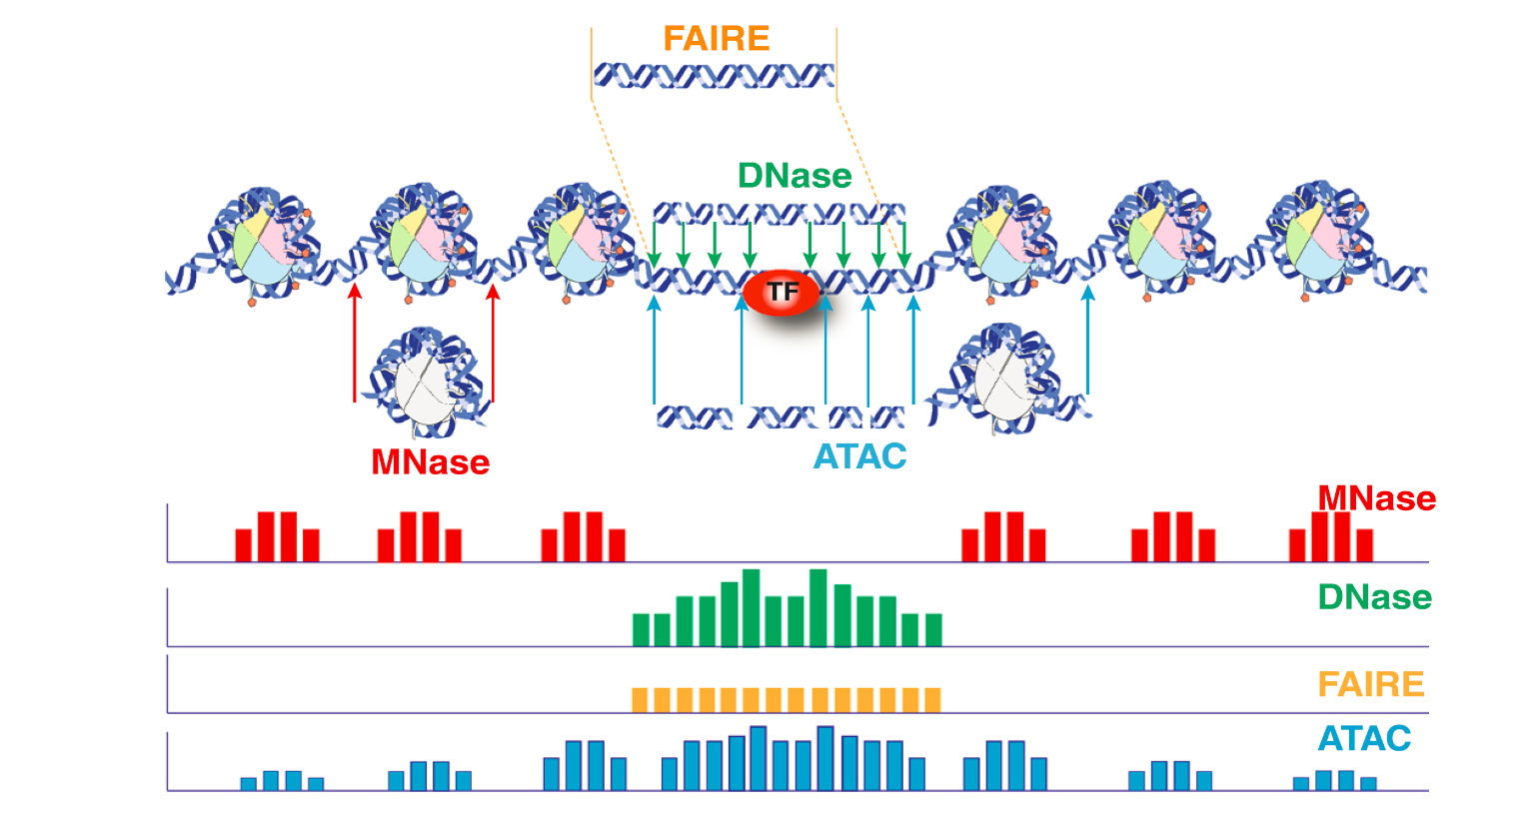
ATAC-seq
https://haibol2016.github.io/ATACseqQCWorkshop/articles/ATACseqQC_workshop.html

Slide 11
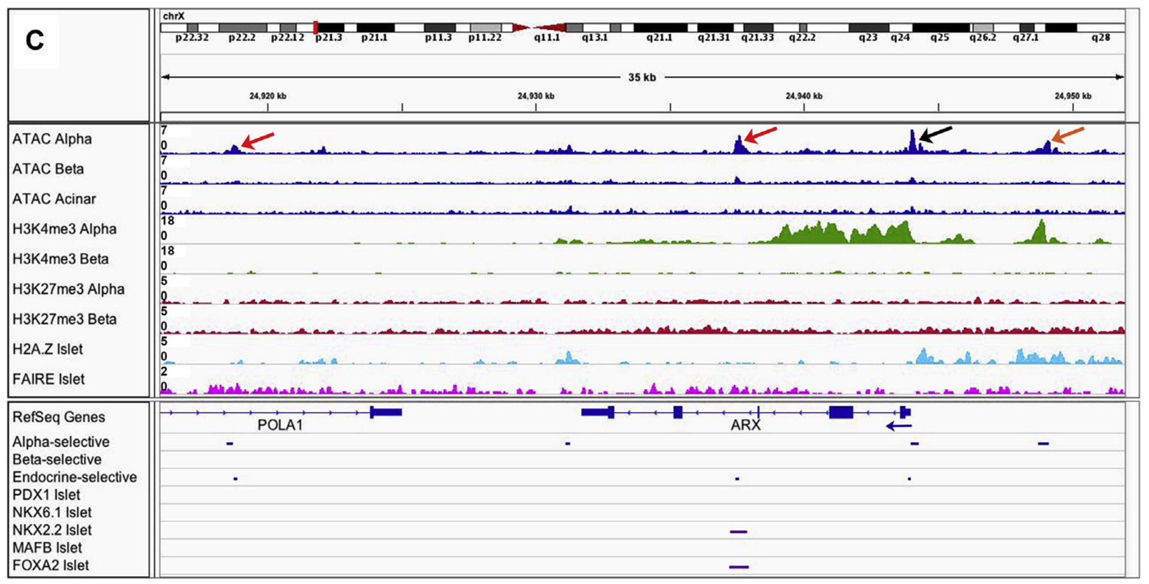
Reading the output of ATAC-seq
https://doi.org/10.1016/j.molmet.2016.01.002

Slide 12
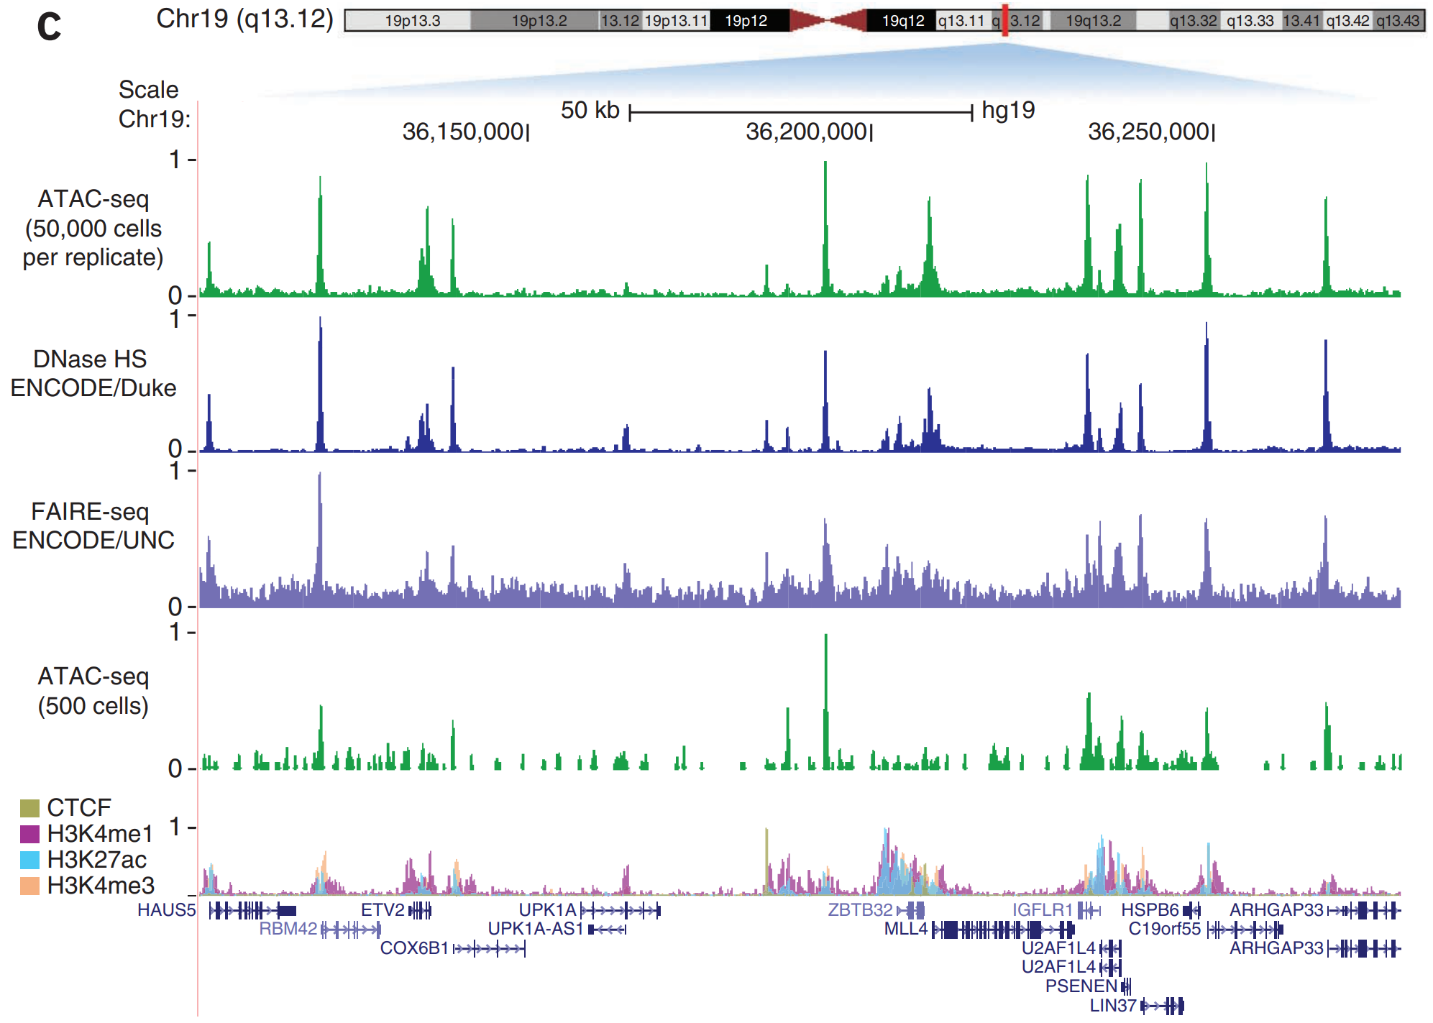
http://www.nature.com/doifinder/10.1038/nmeth.2688

Slide 13
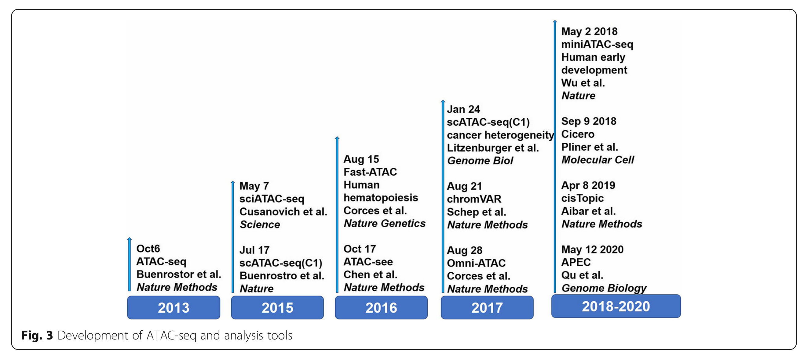
https://doi.org/10.1186/s43556-020-00009-w

Slide 14
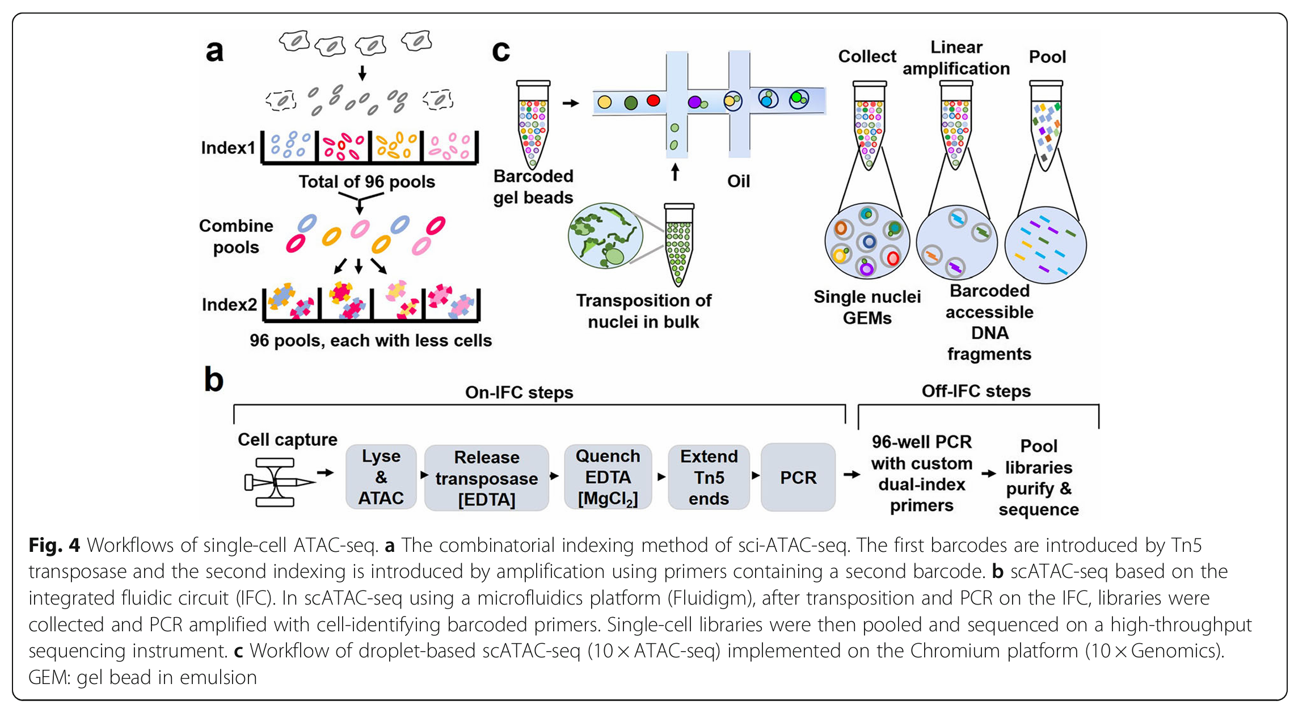

Slide 15
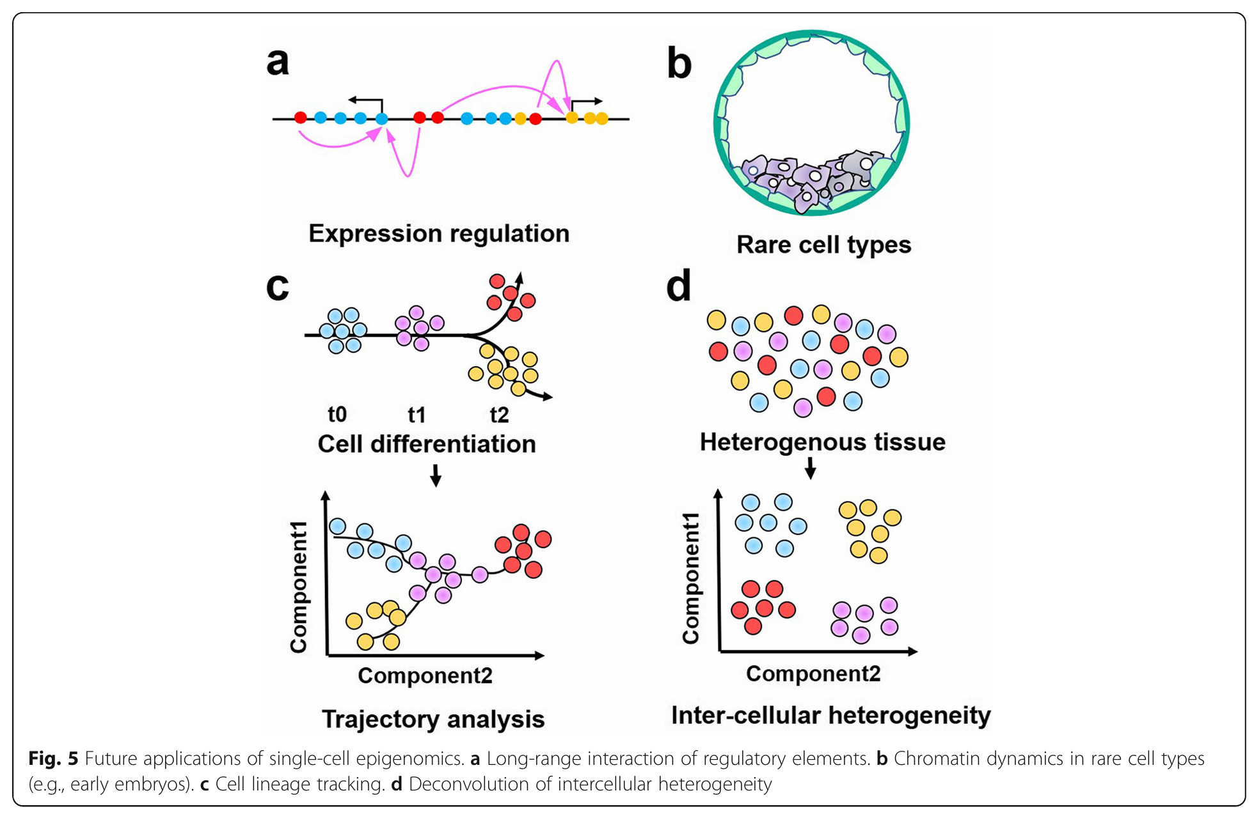

Slide 16
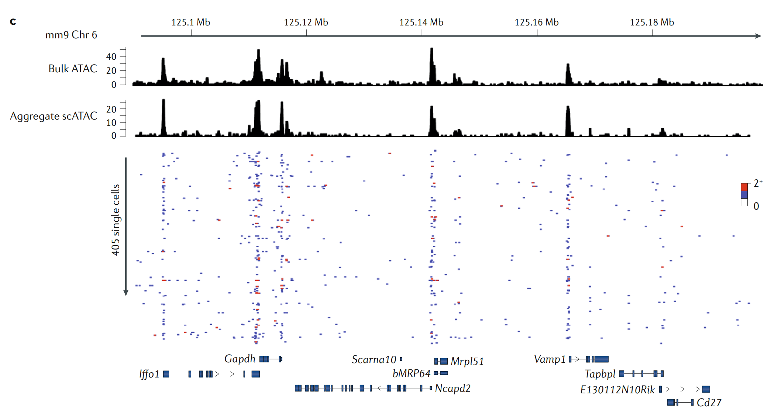
Population-scale measurements of chromatin accessibility reflect the average accessibility of a heterogeneous collection of single molecules
https://www.nature.com/articles/s41576-018-0089-8

Slide 17
ChIP-seq for Histone modifications and TFBSs & ChromHMM

Slide 18
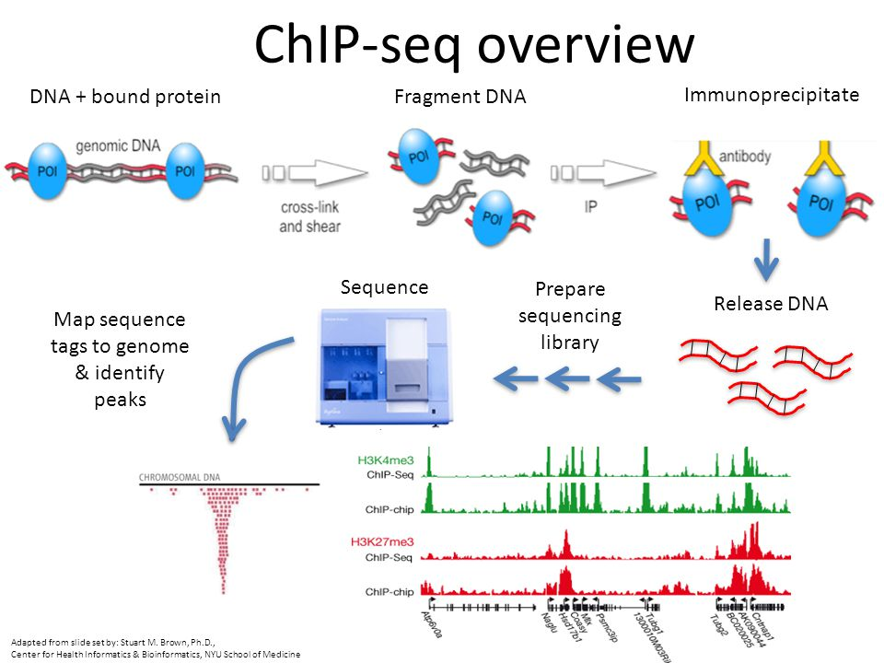
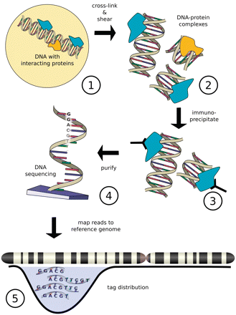
Figure from Szalkowski, A.M, and Schmid, C.D.(2010). Rapid innovation in ChIP-seq peak-calling algorithms is outdistancing banchmarking efforts. Briefings in Bioinfomatics.

Slide 19
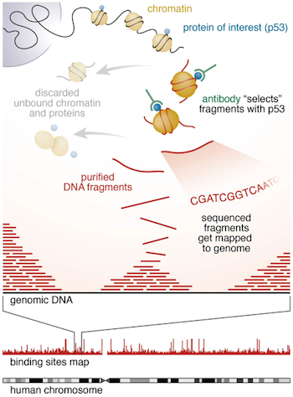
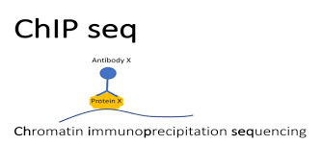
https://hbctraining.github.io/Intro-to-ChIPseq/lessons/01_Intro_chipseq_data_organization.html

Slide 20
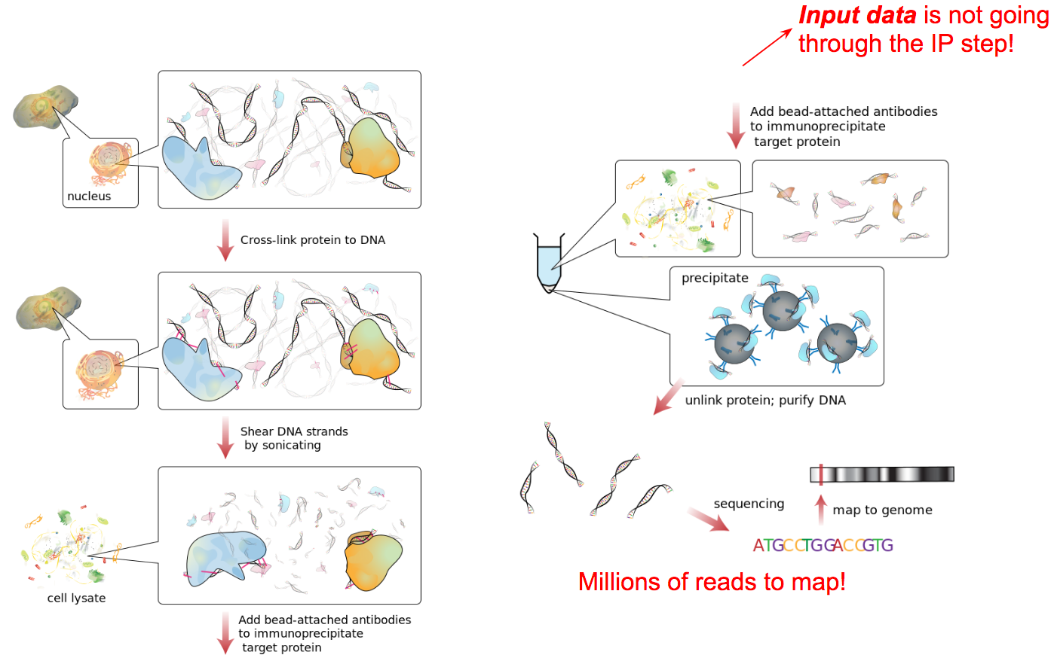
https://training.galaxyproject.org/training-material/topics/epigenetics/tutorials/formation_of_super-structures_on_xi/slides-plain.html

Slide 21
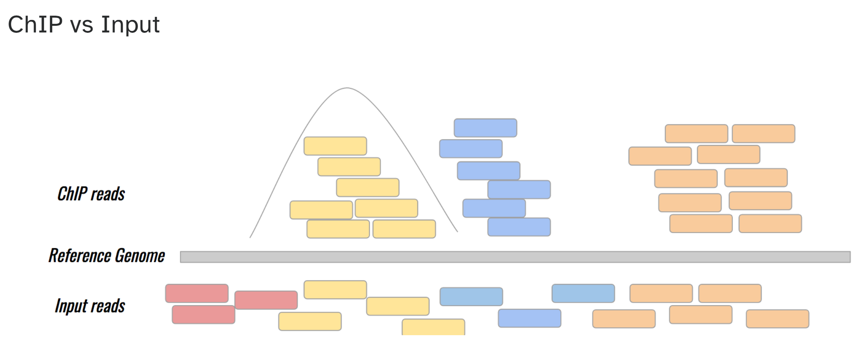
https://training.galaxyproject.org/training-material/topics/epigenetics/tutorials/formation_of_super-structures_on_xi/slides-plain.html

Slide 22
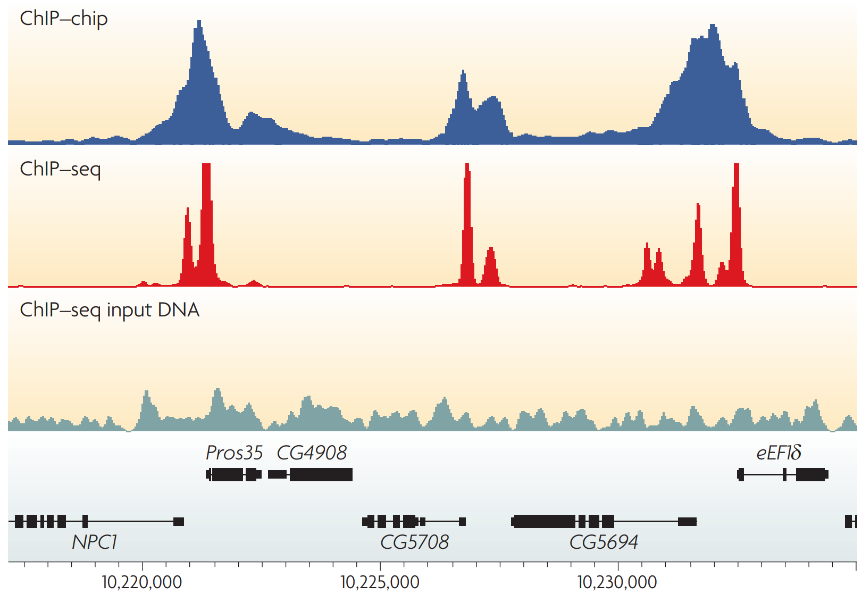
ChIP profiles: Examples of the profiles generated by chromatin immunoprecipitation
https://www.nature.com/articles/nrg2641

Slide 23
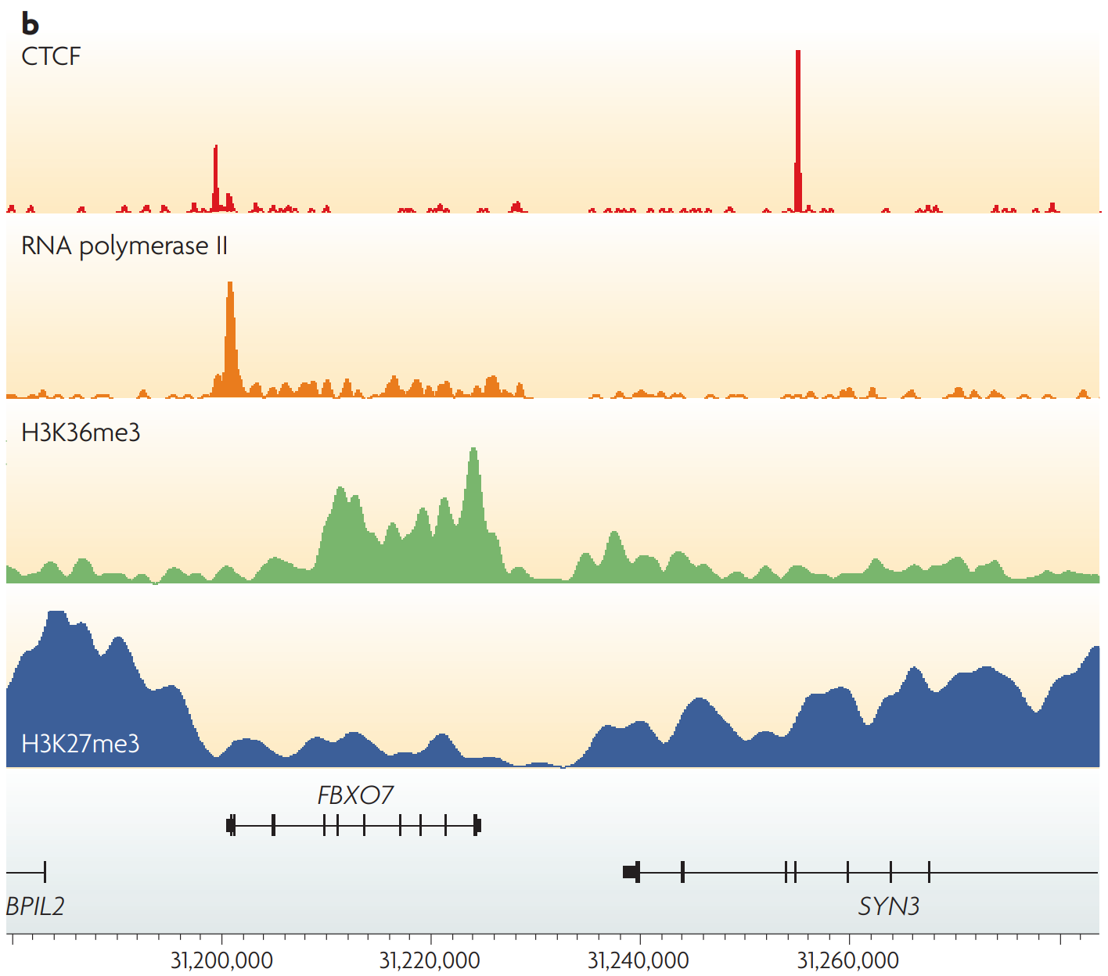
ChIP profiles: Examples of different types of ChIP–seq tag density profiles in human T cells
https://www.nature.com/articles/nrg2641

Slide 24
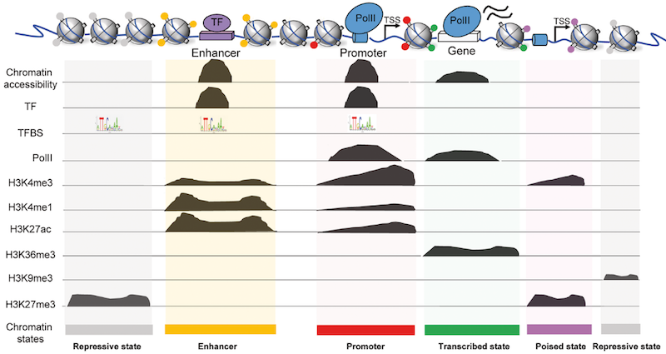
Types of ChIP-seq
https://training.galaxyproject.org/training-material/topics/epigenetics/tutorials/formation_of_super-structures_on_xi/slides-plain.html

Slide 25
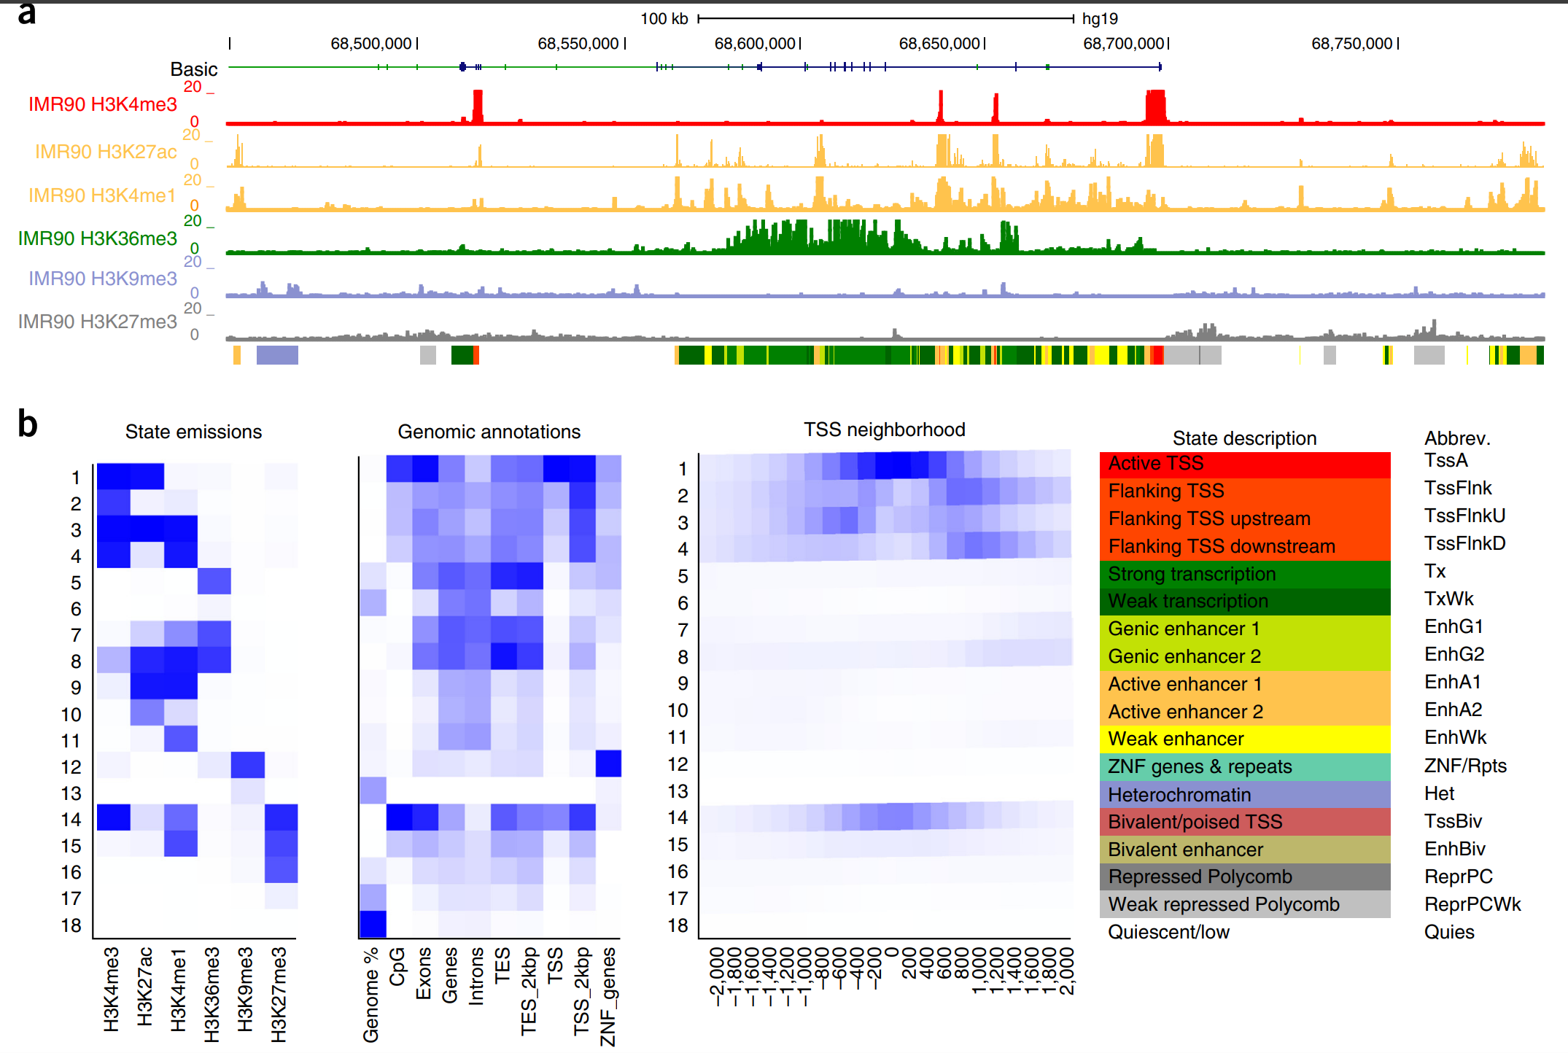
Chrom HMM
10.1038/nprot.2017.124

Slide 26
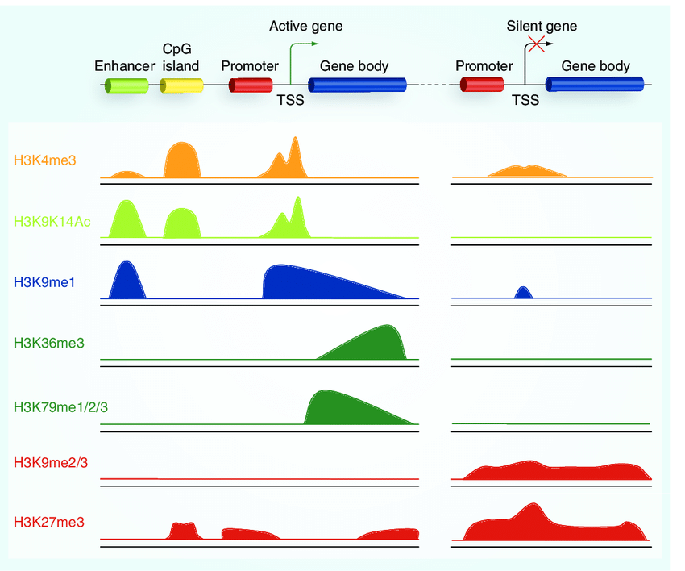
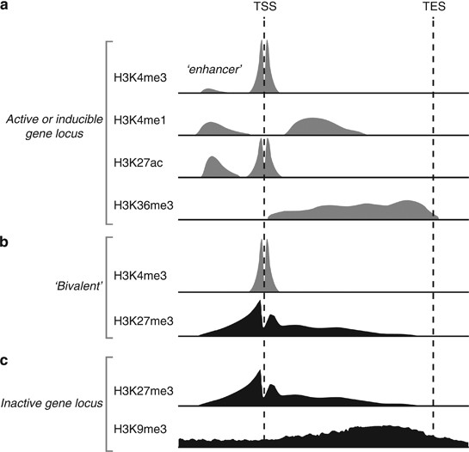
Peak types and locations of histone methylation
https://www.nature.com/articles/jhg201366
DOI:10.2217/epi.10.55

Slide 27
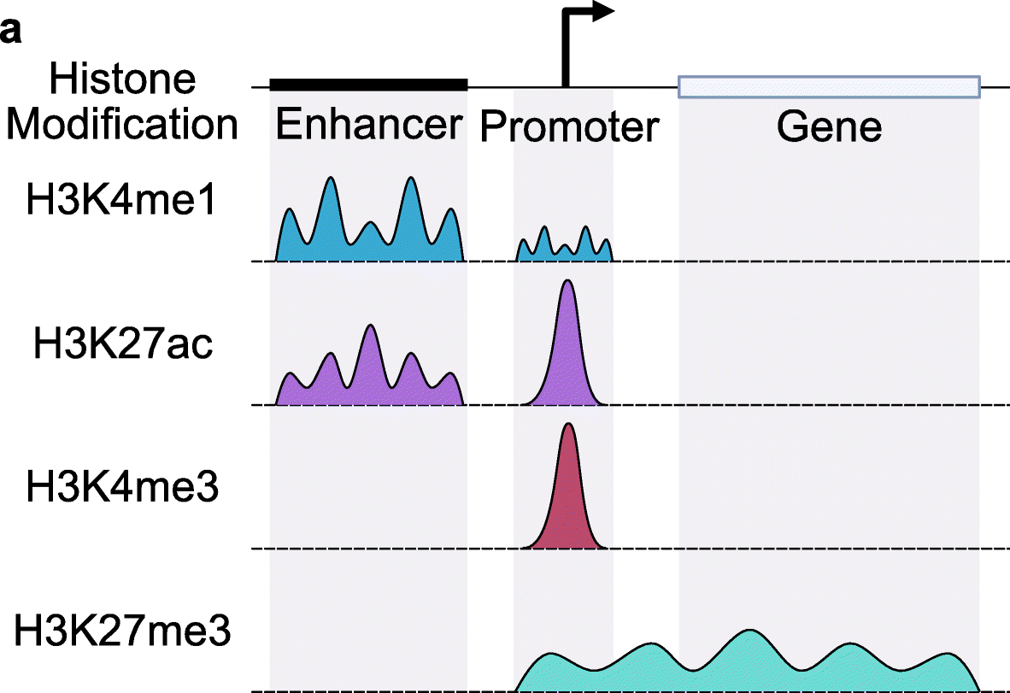
Peak types and locations of histone modifications
https://genomebiology.biomedcentral.com/articles/10.1186/s13059-022-02707-w

Slide 28
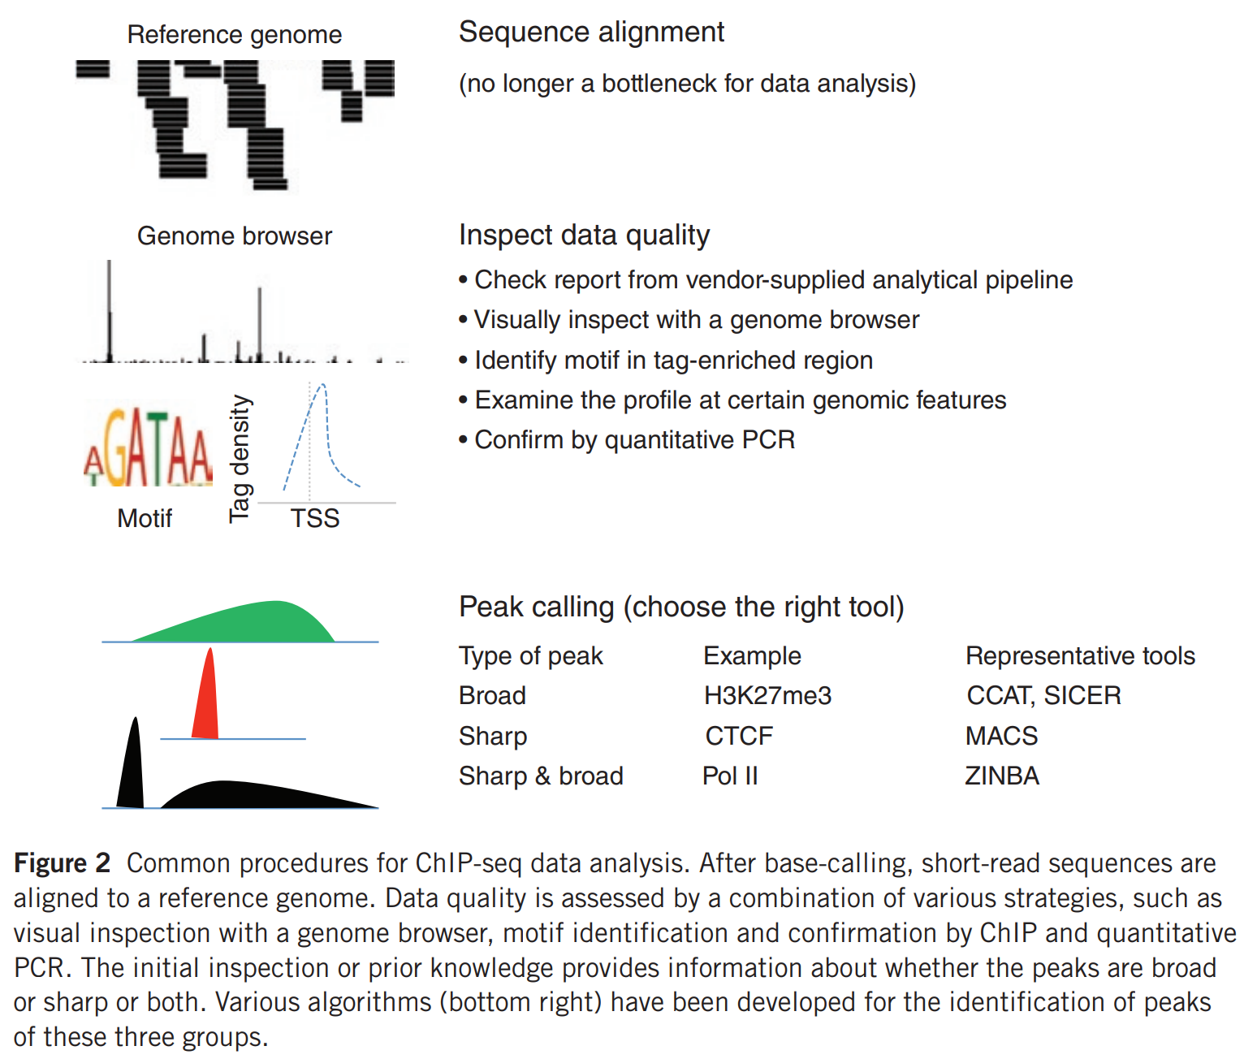
https://www.nature.com/articles/ni.2117

Slide 29
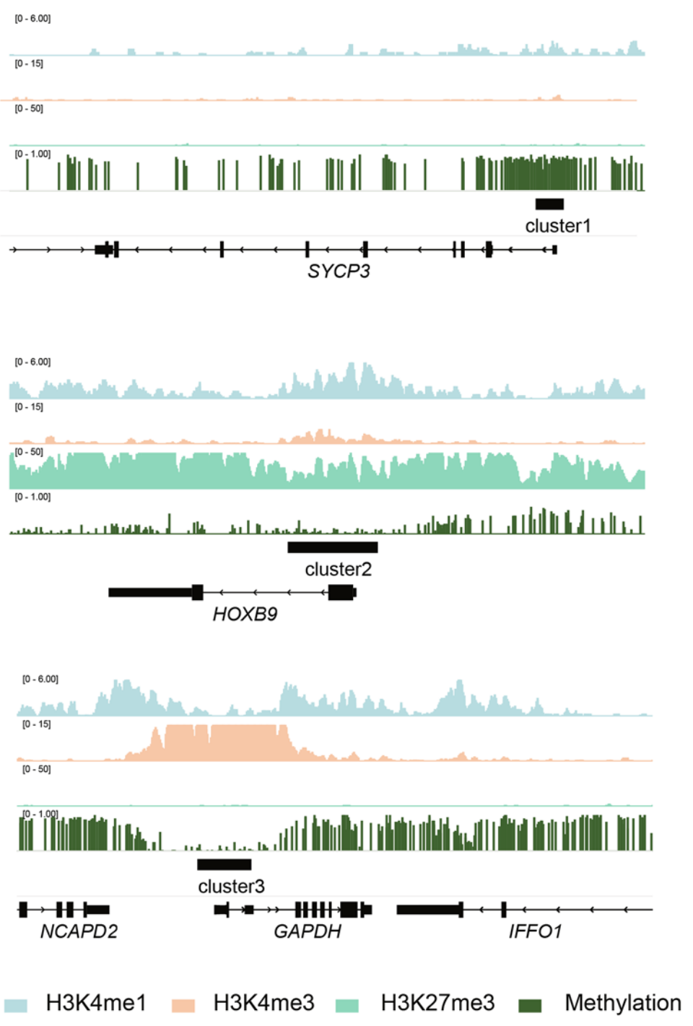
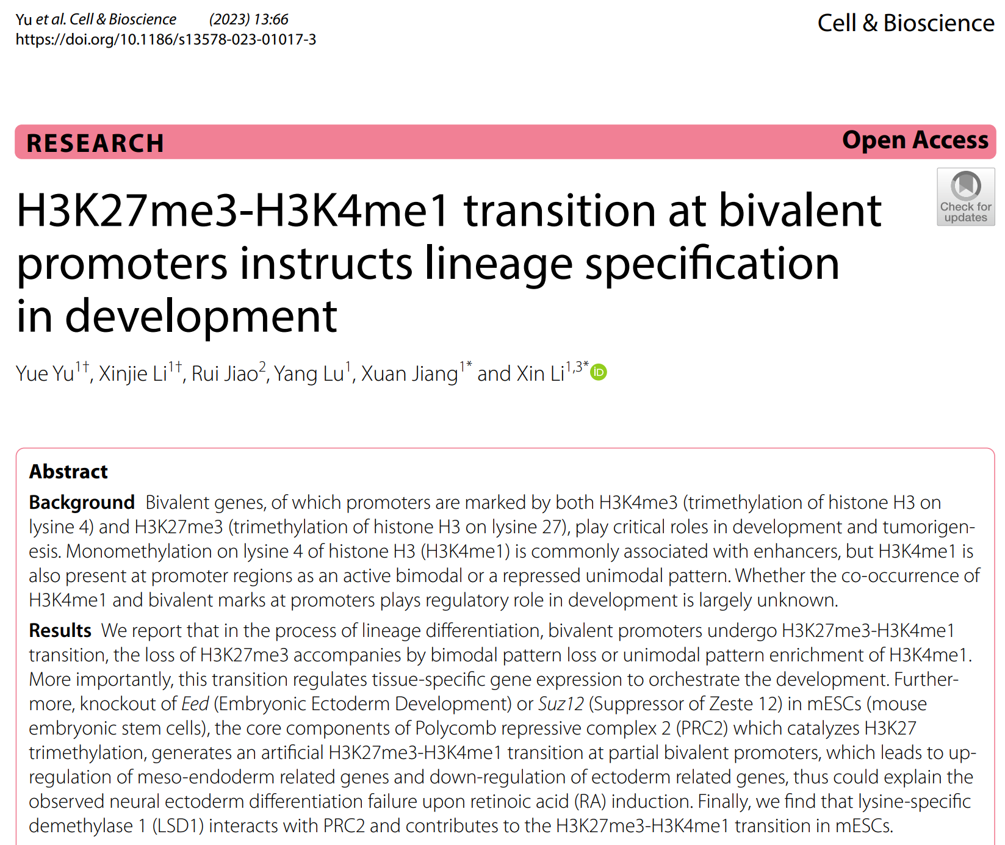

Slide 30
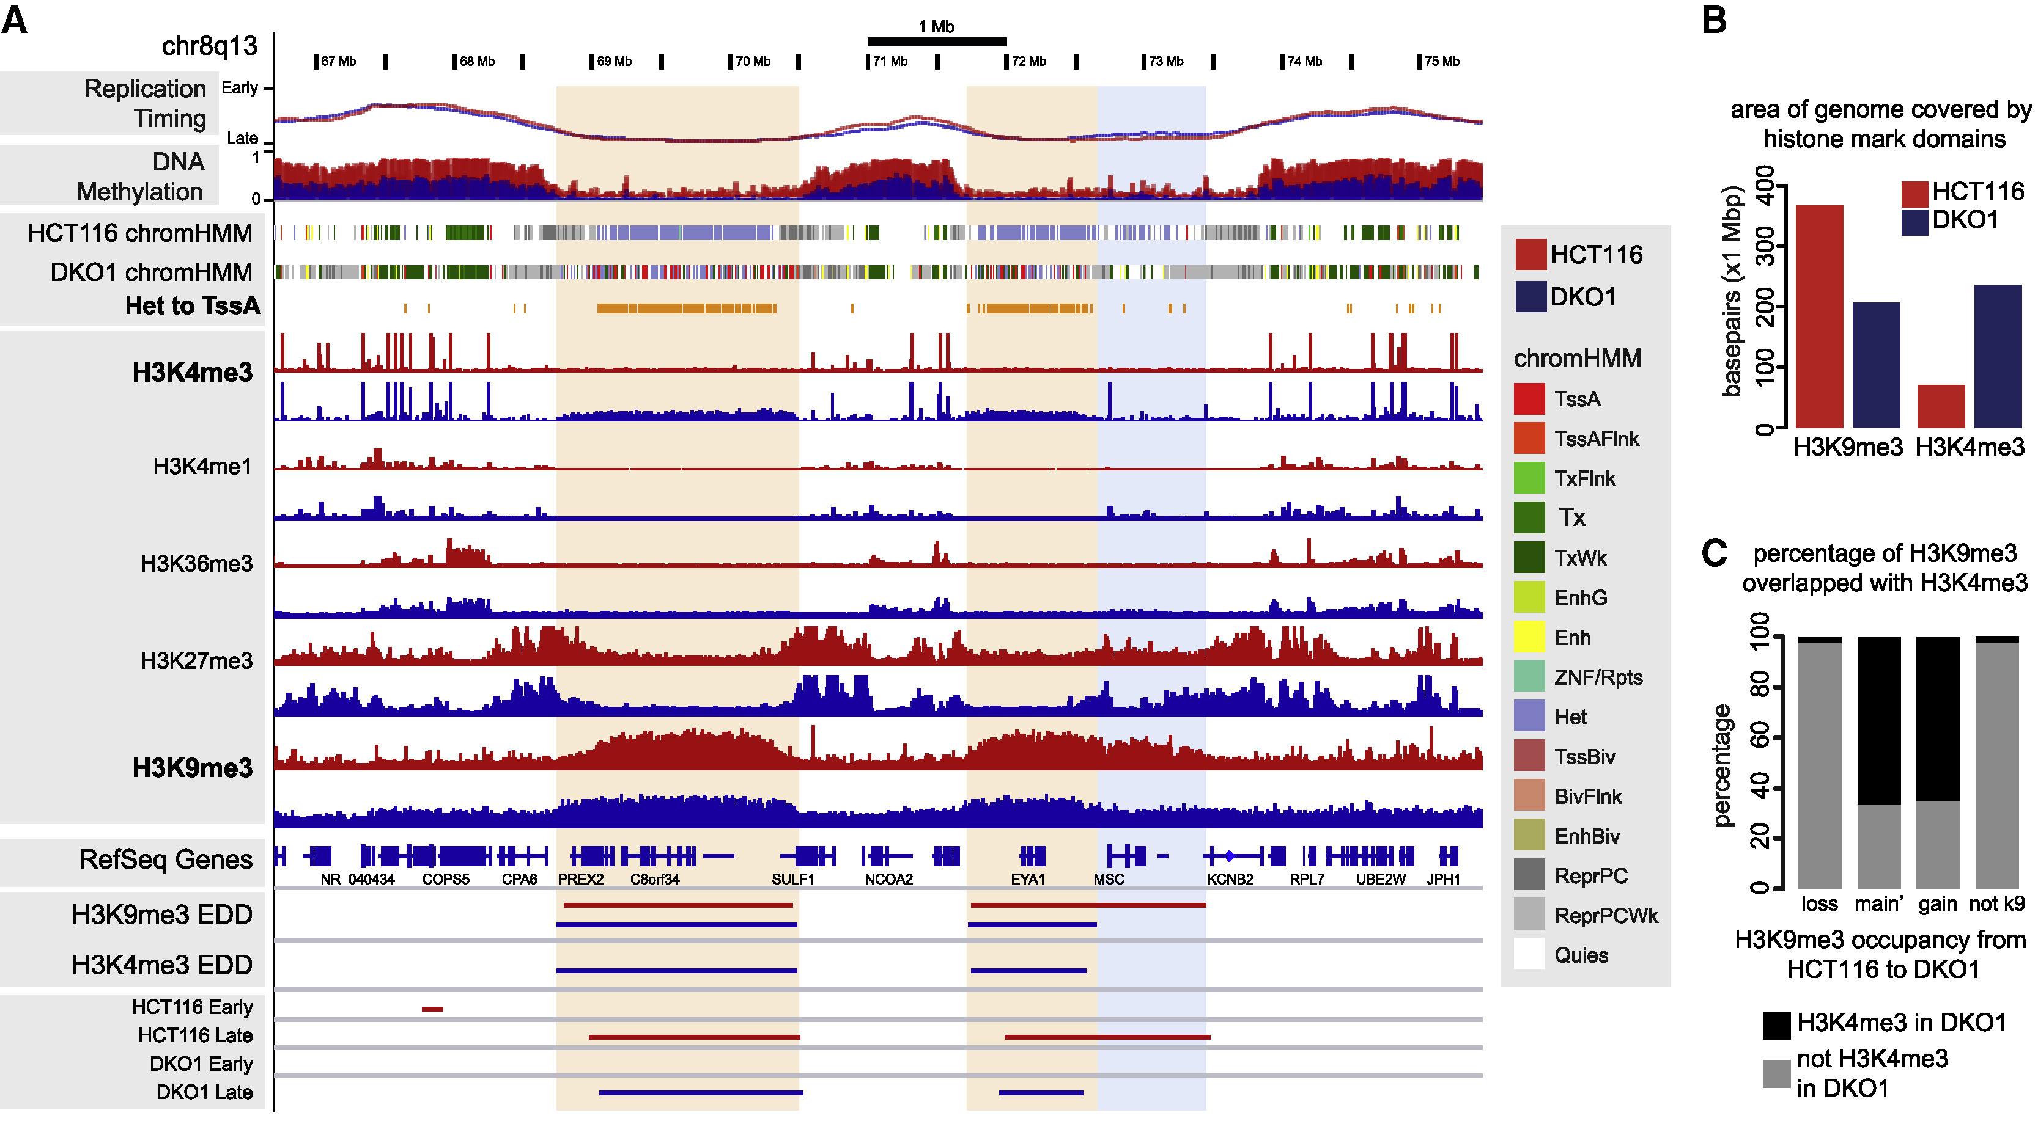
Reading the output of ChIP-Seq of Histone Modifications
Du Q, Smith G, Luu PL et al. DNA methylation is required to maintain both DNA replication timing precision and 3D genome organization integrity. Cell Reports

