Slide 1
Hi-C for Chromosome Conformation Capture Technologies
April 18 2026
Phuc-Loi Luu, PhD

Slide 2
Content
From 3C, 4C, 5C to Hi-C
Reading Hi-C output

Slide 3
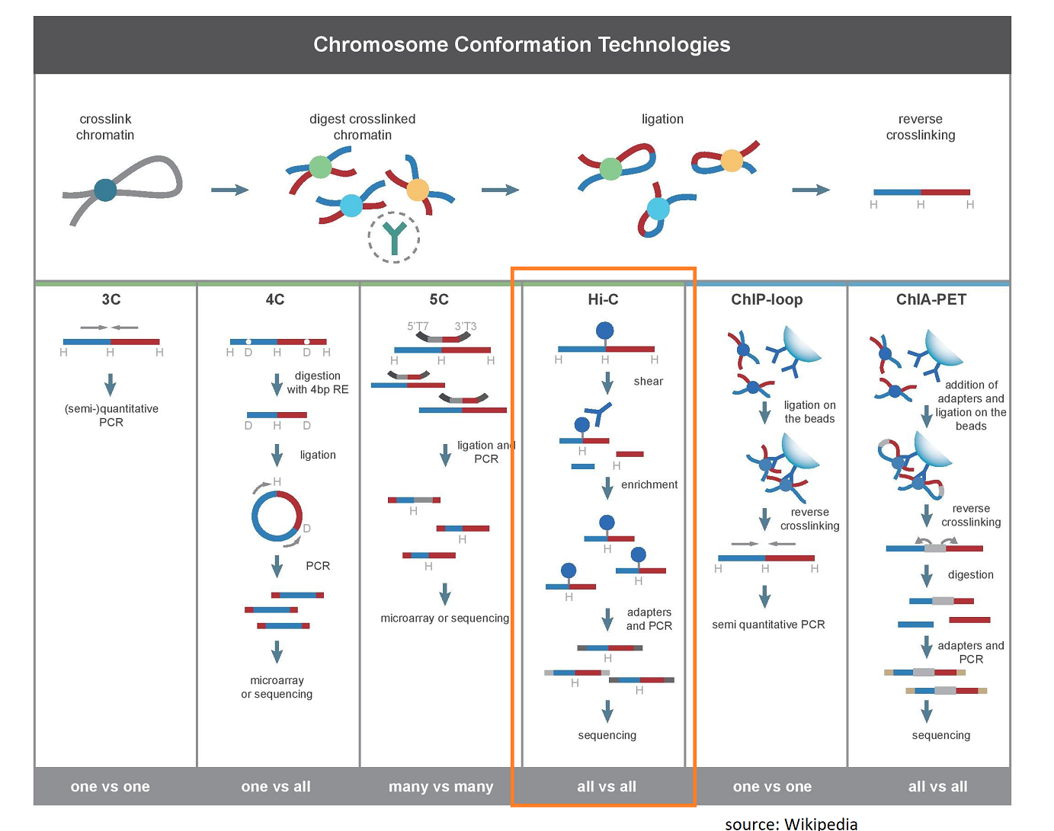
https://dnatech.ucdavis.edu/hi-c-library-preparations-and-sequencing

Slide 4
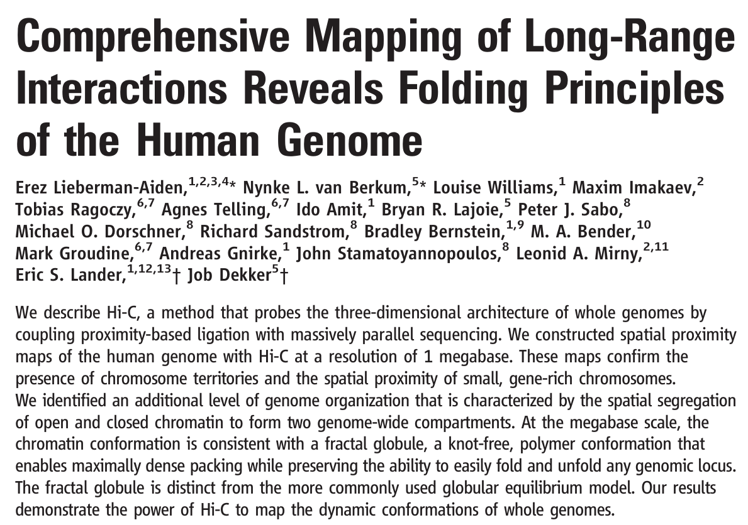

Hi-C

Slide 5
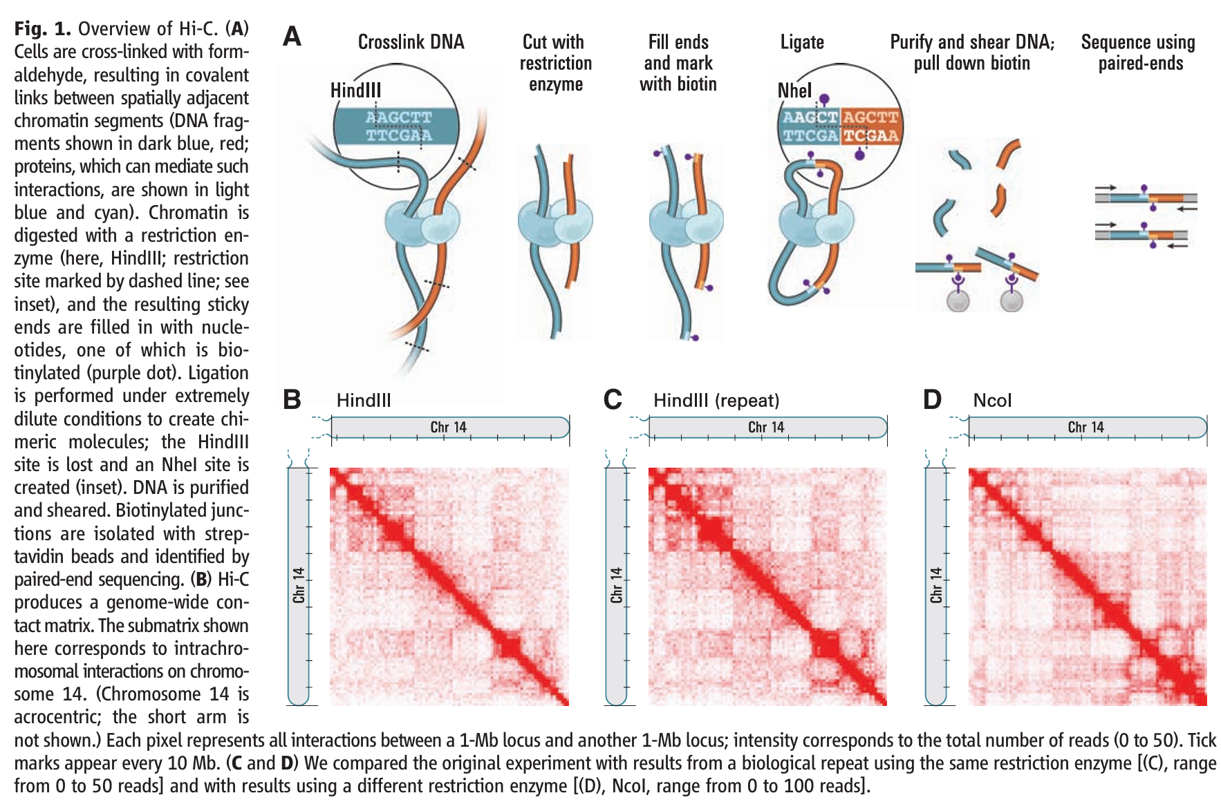

Slide 6
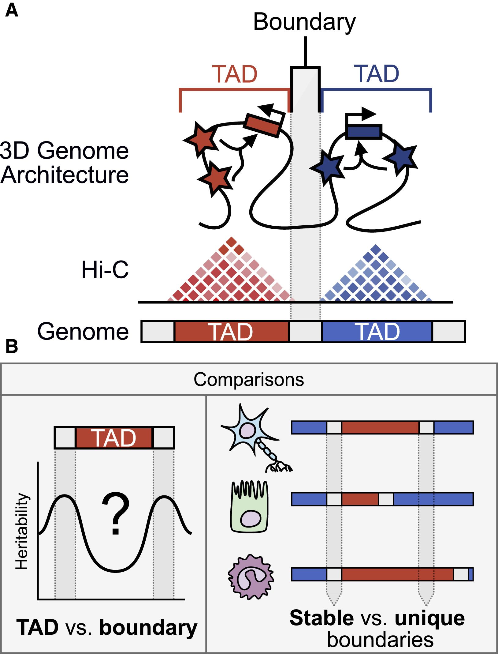
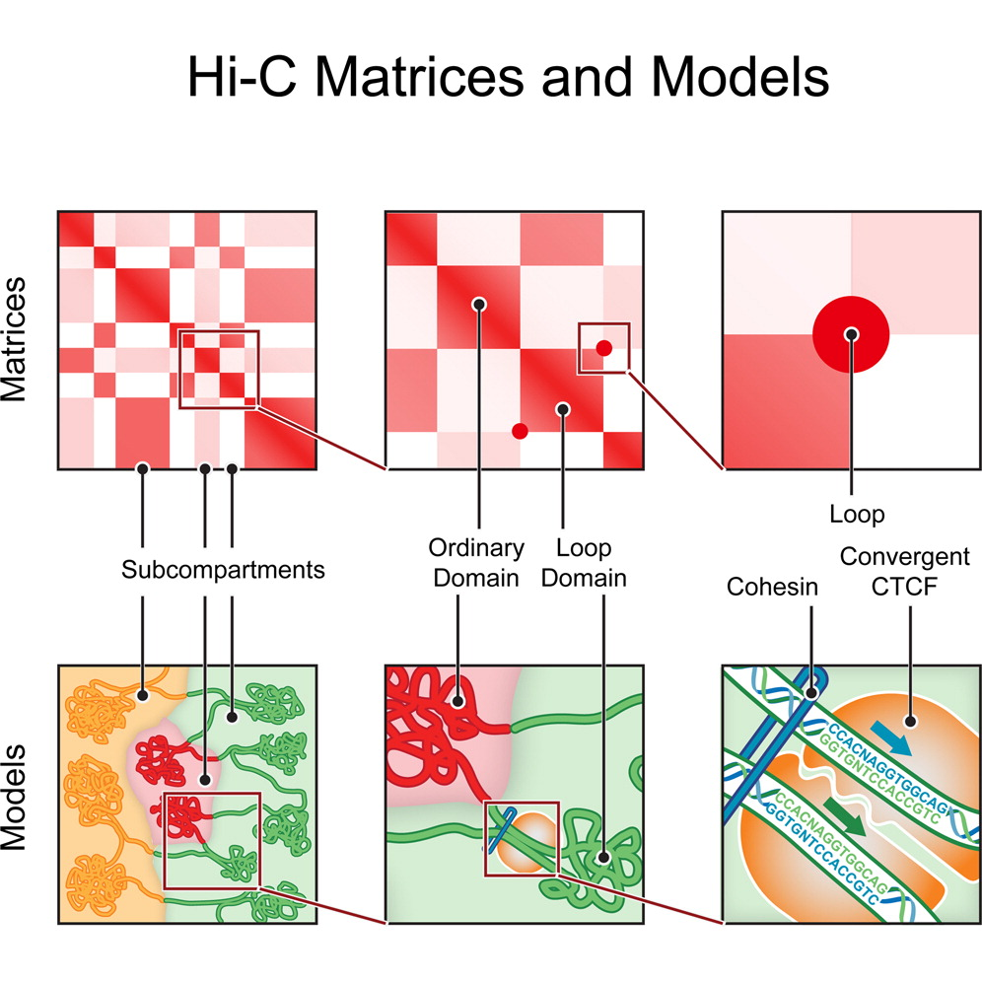
https://www.cell.com/fulltext/S0092-8674%2814%2901497-4
https://www.sciencedirect.com/science/article/pii/S000292972100001X

Slide 7
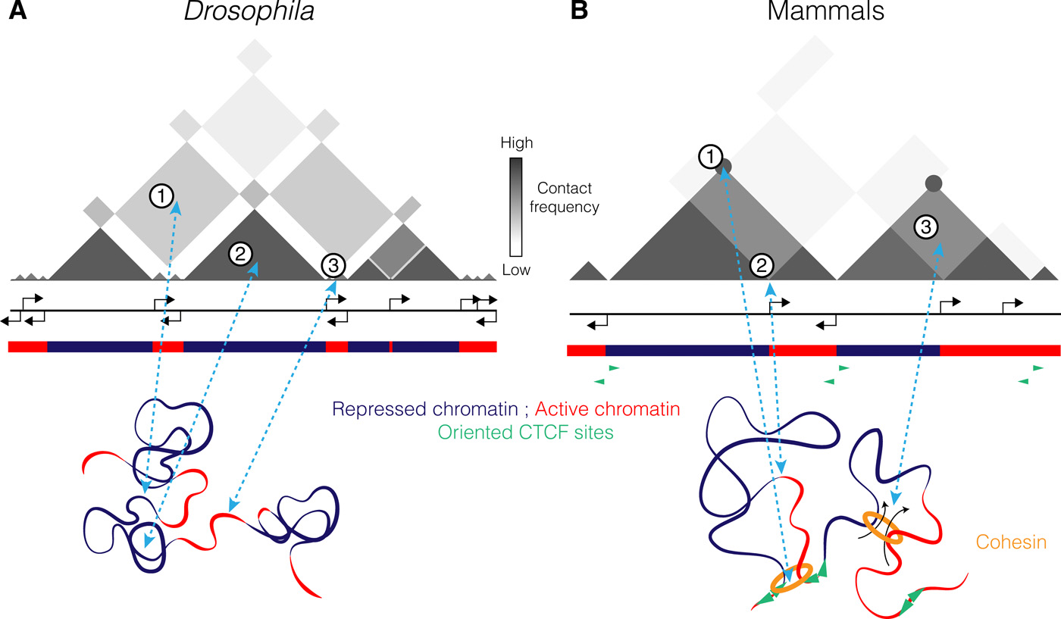
Read the Hi-C data (0)
https://www.science.org/doi/10.1126/sciadv.aaw1668

Slide 8
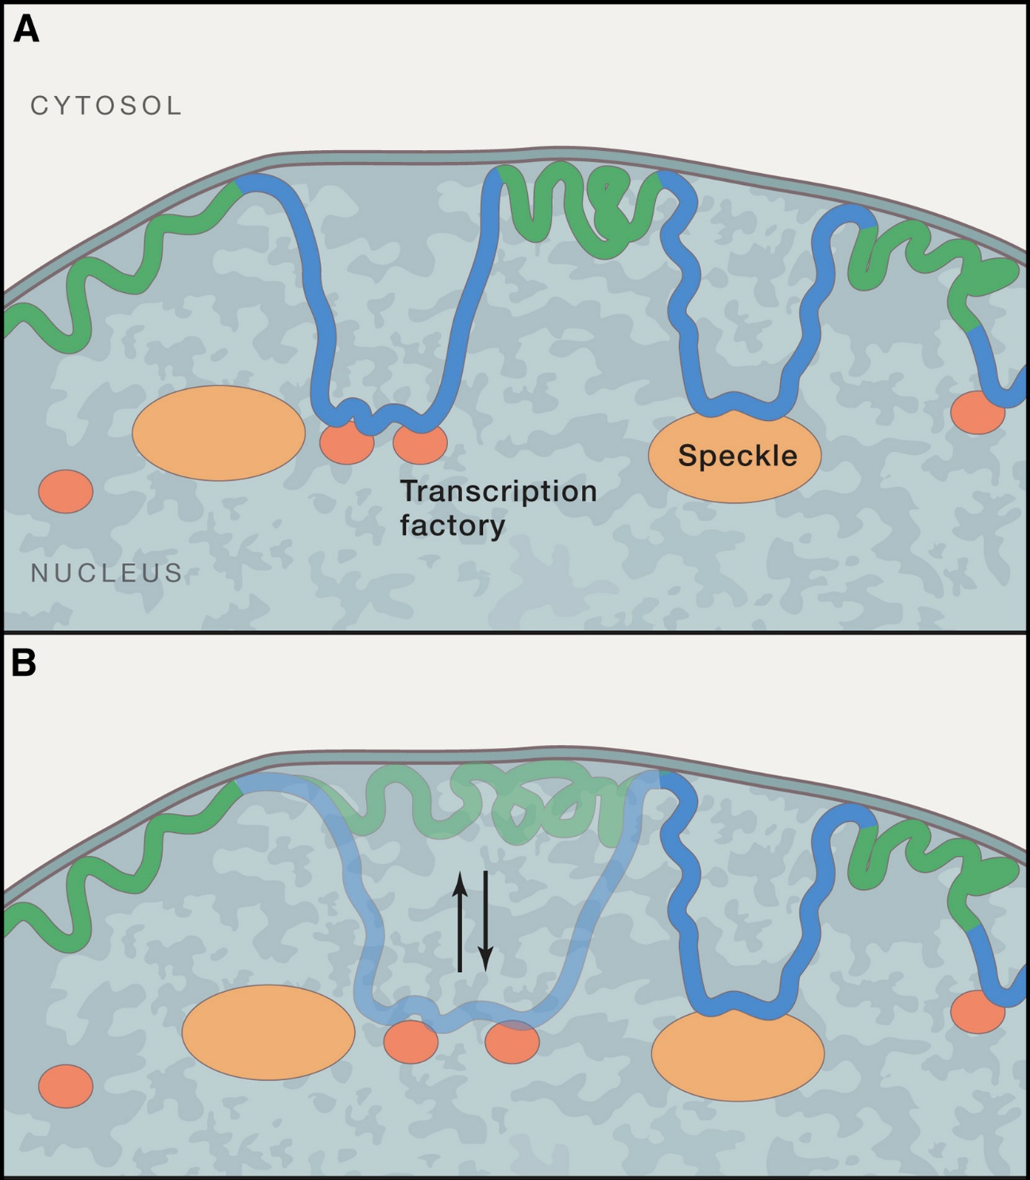
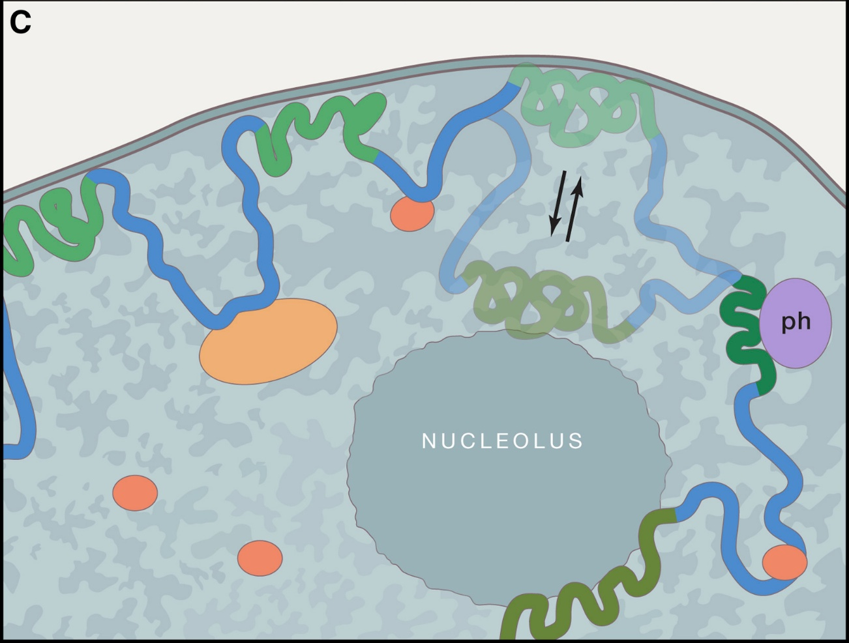
(A) Besides anchoring of LADs (green) to the NL, other regions (blue) may be tethered to nuclear structures that are permissive for transcription (orange), such as transcription factories (tf) or splicing factor speckles (speckles).
(B) Some LADs (semi-transparent green) contact the NL erratically (i.e., in a subset of cells) and may become transcriptionally active when associated with a permissive compartment (semi-transparent blue).
(C) Some LADs are apparently stochastically distributed between the NL, nucleoli, and pericentromeric heterochromatin (ph), which are all repressive environments.
https://www.cell.com/cell/fulltext/S0092-8674%2817%2930473-7

Slide 9
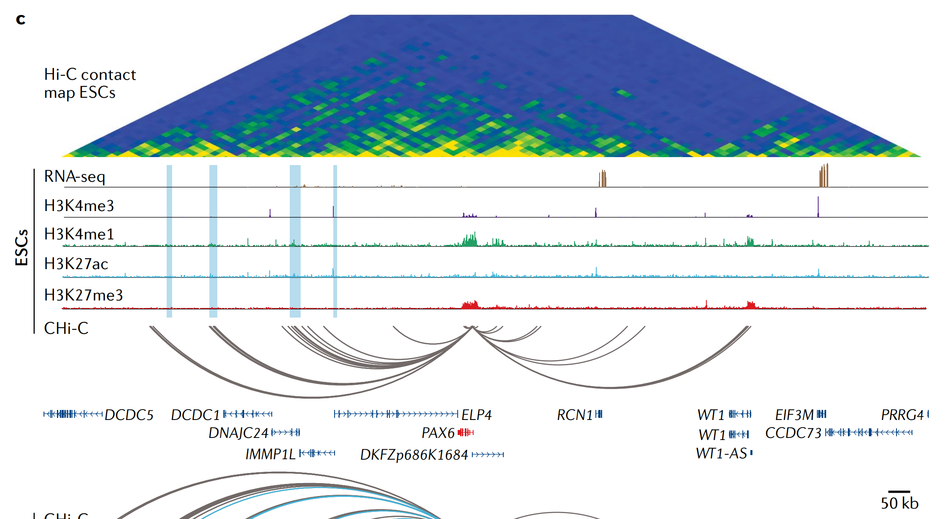
Read the Hi-C data (1)
https://www.nature.com/articles/s41576-019-0128-0

Slide 10
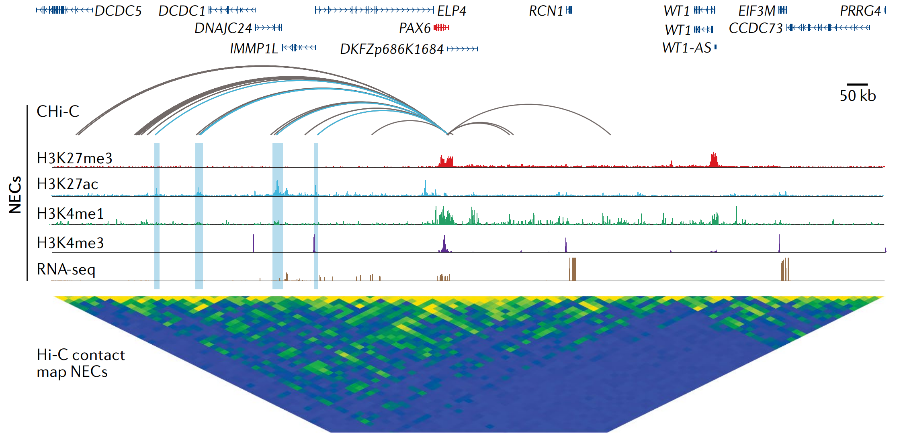
Read the Hi-C data (2)
https://www.nature.com/articles/s41576-019-0128-0

Slide 11
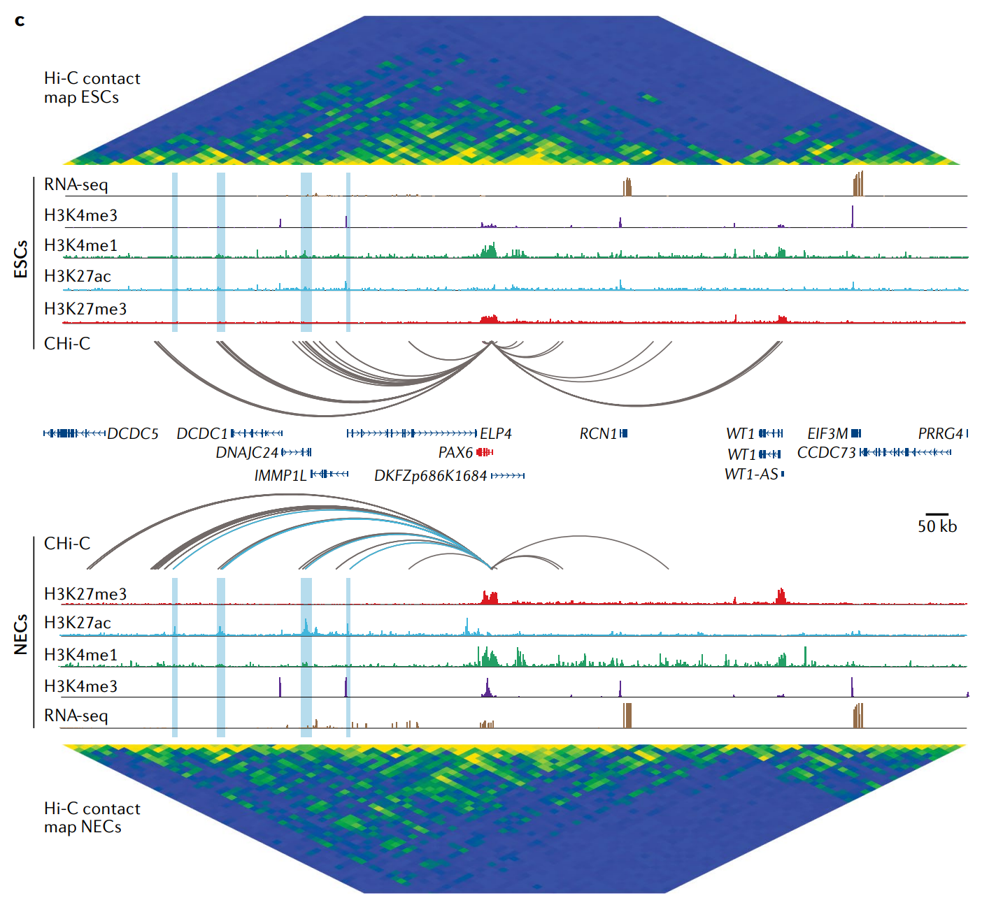
Read the Hi-C data (3)
https://www.nature.com/articles/s41576-019-0128-0

Slide 12
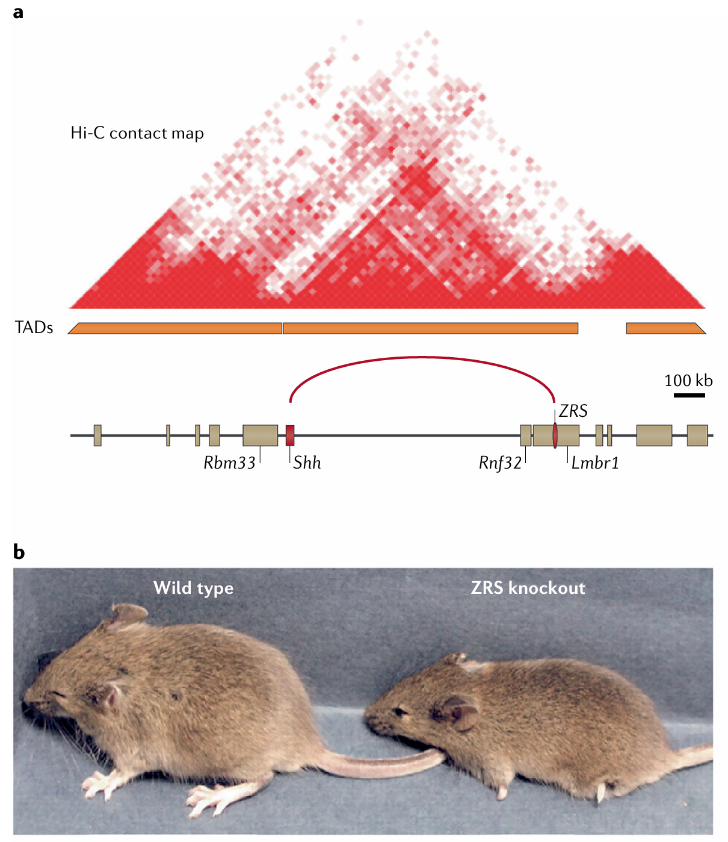
Fig. 2 | The Shh limb bud enhancer: a paradigm for long-range enhancer control of gene expression.
a | Genomic organization of the mouse sonic hedgehog (Shh) locus. In developing limb buds, the ‘zone of polarizing activity regulatory sequence’ (ZRS) enhancer controls the expression of Shh located ~850 kb away.
b | Mice lacking the ZRS Shh limb bud enhancer are born with severely truncated limbs.
https://www.nature.com/articles/s41576-019-0128-0

Slide 13
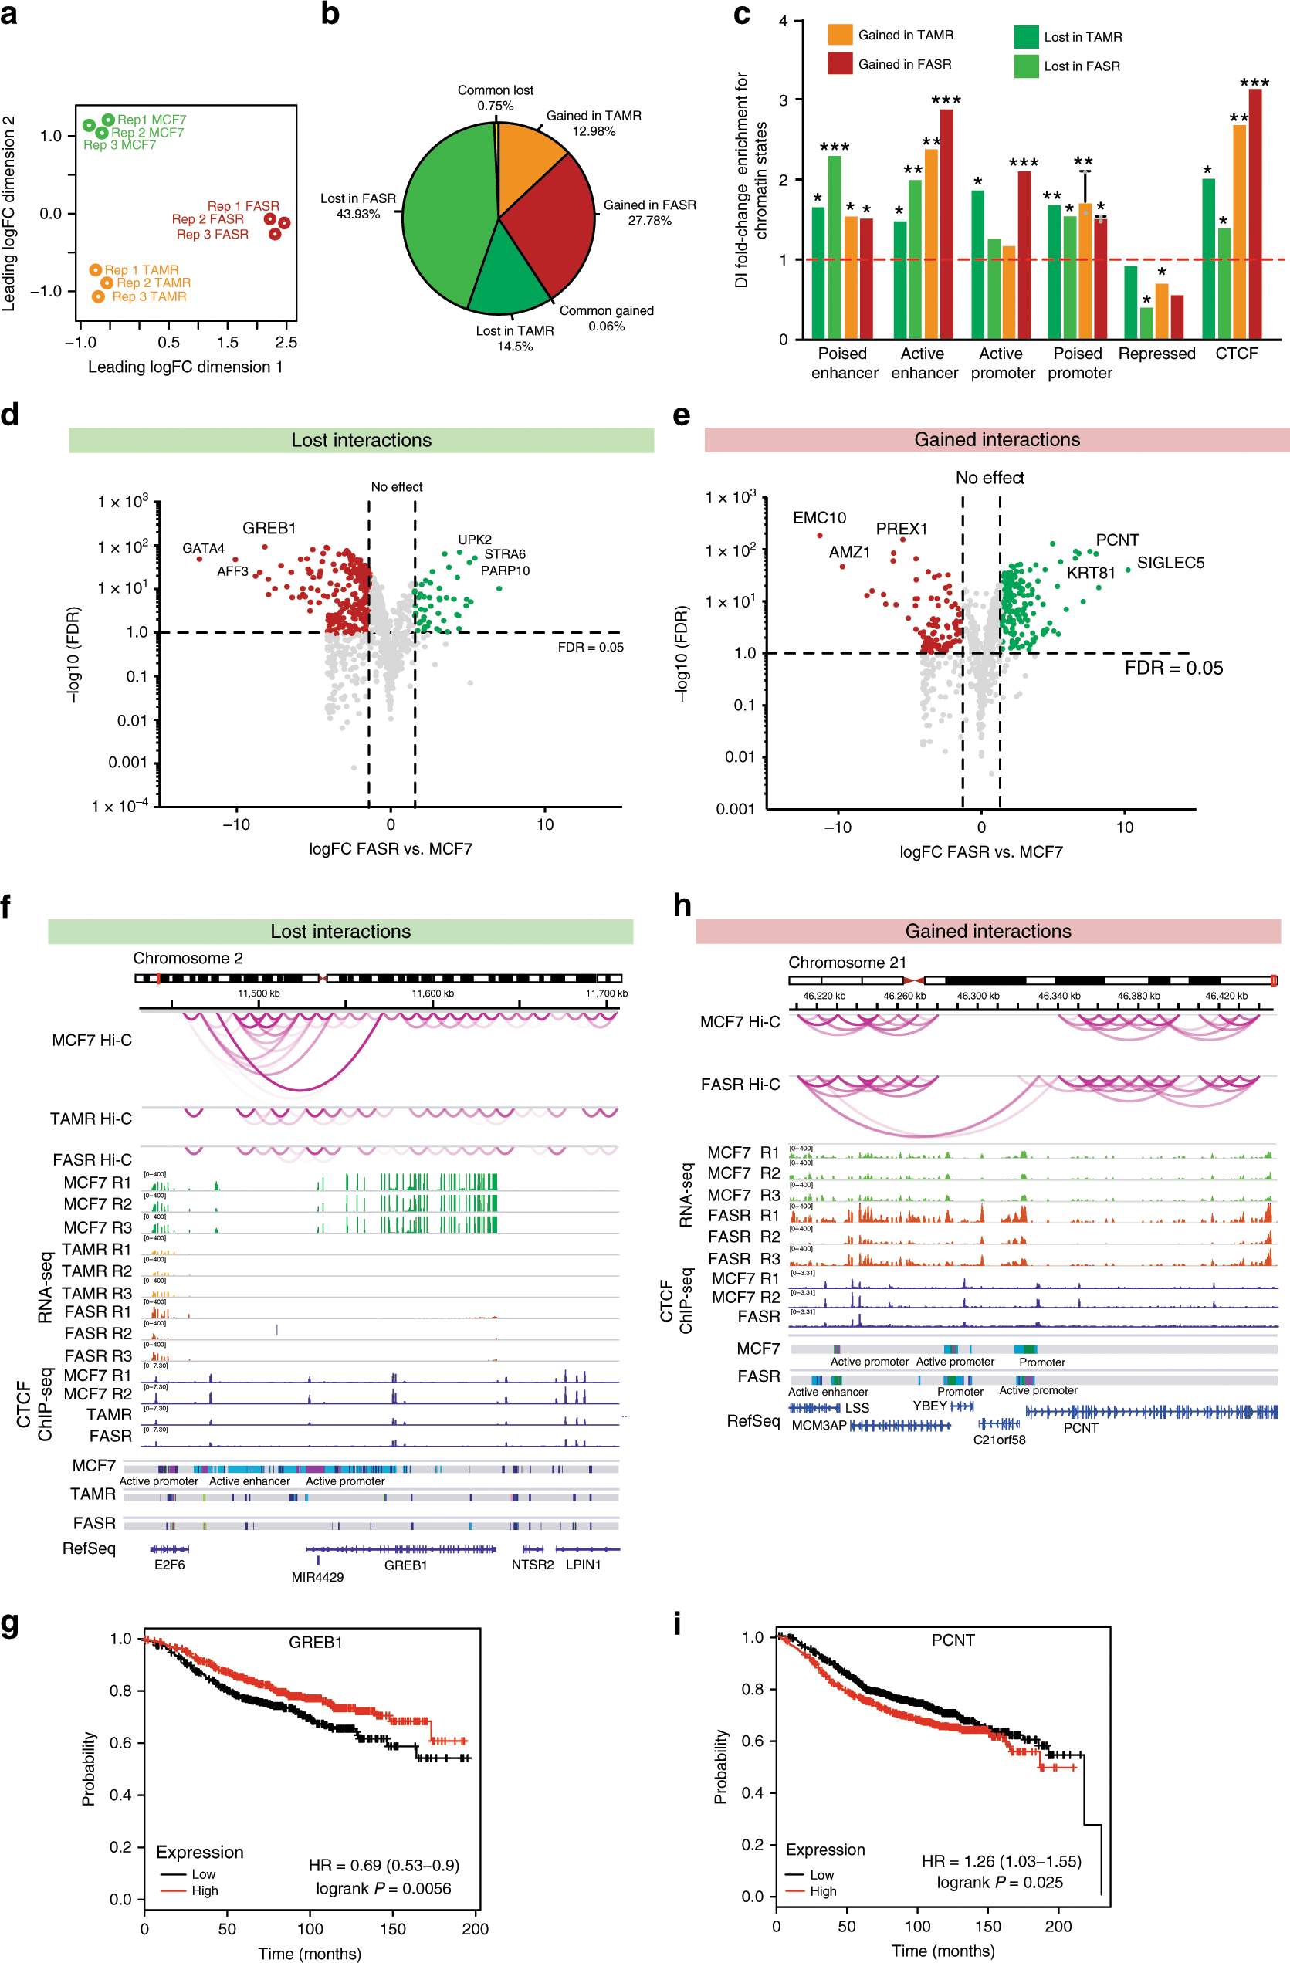
Differential enhancer−promoter interactions and gene deregulation
https://www.nature.com/articles/s41467-019-14098-x

Slide 14
Differential enhancer−promoter interactions and gene deregulation
https://www.nature.com/articles/s41467-019-14098-x

Slide 15
Differential enhancer−promoter interactions and gene deregulation
https://www.nature.com/articles/s41467-019-14098-x

Slide 16
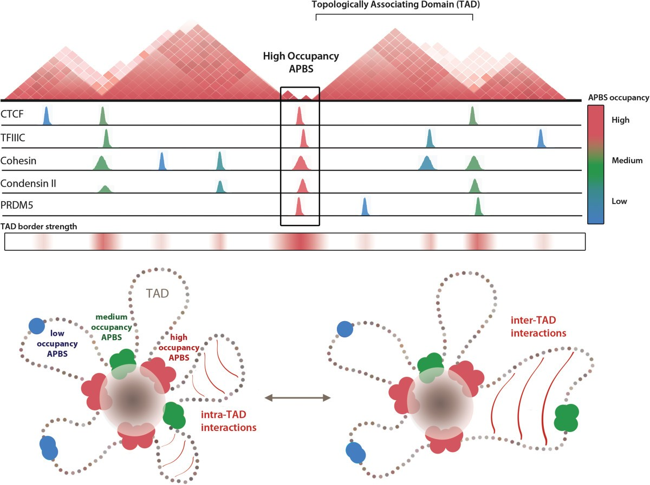
Combinatorial binding of architectural proteins shapes topological domain structure
https://genomebiology.biomedcentral.com/articles/10.1186/gb-2014-15-5-r82

Slide 17
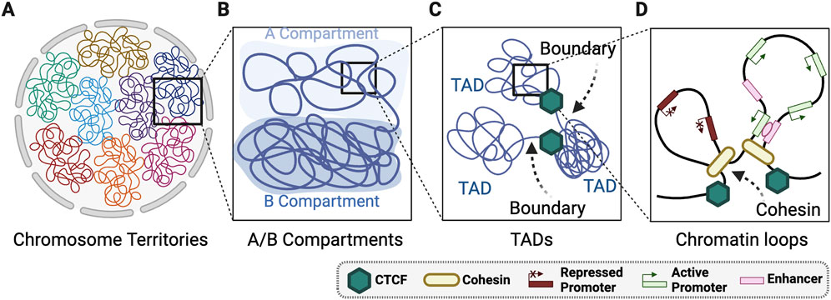
Layers of 3D genome organisation
https://doi.org/10.3389/fcell.2025.1548946

Slide 18
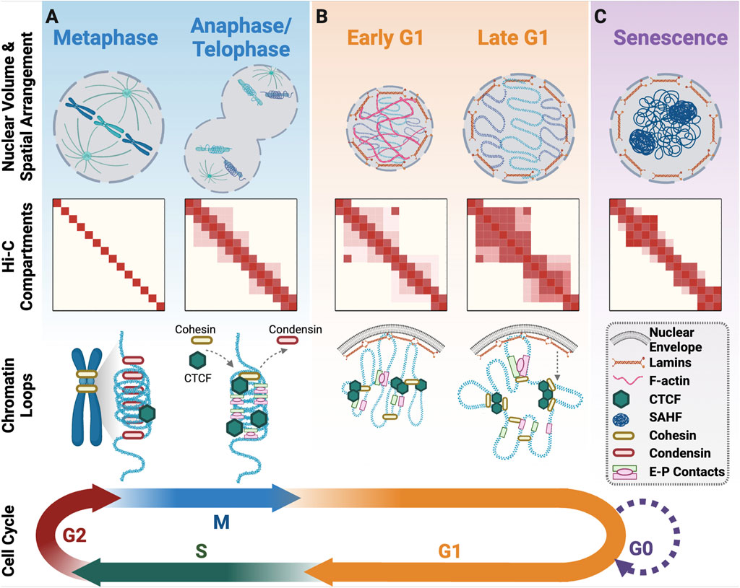
3D genome organisation upon cell cycle exit and re-entry
https://doi.org/10.3389/fcell.2025.1548946

Slide 19
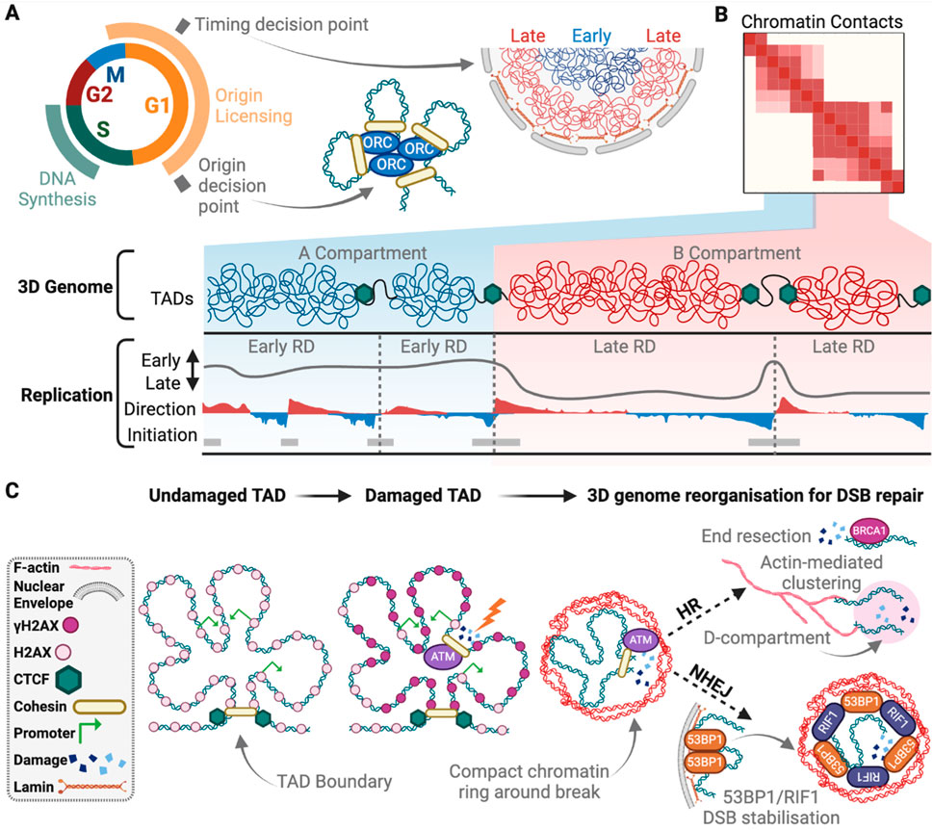
The 3D genome in DNA replication and repair
https://doi.org/10.3389/fcell.2025.1548946

Slide 20
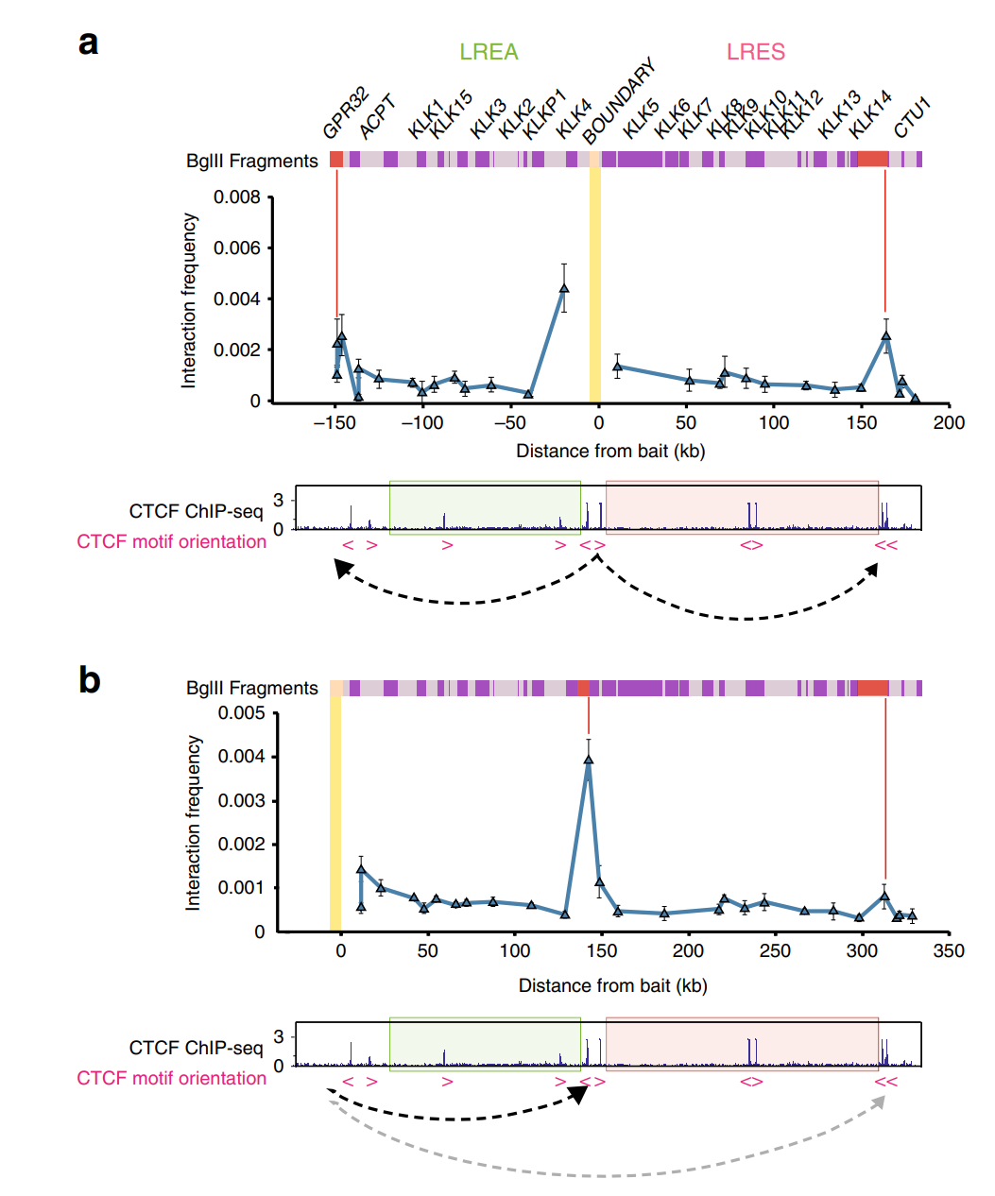
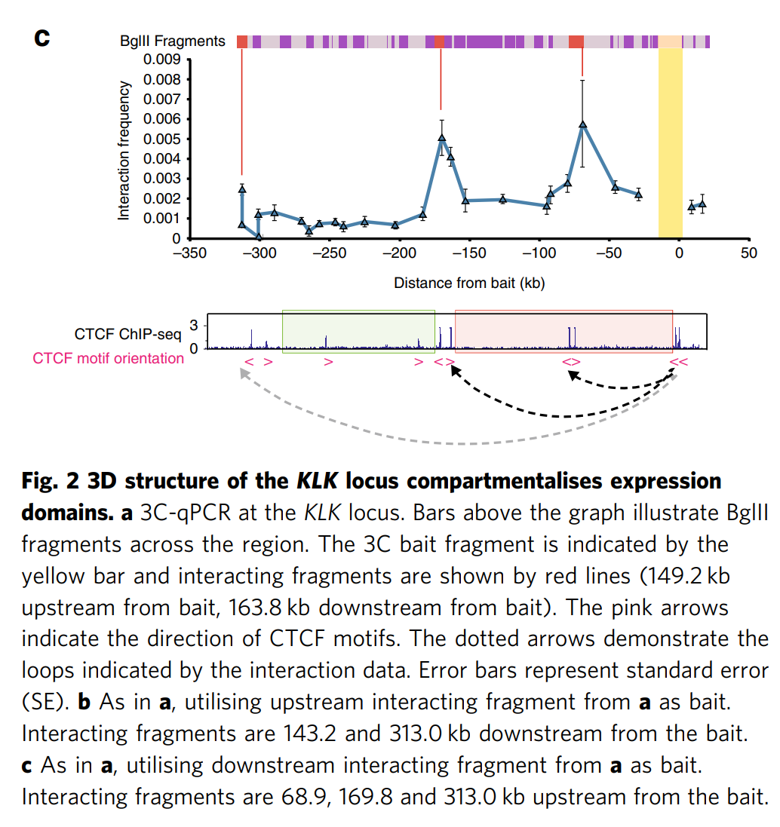
https://www.nature.com/articles/s41467-019-13753-7

Slide 21
