Slide 1
The Basal Transcriptional Machinery
Focus: The Core Engine of Gene Expression.
Goal: Understanding the minimum requirements to transcribe DNA into RNA in eukaryotes.
Chapter 3 of Gene Regulation and Epigenetics, Carsten Carlberg (2024)
Nov 23 2025
Giảng viên: TS. Lưu Phúc Lợi
Email: Luu.p.loi@googlemail.com
Zalo: 0901802182

Slide 2
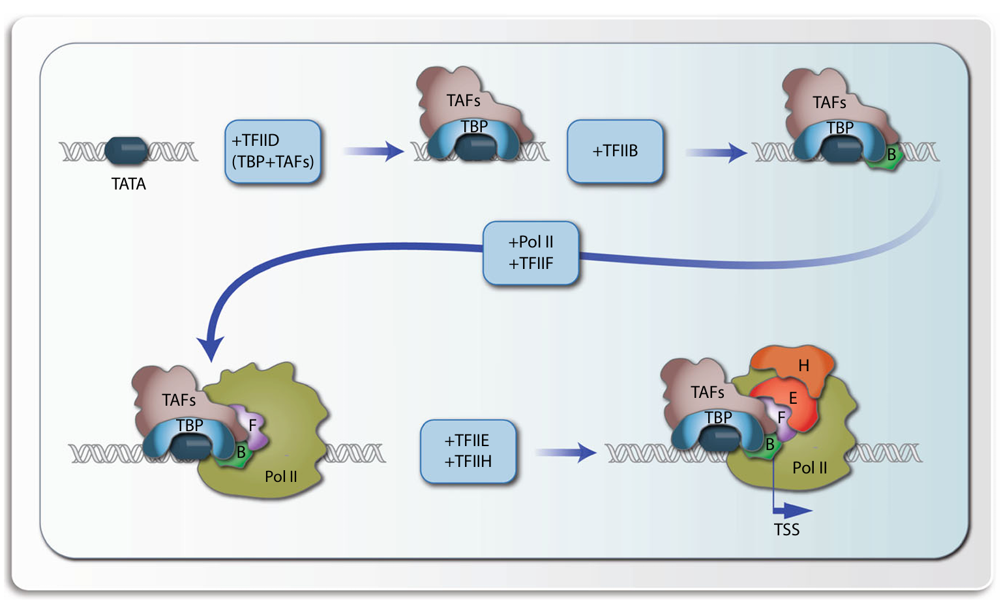
Content
Basal Transcription
RNAPII Needs Help of General Transcription Factors (GTFs).
PIC Assembly:
TFIID/TBP (recognition)
TFIIA/B (stabilization/orientation)
RNAPII/TFIIF (recruitment)
TFIIE/H (activation)
TFIIH is Critical
CTD Code
Mediator

Slide 3
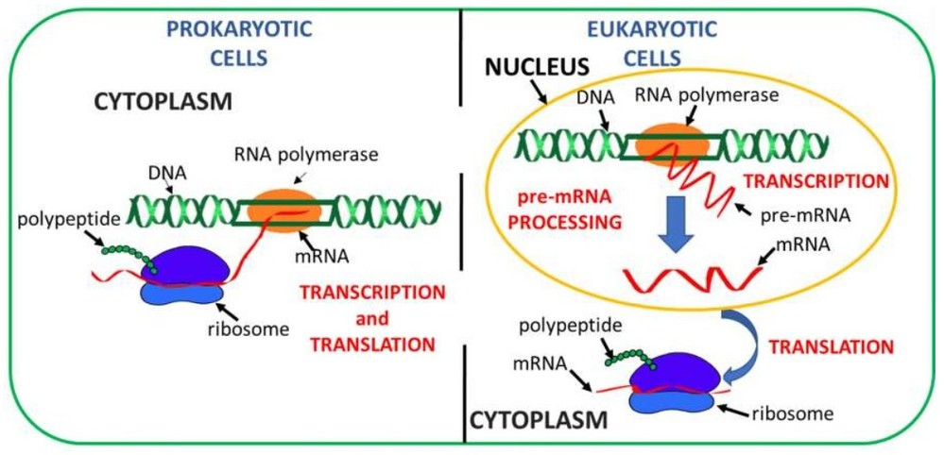
The Challenge of Eukaryotic Transcription
https://www.creative-biostructure.com/protein-synthesis-in-prokaryotes-vs-eukaryotes.htm

Slide 4
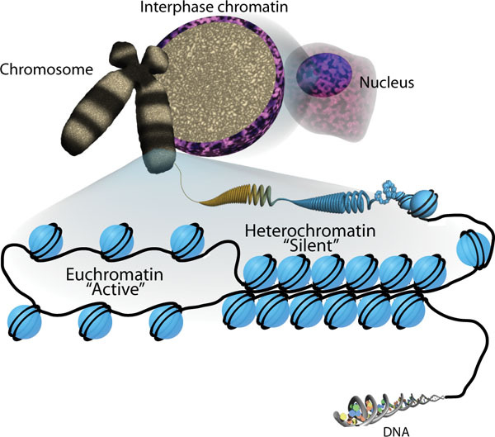
The Challenge of Eukaryotic Transcription
https://www.ncbi.nlm.nih.gov/books/NBK27041/figure/thechromatinsignature.F1/

Slide 5
Eukaryotic vs. Prokaryotic Context
Prokaryotes (e.g., E. coli): The RNA Polymerase holoenzyme (core enzyme + sigma factor) can directly recognize and bind to promoter sequences (-10 and -35 regions) → Relatively simple recruitment.
Eukaryotes (e.g., Humans): DNA is wrapped in chromatin (nucleosomes), creating a physical barrier.
Crucial difference: Eukaryotic RNA Polymerases act "blindly." They cannot recognize promoter sequences on their own.
The Solution: Eukaryotes require auxiliary proteins called General Transcription Factors (GTFs) to locate promoters and load the polymerase onto the DNA.

Slide 6
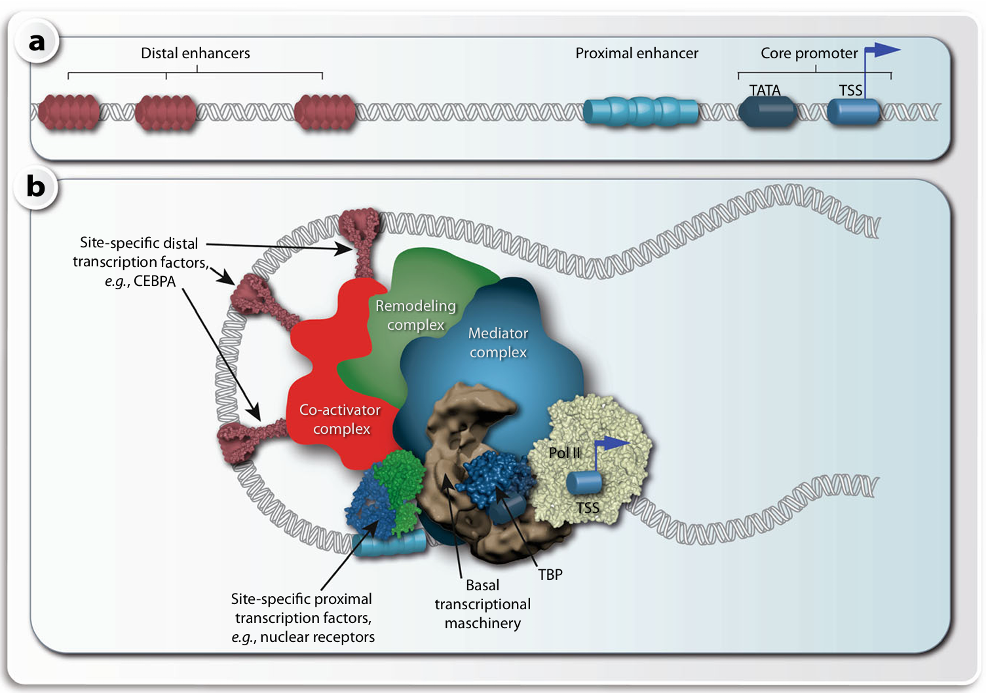
Defining "Basal" Transcription
Components of transcriptional regulation. In a linear schematic picture of the regulatory region of a gene a, the core promoter (TSS region), proximal TFBSs (proximal enhancers) and distal enhancers are distinguished. For simplicity only elements upstream of the TSS are indicated but, with exception of the TATA box, these TFBSs are also found downstream of the TSS. A more realistic DNA looping model b, in which also transcription factors, coactivators, other chromatin modifying proteins and Pol II are shown, suggests that all protein-bound TFBSs are connected via several multiprotein complexes, such as the coactivator complex, the remodeling complex, the MED complex and the basal transcriptional machinery. Different complexes are distinguished here, because they can be separately purified or assembled in vitro, but it is likely that they all together form a large super-complex, also called the transcription factory

Slide 7
What is Basal Transcription?
The Core Concept: Basal transcription refers to the minimum level of transcription that occurs in the absence of specific activators or repressors.
The "Machinery": It requires a specific set of general proteins that assemble at a gene promoter to recruit RNA Polymerase.
Key characteristic: It is generally low-level and inefficient.
While the basal machinery can initiate transcription in a test tube (in vitro), in a living cell (in vivo), it is rarely sufficient for meaningful gene expression.
The Foundation: Think of it as the engine block of a car. It can turn over, but it needs an accelerator (specific transcription factors) and transmission (Mediator) to actually drive the car effectively.
The Contrast: It is distinct from regulated transcription, which involves tissue-specific factors responding to signals.

Slide 8
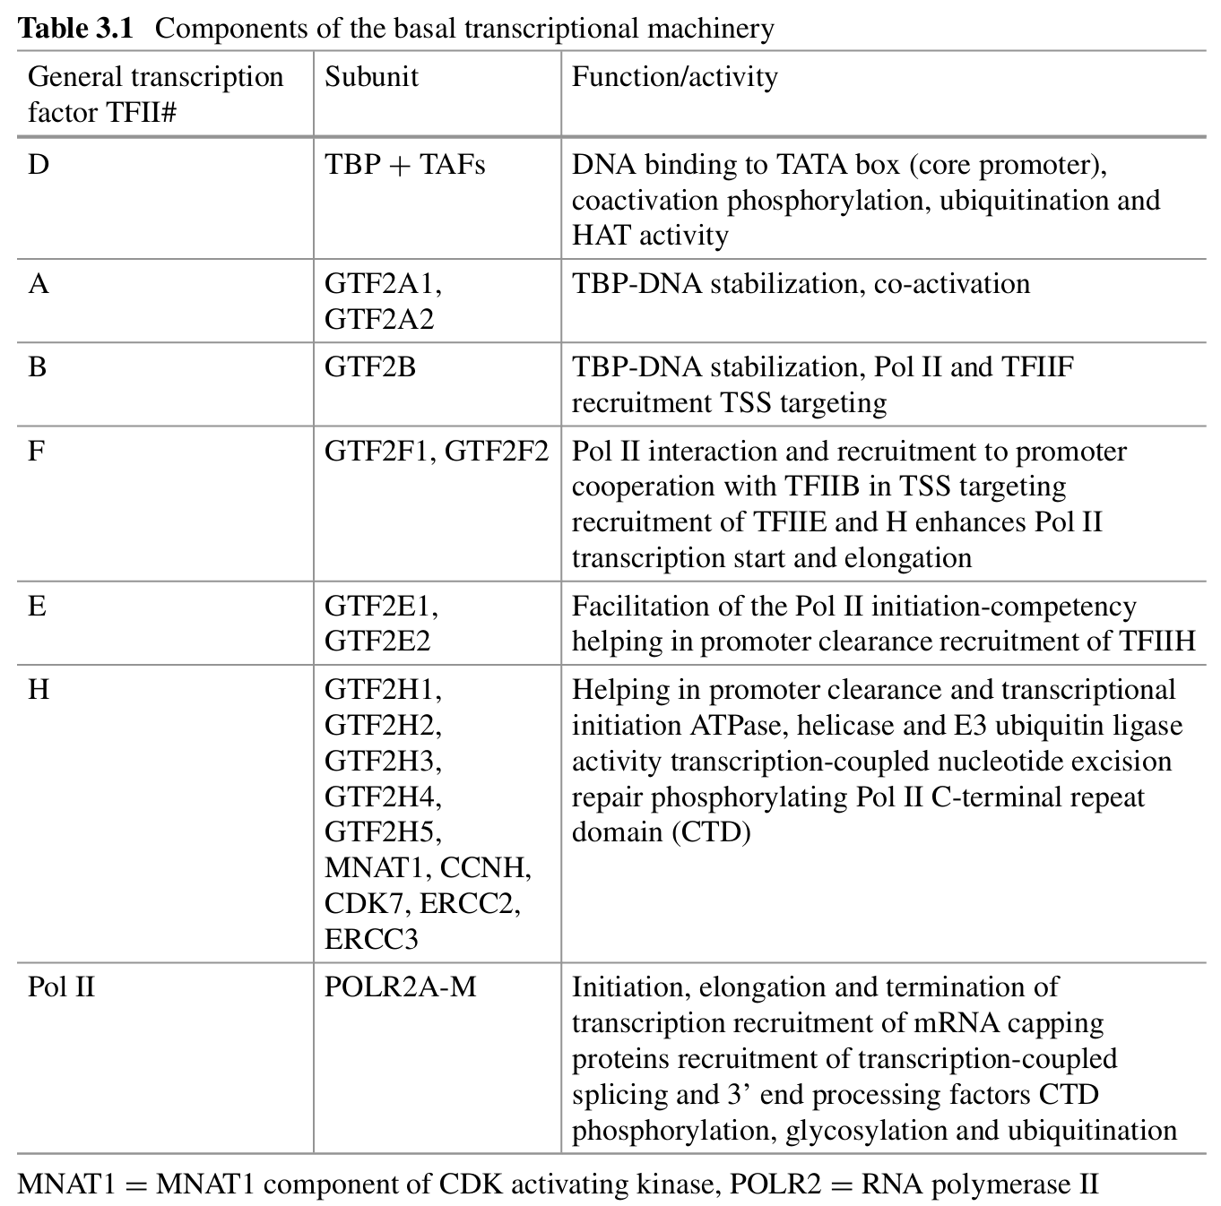

Slide 9
The Main Character – RNA Polymerase II (RNAPII)

Slide 10
RNA Polymerase II: The mRNA Synthesizer
Eukaryotic Polymerases: There are three main types, but RNAPII is the focus of gene regulation:
RNAPI: Transcribes large rRNAs.
RNAPIII: Transcribes tRNAs and small rRNAs.
RNAPII: Transcribes all protein-coding genes (mRNA) and many non-coding RNAs (e.g., lncRNA, miRNA).
Structure: A massive, multi-subunit complex (12 subunits in yeast/humans).
The Catalytic Core: Forms a "crab claw" shape that grips DNA, unwinds it, and synthesizes RNA using the DNA template strand.
The Unique Feature: The Carboxy-Terminal Domain (CTD)
Located on the largest subunit (RPB1).
A long, flexible tail protruding from the core enzyme.
Consists of tandem repeats of a heptapeptide sequence: Tyr-Ser-Pro-Thr-Ser-Pro-Ser (YSPTSPS).
Crucial: This tail is the site of extensive regulatory phosphorylation (discussed later).

Slide 11
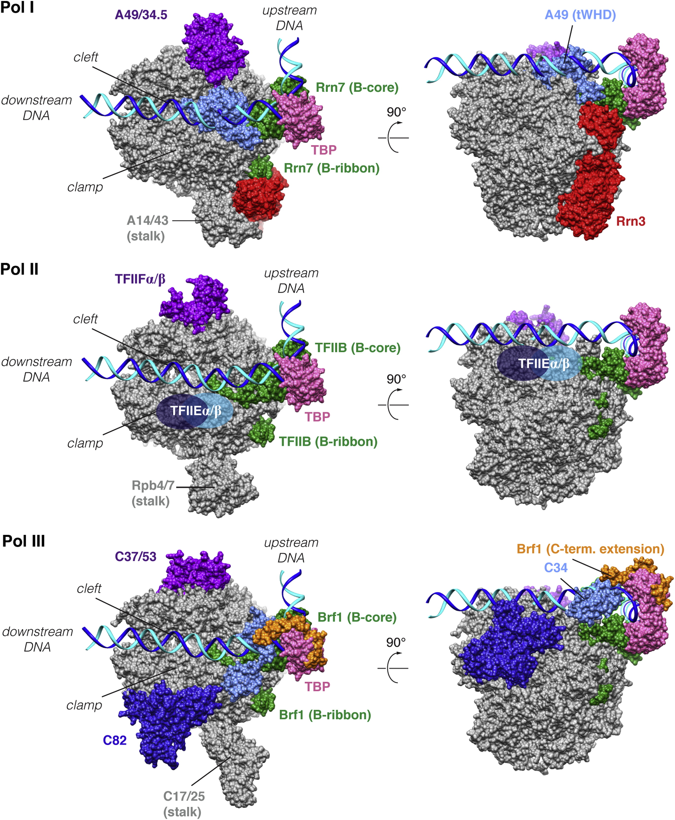
RNA Polymerase II (The Regulator)
RNA Pol II:
Transcribes all protein-coding genes (mRNA).
Transcribes the majority of non-coding RNAs (miRNAs, lncRNAs).
Function: It is responsible for the synthesis of transcripts that define the cell's specialized function and its response to external stimuli.
Regulation: Its activity is the most highly regulated and cell-specific of the three polymerases.
https://www.cell.com/molecular-cell/fulltext/S1097-2765%2812%2900089-5

Slide 12
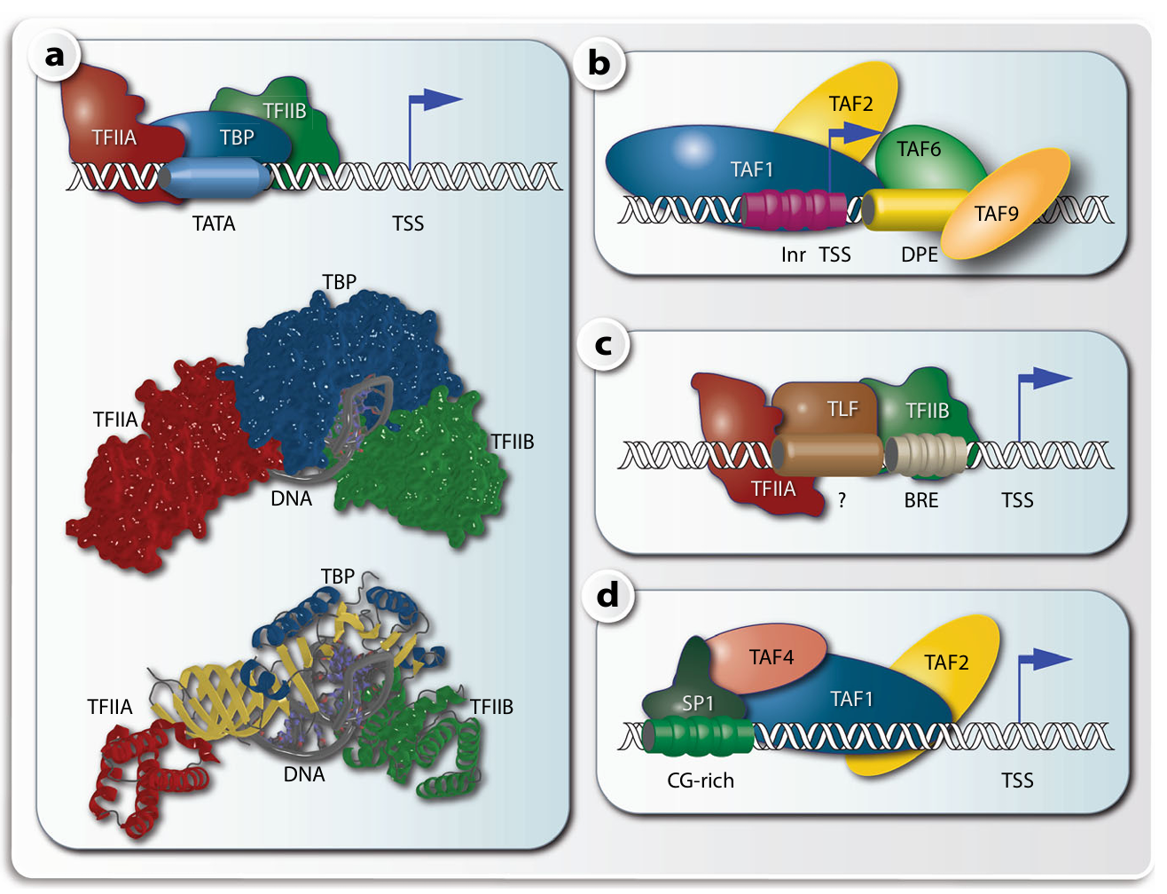
The Supporting Cast – General Transcription Factors (GTFs)
Different protein complexes on TSS regions. Core promoters that contain a TATA box are bound by TBP in complex with TFIIA and TFIIB
The complex is shown as a schematic drawing (top), as a Connolly surface model (center) or as a ribbon model (bottom). The unwound DNA is visible best in the ribbon model. On TATA-lacking core promoters the Inr element is used alone or in combination with DPE to attract TAF1 and TAF2 (to Inr) and TAF4 and TAF9 (to DPE)
Alternatively, TBP-like factor (TLF) can form a complex with TFIIA and TFIIB on a BRE element c or SP1 binding to a CG-rich sequence directs complex assembly of TAF1, TAF2 and TAF4 d

Slide 13
The "General" Transcription Factors (GTFs)
Definition: A highly conserved set of proteins absolutely required for RNAPII transcription initiation at all core promoters.
Collective Name: Often referred to as TFII proteins (Transcription Factor for RNAP II).
The Main Players: TFIIA, TFIIB, TFIID, TFIIE, TFIIF, TFIIH.
Overall Function: They form a platform on the DNA promoter that recruits and positions RNAPII correctly at the Transcription Start Site (TSS).

Slide 14
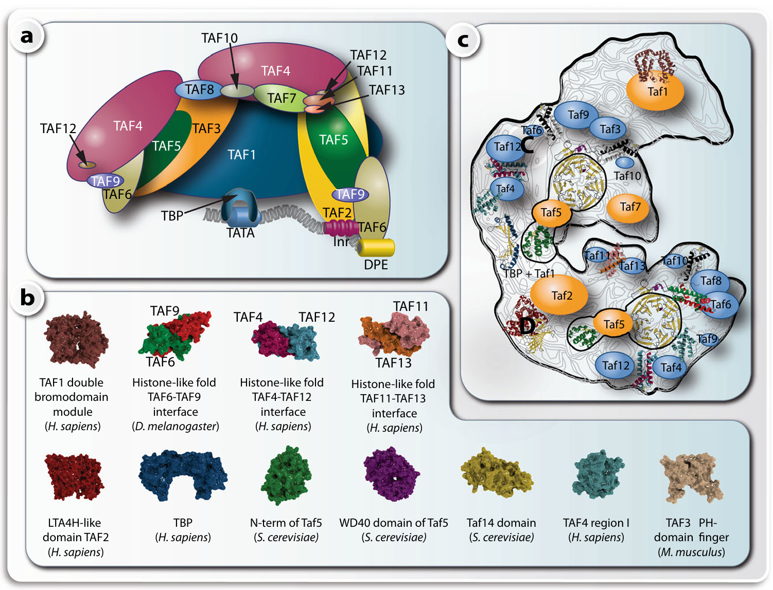
TFIIB as a paradigm of a multiprotein complex
Schematic representation of the multi protein complex TFIID, where the size of the different subunits is relative to their molecular mass a. Crystallized domains and folds of TAFs from different species b. With the exception of the histone fold domains, there is the same fold in TAF10-TAF8 and TAF10-TAF3 interacting surfaces. The LTA4H (leukotriene A4 hydrolase)-like domain that is homologous to TAF2 is based on human M1 aminopeptidase (PDB identifier 3B7S) and the characteristic WD40 propeller domain found in TAF5 is based on the carboxy-terminal domain of Tup1, which is a transcriptional corepressor in yeast (PDB identifier 1ERJ). Subunits of the yeast TFIID complex c. The known 3D structures of yeast Taf domains or their homology models are roughly positioned according to the available data on protein–protein interactions into an electron density map obtained from electron microscopic images. Tafs containing histone folds are displayed in blue. TBP is complexed with the TAND domain of Taf1

Slide 15
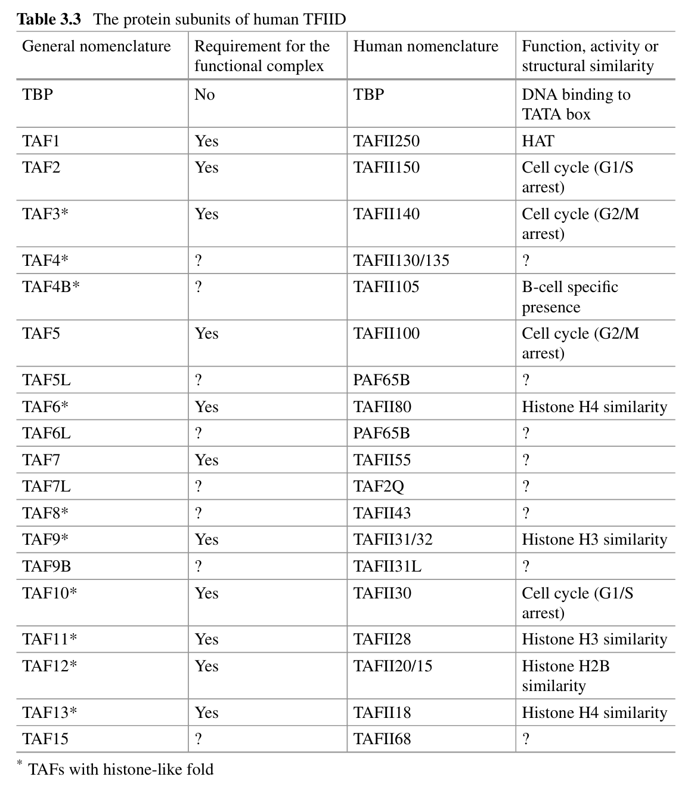

Slide 16
The Core Promoter
Assembly of the basal transcriptional machinery. The TATA box of a core promoter
(TSS region) is specifically bound by TBP that forms together with TAF proteins the multiprotein
Complex TFIID. In an ordered fashion further GTFs, such as TFII B, F, E and H, as well as Pol II
are recruited to the DNA-bound TFIID complex. Within this basal transcriptional machinery, the
catalytic site of Pol II is in a defined distance of the TATA box, i.e., the binding of TBP determines the start of transcription.

Slide 17
The Landing Pad: The Core Promoter
The Promoter Region: The DNA sequence immediately surrounding the transcription start site (TSS, usually designated +1).
Promoter Diversity: Unlike bacteria, eukaryotic core promoters are diverse and often lack strong consensus sequences.
The TATA Box: The most famous core promoter element.
Sequence: TATA(A/T)A(A/T).
Location: Typically ~25-30 base pairs upstream of the TSS (-25 to -30).
Note: Only present in a minority of human promoters (often highly regulated "sharp" promoters), but essential for understanding the basal mechanism.
Other Elements: Many genes lack TATA boxes (TATA-less promoters) and rely on other elements like the Initiator (Inr) or Downstream Promoter Element (DPE) near the TSS.

Slide 18
Assembling the Machine – Step 1: Recognition
Assembly of the basal transcriptional machinery. The TATA box of a core promoter
(TSS region) is specifically bound by TBP that forms together with TAF proteins the multiprotein
Complex TFIID. In an ordered fashion further GTFs, such as TFII B, F, E and H, as well as Pol II
are recruited to the DNA-bound TFIID complex. Within this basal transcriptional machinery, the
catalytic site of Pol II is in a defined distance of the TATA box, i.e., the binding of TBP determines the start of transcription.

Slide 19
Pre-Initiation Complex (PIC) Assembly: The First Step
The Pre-Initiation Complex (PIC): The complete assembly of GTFs and RNAPII at the promoter, ready to start transcription.
Step 1: TFIID recognizes the Promoter
TFIID is the first complex to bind. It is massive and composed of multiple subunits.
TBP (TATA-Binding Protein): A subunit of TFIID that specifically recognizes the TATA box.
Mechanism: TBP binds to the minor groove of the DNA double helix and sharply bends the DNA (~80 degrees). This structural distortion marks the spot for assembly.
TAFs (TBP-Associated Factors): Other subunits of TFIID that recognize non-TATA elements (like Inr or DPE) in TATA-less promoters.

Slide 20
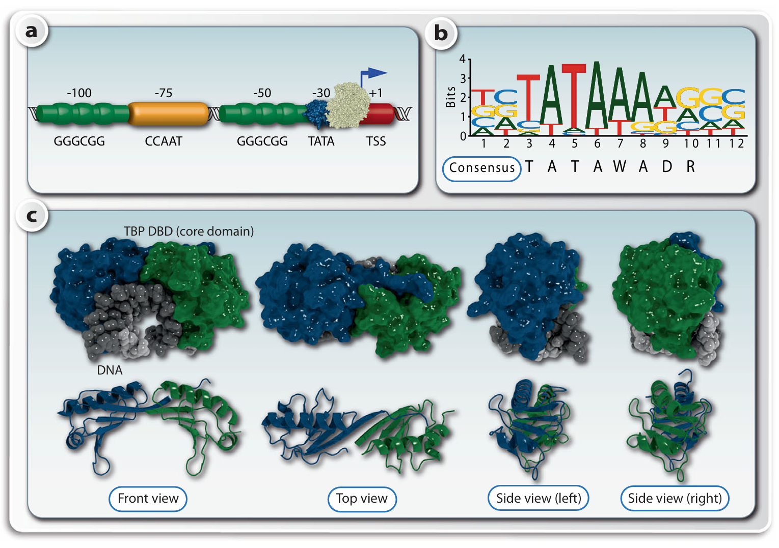
TATA box in complex with TBP
The TATA box is found some 30 base pairs upstream of the TSS of a subset of human genes and is specifically recognized by TBP
a. Other possible proximal TFBSs are CG-rich motifs being recognized by the transcription factor SP1 or CCAAT boxes bound by the transcription factors of the CEBP (CCAAT enhancer binding protein) family. All these elements belong to the core promoter (TSS region). The TATA box is the prototype of a TFBS. It can be represented either by a consensus sequence or more accurately by a sequence logo
b. Two nearly identical DBDs (blue and green) of TBP are shown in a Connolly surface model (c, top) in complex with DNA (gray) or as a ribbon model (c, bottom) in the absence of DNA

Slide 21
Assembling the Machine – Steps 2 & 3: Stabilization and Recruitment
Assembly of the basal transcriptional machinery. The TATA box of a core promoter
(TSS region) is specifically bound by TBP that forms together with TAF proteins the multiprotein
Complex TFIID. In an ordered fashion further GTFs, such as TFII B, F, E and H, as well as Pol II
are recruited to the DNA-bound TFIID complex. Within this basal transcriptional machinery, the
catalytic site of Pol II is in a defined distance of the TATA box, i.e., the binding of TBP determines the start of transcription.

Slide 22
PIC Assembly: Building the Scaffold
Step 2: TFIIA and TFIIB Bind
TFIIA: Stabilizes the TBP-DNA interaction and prevents repressors from binding.
TFIIB: A critical bridge protein. It binds to TBP and specifically contacts DNA both upstream and downstream of the TATA box. Crucially, TFIIB orients the complex, determining the direction of transcription and helping locate the TSS.
Step 3: RNAPII arrives with TFIIF
RNAPII does not arrive alone; it is escorted by TFIIF.
TFIIF binds to the RNAPII core enzyme and helps target it to the TFIID-TFIIB-DNA complex.

Slide 23
Assembling the Machine – Step 4: Activation
Assembly of the basal transcriptional machinery. The TATA box of a core promoter
(TSS region) is specifically bound by TBP that forms together with TAF proteins the multiprotein
Complex TFIID. In an ordered fashion further GTFs, such as TFII B, F, E and H, as well as Pol II
are recruited to the DNA-bound TFIID complex. Within this basal transcriptional machinery, the
catalytic site of Pol II is in a defined distance of the TATA box, i.e., the binding of TBP determines the start of transcription.

Slide 24
PIC Assembly: The Final Components (TFIIE and TFIIH)
Assembly of the basal transcriptional machinery. The TATA box of a core promoter
(TSS region) is specifically bound by TBP that forms together with TAF proteins the multiprotein
Complex TFIID. In an ordered fashion further GTFs, such as TFII B, F, E and H, as well as Pol II
are recruited to the DNA-bound TFIID complex. Within this basal transcriptional machinery, the
catalytic site of Pol II is in a defined distance of the TATA box, i.e., the binding of TBP determines the start of transcription.

Slide 25
The Powerhouse – TFIIH
Step 4: Completion of the PIC
Once RNAPII is positioned, TFIIE binds, which then recruits the final and most complex GTF, TFIIH.
The Closed Complex: At this stage, all components are present, but the DNA is still double-stranded (closed). The machine is built but not running.

Slide 26
TFIIH: Helicase and Kinase Activity
TFIIH is unique: It is the only GTF with significant enzymatic activities crucial for initiation. It is a massive complex of 10 subunits.
Activity 1: DNA Helicase (Unwinding)
Subunits of TFIIH use ATP hydrolysis to pry open the DNA double helix around the TSS.
This creates the "transcription bubble," allowing RNAPII access to the template strand.
Transition from Closed Complex to Open Complex.
Activity 2: CTD Kinase (Phosphorylation)
A subunit of TFIIH (CDK7) is a kinase.
It phosphorylates the Serine 5 (Ser5) residues of the RNAPII CTD tail.

Slide 27
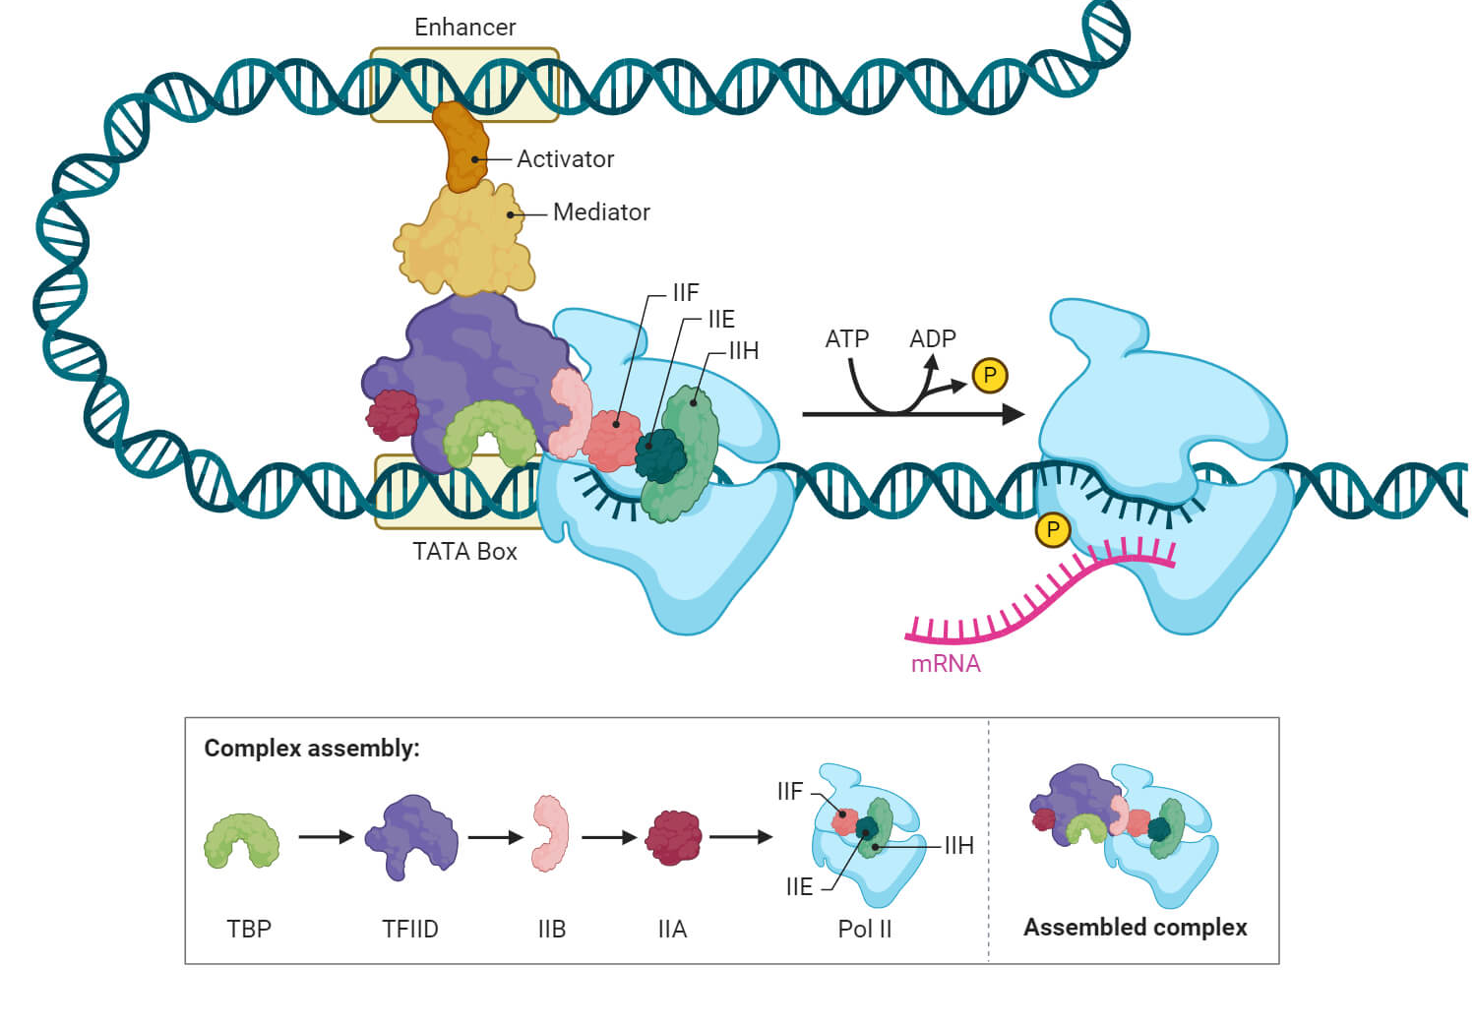
The Elongation Phase
https://microbenotes.com/eukaryotic-transcription/

Slide 28
Transition to Elongation
The Changing Code: As RNAPII moves away from the promoter, the phosphorylation pattern on the CTD changes.
Ser5-P decreases; Ser2-P increases.
Another kinase (P-TEFb) phosphorylates Serine 2 (Ser2) on the CTD repeats.
The Role of Ser2-P: This marks the polymerase as being in the "productive elongation" phase.
mRNA Processing Platform: The phosphorylated CTD tail serves as a docking platform for mRNA processing enzymes:
Ser5-P recruits 5' capping enzymes (early).
Ser2-P recruits splicing factors and 3' polyadenylation factors (later).

Slide 29
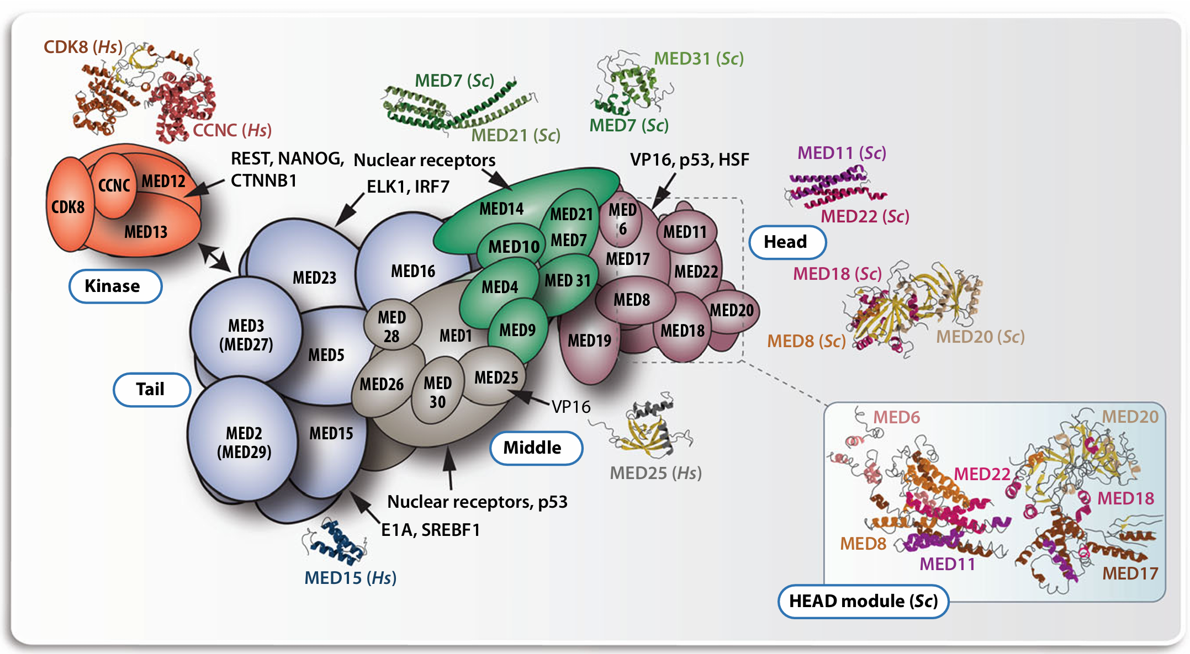
The "Real World" Context: The Mediator Complex
The MED complex. The schematic structure of the human MED complex is displayed.
The relative position of the subunits in the modules kinase (orange), tail (blue), middle (brown and
green) and head (red) is based on the displayed cocrystal structures

Slide 30
Connecting Basal Machinery to Gene Regulation
Basal is Insufficient: As noted, the GTFs + RNAPII alone are inefficient in vivo due to chromatin and the need for precise signals.
The Bridge: The Mediator Complex
A gigantic multi-subunit complex (larger than RNAPII).
It does not bind specific DNA sequences itself.
Function: It acts as a molecular bridge or "adaptor.“
One face of Mediator interacts with specific transcription factors (activators) bound to enhancers far away.
The other face interacts with the basal machinery (specifically RNAPII CTD and TFIID) at the promoter.
Significance: Mediator integrates signals from multiple regulatory proteins and transmits them to the basal machinery to stabilize the PIC and greatly stimulate transcription rates.

Slide 31
Summary: Key Takeaways
Basal Transcription: The minimum requirement for eukaryotic transcription, driven by core promoters (like TATA boxes).
RNAPII Needs Help: Unlike prokaryotic enzymes, RNAPII cannot bind promoters alone; it requires General Transcription Factors (GTFs).
PIC Assembly: An ordered process: TFIID/TBP (recognition) -> TFIIA/B (stabilization/orientation) -> RNAPII/TFIIF (recruitment) -> TFIIE/H (activation).
TFIIH is Critical: It opens the DNA (helicase) and kickstarts the polymerase via phosphorylation (kinase).
CTD Code: Phosphorylation patterns on the RNAPII C-terminal domain (Ser5-P vs. Ser2-P) orchestrate the stages of transcription and mRNA processing.
Mediator: The crucial link between specific regulatory signals and the basal machinery.

Slide 32
Xin chân thành cảm ơn!
Luu Phuc Loi, PhD
Zalo: 0901802182
luu.p.loi@googlemail.com

