Slide 1
Cancer Epigenetics Oral Midterm Exam I Module I: Fundamentals of Epigenetics
Dec 14 2025
Phuc-Loi Luu, PhD
Email: luu.p.loi@googlemail.com
Zalo: 0901802182

Slide 2
Content
Background Concepts
Interpretation

Slide 3
Background Concepts

Slide 4
? | A | A statement | B statement | B
6 | a | Gene Expression | mRNA/Protein | 1
15 | b | Genetic information | Profiling variants/mutations | 2
1 | c | A cellular trait | 1.5% of human genome | 3
7 | d | RNA-seq | Histone Octamer | 4
2 | e | DNA-seq | loosely packed and active | 5
3 | f | Protein coding genes | converts genetic information into a cellular trait | 6
11 | g | RNA Pol I | Profiling gene expression | 7
16 | h | RNA Pol II | Always heterochromatin (e.g., centromeres) | 8
4 | k | Nucleosome | They act as regulatory neighborhoods and preventing regulatory crosstalk. | 9
12 | l | chromatosome | LADs | 10
5 | n | Euchromatin | Transcribes the large ribosomal RNA genes | 11
14 | m | Heterochromatin | Histone Octamer + linker H1 | 12
8 | p | Constitutive | Can be reversibly converted to euchromatin (e.g., developmental genes) | 13
13 | q | Facultative | tightly packed and silenced | 14
9 | s | TADs | DNA | 15
10 | x | Tethering to the periphery is strongly associated with stable, long-term gene silencing. | Transcribes all protein-coding genes (mRNA) | 16

Slide 5
? | A | A statement | B statement | B
6 | a | Gene Expression | mRNA/Protein | 1
15 | b | Genetic information | Profiling variants/mutations | 2
1 | c | A cellular trait | 1.5% of human genome | 3
7 | d | RNA-seq | Histone Octamer | 4
2 | e | DNA-seq | loosely packed and active | 5
3 | f | Protein coding genes | converts genetic information into a cellular trait | 6
11 | g | RNA Pol I | Profiling gene expression | 7
16 | h | RNA Pol II | Always heterochromatin (e.g., centromeres) | 8
4 | k | Nucleosome | They act as regulatory neighborhoods and preventing regulatory crosstalk. | 9
12 | l | chromatosome | LADs | 10
5 | n | Euchromatin | Transcribes the large ribosomal RNA genes | 11
14 | m | Heterochromatin | Histone Octamer + linker H1 | 12
8 | p | Constitutive | Can be reversibly converted to euchromatin (e.g., developmental genes | 13
13 | q | Facultative | tightly packed and silenced | 14
9 | s | TADs | DNA | 15
10 | x | Tethering to the periphery is strongly associated with stable, long-term gene silencing. | Transcribes all protein-coding genes (mRNA) | 16

Slide 6
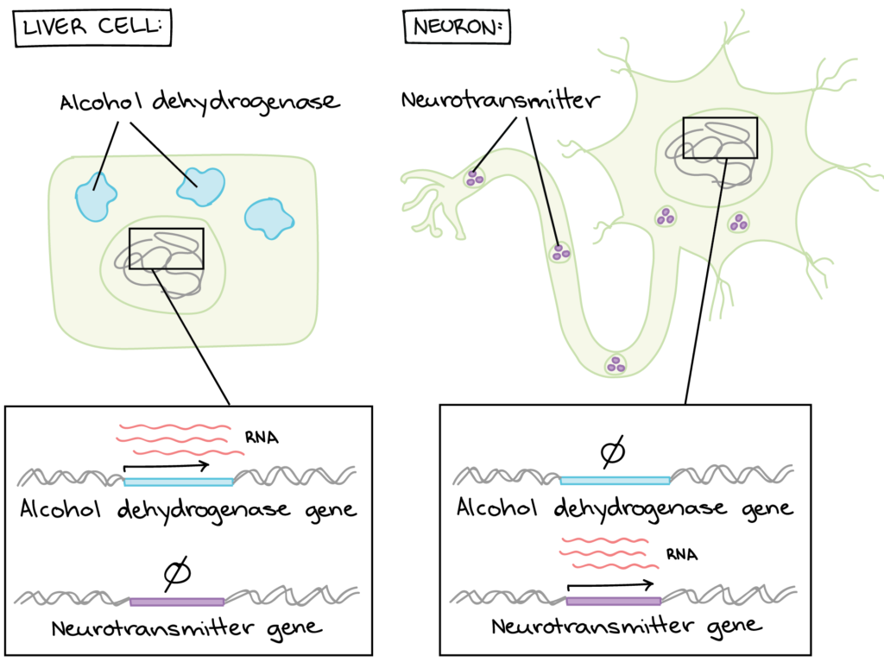
The Outcome of Gene Expression
a)
b)
d)
c)
https://courses.lumenlearning.com/wm-nmbiology1/chapter/reading-expression-of-genes/

Slide 7
The Outcome of Gene Expression
https://courses.lumenlearning.com/wm-nmbiology1/chapter/reading-expression-of-genes/

Slide 8
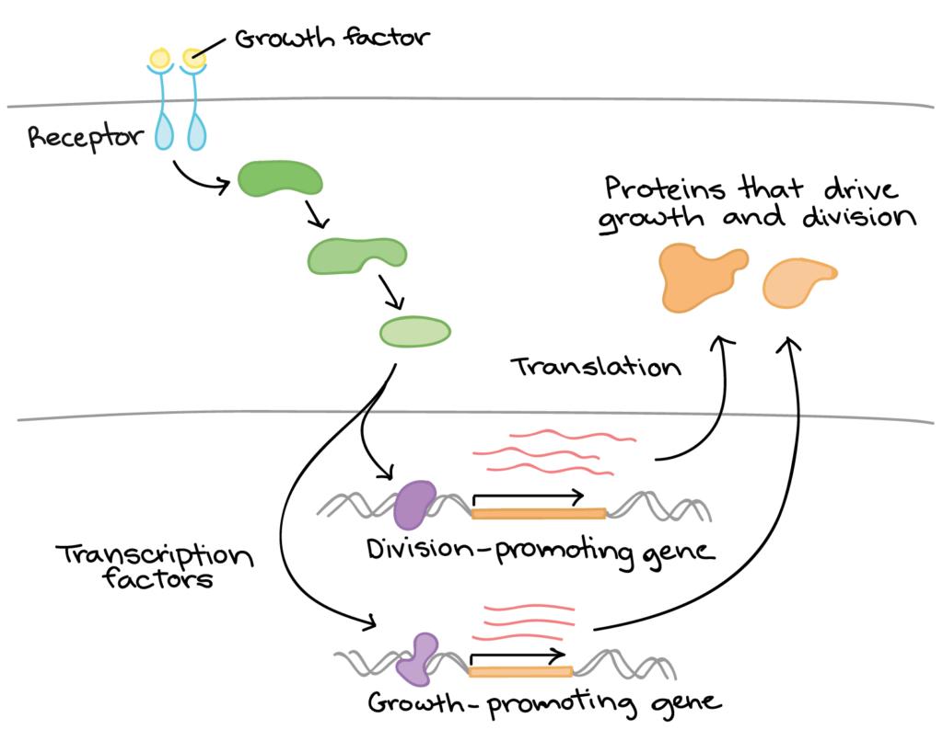
Gene expression is triggered by a signal from the cell environment
a)
Process of Signal Transduction Cascades
An Extracellular Signal (ligand) binds to a cell-surface or intracellular Receptor.
This activates a downstream cascade, often involving sequential activation of Protein Kinases.
The final step modifies a nuclear protein: a Transcription Factor (TF) or a Chromatin Modifying Enzyme.
c)
b)

Slide 9
Gene expression is triggered by a signal from the cell environment
https://courses.lumenlearning.com/wm-nmbiology1/chapter/reading-expression-of-genes/

Slide 10
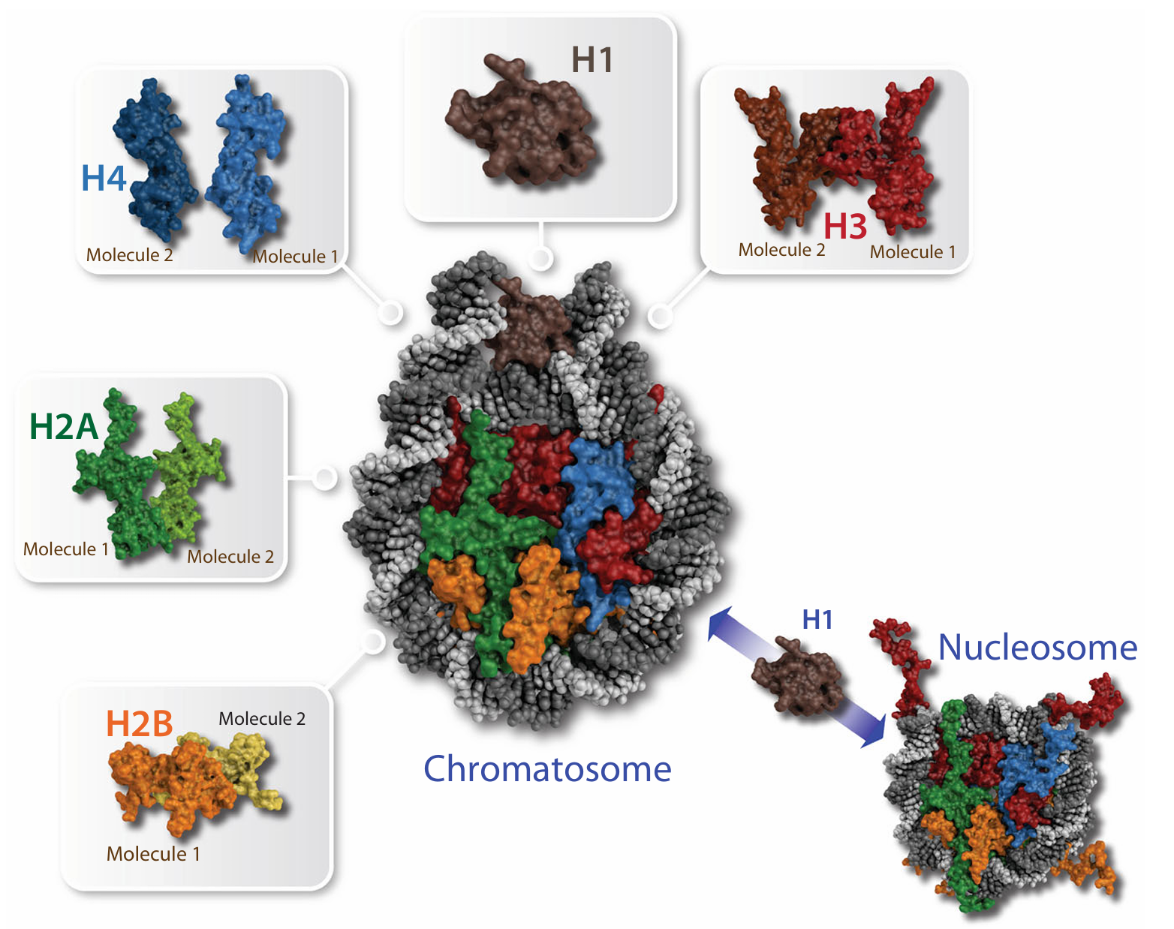
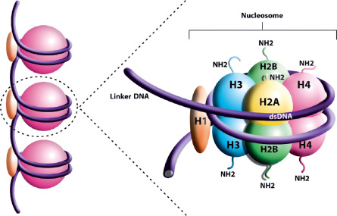
The Histone Octamer Core
c)
d)
e)
a)
f)
b)
Notes:
The nucleosome. This space-filling surface representation of a nucleosome contains two copies each of the four core histone proteins H2A (green), H2B (orange), H3 (red) and H4 (blue) and 147 base pairs of genomic DNA (gray) being wrapped 1.8-times around the histone core. In complex with the linker histone H1 (brown) the nucleosome is referred to as chromatosome

Slide 11
The Histone Octamer Core
Notes:
The nucleosome. This space-filling surface representation of a nucleosome contains two copies each of the four core histone proteins H2A (green), H2B (orange), H3 (red) and H4 (blue) and 147 base pairs of genomic DNA (gray) being wrapped 1.8-times around the histone core. In complex with the linker histone H1 (brown) the nucleosome is referred to as chromatosome

Slide 12
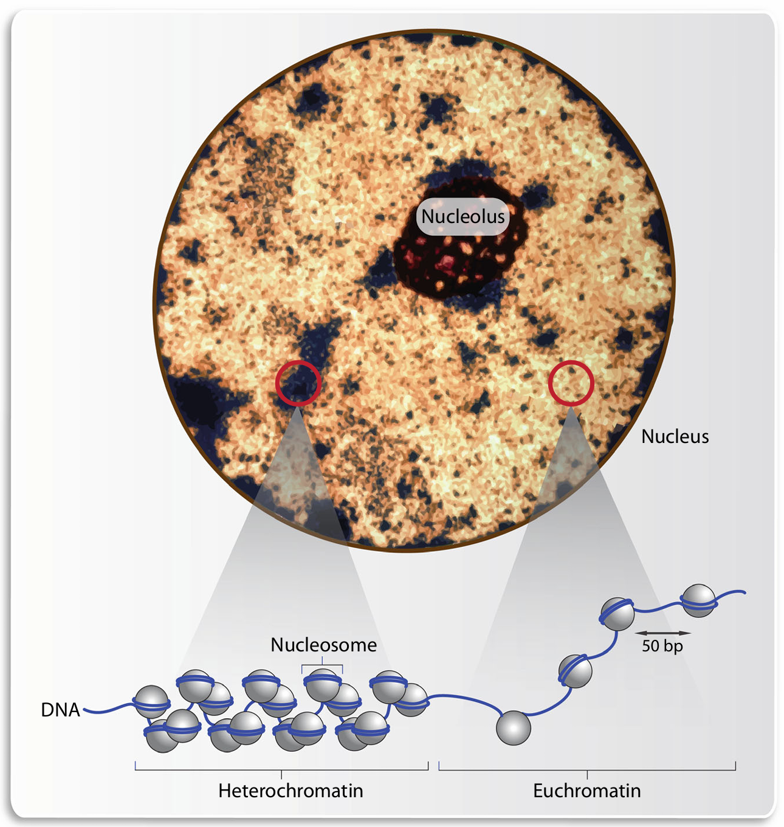
Chromatin in Interphase
During the non-dividing state (Interphase), the nucleus exhibits two main chromatin states based on condensation:
Euchromatin (loosely packed, active)
Heterochromatin (tightly packed, silenced)
These states are visible via microscopy and are the physical manifestation of epigenetic status.
d)
c)
a)
b)

Slide 13
Chromatin in Interphase
During the non-dividing state (Interphase), the nucleus exhibits two main chromatin states based on condensation:
Euchromatin (loosely packed, active)
Heterochromatin (tightly packed, silenced)
These states are visible via microscopy and are the physical manifestation of epigenetic status.

Slide 14
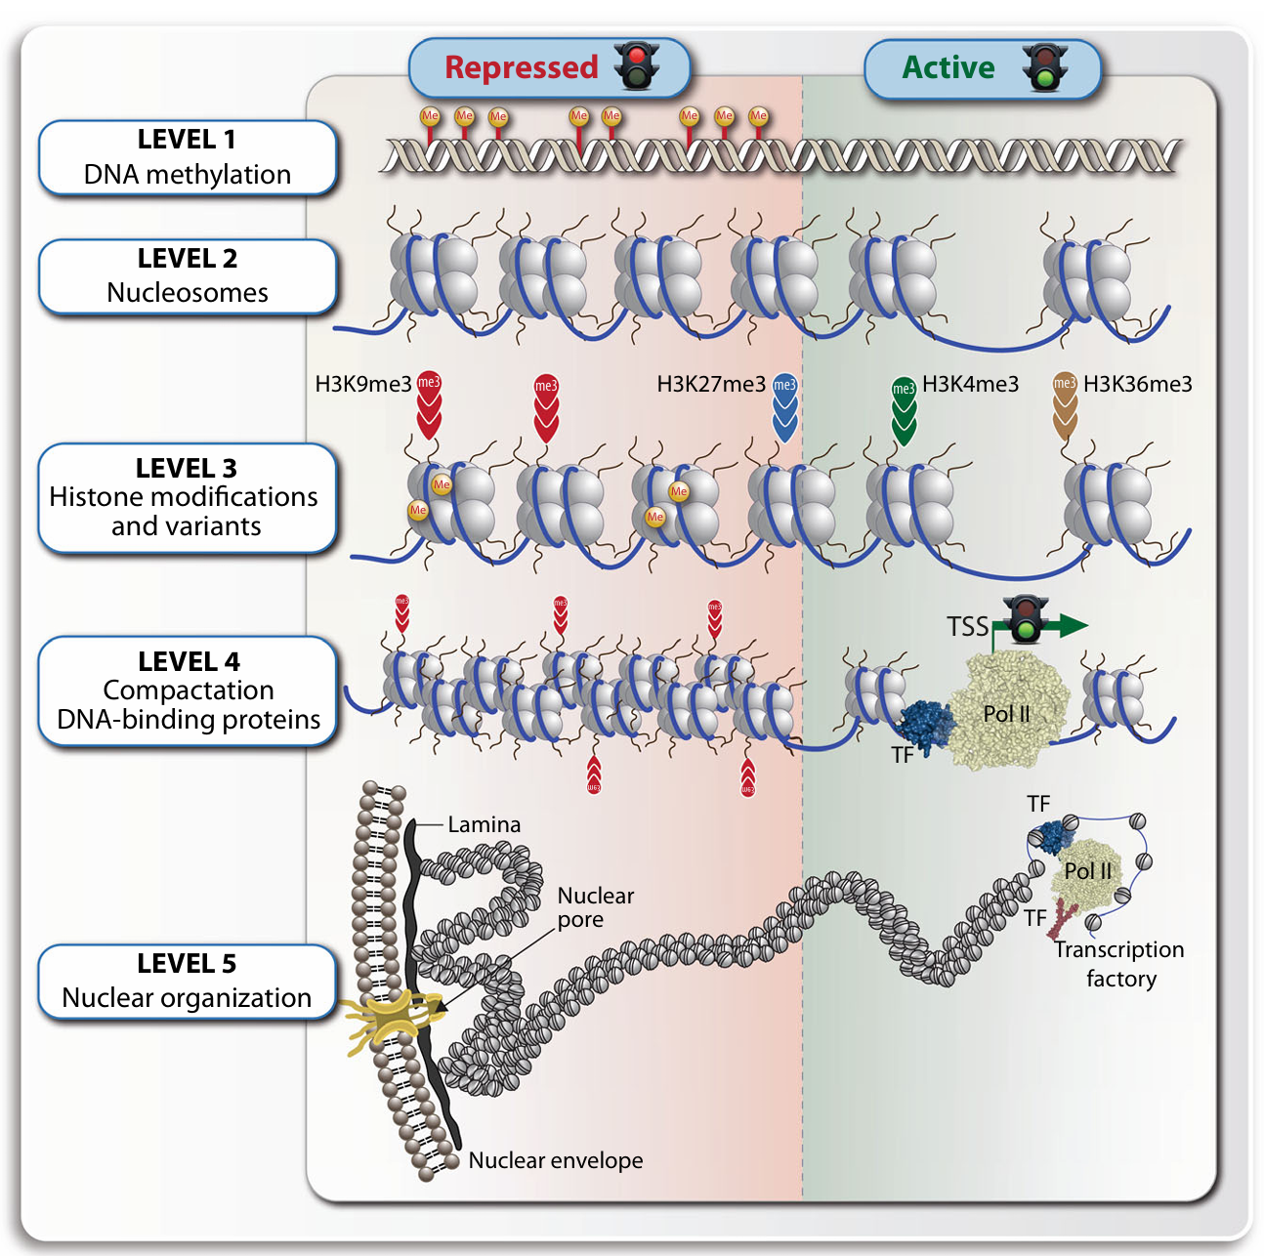
Nuclear Periphery and Silencing
a)
b)
c)
d)

Slide 15
Nuclear Periphery and Silencing
Nuclear Lamina: A protein meshwork beneath the inner nuclear membrane.
Lamin-Associated Domains (LADs): Large regions of heterochromatin that are physically anchored to the Nuclear Lamina.
Consequence: Tethering to the periphery is strongly associated with stable, long-term gene silencing.

Slide 16
Interpretation

Slide 17
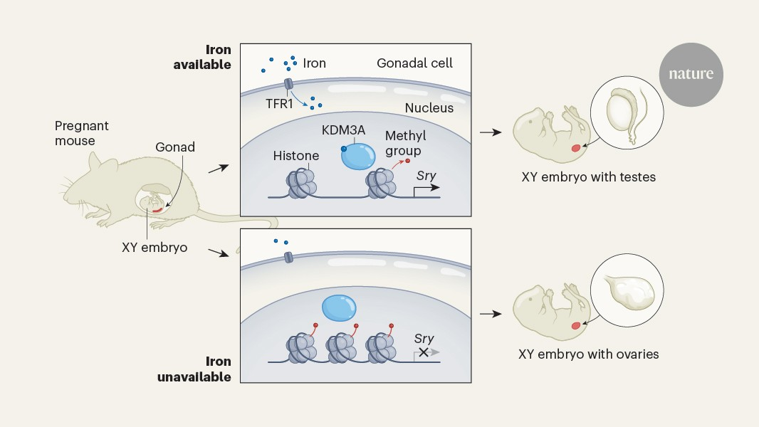
In mice, a lack of maternal iron impairs an iron-dependent enzyme that activates the male sex-determining gene, causing some XY embryos to develop ovaries
KDM3A is a histone lysine demethylase, meaning it removes methyl groups from lysine residues on histones. Specifically, it demethylates H3K9me2 and H3K9me1, making it a crucial enzyme for regulating gene expression and chromatin structure.

Slide 18
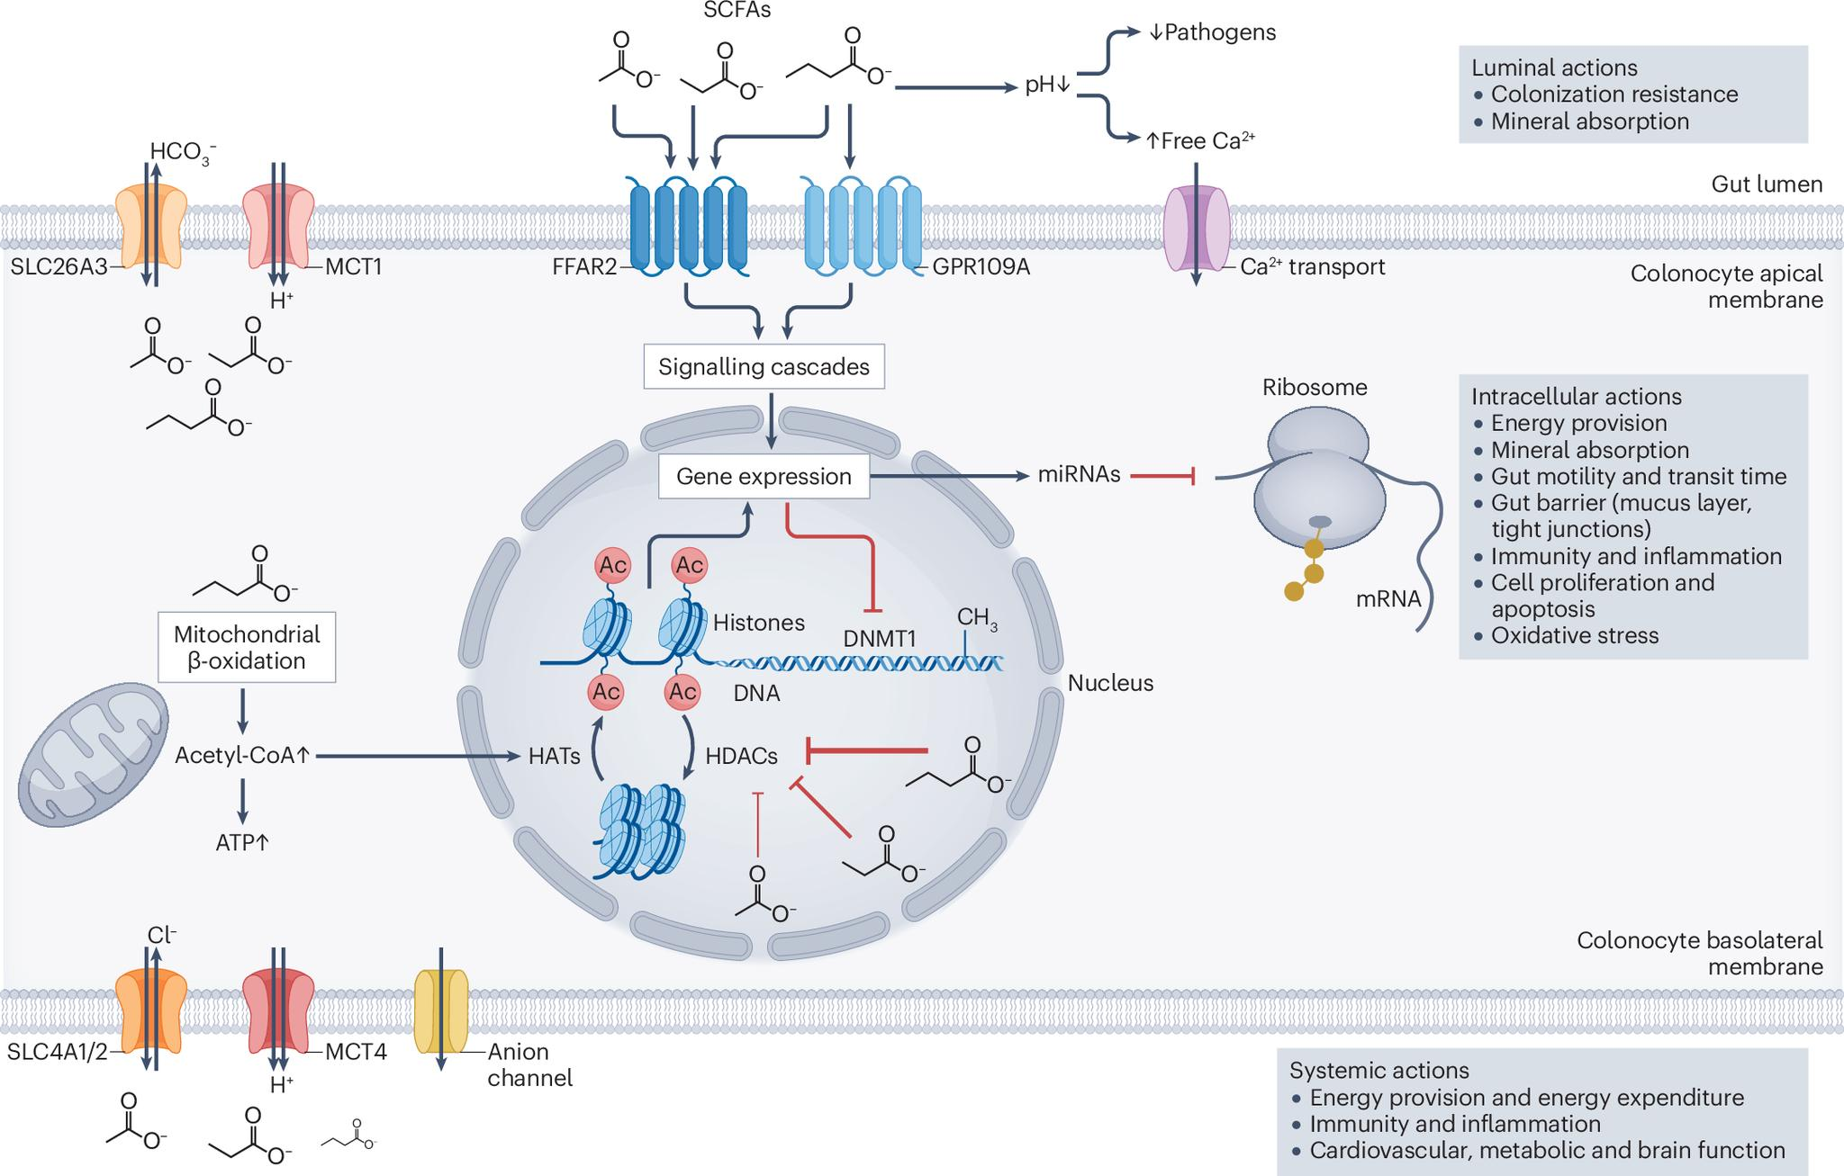
Gut microbiota-derived short-chain fatty acids and their role in human health and disease
Short-chain fatty acids (SCFAs) are a group of organic compounds produced by the fermentation of dietary fibre by the human gut microbiota. They play diverse roles in different physiological processes of the host with implications for human health and disease. This Review provides an overview of the complex microbial metabolism underlying SCFA formation, considering microbial interactions and modulating factors of the gut environment. We explore the multifaceted mechanistic interactions between SCFAs and the host, with a particular focus on the local actions of SCFAs in the gut and their complex interactions with the immune system. We also discuss how these actions influence intestinal and extraintestinal diseases and emerging therapeutic strategies using SCFAs.
https://www.nature.com/articles/s41579-025-01183-w

Slide 19
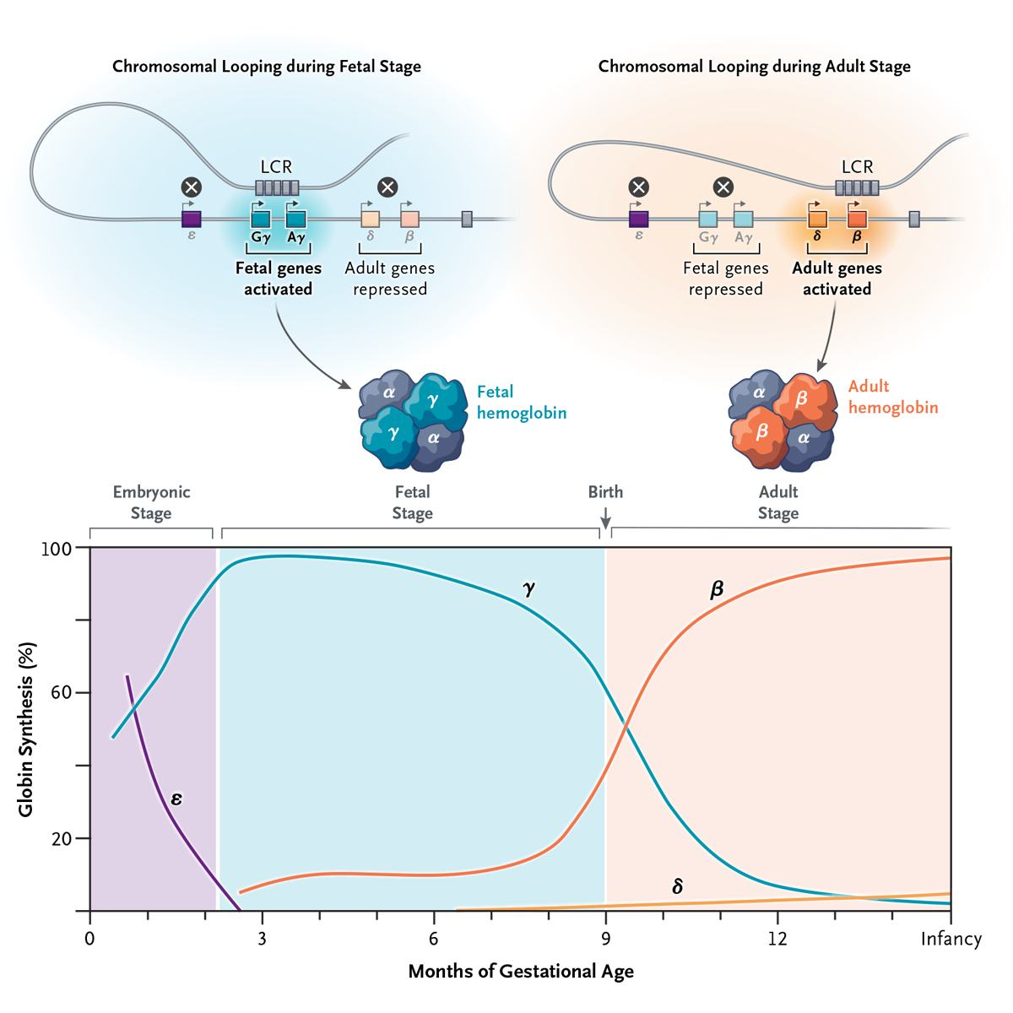
The Fetal-to-Adult Hemoglobin Switch — Mechanism and Therapy
Locus Control Region (LCR)
a
b
d
C
DOI: 10.1056/NEJMra2405260

Slide 20
The Fetal-to-Adult Hemoglobin Switch — Mechanism and Therapy
Locus Control Region (LCR)
DOI: 10.1056/NEJMra2405260

Slide 21
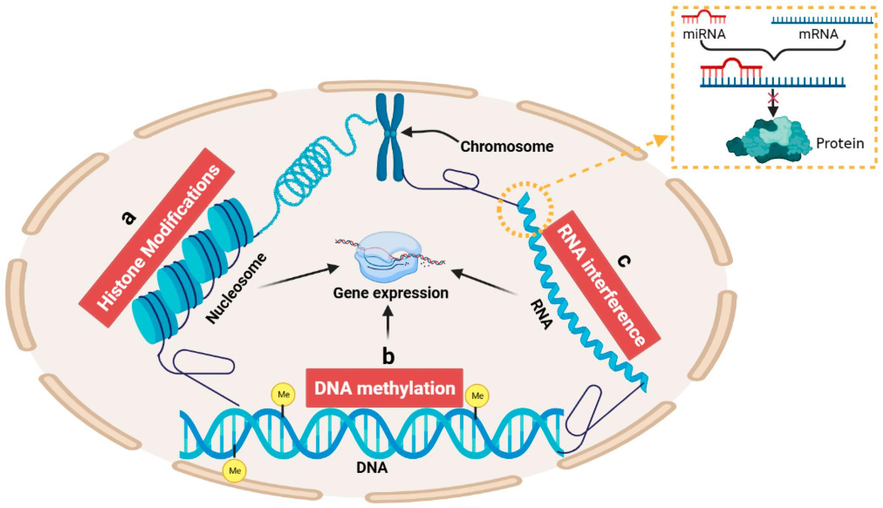
Epigenetic Mechanisms in Gene Regulation
Zhang, J.; Sheng, H.; Hu, C.; Li, F.; Cai, B.; Ma, Y.; Wang, Y.; Ma, Y. Effects of DNA Methylation on Gene Expression and Phenotypic Traits in Cattle: A Review. Int. J. Mol. Sci. 2023, 24, 11882.

Slide 22
Epigenetic Mechanisms in Gene Regulation
Zhang, J.; Sheng, H.; Hu, C.; Li, F.; Cai, B.; Ma, Y.; Wang, Y.; Ma, Y. Effects of DNA Methylation on Gene Expression and Phenotypic Traits in Cattle: A Review. Int. J. Mol. Sci. 2023, 24, 11882.

Slide 23
Thank you for your time!
Phuc-Loi Luu, PhD
Email: luu.p.loi@googlemail.com
Zalo: 0901802182

