Slide 1
A Key Transcription Factor Family:
Nuclear Receptors
Chapter 5 of A Key Transcription Factor Family: Nuclear Receptors, Carsten Carlberg (2024)
Dec 07 2025
Giảng viên: TS. Lưu Phúc Lợi
Email: Luu.p.loi@googlemail.com
Zalo: 0901802182

Slide 2
Content
Introduction to Nuclear Receptors
Principles of nuclear receptor signaling
The Nuclear Receptor Superfamily
Structural Domains of Nuclear Receptor
Molecular Interactions of Nuclear Receptor
Mechanism of Transcriptional Activation
Nuclear Receptors as Nutrient Sensors
Clinical Relevance and Therapeutics

Slide 3
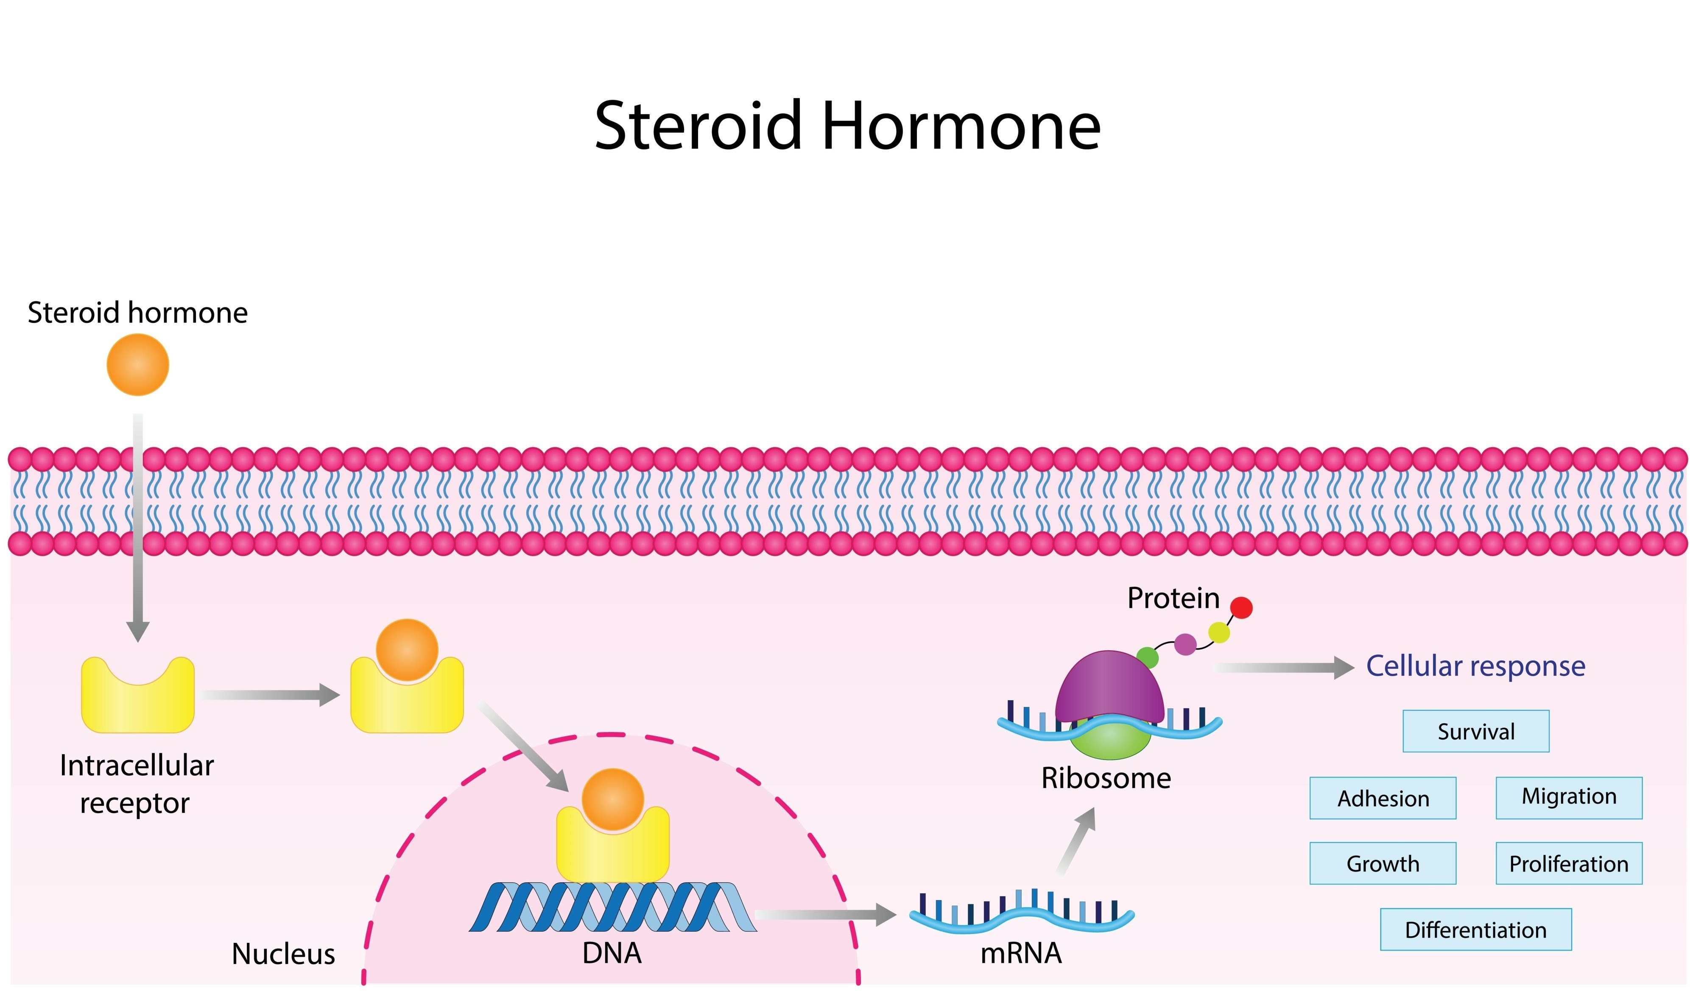
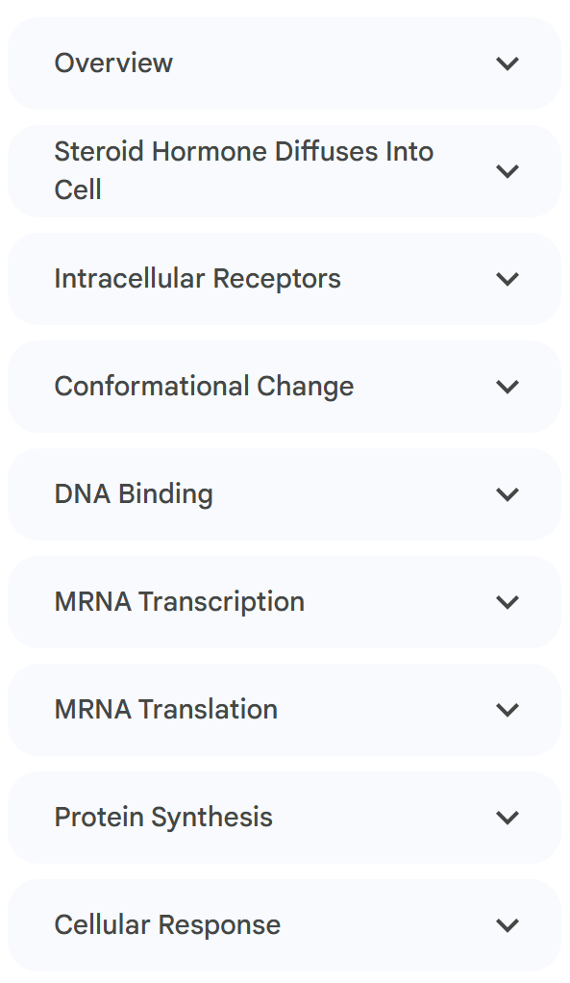
Introduction to Nuclear Receptors (NR)

Slide 4
Introduction to Nuclear Receptors
Definition: Nuclear receptors are a superfamily of ligand-inducible transcription factors.
Significance: They serve as paradigms for understanding transcription factor function, particularly molecular interactions with coactivators and corepressors.
Mechanism: Unlike hydrophilic signals (e.g., peptide hormones) that require membrane receptors and kinase cascades, nuclear receptors interact with small lipophilic signaling molecules that can pass through the cellular membrane.
Direct Link: They act as direct linkers between extracellular signals and gene transcription, often residing in the nucleus or translocating there upon activation.

Slide 5
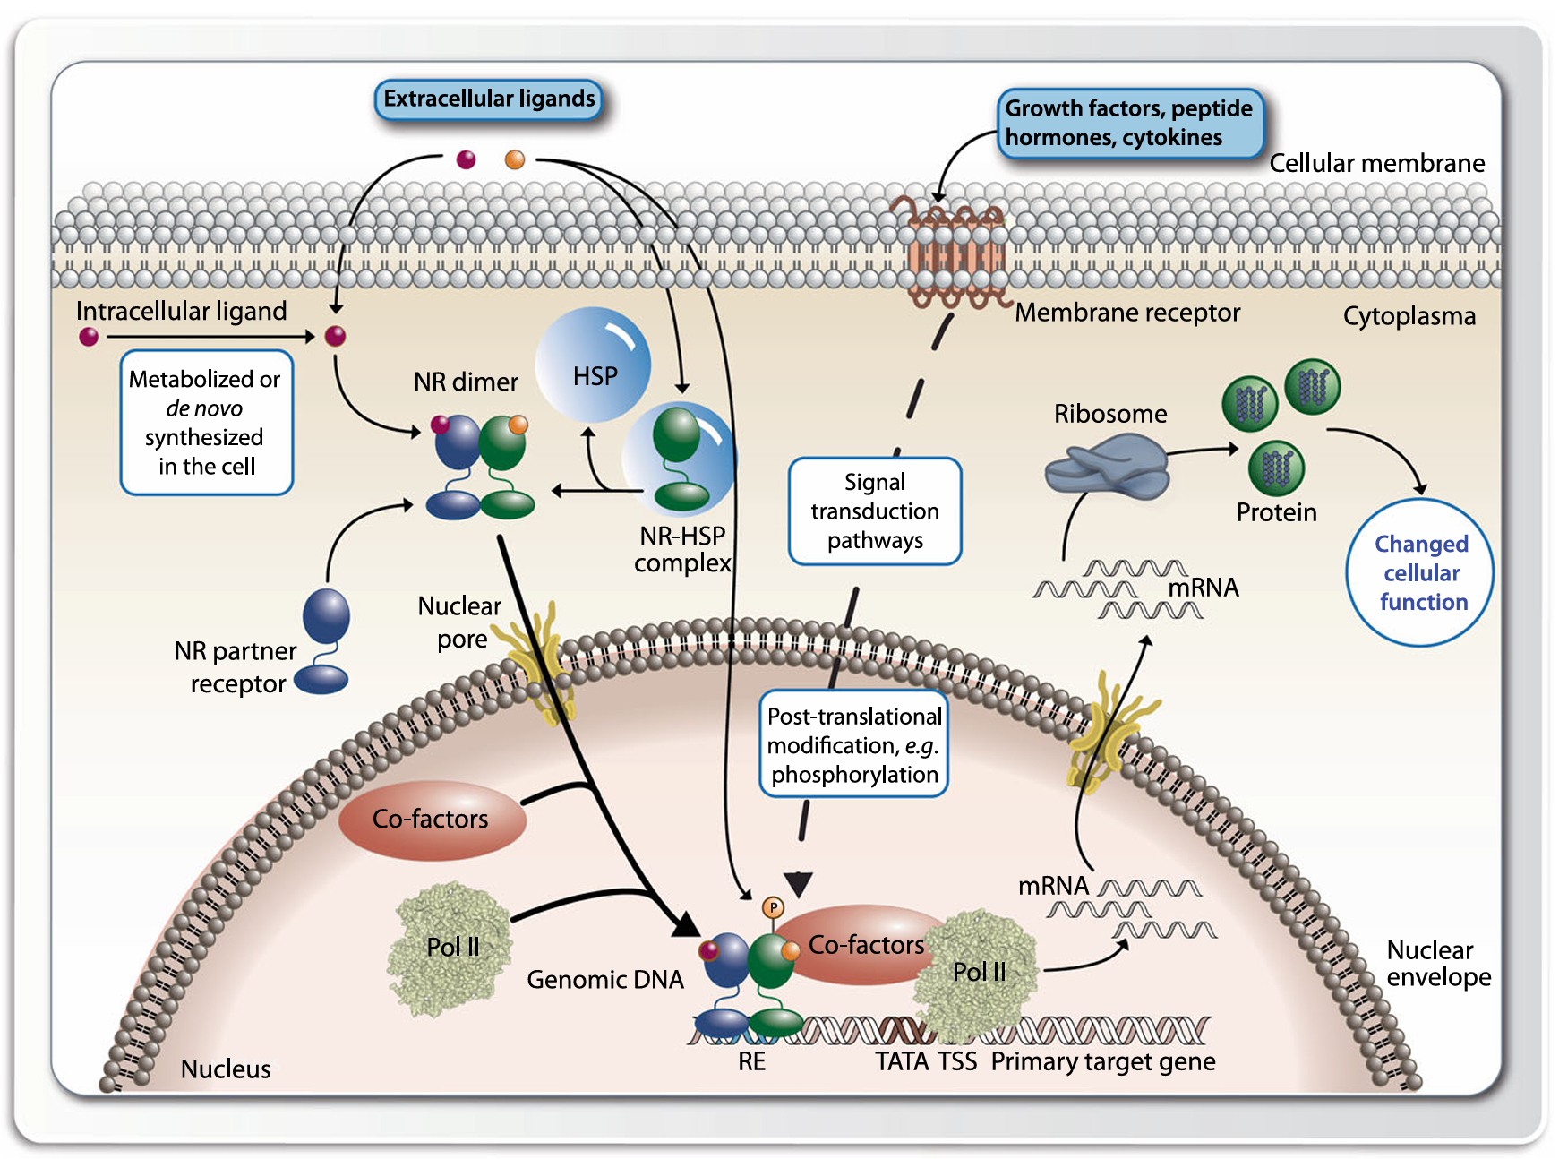
Principles of nuclear receptor signaling
Notes:
Nuclear receptors (NRs) reside either in the cytoplasma (e.g., AR and GR) in a complex with chaperone proteins, such as HSP, or are already located in the nucleus (like most nuclear receptors), when they are activated through the binding of their specific lipophilic ligand. The ligand is either of extracellular origin and has passed the cellular membrane or is a metabolite that was synthesized inside of the cell. Cytoplasmic nuclear receptors dissociate then from their chaperones and translocate to the nucleus, where they bind to their genomic binding sites (REs) in the vicinity of their target genes. Ligand-activated nuclear receptors interact with cofactors that build a bridge to the basal transcriptional machinery with Pol II in its core. This leads then to changes in the mRNA and protein expression of these target genes

Slide 6
The Nuclear Receptor Superfamily: Evolution
Gene Count: The human genome contains 48 protein-coding genes for nuclear receptors.
Evolutionary History:
Simple eukaryotes (e.g., fungi) lack nuclear receptors.
They likely evolved in metazoans as environmental sensors for nutrients and toxins.

Slide 7
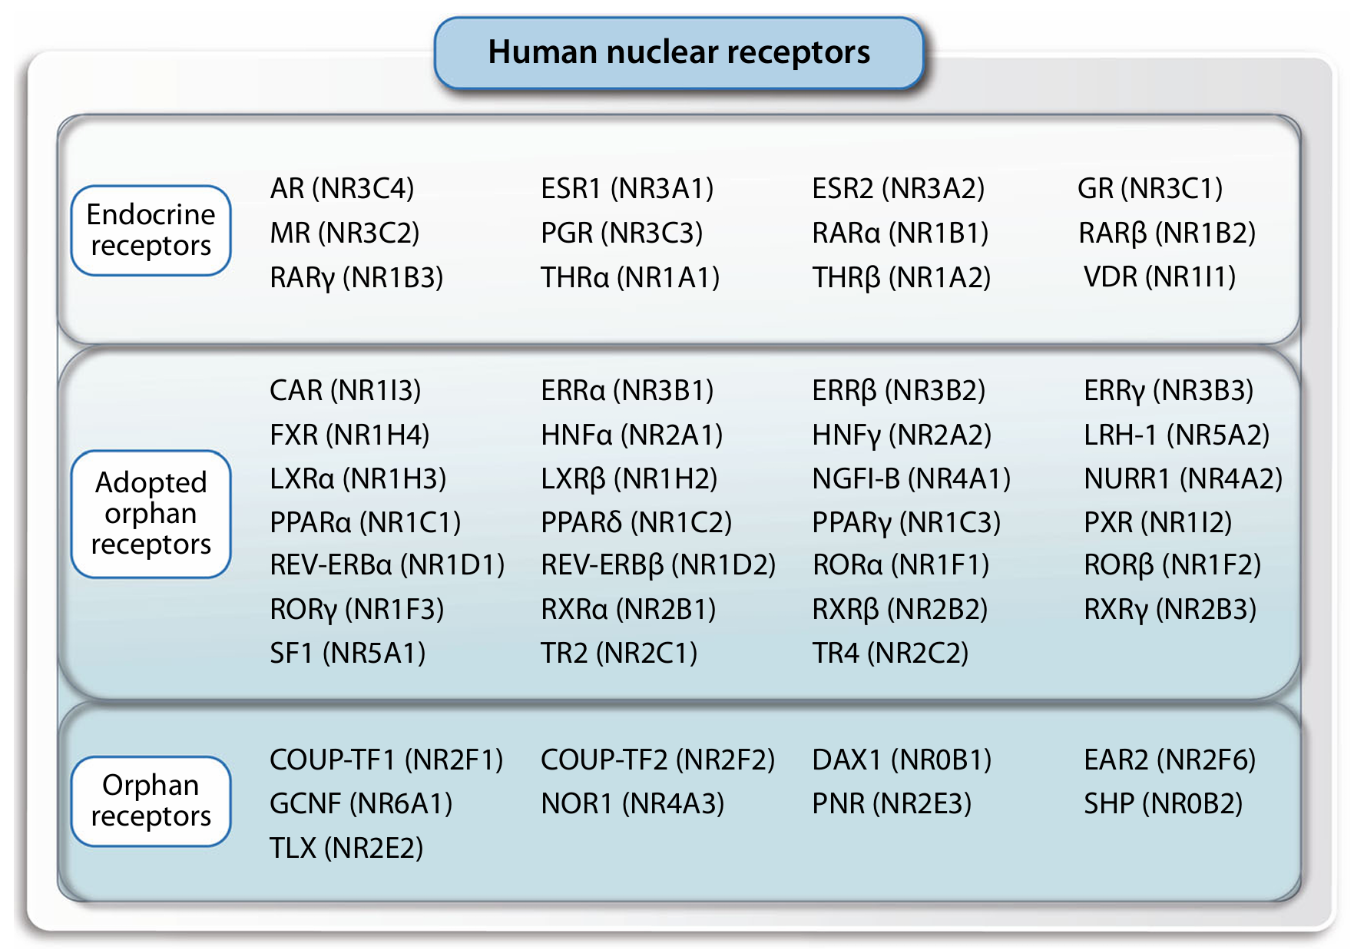
The Nuclear Receptor Superfamily: Classification

Slide 8
The Nuclear Receptor Superfamily: Classification
Three Classes
Endocrine Receptors (12 members): High-affinity receptors (K_{d} in nanomolar range) for hormones like steroids (estrogen, testosterone, cortisol), Vitamin A/D derivatives, and thyroid hormone (T₃).
Adopted Orphan Receptors: Receptors whose ligands were identified later. Ligands are often dietary lipids/metabolites (fatty acids, bile acids) with lower affinity (K_{d} in micromolar/millimolar range).
True Orphan Receptors: Receptors with no known natural ligand. They often have small ligand-binding pockets and function like constitutive transcription factors regulated by posttranslational modifications.

Slide 9
Structural Domains of Nuclear Receptor
Key Domains
DNA-Binding Domain (DBD):
Highly conserved (66–70 amino acids).
Contains two Cys4-type zinc fingers that recognize specific DNA sequences.
Ligand-Binding Domain (LBD):
Structurally conserved 3-layer sandwich of 11–13 alpha-helices.
Contains the hydrophobic ligand-binding pocket.
Helix 12: A dynamic C-terminal helix that acts like a "mouse trap," flipping position upon ligand binding to stabilize the molecule.
N-Terminal Domain:
Variable length (20–450 residues)
site for ligand-independent activation via posttranslational modifications.

Slide 10
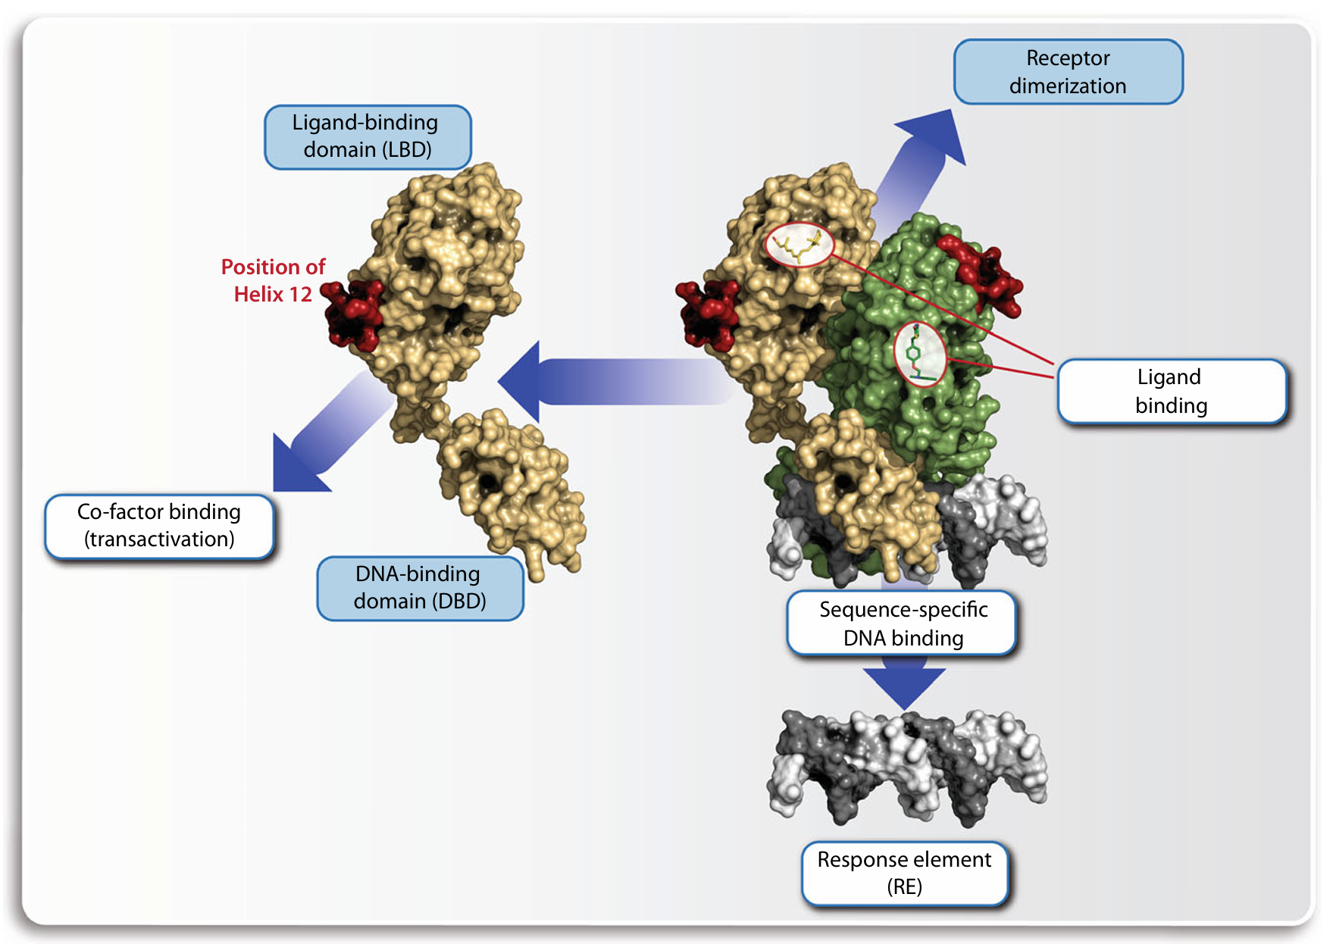
Different molecular interactions of a nuclear receptor
Notes:
Nuclear receptors are performing three types of molecular interactions. With their DBD they specifically contact DNA, with the inner surface of their LBD, the ligand-binding pocket, they bind their specific ligand and with the outer surface of their LBD they interact with partner nuclear receptors and cofactor proteins. DBD-DBD interactions direct the specificity of nuclear receptor dimers for their distinct REs. Ligand binding induces a conformational change within the LBD primarily affecting the most carboxy-terminal α-helix, helix 12. In this changed conformation the LBD has a significantly higher affinity for coactivator proteins. This ligand-induced protein–protein interaction is the core transactivation mechanism of nuclear receptors

Slide 11
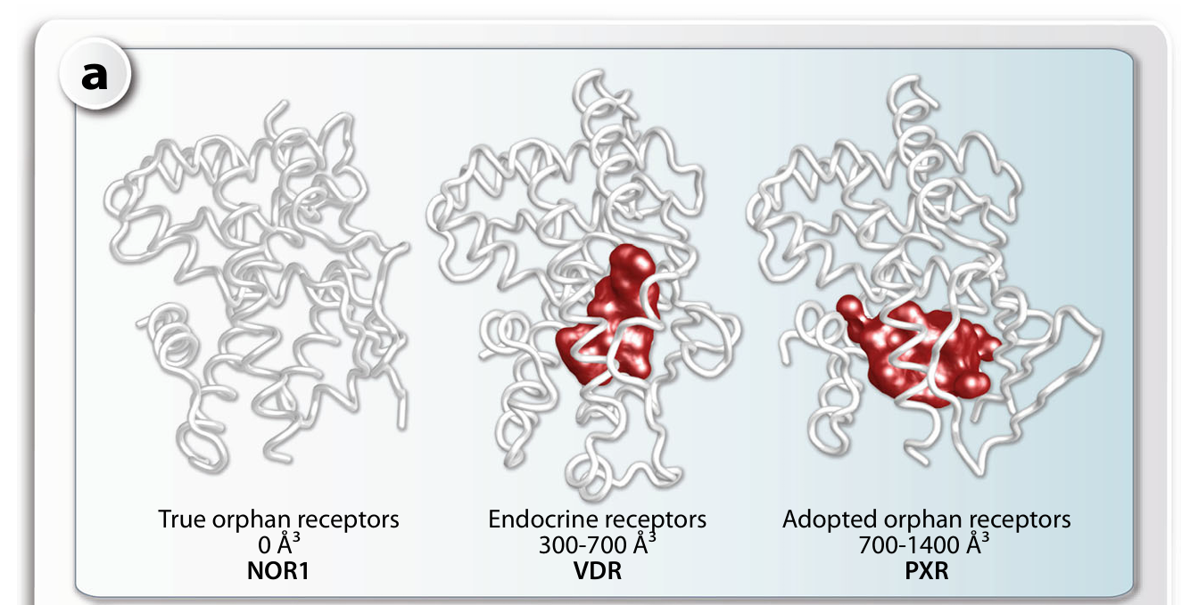
Molecular Interactions of Nuclear Receptor
Pocket Volume Differences
Endocrine Receptors:
Moderate volume (300–700 Å³)
ligand fills 60–80% of the pocket (high specificity/affinity).
Adopted Orphans:
Large volume (up to 1400 Å³)
Ligand fills only 25–50%, allowing binding of diverse promiscuous ligands.
Notes:
The volume of ligand-binding pockets of nuclear receptors and their ligands.On the first view the LBDs of the true orphan receptor NOR1 (left), the endocrine receptor VDR (center) and the adopted orphan receptor PXR (right) appear very similar a. However, NOR1 has no ligand-binding pocket, while that of adopted orphan receptors in average has the double size compared to endocrine receptors. This explains the variability of adopted orphan in ligand affinities. For comparison, the volume b and the molecular weight c of important nuclear receptor ligands are indicated. The vertical red lines mark the average

Slide 12
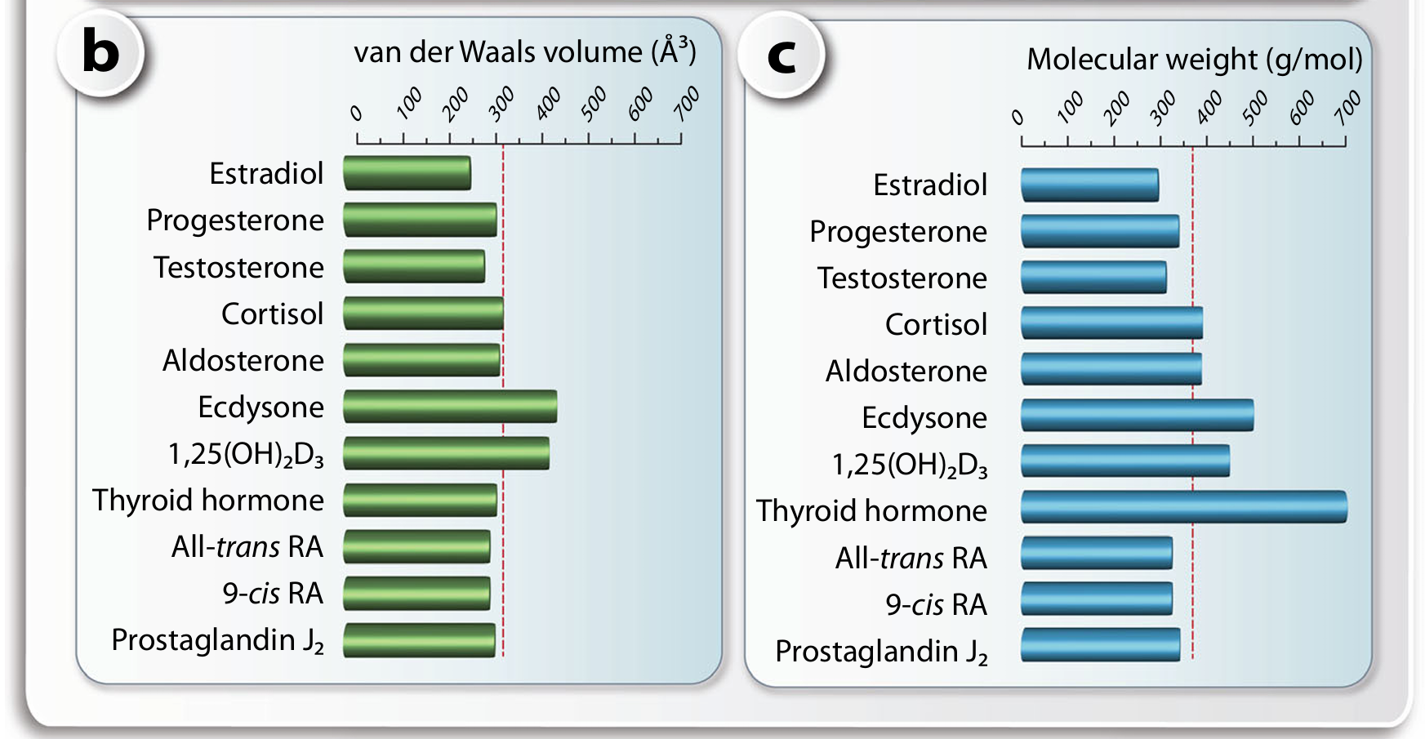
Molecular Interactions of Nuclear Receptor
Notes:
The volume of ligand-binding pockets of nuclear receptors and their ligands.On the first view the LBDs of the true orphan receptor NOR1 (left), the endocrine receptor VDR (center) and the adopted orphan receptor PXR (right) appear very similar a. However, NOR1 has no ligand-binding pocket, while that of adopted orphan receptors in average has the double size compared to endocrine receptors. This explains the variability of adopted orphan in ligand affinities. For comparison, the volume b and the molecular weight c of important nuclear receptor ligands are indicated. The vertical red lines mark the average

Slide 13
DNA Binding Specificity: The "1-to-5 Rule"
Dimerization
Most nuclear receptors bind DNA as dimers.
Homodimers: Steroid receptors (GR, AR, MR, PGR) bind inverted repeats of hexameric motifs.
Heterodimers: 14 receptors (including PPAR, LXR, VDR, THR, RAR) obligatorily partner with RXR (Retinoid X Receptor).
The 1-to-5 Rule
RXR heterodimers bind Direct Repeats (DR) of the motif AGGTCA.
Specificity is determined by the number of spacer nucleotides:
DR1: PPAR-RXR (Peroxisome Proliferator-Activated Receptor)
DR2: (Less common)
DR3: VDR-RXR (Vitamin D Receptor)
DR4: THR-RXR (Thyroid Hormone Receptor)
DR5: RAR-RXR (Retinoic Acid Receptor)

Slide 14
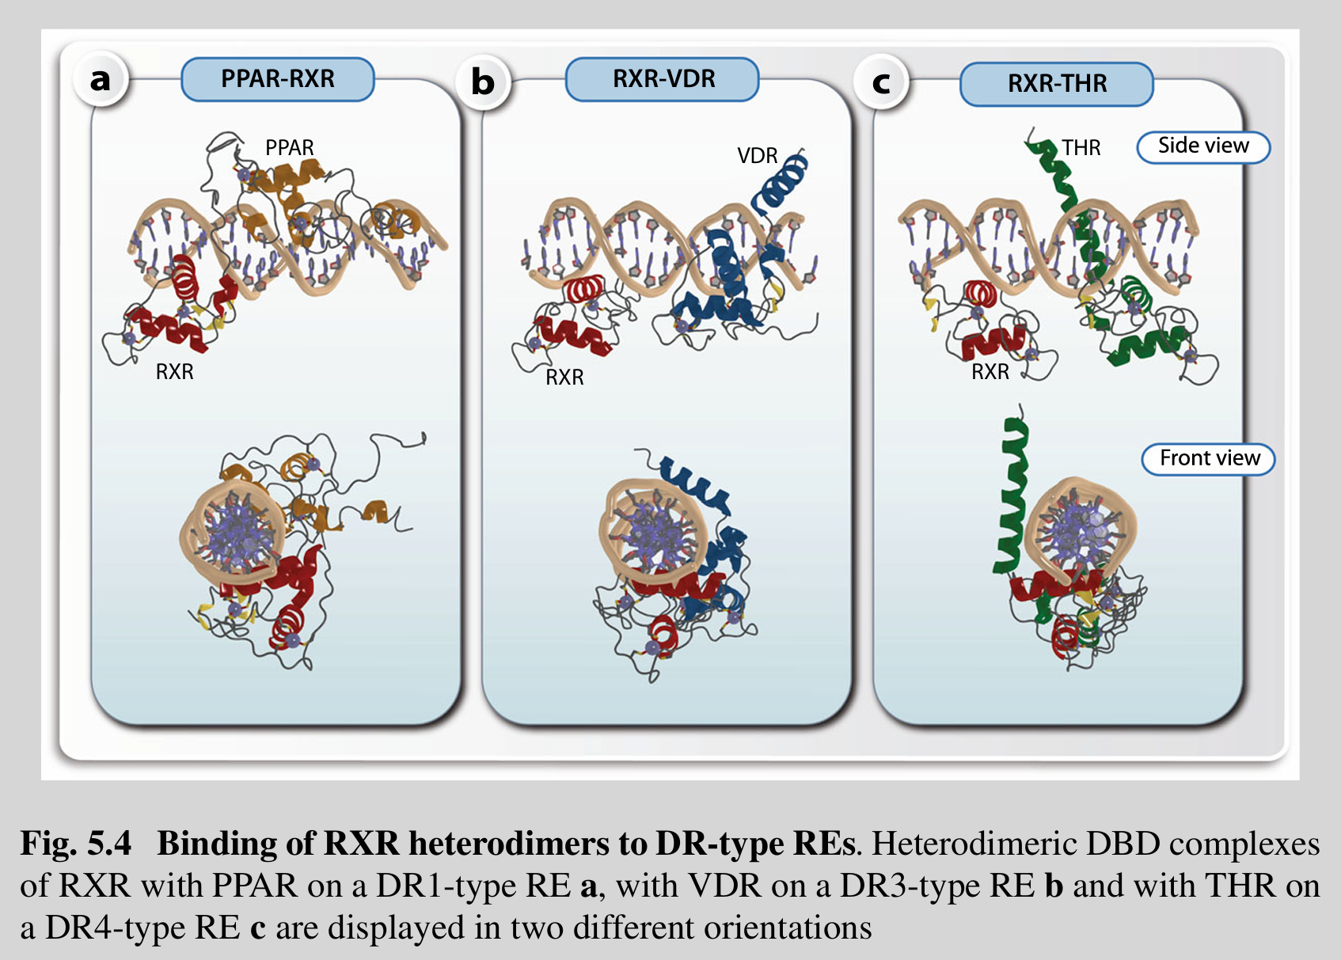

Slide 15
Mechanism of Transcriptional Activation
The 3-Step Transactivation Process
Repression (Absence of Ligand):
DNA-bound nuclear receptors recruit Corepressors (e.g., NCOR1, NCOR2).
These complexes recruit HDACs (Histone Deacetylases), leading to local chromatin condensation and gene silencing.
Activation (Ligand Binding):
Ligand binding triggers a conformational change (Helix 12 flip), displacing corepressors.
Coactivators (e.g., NCOA family) are recruited, which bring in HATs (Histone Acetyltransferases) to open the chromatin (de-repression).
Initiation:
Coactivators are replaced by the Mediator (MED) complex.
This connects the receptor to the basal transcriptional machinery (Pol II), initiating transcription.

Slide 16
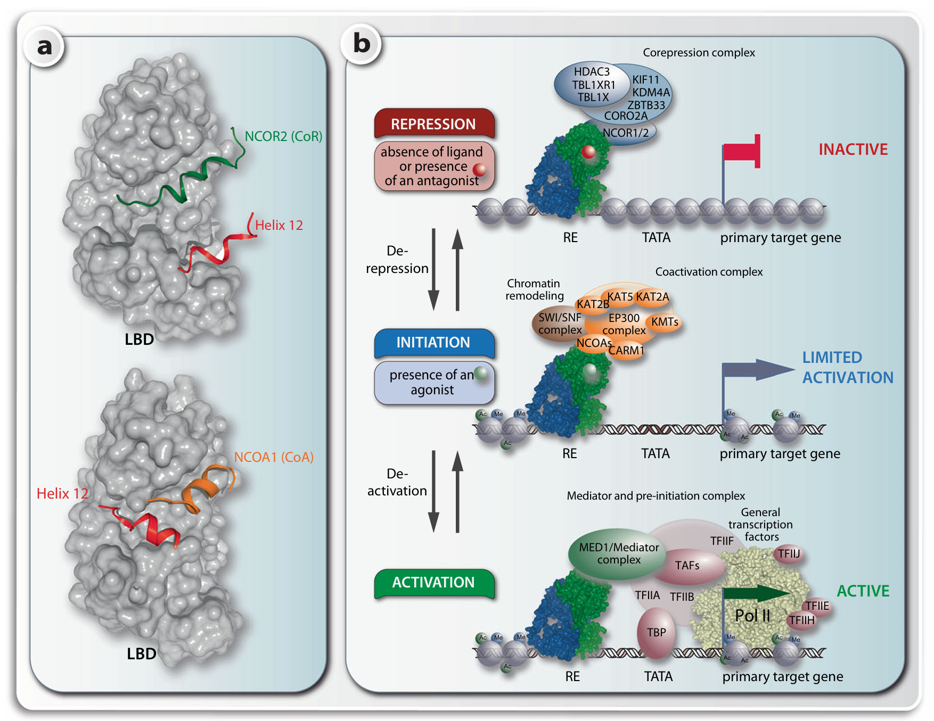
Interaction of nuclear receptors with cofactors.
A solvent excluded surface (Connolly surface) representation of a nuclear receptor LBD in the absence (top) and presence (bottom) of a ligand
Notes:
Interaction of nuclear receptors with cofactors. A solvent excluded surface (Connolly surface) representation of a nuclear receptor LBD in the absence (top) and presence (bottom)ofa ligand a. The ligand-induced conformational change primarily affects helix 12 (red) that is the most carboxy-terminal α-helix of the LBD. In the absence of ligand helix 12 is in a position that allows a corepressor protein (represented by the receptor interaction domain of NCOR2, green) to interact with the LBD, while in the presence of ligand only the binding of a coactivator protein (receptor interaction domain of NCOA1, orange) is possible. The 3-step transactivation process of nuclear receptors is shown in context of a target gene b. In the absence of a ligand the DNA-bound dimeric nuclear receptor complex is connected via corepressor proteins with a multiprotein complex with chromatin modifying activity that leads to local condensation of chromatin and repression of the target gene (top). Following the binding of an agonistic ligand the LBD of nuclear receptors is dissociating from corepressors and associating with coactivators that connect with a multiprotein complex having chromatin decondensation activity (center). The ligand-activated nuclear receptor is changing to another type of coactivator being a subunit of the MED complex (bottom). In this way, the basal transcriptional machinery and Pol II are activated and finally mRNA transcription starts. CORO2A = coronin 2A, KIF11 = kinesin family member 11, TBL1X = transducin β-like 1 X-linked, TBL1XR1 = TBL1X receptor 1, ZBTB33 = zinc finger and BTB domain containing 33

Slide 17
Nuclear Receptors as Nutrient Sensors
Metabolic Integration
Adopted orphan receptors act as sensors for micro- and macronutrients, regulating lipid, glucose, and energy metabolism.
Triangle Regulatory Circuits: A metabolite activates a receptor → receptor regulates the enzyme/transporter → enzyme controls metabolite levels.

Slide 18
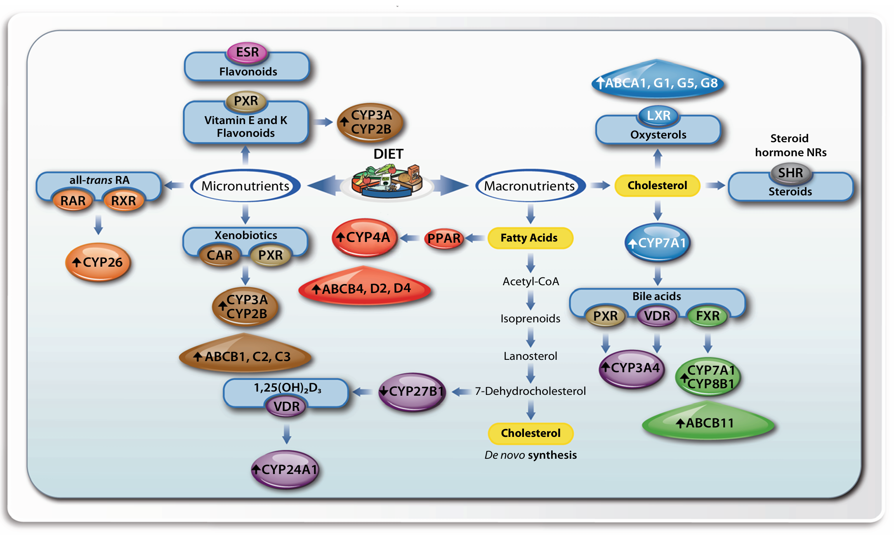

Slide 19
Nuclear Receptors as Nutrient Sensors
Key Metabolic Receptors:
PPARs (Fatty Acid Sensors):
PPAR alpha: Liver/heart. Regulates fatty acid oxidation (fasting response) and ketogenesis.
PPAR gamma: Adipose tissue. Master regulator of adipogenesis and insulin sensitivity.
LXRs (Oxysterol Sensors):
Promote reverse cholesterol transport (via ABCA1, ABCG1) to eliminate excess cholesterol.
Stimulate lipogenesis (SREBF1, FASN) to buffer free cholesterol.
FXR (Bile Acid Sensor): Protects liver from bile acid toxicity by inhibiting their synthesis (CYP7A1) and promoting excretion.

Slide 20
Clinical Relevance and Therapeutics
Pharmacology
Nuclear receptors are major drug targets due to their lipophilic ligand pockets.
Thiazolidinediones (e.g., Rosiglitazone): Activate PPAR-gamma to treat Type 2 Diabetes (improve insulin sensitivity).
Fibrates: Activate PPAR-alpha to treat hyperlipidemia.
Tamoxifen: ER antagonist used in breast cancer therapy.
Inflammation and Immunity
Many NRs (GR, VDR, PPAR, LXR) exert anti-inflammatory effects.
Transrepression: They inhibit inflammatory transcription factors like NF-kappaB and AP1 through protein-protein interactions, reducing cytokine production.
Vitamin D (VDR): Promotes antimicrobial peptide expression (CAMP) in macrophages to fight infection (e.g., tuberculosis).
Notes:
To wrap up, Transcription Factors are the interface between the genome and the environment. They are not just static switches; they are dynamic, structural proteins that form the basis of development and disease. Understanding their domains and signaling pathways allows us to understand how diseases like cancer arise (when these signals go wrong) and how to treat them.

Slide 21
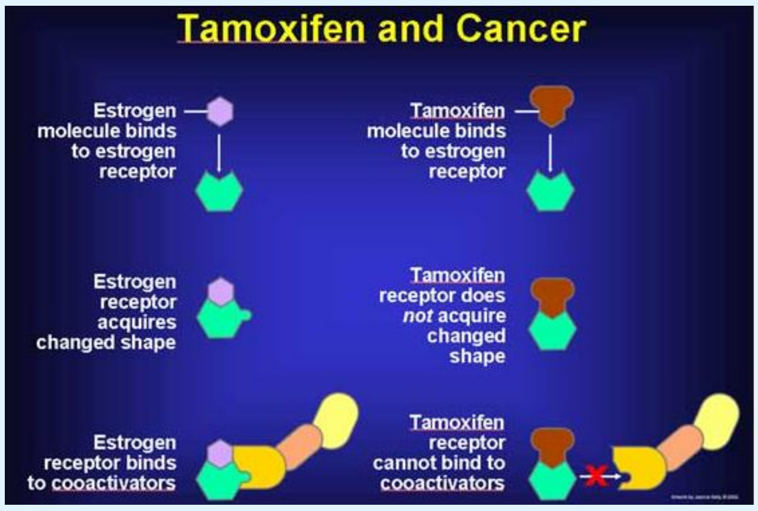
DOI:10.23880/OAJPR-16000143

Slide 22
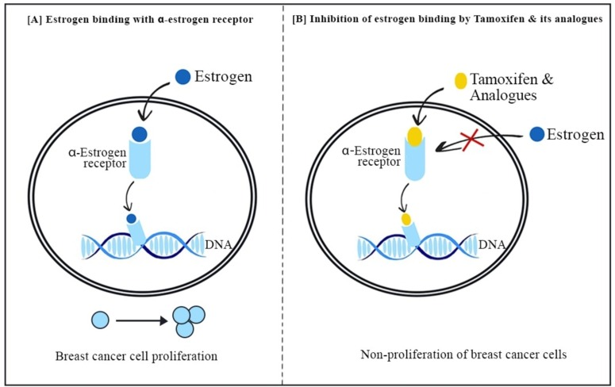
10.1016/j.molliq.2024.126209

Slide 23
Summary
Nuclear receptors serve since some 30 years as paradigms for many functional and structural aspects of transcription factors, such as the interaction with coactivator and corepressor proteins.
Many of the 48 human members of the largest family of transcription factors in metazoans have the unique property to be specifically activated by small lipophilic ligands in the size of cholesterol (approximately 400 Da).
Some of these ligands are known as endocrine hormones, such as estradiol and testosterone, while others are metabolites of dietary compounds, such as fatty acids and cholesterol.
Both types of lipids are of large physiological impact in health and disease, such as metabolic control and the modulation of immunity.
This made nuclear receptors especially attractive for both basic and applied research.
Notes:
To wrap up, Transcription Factors are the interface between the genome and the environment. They are not just static switches; they are dynamic, structural proteins that form the basis of development and disease. Understanding their domains and signaling pathways allows us to understand how diseases like cancer arise (when these signals go wrong) and how to treat them.

Slide 24
Xin chân thành cảm ơn!
Luu Phuc Loi, PhD
Zalo: 0901802182
luu.p.loi@googlemail.com

