Slide 1
Transcription Factors and Signal Transduction
Focus: Transcription factors as the key controllers of gene expression.
Chapter 4 of Transcription Factors and Signal Transduction, Carsten Carlberg (2024)
Nov 30 2025
Giảng viên: TS. Lưu Phúc Lợi
Email: Luu.p.loi@googlemail.com
Zalo: 0901802182

Slide 2
Content
Introduction to Transcription Factors
Functional Domains of Transcription Factors
ChIP-seq
Classification of Transcription Factors
Signal-Dependent Activation Mechanisms

Slide 3
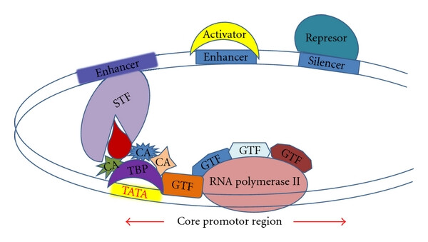
Introduction to Transcription Factors
DOI:10.1155/2011/461979

Slide 4
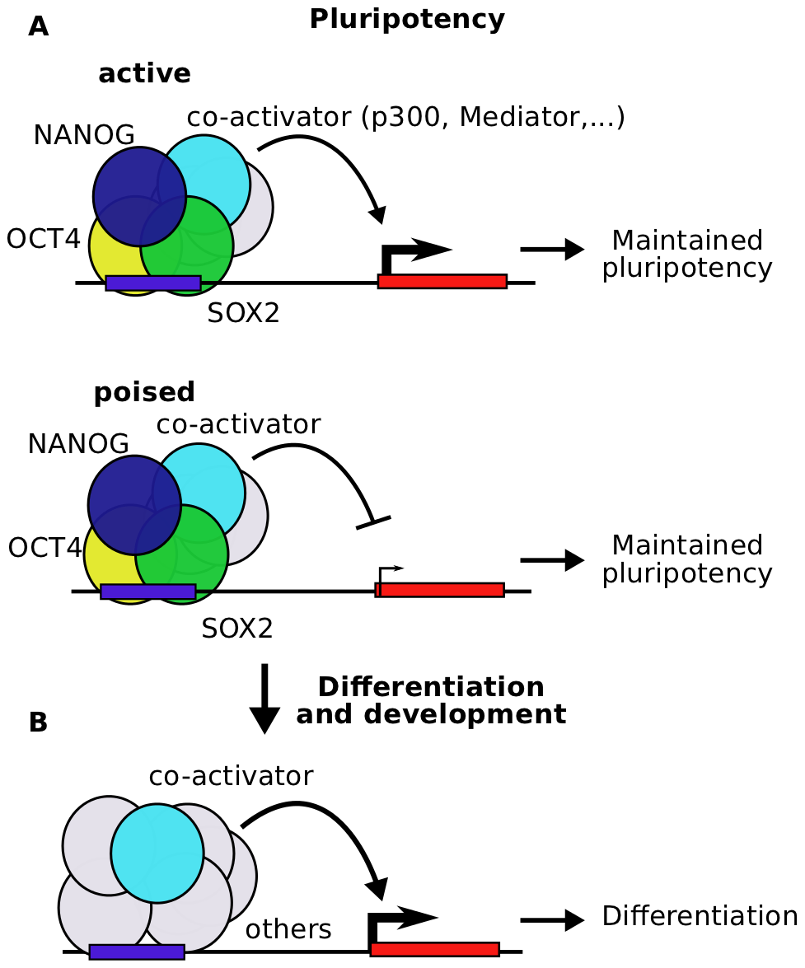
What are Transcription Factors (TFs)?
Definition: Proteins that bind sequence-specifically to genomic DNA to control gene expression.
Role: Key controllers of cell function and response to environmental perturbations.
Scale: Humans have ~1,600 TF genes (~8% of all protein-coding genes).
Mechanism:
Bind to Enhancers (proximal or distal).
Recruit Coactivators and Chromatin Modifiers.
Interact with the Basal Transcriptional Machinery (Pol II complex) via the Mediator complex.
https://doi.org/10.1371/journal.pcbi.1002304

Slide 5
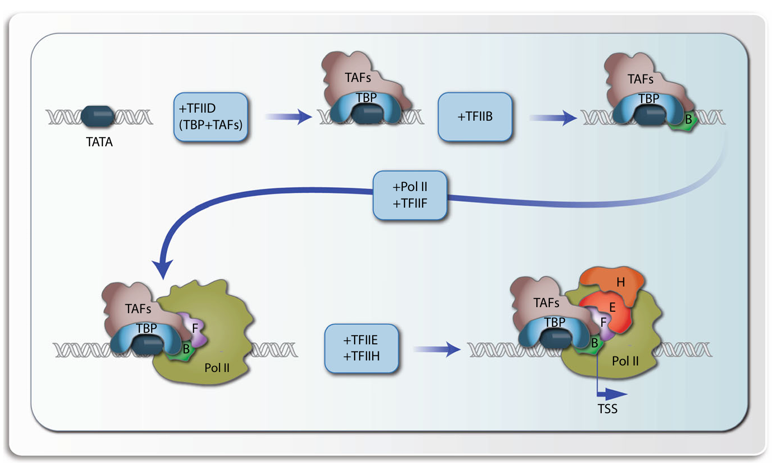
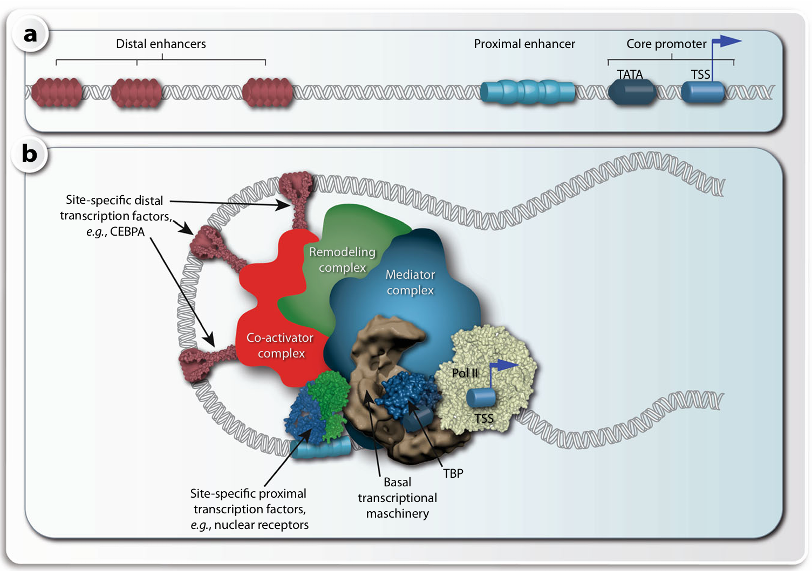
Site-Specific TFs vs General Transcription Factors (GTFs)
General Transcription Factors (GTFs): Part of the basal machinery (e.g., TFIID) at the Transcription Start Site (TSS).
Site-Specific TFs: Regulate specific genes by binding to enhancers.
Notes:
Transcription factors are the "decision makers" of the genome. While the basal machinery (discussed in Chapter 3) is the engine that drives transcription, TFs are the drivers that tell the engine when to start and how fast to go. They translate signals from the environment (like hormones or stress) into changes in gene expression. It is important to distinguish them from GTFs, which are generic and required for all transcription. Site-specific TFs provide the unique regulation required for cell identity.

Slide 6
Functional Domains of Transcription Factors
The Modular Structure of TFs A typical TF contains three specific domains:
DNA-Binding Domain (DBD):
Recognizes specific DNA sequences (motifs).
Average size: 60–90 amino acids.
Interacts primarily with the Major Groove of DNA via hydrogen bonds.
Basic amino acids (Lys, Arg) interact with the negatively charged DNA backbone.
Dimerization Domain:
Allows TFs to form homodimers or heterodimers.
Increases diversity and specificity of gene regulation.
Transactivation Domain:
Site for protein-protein interactions (e.g., with Coactivators or Mediator).
Connects the TF to the transcriptional machinery.
Notes:
TFs are modular proteins. You can think of them as having a "hand" that grabs the DNA (the DBD) and a "body" that connects to other proteins (the transactivation domain). The dimerization domain allows TFs to pair up. This is crucial because pairing increases the length of the DNA sequence recognized, making binding more specific and stable. Most interactions occur in the major groove of the DNA because it exposes more chemical information (hydrogen bond donors/acceptors) unique to each base pair than the minor groove.

Slide 7
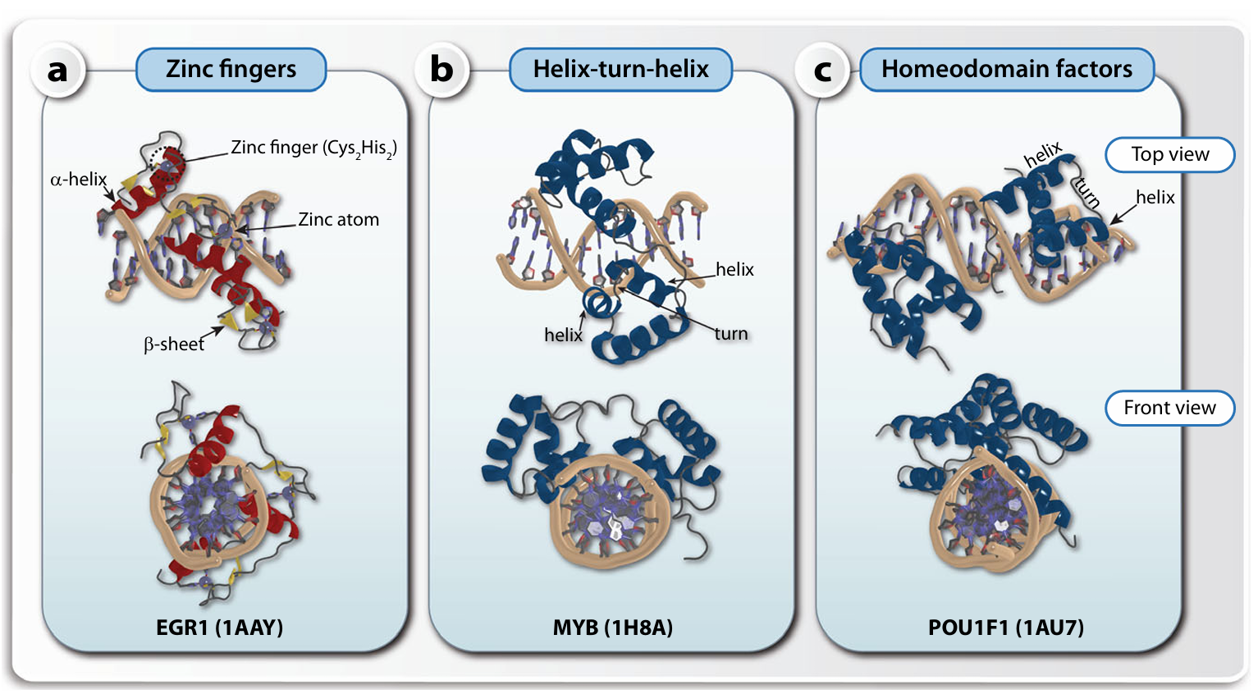
DNA-Binding Domains (DBD)
Notes:
TFs are modular proteins. You can think of them as having a "hand" that grabs the DNA (the DBD) and a "body" that connects to other proteins (the transactivation domain). The dimerization domain allows TFs to pair up. This is crucial because pairing increases the length of the DNA sequence recognized, making binding more specific and stable. Most interactions occur in the major groove of the DNA because it exposes more chemical information (hydrogen bond donors/acceptors) unique to each base pair than the minor groove.

Slide 8
DNA-Binding Domains (DBD) – Class I: Zinc Fingers
Structure:
Small motif (~30 amino acids).
Coordinates a Zinc ion (Zn²⁺)using 4 residues:
C4 Type: 4 Cysteines (common in Nuclear Receptors).
C2H2 Type: 2 Cysteines + 2 Histidines.
Function:
The Zinc ion stabilizes the 3D structure (creates a "finger" loop).
Cooperativity: A single finger binds weakly; TFs usually have multiple fingers linked in a chain to bind DNA with high affinity.
Example: CTCF (11 zinc fingers), Sp1 (3 zinc fingers).
Notes:
The Zinc Finger is the most common DBD in human TFs. The C2H2 superfamily alone has 675 members. The zinc atom is structural—it holds the small peptide domain together so an alpha-helix can insert into the DNA's major groove. Because one finger isn't strong enough, they work in tandem. CTCF, which is vital for chromatin organization (insulators), uses 11 zinc fingers to grab DNA very securely.

Slide 9
DNA-Binding Domains (DBD) – Class II: Helix-Turn-Helix
Helix-Turn-Helix (HTH):
Structure: Two alpha-helices separated by a beta-turn.
Mechanism: One helix is the "Recognition Helix" that sits in the major groove.
Evolution: Ancient motif found in bacteria and eukaryotes.
Homeodomain (Subtype of HTH):
Definition: A specific 60-amino acid HTH motif.
Role: Critical for body pattern formation during development.
Examples: HOX genes (Homeobox), POU family.
Notes:
The Helix-Turn-Helix is another major class. The "recognition helix" reads the DNA sequence. A famous subtype is the Homeodomain. The name comes from "homeotic" genes in fruit flies, where mutations caused body parts to grow in the wrong places (like legs on the head). In humans, these (like the HOX cluster) are master regulators of embryonic development. There are about 250 Homeodomain TFs in humans.

Slide 10
DNA-Binding Domains (DBD) – Class III: Homeodomain factors Dimerization Domains
1. Leucine Zipper (bZIP)
Structure: Two alpha-helices with Leucine residues every 7th position.
Mechanism: Leucines create a hydrophobic surface that "zips" two helices together.
DNA Binding: Adjacent basic region binds DNA.
Example: AP1 (Fos/Jun heterodimer).
2. Basic Helix-Loop-Helix (bHLH)
Structure: Two helices connected by a flexible loop.
Mechanism: Loop allows folding; helices mediate dimerization.
Example: MYOD1 (Muscle differentiation), MYC (Oncogene).
3. Beta-Scaffold (Minor Groove Contacts)
Mechanism: Distorts/bends DNA by inserting amino acids into the Minor Groove.
Example: TBP (TATA-binding protein), SOX factors.
Notes:
Dimerization is the "social" aspect of TFs. The Leucine Zipper gets its name because Leucines appear every 7 amino acids (creating a zipper-like hydrophobic strip). This allows two proteins to stick together. bHLH is similar but uses a loop for flexibility. While most TFs bind the major groove, the Beta-scaffold group (like TBP) is unique—it binds the minor groove and bends the DNA significantly, often acting as a platform for assembling other proteins.

Slide 11
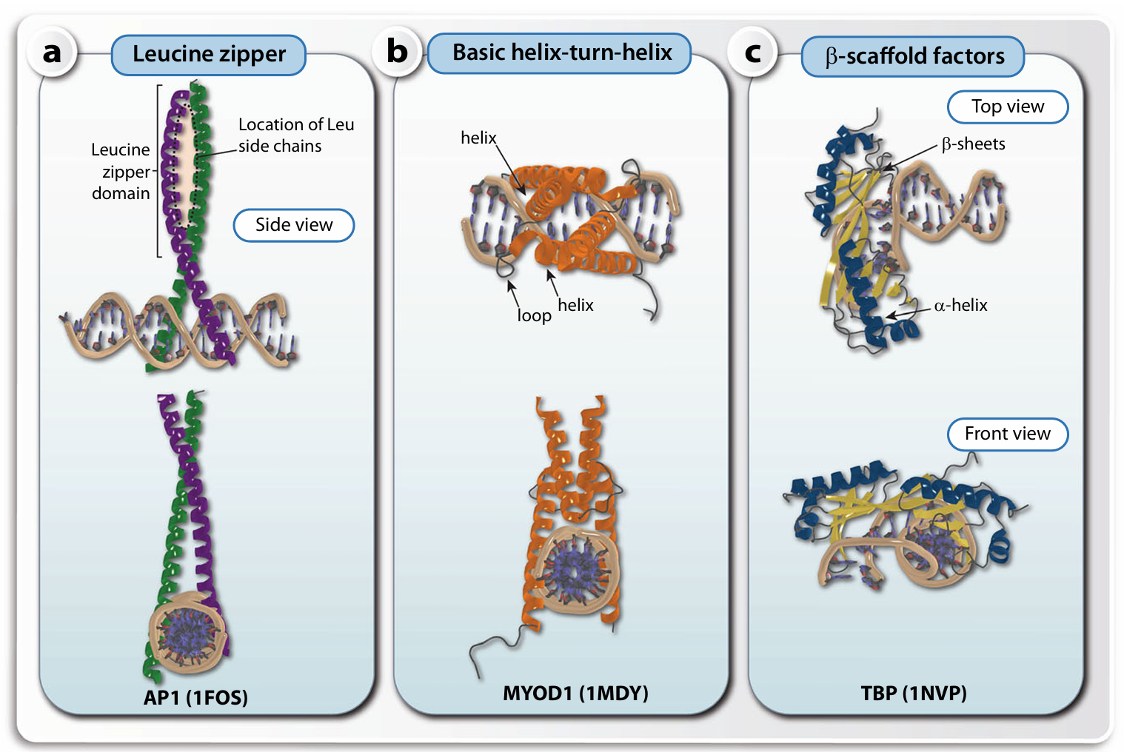
Three main classes of protein–DNA interaction modes of transcription factors
The DNA interaction of transcription factors is often directed by their mode of dimerization.
Representatives of the three main groups, leucine zipper a, helix-loop-helix b and β-scaffold factors with minor groove contacts c, are displayed in two different orientations

Slide 12
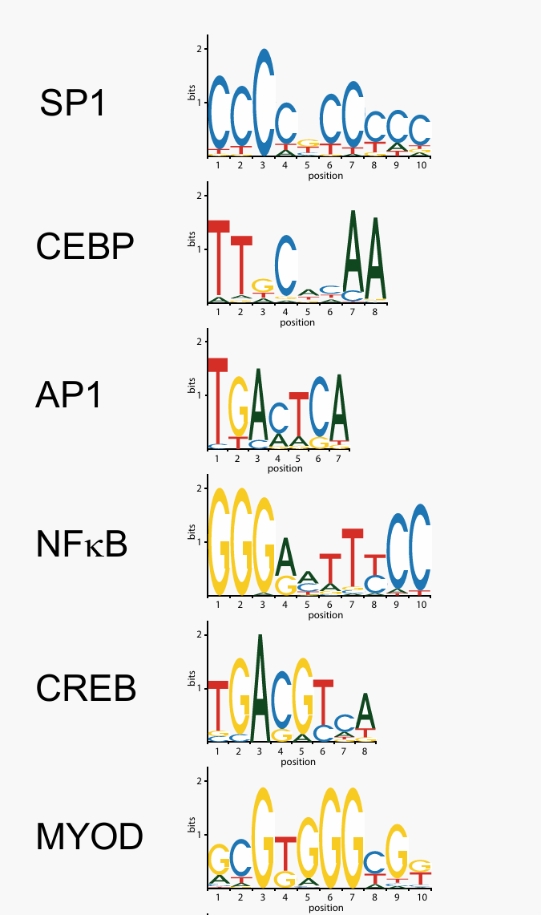
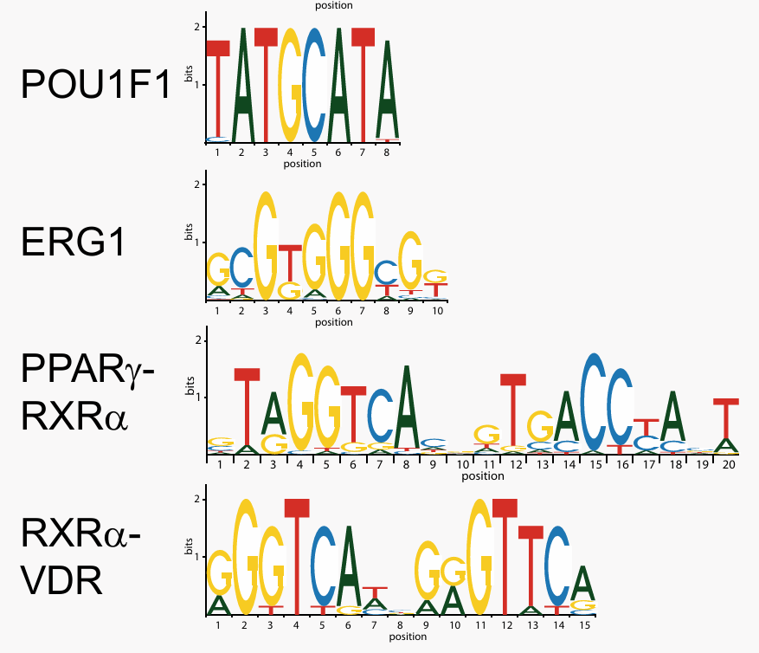
Sequence logos of key TFBSs
Notes:
Dimerization is the "social" aspect of TFs. The Leucine Zipper gets its name because Leucines appear every 7 amino acids (creating a zipper-like hydrophobic strip). This allows two proteins to stick together. bHLH is similar but uses a loop for flexibility. While most TFs bind the major groove, the Beta-scaffold group (like TBP) is unique—it binds the minor groove and bends the DNA significantly, often acting as a platform for assembling other proteins.

Slide 13
ChIP-seq for Histone modifications, TFBSs and DNAaseI Hypersensitivity

Slide 14
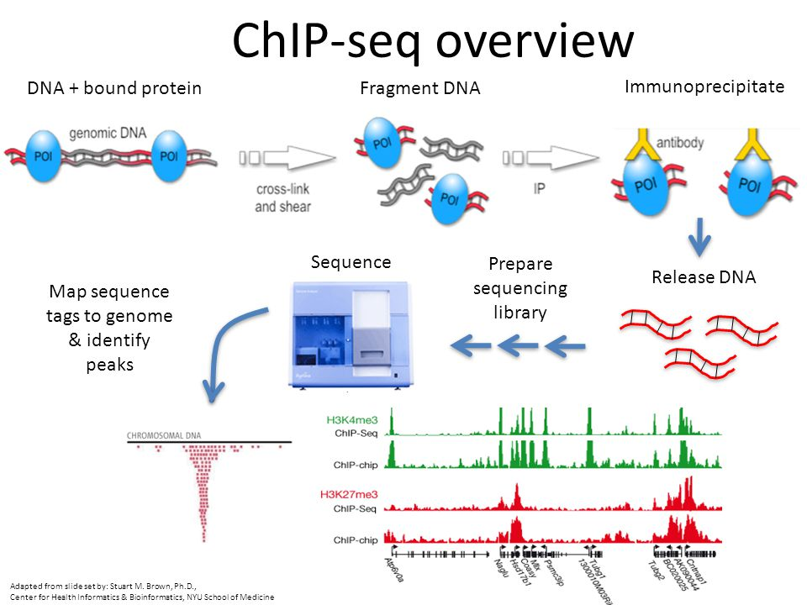
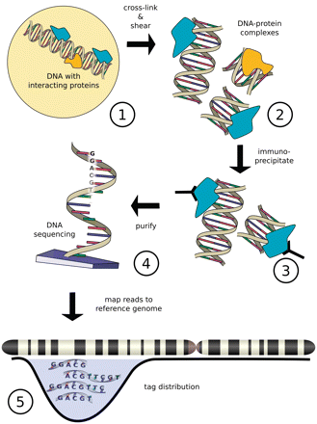
Figure from Szalkowski, A.M, and Schmid, C.D.(2010). Rapid innovation in ChIP-seq peak-calling algorithms is outdistancing banchmarking efforts. Briefings in Bioinfomatics.

Slide 15
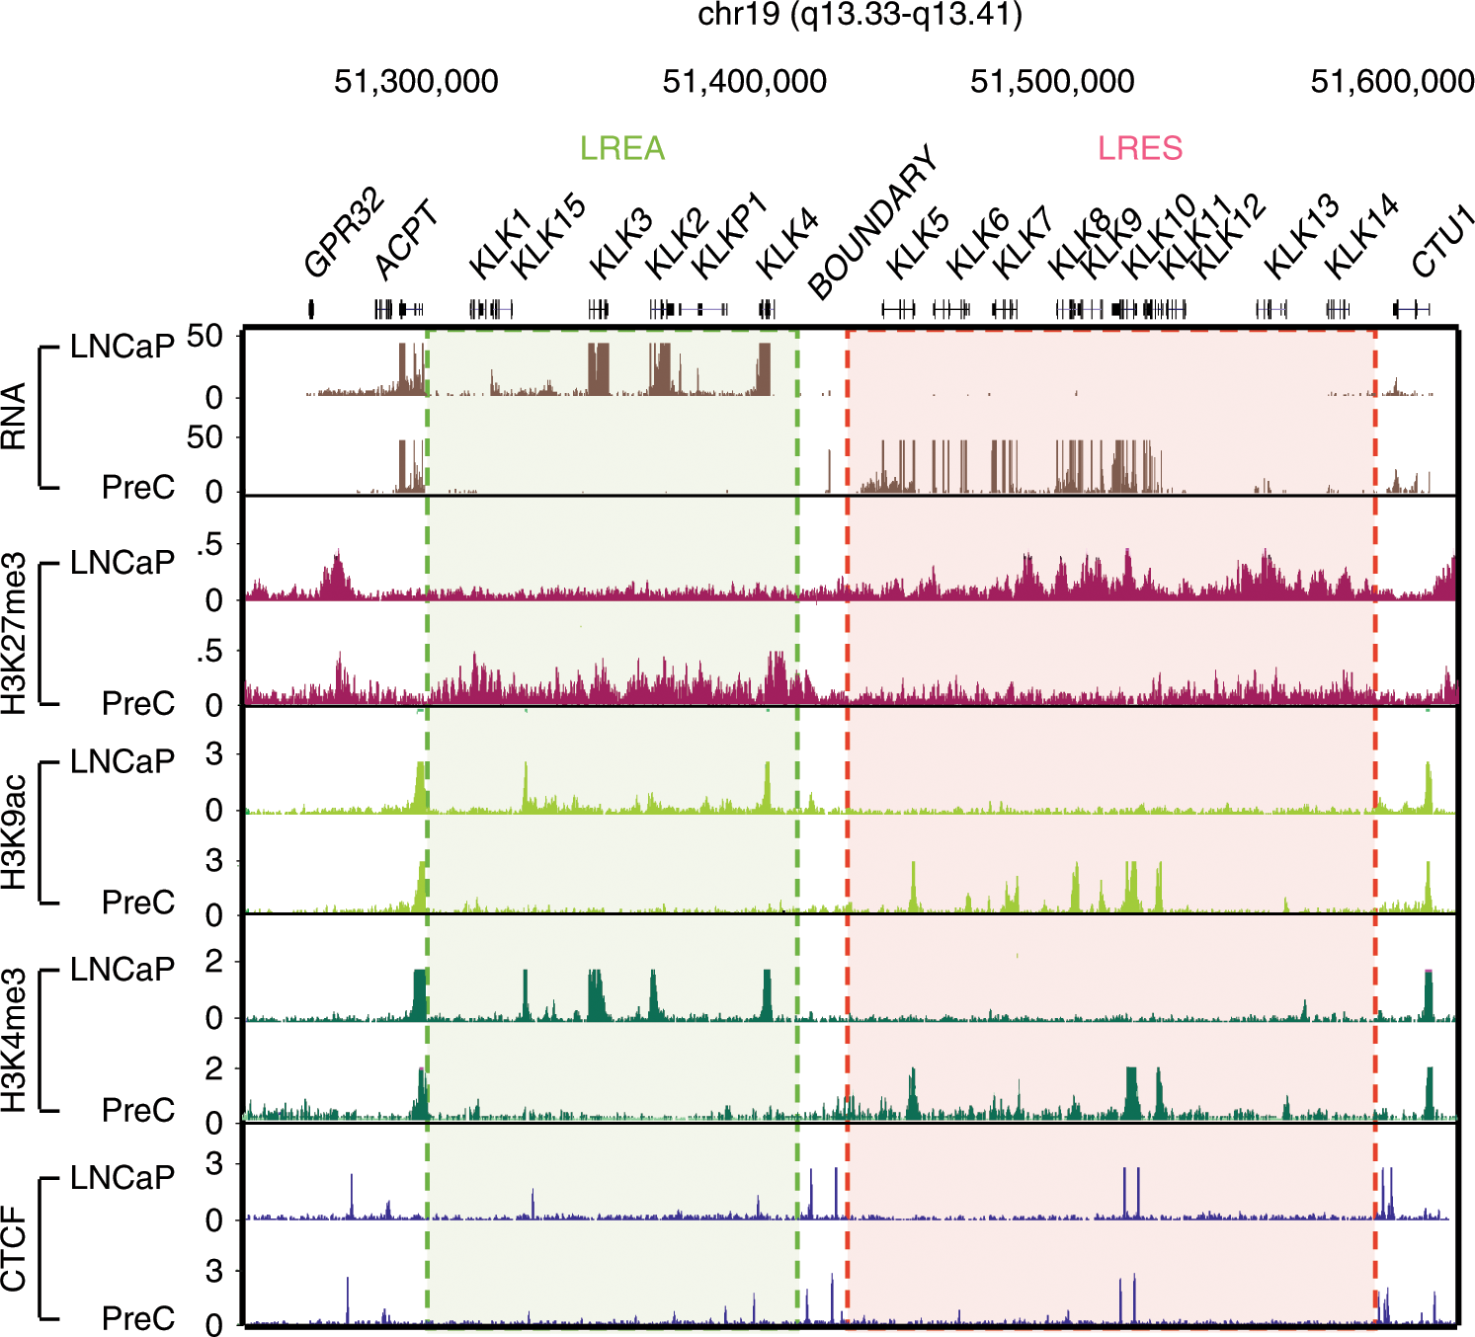
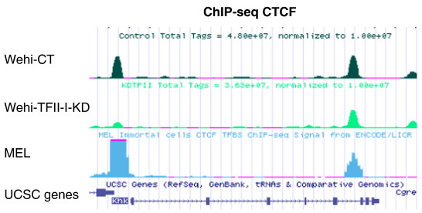
10.1016/j.gdata.2014.09.012
https://www.nature.com/articles/s41467-019-13753-7/figures/1

Slide 16
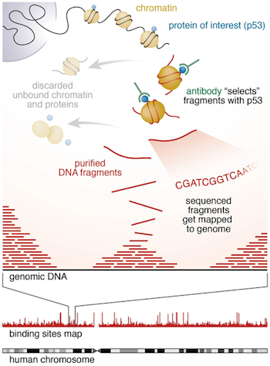
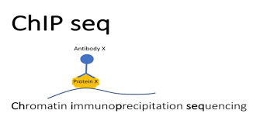
https://hbctraining.github.io/Intro-to-ChIPseq/lessons/01_Intro_chipseq_data_organization.html

Slide 17
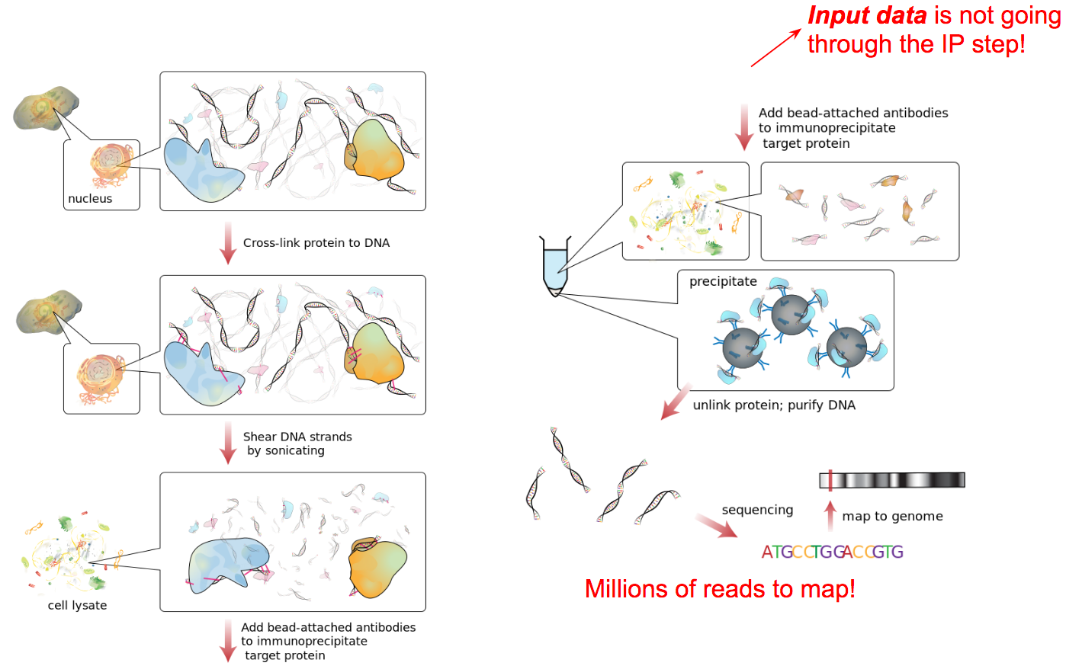
https://training.galaxyproject.org/training-material/topics/epigenetics/tutorials/formation_of_super-structures_on_xi/slides-plain.html

Slide 18
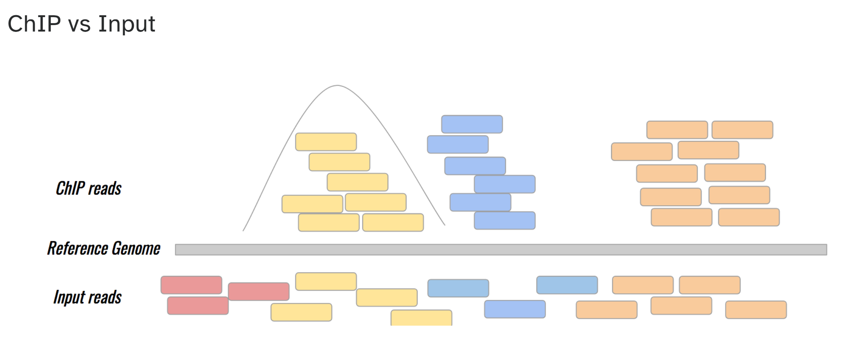
https://training.galaxyproject.org/training-material/topics/epigenetics/tutorials/formation_of_super-structures_on_xi/slides-plain.html

Slide 19
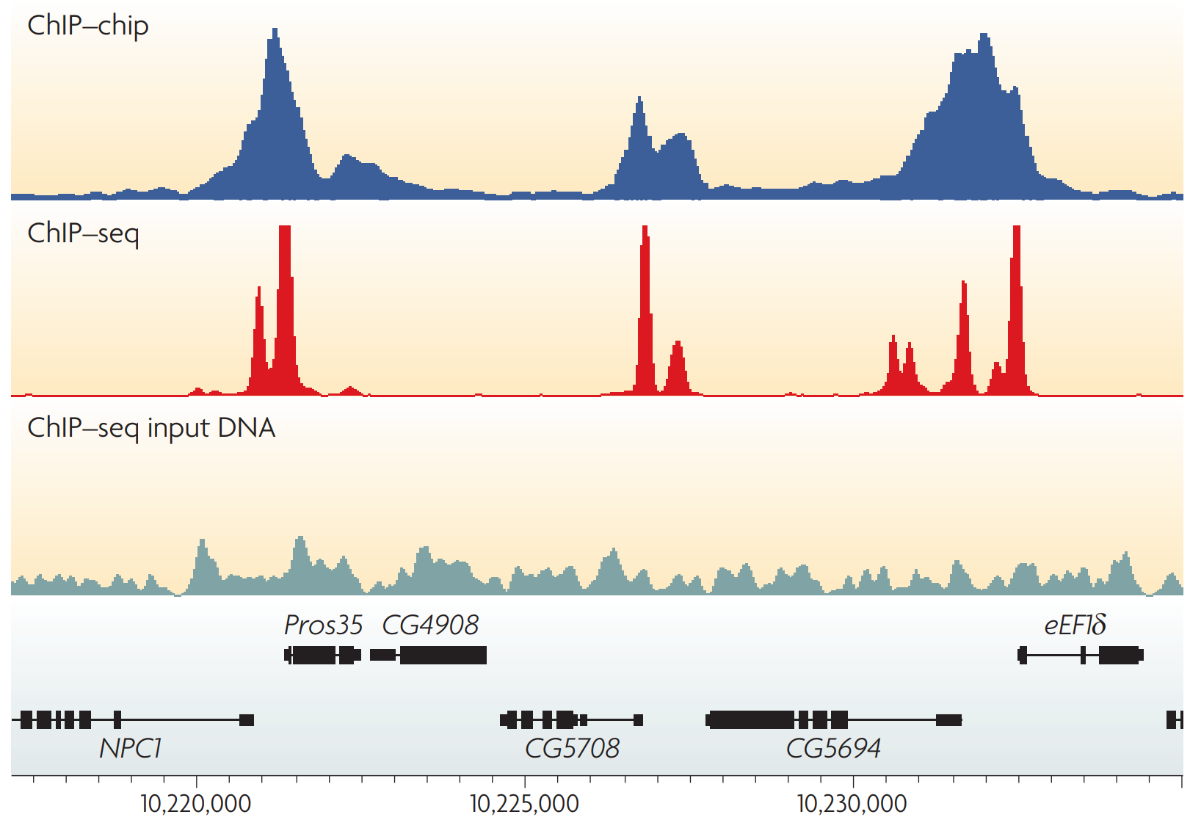
ChIP profiles: Examples of the profiles generated by chromatin immunoprecipitation
https://www.nature.com/articles/nrg2641

Slide 20
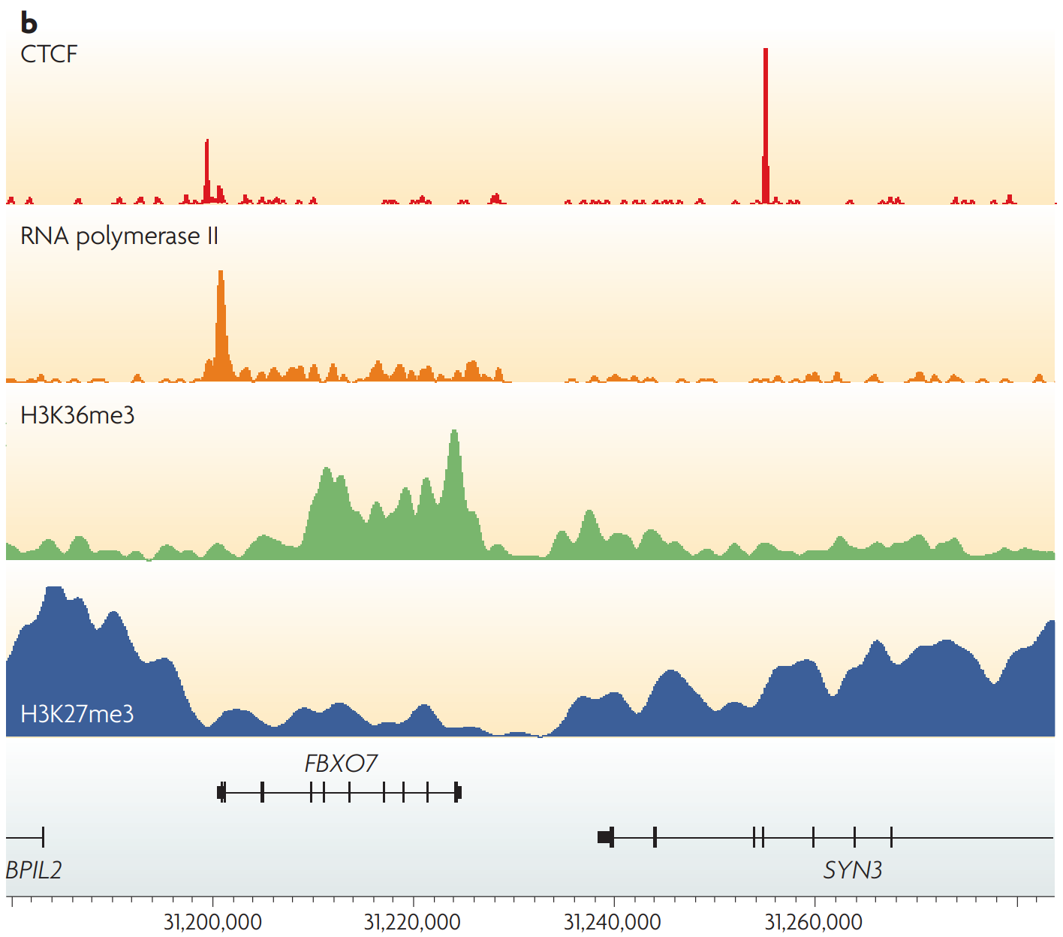
ChIP profiles: Examples of different types of ChIP–seq tag density profiles in human T cells
https://www.nature.com/articles/nrg2641

Slide 21
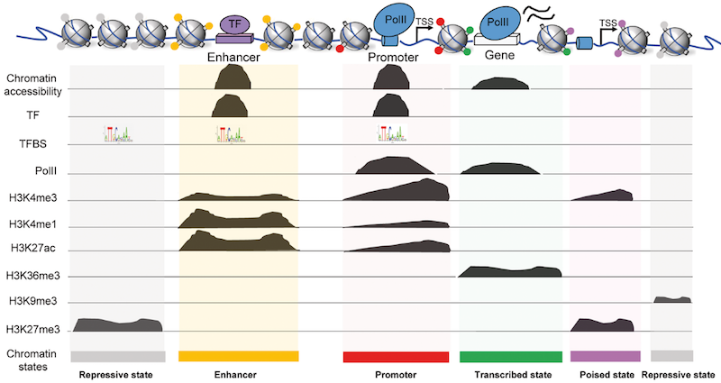
Types of ChIP-seq
https://training.galaxyproject.org/training-material/topics/epigenetics/tutorials/formation_of_super-structures_on_xi/slides-plain.html

Slide 22
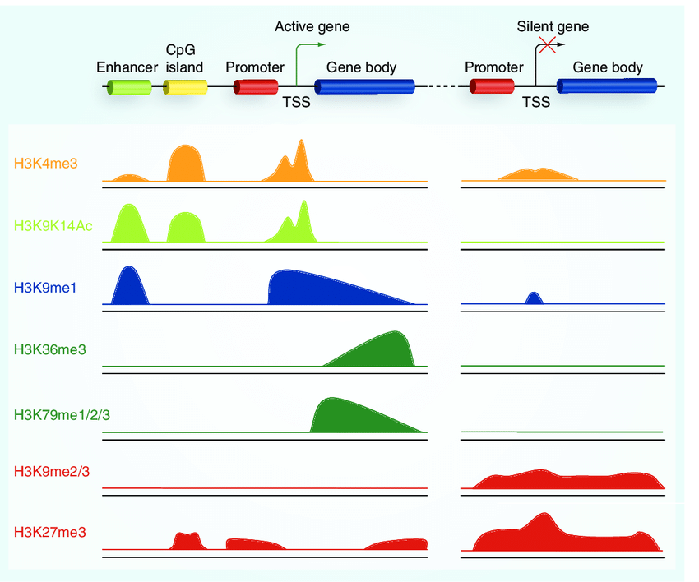
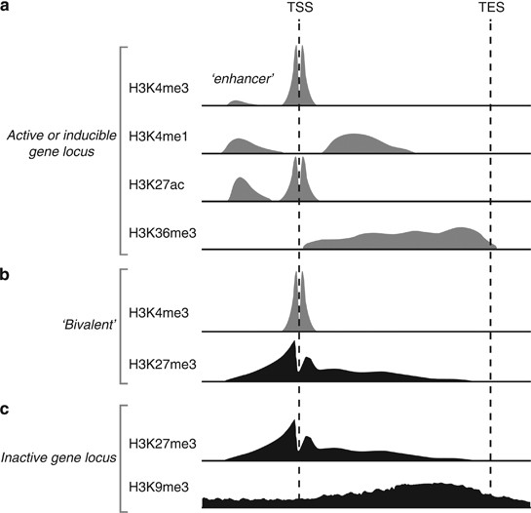
Peak types and locations of histone methylation
https://www.nature.com/articles/jhg201366
DOI:10.2217/epi.10.55

Slide 23
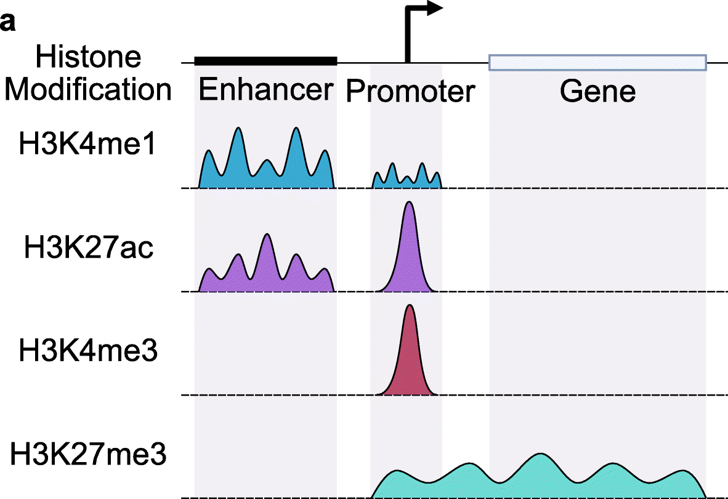
Peak types and locations of histone modifications
https://genomebiology.biomedcentral.com/articles/10.1186/s13059-022-02707-w

Slide 24
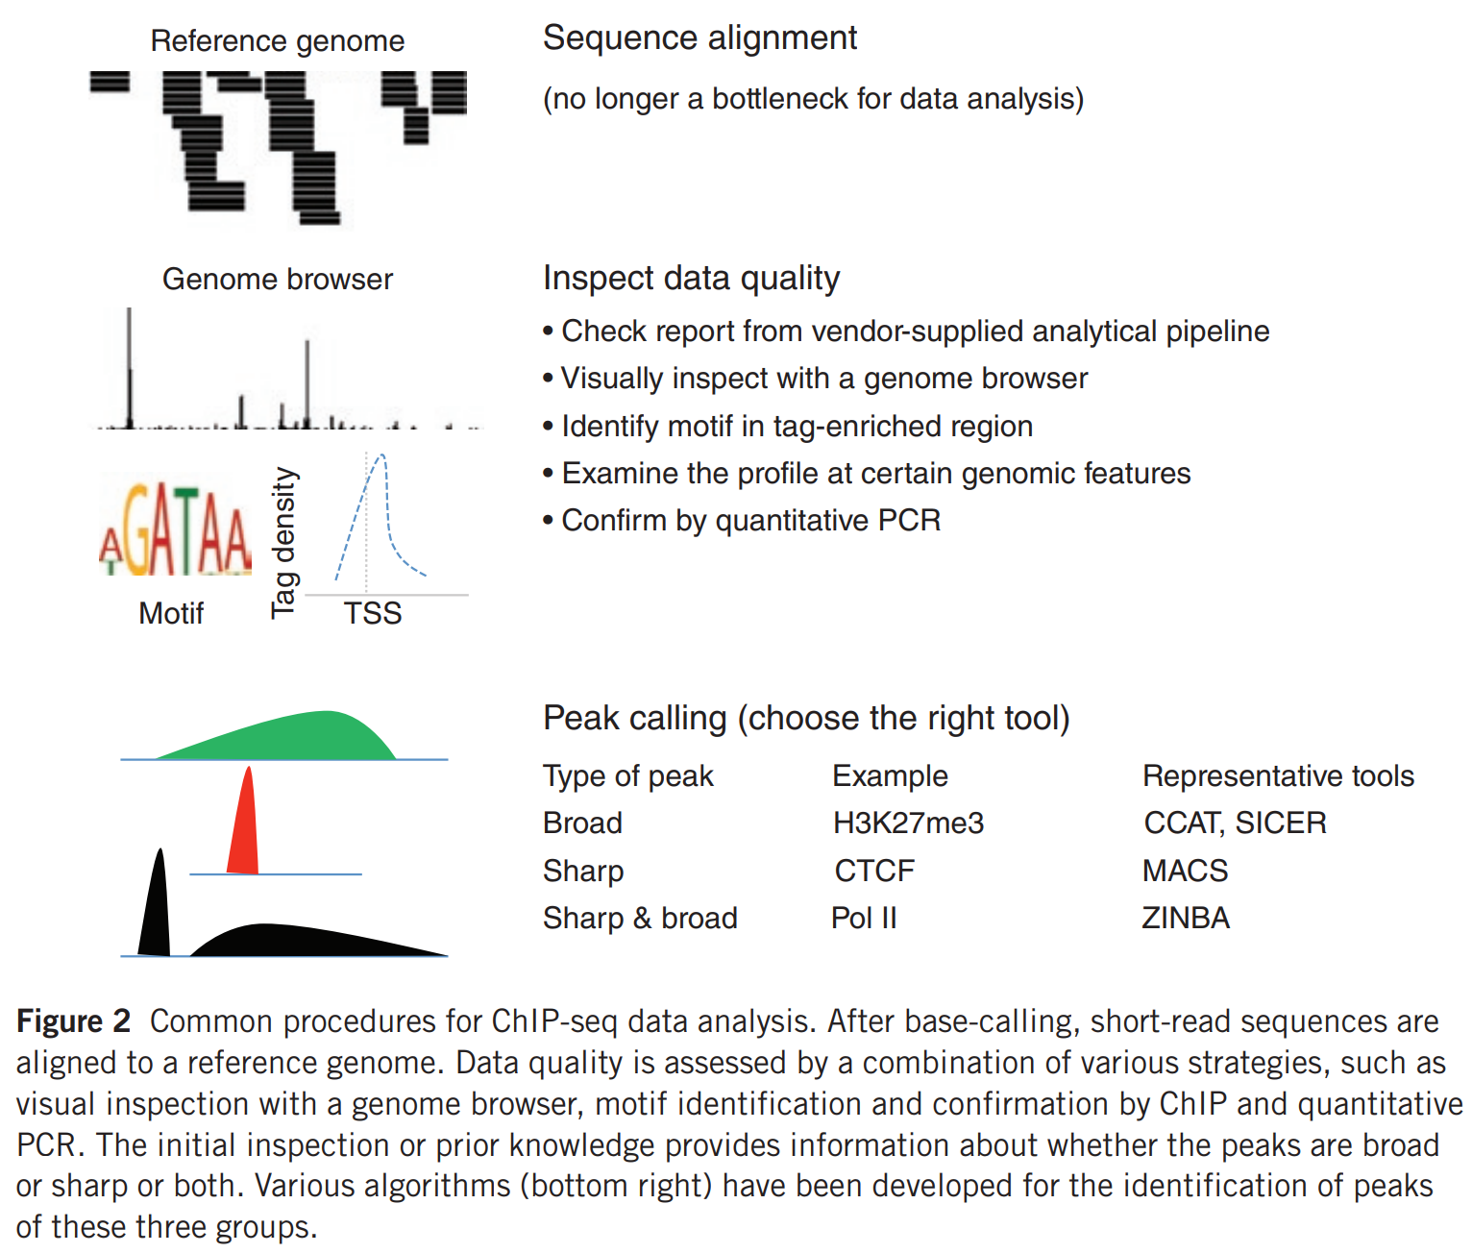
https://www.nature.com/articles/ni.2117

Slide 25
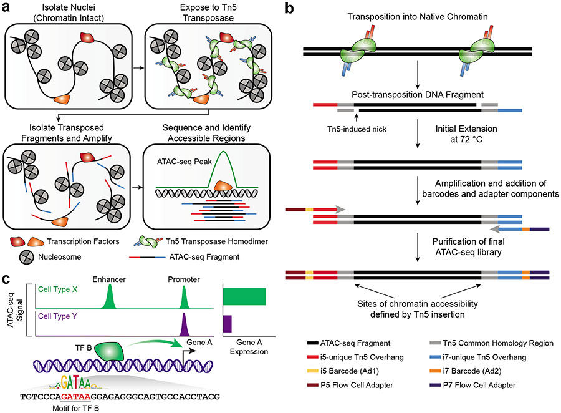
ATAC-seq
https://pubmed.ncbi.nlm.nih.gov/35478247/

Slide 26
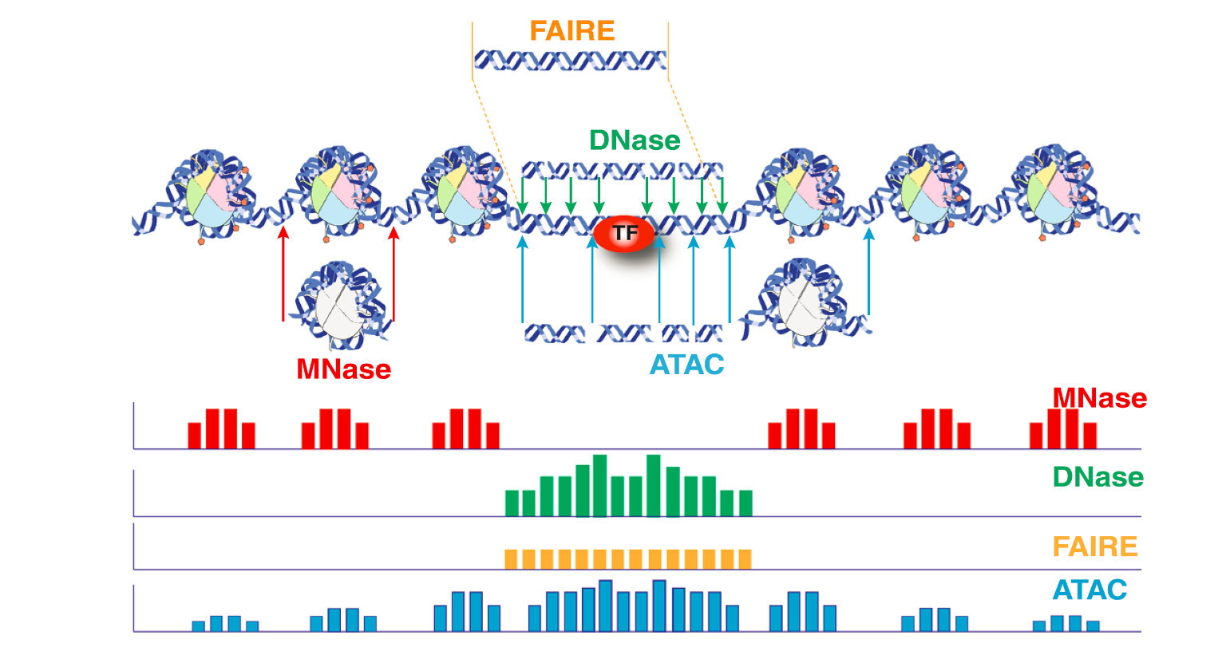
ATAC-seq
https://haibol2016.github.io/ATACseqQCWorkshop/articles/ATACseqQC_workshop.html

Slide 27
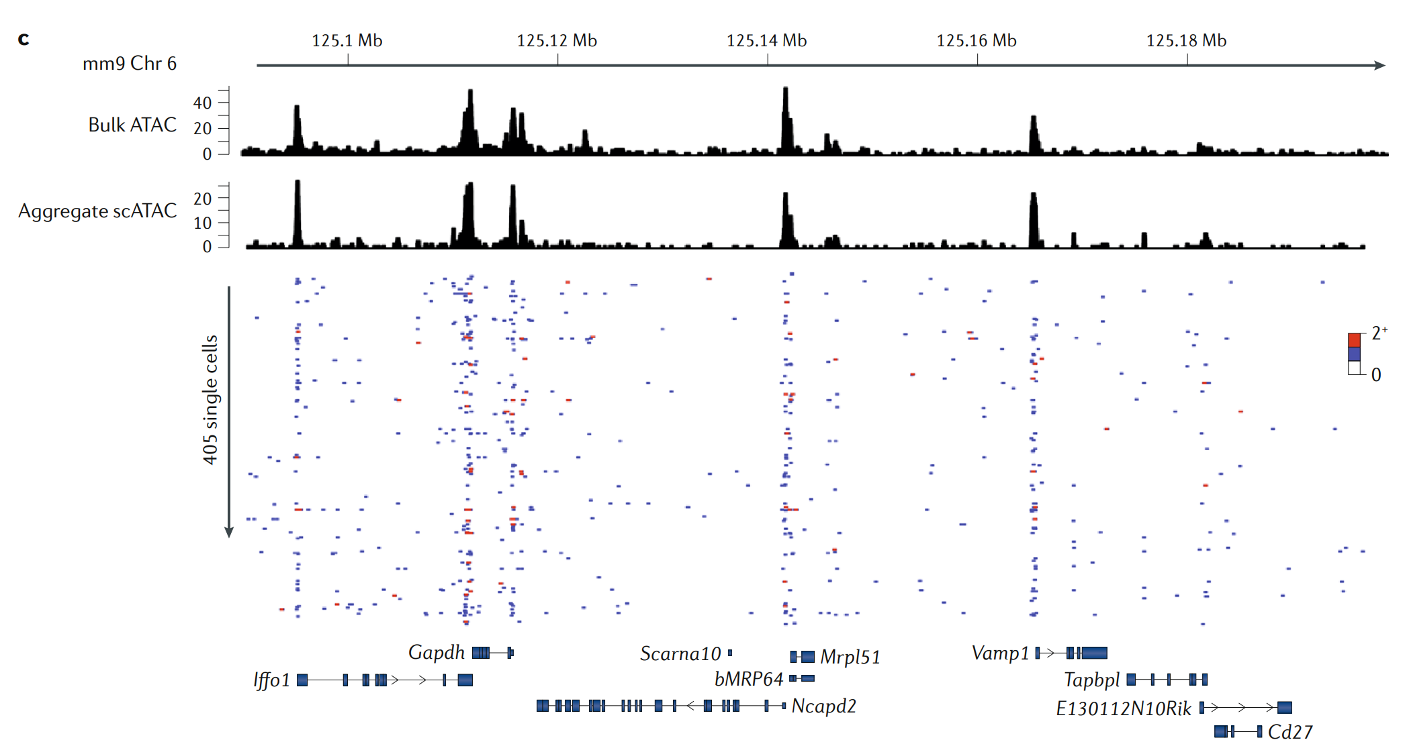
Population-scale measurements of chromatin accessibility reflect the average accessibility of a heterogeneous collection of single molecules
https://www.nature.com/articles/s41576-018-0089-8

Slide 28
Classification of Transcription Factors
TFs are classified by how they are activated:
Constitutive Factors (Always present/active)
Ubiquitous: Present in all cells (e.g., SP1).
Cell-Type Specific: Developmental factors (e.g., MYOD).
Signal-Dependent Factors (Require activation)
Nuclear Receptors: Activated by lipids/hormones.
Internal Signals: Activated by metabolites (e.g., p53, SREBP).
Cell Surface Receptor Dependent:
Phosphorylation: MAPK pathway (e.g., CREB).
Latent Cytoplasmic: Translocate upon signal (e.g., NFkB).
Notes:
Dimerization is the "social" aspect of TFs. The Leucine Zipper gets its name because Leucines appear every 7 amino acids (creating a zipper-like hydrophobic strip). This allows two proteins to stick together. bHLH is similar but uses a loop for flexibility. While most TFs bind the major groove, the Beta-scaffold group (like TBP) is unique—it binds the minor groove and bends the DNA significantly, often acting as a platform for assembling other proteins.

Slide 29
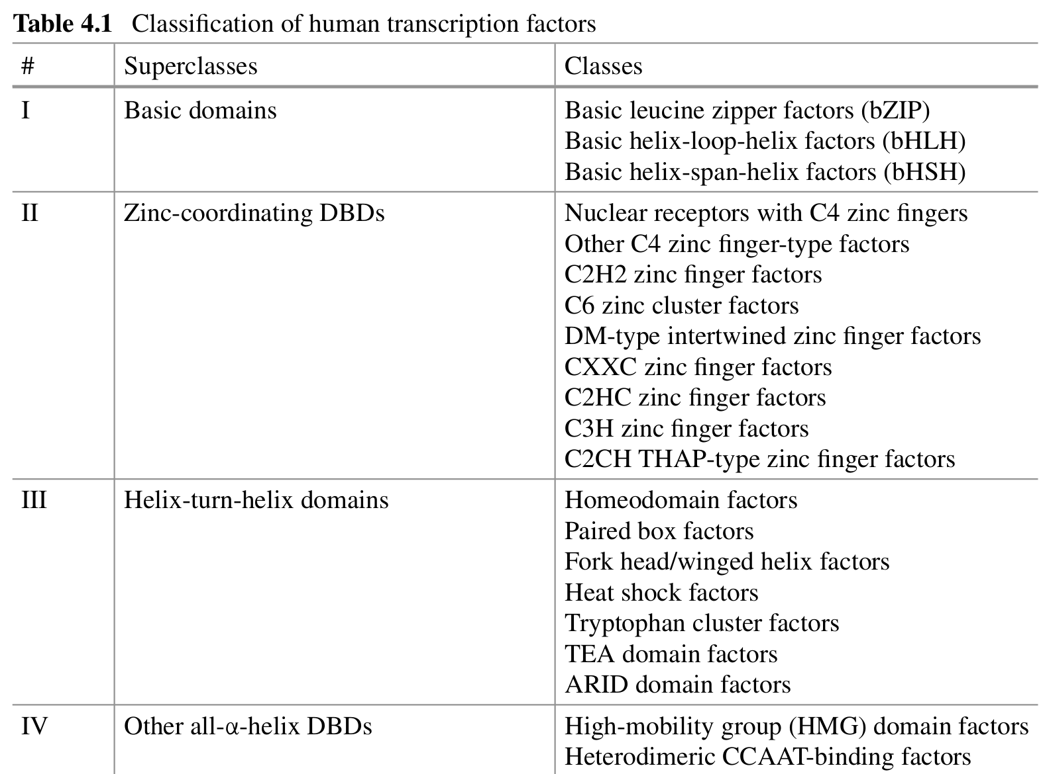
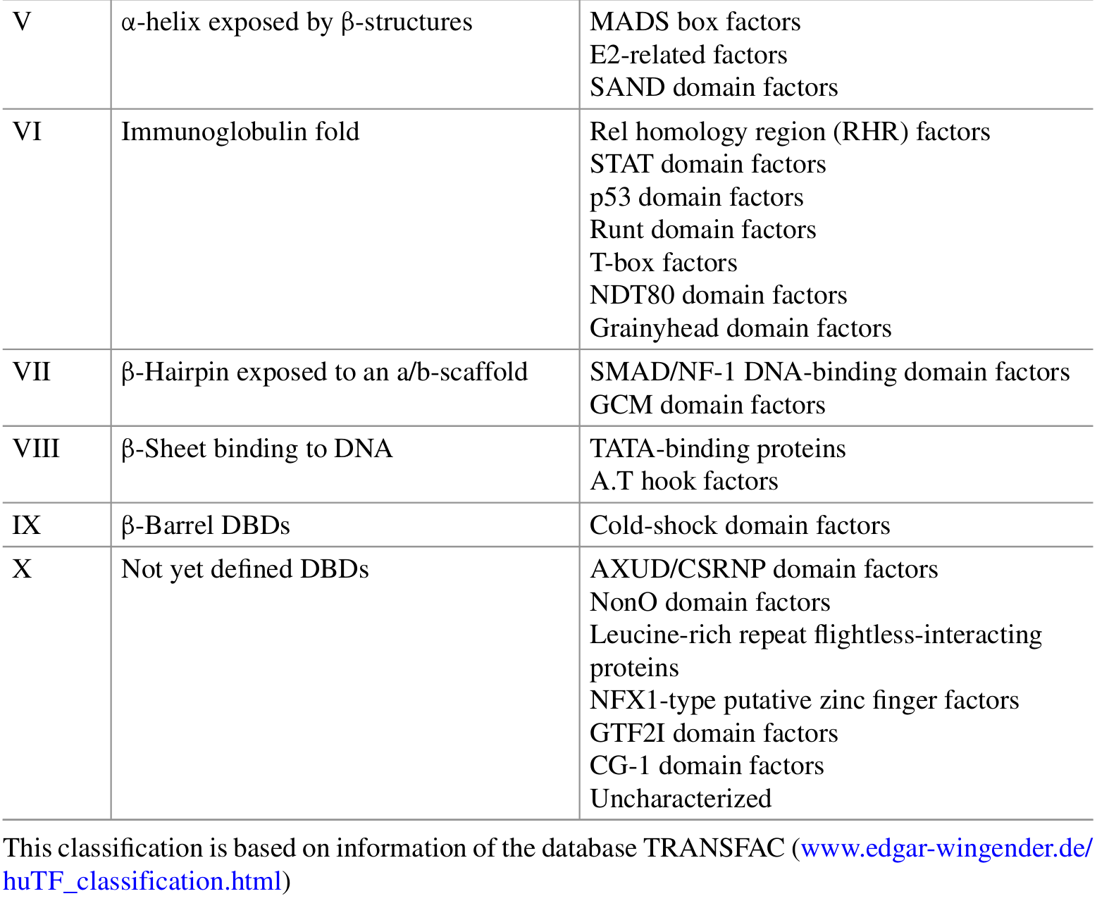
Classification of Transcription Factors
Notes:
Dimerization is the "social" aspect of TFs. The Leucine Zipper gets its name because Leucines appear every 7 amino acids (creating a zipper-like hydrophobic strip). This allows two proteins to stick together. bHLH is similar but uses a loop for flexibility. While most TFs bind the major groove, the Beta-scaffold group (like TBP) is unique—it binds the minor groove and bends the DNA significantly, often acting as a platform for assembling other proteins.

Slide 30
Signal-Dependent Activation Mechanisms (I)
Endocrine Nuclear Receptors:
Ligands: Lipophilic hormones (Estrogen, Testosterone, Cortisol, Vitamin D).
Mechanism: Ligand diffuses through membrane → Binds Receptor → Receptor binds DNA.
Example: Estrogen Receptor (ESR1).
Kinase Signaling Cascades (Phosphorylation):
Trigger: Hydrophilic signals (Peptides, Growth Factors) bind membrane receptors (GPCRs, RTKs).
Mechanism: Phosphorylation cascade (e.g., MAPK) targets resident nuclear TFs.
Example: CREB1 (cAMP response), ELK1, AP1.
Notes:
This slide contrasts two major signaling modes. Nuclear receptors (Chapter 5) act as direct sensors—the signal (lipid) walks right into the cell and binds the TF. In contrast, peptide hormones (like insulin or epinephrine) cannot enter the cell. They knock on the door (membrane receptor), triggering a "bucket brigade" of kinases (phosphorylation cascade) that eventually reaches the nucleus to phosphorylate and activate TFs like CREB.

Slide 31
Signal-Dependent Activation Mechanisms (II)
3. Latent Cytoplasmic Factors:
State: Inactive in the cytoplasm (often held by an inhibitor or membrane).
Activation: Signal causes release/cleavage → Translocation to Nucleus.
Key Pathways:
NF–kappa B: Inflammation.
STAT: Cytokine signaling.
SMAD: TGF-beta signaling.
NOTCH: Developmental signaling.
Notes:
These factors are "sleeping" in the cytoplasm. They are heavily used in immune responses and development because they are fast—the protein is already made and just needs to move to the nucleus. They don't require new protein synthesis to act.

Slide 32
Specific Pathways: SMAD and STAT
SMAD Pathway (TGF-beta Family):
Signal: TGF-beta, BMPs, Activins.
Mechanism: Receptor phosphorylates R-SMADs (SMAD 2/3).
Complex: R-SMADs dimerize with SMAD4 (Co-SMAD).
Action: Translocate to nucleus → Regulate growth/differentiation.
STAT Pathway (JAK-STAT):
Signal: Cytokines (Interleukins, Interferons).
Mechanism: Cytokine binds receptor → JAK kinase phosphorylates STAT.
Action: Phosphorylated STATs dimerize → Translocate to nucleus.
Relevance: Vital for immune cell regulation.
Notes:
The SMAD pathway is critical for growth inhibition and development. Note that SMAD4 is a common partner for the specific R-SMADs. The STAT pathway is the "fast track" for immune signaling. JAK kinases are attached to the receptor, and STATs are the direct messengers to the nucleus.

Slide 33
Specific Pathways: NF-kappa B and WNT
NF-kappa B Pathway (Inflammation):
Resting State: NF-kappa B held in cytoplasm by inhibitor I-kappa B.
Signal: TNF, IL1 beta, Bacterial LPS.
Activation: IKK kinase phosphorylates I-kappa B → I-kappa B degraded.
Result: NF-kappa B (p50/p65) is free to enter nucleus.
WNT Pathway:
Resting State: beta-catenin is degraded by GSK3 complex.
Signal: WNT binds Frizzled receptor.
Activation: Dishevelled (DVL) blocks GSK3 → beta-catenin accumulates.
Result: beta-catenin enters nucleus → Activates TCF7L2 transcription factor.
Notes:
The SMAD pathway is critical for growth inhibition and development. Note that SMAD4 is a common partner for the specific R-SMADs. The STAT pathway is the "fast track" for immune signaling. JAK kinases are attached to the receptor, and STATs are the direct messengers to the nucleus.

Slide 34
Specific Pathways: NF-kappa B and WNT
NF-kappa B Pathway (Inflammation):
Resting State: NF-kappa B held in cytoplasm by inhibitor I-kappa B.
Signal: TNF, IL1 beta, Bacterial LPS.
Activation: IKK kinase phosphorylates I-kappa B → I-kappa B degraded.
Result: NF-kappa B (p50/p65) is free to enter nucleus.
WNT Pathway:
Resting State: beta-catenin is degraded by GSK3 complex.
Signal: WNT binds Frizzled receptor.
Activation: Dishevelled (DVL) blocks GSK3 → beta-catenin accumulates.
Result: beta-catenin enters nucleus → Activates TCF7L2 transcription factor.
Notes:
NF$\kappa$B is the master regulator of inflammation (discussed more in Chapter 13). Its regulation is via "inhibition removal"—destroying the inhibitor (I$\kappa$B) allows activation. WNT signaling is unique because it relies on "protein stabilization." Normally, the co-activator Beta-catenin is constantly destroyed. WNT signaling stops the destruction, allowing Beta-catenin to pile up and enter the nucleus.

Slide 35
Specific Pathways: Hedgehog, NOTCH, NFAT
Hedgehog (Hh):
Ligand (Hh) relieves repression of Smoothened receptor.
Activates GLI transcription factors.
Crucial for embryogenesis.
NOTCH:
Contact-dependent signaling (Delta/Jagged ligands).
Mechanism: Proteolytic cleavage of NOTCH receptor.
Result: Intracellular Domain (NICD) travels to nucleus → Binds RBPJ.
NFAT (Ca²⁺ Signaling):
Signal: Calcium influx (e.g., in T-cells).
Mechanism: Calcineurin (phosphatase) dephosphorylates NFAT.
Result: Nuclear translocation.
Notes:
Notch is unusual because the receptor itself becomes the transcription factor (after being cut by enzymes). It is a "one-time use" receptor. NFAT is critical in T-cells and is regulated by Calcium levels; drugs like Cyclosporine work by inhibiting Calcineurin, thus keeping NFAT out of the nucleus.

Slide 36
Clinical Relevance
Diseases:
Cancer: Mutations in p53 (Guardian of the genome) or overexpression of MYC.
Developmental Disorders: Mutations in HOX or PAX genes.
Immune Disorders: Dysregulation of NF-kappa B or STAT.
Therapy: TFs are major drug targets (e.g., Tamoxifen targets Estrogen Receptor).
Notes:
To wrap up, Transcription Factors are the interface between the genome and the environment. They are not just static switches; they are dynamic, structural proteins that form the basis of development and disease. Understanding their domains and signaling pathways allows us to understand how diseases like cancer arise (when these signals go wrong) and how to treat them.

Slide 37
Summary
TFs convert environmental/internal signals into gene expression changes.
Classified by structure (Zinc Finger, HTH) and activation mode (Constitutive vs. Inducible).
Operate in complex networks involving homo/heterodimerization.
Notes:
To wrap up, Transcription Factors are the interface between the genome and the environment. They are not just static switches; they are dynamic, structural proteins that form the basis of development and disease. Understanding their domains and signaling pathways allows us to understand how diseases like cancer arise (when these signals go wrong) and how to treat them.

Slide 38
Xin chân thành cảm ơn!
Luu Phuc Loi, PhD
Zalo: 0901802182
luu.p.loi@googlemail.com

