Slide 1



Lecture 1 Boxplot and its Variants
Sinh hoạt Khoa học hàng tuần tại bệnh viện Thống Nhất
DeC 10 2025
Phuc-Loi Luu, PhD
Email: loilp@bvtn.org.vn Zalo: 0901802182
Viện Nghiên cứu Ứng dụng Khoa học Sức khỏe và Lão hóa – Bệnh viện Thống Nhất

Slide 2
CONTENT
Barplot
Boxplot: how to read
Boxplot and its variants
Violinplot
Beanplot

Slide 3
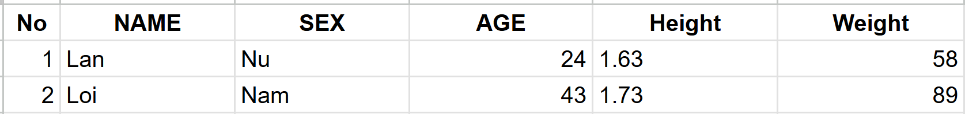
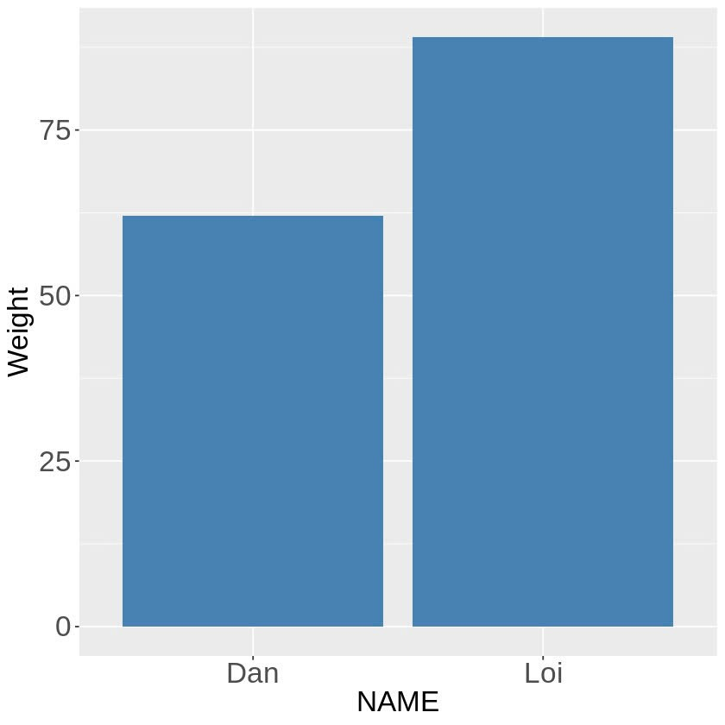
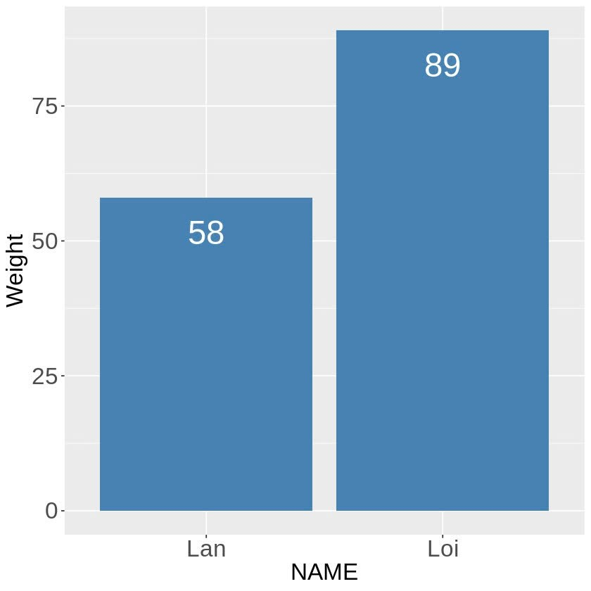
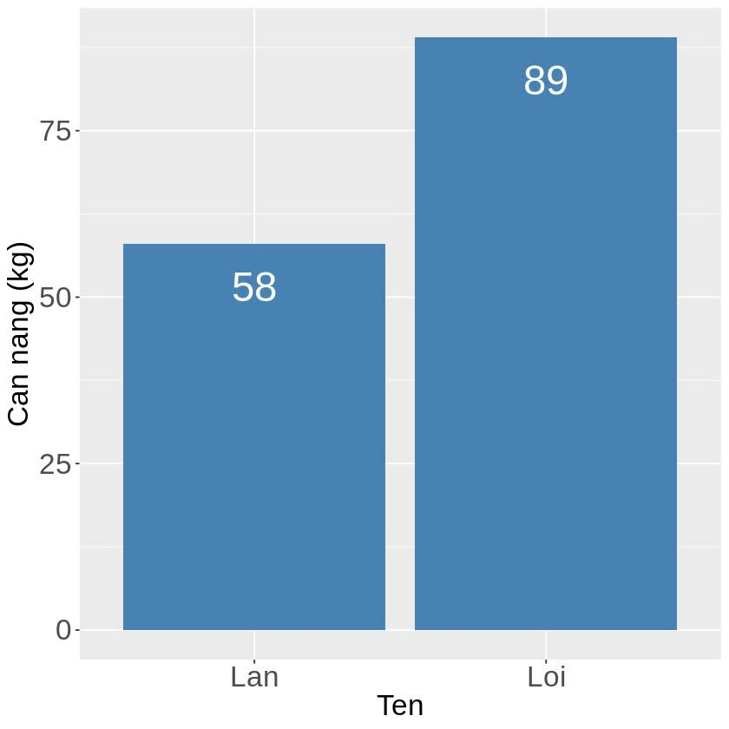
Bar Plot

Slide 4
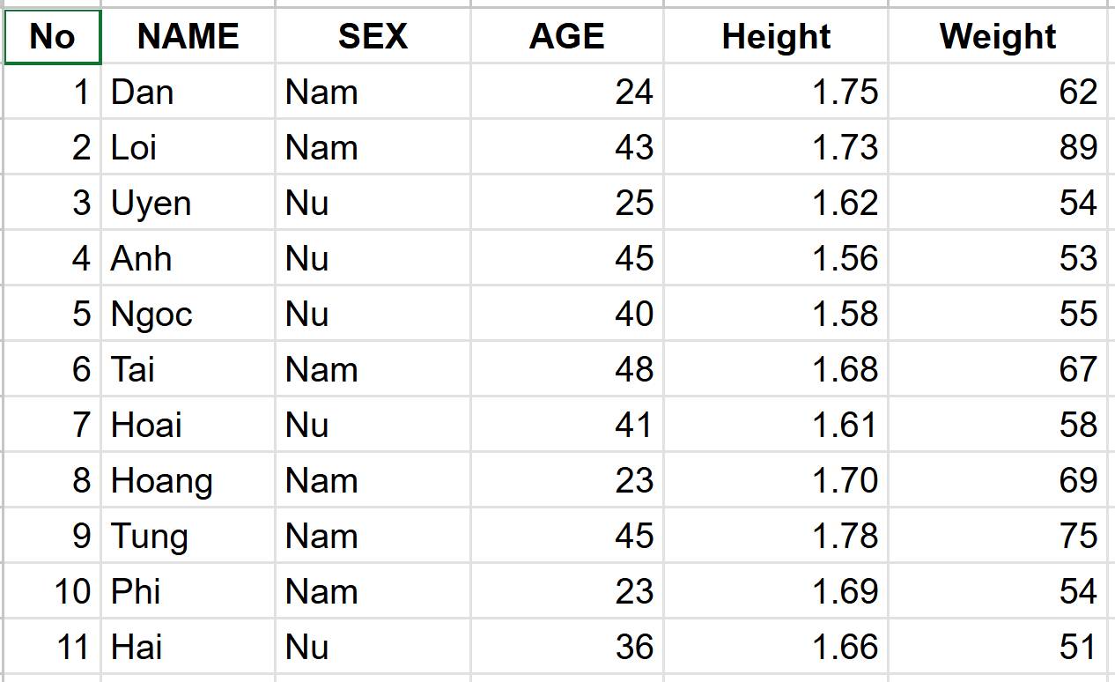
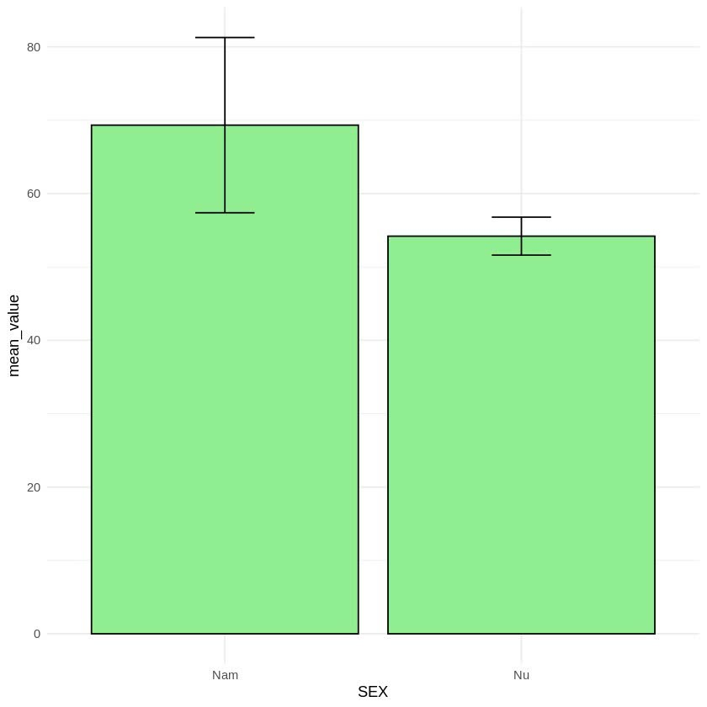
Bar Plot with Error Bar

Slide 5
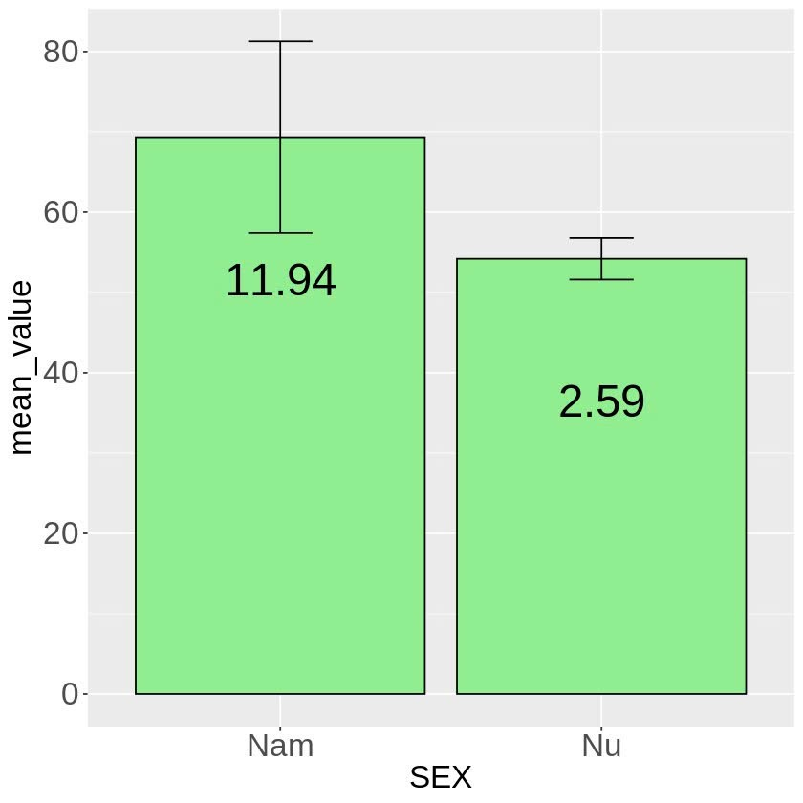
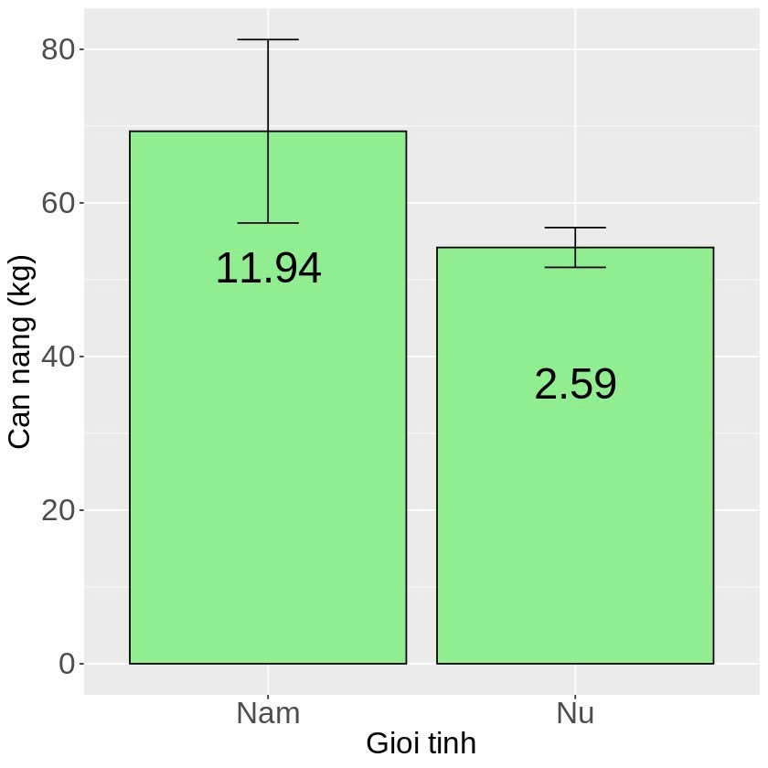
Bar Plot with Error Bar

Slide 6
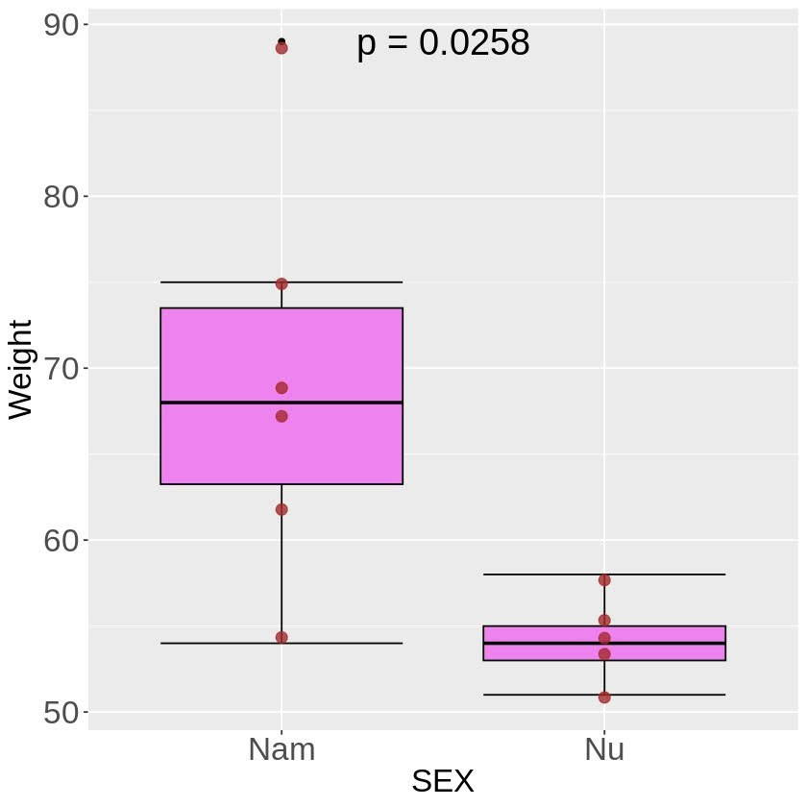
Boxplot

Slide 7
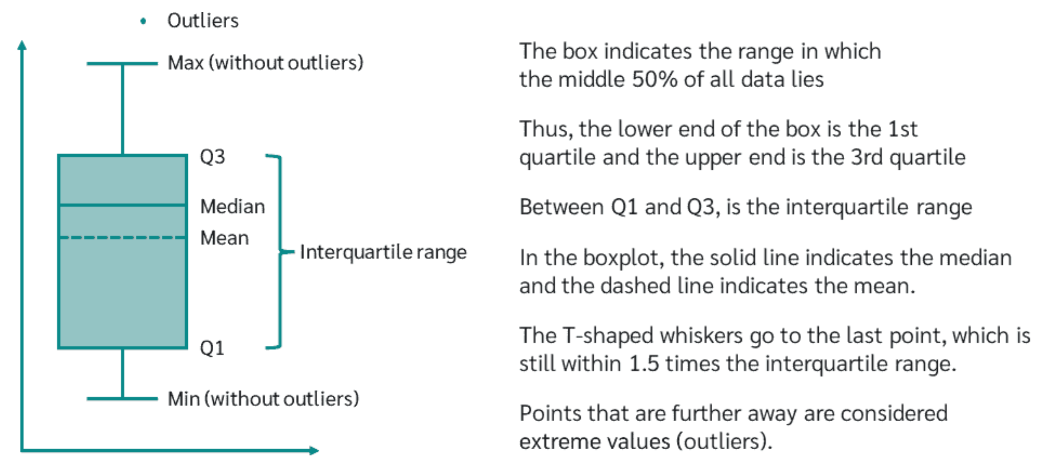
Boxplot
https://numiqo.com/tutorial/box-plot

Slide 8
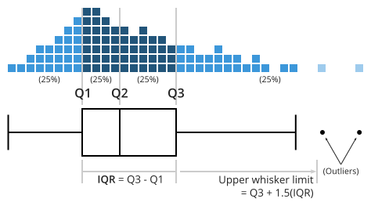
Boxplot
https://www.atlassian.com/data/charts/box-plot-complete-guide

Slide 9
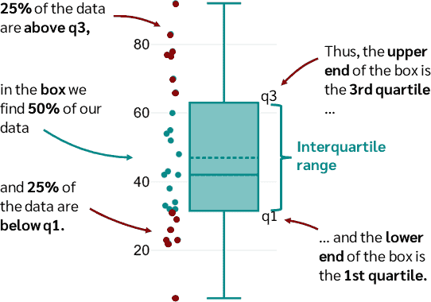
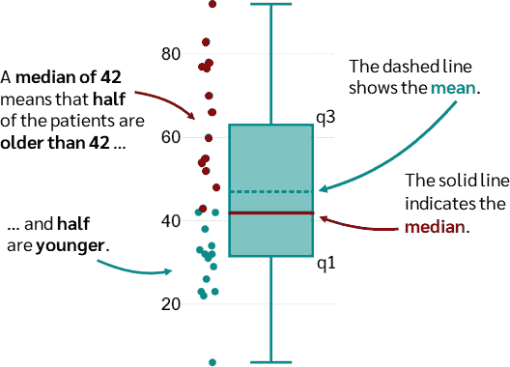
Boxplot
https://numiqo.com/tutorial/box-plot

Slide 10
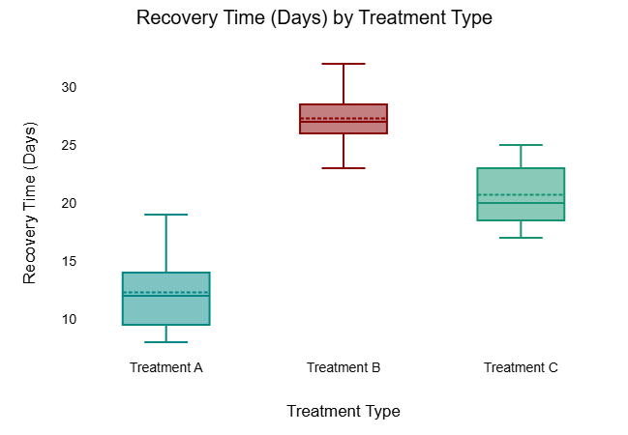
Boxplot
https://numiqo.com/tutorial/box-plot

Slide 11
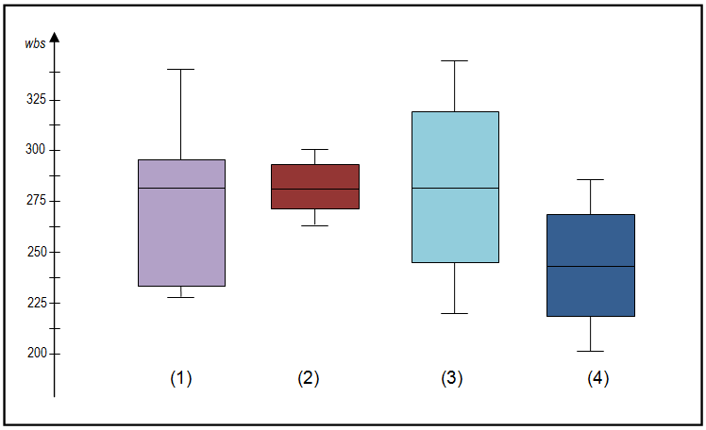
Boxplot
https://wellbeingatschool.org.nz/information-sheet/understanding-and-interpreting-box-plots

Slide 12
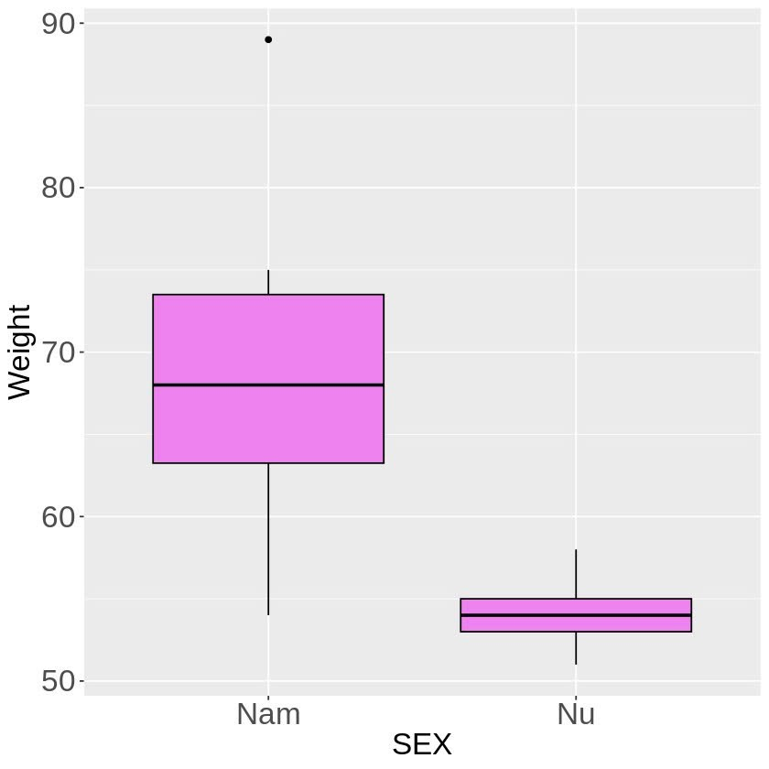
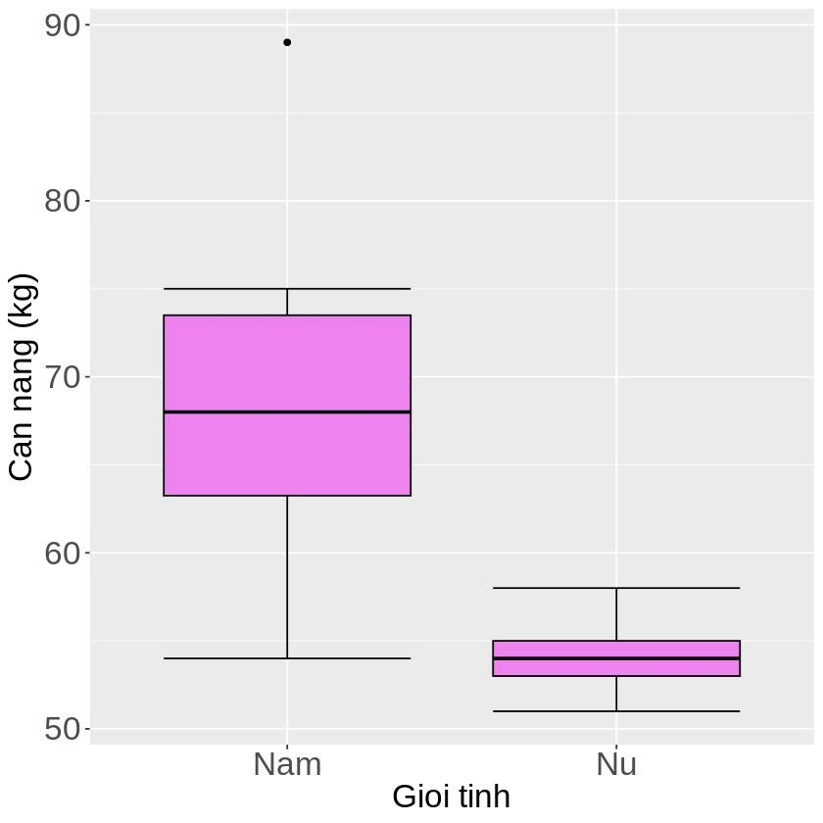
Boxplot

Slide 13
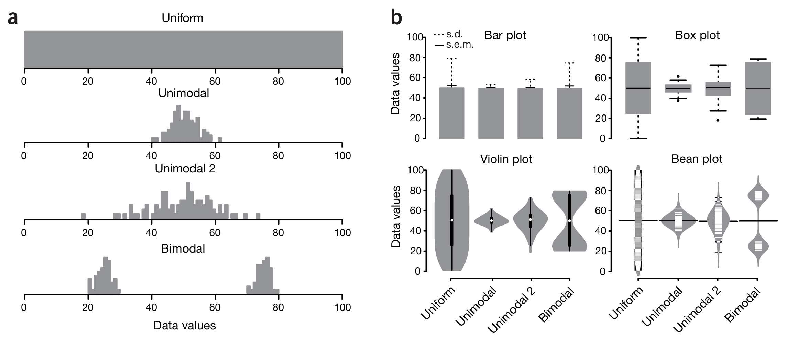
Boxplot and its Variants
Spitzer, M., Wildenhain, J., Rappsilber, J. et al. BoxPlotR: a web tool for generation of box plots. Nat Methods 11, 121–122 (2014). https://doi.org/10.1038/nmeth.2811

Slide 14
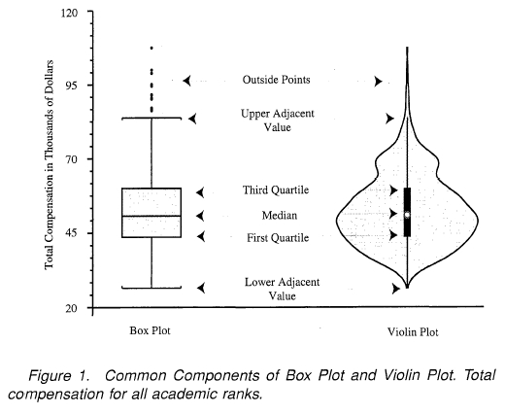
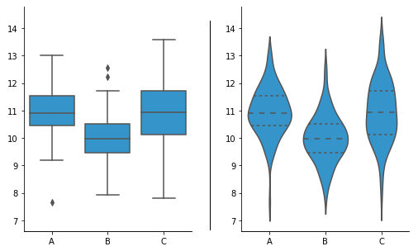
Box Plot vs Violin Plot
https://towardsdatascience.com/violin-plots-explained-fb1d115e023d/

Slide 15
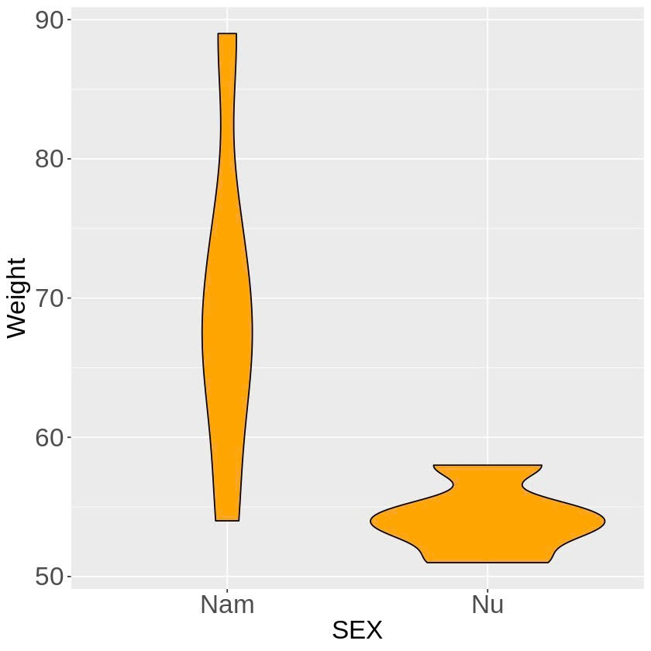
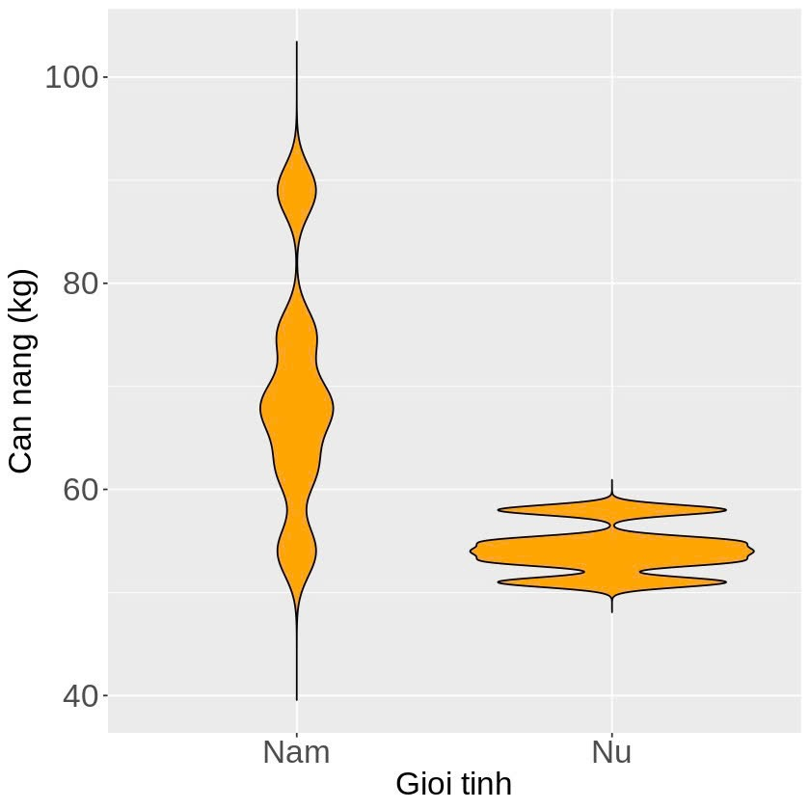
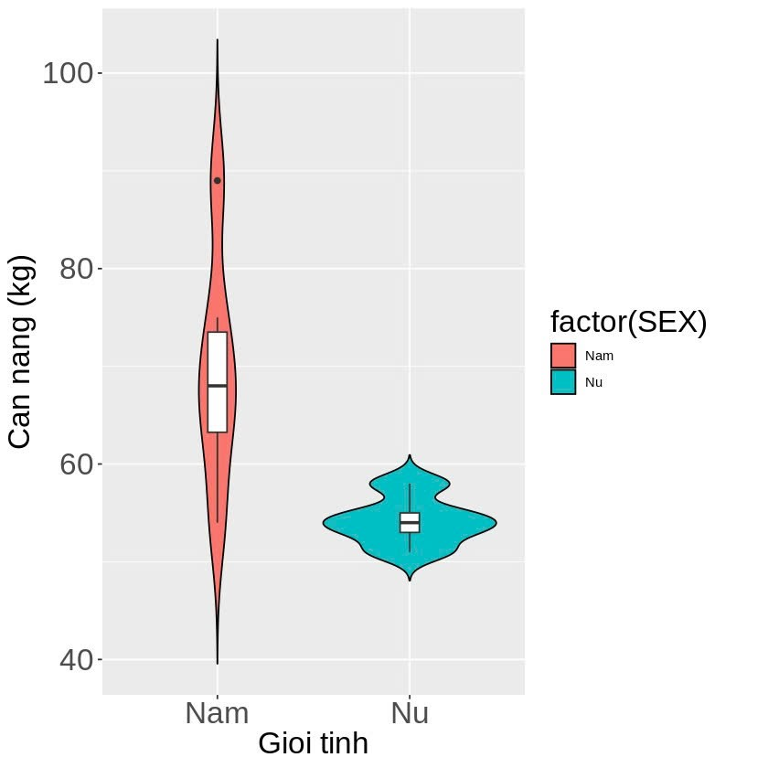
Violin Plot

Slide 16
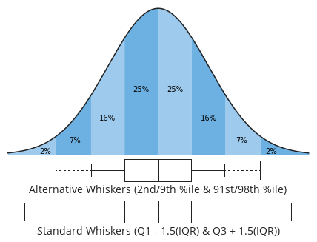
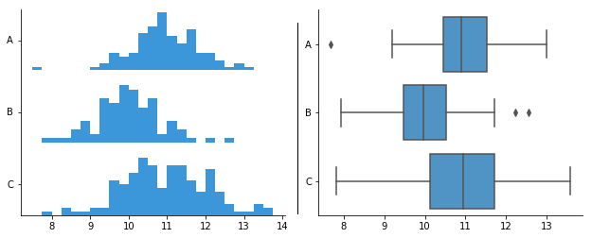
Box Plot vs Histogram
https://www.atlassian.com/data/charts/box-plot-complete-guide

Slide 17
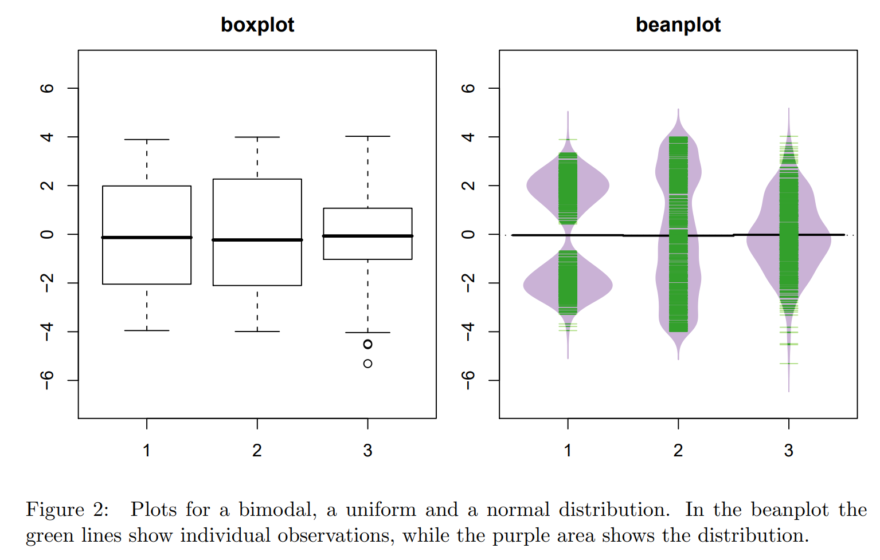
Box Plot vs Bean Plot
https://www.atlassian.com/data/charts/box-plot-complete-guide

Slide 18
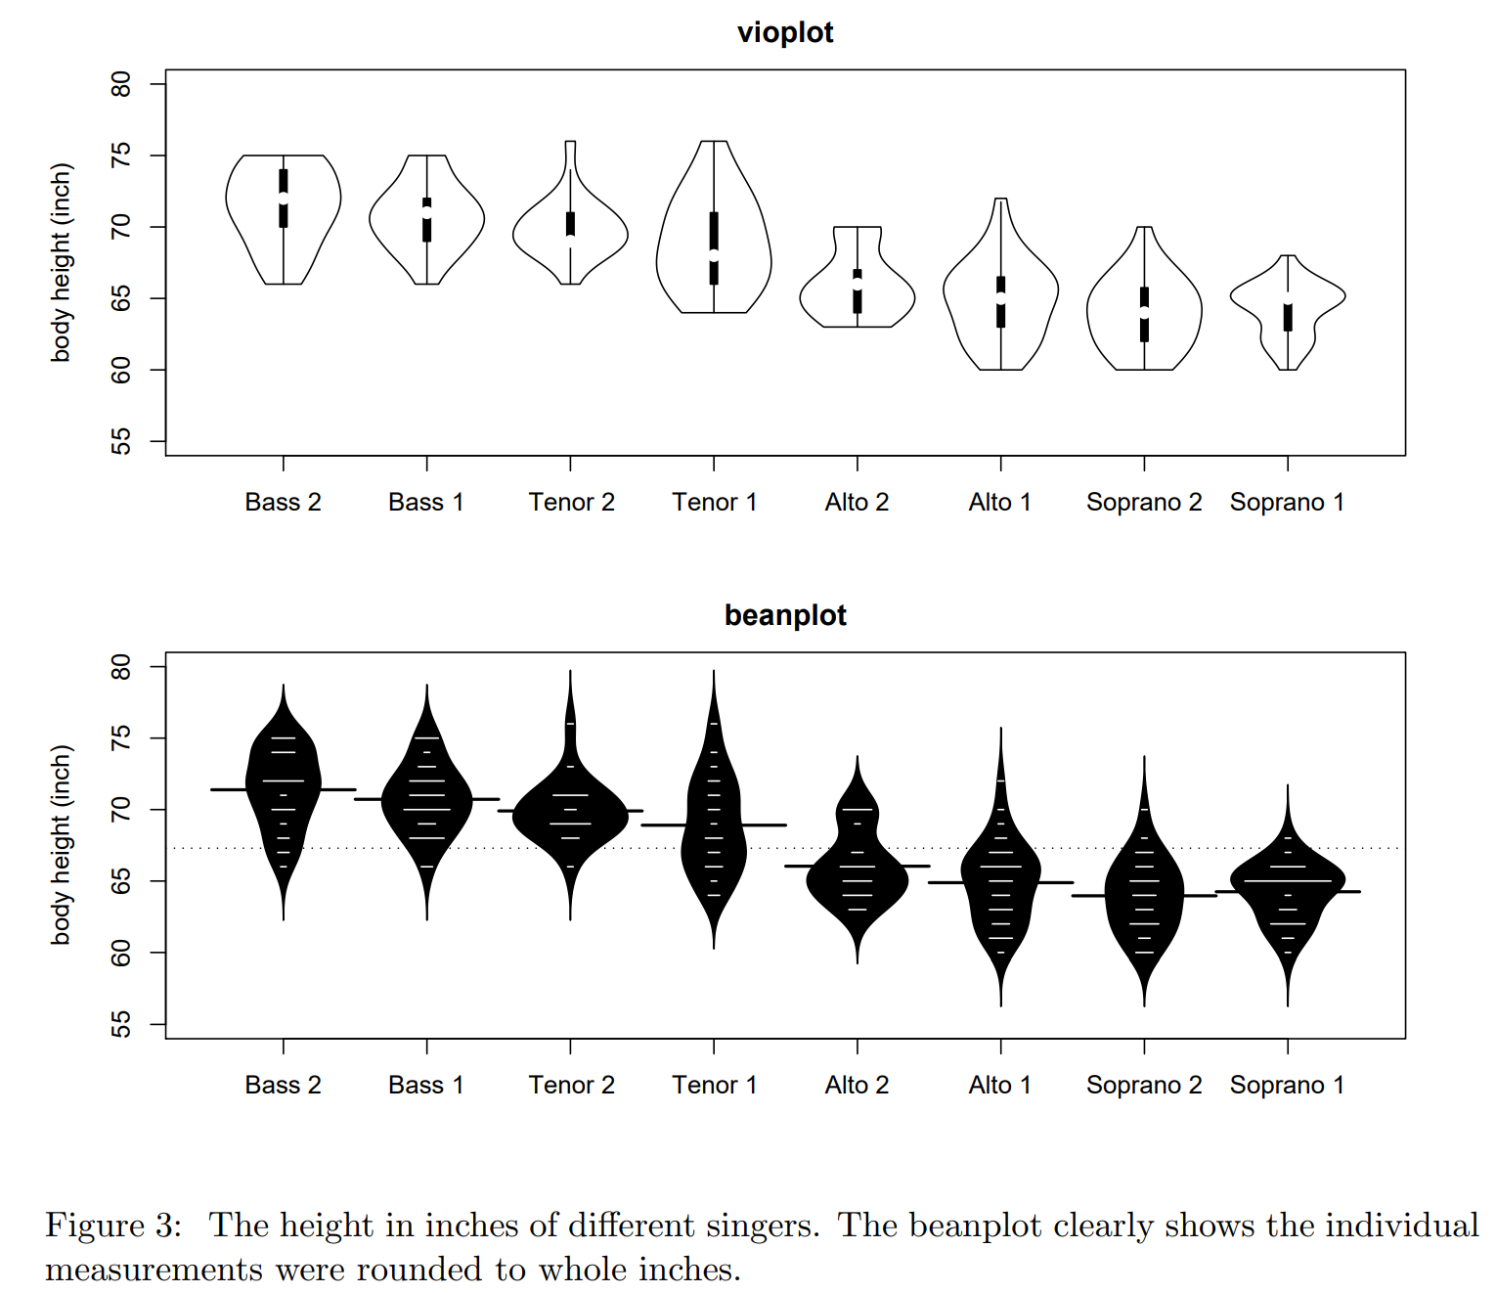
Violin Plot vs Bean Plot
DOI:10.18637/jss.v028.c01

Slide 19
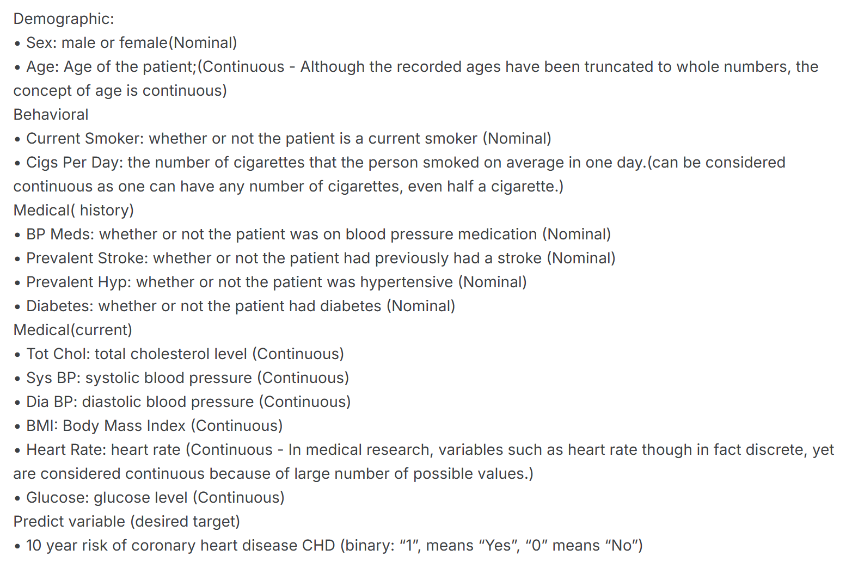
Practice: Predict heart disease
https://www.kaggle.com/datasets/dileep070/heart-disease-prediction-using-logistic-regression

Slide 20
Thank you for your listening Q & A

