Slide 1
DNA METHYLATION ANALYSIS WITH DMRCATE
Apr 11 2025
Tran Ba Thien

Slide 2

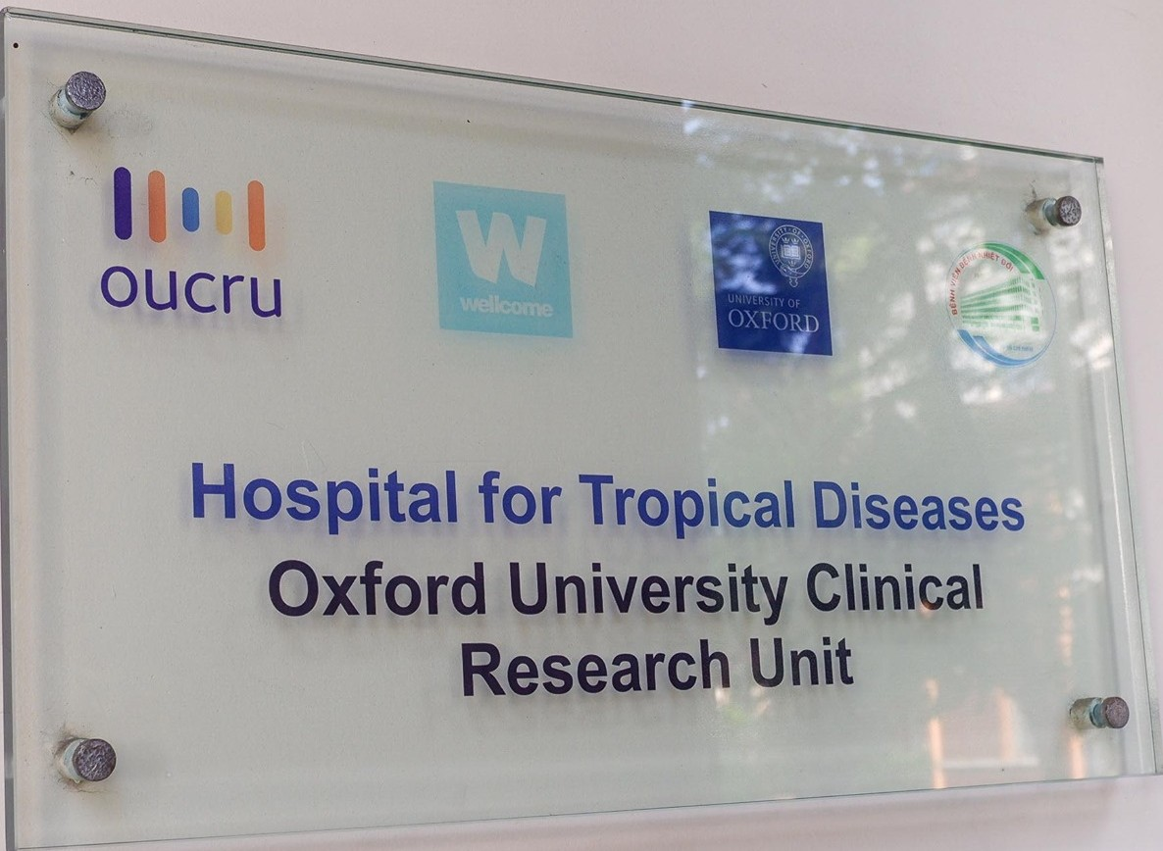
About me
Affiliation | OUCRU-HCM (Oxford University Clinical Research Unit)
 | Emerging Infections group
 | Research Assistant (Bioinformatics)
ORCID | 0009-0007-2964-7747
Webpage | Trần Bá Thiên – OUCRU
Phone | +84 815451019
Email | thientb@oucru.org / thien2522k@gmail.com

Slide 3
Commonly Used Methods to Characterize DNA Methylation
Technique |  | Mechanism |  | Genomic Targets |  | Advantages |  | Disadvantages
Whole genome bisulfite sequencing (WGBS) |  | Treatment of DNA with sodium bisulfite followed by next-generation sequencing |  | All nucleotides |  | The most extensive analysis of DNA methylation Nucleotide-level resolution |  | Expensive Confounding C/T polymorphisms Analyses are computationally intensive
Reduced representation Bisulfite Sequencing (RRBS) |  | Cleavage of DNA with methylation sensitive restriction enzymes followed by bisulfite sequencing |  | Genomic fragments within pairs of certain recognition sites |  | Intermediate cost Nucleotide-level resolution |  | Only methylation events within the recognition sites are assayed Confounding C/T polymorphisms
Methylated DNA immunoprecipitation chip (MeDIP-chip) |  | Sample methylated DNA fragments using 5mC antibody Assay by microarray hybridization |  | Genomic fragments with substantial DNA methylation |  | Large scale Low cost |  | Low resolution (1 kb) Could be affected by antibody efficiency Batch effects
Methylated DNA immunoprecipitation sequencing (MeDIP-seq) |  | Sample methylated DNA fragments using 5mC antibody Assay by next-generation sequencing |  | Genomic fragments with substantial DNA methylation |  | Large scale Intermediate cost |  | Low resolution (150–200 bp) Could be affected by antibody efficiency
CXXC affinity purification (CAP)-seq |  | Sample unmethylated DNA using zinc-finger CxxC affinity chromatography Assay by next-generation sequencing |  | Genomic fragments devoid of DNA methylation |  | Large scale Cost-effective to capture the unmethylated genomic fraction |  | Requires large amounts of input DNA Could be affected by binding efficiency
Methylation array |  | Treatment of DNA with sodium bisulfite and array hybridization |  | Preselected CpG sites via the source company |  | Low cost Nucleotide-level resolution |  | Predefined CpGs are interrogated Batch effects
https://doi.org/10.1093/gbe/evx203

Slide 4
Illumina Methylation Array Platforms
Platform | Release | # CpG Sites | Key Features
27K (HumanMethylation27) | ~2009 | ~27,578 | Early version; focused mostly on promoter regions of ~14,000 genes
450K (HumanMethylation450) | ~2011 | ~485,577 | Genome-wide; includes CpG islands, shores, shelves, promoters, gene bodies
EPIC (850K, MethylationEPIC) | ~2015 | ~865,918 | Improved version of 450K; adds enhancer CpGs (ENCODE, FANTOM5, etc.)
EPIC v2.0 (MethylationEPIC v2.0) | ~2022 | ~935,000 | Expanded coverage of regulatory regions, enhancers, and TSSs
Custom Infinium Arrays | Variable | Variable (10K–>1M+) | Tailored to specific genes, diseases, or CpG regions

Slide 5
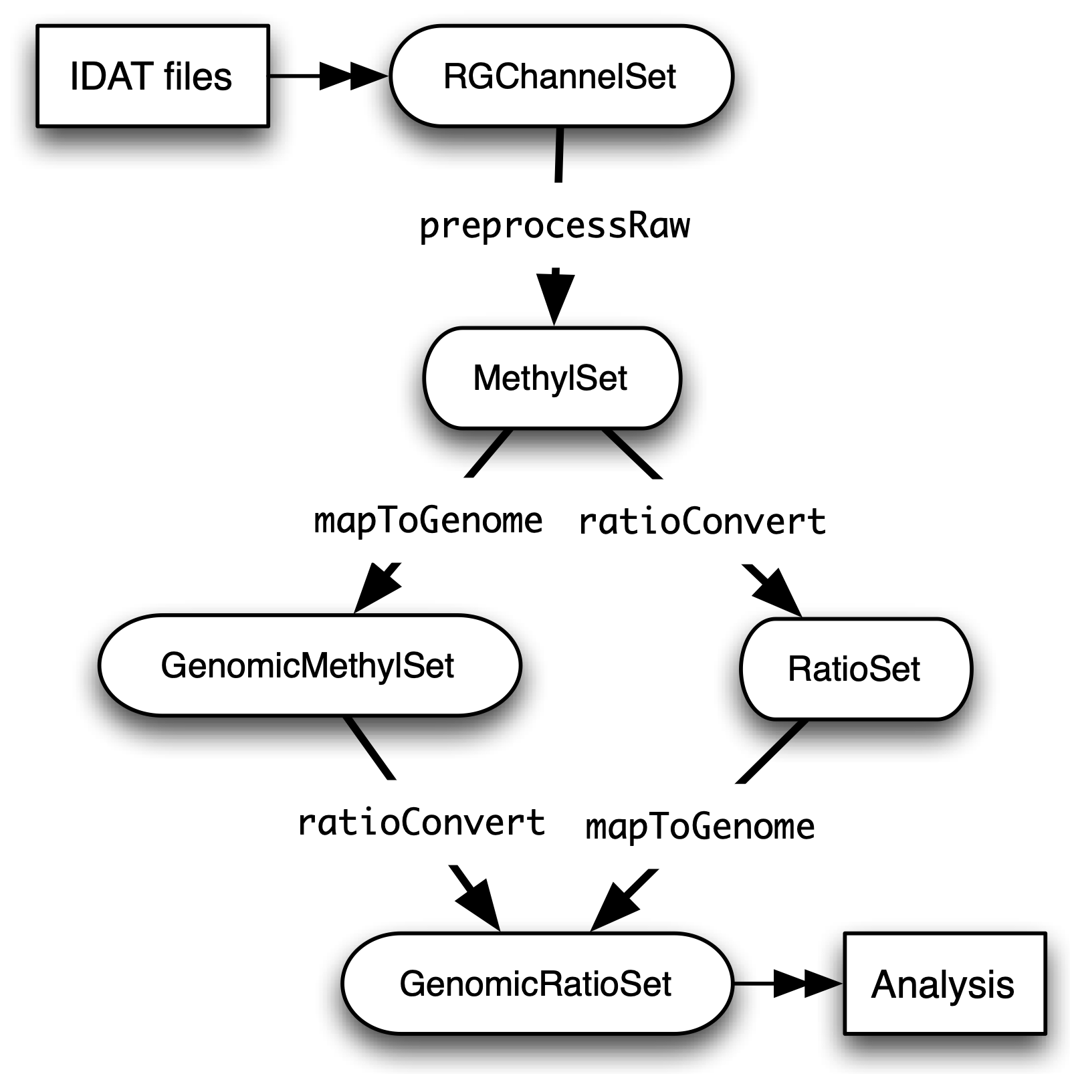
Illumina Methylation Array Processing Workflow
DNA Methylation: Array Workflow — Epigenomics Workshop 2024 1 documentation

Slide 6
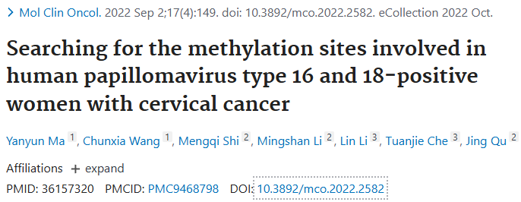
Outline
Raw data downloading and processing
DMRcate: DMPs and DMRs calling
DMPs and DMRs visualizing
DMRs annotating
Gene ontology calling
DMPs: Differential Methylation Positions
DMRs: Differential Methylation Regions
https://doi.org/10.3892/mco.2022.2582

Slide 7
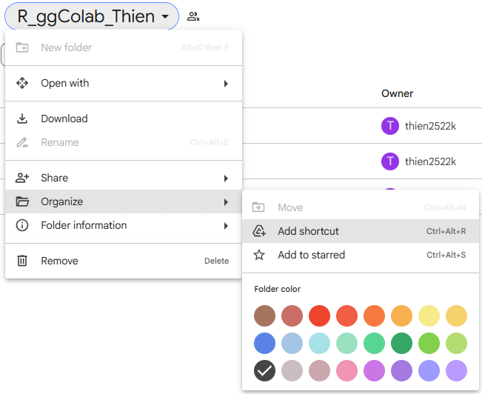
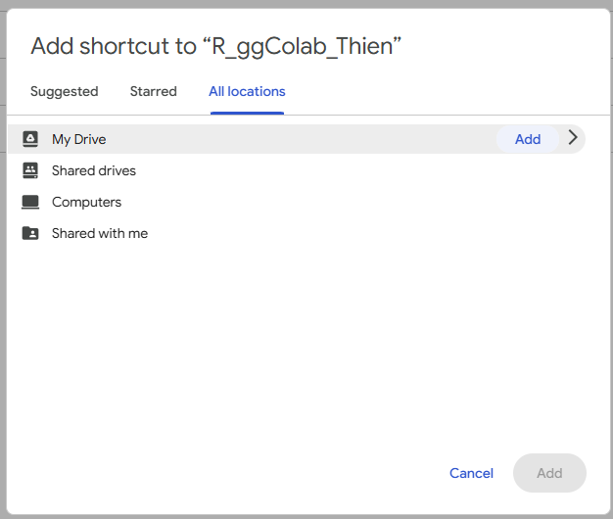
Before we start R_ggColab_Thien - Google Drive

