Slide 1
Cancer Epigenetics Oral Midterm Exam II Module I: Fundamentals of Epigenetics
may 28 2026
Phuc-Loi Luu, PhD
Email: luu.p.loi@googlemail.com
Zalo: 0901802182

Slide 2
Content
Background Concepts
Interpretation

Slide 3
Background Concepts

Slide 4
? | A | A statement | B statement | B
 | a | Prokaryotic transcription | The minimum level of transcription that occurs in the absence of specific activators or repressors. | 1
 | b | Eukaryotic transcription | It requires a specific set of general proteins that assemble at a gene promoter to recruit RNA Polymerase. | 2
 | c | RNAPI, RNAPII and RNAPIII | Collective name for GTFs | 3
 | d | The Pre-Initiation Complex (PIC) | RNAPII | 4
 | e | They form a platform on the DNA promoter that recruits and positions RNAPII correctly at the Transcription Start Site (TSS). | TFIIH is critical | 5
 | f | The crucial link between specific regulatory signals and the basal machinery. | The DNA sequence immediately surrounding the transcription start site (TSS, usually designated +1). | 6
 | g | The "General" Transcription Factors (GTFs) | The RNA Polymerase holoenzyme can directly recognize and bind to promoter sequences. | 7
 | h | TFII proteins (Transcription Factor for RNAP II) | A technique for genome-wide profiling of DNA-binding proteins, histone modifications or nucleosomes. | 8
 | k | Basal transcription | Require auxiliary proteins called General Transcription Factors (GTFs) to locate promoters and load the polymerase onto the DNA. | 9
 | l | Its activity is the most highly regulated and cell-specific of the three polymerases. | Transcribes large rRNAs, all protein-coding genes (mRNA) and many non-coding RNAs, tRNAs and small rRNAs. | 10
 | n | Transcription Factors (TFs) | Estrogen, Testosterone, Cortisol and Vitamin D | 11
 | m | ChIP-seq | Function of GTFs | 12
 | p | Machinery | Mediator | 13
 | q | It opens the DNA (helicase) and kickstarts the polymerase via phosphorylation (kinase). | The complete assembly of GTFs and RNAPII at the promoter, ready to start transcription. | 14
 | s | Ligands | A highly conserved set of proteins absolutely required for RNAPII transcription initiation at all core promoters. | 15
 | x | Core Promoter | Proteins that bind sequence-specifically to genomic DNA to control gene expression. | 16
 | y | Nuclear receptors | ER antagonist used in breast cancer therapy. | 17
 | z | Signal-Dependent Factors (Require activation) | A superfamily of ligand-inducible transcription factors. | 18
 | v | Tamoxifen | Nuclear Receptors, Internal Signals, Cell Surface Receptor Dependent | 19

Slide 5
? | A | A statement | B statement | B
7 | a | Prokaryotic transcription | The minimum level of transcription that occurs in the absence of specific activators or repressors. | 1
9 | b | Eukaryotic transcription | It requires a specific set of general proteins that assemble at a gene promoter to recruit RNA Polymerase. | 2
10 | c | RNAPI, RNAPII and RNAPIII | Collective name for GTFs | 3
14 | d | The Pre-Initiation Complex (PIC) | RNAPII | 4
12 | e | They form a platform on the DNA promoter that recruits and positions RNAPII correctly at the Transcription Start Site (TSS). | TFIIH is critical | 5
13 | f | The crucial link between specific regulatory signals and the basal machinery. | The DNA sequence immediately surrounding the transcription start site (TSS, usually designated +1). | 6
15 | g | The "General" Transcription Factors (GTFs) | The RNA Polymerase holoenzyme can directly recognize and bind to promoter sequences. | 7
3 | h | TFII proteins (Transcription Factor for RNAP II) | A technique for genome-wide profiling of DNA-binding proteins, histone modifications or nucleosomes. | 8
1 | k | Basal transcription | Require auxiliary proteins called General Transcription Factors (GTFs) to locate promoters and load the polymerase onto the DNA. | 9
4 | l | Its activity is the most highly regulated and cell-specific of the three polymerases. | Transcribes large rRNAs, all protein-coding genes (mRNA) and many non-coding RNAs, tRNAs and small rRNAs. | 10
16 | n | Transcription Factors (TFs) | Estrogen, Testosterone, Cortisol and Vitamin D | 11
8 | m | ChIP-seq | Function of GTFs | 12
2 | p | Machinery | Mediator | 13
5 | q | It opens the DNA (helicase) and kickstarts the polymerase via phosphorylation (kinase). | The complete assembly of GTFs and RNAPII at the promoter, ready to start transcription. | 14
11 | s | Ligands | A highly conserved set of proteins absolutely required for RNAPII transcription initiation at all core promoters. | 15
6 | x | Core Promoter | Proteins that bind sequence-specifically to genomic DNA to control gene expression. | 16
18 | y | Nuclear receptors | ER antagonist used in breast cancer therapy. | 17
19 | z | Signal-Dependent Factors (Require activation) | A superfamily of ligand-inducible transcription factors. | 18
17 | v | Tamoxifen | Nuclear Receptors, Internal Signals, Cell Surface Receptor Dependent | 19

Slide 6
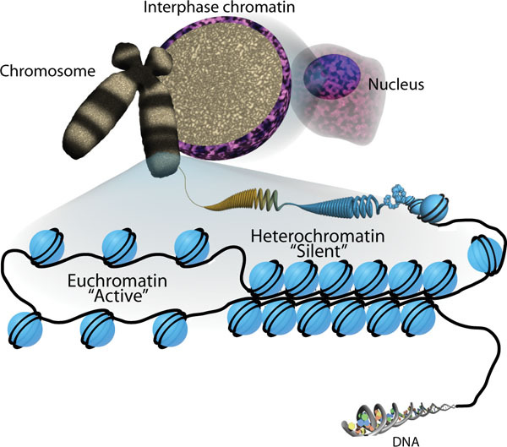
The Challenge of Eukaryotic Transcription
a)
c)
b)
d)
e)
f)
https://www.ncbi.nlm.nih.gov/books/NBK27041/figure/thechromatinsignature.F1/

Slide 7
The Challenge of Eukaryotic Transcription
https://www.ncbi.nlm.nih.gov/books/NBK27041/figure/thechromatinsignature.F1/

Slide 8
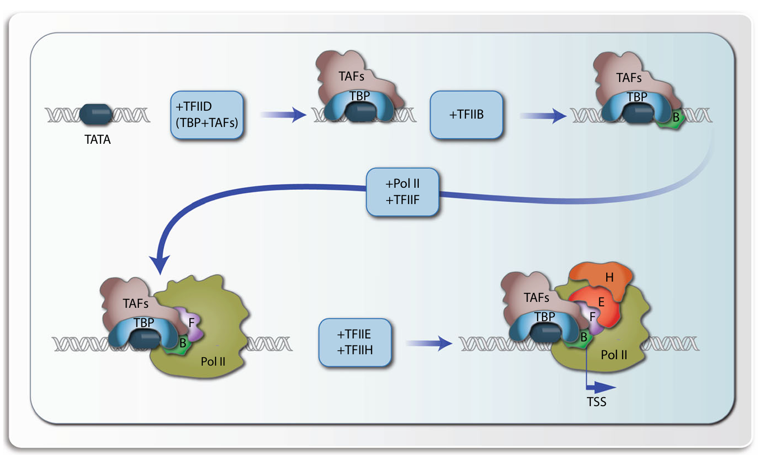
Assembly of the basal transcriptional machinery
a)
c)
b)
d)
e)
f)

Slide 9
Assembly of the basal transcriptional machinery

Slide 10
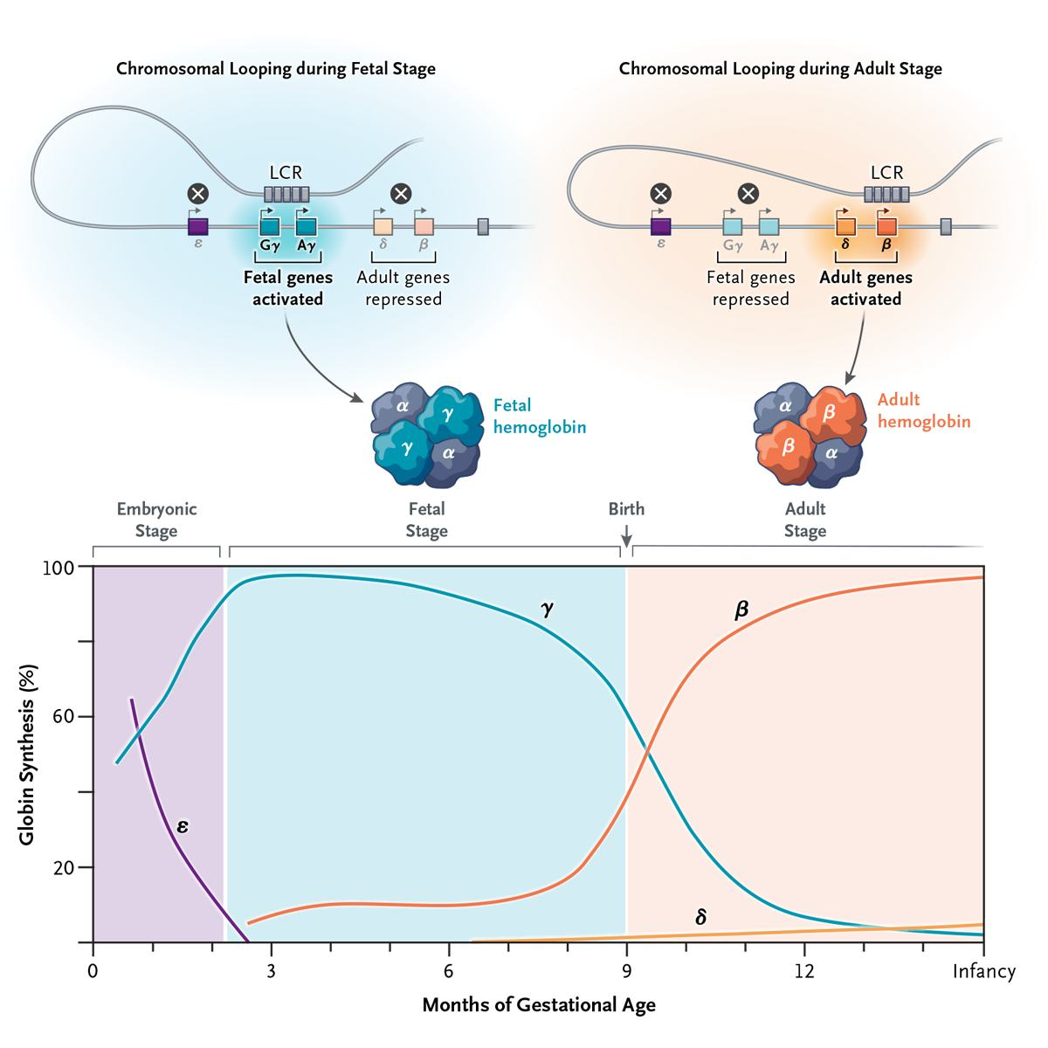
The Fetal-to-Adult Hemoglobin Switch — Mechanism and Therapy
Locus Control Region (LCR)
a
b
d
C
DOI: 10.1056/NEJMra2405260

Slide 11
The Fetal-to-Adult Hemoglobin Switch — Mechanism and Therapy
Locus Control Region (LCR)
DOI: 10.1056/NEJMra2405260

Slide 12
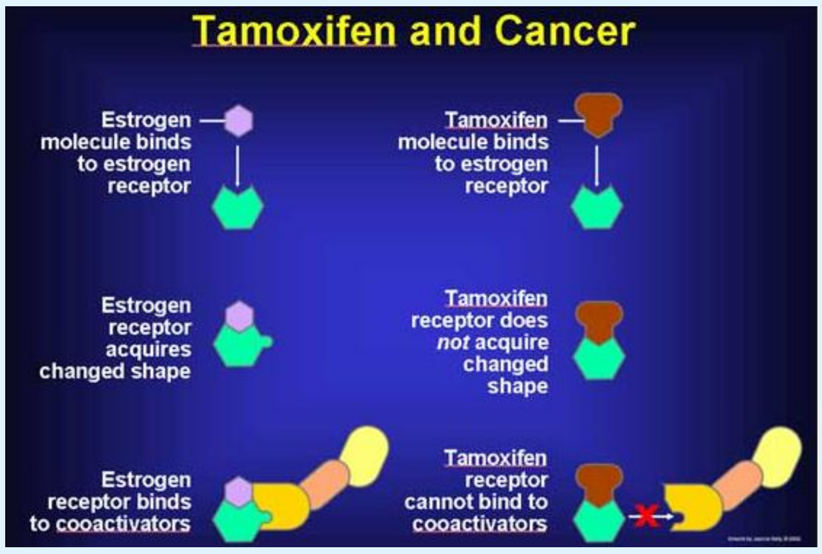
b)
c)
a)
DOI:10.23880/OAJPR-16000143

Slide 13
DOI:10.23880/OAJPR-16000143

Slide 14
Interpretation

Slide 15
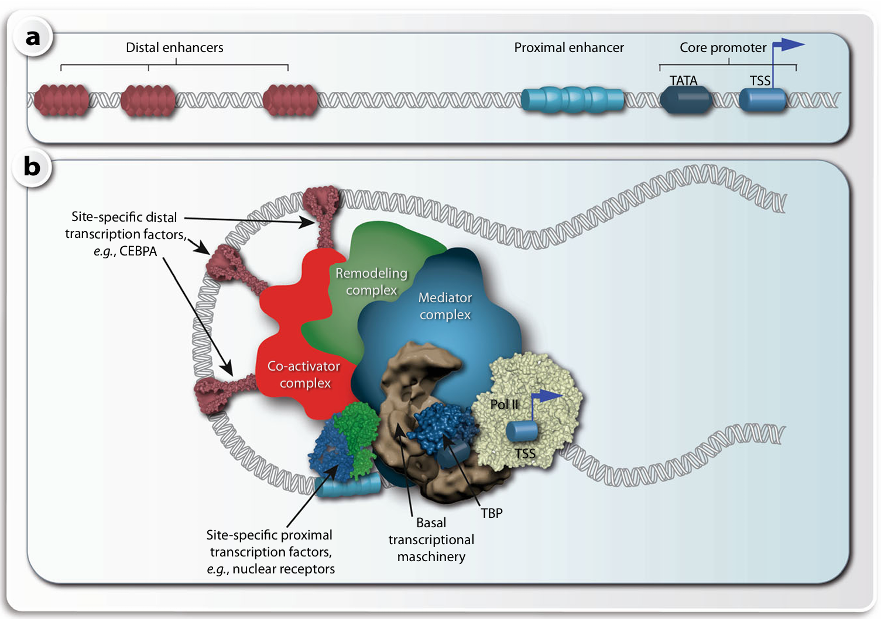
Components of transcriptional regulation

Slide 16
Components of transcriptional regulation
Basal is Insufficient: As noted, the GTFs + RNAPII alone are inefficient in vivo due to chromatin and the need for precise signals.
The Bridge: The Mediator Complex
Significance: Mediator integrates signals from multiple regulatory proteins and transmits them to the basal machinery to stabilize the PIC and greatly stimulate transcription rates.

Slide 17
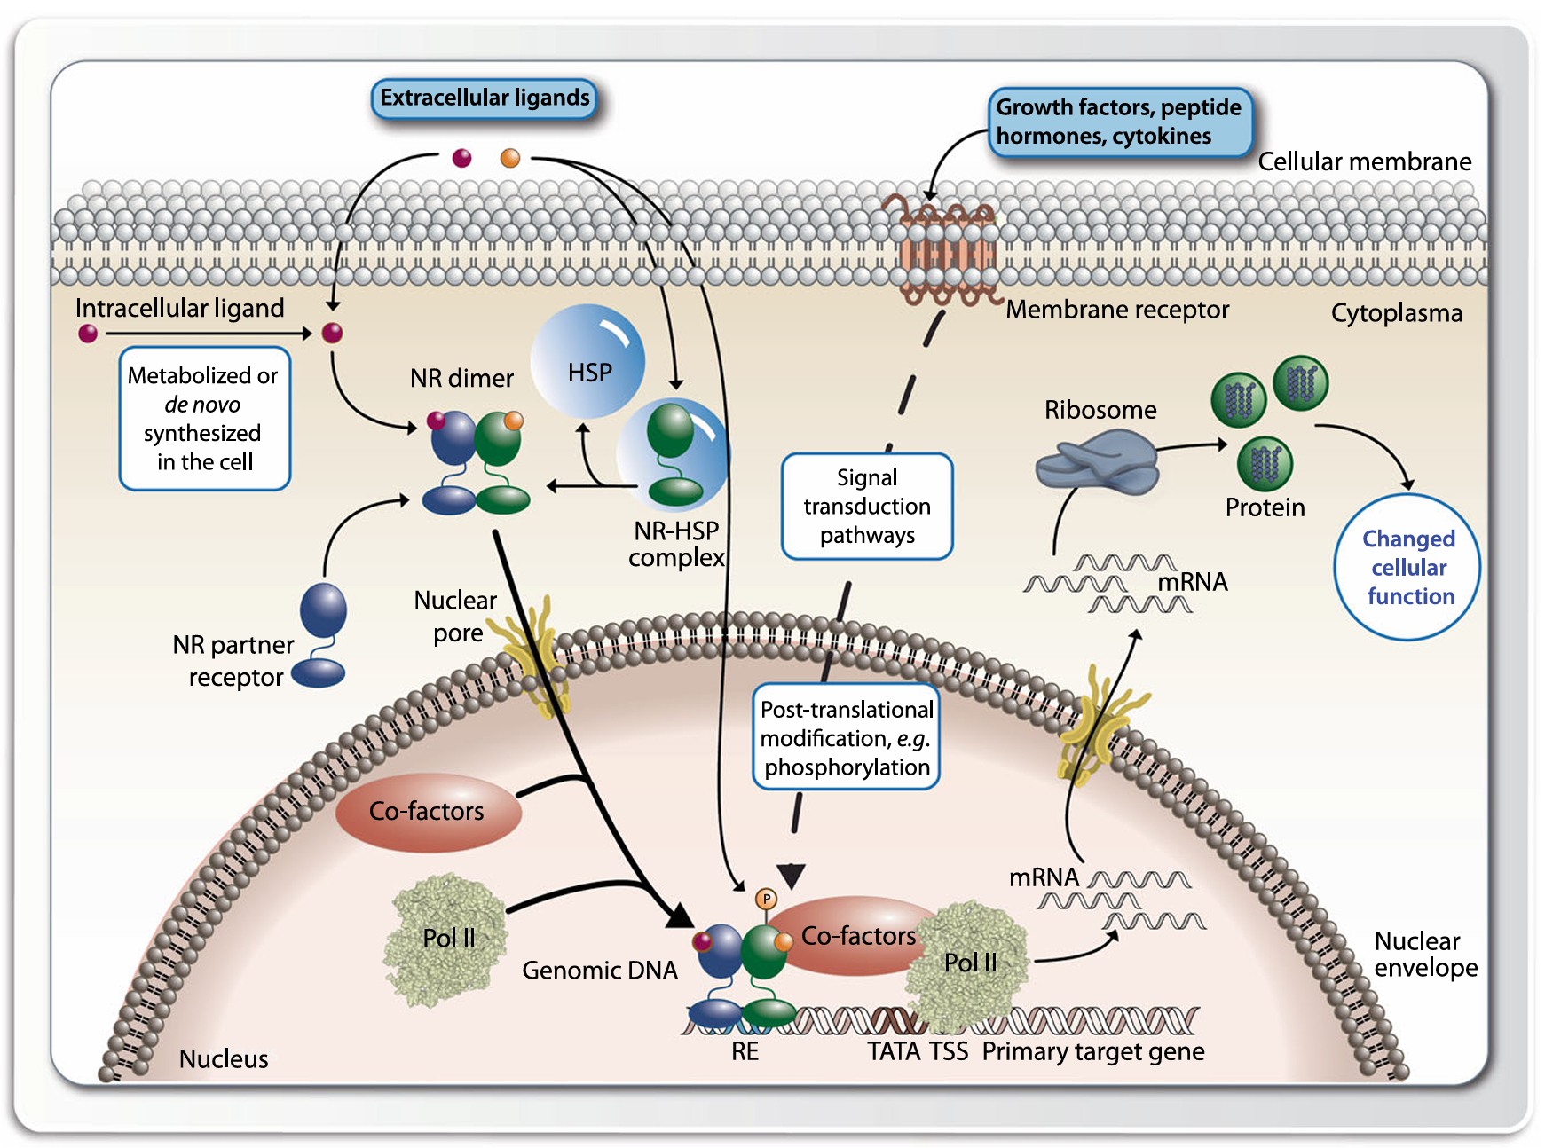
Principles of nuclear receptor signaling
Notes:
Nuclear receptors (NRs) reside either in the cytoplasma (e.g., AR and GR) in a complex with chaperone proteins, such as HSP, or are already located in the nucleus (like most nuclear receptors), when they are activated through the binding of their specific lipophilic ligand. The ligand is either of extracellular origin and has passed the cellular membrane or is a metabolite that was synthesized inside of the cell. Cytoplasmic nuclear receptors dissociate then from their chaperones and translocate to the nucleus, where they bind to their genomic binding sites (REs) in the vicinity of their target genes. Ligand-activated nuclear receptors interact with cofactors that build a bridge to the basal transcriptional machinery with Pol II in its core. This leads then to changes in the mRNA and protein expression of these target genes

Slide 18
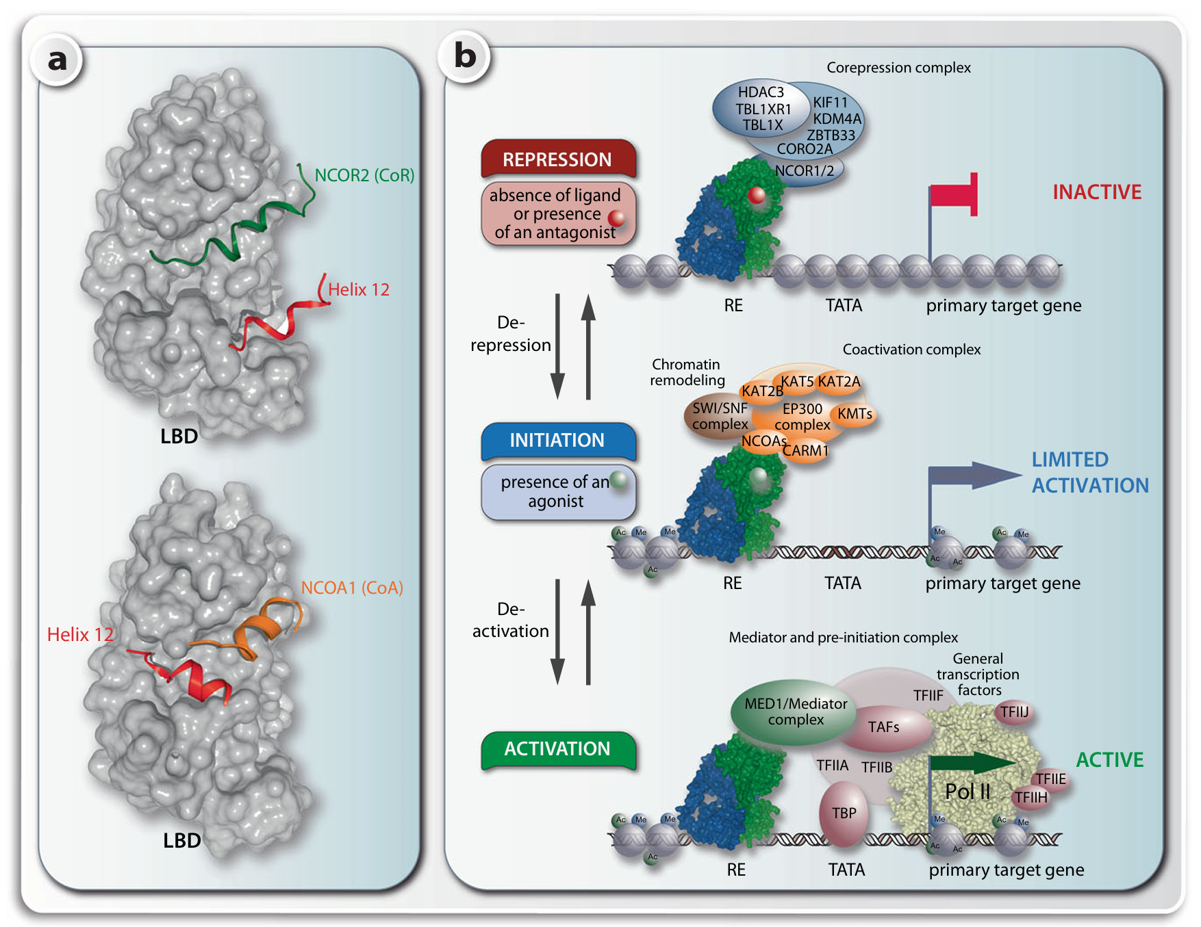
Interaction of nuclear receptors with cofactors.
A solvent excluded surface (Connolly surface) representation of a nuclear receptor LBD in the absence (top) and presence (bottom) of a ligand
Notes:
Interaction of nuclear receptors with cofactors. A solvent excluded surface (Connolly surface) representation of a nuclear receptor LBD in the absence (top) and presence (bottom)ofa ligand a. The ligand-induced conformational change primarily affects helix 12 (red) that is the most carboxy-terminal α-helix of the LBD. In the absence of ligand helix 12 is in a position that allows a corepressor protein (represented by the receptor interaction domain of NCOR2, green) to interact with the LBD, while in the presence of ligand only the binding of a coactivator protein (receptor interaction domain of NCOA1, orange) is possible. The 3-step transactivation process of nuclear receptors is shown in context of a target gene b. In the absence of a ligand the DNA-bound dimeric nuclear receptor complex is connected via corepressor proteins with a multiprotein complex with chromatin modifying activity that leads to local condensation of chromatin and repression of the target gene (top). Following the binding of an agonistic ligand the LBD of nuclear receptors is dissociating from corepressors and associating with coactivators that connect with a multiprotein complex having chromatin decondensation activity (center). The ligand-activated nuclear receptor is changing to another type of coactivator being a subunit of the MED complex (bottom). In this way, the basal transcriptional machinery and Pol II are activated and finally mRNA transcription starts. CORO2A = coronin 2A, KIF11 = kinesin family member 11, TBL1X = transducin β-like 1 X-linked, TBL1XR1 = TBL1X receptor 1, ZBTB33 = zinc finger and BTB domain containing 33

Slide 19
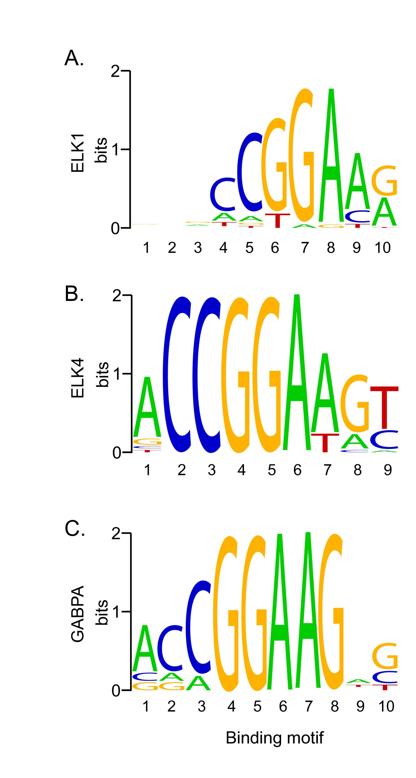
Transcription Factor Binding Sites Motifs
Sequence logos of ETS transcription factor binding sites. Sequence logos of consensus DNA binding sites for the three ETS transcription factors enriched in genes regulated by HNF4α. Y axis indicates amount of information at each position in the motif. These logos were generated from information obtained from the JASPAR core database [42]. (A), ELK1 binding motif; (B), ELK4 binding motif; and (C), GABPA binding motif.
https://link.springer.com/article/10.1186/1471-2164-12-128

Slide 20
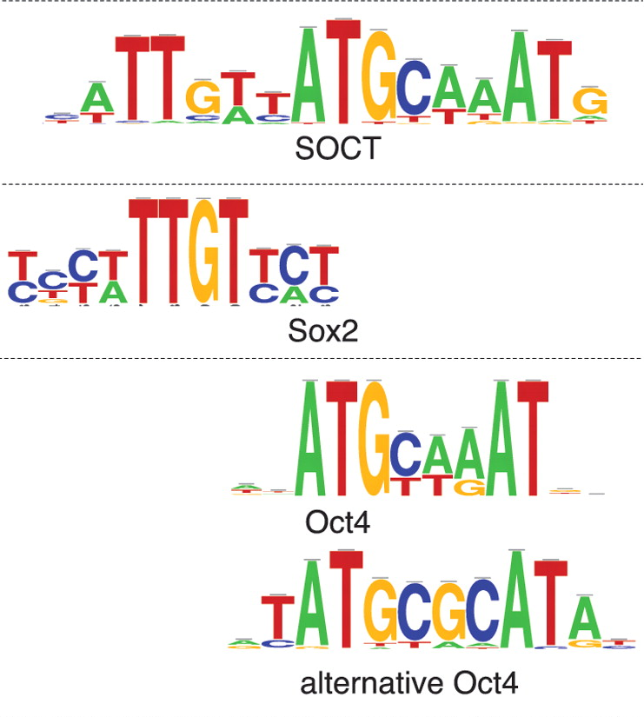
In the Sox2 and Oct4 peak sets, peak-motifs found not only the composite ‘SOCT’ motif bound by the Sox2/Oct4 complex (reported by Chen and co-workers), but also the distinct motifs recognized by Sox2 (CTCTTTGTT) and Oct4 (ATGyAAAt), respectively ( Figure 4 , top). Interestingly, in the Oct4 data set, unknown motifs were returned with a high significance, (i.e. motifs with no significant similarity with the consensus encompassed by the common databases). Such motifs may reveal alternative consensus, as in the case of the motif crTATGCGCATAyg, which actually corresponds to an alternative Oct4 motif, also detected in other recent studies
https://academic.oup.com/nar/article/40/4/e31/2411061

Slide 21
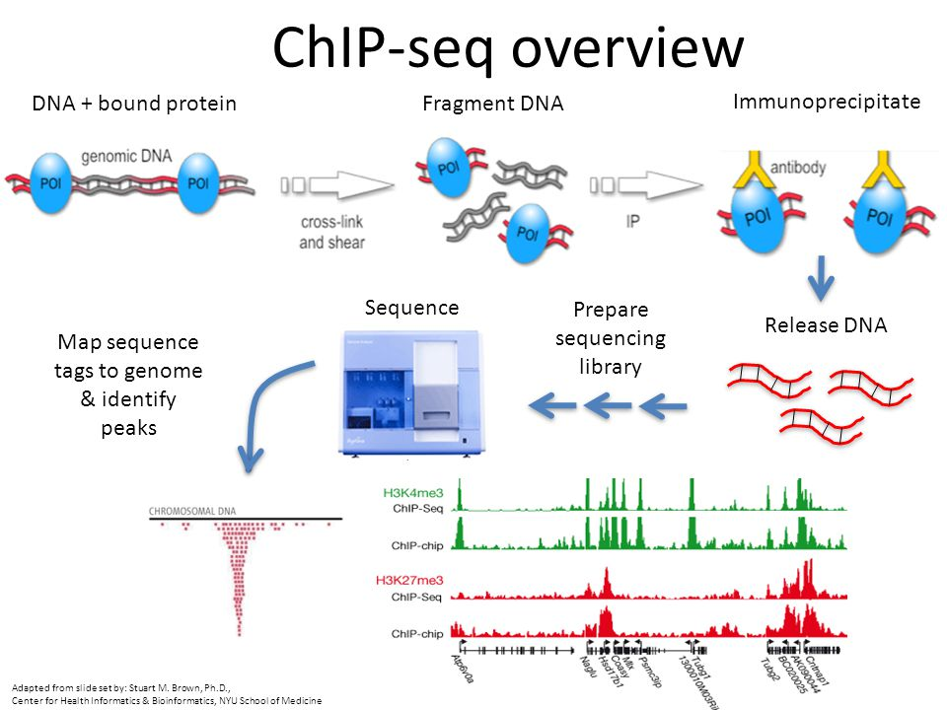
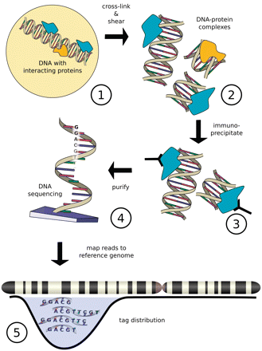
Figure from Szalkowski, A.M, and Schmid, C.D.(2010). Rapid innovation in ChIP-seq peak-calling algorithms is outdistancing banchmarking efforts. Briefings in Bioinfomatics.

Slide 22
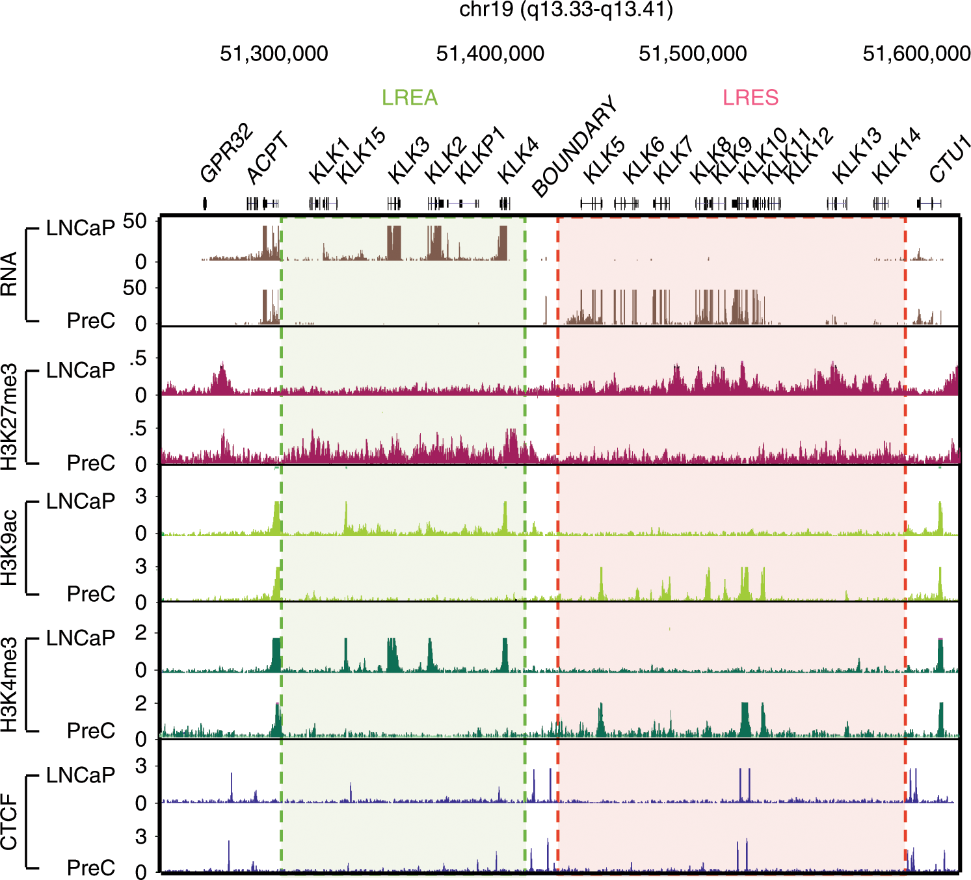
https://www.nature.com/articles/s41467-019-13753-7/figures/1

Slide 23
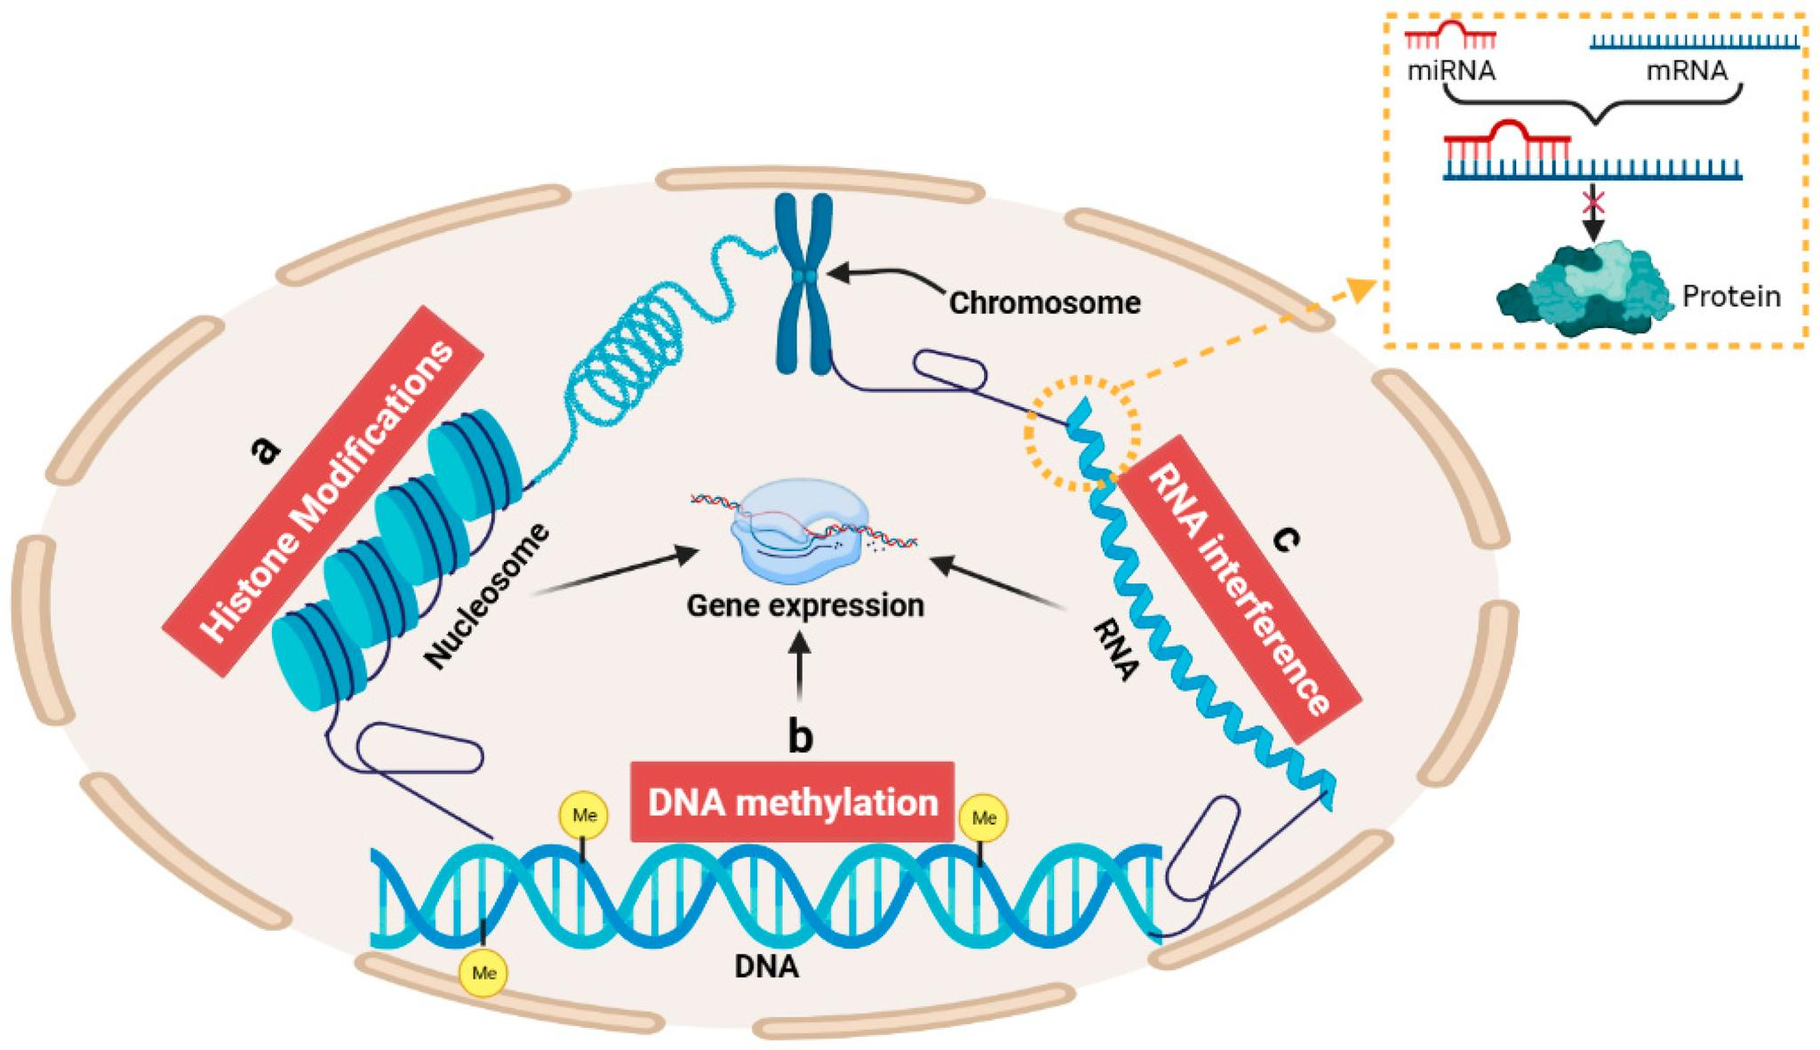
Epigenetic Mechanisms in Gene Regulation
Zhang, J.; Sheng, H.; Hu, C.; Li, F.; Cai, B.; Ma, Y.; Wang, Y.; Ma, Y. Effects of DNA Methylation on Gene Expression and Phenotypic Traits in Cattle: A Review. Int. J. Mol. Sci. 2023, 24, 11882.

Slide 24
Epigenetic Mechanisms in Gene Regulation
Zhang, J.; Sheng, H.; Hu, C.; Li, F.; Cai, B.; Ma, Y.; Wang, Y.; Ma, Y. Effects of DNA Methylation on Gene Expression and Phenotypic Traits in Cattle: A Review. Int. J. Mol. Sci. 2023, 24, 11882.

Slide 25
Thank you for your time!
Phuc-Loi Luu, PhD
Email: luu.p.loi@googlemail.com
Zalo: 0901802182

