Slide 1
Gene Sequence Analysis
Lecture 7: BLAST – Homology Search
Pairwise Alignment
Adapted from Dr. Morgan Langille’s Lecture
07/06/2026
Phuc-Loi Luu, PhD

Slide 2
What is homology?
●
Homology refers to shared ancestry
●
Two sequences are homologous if they are derived from a common ancestral sequence
●
One sequence by itself is not informative
●
it must be analyzed by comparative methods against existing sequence databases to develop hypothesis concerning relatives and function.

Slide 3
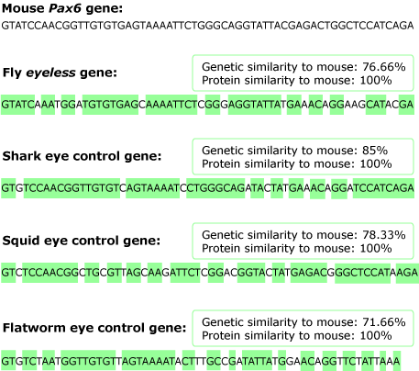
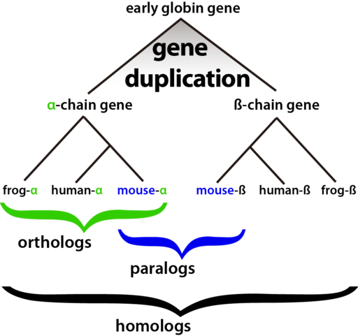
What is homology?
https://evolution.berkeley.edu/evolibrary/article/1_0_0/eyes_10
Photo courtesy of: Popo H. Liao (Own work), via Wikimedia Commons

Slide 4
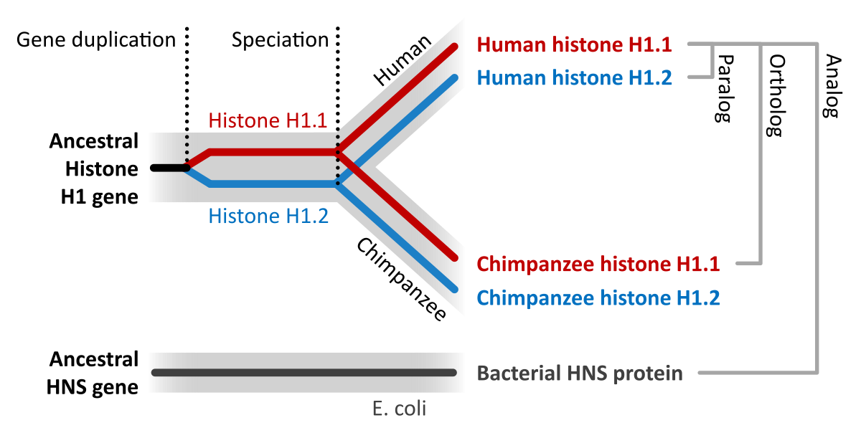
Types of homologs
●
Orthologs
Think same gene in different organism Often thought to have similar function
●
●
●
Paralogs
Think gene duplication
Less likely to have similar function
●
●
https://en.wikipedia.org/wiki/Sequence_homology

Slide 5
What is similarity?
●
Similarity is a measure of the likeness between sequences.
●
Gene searching tools calculate the similarity between sequences and rank more similar sequences higher.
●
Sequences can NOT be partially homologous
●
WRONG: Gene X is 80% homologous to Gene Y
●
Sequences can be partially similar
●
CORRECT: Gene X has 80% identity to Gene Y

Slide 6
Identity vs Similarity
●
Identity is a percentage measurement that states how many characters in the sequence are identical
●
Similarity can also be used as a metric which means how many characters are “positive scoring”

Slide 7
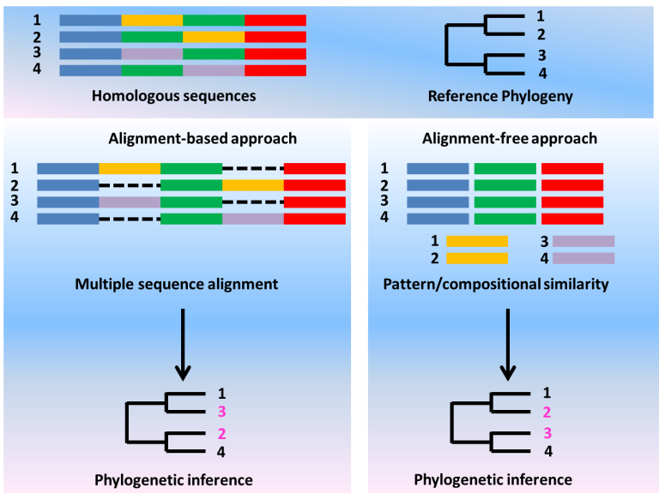
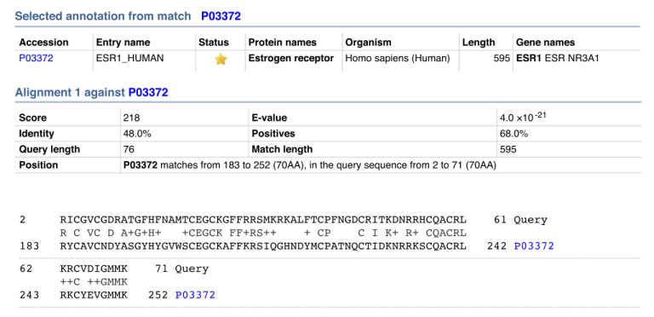
Identity vs Similarity
Similarity in sequence alignment is the resemblance between two sequences when compared. This fact is dependent on the identity of sequences. Similarity depicts the extent to which the residues are aligned. Hence, similar sequences contain similar properties. In bioinformatics, similarity is a tool to assess the likeness between two proteins.
Identity in sequence alignment is the number of characters that match exactly between two different sequences. Hence, gaps do not count when assessing identity. The measurement is considered to be relational to the shorter sequence among the two sequences. It significantly implies that it has the effect where the sequence identity is not transitive. If X=Y and Y=Z, then X is not necessarily equal to Z. This is deduced in terms of the identity distance measure.
X = AAGGCTT, Y = AAGGC and Z = AAGGCAT.
Identity between X and Y is 100% {5 identical nucleotides / min[length(X),length(Y)]}.
Identity between Y and Z is also 100%.
But identity between X and Z is only 85% {(6 identical nucleotides / 7)}.
https://www.differencebetween.com/difference-between-similarity-and-identity-in-sequence-alignment

Slide 8
Identity vs Similarity
Identity
The extent to which two (nucleotide or amino acid) sequences are invariant (identical).
Similarity
The extent to which (nucleotide or amino acid) sequences are related. The extent of similarity between two sequences can be based on percent sequence identity and/or conservation. In BLAST similarity refers to a positive matrix score. This is quite flexible (see later examples of DNA polymerases) – similar across the whole sequence or similarity restricted to domains !
Homology
Similarity attributed to descent from a common ancestor.

Slide 9
Assessing Sequence Similarity
Rbn Lsz
KETAAAKFERQHMD KVFGRCELAAAMKRHGLDNYRGYSLGNWVCAAKFESNFNT
SST SAASSSNYCNQMMKSRNLTKDRCKPMNTFVHESLA QATNRNTDGSTDYGILQINSRWWCNDGRTP GSRN
Rbn Lsz
Rbn Lsz
DVQAVCSQKNVACKNGQTNCYQSYSTMSITDCRETGSSKY LCNIPCSALLSSDITASVNC AKKIVSDGDGMNAWVAWR
PNACYKTTQANKHIIVACEGNPYVPHFDASV NRCKGTDVQA WIRGCRL
is this alignment significant?
Rbn Lsz

Slide 10
DNA scoring systems
Sequence 1 ACTACCAGTTCATTTGATACTTCTCAAA
| | | ||
Sequence 2 TACCATTACCGTGTTAACTGAAAGGACTTAAAGACT
A C G T
A 1 0 0 0
C 0 1 0 0
G 0 0 1 0
T 0 0 0 1
Match: 5 x 1 = 5
Mismatch: 19 x 0 = 0
Score: 5

Slide 11
The Scoring Schemes or Weight Matrices
Genetic Code Scoring
Fitch 1966 based on Nucleotide Base change required (0,1,2,3)
Required to interconvert the codons for the two amino acids
Rarely used nowadays

Slide 12
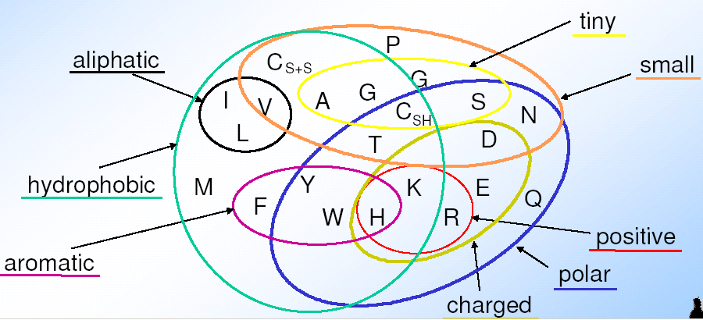
Complication: „inexact“ is not binary (1|0) but something relative
Amino acids have different physical and biochemical properties that are/are not important for function and thus influence their probability to be replaced in evolution

Slide 13
The Scoring Schemes or Weight Matrices
Chemical Similarity Scoring
Similarity based on Physio-chemical properties
MacLachlan 1972, Based on size, shape, charge and polar
Score 0 for opposite (e.g. E & F) and 6 for identical character

Slide 14
The Scoring Schemes or Weight Matrices
Observed Substitutions or PAM matrices
Based on Observed Substitutions
Chicken and Egg problem
Dayhoff group in 1977 align sequence manually
Observed Substitutions or point mutation frequency
MATRICES are PAM30, PAM250, PAM100 etc
AILDCTGRTG……
ALLDCTGR--……
SLIDCSAR-G……
AILNCTL-RG……

Slide 15
Where does the score (S) come from?
●
The quality of each pair-wise alignment is represented as a score and the scores are ranked.
Scoring matrices are used to calculate the score of the alignment base by base (DNA) or amino acid by amino acid (protein).
The alignment score will be the sum of the scores for each position.
●
●

Slide 16
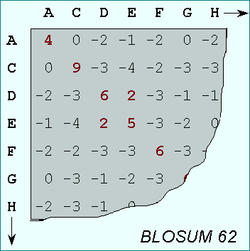
What’s a scoring matrix?
●
Substitution matrices are used for amino acid alignments.
each possible residue substitution is given a score
A simpler unitary matrix is used for DNA pairs
●
●
●
each position can be given a score of +1 if it matches and a score of
-1 if it does not.

Slide 17
BLOSUM vs. PAM
BLOSUM 45
PAM 250
More Divergent
BLOSUM 62
PAM 160
BLOSUM 90
PAM 100
Less Divergent
•
BLOSUM 62 is the default matrix in BLAST. Though it is tailored for comparisons of moderately distant proteins, it performs well in detecting closer relationships. A search for distant relatives may be more sensitive with a different matrix.

Slide 18
Importance of Similarity
Ancestral protein/gene sequence
Similar (homologous) protein/gene
sequences
Similar sequences: probably have the same ancestor, share the same structure, and have a similar biological function

Slide 19
Importance of Similarity
Sequence DB
unknown function ?
Similarity Search
similar protein
with known function
extrapolate
function

Slide 20
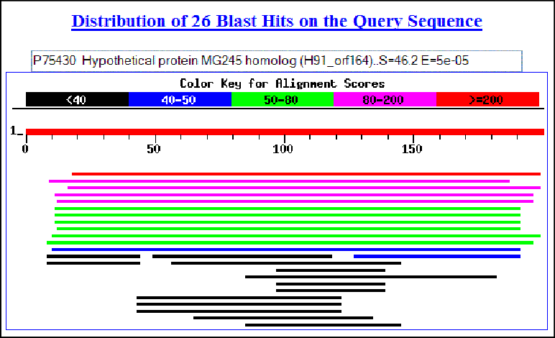
QUERY sequence(s)
BLAST results
BLAST program
BLAST
database

Slide 21
Considerations for choosing a BLAST database
●
First consider your research question:
●
Are you looking for an particular gene in a particular species?
– BLAST against the genome of that species.
Are you looking for additional members of a protein family across all species?
●
BLAST against the non-redudant database (nr), if you can’t find hits check wgs, htgs, and the trace archives.
Are you looking to annotate genes in your species of interest?
–
●
– BLAST against known genes (RefSeq) and/or ESTs from a closely related species.

Slide 22
When choosing a database for BLAST…
●
Changing your choice of database is changing your search space
●
Database size affects the BLAST statistics
●
Databases change rapidly and are updated frequently

Slide 23
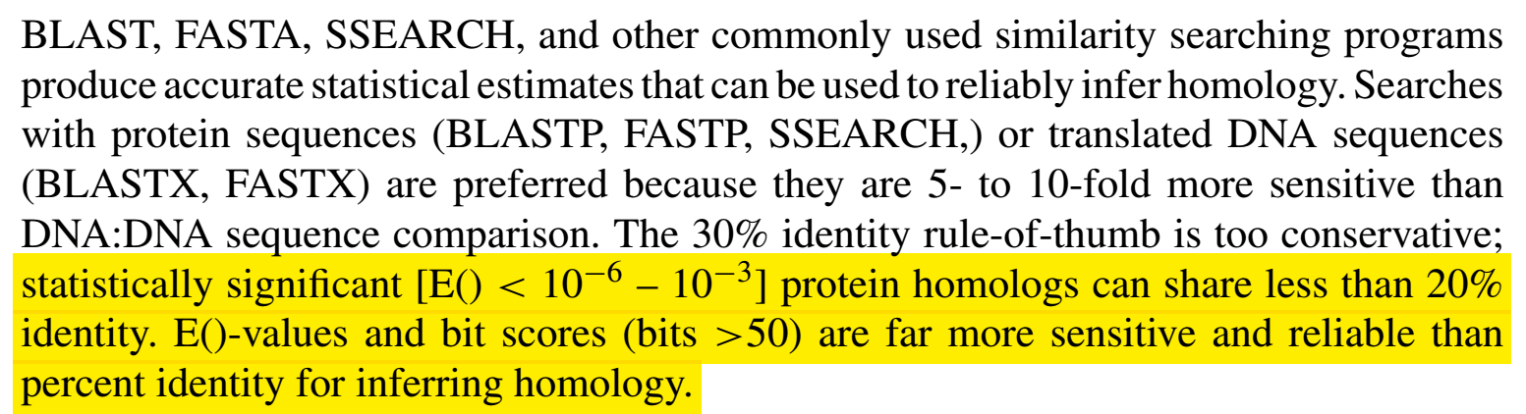
Importance of Similarity
Rule-of-thumb:
If your sequences are more than 100 amino acids long (or 100 nucleotides long) you can considered them as homologues if 25% of the aa are identical (70% of nucleotide for DNA). Below this value you enter the twilight zone.
Twilight zone = protein sequence similarity between ~0-20% identity: is not statistically significant, i.e. could have arisen by chance.
Beware:
E-value (Expectation value)
length of the segments similar between the two sequences
The number of insertions/deletions

Slide 24
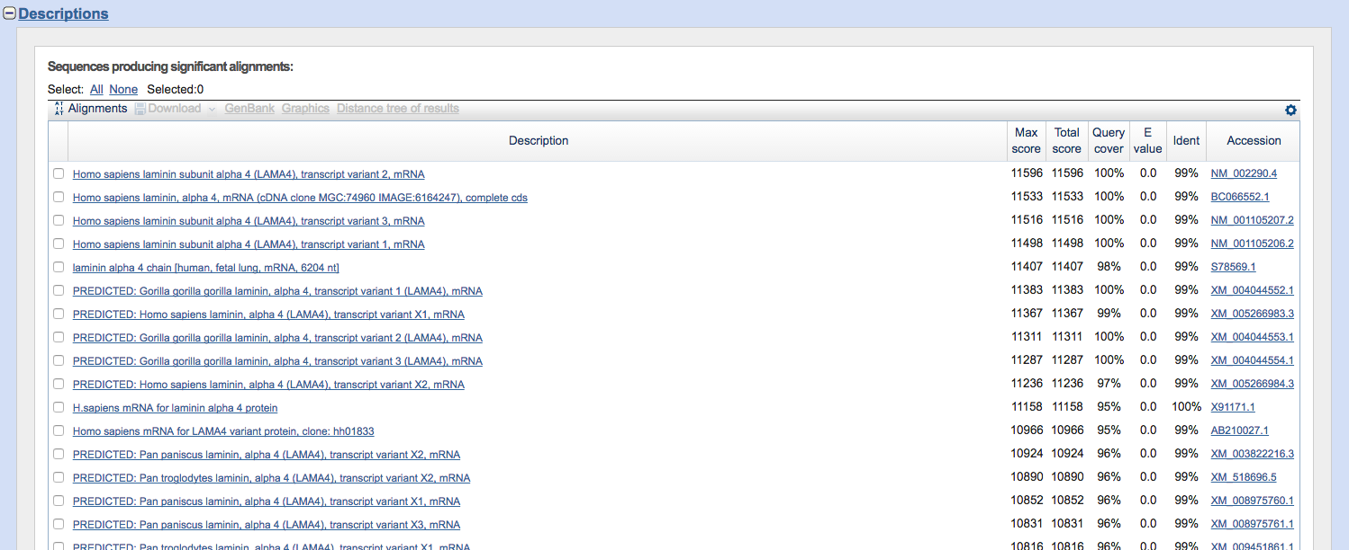
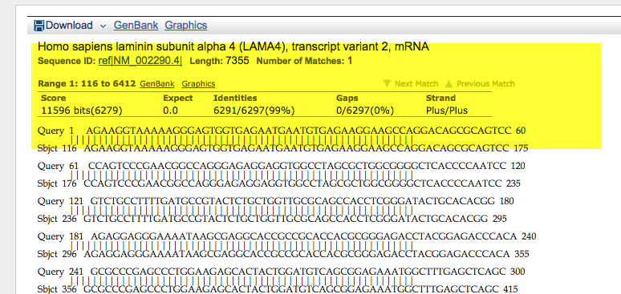

Slide 25
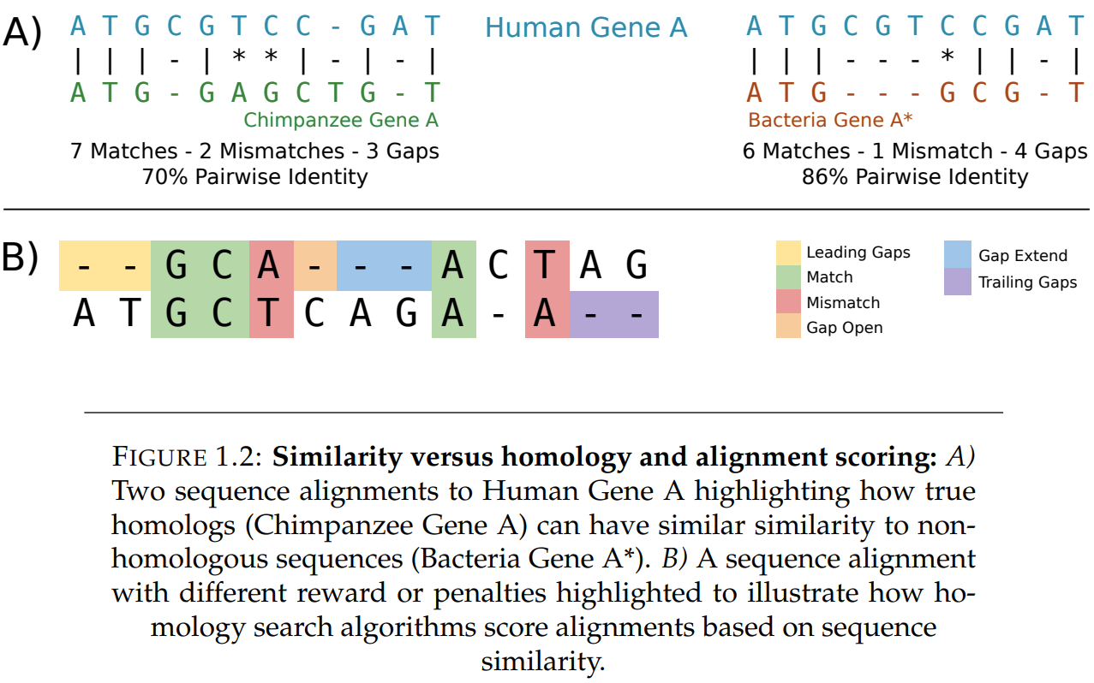
https://ourarchive.otago.ac.nz/bitstream/handle/10523/9302/McGimpseyStephanie2019MSc.pdf

Slide 26
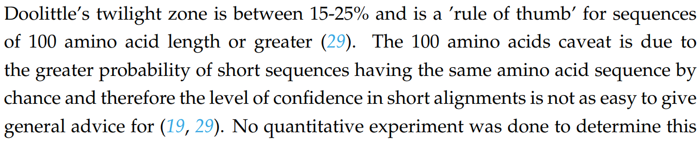
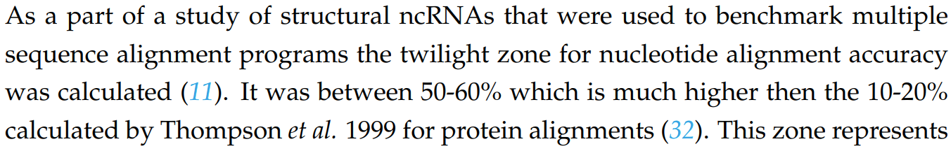
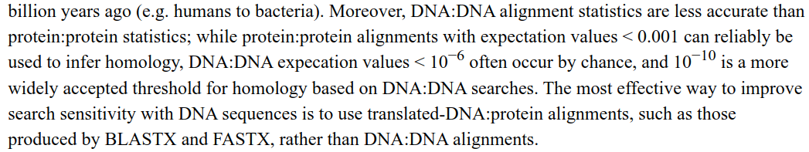
https://ourarchive.otago.ac.nz/bitstream/handle/10523/9302/McGimpseyStephanie2019MSc.pdf
https://www.ncbi.nlm.nih.gov/pmc/articles/PMC3820096/

Slide 27
Sequence Similarity Searching – The statistics are important
Discriminating between real and artifactual matches is done using an estimate of probability that the match might occur by chance.
●

Slide 28
What do the Score and the e-value really
mean?
●
The quality of the alignment is represented by the Score.
●
Score (S)
The score of an alignment is calculated as the sum of substitution and gap scores. Substitution scores are given by a look-up table (PAM, BLOSUM) whereas gap scores are assigned empirically .
The significance of each alignment is computed as an E value.
–
●
●
E value (E)
–
Expectation value. The number of different alignments with scores equivalent to or better than S that are expected to occur in a database search by chance. The lower the E value, the more significant the score.

Slide 29
I’m confused! What does the E-value mean
again?
●
E value (E)
Expectation value. The number of different alignments with scores equivalent to or better than S that are expected to occur in a database search by chance. The lower the E value, the more significant the score.
When E < 0.01, P-values and E-value are nearly identical.
●
●
●
So, the E-value is the number of times you expect to see your hit occur in the database (with as good as or better score) due to random chance alone.

Slide 30
Notes on E-values
●
Low E-values suggest that sequences are homologous
●
Can’t show non-homology
●
Statistical significance depends on both the size of the alignments and the size of the sequence database
●
Important consideration for comparing results across different searches
E-value increases as database gets bigger E-value decreases as alignments get longer
●
●

