Slide 1

The Central Dogma
A Comprehensive Review of DNA, RNA, and Protein Synthesis

Slide 2
Part 1: The Core Concept
Tracing the flow of genetic information

Slide 3

The Foundation
The Central Dogma. This states that once 'information' has passed into protein it cannot get out again.
"
"
— Francis Crick, 1958

Slide 4






The Three Pillars
Replication
Transcription
Translation
The process by which a cell duplicates its DNA prior to cell division, ensuring vital information is passed on.
The synthesis of an RNA copy from a segment of DNA, taking the instructions out of the protected nucleus.
The decoding of the mRNA sequence by a ribosome complex to build a highly specific protein molecule.

Slide 5
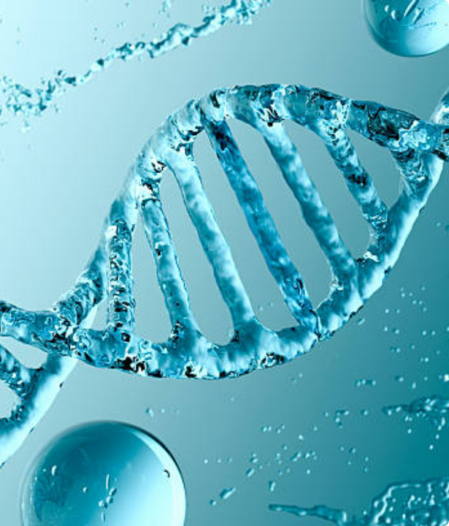
The Master Blueprint: DNA
The Double Helix Structure
Deoxyribonucleic acid (DNA) is a robust, double-stranded molecule responsible for the long-term storage of the genetic code.
The two strands are antiparallel and are firmly held together by hydrogen bonds between complementary nucleotide base pairs: Adenine (A) pairs with Thymine (T), and Cytosine (C) pairs with Guanine (G).

Slide 6


DNA versus RNA
Deoxyribonucleic Acid (DNA)
Ribonucleic Acid (RNA)
•
Structure: Stable, double-stranded helix.
•
Structure: Typically single-stranded and flexible.
•
Sugar Base: Deoxyribose.
•
Sugar Base: Ribose.
•
Nucleobases: Adenine, Thymine, Cytosine, Guanine.
•
Nucleobases: Adenine, Uracil (replaces T), Cytosine, Guanine.
•
Function: Long-term, secure storage of genetic information within the nucleus.
•
Function: Transfers genetic instructions and actively synthesizes proteins.

Slide 7
Part 2: DNA Replication
Duplicating the Genome

Slide 8

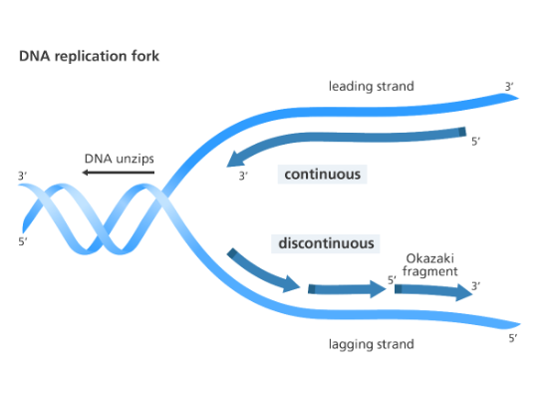
The Replication Fork
DNA replication is a semi-conservative process. This means each newly formed double helix contains one original parent strand and one newly synthesized strand.
The origin of replication is the site where the double helix unwinds, forming a characteristic Y-shaped structure known as the "replication fork."
Because DNA strands run antiparallel, enzymatic synthesis occurs continuously on the leading strand, but discontinuously in small sections (Okazaki fragments) on the lagging strand.

Slide 9
Key Enzymes in Replication
Helicase Unzips the DNA double helix by breaking the hydrogen bonds between base pairs, creating the replication fork.
Primase Synthesizes a short RNA primer, providing a starting point for DNA synthesis.
DNA: ACGATCAGCTAGCA… Primer: ?????
DNA Polymerase Binds to the primer and adds complementary nucleotides to build the new, growing DNA strand.
DNA: ACGATCAGCTAGCA… Primer: ??????????????…
Ligase Seals the gaps between Okazaki fragments on the lagging strand, ensuring a continuous sugar-phosphate backbone.

Slide 10
Key Enzymes in Replication
Helicase Unzips the DNA double helix by breaking the hydrogen bonds between base pairs, creating the replication fork.
Primase Synthesizes a short RNA primer, providing a starting point for DNA synthesis.
DNA: ACGATCAGCTAGCA… Primer: UGCUA
DNA Polymerase Binds to the primer and adds complementary nucleotides to build the new, growing DNA strand.
DNA: ACGATCAGCTAGCA… Primer: UGCUAGTCGATCGT…
Ligase Seals the gaps between Okazaki fragments on the lagging strand, ensuring a continuous sugar-phosphate backbone.

Slide 11
Part 3: Transcription
DNA to RNA

Slide 12






Stages of Transcription
Initiation
Elongation
Termination
RNA Polymerase recognizes and binds to a specific promoter sequence on the DNA, unwinding a small portion of the helix to begin synthesis.
The polymerase enzyme moves along the template strand, accurately assembling the RNA transcript using complementary base pairing.
Upon reaching a terminator sequence, the polymerase detaches from the template, and the newly formed RNA strand is released.

Slide 13






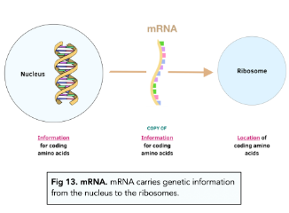
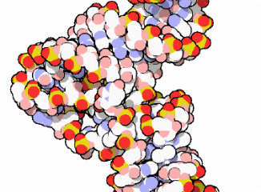
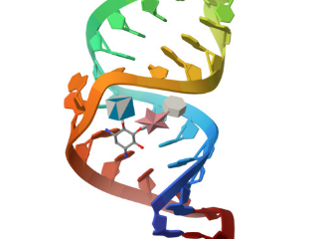
The Three Types of RNA
Messenger (mRNA)
Transfer (tRNA)
Ribosomal (rRNA)
Carries the vital genetic instructions copied from DNA out to the ribosomes in the cytoplasm.
Matches specific individual amino acids to the corresponding mRNA codons during protein synthesis.
Forms the core physical framework and provides the crucial catalytic activity of the ribosome.

Slide 14
Part 4: Translation
RNA to Protein

Slide 15
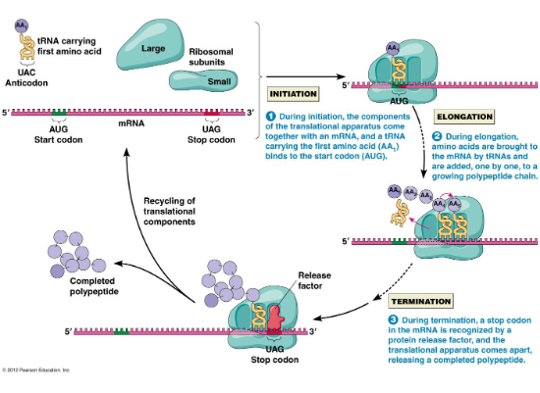
Decoding the Message
Translation is the process where ribosomes synthesize proteins using the mature mRNA transcript.
The ribosome complex carefully assembles around the target mRNA. The very first tRNA, carrying Methionine, is attached at the start codon to initiate the process.
The ribosome then shifts along the mRNA, matching incoming tRNA anticodons to the mRNA codons. Each tRNA efficiently adds its specific amino acid to the growing polypeptide chain via strong peptide bonds.

Slide 16
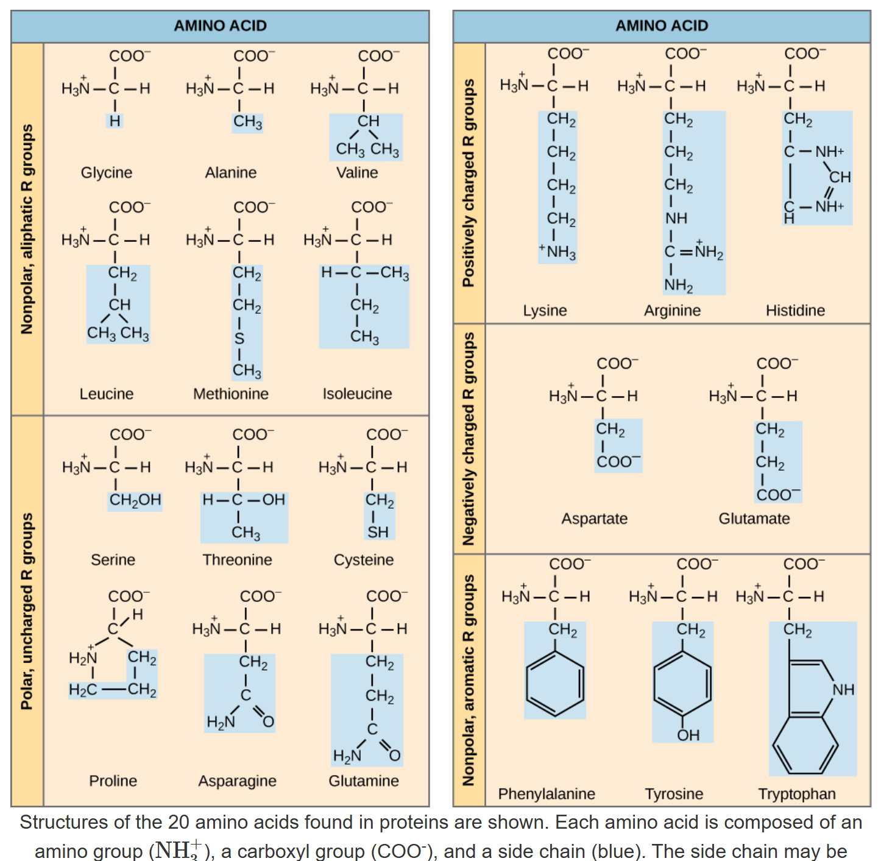
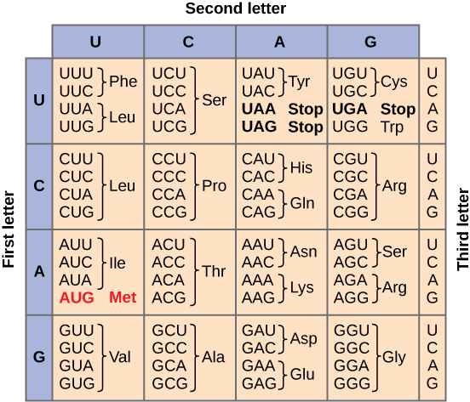
https://oertx.highered.texas.gov/courseware/lesson/1682/student/?section=6

Slide 17

The Genetic Code (Codons)
Codon Type | RNA Sequence | Amino Acid Assigned | Biological Function
Start Codon | AUG | Methionine (Met) | Strictly initiates the translation process.
Stop Codons | UAA, UAG, UGA | None | Signals the ribosome to terminate translation.
Standard Codons | 61 Variations | 20 Different Acids | Specifies the exact sequence of the polypeptide chain.

Slide 18
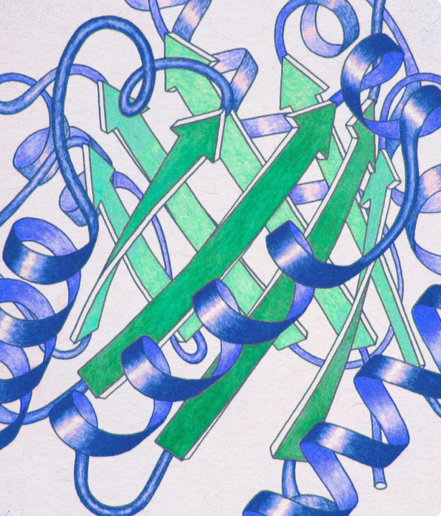
The Final Product: Proteins
Form Defines Function
Once the long polypeptide chain is fully synthesized, it must immediately fold into a highly specific three-dimensional shape to become a functional protein.
This unique conformation is entirely driven by the complex chemical interactions of the individual amino acid side chains and is absolutely vital for the protein's biological activity within the organism.

Slide 19



Protein Folding Levels
Primary Structure
Secondary Structure
Tertiary Structure
The linear, one-dimensional sequence of amino acids in the polypeptide chain, dictated directly by the mRNA sequence.
Local folding patterns within the chain, primarily alpha-helices and beta-pleated sheets, stabilized by hydrogen bonds.
The overall, complex three-dimensional shape of a single protein molecule, dictated by distant side-chain interactions.

Slide 20
Make a DNA Replication of the sequence below
ACATCACGGCAGG (DNA)
????????????? (DNA)
Make a transcription of the sequence below
ATGATCACGGCAGG (DNA)
??????????????(RNA)
Make a translation of the sequence below
AUG AUC AUG GUA GGG (RNA)
??? ??? ??? ??? ??? (Protein/Peptide)

Slide 21
Make a DNA Replication of the sequence below
ACATCACGGCAGG (DNA)
TGTAGTGCCGTCC (DNA)
Make a transcription of the sequence below
ATGATCACGGCAGG (DNA)
UACUAGUGCCGUCC (RNA)
Make a translation of the sequence below
AUG AUC AUG GUA GGG (RNA)
Met Ile Met Val Gly (Protein/Peptide)

Slide 22
Fidelity of Information Flow
Exceptional Precision
10-9
The Central Dogma relies on extreme precision to function. Thanks to the sophisticated proofreading abilities of enzymes like DNA polymerase, errors in copying the genome are exceptionally rare.
This incredible fidelity (approximately one mistake per billion nucleotides) ensures long-term genetic stability across generations.
ERROR RATE

Slide 23




Summary: Information Flow
2. Transcription
4. Translation
RNA polymerase transcribes the target gene into an mRNA copy.
Ribosomes decode the mRNA to synthesize the final protein product.
1. DNA Storage
3. Transport
The intact genetic blueprint is securely stored in the cell nucleus.
The mature mRNA transcript travels from the nucleus to the cytoplasm.

Slide 24
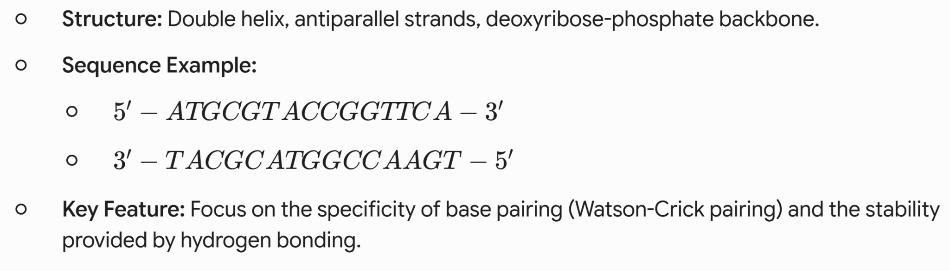
DNA: The Blueprint

Slide 25
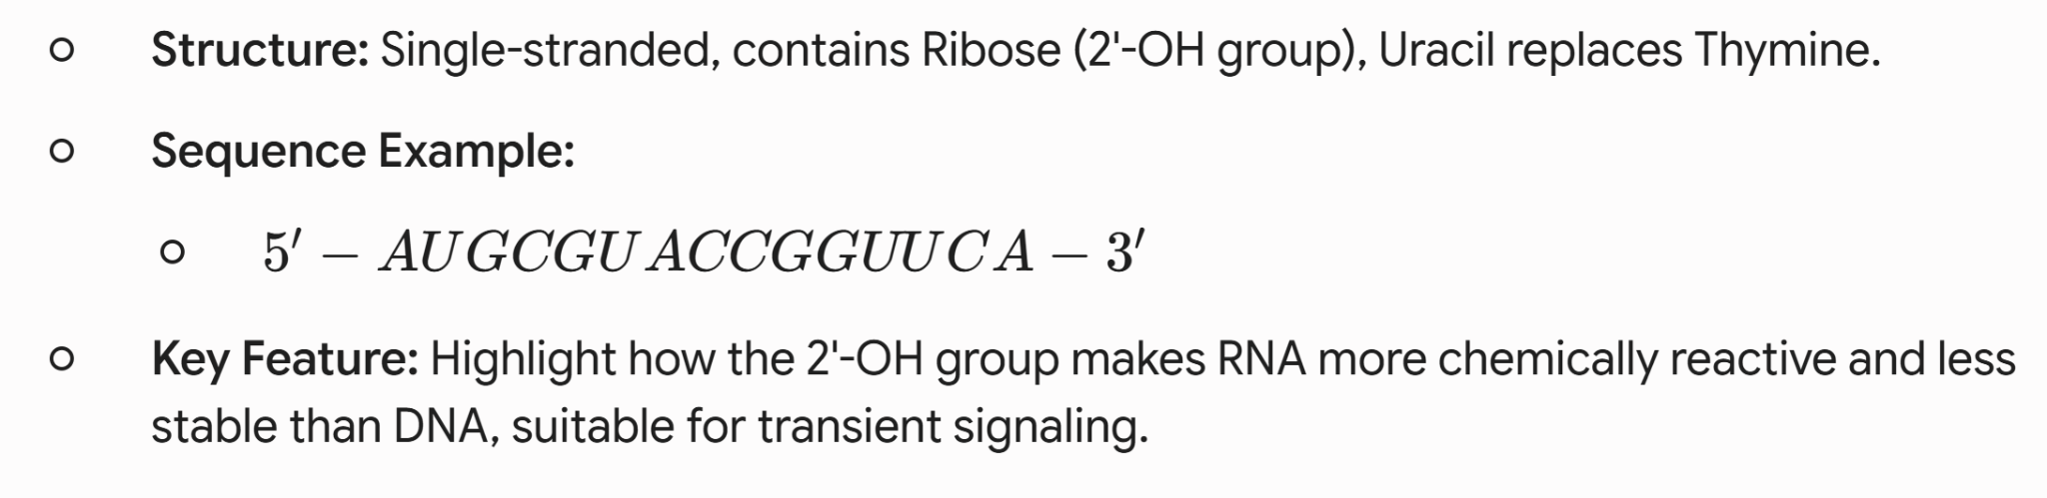
RNA: The Messenger

Slide 26
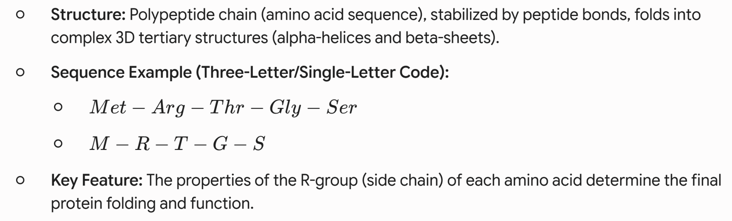
Protein: The Functional Product

Slide 27
Molecule | Sugar | Bases | Typical Structure
DNA | Deoxyribose | A, T, C, G | Double Helix
RNA | Ribose | A, U, C, G | Single-Stranded
Protein | N/A | Amino Acids | Folded Globular/Fibrous

Slide 28
Questions?
Reviewing the Central Dogma
Molecular Biology Review Session

Slide 29






Image Sources
https://media.istockphoto.com/id/2227323055/photo/abstract-3d-render-of-a-dna-double-helix-made-of-water-symbolizing-genetics-biotechnology-and.jpg?s=612x612&w=0&k=20&c=1LUGzYc82__ho8JEW87I8VMGw8MuOTjxL026vLnln3Y=
Source: www.istockphoto.com
https://cdn.zmescience.com/wp-content/uploads/2018/06/dna_replication_yourgenome.png
Source: www.zmescience.com
https://studymind.co.uk/wp-content/uploads/2022/03/Screen-Shot-2022-03-31-at-7.53.40-PM.png
Source: studymind.co.uk
https://cdn.rcsb.org/pdb101/motm/15/4tna-figure.gif
Source: pdb101.rcsb.org
https://cdn.rcsb.org/images/structures/1pbr_model-1.jpeg
Source: www.rcsb.org
https://cdn-ccnli.nitrocdn.com/hPbgvskpJmIfLTeYLYGdGpfRfGKbrYYq/assets/images/optimized/rev-369eac4/alevelbiology.co.uk/wp-content/uploads/2017/11/Translation.jpg
Source: alevelbiology.co.uk

Slide 30
Image Sources
https://www.quantamagazine.org/wp-content/uploads/2024/08/RibbonModel-crJaneRichardson-Lede-scaled.webp
Source: www.quantamagazine.org

