Slide 1
Principles of Sequence Alignment
14/06/2026
Phuc-Loi Luu, PhD

Slide 2
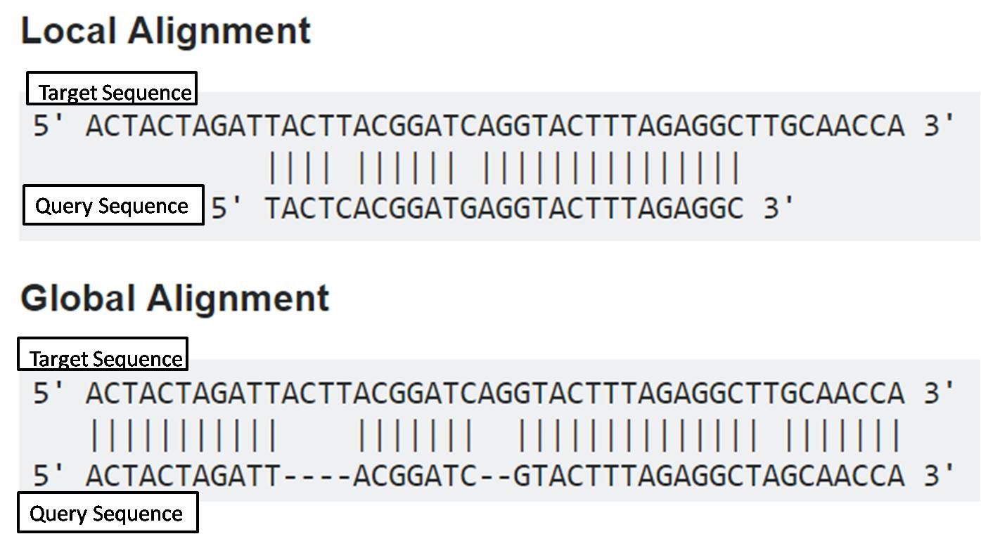
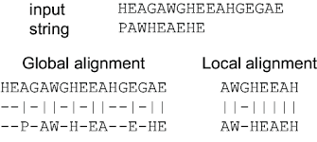
Global vs Local Alignment

Slide 3
1. Global Alignment (Needleman-Wunsch)
Global alignment attempts to align every character in every sequence from the beginning to the end.
It is best used when two sequences are of similar length and are expected to be homologous across their entire span.
What: Aligning two full-length sequences (e.g., comparing two versions of the same gene from different species).
How: It uses the Needleman-Wunsch algorithm, a dynamic programming approach that maximizes the total alignment score across the entire length of both sequences, including gaps at the ends if necessary.
Why: To determine the total evolutionary distance or structural conservation between two related sequences.
Example: Comparing the entire nucleotide sequence of the human insulin gene to that of a chimpanzee to identify overall conservation rates.

Slide 4
2. Local Alignment (Smith-Waterman)
Local alignment searches for the most similar sub-regions (motifs or domains) within larger sequences.
It ignores the parts of the sequences that do not match well.
What: Finding conserved functional domains, gene families, or short regulatory motifs hidden within large, otherwise dissimilar sequences.
How: It uses the Smith-Waterman algorithm. Unlike the global approach, this algorithm assigns a score of zero to any negative alignment segments, effectively "restarting" the alignment whenever a match is found and ending it when the similarity drops off.
Why: To identify functional modules, binding sites, or domains that have been conserved through evolution even when the rest of the genetic context has diverged or been rearranged.
Example: Searching for a specific protein domain (like a zinc finger motif) within a large, uncharacterized protein sequence. BLAST (Basic Local Alignment Search Tool) is the most common implementation of this.

Slide 5
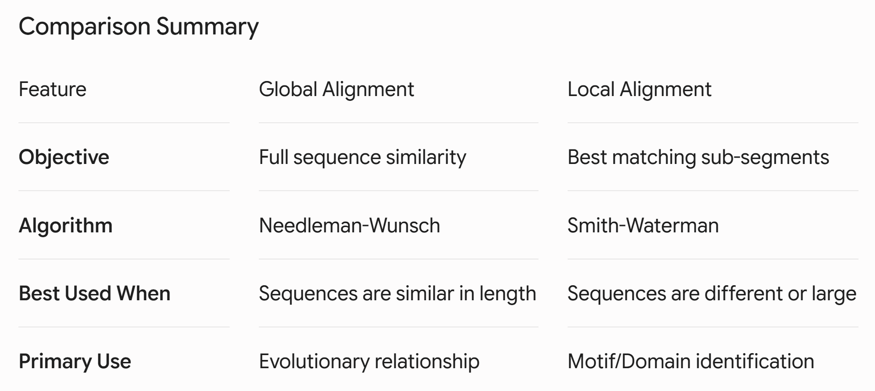

Slide 6
Practical Guidance: When to choose which?
Use Global Alignment if you are performing a comparative genomics study on well-defined, orthologous genes where you expect the sequences to be roughly the same size and essentially "the same" thing.
Use Local Alignment for database searching (like BLAST). If you have a sequence "read" from a sequencer and you want to know what it is, you don't care about the whole sequence of every gene in the database; you want to find the specific "home" for that read.

Slide 7
