Slide 1




Initiating DNA Replication
Phuc Loi Luu, PhD
Email: Luu.p.loi@googlemail.com
Zalo: 0901802182
Feb 03 2026

Slide 2
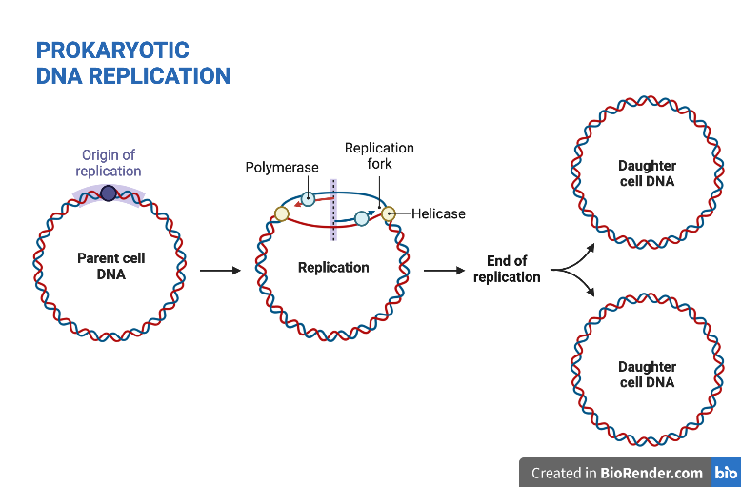
DNA Replication

Slide 3
Three-stage process of DNA Replication
Initiation
  Origin Recognition: Replication begins at specific locations called the "origin of replication". Initiator proteins identify these sites, and enzymes like helicase begin to unwind the double helix, forming a "replication fork".
  Unwinding and Stabilizing: Helicase breaks the hydrogen bonds between base pairs, separating the two strands. Single-strand binding proteins coat the DNA around the fork to prevent it from rewinding, while Topoisomerase/Gyrase acts ahead of the fork to prevent excessive supercoiling.
  Priming: DNA primase binds to the template strand and synthesizes a short RNA primer, providing the starting point (a 3' end) for DNA polymerase to begin building the new strand.
Elongation (Synthesis): DNA polymerase adds nucleotides to the primer, moving in a 5' to 3' direction.
  Leading Strand: Synthesized continuously toward the replication fork.
  Lagging Strand: Synthesized discontinuously away from the fork in short, 5' to 3' segments called Okazaki fragments, which require multiple primers.
Termination and Proofreading: Once the entire strand is copied, RNA primers are removed, and the gaps are filled by DNA polymerase I and sealed by DNA ligase, which joins Okazaki fragments. The newly synthesized DNA is then proofread for errors.

Slide 4
Beyond the "Ends": Where Replication Begins
Most organisms do not start replication at the end of a chromosome.
Bacteria (E. coli): Chromosomes are circular; therefore, there is no "end" to start from.
Eukaryotes: Though chromosomes are linear, replication still initiates internally rather than at the tips.
Exceptions: Only a few specific viruses are known to initiate replication from the ends of the genome.

Slide 5
Some Definitions
Term | Definition
Origin of Replication | The physical site where DNA is initially unwound and synthesis is initiated.
Efficiency | The percentage of cell divisions in which a specific origin initiates.
Replicon | The total region of DNA replicated by the forks derived from a single origin.
Origin Efficiency: Bacterial origins usually initiate at or near 100%, while most eukaryotic origins are much less efficient.
Directionality: Almost all known origins are bi-directional, generating two replication forks that move in opposite directions.

Slide 6
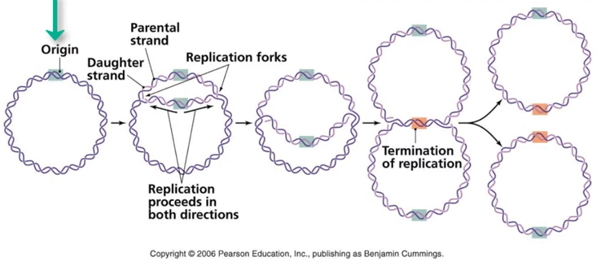
DNA Replication

Slide 7
The Replicon Model
Proposed by Sydney Brenner and François Jacob, this model defines two functional components required for initiation:
The Replicator (Genetic Entity): The specific DNA sequence required to initiate replication. If essential parts of this sequence are removed, replication will not start.
The Initiator (Protein): A protein that recognizes and binds to the replicator to activate the initiation process.

Slide 8
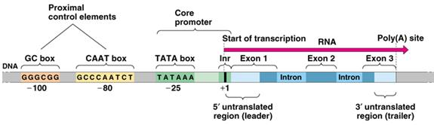
Replicator vs. Origin: The Transcription Analogy
It is vital to distinguish between the genetic instructions and the physical action.
"The replicator is to the origin as a promoter is to a transcription start site."
Overlap: Replicators and origins typically overlap, but they are not identical.
Size Variance: The replicator is usually the same size or much larger than the origin.
Extreme Cases: Some replicators exceed 50 Kb in size, while the physical origin may only be a 100 base pair region.

Slide 9
Test your understanding of the lecture
1. True or False? Most eukaryotic organisms initiate DNA replication at the very ends of their linear chromosomes.
Answer: False. In all but a few viruses, replication does not start from the ends.
2. Efficiency Check: If a specific origin of replication in a eukaryotic cell has an "efficiency" of 60%, what does that mean?
Answer: It means the origin initiates replication in 60% of cell divisions. Unlike bacterial origins, eukaryotic origins are often much less than 100% efficient.
3. The Genetic vs. Physical: Which term refers to the physical site where DNA is initially unwound?
Answer: The Origin of Replication. The "Replicator" is the genetic DNA sequence required for that initiation to occur.
4. The Initiator's Role: According to the Brenner and Jacob "Replicon Model," what is the function of the Initiator?
Answer: It is a protein that recognizes and binds to the replicator sequence to activate the initiation of replication.

