Slide 1
Review OMICs 2025
Phuc Loi Luu, PhD
Email: luu.p.loi@googlemail.com
Zalo: 0901802182
April 19 2025

Slide 2
Content
DNA-seq
Bulk RNA-seq
Histone modifications
DNA methylation
Integration Analysis

Slide 3
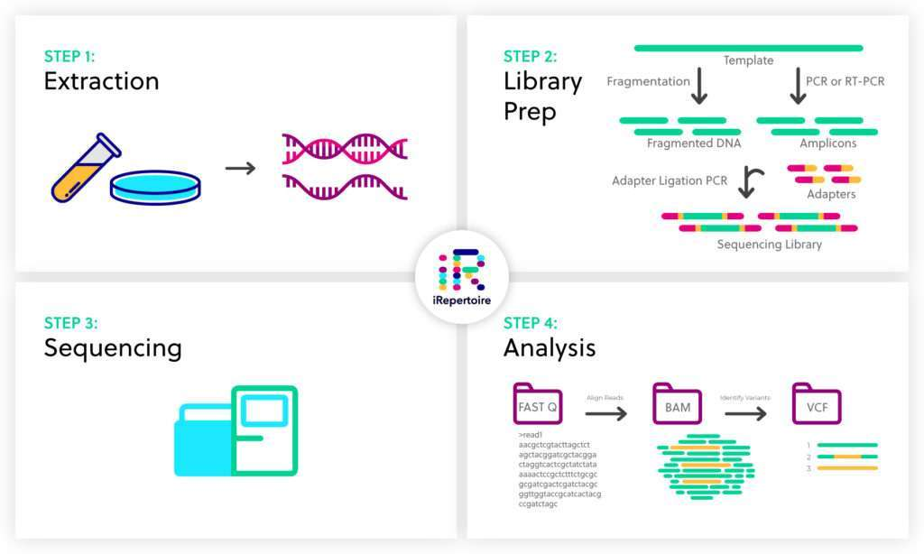
DNA-seq

Slide 4
Quy trình XÉT NGHIỆM gen bằng phương pháp giải trình tự thế hệ mới (NGS)

Slide 5
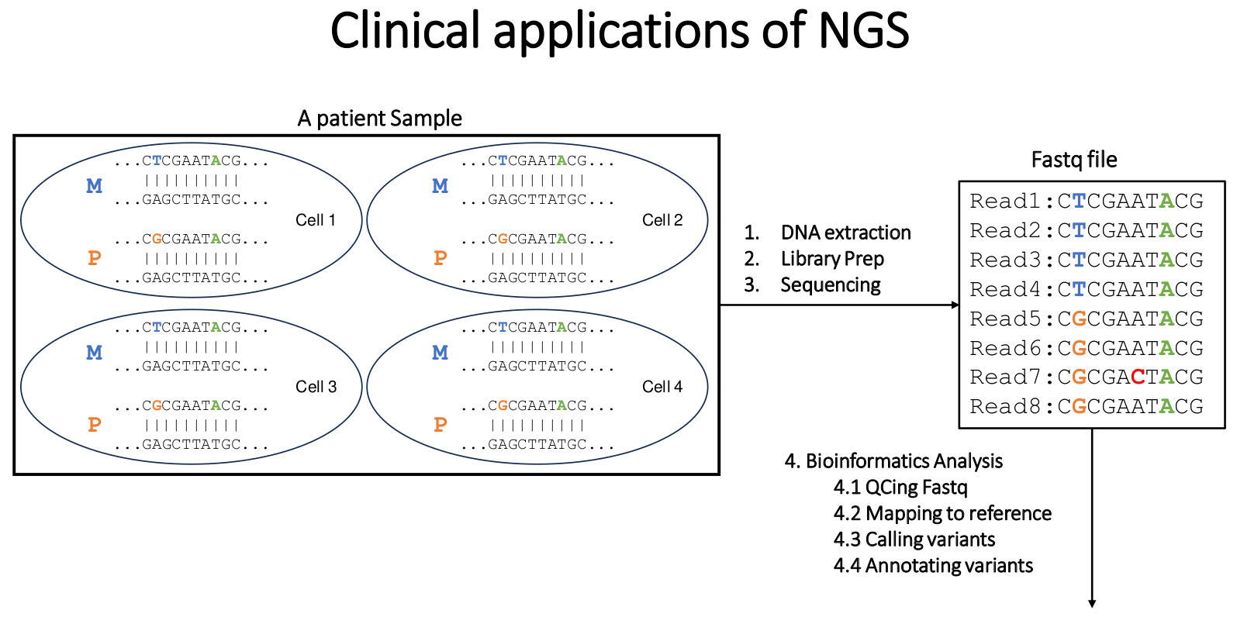
Các bước trong XÉT NGHIỆM gen bằng phương pháp giải trình tự thế hệ mới (1)

Slide 6
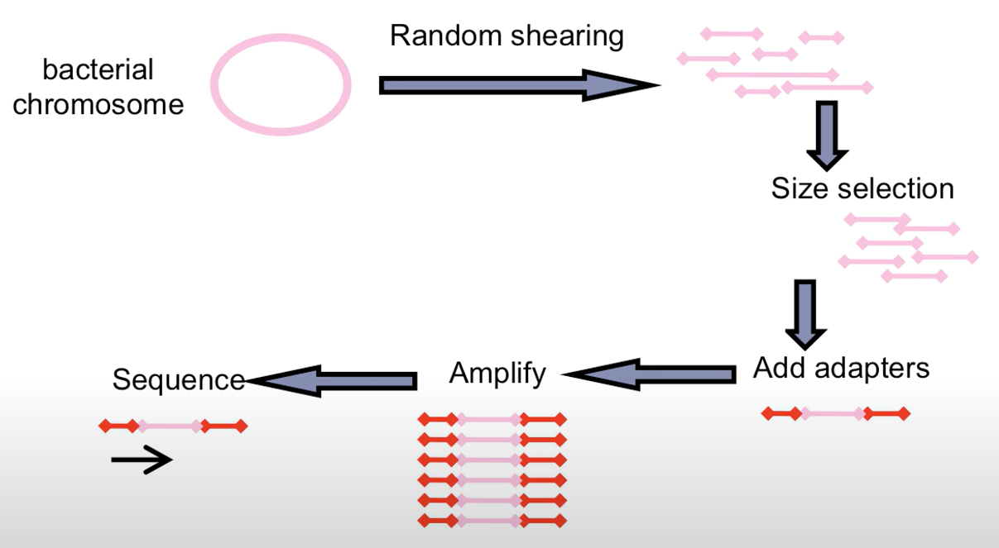
Whole genome sequencing – Shotgun Library Prep
Genomics DNA

Slide 7
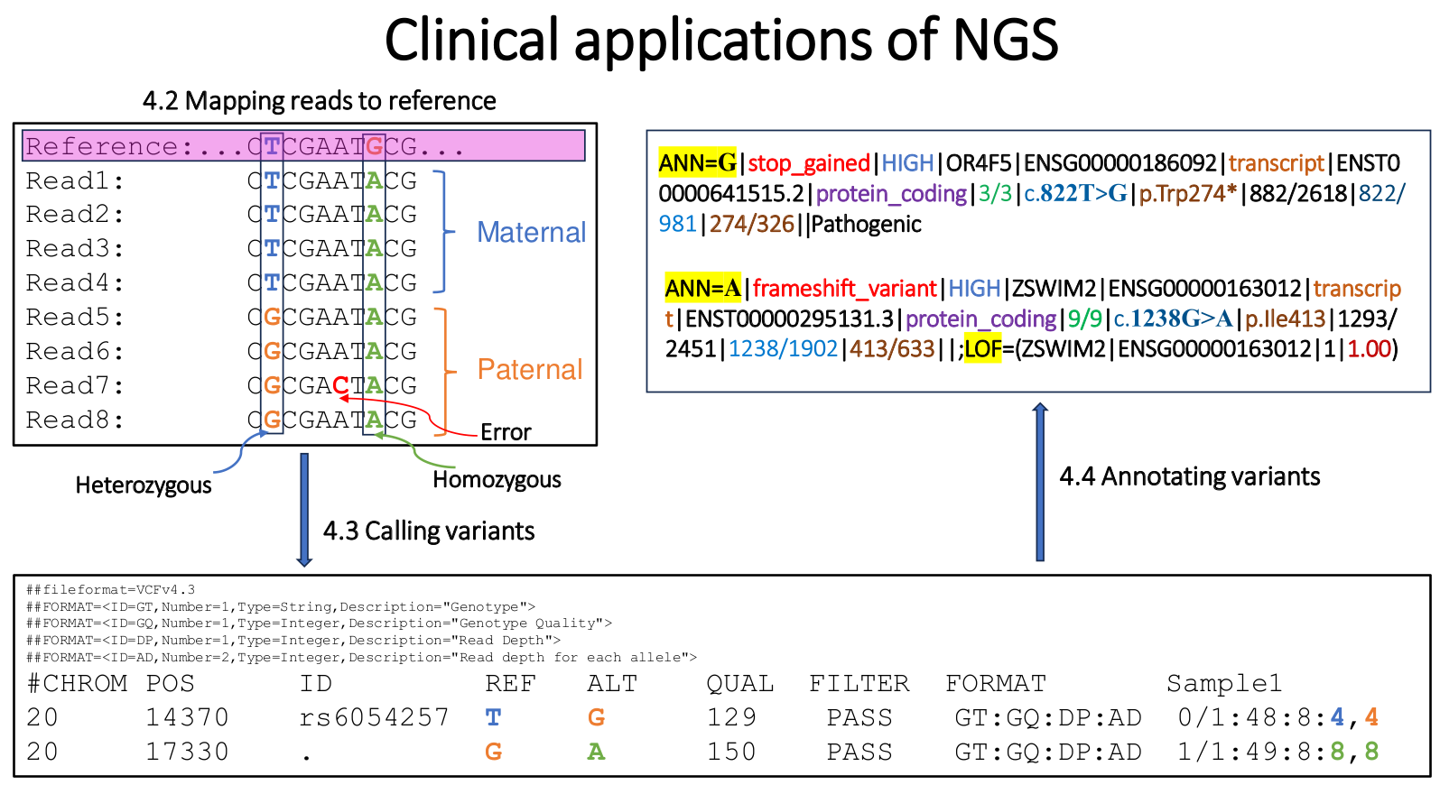
Các bước trong XÉT NGHIỆM gen bằng phương pháp giải trình tự thế hệ mới (2)

Slide 8

Hội đồng Hệ Gen: phiên giải và hội chẩn những biến thể
trong báo cáo kết quả NGS
https://ggba.swiss/en/the-first-medical-genomics-center-opens-in-geneva/

Slide 9
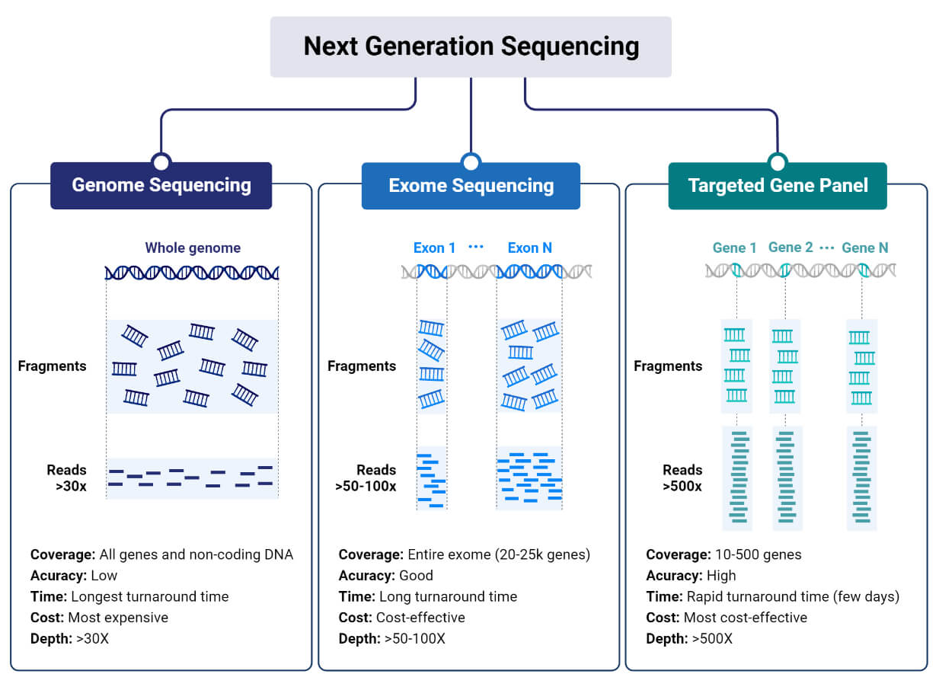
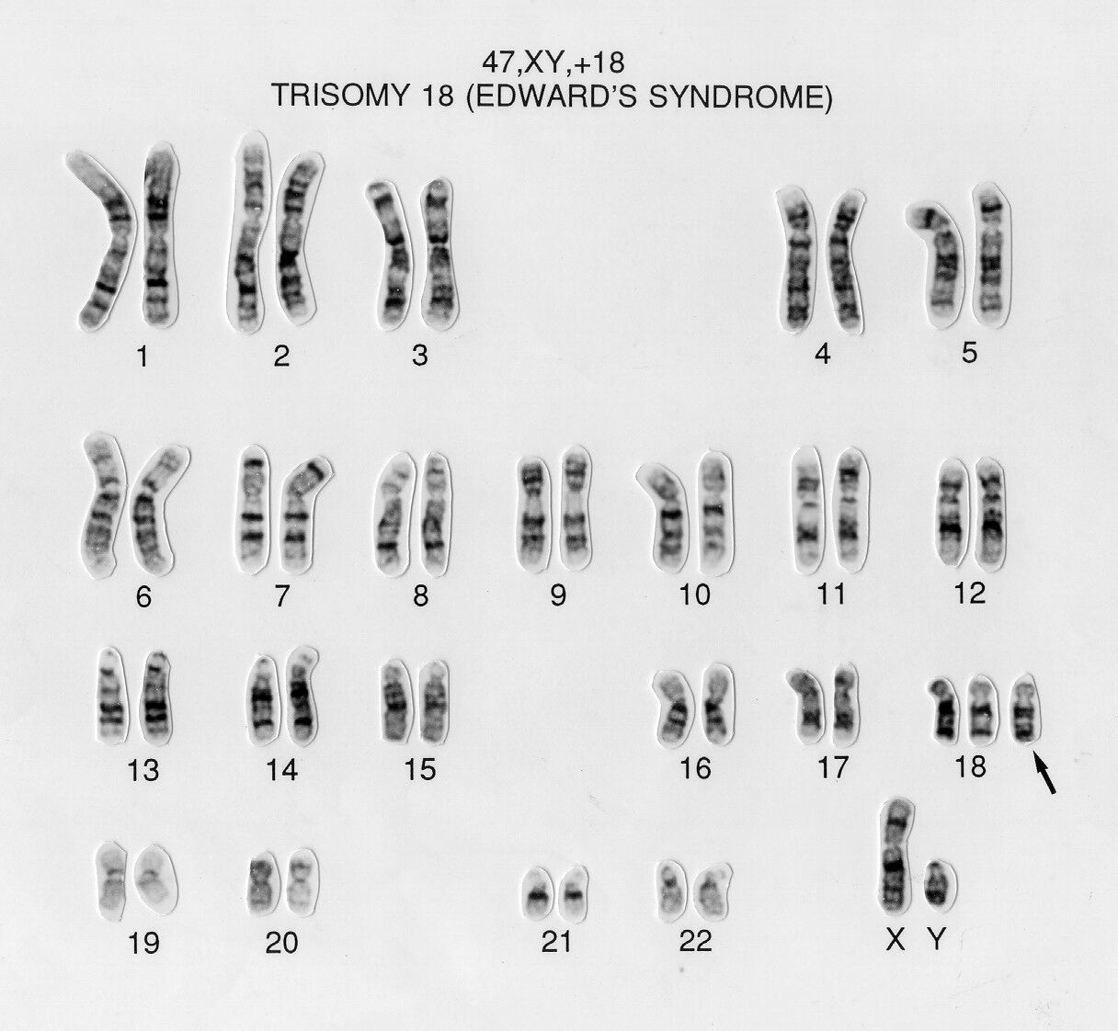
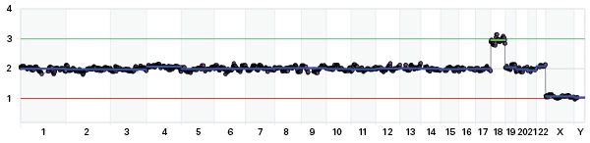
Ứng dụng giải trình tự gen thế hệ mới trong lâm sàng
Single Nucleotide Variant (SNV)
Copy Number Variation (CNV) Low-Pass Genome Sequencing
Karyotype
https://microbenotes.com/next-generation-sequencing-ngs/
https://wellcomecollection.org/search/images?query=eaahzt2u#

Slide 10
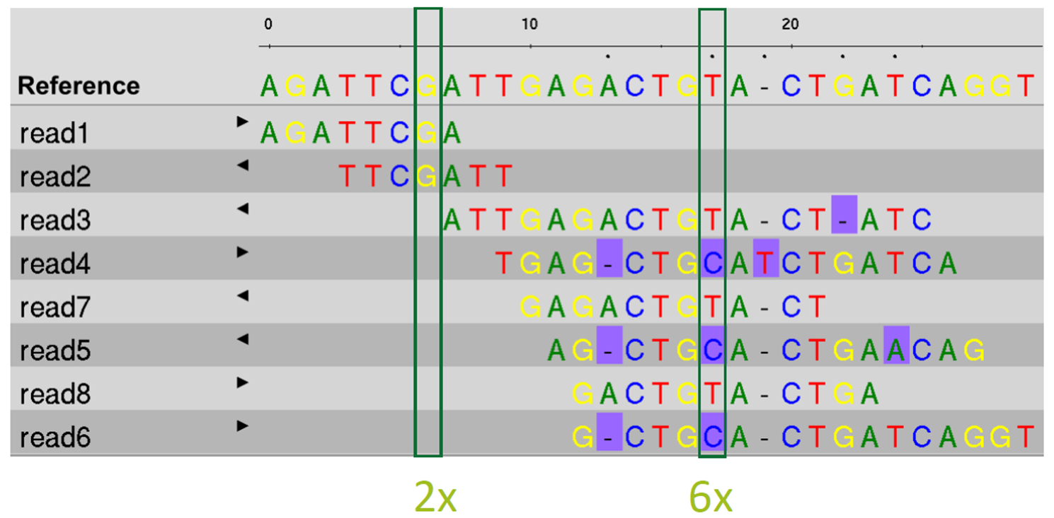
Variants in PAH

Slide 11
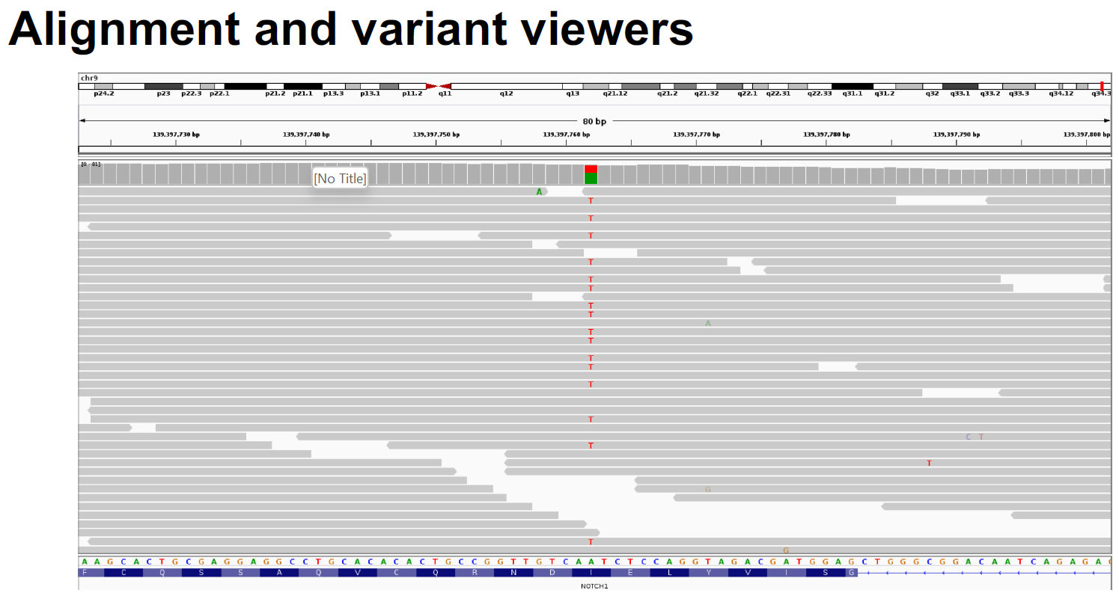

Slide 12
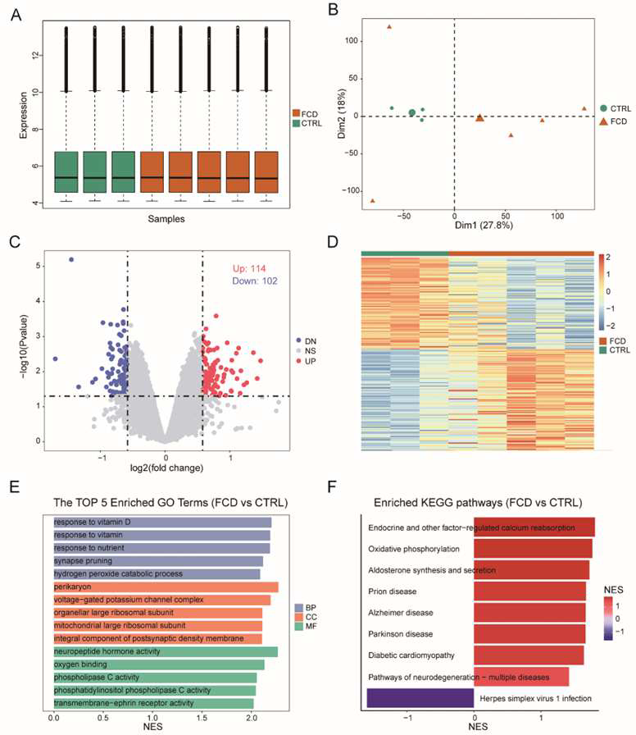
Bulk RNA-seq
DOI:10.21203/rs.3.rs-4253627/v1

Slide 13
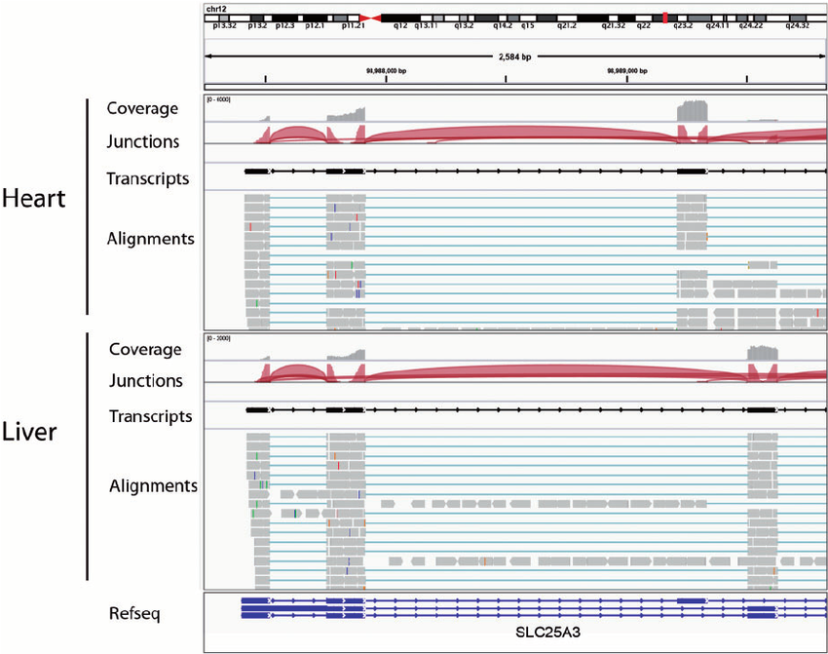
DOI:10.1093/bib/bbs017

Slide 14
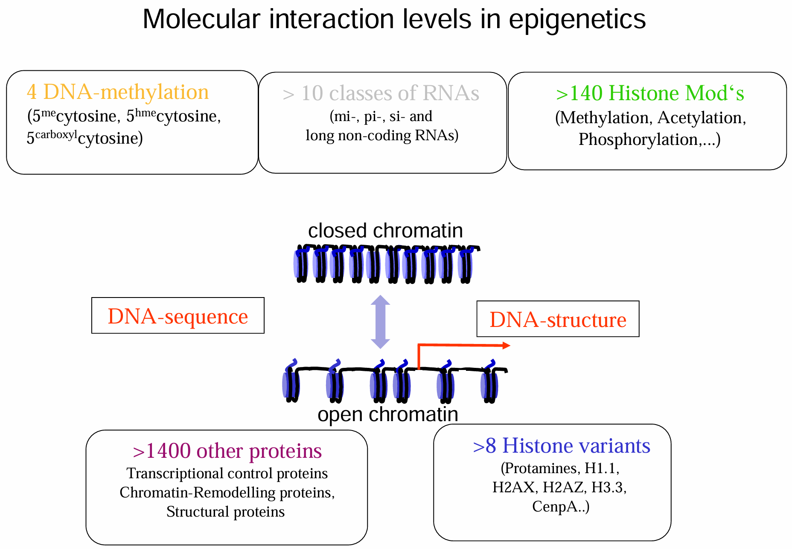

Slide 15
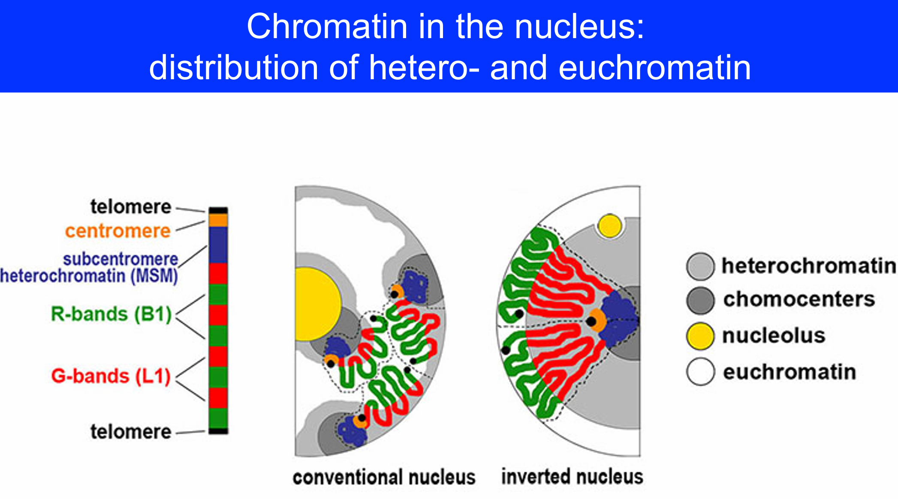

Slide 16
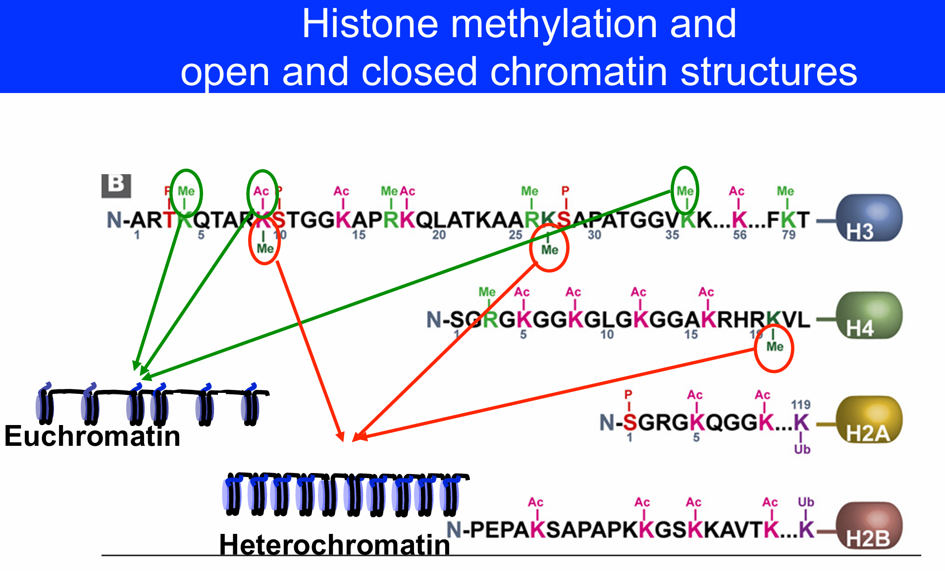

Slide 17
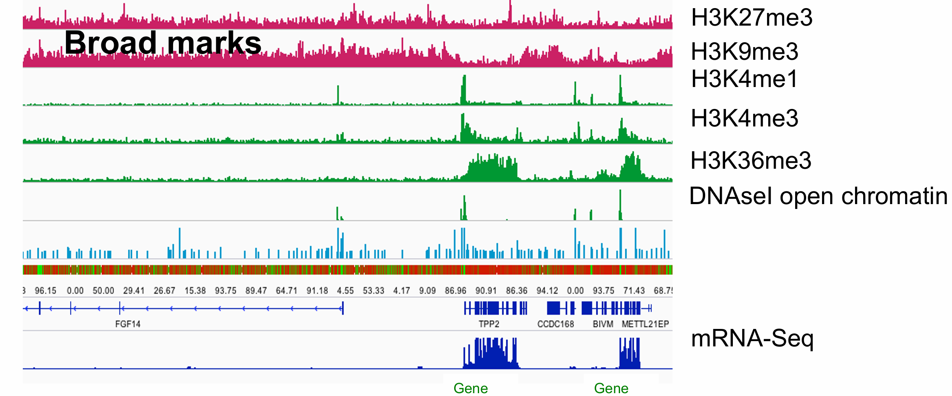

Slide 18
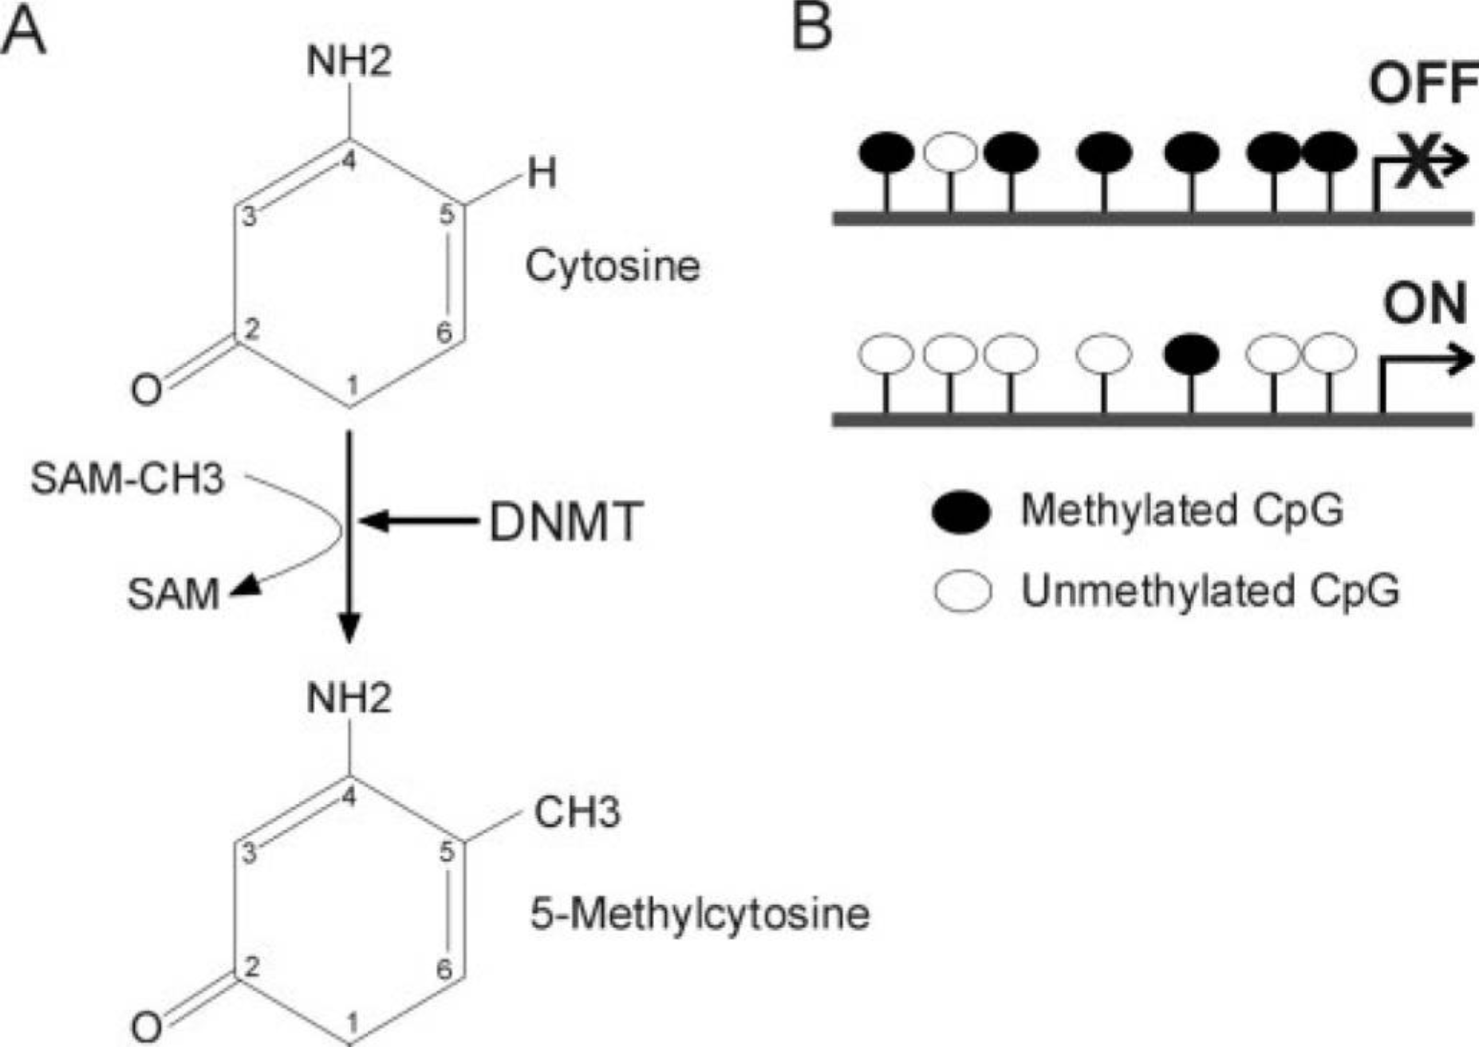
DNA methylation regulates gene expression
https://pmc.ncbi.nlm.nih.gov/articles/PMC3083288/

Slide 19
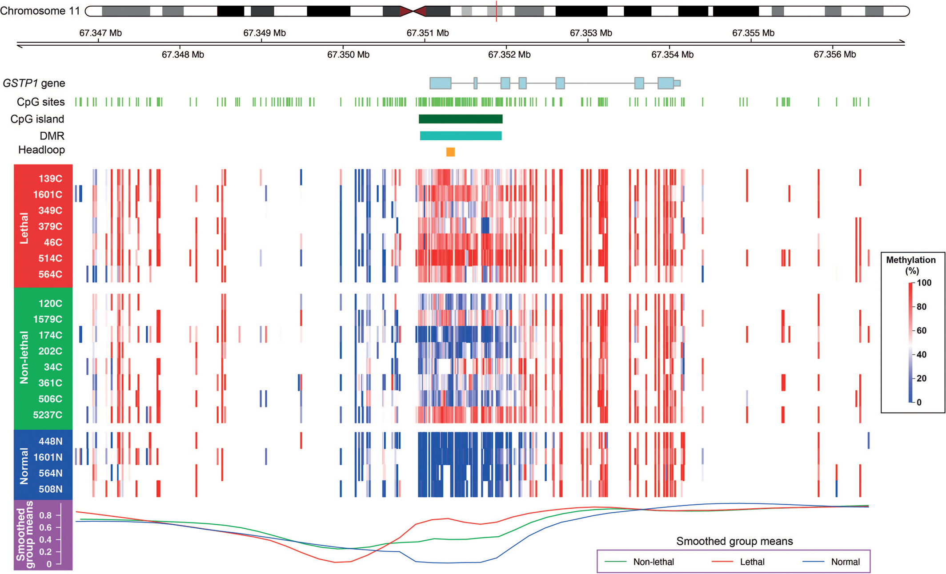
https://doi.org/10.1002/bco2.445

Slide 20
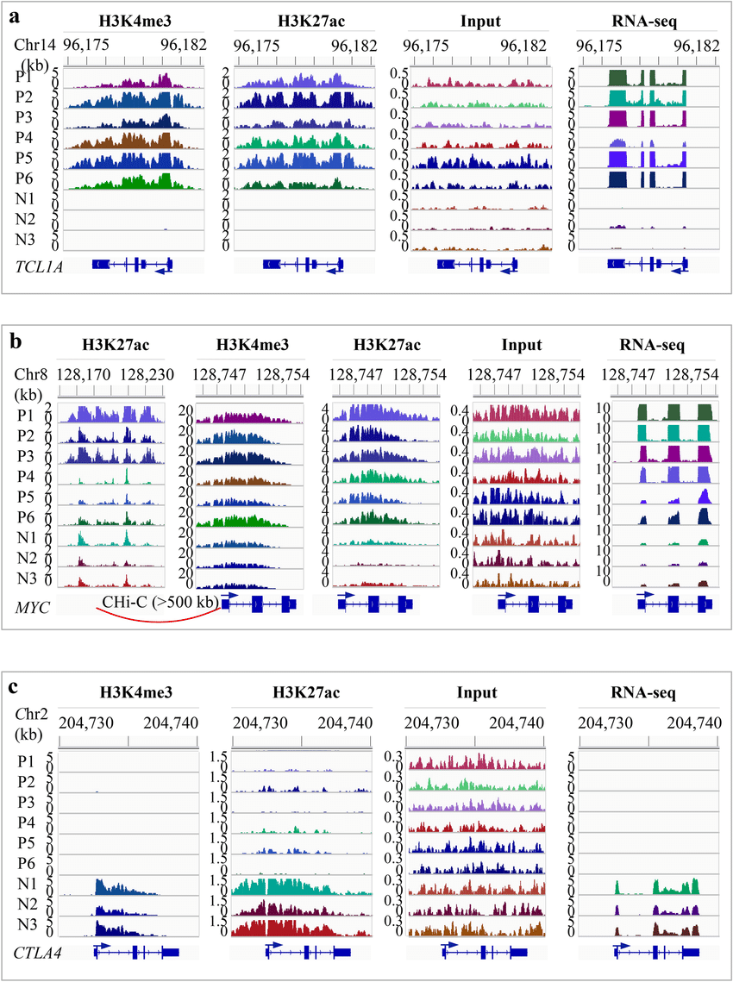
Integration Analysis
IGV snapshots showing the changes of histone marks and gene expression in T-PLL. (a) Increased expression of TCL1A and the associated gains of H3K4me3 and H3K27ac. TCL1A was actively expressed in T-PLL but not in normal. All T-PLL cases gained both H3K4me3 and H3K27ac peaks (~ 6-kb) that covered the promoter and gene body. Based on the read density in the inputs, there are copy number gains in two T-PLL (P1 and P5). (b) Increased expression of MYC and the associated increase of H3K4me3 and H3K27ac. MYC expression was up-regulated in T-PLL. There was an overall increase in H3K4me3 and H3K27ac occupancy over an ~ 6 kb region that covers the promoter and gene body. The signal level in the inputs suggested a copy number gain in P1, P5 and P6. Promoter capture Hi-C data from 17 blood cell types suggested that an ~ 50-kb enhancer located > 500 kb upstream interacted with MYC promoter in total B, naïve B, fetal thymus and five types of T cells. This enhancer showed a marked increase of H3K27ac in three of the T-PLL (P1-P3) compared to the normal. (c) Markedly reduced expression of CTLA4 and the associated loss of H3K4me3 and H3K27ac. The signal in the inputs suggested no copy number alteration within CTLA4 in T-PLL. N1-N3, normal; P1-P6, T-PLL. Y-axis indicates the number of reads per 200-bp (for ChIP-seq and input) or per base pair (for RNA-seq).
DOI:10.1038/s41598-021-87890-9

Slide 21
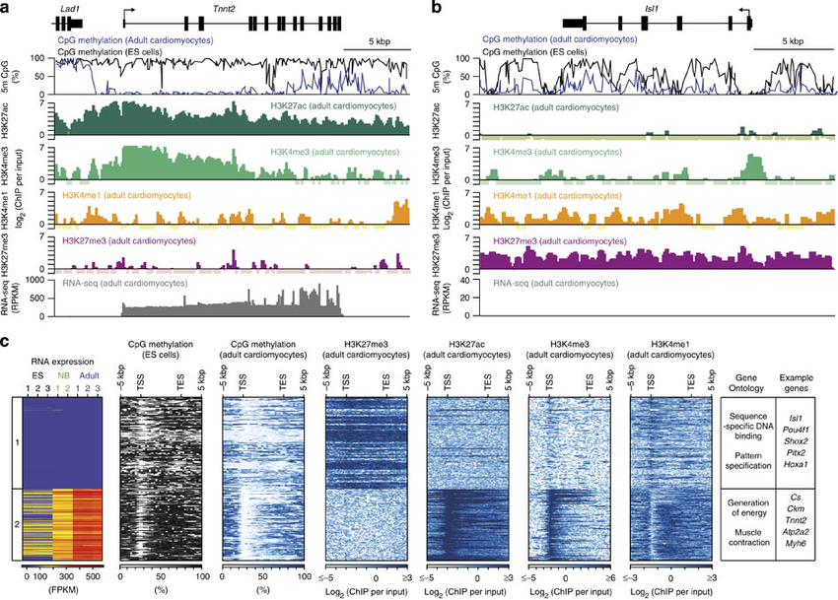
Integration Analysis
https://www.nature.com/articles/ncomms6288

Slide 22
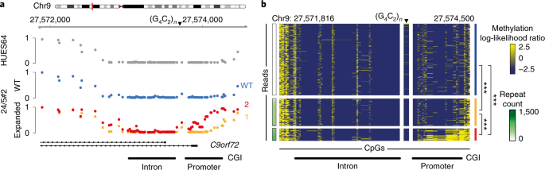
Integration Analysis
https://www.nature.com/articles/s41587-019-0293-x

Slide 23
Xin chân thành cảm ơn!

