Slide 1
Best Practice for Bulk RNA-seq analysis
Ngày 29 tháng 03 năm 2025
TS. Lưu Phúc Lợi
Email: luu.p.loi@googlemail.com
Zalo: 0901802182

Slide 2
Content
Aim of the methods
Library prep for RNA-seq
Upstream Analysis Workflow
Downstream Analysis Workflow
From BAM to Count
Differential Gene Expression
Enrichment of DEGs with Over Representation Analysis (ORA)
RNA-seq databases: GTEx and TCGA

Slide 3
Aim of the methods
Bulk DNA-seq?
Bulk RNA-seq?

Slide 4
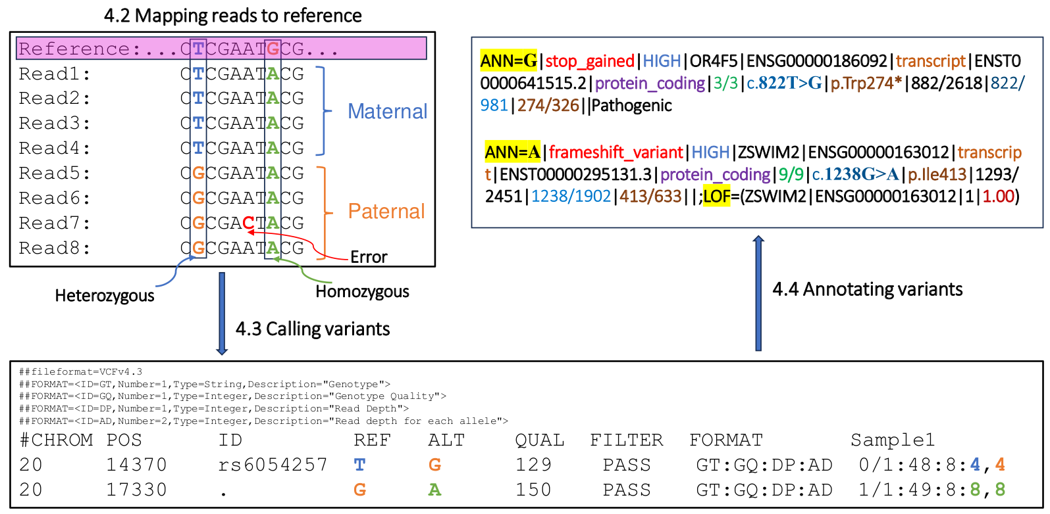
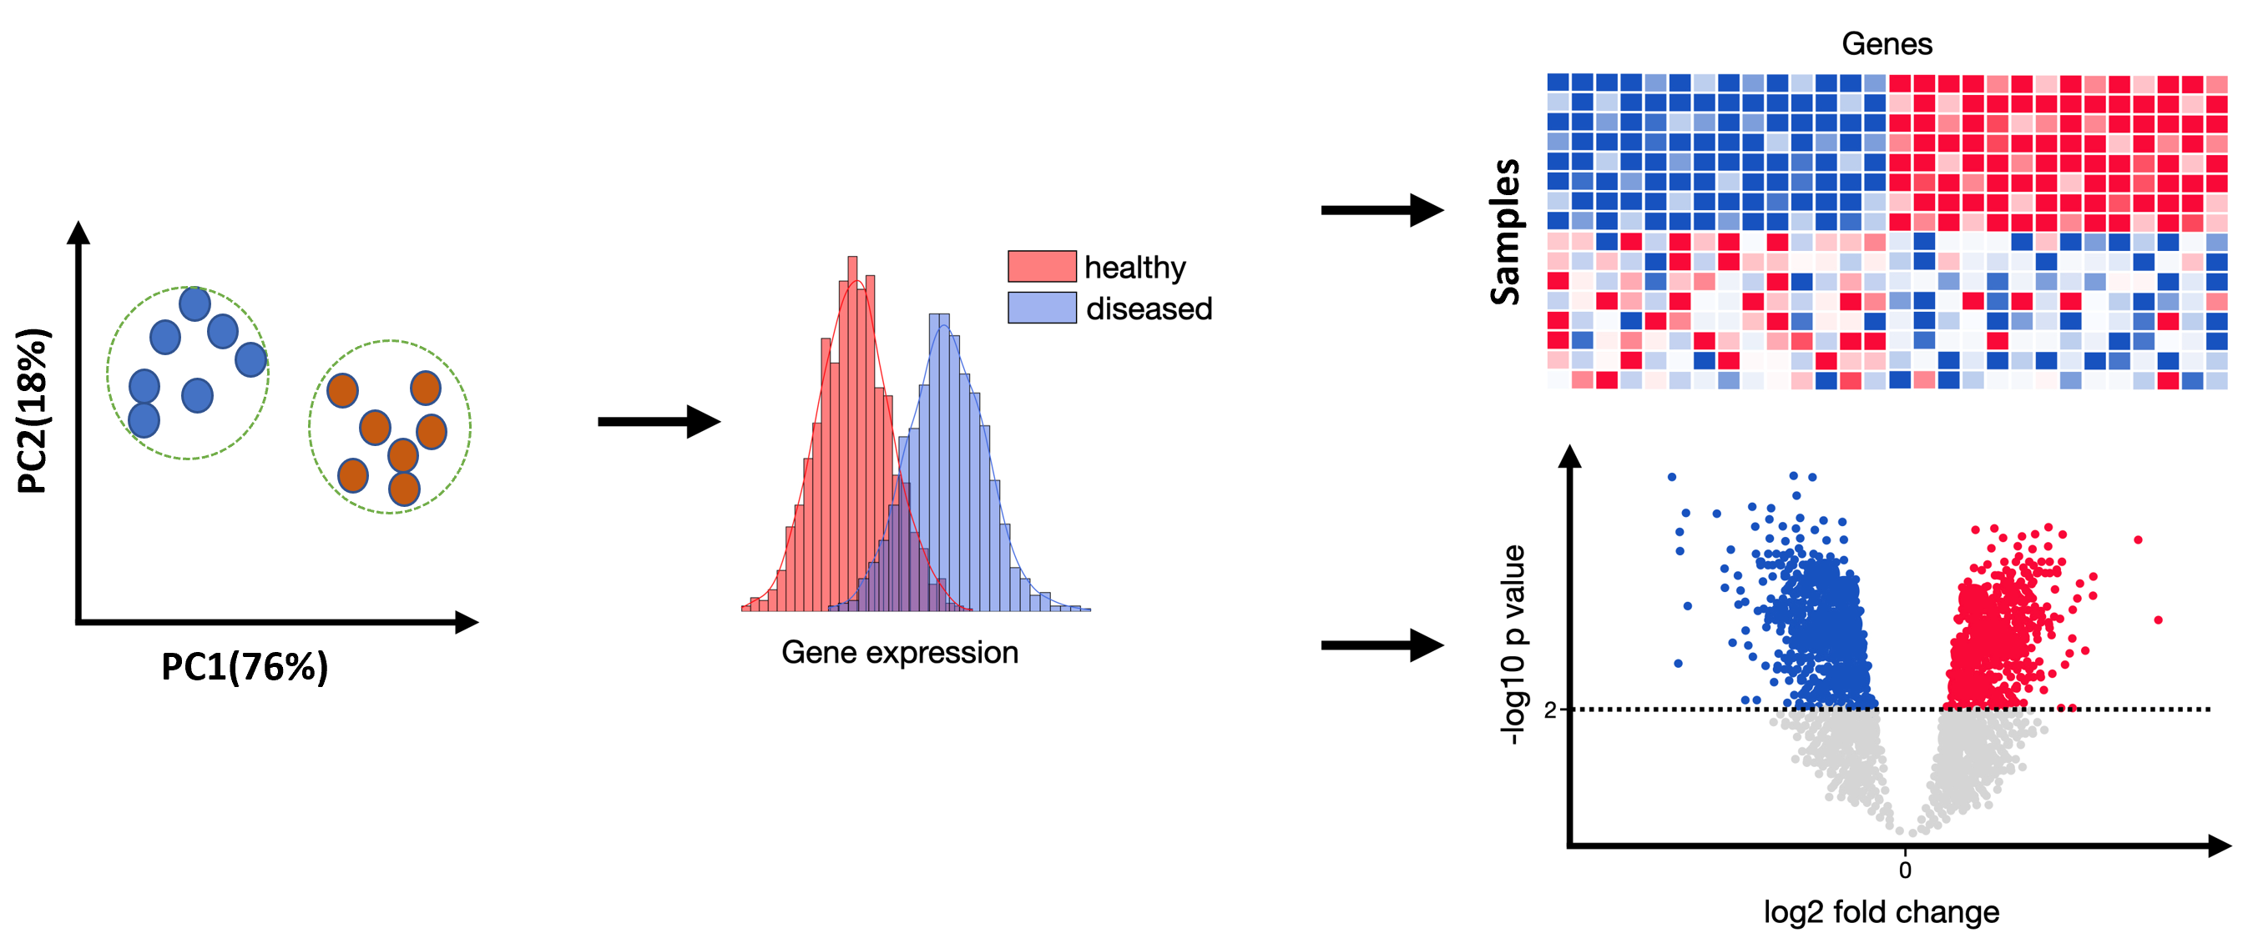
Aim of the methods
Bulk DNA-seq
Bulk RNA-seq

Slide 5
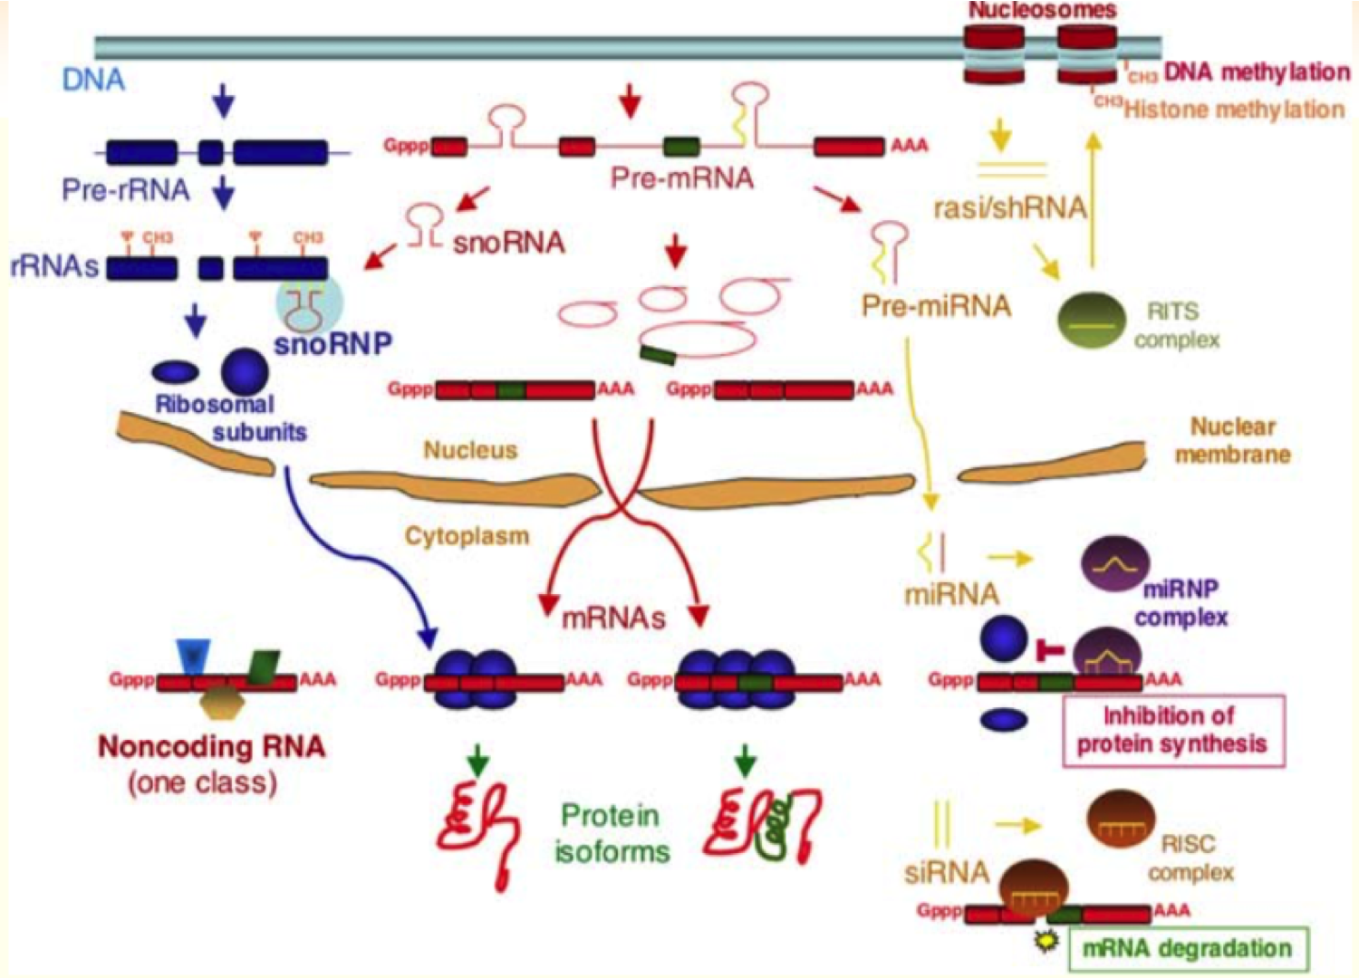
Different types of RNA

Slide 6
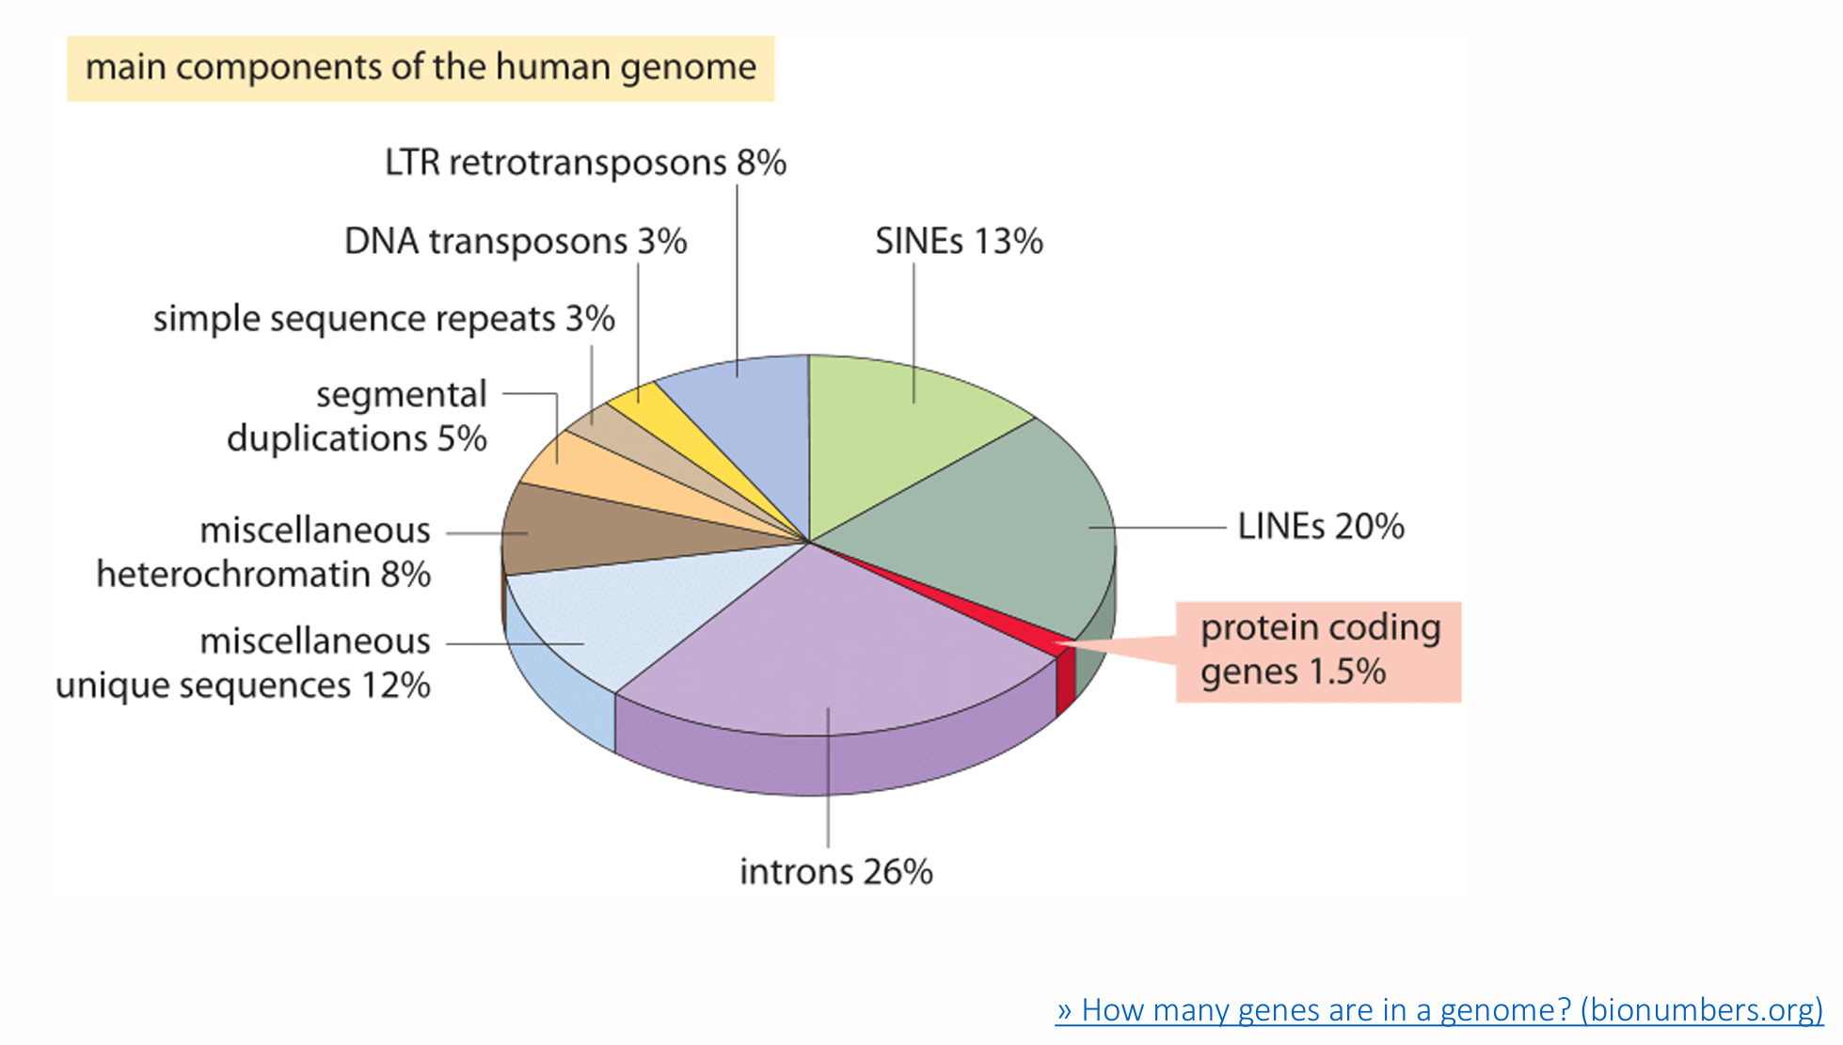
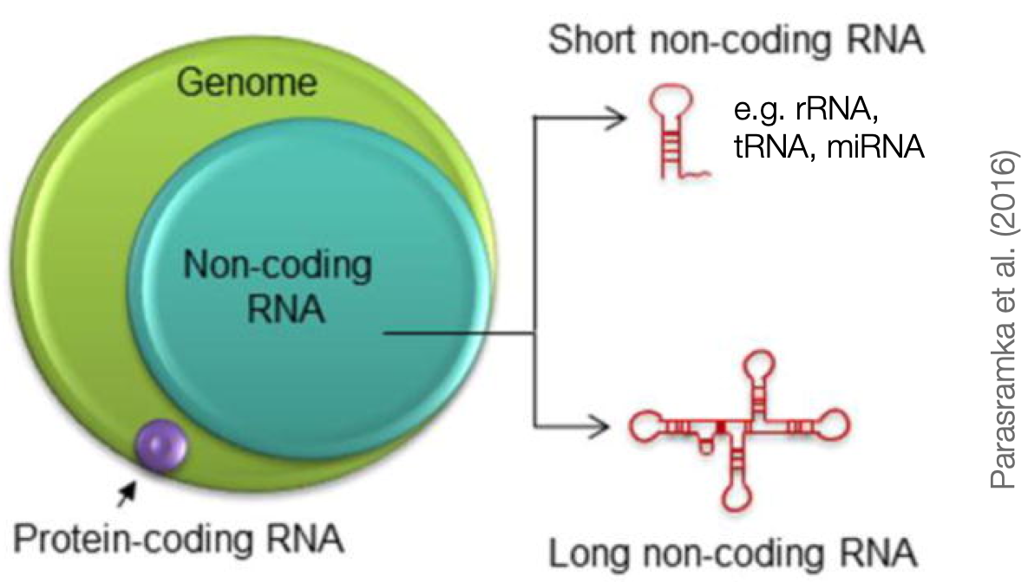
Different types of RNA

Slide 7
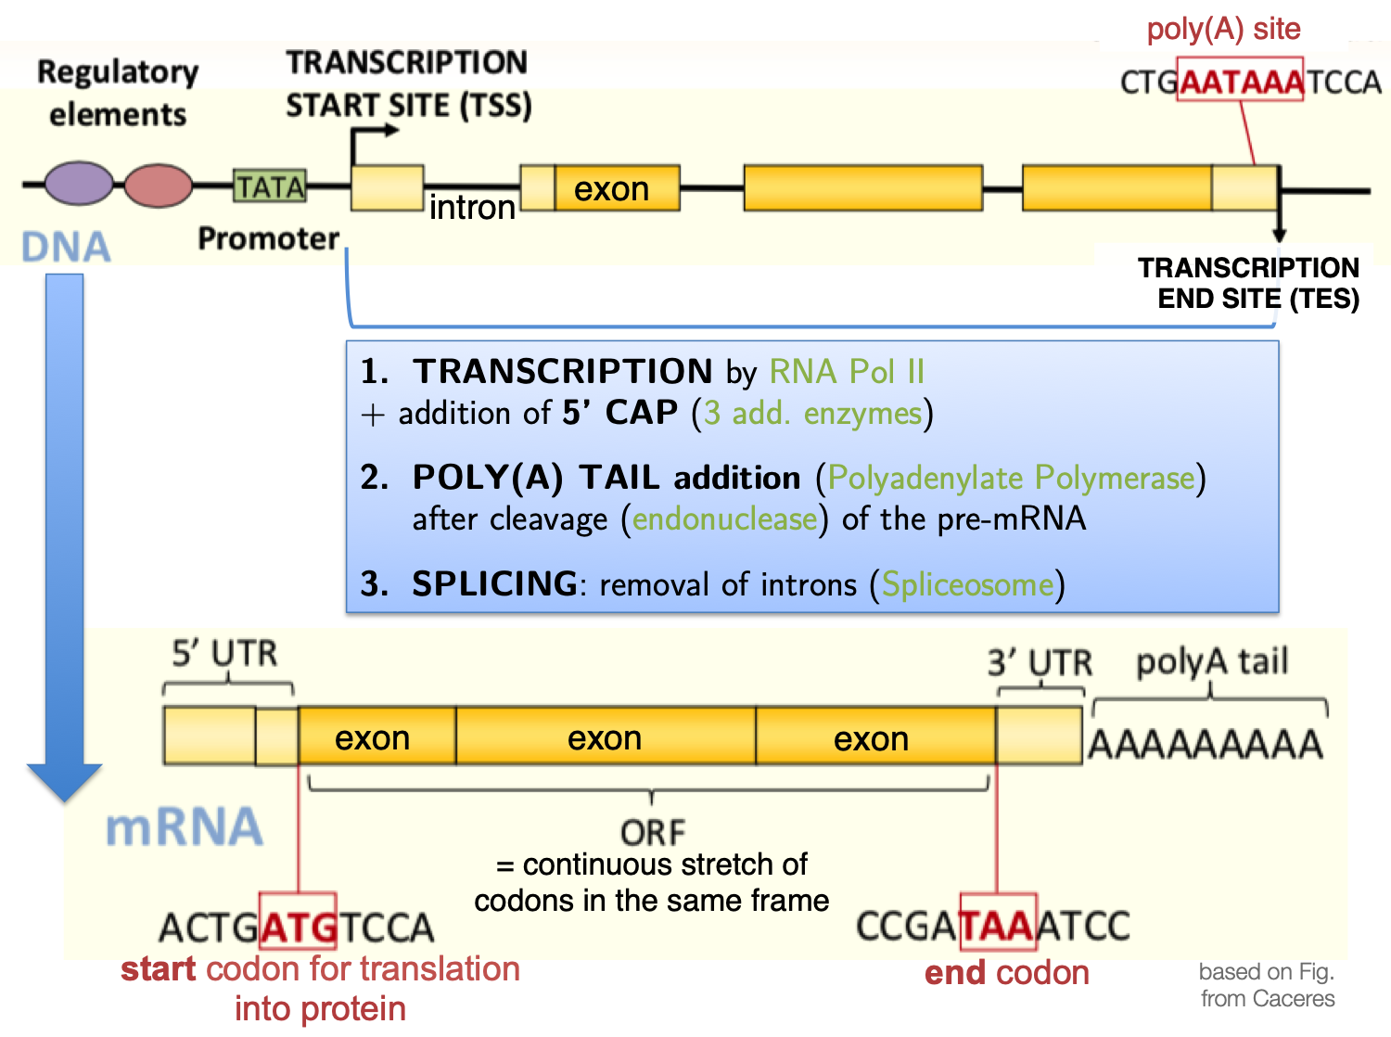
Sequencing library prep protocol depends on the RNA properties
It is not a one-size-fits-all situation!
Abundance and stability
rRNA: 90-95% (!)
tRNA: 3-5%
mRNA: 2%
all other non-coding RNAs: well below 1%
Cellular location
most are in the cytoplasm
Size
miRNAs: 18-23bp
mRNA: several 100 to 1000 bp
Specific sequences/modifications
poly(A) tails of mRNA
2D structure
antisense transcripts

Slide 8
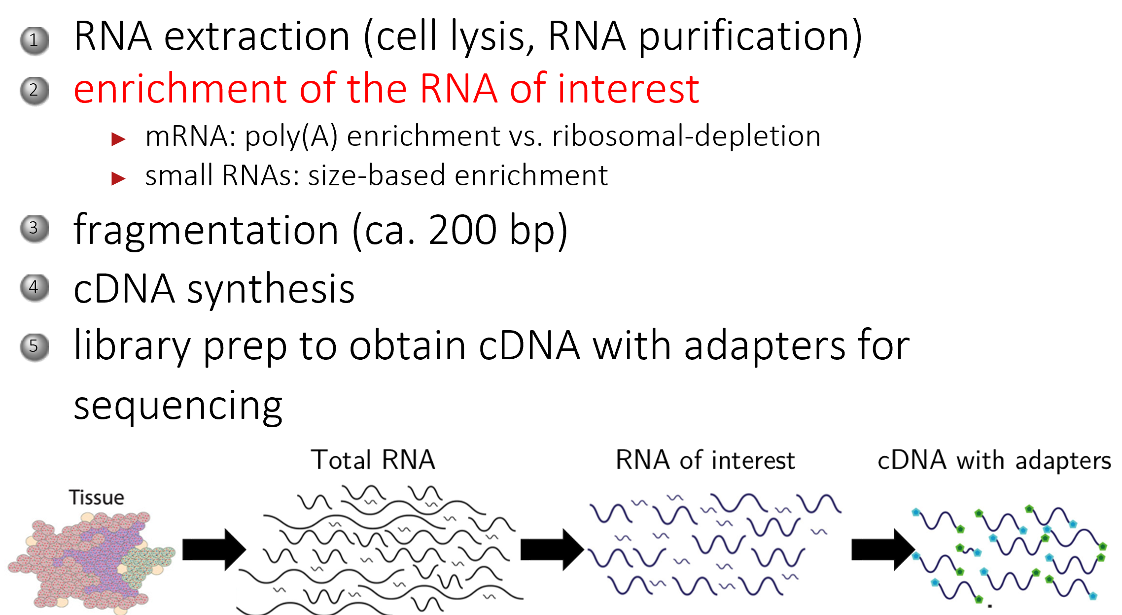
General steps of RNA-seq preparation

Slide 9
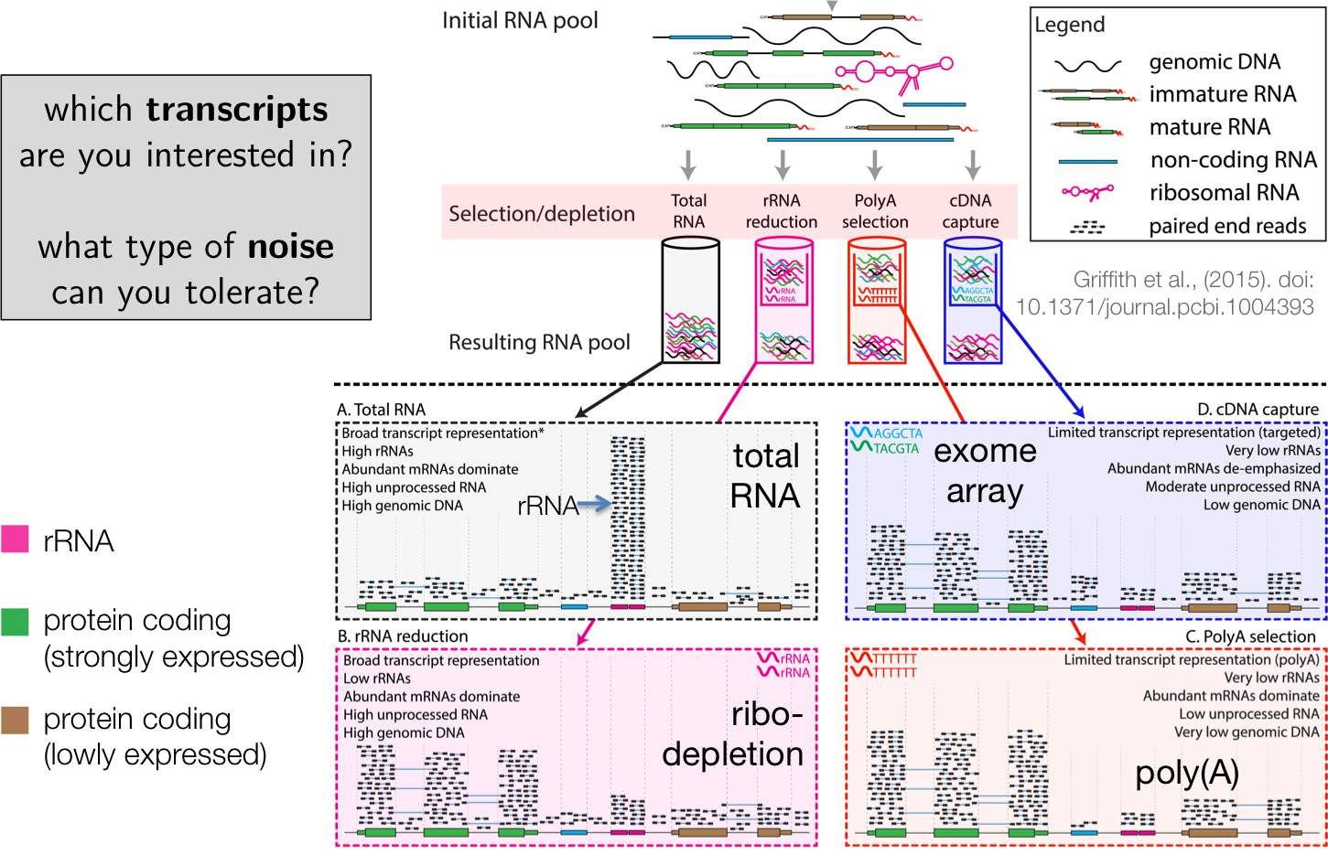
General steps of RNA-seq preparation

Slide 10
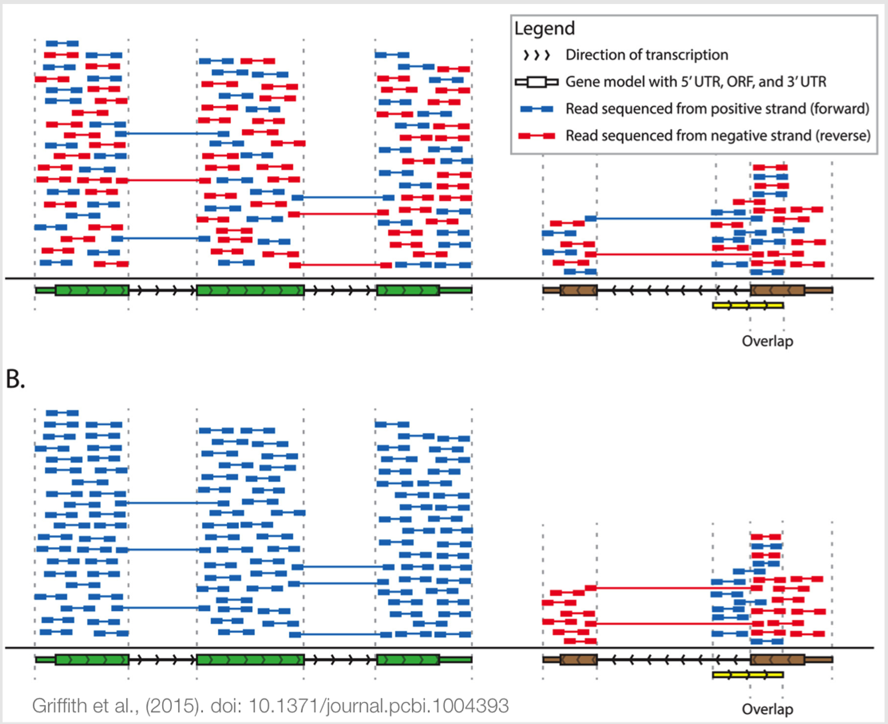
A.
Non-stranded
Stranded

Slide 11
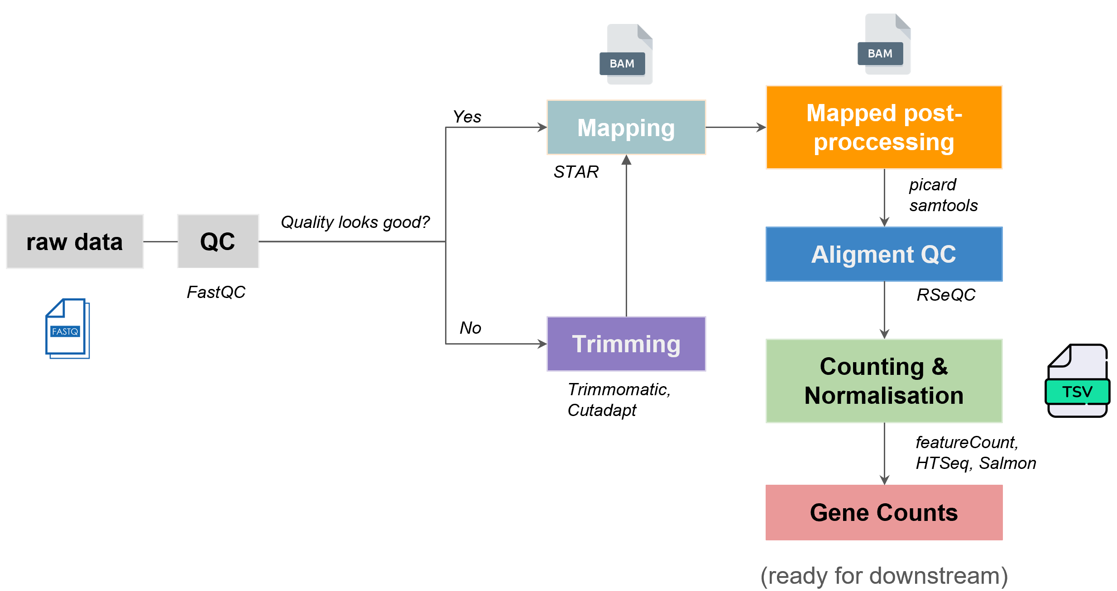
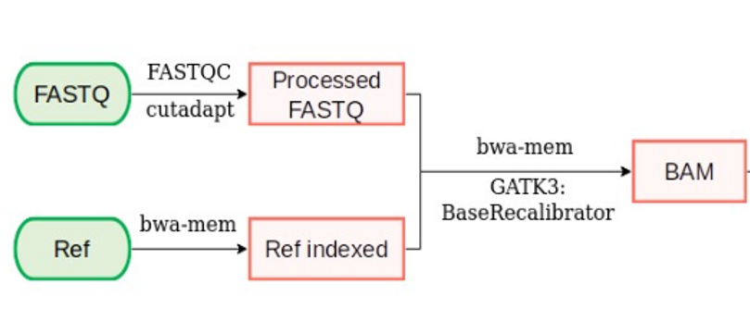
Upstream Analysis Workflow
Bulk DNA-seq
Bulk RNA-seq

Slide 12
Upstream Analysis Workflow
Bulk DNA-seq
Bulk RNA-seq
Where are the References need? And what are these?

Slide 13
Upstream Analysis Workflow
Bulk DNA-seq
Bulk RNA-seq
Where are the References need? And what are these?

Slide 14
Upstream Analysis Workflow
Bulk DNA-seq
Bulk RNA-seq
Human Genome Sequences can be found at UCSC, NCBI and Ensembl and GENCODE as fasta format
The four most common gene annotation databases are currently RefSeq, UCSC, Ensembl and GENCODE as GTF format

Slide 15
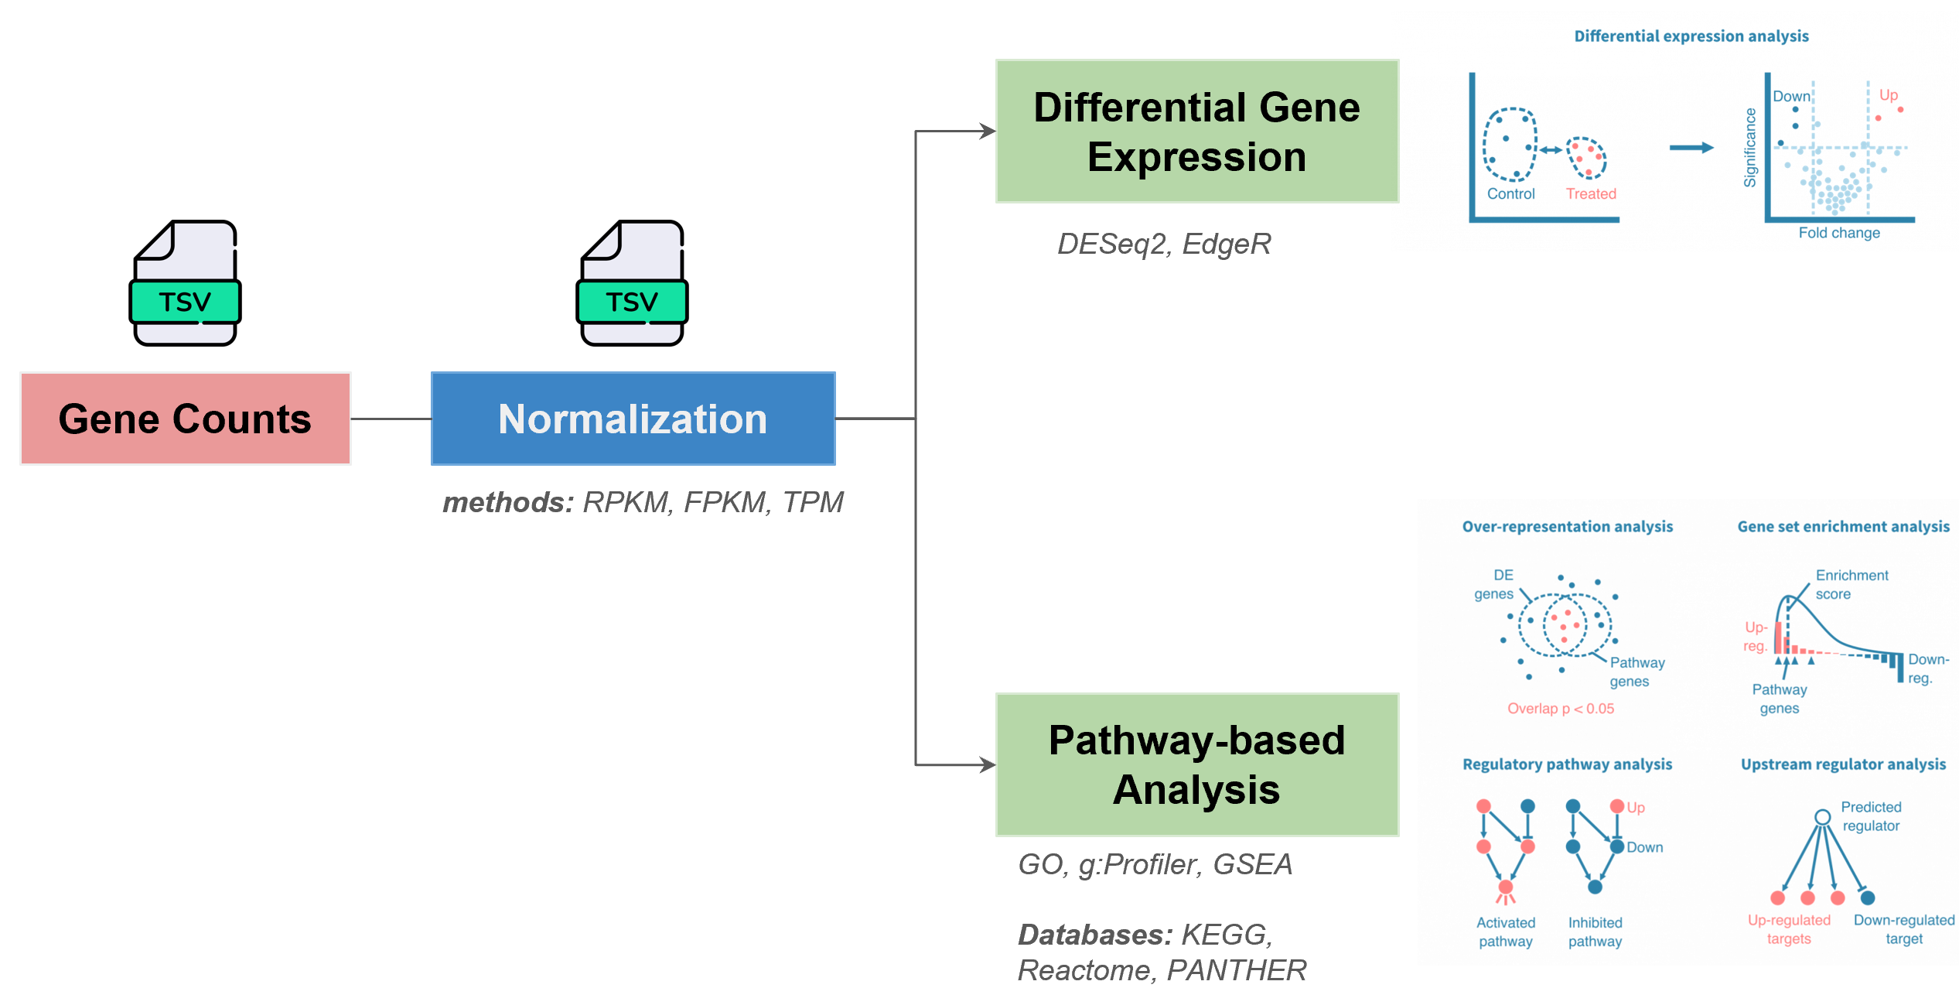
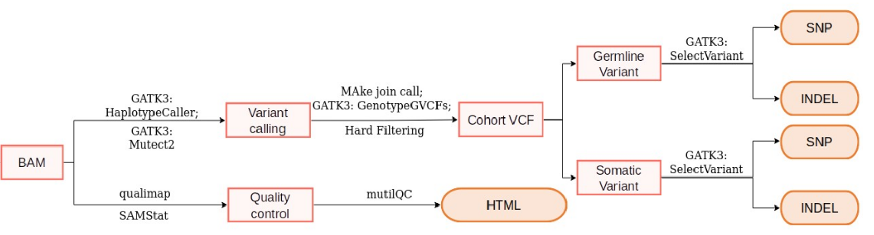
Downstream Analysis Workflow
Bulk DNA-seq
Bulk RNA-seq

Slide 16
Downstream Analysis Workflow
Bulk DNA-seq
Bulk RNA-seq
What is the unmatch?

Slide 17
Downstream Analysis Workflow
Bulk DNA-seq
Bulk RNA-seq
What is the unmatch?

Slide 18
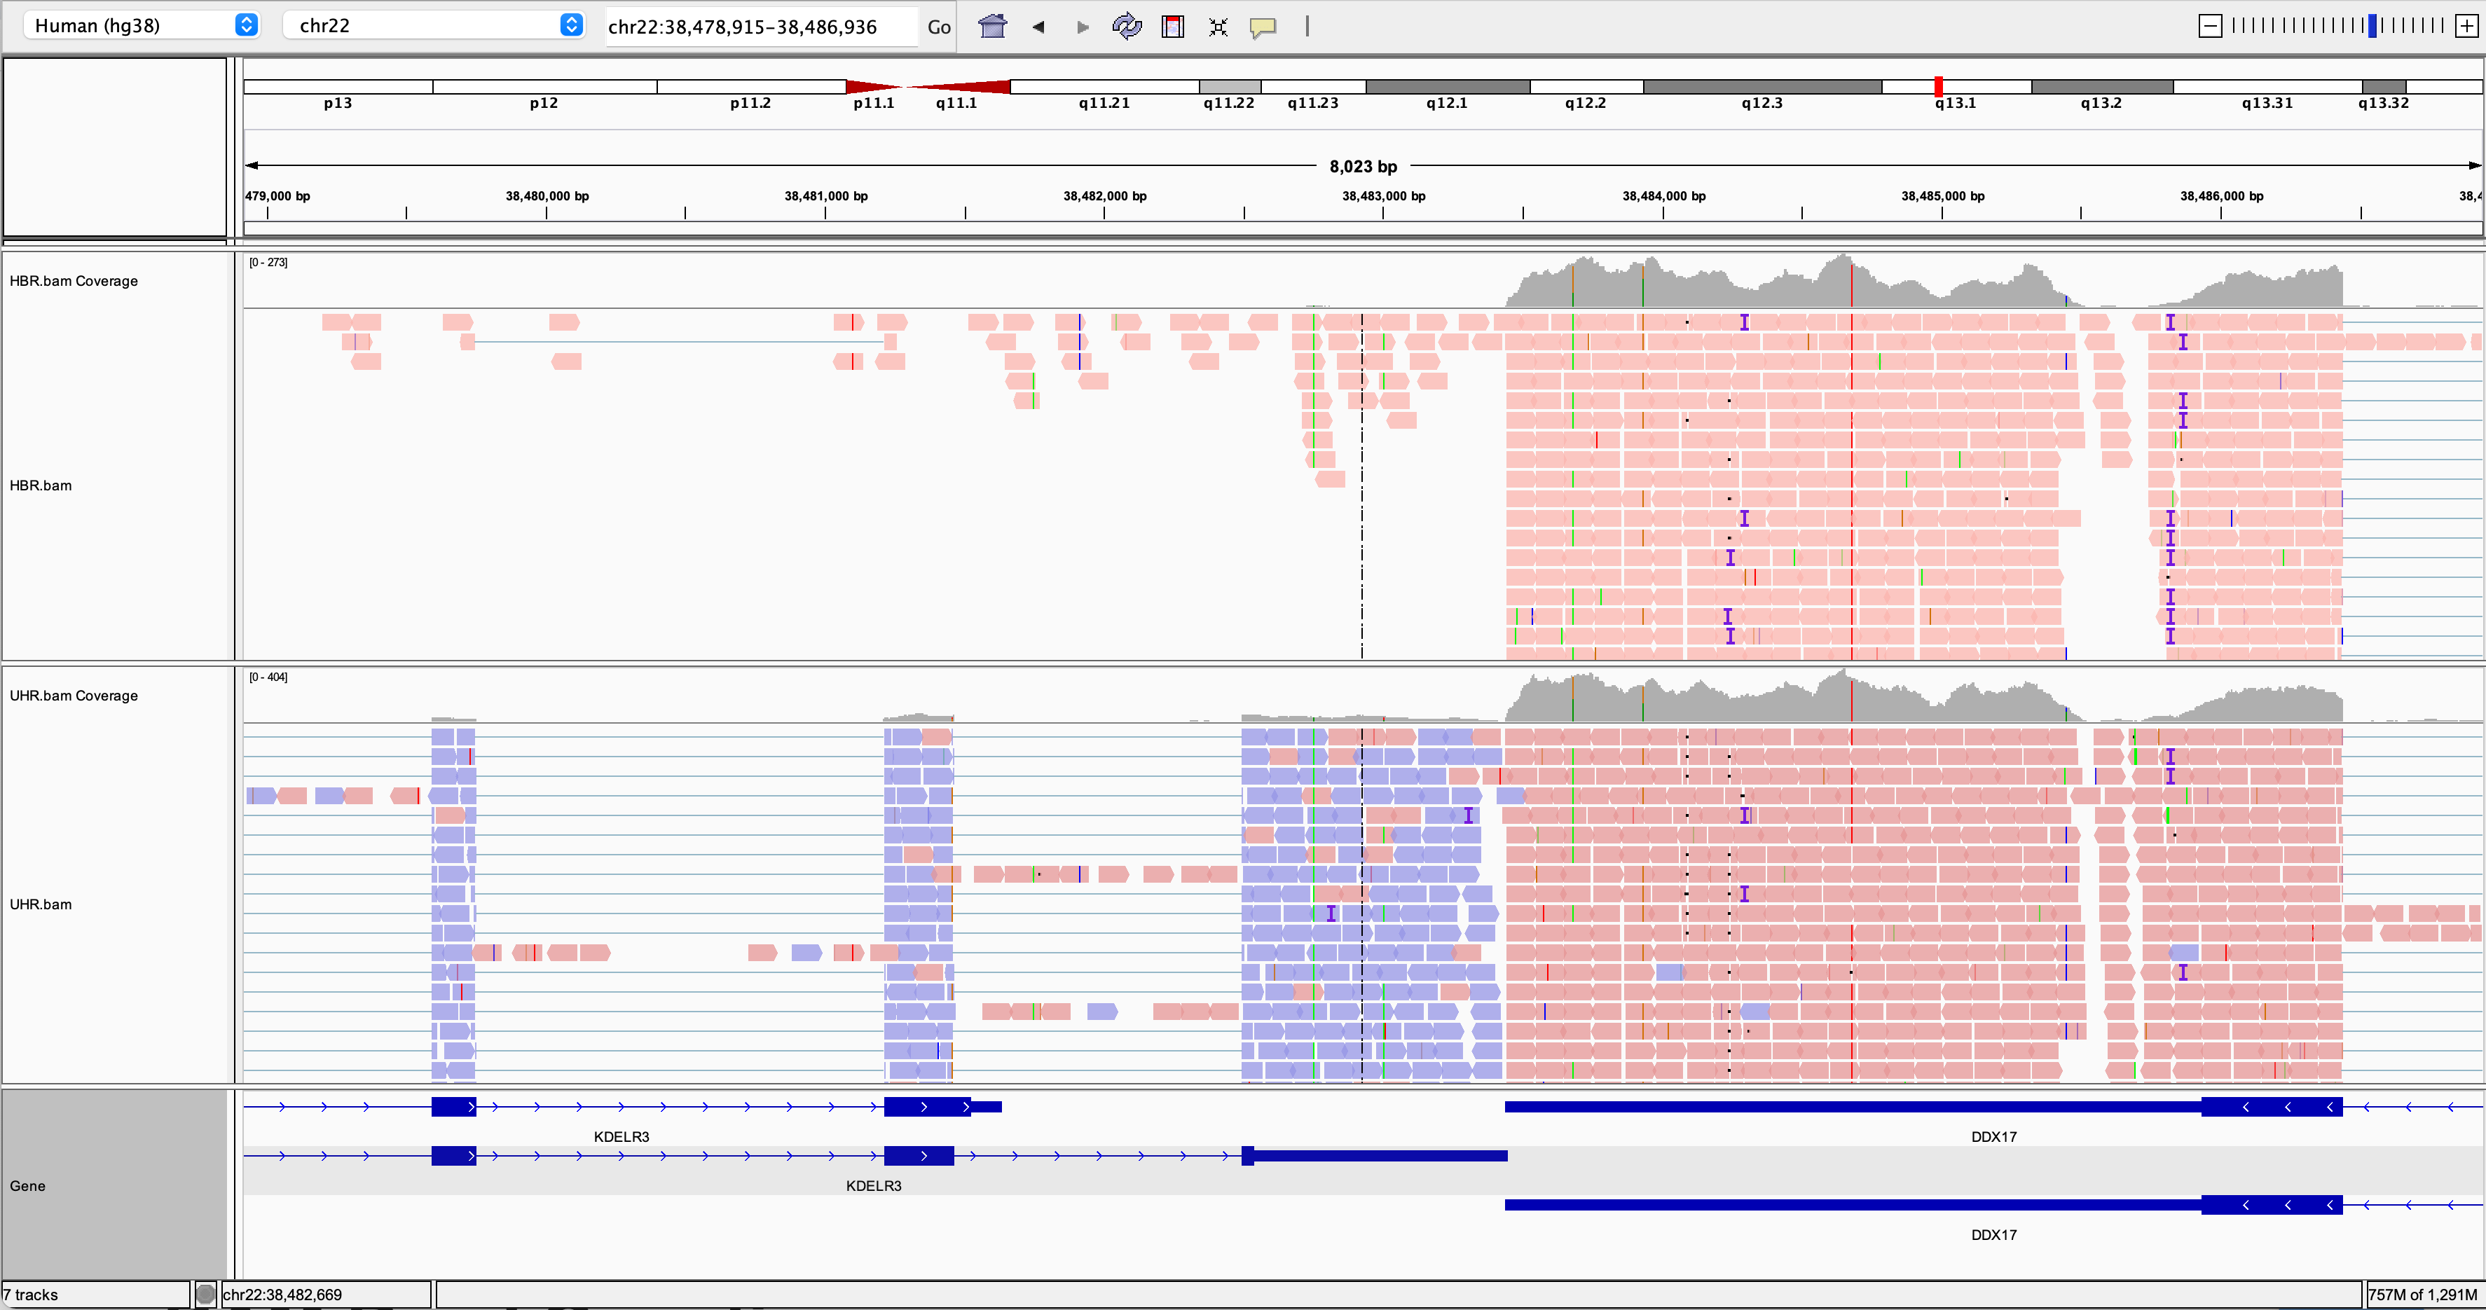
From BAM to Count
Gene | Sample 1 Healthy | Sample 2 Healthy | Sample 3 Healthy | Sample 4 Tumor | Sample 5 Tumor | Sample 6 Tumor
A | 100 | 101 | 105 | 160 | 163 | 154
B | 10 | 8 | 9 | 1 | 2 | 3
C | 45 | 45 | 45 | 46 | 46 | 46
D | 0.11 | 0.12 | 0.13 | 0.0012 | 0.0014 | 0.0013

Slide 19
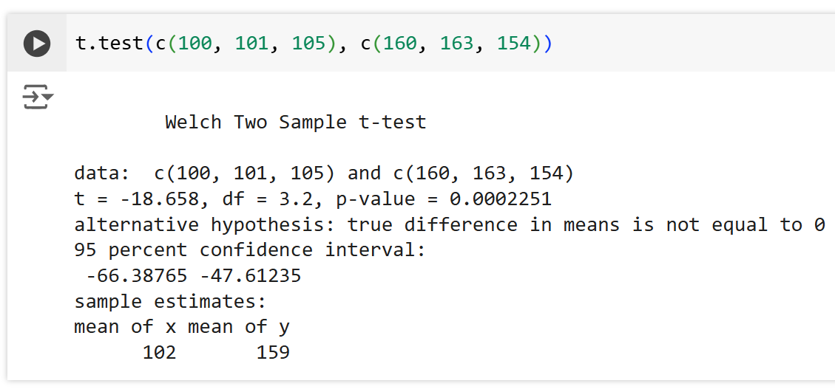
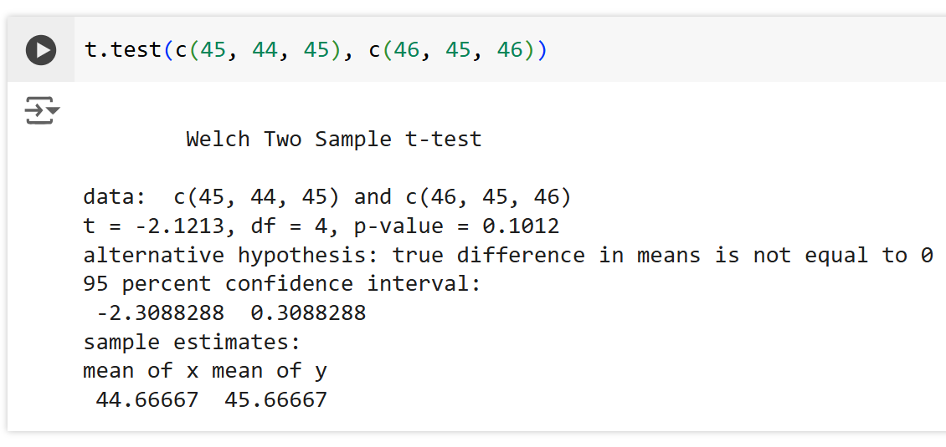
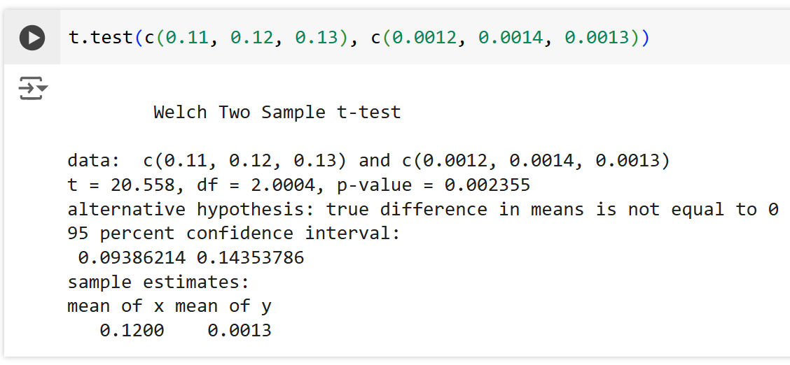
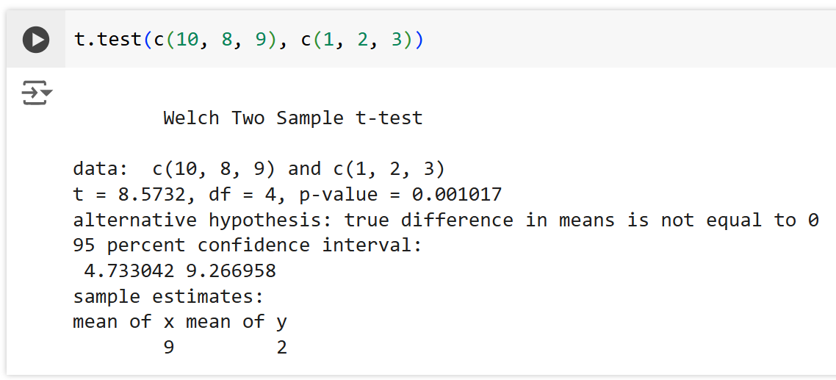
Differential Gene Expression
Gene | Sample 1 Healthy | Sample 2 Healthy | Sample 3 Healthy | Sample 4 Tumor | Sample 5 Tumor | Sample 6 Tumor
A | 100 | 101 | 105 | 160 | 163 | 154
B | 10 | 8 | 9 | 1 | 2 | 3
C | 45 | 44 | 45 | 46 | 47 | 46
D | 0.11 | 0.12 | 0.13 | 0.0012 | 0.0014 | 0.0013
Gene A
Gene D
Gene B
Gene C

Slide 20
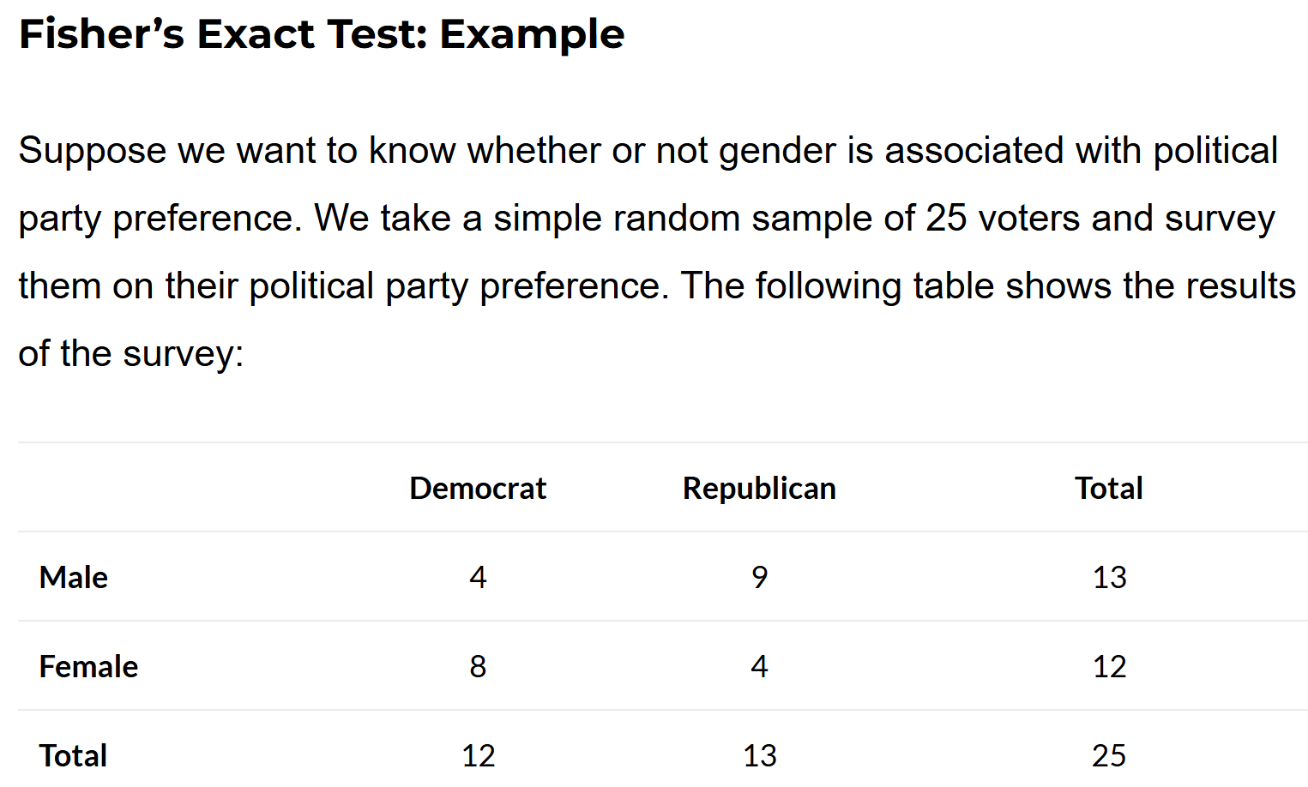
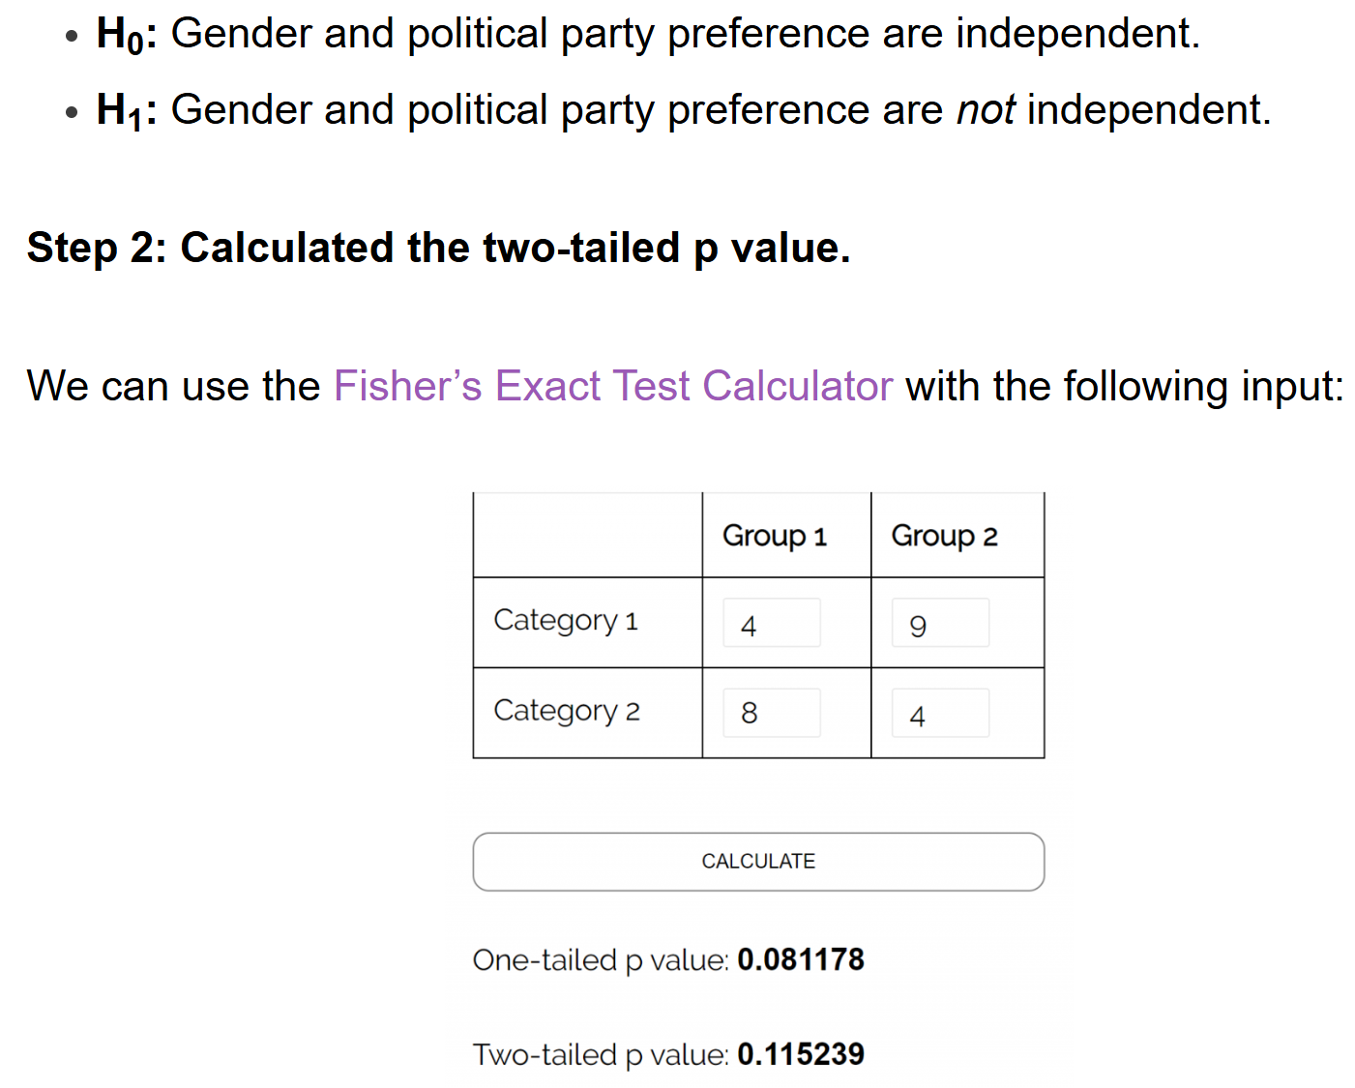
https://www.statology.org/fishers-exact-test/

Slide 21
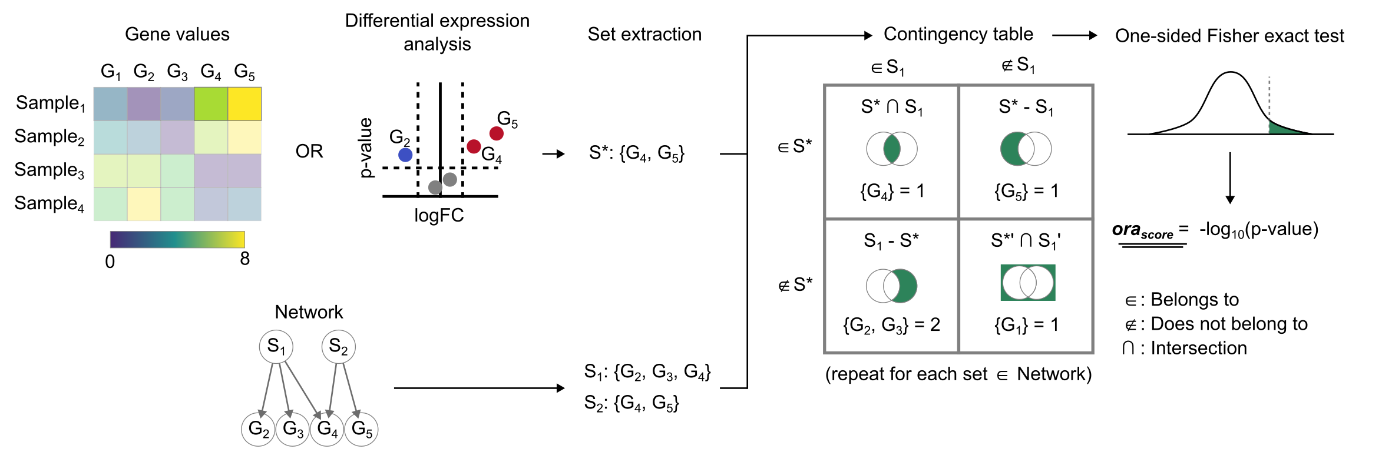
Enrichment of DEGs with Over Representation Analysis (ORA)
https://decoupler-py.readthedocs.io/en/latest/notebooks/msigdb.html

Slide 22
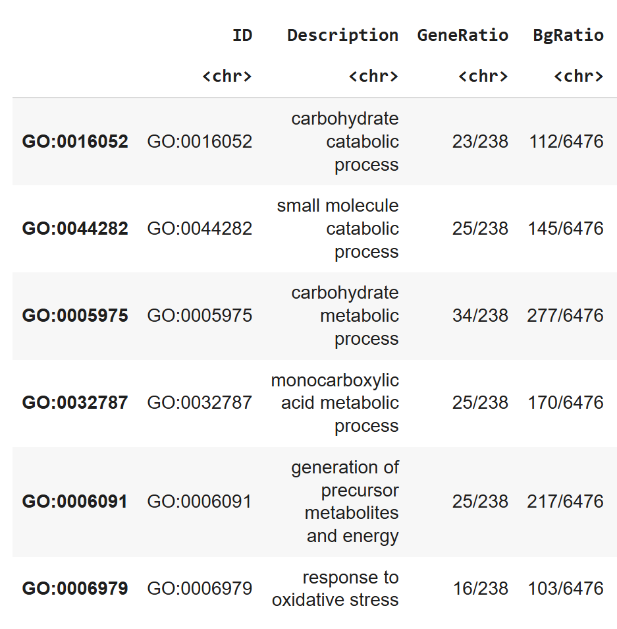
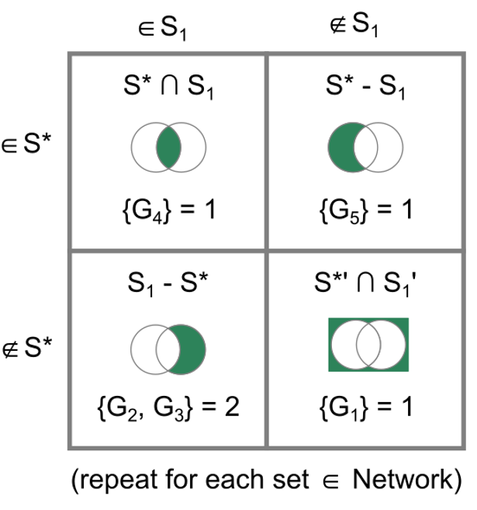
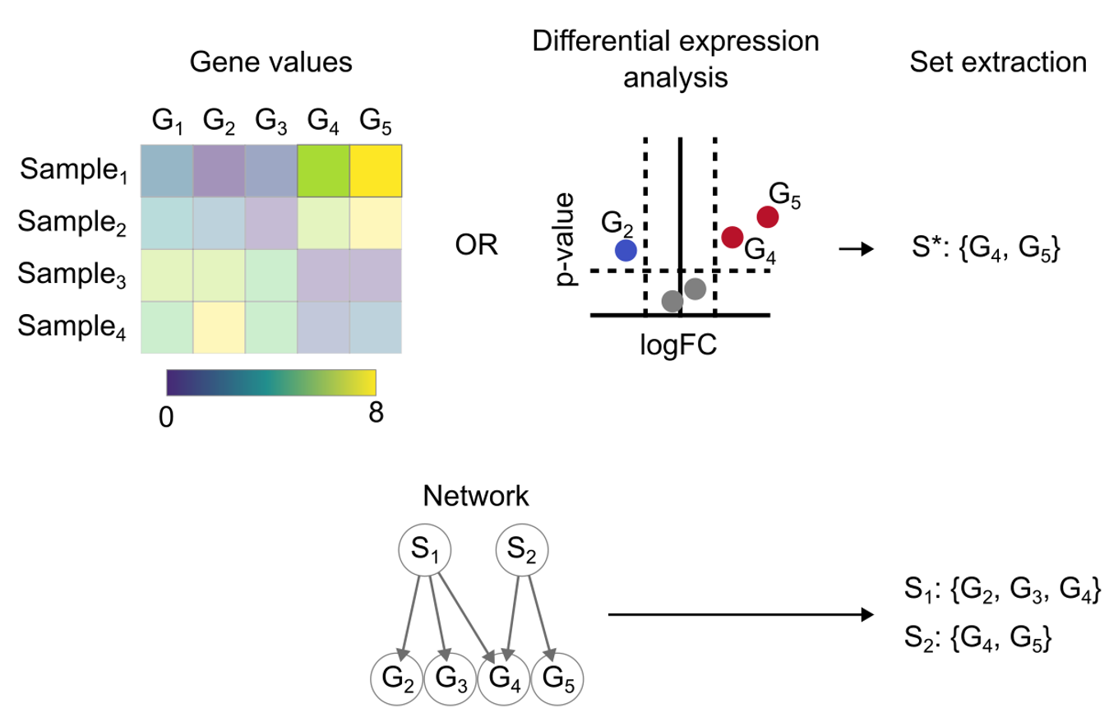
Enrichment of DEGs with Over Representation Analysis (ORA)
https://decoupler-py.readthedocs.io/en/latest/notebooks/msigdb.html

Slide 23
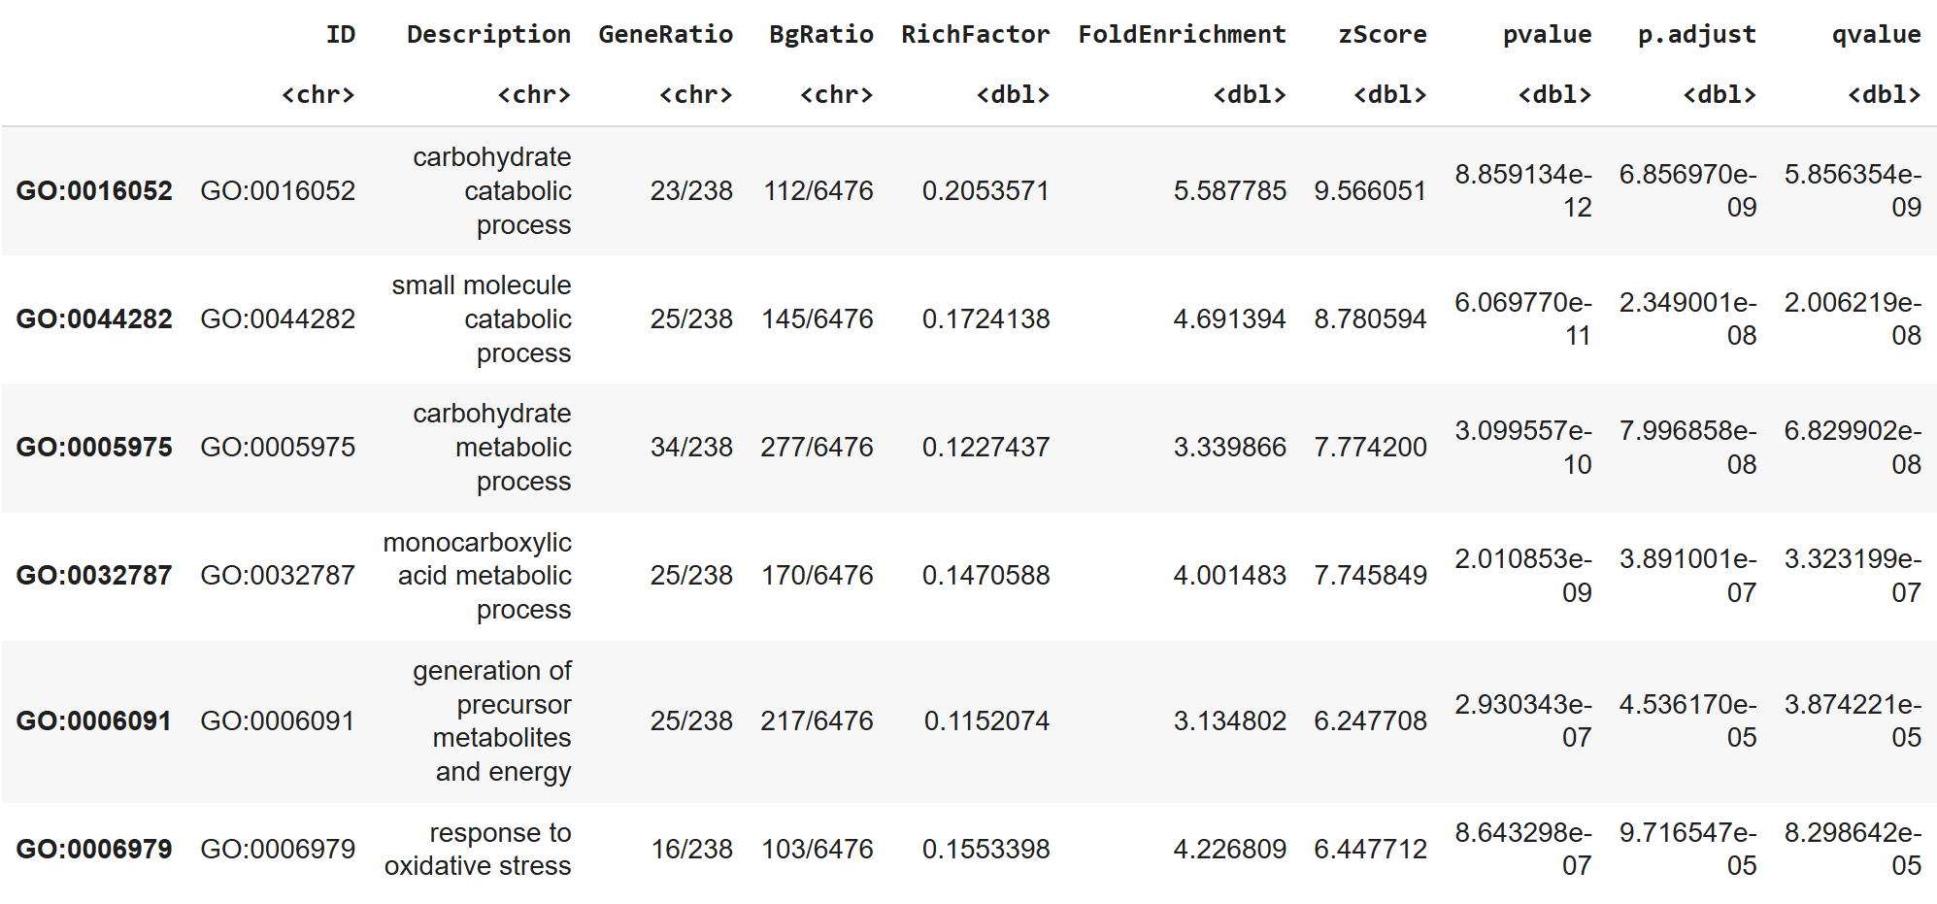
Enrichment of DEGs with Over Representation Analysis (ORA)
The qvalue in the results table from enrichGO represents the adjusted p-value for multiple testing correction. It is typically calculated using the False Discovery Rate (FDR) method, which controls the proportion of false positives among the list of enriched terms.
https://colab.research.google.com/drive/1uvY0IK2Dl75L61A0KEkXAIad3DDaEOMp?usp=sharing

Slide 24
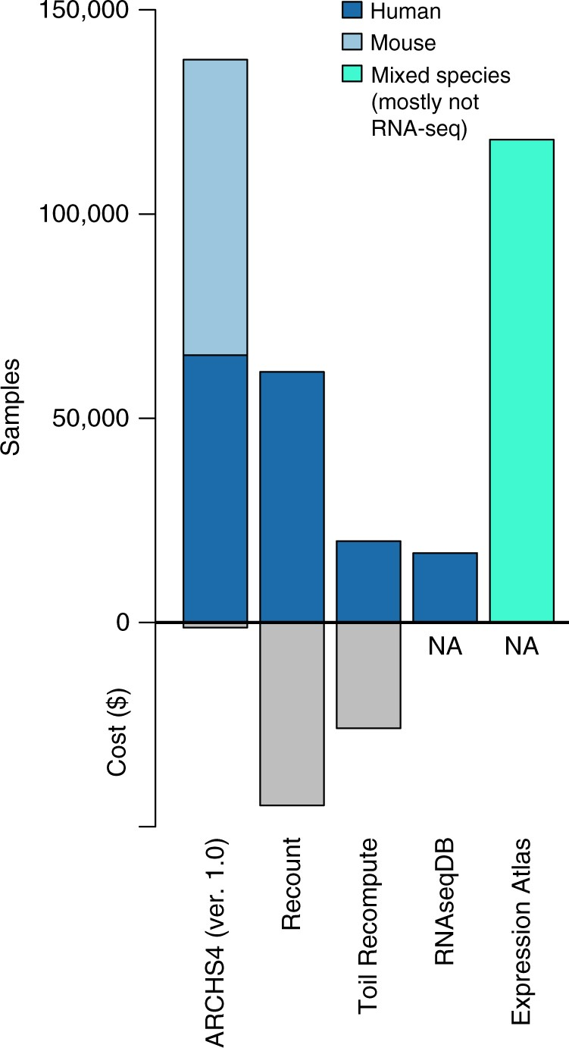
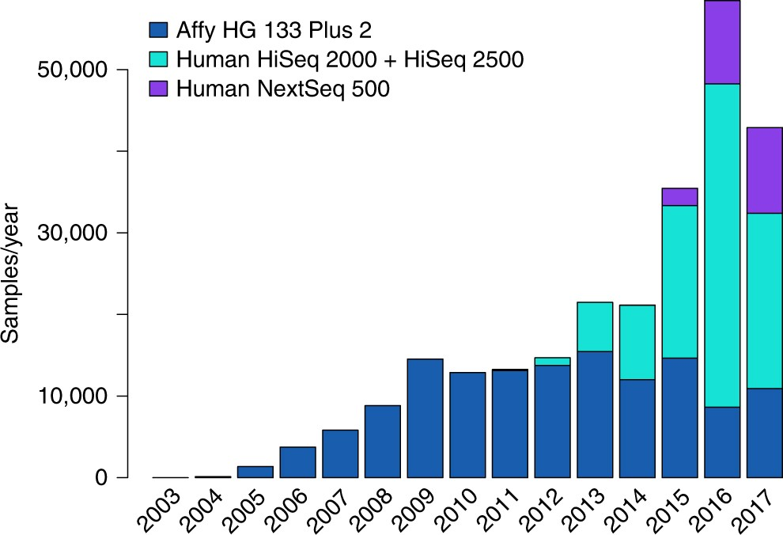


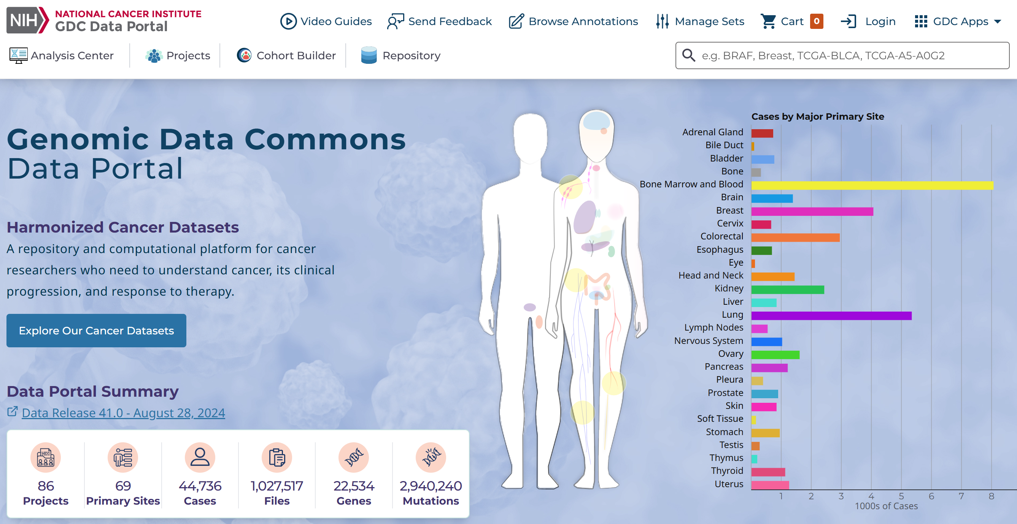
RNA-seq databases
https://gtexportal.org/home/
https://www.nature.com/articles/s41467-018-03751-6

Slide 25
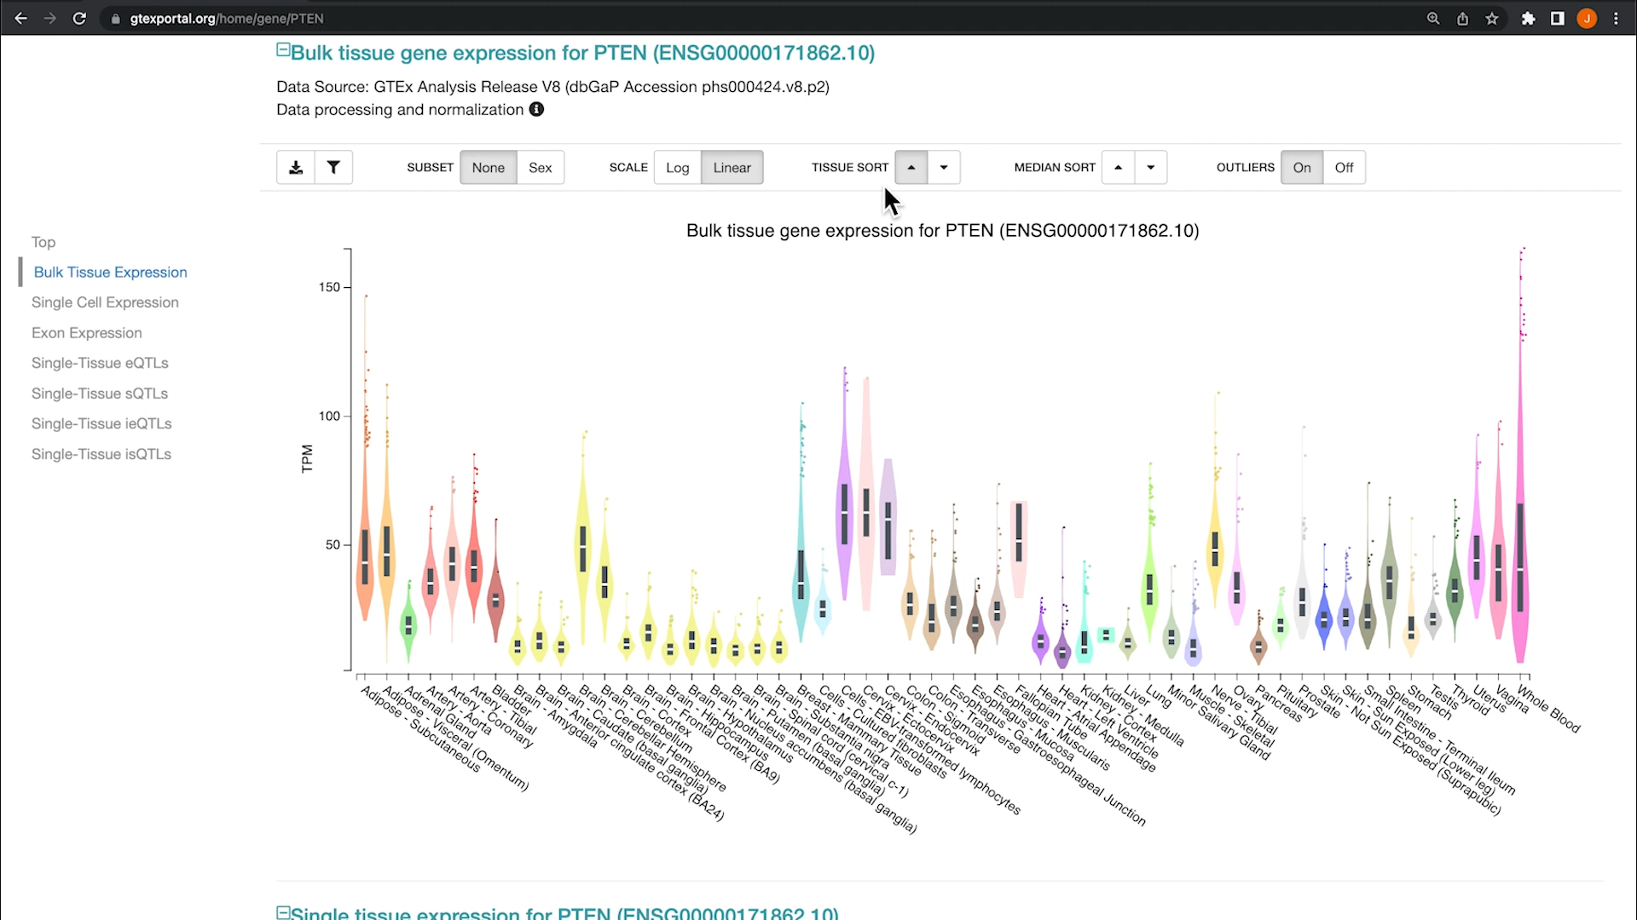
https://www.youtube.com/watch?v=WjHkb_y_yFk&t=2s
https://gtexportal.org/home/

Slide 26
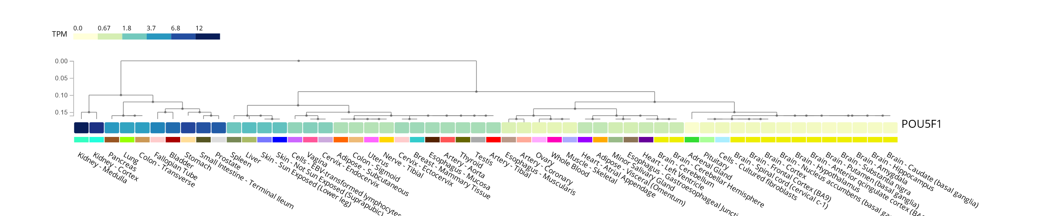
https://www.gtexportal.org/home/multiGeneQueryPage/POU5F1

Slide 27
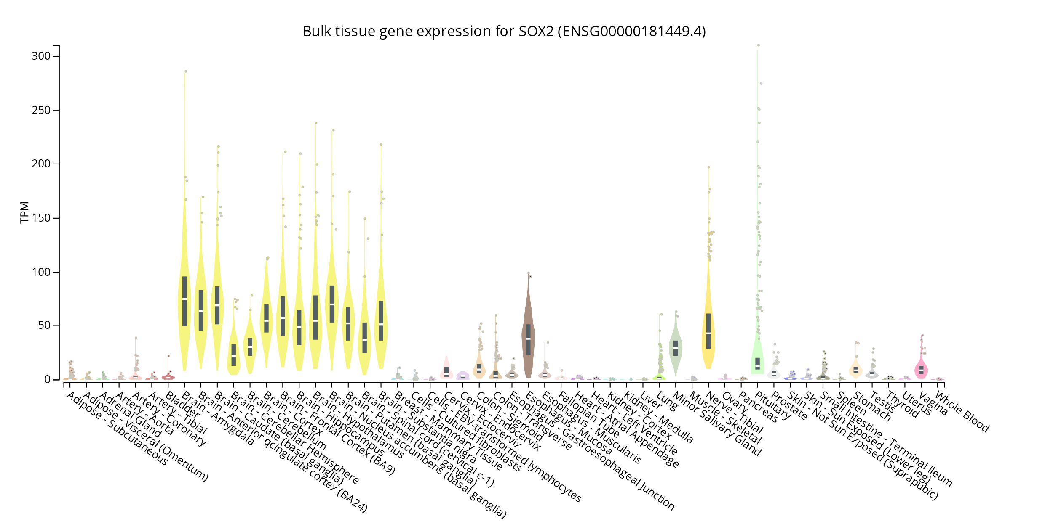
https://www.gtexportal.org/home/gene/SOX2#geneExpression

Slide 28
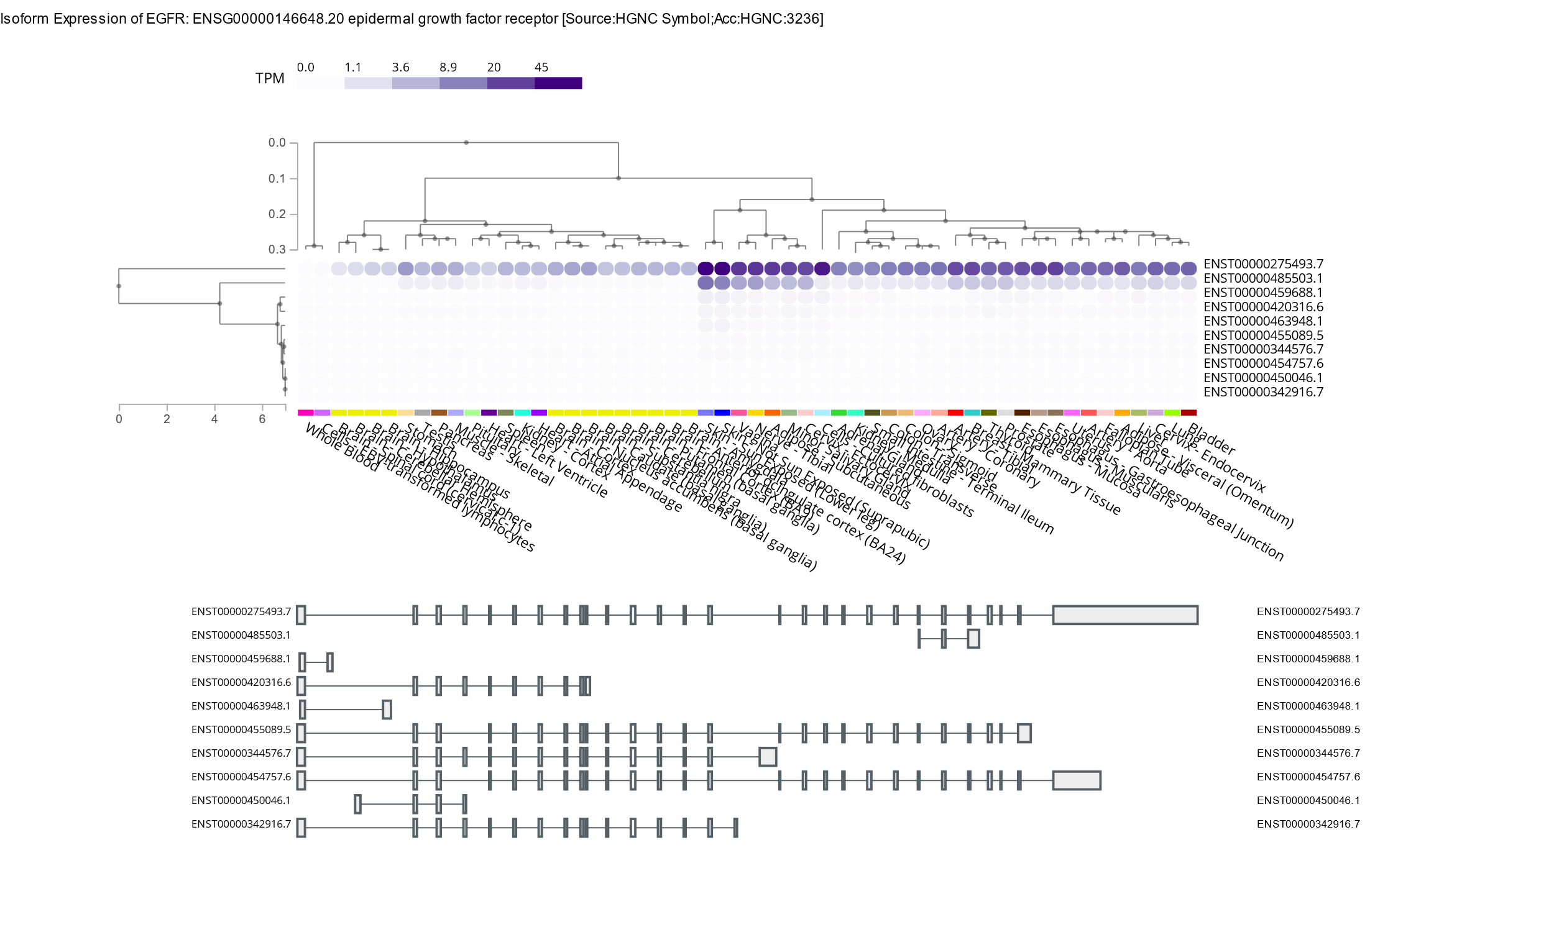
https://www.gtexportal.org/home/transcriptPage

Slide 29
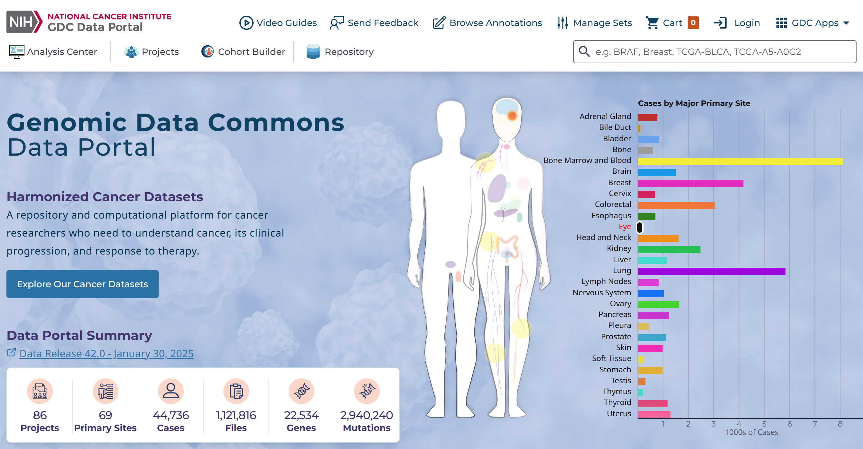
https://portal.gdc.cancer.gov/

Slide 30
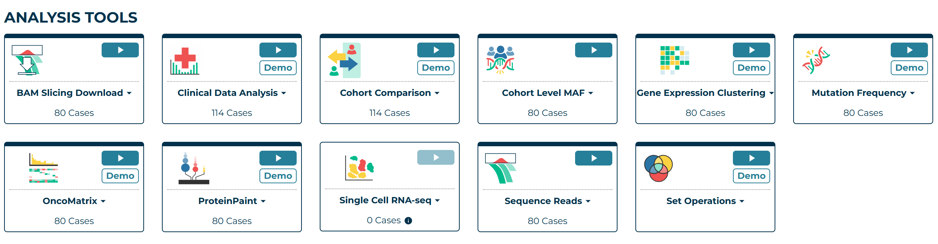
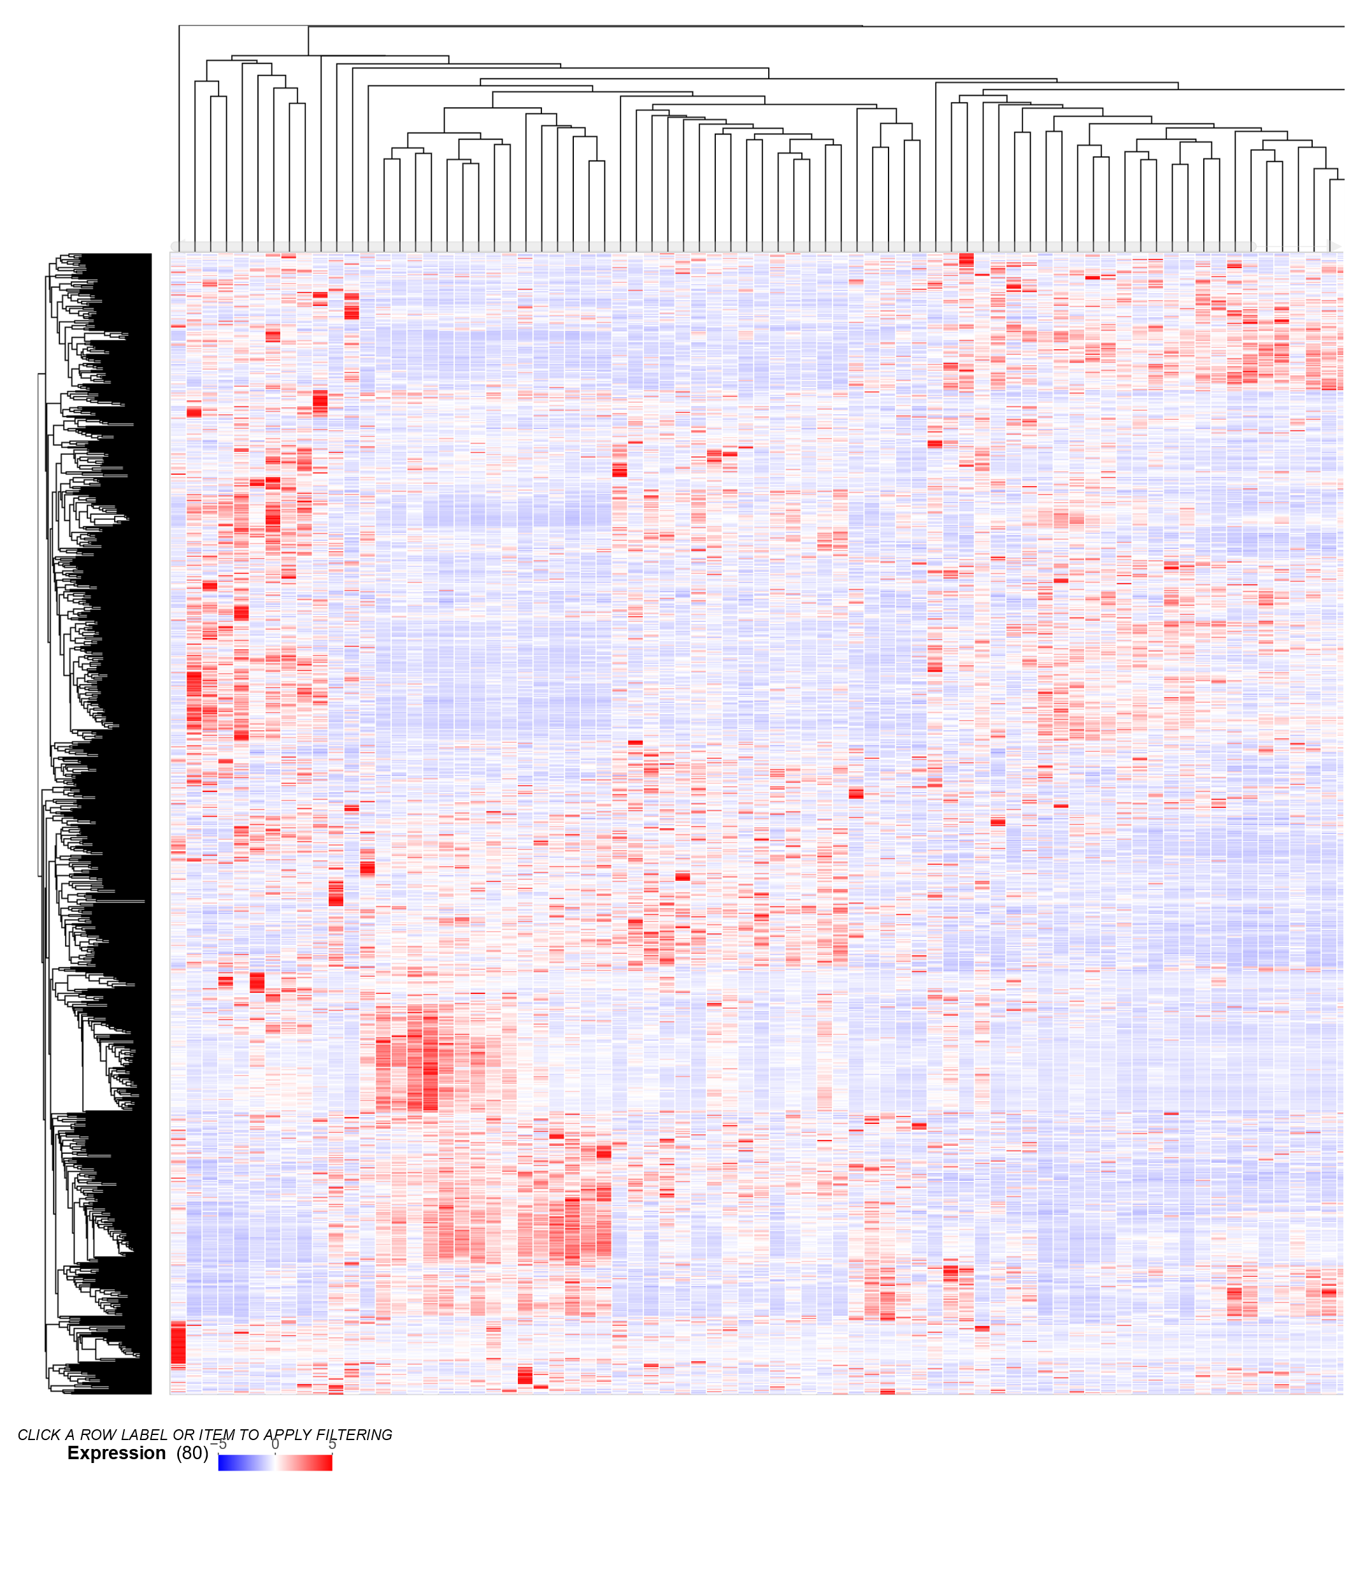
https://portal.gdc.cancer.gov/analysis_page?app=GeneExpression

Slide 31
Cảm ơn các thầy cô và các bạn!
Ngày 29 tháng 03 năm 2025
TS. Lưu Phúc Lợi
Email: luu.p.loi@googlemail.com
Zalo: 0901802182

