Slide 1



Introduction to Machine Learning
Luu Minh Sao Khue
Department of Mathematics and Mechanics

Slide 2
Course Overview
Github: https://github.com/luumsk/NSU_ML
Email: khue.luu@g.nsu.ru
Telegram: @khueluu
Notes:
Theory + practice (*)
Lectures + assignments + personal final project
Extra points

Slide 3
Get to know Machine Learning
What is Machine Learning?
Applications of Machine Learning
Types of Machine Learning
Machine Learning pipline
Component of a Machine Learning pipeline

Slide 4
What is machine learning?
Artificial Intelligence
The broad field of creating systems that mimic human intelligence to perform tasks autonomously
Machine Learning
A subset of AI that enables computers to learn patterns from data and improve over time without explicit programming for every task
Deep Learning
A specialized area of ML that uses neural networks with multiple layers to model complex patterns.

Slide 5
What is machine learning?
Machine Learning
A subset of AI that enables computers to learn patterns from data and improve over time without explicit programming for every task

Slide 6
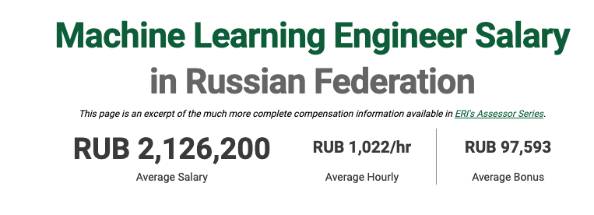
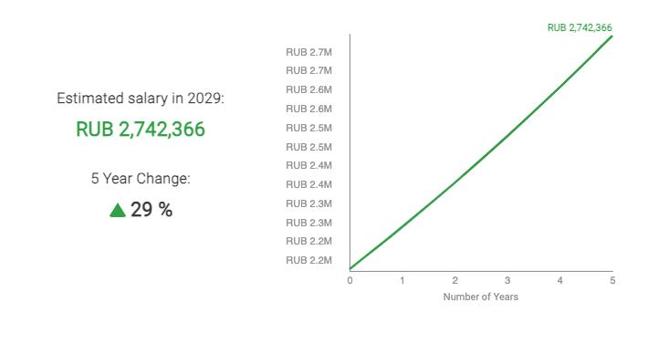
Job titles
Machine Learning Engineer
Data Scientist
Research Scientist (Machine Learning)
Applied Machine Learning Scientist
Machine Learning Analyst
Lead Machine Learning Scientist
Director of Machine Learning
Chief AI Officer
Source: https://www.erieri.com/salary/job/machine-learning-engineer/russian-federation

Slide 7
Applications of machine learning
Manufacturing
Transport and Logistic
Healthcare
E-commerce
Finance

Slide 8
Applications of machine learning
- Diagnostics
- Predictive Analytics
- Personalized Medicine
Manufacturing
Transport and Logistic
Healthcare
E-commerce
Finance
- Recommendation Engines
- Customer Segmentation
- Inventory Management
- Fraud Detection
- Credit Scoring
- Algorithmic Trading
- Predictive Maintenance
- Quality Control
- Supply Chain Optimization
- Route Optimization
- Traffic Prediction

Slide 9

What ML applications you know/being used in your country?

Slide 10
What ML applications you are interested in?

Slide 11
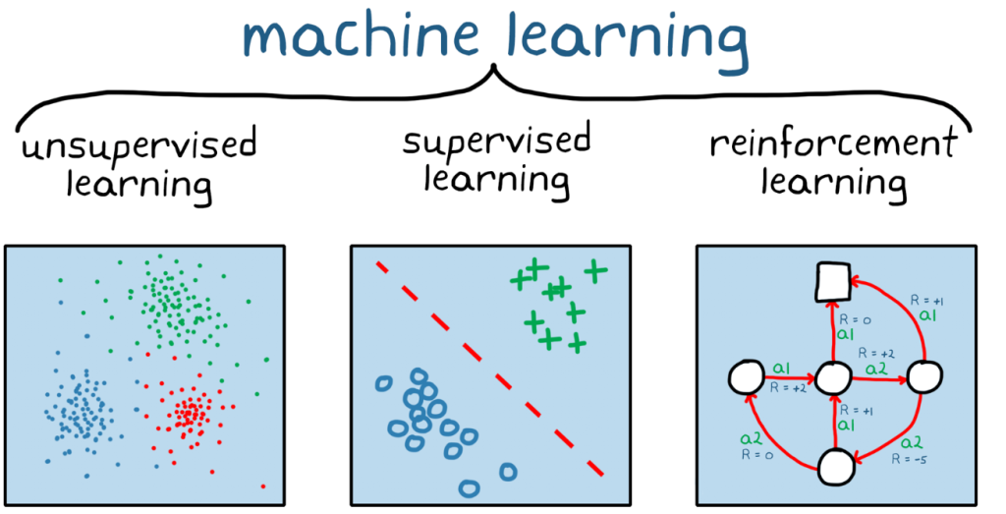
Types of machine learning
Unlabeled data
No feedback
Find hidden structure
Labeled data
Predict next value
Decision process
Reward system
Learn series of actions
Source: https://www.theaiops.com/machine-learning-compare-supervised-learning-vs-unsupervised-learning-vs-reinforcement-learning/

Slide 12
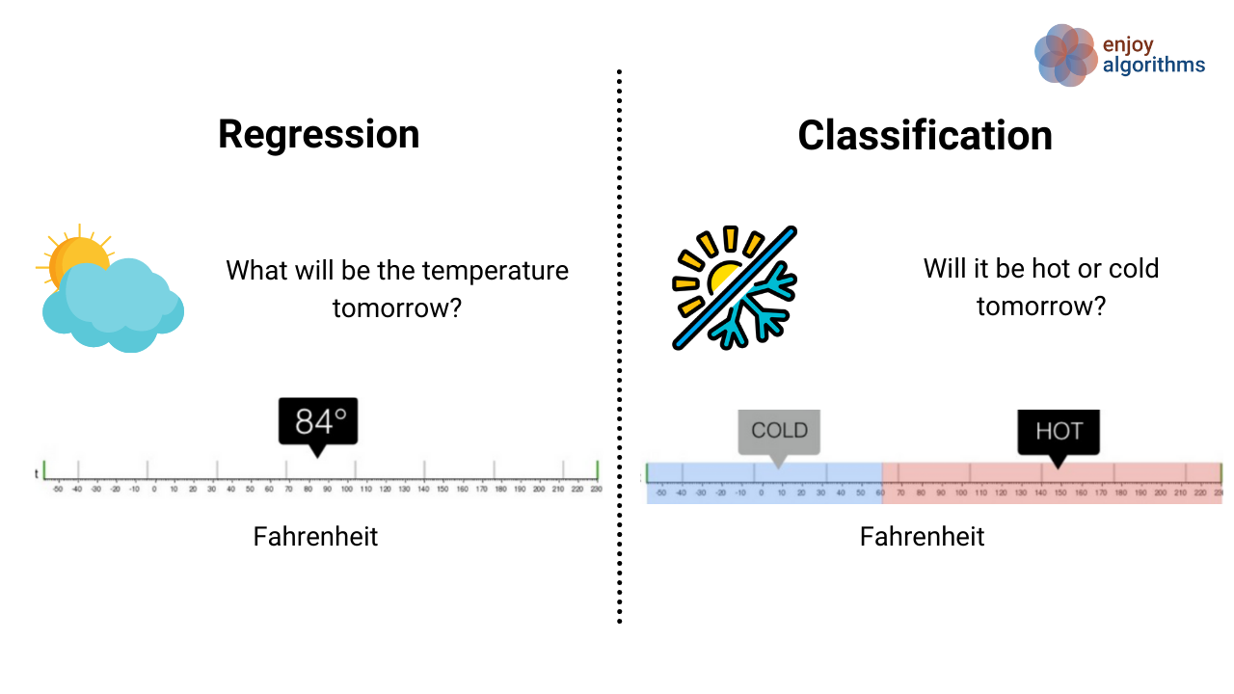
Types of Supervised Learning
Binary/
Multi-class
Source: https://www.enjoyalgorithms.com/blogs/classification-and-regression-in-machine-learning

Slide 13
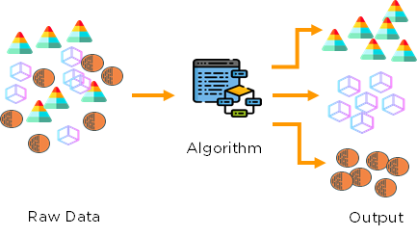
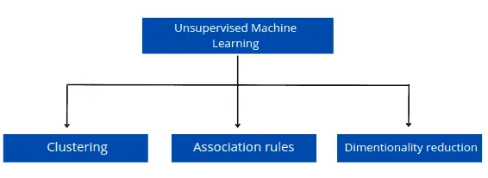
Types of Unsupervised Learning
Source:https://hands-on.cloud/ml-unsupervised-learning-guide/
Source: https://medium.com/analytics-vidhya/beginners-guide-to-unsupervised-learning-76a575c4e942

Slide 14
What type of ML problem do you think it is?
Scenario 1: A bank wants to predict whether a new applicant will default on a loan. They have data on previous applicants, including income, credit score, and past financial behavior.
Question: What type of machine learning problem is this, and why?

Slide 15
What type of ML problem do you think it is?
Scenario 2: An e-commerce company wants to group its customers into different segments to better tailor its marketing strategy. They have information on customer behavior, such as purchase frequency, spending habits, and browsing history, but they do not know how which customer belongs to which group.
Question: What type of machine learning problem is this, and why?

Slide 16
What type of ML problem do you think it is?
Scenario 3: Imagine a robotic vacuum cleaner that navigates around a house, cleaning floors and avoiding obstacles. The robot has to learn how to move efficiently, avoid furniture, and return to its charging station when its battery is low. The robot doesn’t start with any prior knowledge about the house layout or where obstacles are located.
Question: What type of machine learning problem is this, and why?

Slide 17
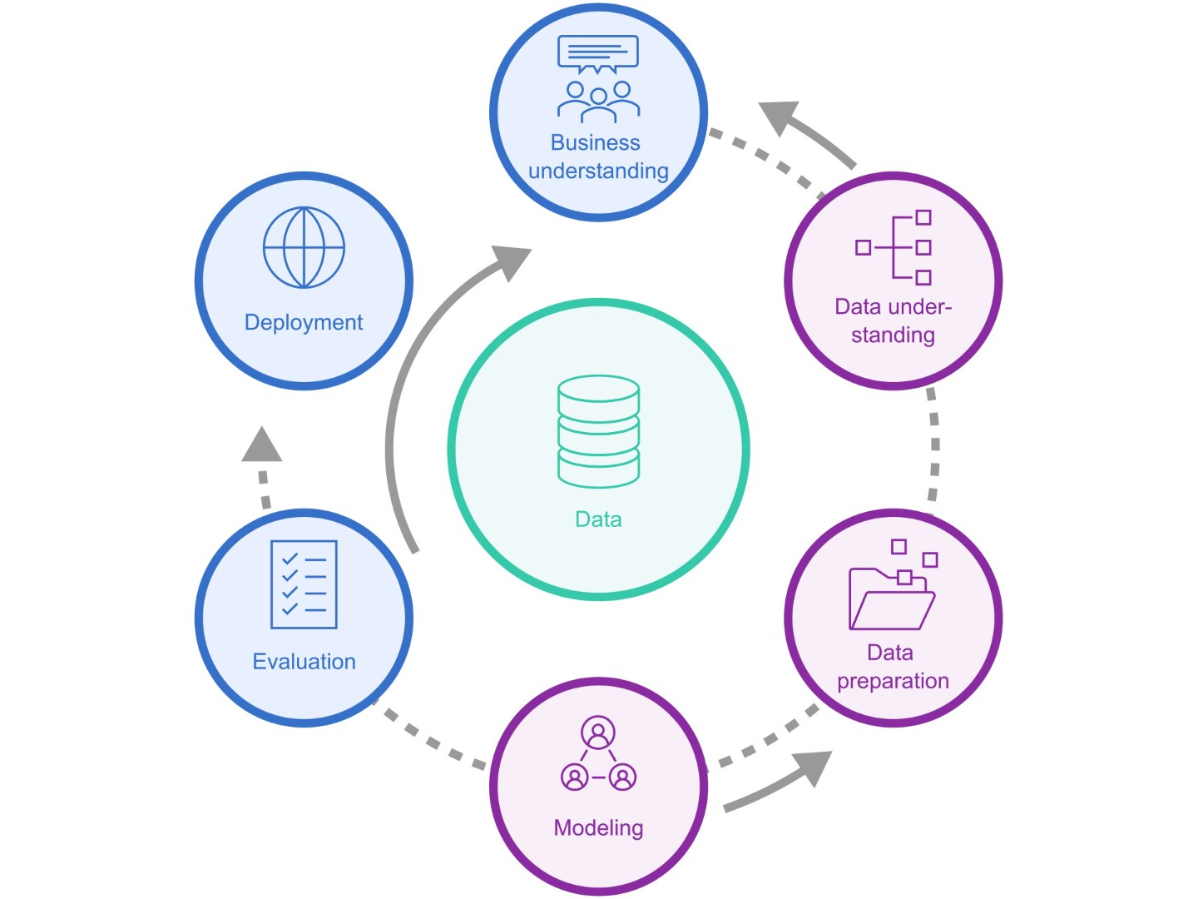
Machine learning pipline
Cross-Industry Standard Process for Data Mining (CRISP-DM)

Slide 18
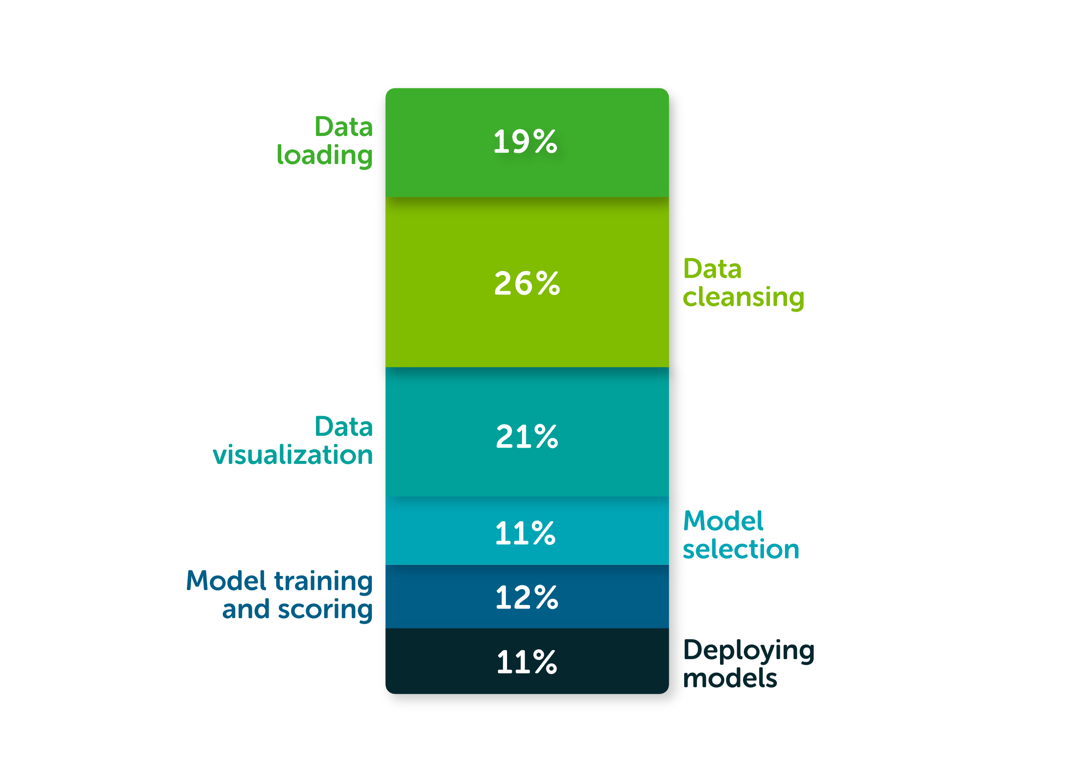
Time allocation for ML tasks
Focus of this course
Source: https://www.anaconda.com/resources/whitepapers/state-of-data-science-2020

Slide 19
Components of a machine learning pipeline
Input Data
Raw data used to train the model, containing independent variables (predictors) and, in supervised learning, target labels.
Features
Selected attributes from the data that represent relevant information, influencing model accuracy and performance.
Model
The algorithm or mathematical representation that learns patterns in the data (e.g., linear regression, decision trees).
Model Output (Prediction)
The result generated by the model, such as predicted labels, probabilities, or continuous values.
Evaluation Metrics
Measures like accuracy, precision, and recall used to assess model performance and generalization.

Slide 20
Some practical aspects
Underfitting vs Overfitting
Training, validation, and test dataset splitting
Cross-validation
Hyperparameters tuning
Ensemble method

Slide 21
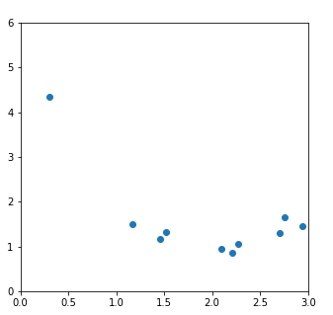
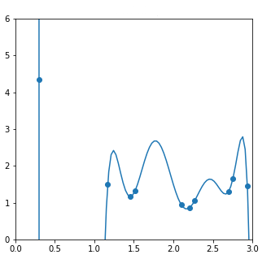
Choosing the function class

Slide 22
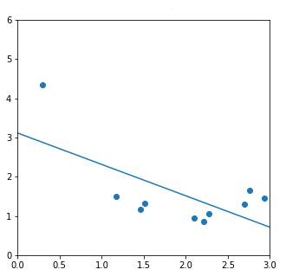
Choosing the function class

Slide 23
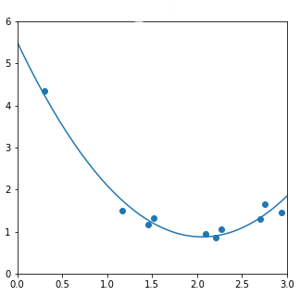
Choosing the function class

Slide 24
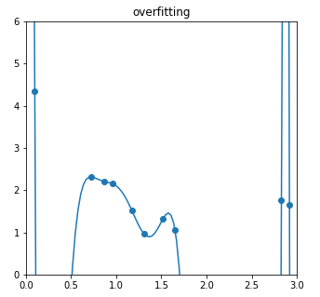
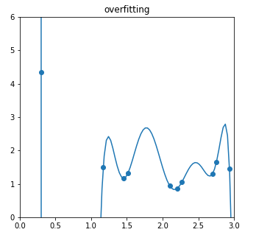
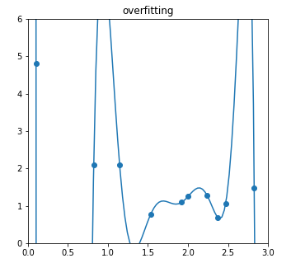
High Variance

Slide 25
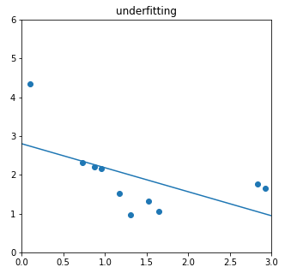
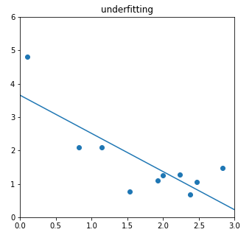
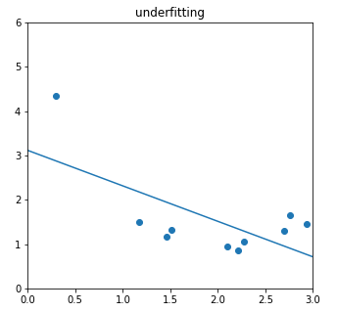
High Bias

Slide 26
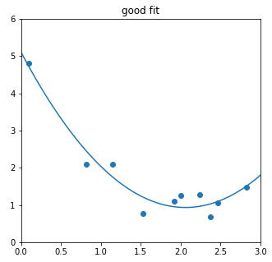
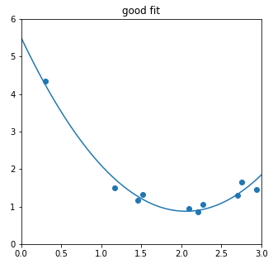
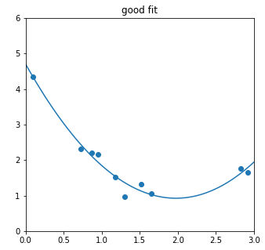
Optimal Bias and Variance

Slide 27
Overfitting and Underfitting
A model with a high bias and low variance is an underfit model. It does not sufficiently represent the statistical relationships in our data.
A model with high variance and low bias is an overfit model, because it captures relationships that are too specific to the exact data we happen to train it on. These relationships may not exist in the general distribution and are likely spurious.

Slide 28
Dataset splitting
Training Dataset
Used to train the model by allowing it to learn patterns and relationships.
Typically the largest portion of the data (e.g., 60-70%).
Validation Dataset
Used to tune model parameters and prevent overfitting.
Helps evaluate model performance during training but isn’t used to train the model directly.
Test Dataset
A completely separate dataset used for final model evaluation.
Provides an unbiased assessment of model performance on new data.

Slide 29
Cross Validation
Purpose: An approach to maximize data usage for training and validation.
Process: The dataset is split into k "folds." Each fold is used as a validation set while the remaining k-1 folds are used for training.
Common Approach: k-fold Cross-Validation (e.g., 5-fold), where results are averaged across folds.
Benefit: Provides a more robust evaluation, reducing the risk of overfitting and underfitting

Slide 30
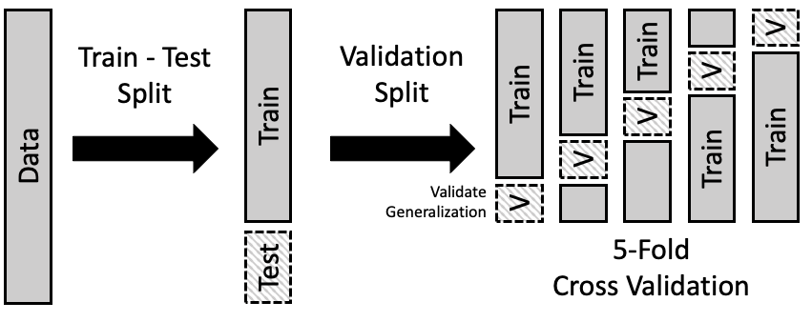
Cross Validation
Source: https://learningds.org/ch/16/ms_cv.html

Slide 31
Hyperparameter Tuning
Definition: The process of optimizing model settings (hyperparameters) that aren’t learned from data, such as learning rate, number of neighbors (in k-NN), or max depth (in decision trees).
Goal: To improve model accuracy, reduce overfitting, and achieve the best possible performance.
Methods:
Grid Search: Tests all possible combinations of hyperparameters within a predefined range.
Random Search: Samples random combinations of hyperparameters, offering faster exploration.
Tools: GridSearchCV and RandomizedSearchCV in scikit-learn.

Slide 32
Ensemble Method
Definition: Combines multiple models to improve overall performance by reducing errors and capturing more complex patterns.
Types:
Bagging: Trains multiple models on random subsets of data (e.g., Random Forest).
Boosting: Sequentially trains models, each focusing on correcting errors from the previous one (e.g., AdaBoost, Gradient Boosting).
Stacking: Combines outputs of multiple models through a meta-model to improve predictions.
Benefits: Increases accuracy, robustness, and generalization, often outperforming individual models.

Slide 33

Practice
Sources to learn Machine Learning
Lab work

Slide 34
Sources to learn ML
Scikit learn: https://scikit-learn.org/stable/
Kaggle: https://www.kaggle.com/
Machine Learning Mastery: https://machinelearningmastery.com/
Books: https://github.com/josephmisiti/awesome-machine-learning/blob/master/books.md

Slide 35
Lab
Link: https://github.com/luumsk/NSU_ML/blob/main/Labs/lab1.ipynb

Slide 36
References
https://acropolium.com/blog/machine-learning-in-healthcare-use-cases-benefits-and-success-stories/
https://www.enjoyalgorithms.com/blogs/classification-and-regression-in-machine-learning
https://hands-on.cloud/ml-unsupervised-learning-guide/
https://medium.com/analytics-vidhya/beginners-guide-to-unsupervised-learning-76a575c4e942
https://www.erieri.com/salary/job/machine-learning-engineer/russian-federation
https://www.tealhq.com/job-titles/machine-learning-scientist
https://learningds.org/ch/16/ms_cv.html

