Slide 1


Spinnaker

Slide 2
Architecture
Spinnaker is an automated CD with pipelines with flexible service model
Code
Build Container
Container Unit Test
Container in Registry
Test fails
Test Pass
QA and Operations Can use for Deployment

Slide 3
Architecture
Deck is the browser-based UI.
Gate is the API gateway
Orca is the orchestration engine.
Clouddriver is responsible for all mutating calls to the cloud providers and for indexing/caching all deployed resources.
Front50 is used to persist the metadata of applications, pipelines, projects and notifications.
Rosco is the bakery. It produces immutable VM images (or image templates) for various cloud providers.
Igor is used to trigger pipelines via continuous integration jobs
Echo is Spinnaker’s eventing bus.
Fiat is Spinnaker’s authorization service.
Kayenta provides automated canary analysis for Spinnaker.

Slide 4
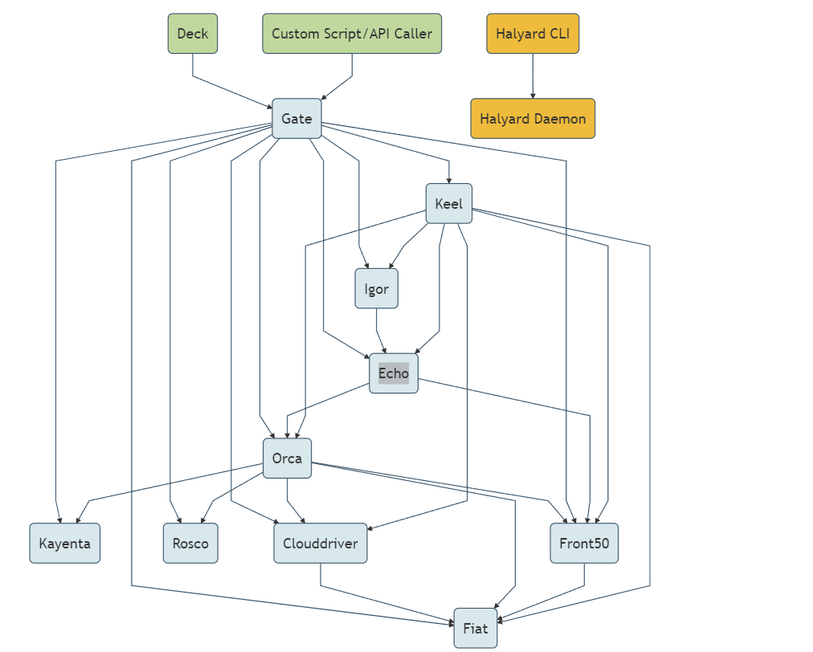

Slide 5
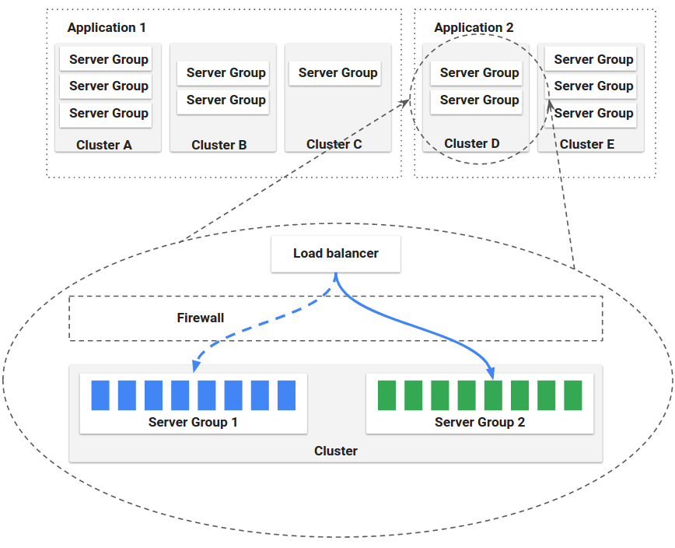
Management

Slide 6
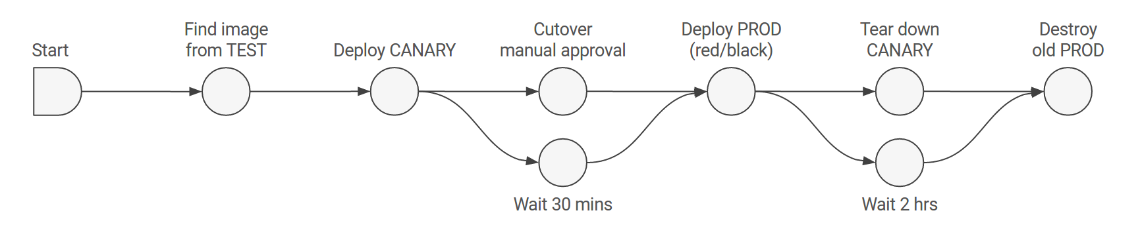
Deployment

Slide 7
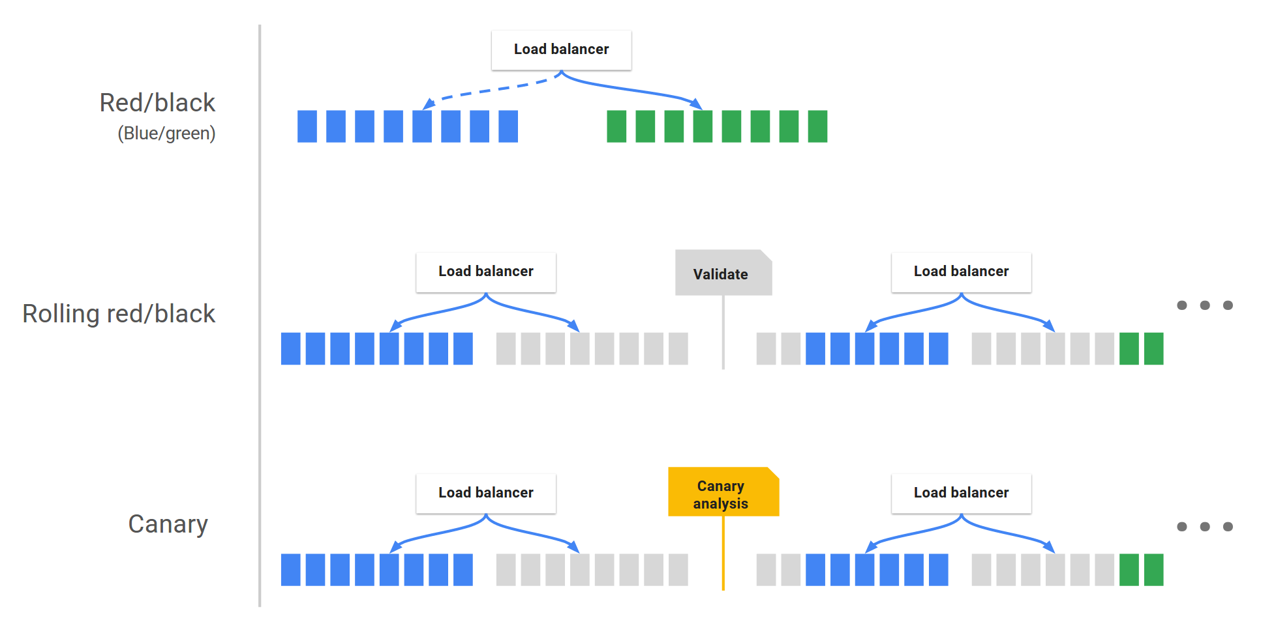
Deployment Strategy
Strategy

