Slide 1
OPEN SOURCE Software
GROUP 1
INSTRUCTOR: Mr. Sung Le

Slide 2
Introduction GROUP 1
Anh Hoang
Dat Huynh
Tuan Vo
An Huynh
Canh Nguyen
Cuong Nguyen
Dat Phan
Dung Ly
Hoa Phan
Hoanh Ly
Hung Tran
Khoa Vo

Slide 3
Outline
What is Linux?
History of Linux
Distribution
What is Kernel?
What is Linux Kernel?
Description of Linux Kernel architecture
Linux Kernel functions
Relationship between Linux Kernel, Hardware, Applications
Memory-mapped I/O and Port-mapped I/O
System call
Interaction between Linux Kernel and Users

Slide 4
Outline
What is Embedded Linux?
Why is Embedded Linux?
Overview about boot process of Embedded Linux
What is Toolchain?
What is Native Toolchain?
What is Cross Toolchain?
Comparison Native and Cross Toolchain

Slide 5
Outline
What is Linux?
History of Linux
Distribution
What is Kernel?
What is Linux Kernel?
Description of Linux Kernel architecture
Linux Kernel functions
Relationship between Linux Kernel, Hardware, Applications
Memory-mapped I/O and Port-mapped I/O
System call
Interaction between Linux Kernel and Users

Slide 6
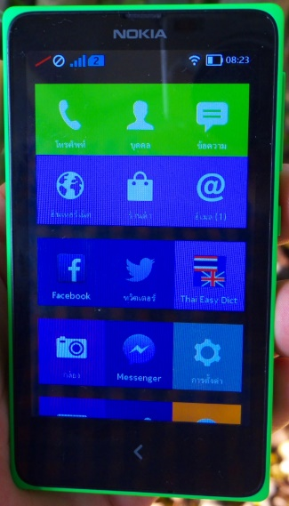
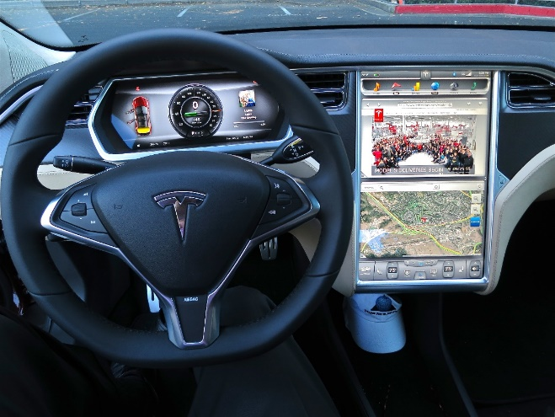
What is linux?
Linux is an implementation of UNIX
Linux is a multi-tasking and multi-user operating system assembled under the model of free and open-source software development and distribution.
Nowadays, Linux is very popular operating system for servers.
Notes:
Initially it was developed for personal computer, but due to its some fantastic features and robustness, it is used in with various hardware.

Slide 7


History of linux (1)
Tux
Linus Torvalds
Notes:
When Linus Torvalds was studying computer science at University of Helsinki, he was using Minix
Linus with some other students sent request for some modification in Minix to its creator Andrew.
But Andrew did not think that the changes are necessary. Then Linus started writing his own operating system to incorporate his ideas.
Linux development is started by Linus Torvalds in 1991.

Slide 8
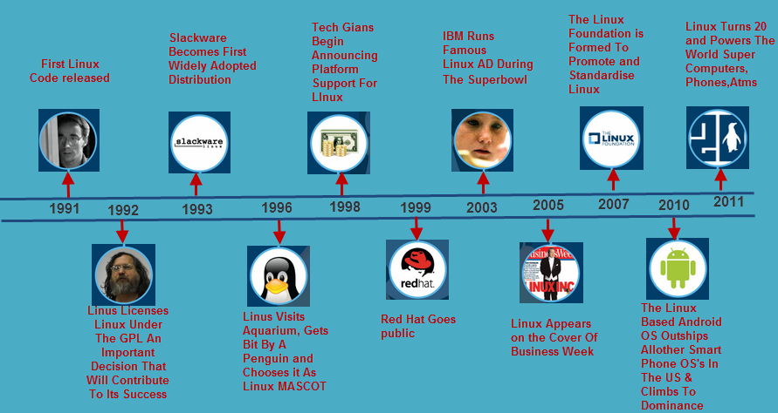
History of linux (2)

Slide 9







Distributions of linux
Since Linux kernel is open source. Lots of communities and companies made specific Operating system by using Linux kernel. These specific operating systems are known as distribution of Linux. Some of them are free (community developed) and few are paid also.
Following are few popular Linux distributions:

Slide 10
What is kernel?
Manage input/output requests from software and translates them into data processing instructions for the central processing unit and other electronic components of a computer.
Known as the central core of a computer's operating system.
Various kernel designs differ in how they manage system calls and resources.
Applications
Kernel
CPU
Memory
Devices
Notes:
When a process makes requests of the kernel, the request is called a system call. Various kernel designs differ in how they manage system calls and resources

Slide 11
What is linux kernel?
The Linux kernel is a Unix-like operating system kernel used by a variety of operating systems based on it, which are usually in the form of Linux distributions.
The Android operating system for tablet computers, smartphones and smartwatches is also based atop the Linux kernel.
Kernel type: Monolithic
Linux kernel main roles are:
Managing all the hardware resources.
Providing a set of portable, architecture and hardware independent APIs.
Handling concurrent access and usage.
Notes:
The Linux operating system is based on it and deployed on both traditional computer systems such as personal computers and servers, usually in the form of Linux distributions
The Linux kernel is released under the GNU General Public License version 2
The GNU General Public License (GNU GPL or GPL) is the most widely used free software license, which guarantees end users (individuals, organizations, companies) the freedoms to use, study, share (copy), and modify the software.
Image for this

Slide 12
Outline
What is Linux?
History of Linux
Distribution
What is Kernel?
What is Linux Kernel?
Description of Linux Kernel architecture
Linux Kernel functions
Relationship between Linux Kernel, Hardware, Applications
Memory-mapped I/O and Port-mapped I/O
System call
Interaction between Linux Kernel and Users

Slide 13
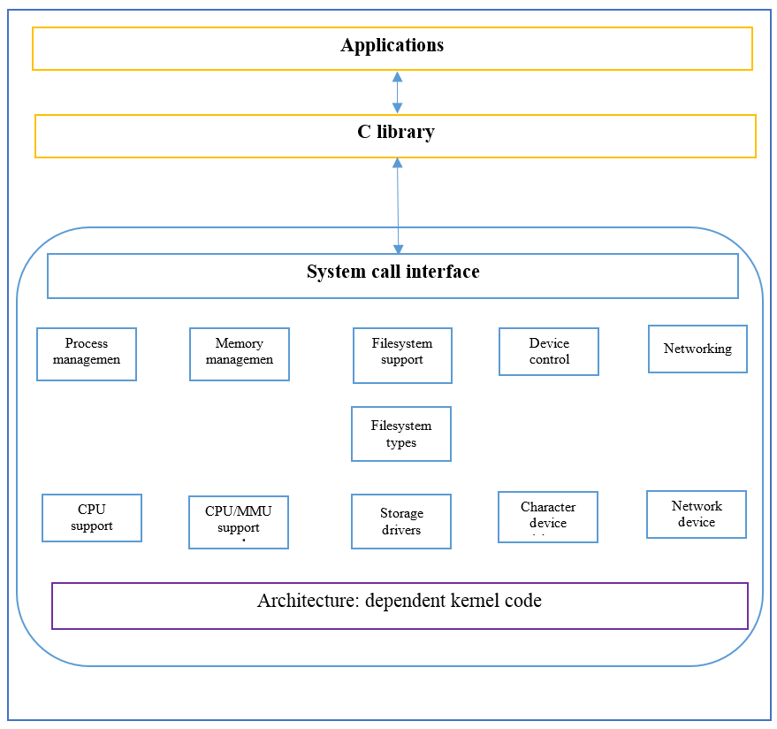
Description of linux kernel architecture
Linux Kernel architecture to be divided into two levels – User Space and Kernel Space.
User space
Kernel space
Notes:
User space:
+) User applications executed.
+) GNU C library
Kernel space: divided into 3 layers
+) System call interface.
+) Kernel code
+) Architecture dependent kernel code

Slide 14
Description of linux kernel architecture
System call interface.
Implements the basic function such as read, write…

Slide 15
Description of linux kernel architecture
System call interface.
Code is common to all of the processor architectures supported by Linux

Slide 16
Description of linux kernel architecture
System call interface.
Architecture-dependent code: This code serves as the processor and platform-specific code for the given architecture.

Slide 17
Linux kernel functions
1. Resource allocation
2. Process management
3. Memory management
4. I/O device management
5. Inter-process communication
6. Scheduling
7. System call and interrupt handling
8. Security or protection management

Slide 18
Resource allocation
Manage the computer's resources: CPU, Memory and I/O devices.
Allow other programs to run and use these resources.

Slide 19
Process Management
A process defines which memory portions the application can access.
Allow the execution of applications and support them with features such as hardware abstraction.
To run an application:
Set up an address space for the application
Loads the file containing the application's code into memory
Set up a stack for the program and branches to a given location inside the program
Starting its execution

Slide 20
Memory Management
Allows processes to safely access this memory as they require it.
Virtual addressing helps kernel to create virtual partitions of memory in two disjointed areas:
One is reserved for the kernel (kernel space).
The other for the applications (user space).

Slide 21
I/O Device Management
Processes need access to the peripherals connected to the computer, which are controlled by the kernel through Device Drivers.
A device driver is a computer program that enables the operating system to interact with a hardware device.
Provides the operating system with information of how to control and communicate with a certain piece of hardware.

Slide 22
Inter-Process Communication
Kernel provides methods for Synchronization and Communication between processes called Inter- Process Communication (IPC).
There are various approaches of IPC say, semaphore, shared memory, message queue, pipe (or named FIFO), etc.

Slide 23
Scheduling
In a Multitasking system, the kernel will give every program a slice of time and switch from process to process.
The kernel uses Scheduling Algorithms to determine which process is running next and how much time it will be given.
The algorithm sets priority among the processes.

Slide 24
System Calls and Interrupt Handling
A system call is a mechanism that is used by the application program to request a service from the operating system.
System calls include close, open, read, wait and write.
To access the services provided by the kernel we need to invoke the related kernel functions.

Slide 25
Security or Protection Management
Kernel also provides protection from faults (error control) and from malicious behaviors (Security).
One approach towards this can be Language based protection system.
In which the kernel will only allow code to execute which has been produced by a trusted language compiler.

Slide 26
Outline
What is Linux?
History of Linux
Distribution
What is Kernel?
What is Linux Kernel?
Description of Linux Kernel architecture
Linux Kernel functions
Relationship between Linux Kernel, Hardware, Applications
Memory-mapped I/O and Port-mapped I/O
System call
Interaction between Linux Kernel and Users

Slide 27
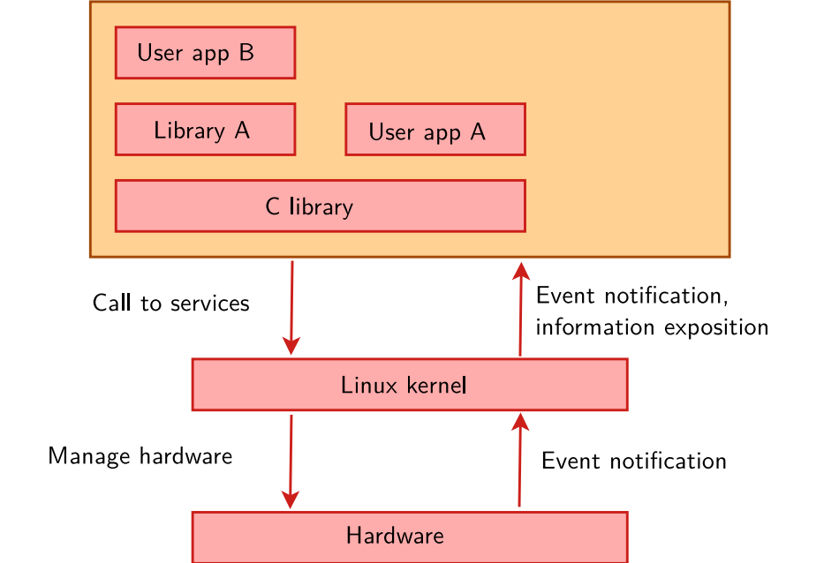
Relationship between Linux kernel, hardware and application
Hardware: CPU, memory, I/O
Kernel: Provide architecture and hardware independent APIs to allow user space applications and libraries to use the hardware resources
Application: Web browsers, text editor, …
Figure 1.1 Relationship between kernel, hardware, application
Notes:
When you use applications on Linux like: web browsers, text editor,…
You call a request, call to services to kernel. At here have C library: The interface between the kernel and the user space applications.
As you know, kernel manage hardware resources. After that, HW notify event to kernel. Finally, kernel expose, display information to user

Slide 28
Memory-mapped i/o and Port-mapped i/o
#FFFFH
#FFFFH
Memory
#A000H
#DFFFH
#DFFFH
#9FFFH
Address space
I/O devices
Address space
#8000H
#2FFFH
Memory
#7FFFH
I/O devices
Memory
#0000H
#0000H
#0000H
#0000H
#0000H
Memory-mapped I/O
Port-mapped I/O
Notes:
Memory-mapped: I/O devices are mapped into the system memory map along with RAM and ROM.
To access a hardware device, simply read or write to those “special” addresses using the normal memory access instructions.
Port-mapped: I/O devices are mapped into a separate address space.
This is usually accomplished by having a different set of signal lines to indicate a memory access versus a port access.
The address lines are usually shared between the two address spaces, but less of them are used for accessing ports.
For example: the standard PC which uses 16 bits of port address space, but 32 bits of memory address space.

Slide 29
Comparison
Memory-mapped I/O
Port-mapped I/O
Using same address space and bus to address memory and I/O devices
Using different address space and bus to address memory and I/O devices
Uses regular instructions to access the I/O devices
Uses special instructions to access the I/O devices

Slide 30
Memory-mapped i/o
Advantage
Every instruction which can access memory can be used for an I/O device.
Faster, easy to build, consume less power, smaller size.
Disadvantage
The entire address bus must be fully decoded
Cost for adding hardware
Notes:
Disadvantage:
For example, a machine with a 32-bit address bus would require logic gates to resolve the state of all 32 address lines to properly decode the specific address of any device.

Slide 31
port-mapped i/o
Advantage
Less logic is needed to decode a discrete address
Less cost to add hardware devices to a machine
Disadvantage
More instructions are required to accomplish the same task
Notes:
Disadvantage:
For example: to add a constant to a port-mapped device register would require three instructions:
read the port to a CPU register, add the constant to the CPU register, and write the result back to the port.

Slide 32
Outline
What is Linux?
History of Linux
Distribution
What is Kernel?
What is Linux Kernel?
Description of Linux Kernel architecture
Linux Kernel functions
Relationship between Linux Kernel, Hardware, Applications
Memory-mapped I/O and Port-mapped I/O
System call
Interaction between Linux Kernel and Users

Slide 33
System call
System call is a way in which a computer program requests a service from the kernel of the operating system it is executed on.
This may include:
Hardware-related services (accessing a hard disk drive),
Creation and execution of new processes,
Communication with integral kernel services such as process scheduling.

Slide 34
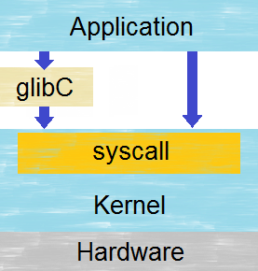
System call

Slide 35
System call
Linux has over 300 different calls.
Can be grouped into 5 major categories:
Process control: Load, execute, abort process,…
File management: Create, delete, open,…
Device management: Request, release,…
Information management: Get/set system data,…
Communication: Create, delete communication connection,…

Slide 36


Interaction between Linux kernel and users
Root user (super-user):
special user for administrator.
can do anything.
User name is “root”.
Normal user:
Assigned in group(s).
Limited authority
User name can’t be “root”, must be unique.

Slide 37
Interaction between Linux kernel and users
Linux system is described as kernel and shell.
Shell is an interface between user and kernel.
Role:
Reading command line
Interpreting command meaning.
Carry out command.
Return result via output.

Slide 38
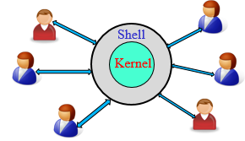
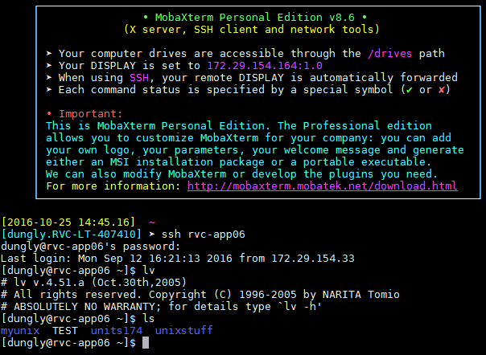
Interaction between Linux kernel and users
Many people can use 1 machine at the same time via shell.

Slide 39
Interaction between Linux kernel and users
Linux command:
Tell the operating system to perform set of operation.
Is sent to kernel via shell
Syntax: [command] [option] [arguments]

Slide 40
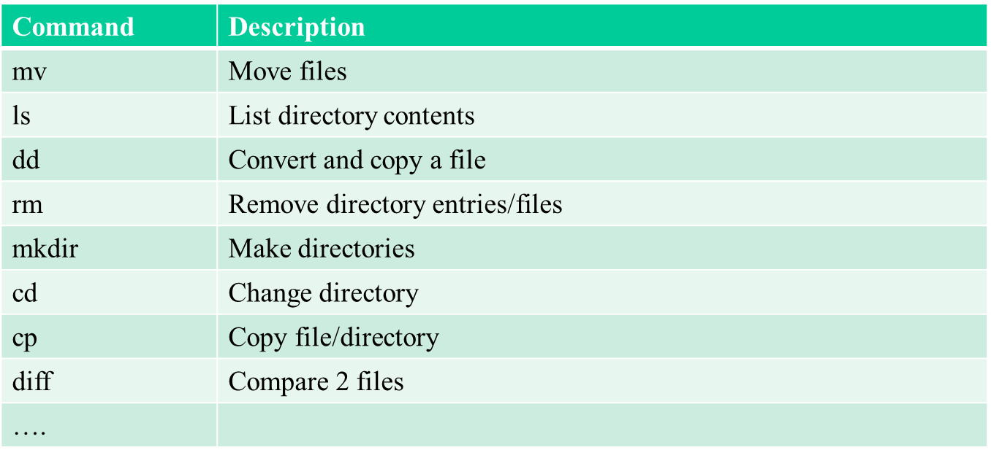
Interaction between Linux kernel and users
Common commands:

Slide 41
Outline
What is Embedded Linux?
Why is Embedded Linux?
Overview about boot process of Embedded Linux
What is Toolchain?
What is Native Toolchain?
What is Cross Toolchain?
Comparison Native and Cross Toolchain

Slide 42

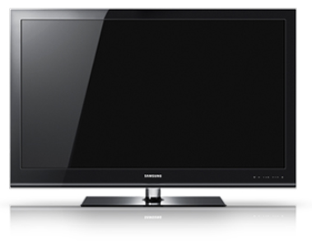
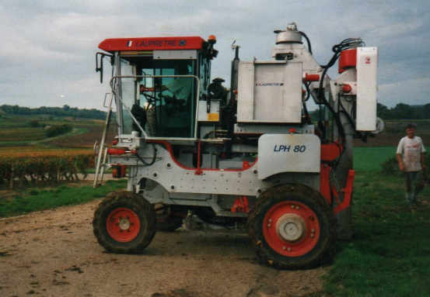
What is embedded linux?
Operating systems based on the linux kernel are used in embedded systems such as consumer electronics
television
vehicle
Mobile phone

Slide 43
Why is embedded linux
Low cost: free software can be duplicated on as many devices as you want, free of charge
Full control: with open-source, user have the source code for all components in system, allows inlimited modifications, changes, tuning, debugging, optimization, for an unlimited period of time
Quality: many open-source components are widely used, on millions of systems
Eases testing of new features: allows to easily explore new possibilities and solutions
Community support: allows to speed up the resolution of problems when developing system
Re-using components: allow to quickly design and develop complicated products, based on existing components.

Slide 44
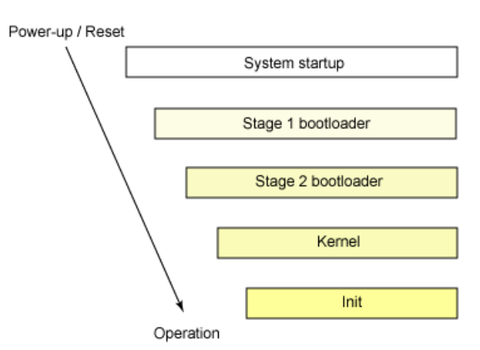
Boot process of embedded linux five stages of boot process
Notes:
When a system is first booted, or is reset, the processor executes code at a well-known location. The central processing unit (CPU) in an embedded system invokes the reset vector to start a program at a known address in flash/ROM………must determine which devices are candidates for boot.
System startup: The system startup stage depends on the hardware that Linux is being booted on. On an embedded platform, a bootstrap environment is used when the system is powered on, or reset. Embedded platforms are commonly shipped with a boot monitor. These programs reside in special region of flash memory on the target hardware and provide the means to download a Linux kernel image into flash memory and subsequently execute it
When a boot device is found, the first-stage boot loader is loaded into RAM and executed. its job is to load the second-stage boot loader.
When the second-stage boot loader is in RAM and executing, a splash screen is commonly displayed, and Linux and an optional initial RAM disk (temporary root file system) are loaded into memory. When the images are loaded, the second-stage boot loader passes control to the kernel image and the kernel is decompressed and initialized. At this stage, the second-stage boot loader checks the system hardware, enumerates the attached hardware devices, mounts the root device, and then loads the necessary kernel modules. When complete, the first user-space program (init) starts, and high-level system initialization is performed.
With the kernel image in memory and control given from the stage 2 boot loader, the kernel stage begins. The kernel image isn't so much an executable kernel, but a compressed kernel image.
Init After the kernel is booted and initialized, the kernel starts the first user-space application. This is the first program invoked that is compiled with the standard C library. Prior to this point in the process, no standard C applications have been executed.

Slide 45
Outline
What is Embedded Linux?
Why is Embedded Linux?
Overview about boot process of Embedded Linux
What is Toolchain?
What is Native Toolchain?
What is Cross Toolchain?
Comparison Native and Cross Toolchain

Slide 46
What is Toolchain in software?
In software, a toolchain is the set of programming tools that is used to perform a more complex software development task or to create a software product
A toolchain is the set of compiler, linker, librarian and any other tools you need to produce the executable (Shared libraries, etc) for the target device

Slide 47
Toolchain Type
Native Toolchain
Cross-compiling Toolchain

Slide 48
Native Toolchain
The usual software development tools available on a GNU/Linux workstation is a native toolchain.
This toolchain runs on workstation and generates code for the same kind workstation, usually x86.

Slide 49
Cross-compiling toolchain
Cross-compiling toolchain is a set of software development tools available on any specific workstation platform and can generate for other target device platform.
Cross-compiling toolchain use the cross-compiler, cross-compiler is a compiler where the target is different from the host
- For example, a compiler that runs on a Windows 7 PC but generates code that runs on Android smartphone

Slide 50
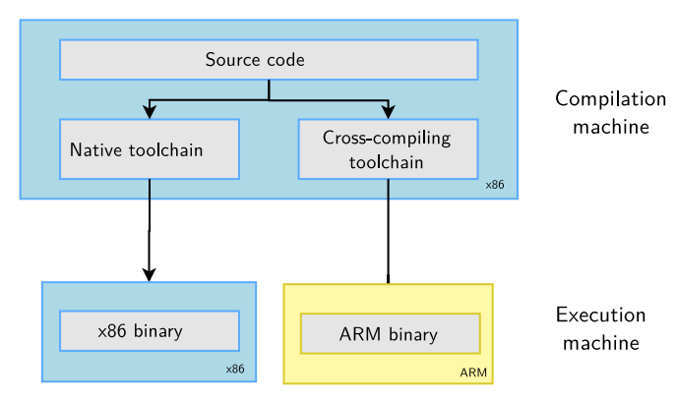
Native toolchain vs Cross-compiling toolchain

Slide 51
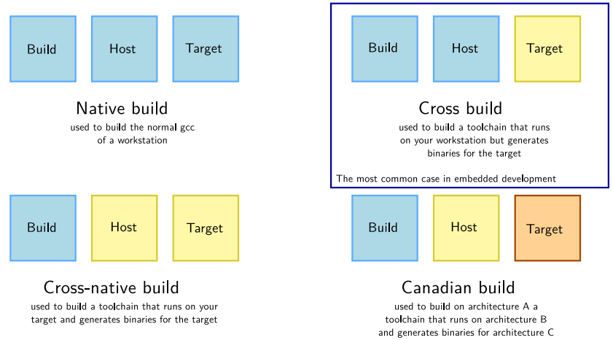
Compare
Different toolchain build procedure build kinds

Slide 52
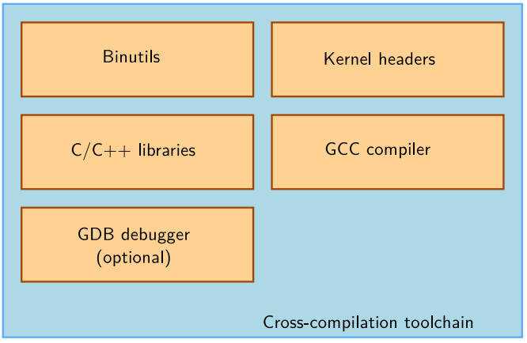
Cross-compilation toolchain components

Slide 53

Binutils
Binutils is a set of tools to generate and manipulate binaries for a given CPU architecture
as, the assembler, that generates binary code from assembler source code.
ld, the linker.
ar, ranlib, to generate .a archives, used for libraries

Slide 54
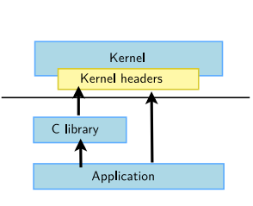
Kernel headers
The C library and compiled programs needs to interact with the kernel .

Slide 55

GCC
GNU Compiler Collection, the famous free software compiler
Can compile C, C++, Ada, Fortran, Java, Objective-C, Objective-C++, and generate code for a large number of CPU architectures.
Available under the GPL license, libraries under the LGPL

Slide 56
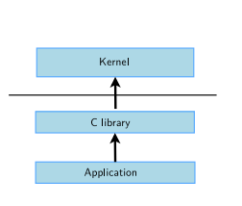
C library
The C library is an essential component of a Linux system.
Several C libraries are available: glibc, uClibc, musl, dietlibc, newlib,ect..
The choice of the C library must be made at the time of the cross-compiling toolchain generation, as the GCC compiler is compiled against a specific C library.

Slide 57
Thank you for listening

