Slide 1
TA report system
Integrated Exercise for Software II
Team kitakata-ramen
member1 s1280014, Kazuma Tamura
member2 s1280145, Ryo Kurihara
member3 s1280195, Kana Yuda
member4 s1282013, Luu Trong Nhan
member s1270248, Yoshiaki Hoshi

Slide 2
Activities of Previous week
Task | Member | Status | Work Hours
Define user story(TA) | Ryo Kurihara | 100% | 1:00
Define user story(Staff, Faculty) | Kana Yuda | 100% | 1:00
Create requirement definition | Kazuma Tamura Kana Yuda Ryo Kurihara Luu Trong Nhan | 100% | 3:30
Create demo presentation | Ryo Kurihara Kana Yuda | 100% | 10:00
Refinement the use-case diagram | Ryo Kurihara | 100% | 1:00
Create major view mock-ups | Kazuma Tamura | 100% | 5:00
Set up user auth system | Luu Trong Nhan | 30% | 2:00
 |  | Total time: | 23:30

Slide 3
Plan for This Week
Task | Member | Work Hours
Create Phase2 backlog | Everyone | 1:00
Create MySQL database | Kazuma Tamura | 4:00
Create sequence diagram | Kana Yuda Ryo Kurihara Luu Trong Nhan | 4 :00
Reconfirmation screen transition | Everyone | 1:00
Improve user auth system | Luu Trong Nhan Kazuma Tamura | 4:00
 | Total Time: | 14:00

Slide 4
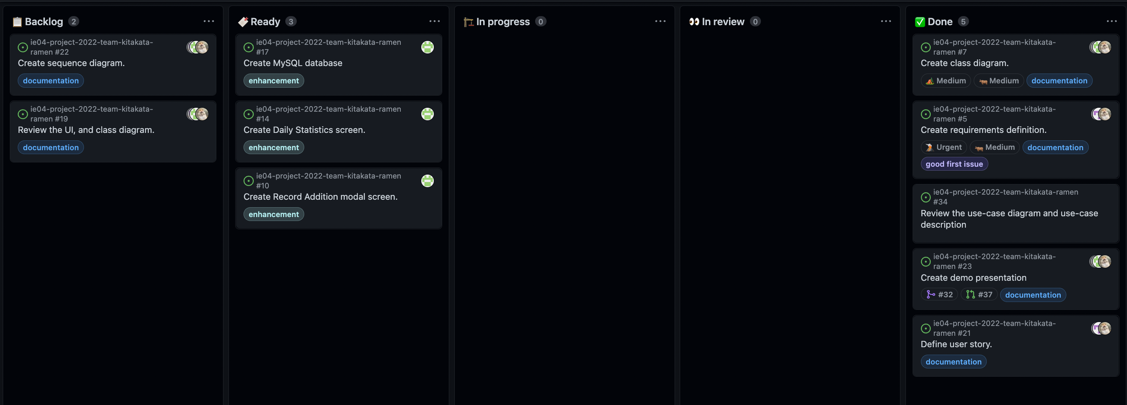
Phase Task Board

Slide 5
Issues & Risks (*if any)
Problem
We ended up creating materials just barely
Cause
Because we didn't decide when prepare it.
Possible Solution
We make a plan.

Slide 6
What is the Product
What kind of Web Application
TA report system
Purpose of Web Application
Support for correct input data
Support efficient workload

Slide 7
What is the Product
User
TA
Staff
Faculty
User story
TA: Record of work
TA: Edit of record contents
Staff: Lock report
Staff: Request for payment to Accounting Section
Faculty: Sign to monthly TA work reports

Slide 8
TA：Record of Work
Start the TA report system and log in with your student ID number and password.
After logging in, click the Quick record button on the Report list screen or the Add record button on the Edit report screen to display the Record modal screen.
Enter the subject, date, time (start and end time), and break time (start and end time), and click the add button.
The record will appear on the Report list screen or the Edit report screen.

Slide 9
TA：Edit of record contents
Start the TA report system and log in with your student ID number and password.
After logging in, click the report of the month you have already recorded in the report list to move to the Edit report screen.
Click the Edit button displayed to the right of the report you wish to edit.
Enter the information you wish to change, and click the Record button.
The report is recorded with the edited contents.

Slide 10
Staff：Report lock
Receive and confirm the report submitted by the student to the student affairs office (with the instructor's signature) * Hand in the report here.
After confirmation, log in to the TA report system with [email address and password].
Select the student whose report has been confirmed from the TA List and lock it so that the student cannot change it again. (By subject)
Notes:
確認事項））
◯学生から学生課へレポートを提出するときの方法（本当に手渡しで合ってるか再確認、多分合ってるけど）
◯『内容に問題がなければ』のところ、問題ある場合があるか、もしあった時どういった問題が起きるか（バリデーションでうまくいかないと印刷できないようになってるから報告書の内容に問題はないはず）
◯スタッフ（学生課職員）がログインするときのuser nameは結局何か

Slide 11
Staff：Request for payment to Accounting Section
*After locking the report in the scenario "Report lock".
Export the target report to Excel format.
After printing 1., submit it to the accounting department (hand in the paper here)
*One paper per student per month. (For those who are TAs for more than one course, all reports will be totaled)
Notes:
確認事項））
◯スタッフ（学生課職員）が経理課にわたす報告書は、
１）エクセル形式にエクスポートしたもの or ２）印刷できる形式（pdfなど）に書き出したものか確認

Slide 12
Faculty：Sign to monthly TA work reports
After reviewing the report shared by the TA, print it out, sign (stamp) it, and return it to the TA.

Slide 13
Reasons for designing each function
Login function
To make it easier for TAs to check and edit saved reports again
To make it easy for TAs to check and edit a saved report again.
TA list screen
To make it easy for staff to check TAs to edit or lock
Report list screen
To make it easier for TAs, Staff, and Faculty to manage their reports
Edit report screen
To enable modification of record contents

