Slide 1
TA report system
Integrated Exercise for Software II
Team kitakata-ramen
member1 s1280014, Kazuma Tamura
member2 s1280145, Ryo Kurihara
member3 s1280195, Kana Yuda
member4 s1282013, Luu Trong Nhan
Notes:
https://uaizuacjp-my.sharepoint.com/:p:/g/personal/s1280195_o365_u-aizu_ac_jp/EaZHHQuAdiROmI930g0xCYoBUYs7n5GGJ0sQhmI8iLsrIg?e=8XaFYh

Slide 2
What is the Product ①
What kind of Web Application
TA report system for TA and Staff
Purpose of Web Application
Support input correct data
Support efficient workload
Notes:
今回開発しているのは、学生によるTA勤務時間の入力から職員による支給申請書類の作成までの一連の作業の手助けをするアプリです。
We are developing an application that will assist students in entering their TA work hours and staff in completing the payment application documents.
このアプリは、必要事項の正しい入力の支援とそれによって学生課スタッフの業務の効率化が目的です。
The purpose of this application is to assist in the correct entry of required information and thereby improve the efficiency of the Student Affairs staff.

Slide 3
What is the Product ②
Status
There are several miss in input details.
Goal
Can input correct details.
Decrease incorrect input
User
TA/SA
Notes:
現状(Currently)、
このアプリの目標は（Goal of the application are）...
ユーザーについて、予定ではTA・Staff・Facultyをユーザーとしていましたが、納期までに間に合わせるのが難しいと判断したためユーザーはTAのみに変更しました。
About users, the plan was to have TAs, Staff, and Faculty as users, but we decided to change the users to TAs only because we found it difficult to meet the deadline.

Slide 4
Function
Already mounted
Login
Create daily reports.
Edit daily reports.
Delete daily reports.
View monthly reports.
View daily reports.
Scheduled for mounting
Print monthly reports
Validate reports.

Slide 5
Reasons for designing each function
Login function
To make it easier to check and edit saved reports again.
Edit daily reports function
To allow changes to be made to the content of the report.
Delete daily reports function
To be able to erase a report if it was created by mistake.
Notes:
ログイン機能
保存したレポートの再確認・編集を容易にするために
レポート編集機能
レポートの内容に変更を加えられるようにするため
レポート削除機能
間違って作成したレポートを削除できるようにするため

Slide 6
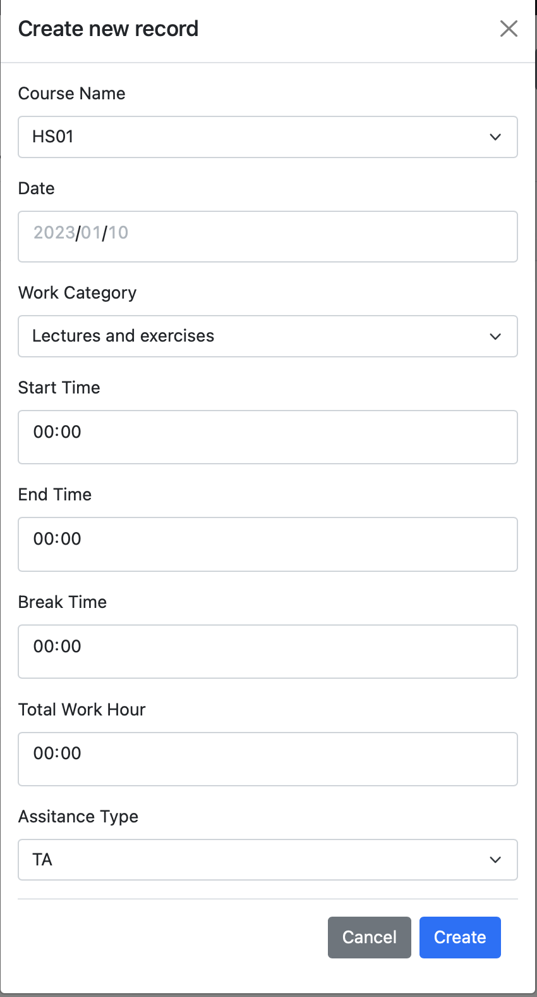


User story ①
TA/SA create daily reports.
Login
Create daily reports(Input “Course”, ”Date”, “Work Category”, “Start time”, “End time”, “Break time”)
Example...
Login
userID: m5251201
Password: *********
2. Create daily reports
Course: IE04,
Date: 2023/4/1,
Work Category: Lecture and Exercise,
Start time: 13:20,
End time: 15:00,
Break time: 0

Slide 7
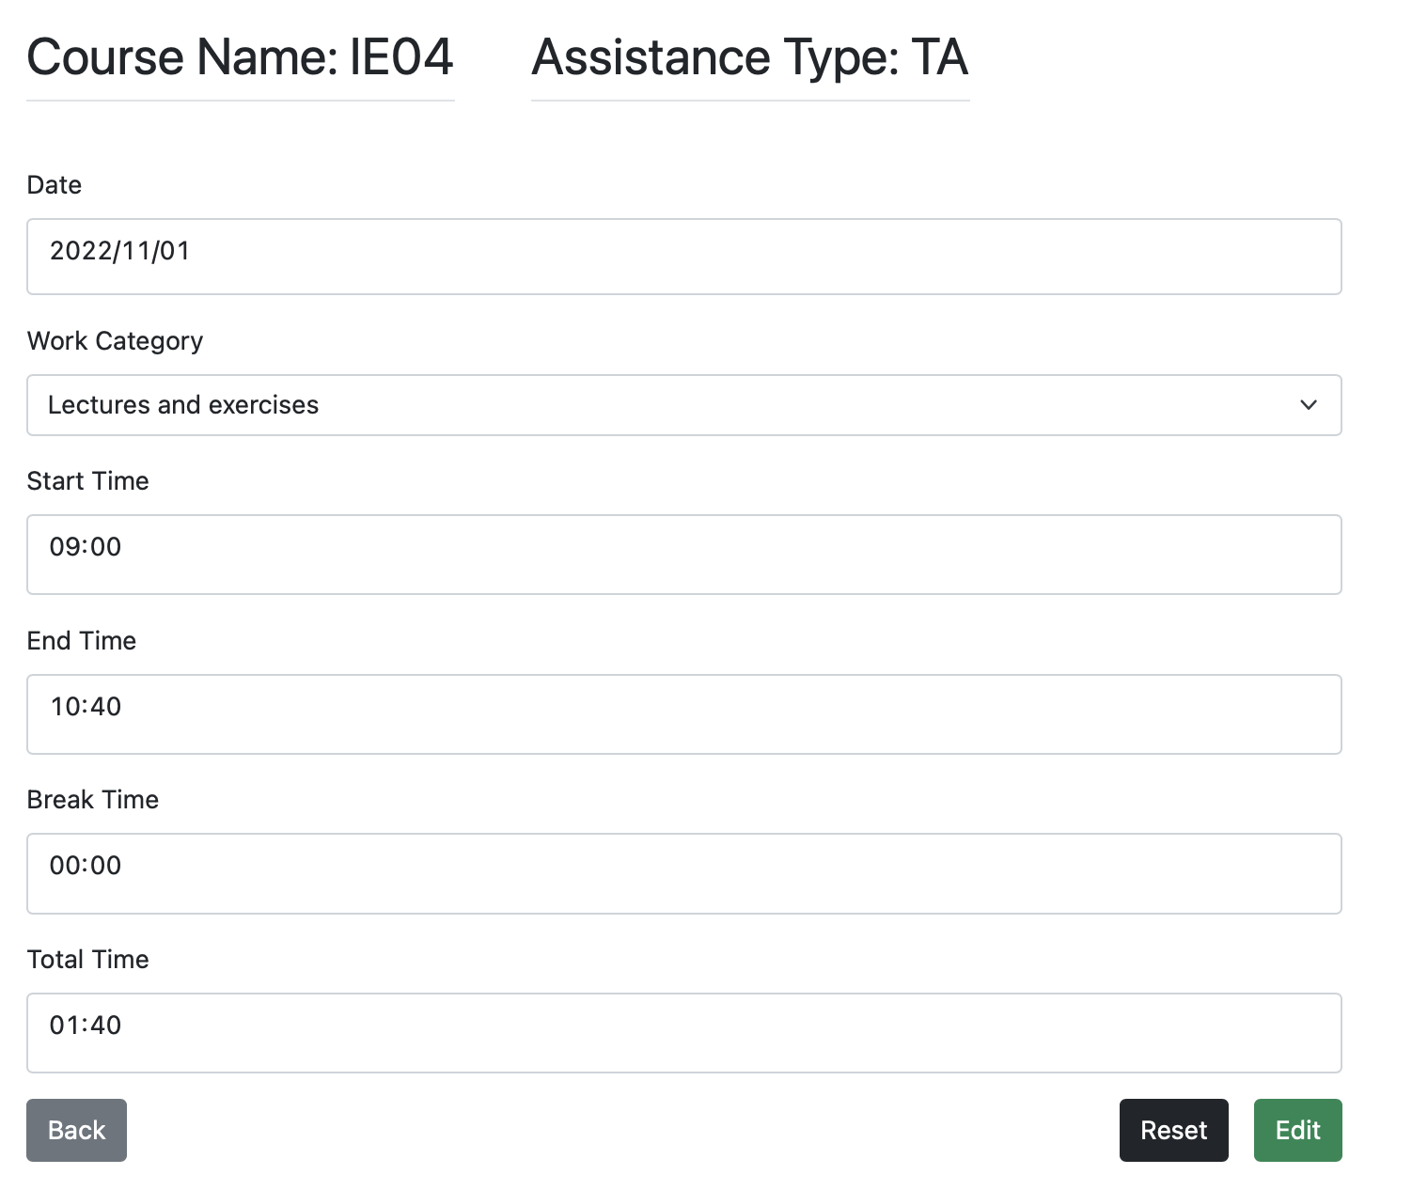





User story ②
TA/SA edit daily reports.
Login
Select daily reports and push ”Edit” button.
Edit details.
Example...
Login
userID: m5251201
Password: ********
Select daily reports.
Select report of April 1(2023/4/1).
Edit details
End time: 15:00 -> 14:40

Slide 8
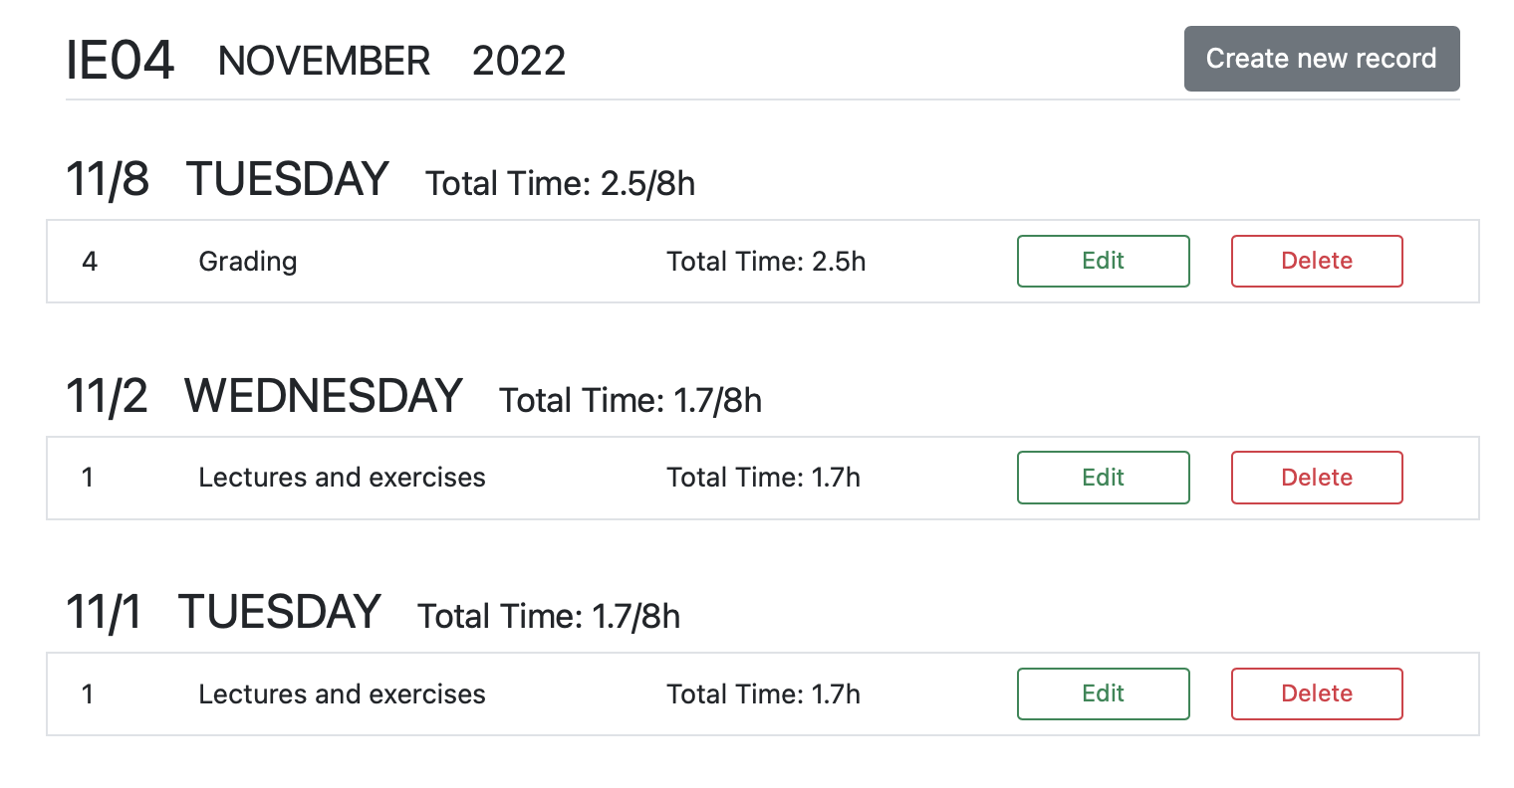
User story ③
TA/SA delete daily reports.
Login
Select daily reports and push ”Delete” button.
Example...
Login
userID: m5251201
Password: ********
Select daily reports and delete it.
Select report of April 1(2023/4/1).

Slide 9
Plan
Task | Phase3 Demo(1/11) | Test(1/18) | Test(1/25) | Final Demo(2/1)
Login to the system.(No use database) | *
Login to the system.(use database) | *
Create daily reports.(No validation) | * | *
Edit daily reports.(No validation) | *
Delete daily reports. | * | *
View monthly reports. | *
View daily reports. | *
Print monthly reports |  | * | * | *
Validate reports. |  | * | * | *
Notes:
こちらがPlanになります
This is the Plan for future
アスタリスクはその週までに行っておくことを示しています
An asterisk indicates that it should be done by that week
このデモで表にある７項目が完了したことになります。
With this demonstration, the seven items in the table have been completed.
しかし、「Create daily reports」する際に、月とCourse Name に同じ値を入力すると、月とCourse Name が同じ二つ目のレポートが作成されてしまうなどのバグもまだみられる箇所が存在します。
However, there are still some bugs, such as when the same values are entered for Month and Course Name in "Create daily reports," a second report with the same month and course name is created.
従って、次のデモまでにはこれらの修正とPrint monthly reports 機能、daily reports を作成する際のValidation 機能の実装を進めていきたいと思います。
Therefore, before the next demo, we would like to fix these problems and implement the Print monthly reports function and the Validation function for creating daily reports.

