Slide 1
Project: TA report system
IE04 Weekly Progress Report
2022/12/14
Team: kitakata-ramen
Notes:
Let's startnnn

Slide 2
Activities of Previous Week ①
Task | Member | Status | Work Hours
Connect to database. | Kurihara Tamura | 100% | 1.5h
Discuss basic design for data exchange. | Kurihara Yuda Tamura | 50% | 3h
Changed to an easy-to-understand screen design by Figma. | Kurihara Yuda Tamura | 100% | 0.5h
Commonize css and js implementation for the HTML files. | Tamura Yuda | 100% | 1.5h
Create entities in Java | Tamura | 50% | 5h
Prepare weekly report. | Yuda | 100% | 1h
 |  | Total time: | 12.5h
Ready: 10%
In progress: 10~90%
In review: 90%
Done: 100%
Notes:
日曜日のミーティングではデータのやり取りに関しての話し合いを中心にしました。
Sunday's meeting focused on discussions regarding data exchange.
また、指摘されていた画面デザインについても見易くなるように変更しました。
We also made changes to the screen design to make it easier to view, which had been pointed out.

Slide 3
Plan for This Week
Task | Member | Work Hours
Create entities in Java | Tamura | 5h
Create "Report Addition" modal to insert record to the DB. | Tamura | 5h
Create "Record Addition" modal to insert record to the DB. | Kurihara | 5h
Create "Report List" screen to show data in the DB | Nhan | 3h
Create "Report Detail" screen to show data in the DB. | Kurihara | 3h
Create Daily Statistics screen. | Yuda | 3h
 | Total time: | 24h
Notes:
データベースにデータを登録して、それを表示させることを目標に、これらのタスクをしていこうと考えています。
We are planning to do these tasks with the goal of registering the data in the database and displaying it.

Slide 4
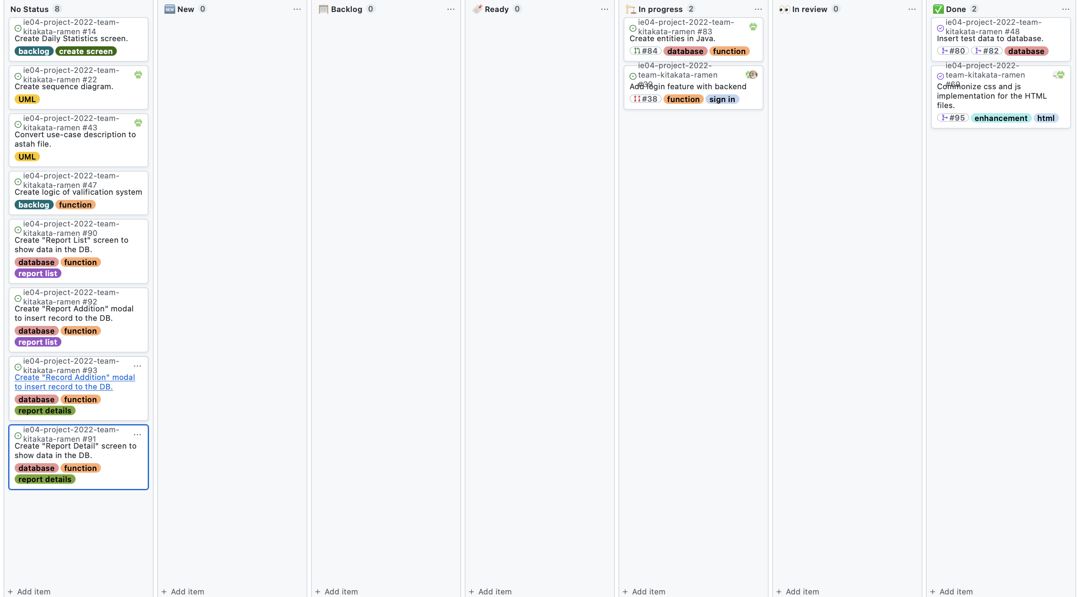
Phase Task Board

