Slide 1
Project: TA report system
IE04 Weekly Progress Report
2022/12/21
Team: kitakata-ramen
Notes:
Let's startnnn

Slide 2
Activities of Previous Week ①
Previous week goal
->Can add new monthly TA work Report.(No validation)
Status
->We didn’t
->We can show data of database. We necessary record input data to the database.
Task | Member | Status | Work Hours
Review of how backlogs are created | Yuda | 100% | 1h
Create ”Monthly TA Report List" screen to show data in the DB | Tamura | 90% | 8h
Create ”Monthly TA Report Addition" modal to insert record to the DB | Tamura | 50% | 3h
Create ”Report details Addition" modal to insert record to the DB. | Kurihara | 50% | 4h
Create "Report Detail" screen to show data in the DB. | Kurihara | 90% | 7h
 |  | Total time: | 23h
Ready: 10%
In progress: 10~90%
In review: 90%
Done: 100%
Notes:
今週の目標は「TAレポートを追加できるようにする」
今の状況は

Slide 3
Plan for This Week
Goal of from this week to next class
->Can add new monthly TA work Report.(No validation)
->Can add new monthly TA work Report.(with validation)
->Can add records (register TA work details)(with validation)
->Can edit TA work reports and report details.
We necessary record input data to the database and add validation.
Task | Member | Work Hours
Create logic of vilification. | all | 3h
Create test data to check validation. |  | 1h
Create ”Monthly TA Report Addition" modal to insert record to the DB | Tamura | 5h
Create ”Report details Addition" modal to insert record to the DB. | Kurihara | 5h
 | Total time: | h

Slide 4
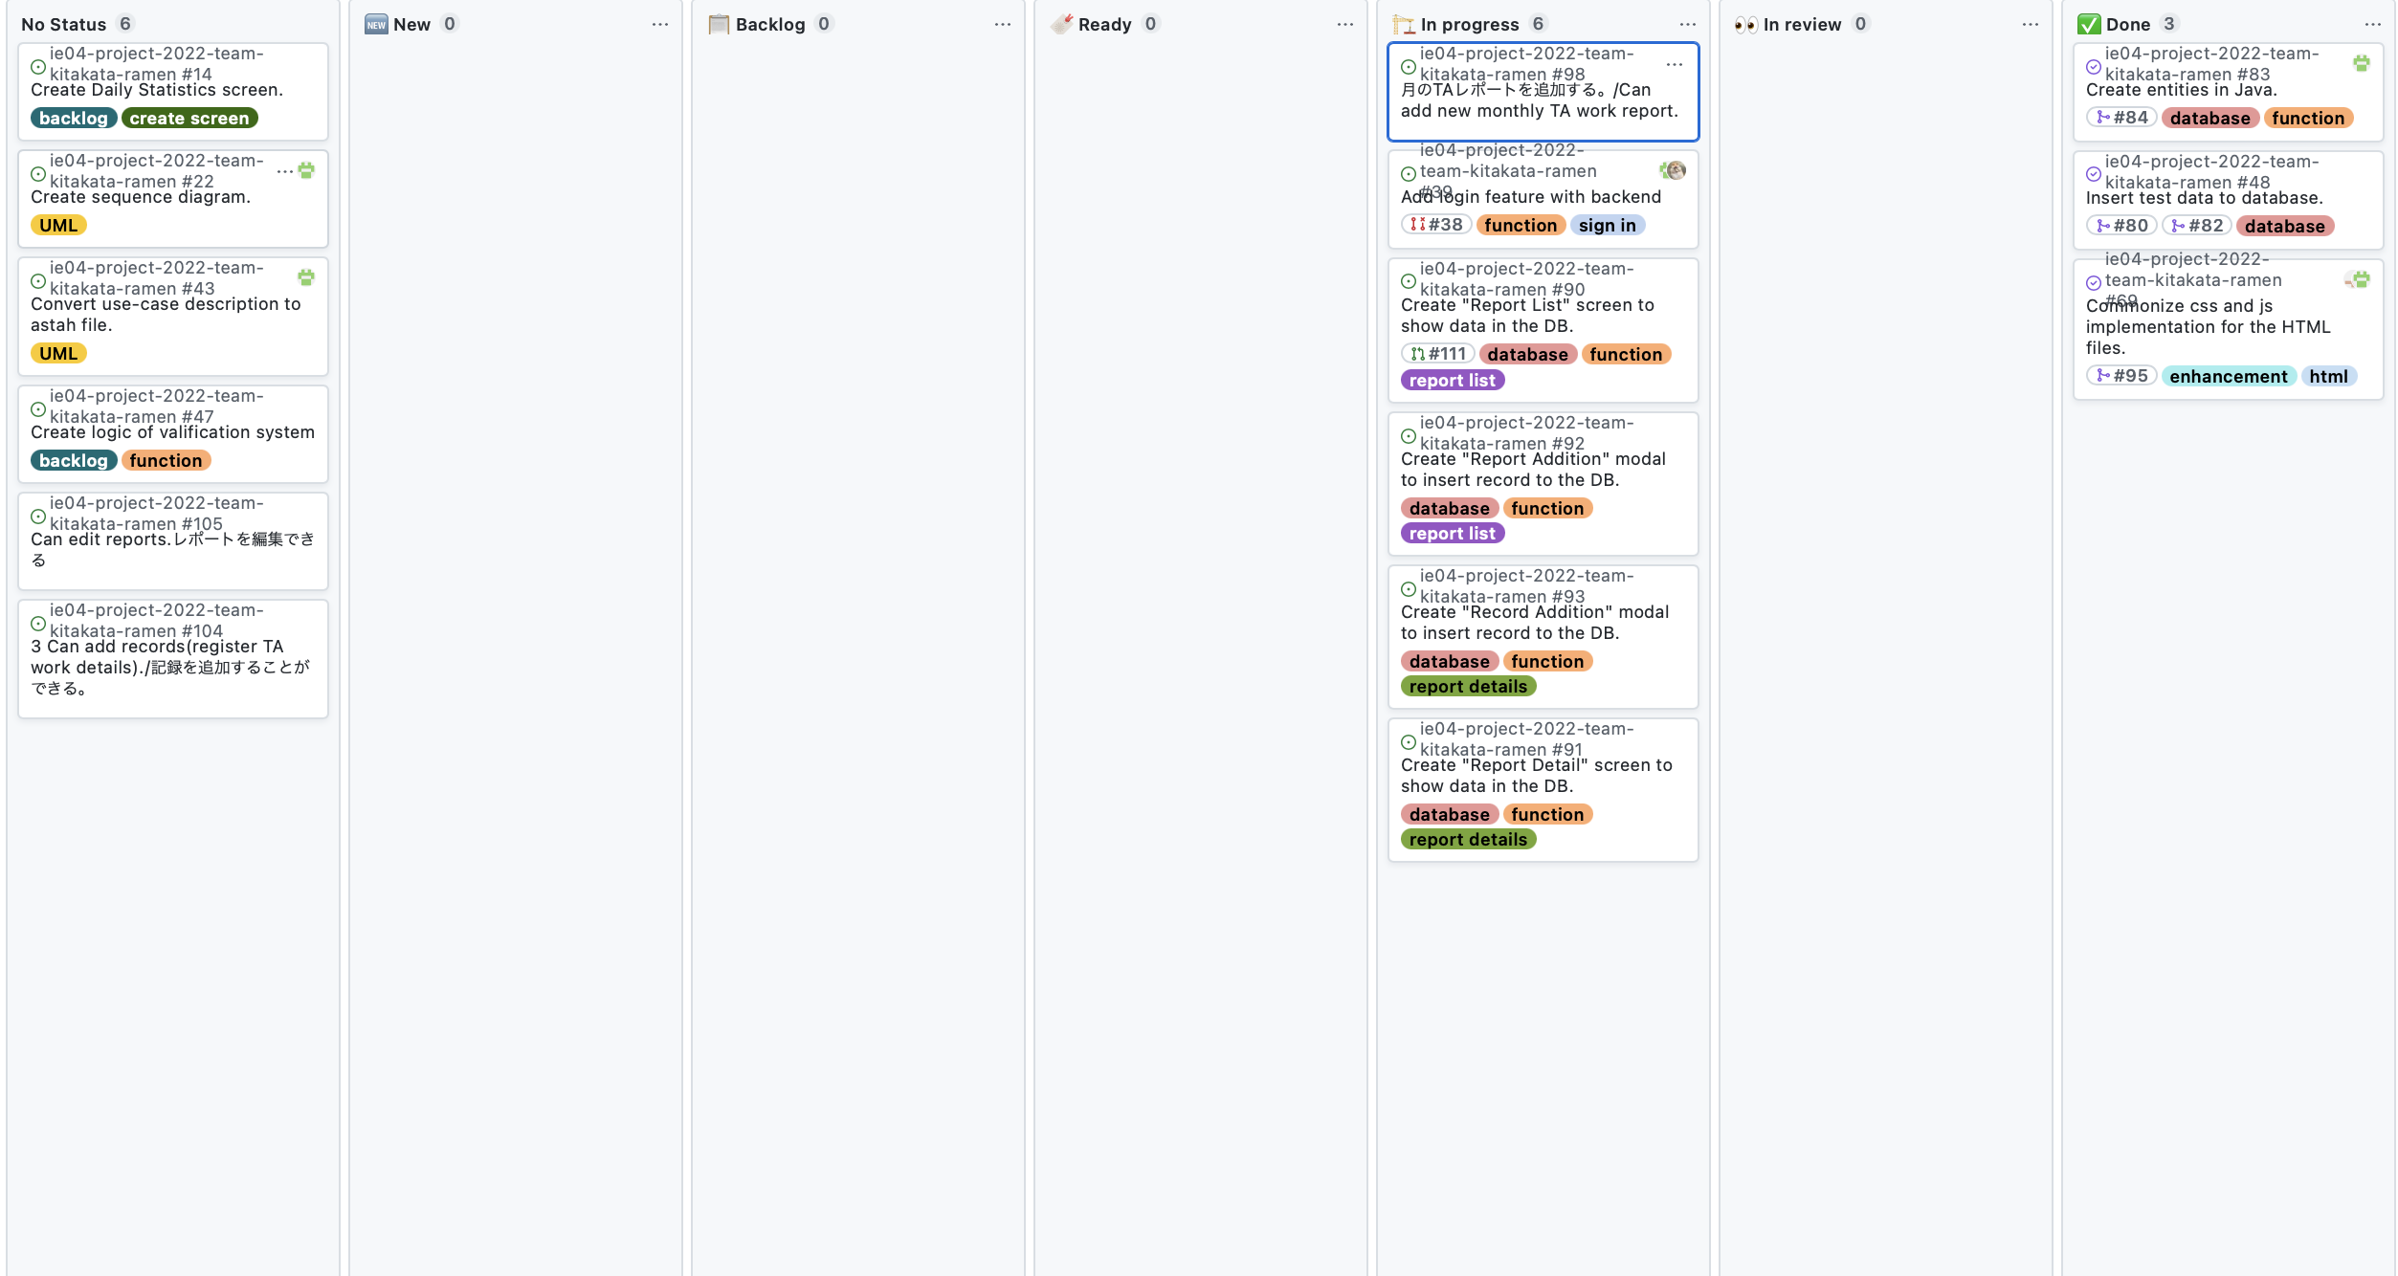
Phase Task Board

