Slide 1
Project: TA report system
IE04 Weekly Progress Report
2022/12/21
Team: kitakata-ramen
Notes:
Let's start

Slide 2
Activities of Previous Week ①
Previous week goal
->・Fix some bugs that occur when creating daily reports.
・Ensure that the total hours worked is calculated correctly.
・Enable to display a screen to print a monthly report,
Status
->User can register for the Daily Report. However, multiple daily reports can be registered at the same time.
->As project, being a little behind schedule.
Task | Member | Status | Work Hours
Fix bugs when create daily report. | Kurihara | 50% | 3.0h
➡︎Disable the ability to create daily reports outside of that month within the corresponding month's report. | Kurihara | 100% | 1.5h
➡︎Avoid creating the same daily reports or overlapping dialy reports. | Kurihara | 50% | 1.5h
Create print monthly report screen. | Yuda | 15% | 1.5h
Prevent other users from seeing other users' pages.（Login security） | Nhan | 100% | 2.0h
 |  | Total time: | 9.5h
Ready: 10%
In progress: 10~90%
In review: 90%
Done: 100%
Notes:
今週の目標は「TAレポートを追加できるようにする」
今の状況は
二つのバグが存在します。
一つ目は、対応した月のレポート内ではその月以外の記録を作れないようにする
二つ目は、同じ記録や、時間が重なっている記録を作れないようにする
です。
一つ目のバグに関しては、既にチームでレビューも行い完了しているためステータスが100％になっています。
しかし、二つ目のバグに関しては、同じ記録に関しては作れないようになっていますが、時間が重なっている記録は作れてしまうので、50％となっています。
従って全体としてはステータスが50％となっています
There are two types of bugs in fix bugs create daily report.
First, Disable the ability to create daily reports outside of that month within the corresponding month's report.
Second, Avoid creating the same daily reports or overlapping dialy reports.
About first bug, The team has already reviewed and completed the project. So the status is 100%.
However, about second bug, the status is 50% because They are not able to made the same record, but records that overlap in time can be made.
Therefore, the status is 50%
田村さんについては体調不良のためゆっくり休んでいただいています。
As for Mr. Tamura, he is taking a good rest due to his poor health.
ステータス
→ユーザーができるのは、「デイリーレポート」を登録することです。ただし、複数のレポートを同時に登録することができてしまう状況です。
予定より少し遅れていること。

Slide 3
Plan for This Week
Goal of from this week to next class
->Users cannot create multiple records of the same time. Reports can be printed.
->Make it ready for testing. We will proceed with ① and ⑤ as our top priorities.
Task | Member | Work Hours
Fix bug when create daily report. ➡︎①Avoid creating the same daily reports or overlapping time daily reports. ➡︎②Be able to display monthly reports by subject. ➡︎③Allow daily reports to be sorted by date. | Kurihara | 5.0h
④Create print monthly report screen. | Yuda | 4h
⑤Total time can be calculated. | Nhan
 | Total time: | h
Notes:
Fix bug when create daily report.
➡︎①Avoid creating the same daily reports or overlapping time daily reports.
同じ記録や、時間が重なっている記録を作れないようにする
➡︎②Be able to display monthly reports by subject.
月のレポートを教科ごとに見れるようにする
➡︎③Allow daily reports to be sorted by date.
日付順に見れるようにする

Slide 4
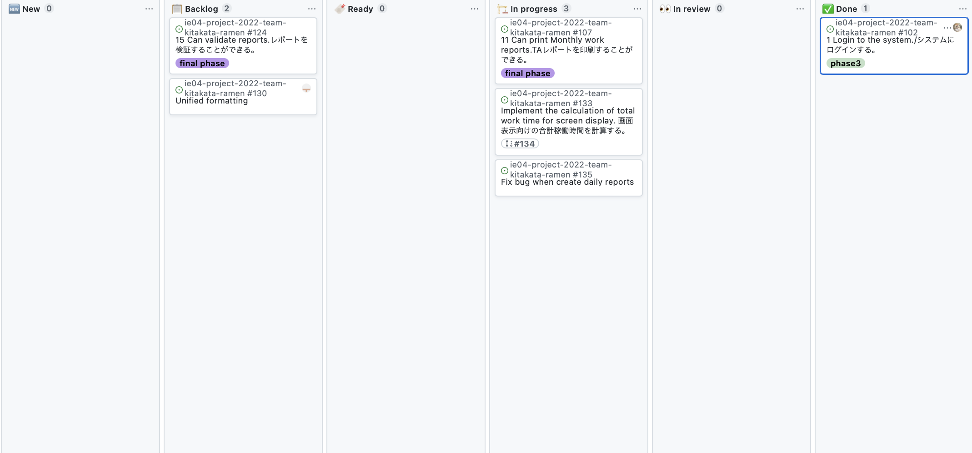
Phase Task Board

Slide 5
Function Board
Task​ | Phase3 Demo(1/11)​ | Test(1/18)​ | Test(1/25)​ | Final Demo(2/1)​
1.1 Login to the system.(No use database)​ | *​ | ​ | ​ | ​
1.２Login to the system.(use database)​ | *​ | ​* | ​ | ​
3 Create daily reports.(No validation)​ | *​ | * | ​*① | ​
5 Edit daily reports.(No validation)​ | *​ | ​ | ​ | ​
7 Delete daily reports. ​ | *​ | ​* | ​ | ​
8 View monthly reports.​ | *​ | ​ | ​*② | ​
9 View daily reports.​ | *​ | ​* | ​*③ | ​
11 Print monthly reports​ | ​ | *​ | *​④ | *​
15Validate reports(Work time) | ​ | *​ | *​⑤ | *​
Notes:
赤の「*」はミーティングした時に追加したところ

