Slide 1
Project: TA report system
IE04 Weekly Progress Report
2022/01/25
Team: kitakata-ramen
Notes:
すること
・それぞれのステータスの確認
・ステータスに合わせたタスクボードに変更
・wbs（今後）の予定のところ確認（その他諸々）
・wbsの図の貼り付け
・田村さんのところのステータスと時間
・Nhanさんの時間
・Planのメンバー割り当て

Slide 2
Activities of Previous Week ①
Previous week goal
->To finish all of coding task and can start combine test from next week.
Status
->About half of the planned tasks are completed (Done or In Review).
Task | Member | Status | Work Hours
2.2 Automatically calculate daily total worktime. | Nhan | 90% | 2h
2.3 Displaying Error Messages (When register with wrong input) | Kurihara | 50% | 3.0h
2.4 Display error messages (about work time) | Nhan | 90% | 1.5h
2.5 Add total work hour to monthly total work hour | Kurihara | 90% | 1.0h
3.2 Automatically calculate daily total worktime. | Nhan | 90% | 1.5h
3.3 Display error message. (About incorrect date) | Nhan | 90% | 1h
3.4 Display error message. (About work time | Nhan | 90% | 1h
5.2 View monthly reports by month. (月ごとにまとまっていない。2023年1月のレポートリストが2つ出来てしまう。) | Tamura | 90% | 1.5h
Ready: 10%
In progress: 10~90%
In review: 90%
Done: 100%
Notes:
（Status読んだ後に）
予定よりもだいぶ遅れています。理由としては想定外のバグの修正やコンフリクトの解消に時間がかかってしまったからです。
This is much later than planned. The reason is that it took time to fix unexpected bugs and resolve conflicts.

Slide 3
Activities of Previous Week ②
Task | Member | Status | Work Hours
7.1 Decide design of "Print Monthly report screen". | Yuda | 100% | 0.5h
7.2 Display "Print monthly report screen" by course. | Yuda | 70% | 4.5h
8.1 Create user story. | Yuda | 100% | 1.5h
Resolving errors due to conflicts. | Tamura | 70% | 10h
 |  | Total time: | 29h

Slide 4
Plan for This Week
Goal of from this week to next class
->The work is divided well among the members to complete the application.
！！Those who finish tasks early support those who have not.！！
Task | Member | Hour
2.3 Displaying Error Messages (When register with wrong input) | Kurihara | 3.0h
5.4 Display error message if there is error about total month work time. | Tamura | 2h
5.5 Display error message if there is error about total weekly work time. | Tamura | 2h
5.6 Display error message if there are 7 work days in a week. | Tamura | 2h
5.7 If there is error, disable print button in monthly report screen. | Nhan | 2h
6.4 Display error message if there is error about total daily work time. | Tamura | 2h
6.5 If there is error, disable print button in daily report screen. | Nhan | 2h
7.2 Display "Print monthly report screen" by course. | Yuda | 2h
8.2 Combined test(scenario test) | Yuda | 3h
8.3 Fix bug. | Tamura | 0-10h
 | Total time: | 20-30h
Notes:
目標
->メンバー間でうまく作業を分担し、アプリケーションを完成させる。
早くタスクが終わった人は終わってない人のサポートをするなどして、計画通り進めるようにしたいと考えています。
We want to make sure that those who have finished their tasks early can support those who have not finished, and so on, so that we can proceed as planned.
日曜日のミーティングまでに各自のタスクを終え、日曜日からは結合テストを開始したいと考えています。
We hope to have each person's task completed by Sunday's meeting and to begin the integration test on Sunday.

Slide 5
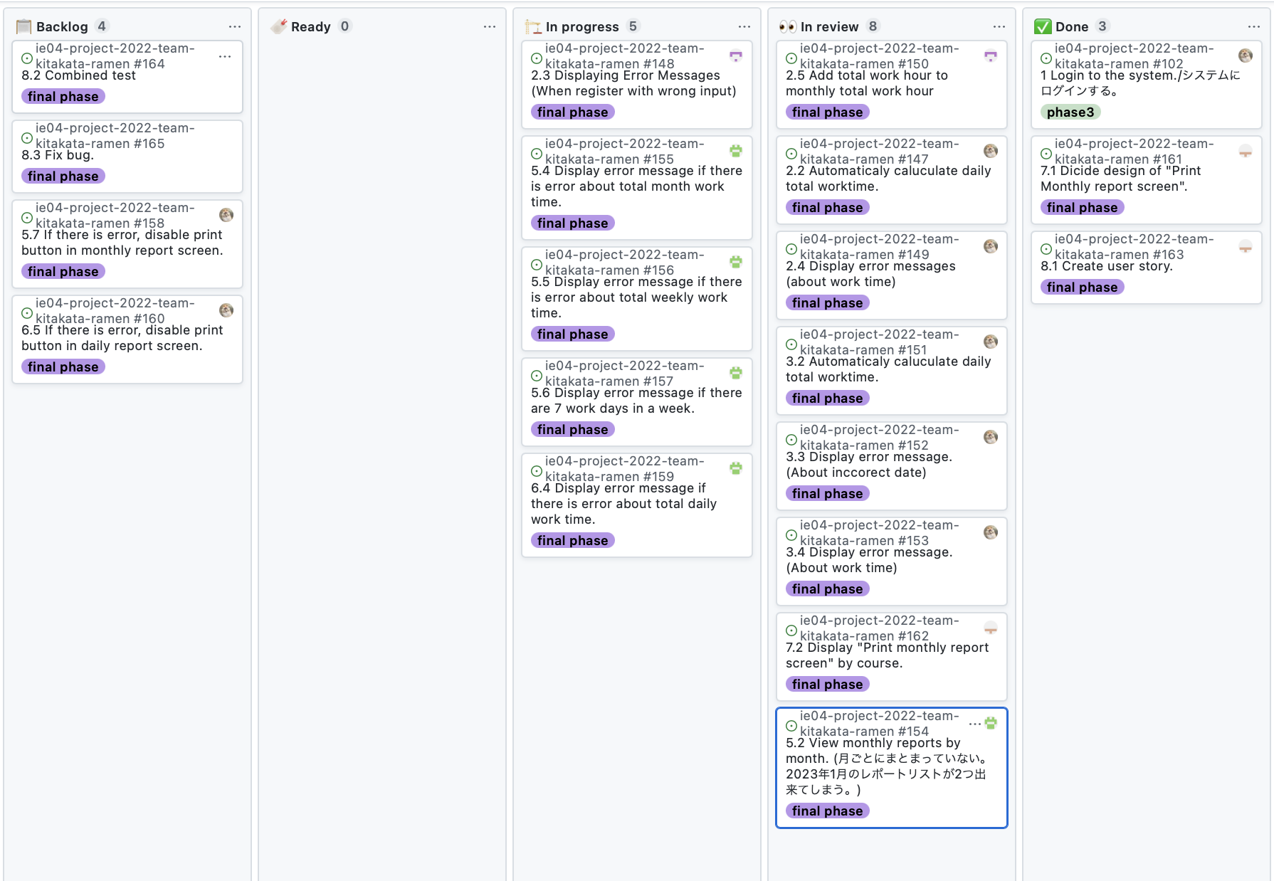
Phase Task Board

Slide 6
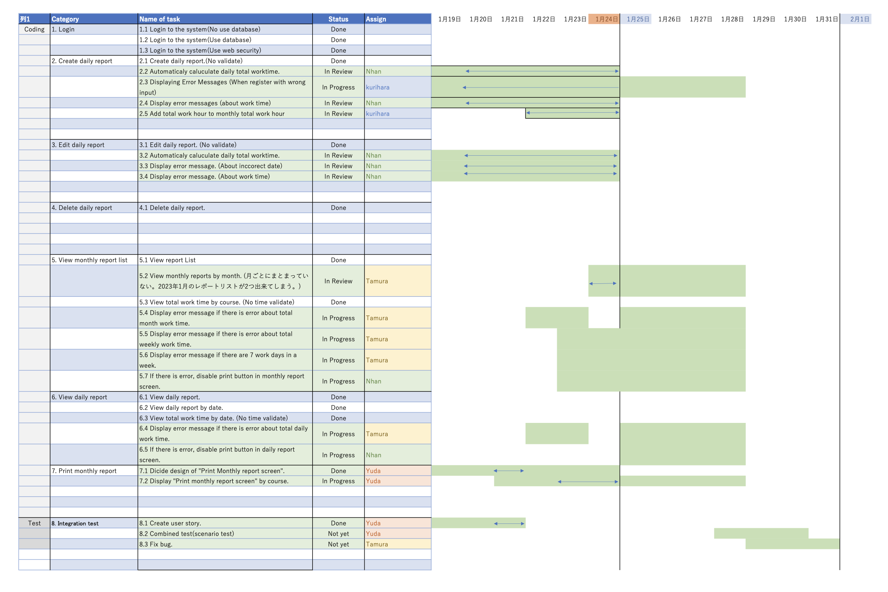
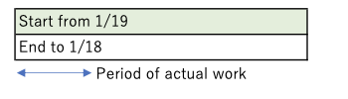
Notes:
日曜日のミーティングまでに各自のタスクを終え、日曜日からは結合テストを開始したいと考えています。
We hope to have each person's task completed by Sunday's meeting and to begin the integration test on Sunday.

Slide 7
Issue & Risks
Problem
There are tasks that were not completed on time
Cause
Due to unexpected bugs or conflicts
Possible Solution
improve test quality
Reconfirm how to develop
Deadline
Today
Notes:
今日中にテストに必要な要素の話し合いとGitを使うときの約束をもう一度確認していきたいと思います。
Later today, we will discuss the elements necessary for testing and reconfirm the promises when using Git.

