Slide 1
Project: TA report system
IE04 Weekly Progress Report
2022/10/26
Team: kitakata-ramen
Notes:
Let's startnnn

Slide 2
Activities of Previous Week
Task | Member | Status | Work Hours
Define UI. | Everyone | 90% | 2.5h
Define class diagram. | Tamura | 90% | 1h
Set up development environment. | Tamura, Kurihara, Yuda | 90% | 2.5h
Set up web server. | Tamura | 100% | 1.5h
 |  | Total time: | 7.5h
Ready: 10%
In progress: 10~90%
In review: 90%
Done: 100%

Slide 3
Plan for This Week
Task | Member | Work Hours
Reconfirmation RFP | everyone | 1h
Reconfirmation of use-case diagrams based on RFP | everyone | 0.5h
Reconfirmation of class diagrams based on RFP | everyone | 1.5h
Reconfirmation of UI definition based on RFP | everyone | 0.5h
Create My SQL database | everyone | 3h
Create each screen | Each member | 6h
 | Total time: | 12.5h

Slide 4
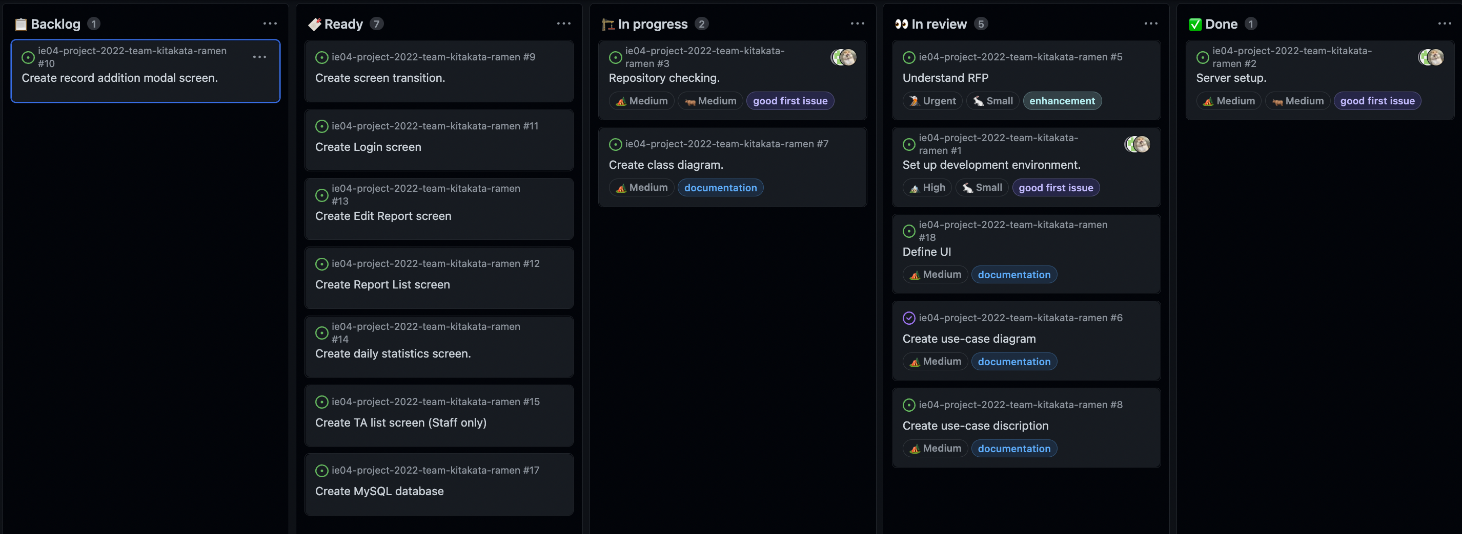
Phase Task Board

Slide 5
Issues & Risks (*if any)
Problem
Unable to contact team members.
Cause
Not coming to class.
Possible Solution
Contact often.
Deadline
Within October

