Slide 1
Project: TA report system
IE04 Weekly Progress Report
2022/11/16
Team: kitakata-ramen
Notes:
Let's startnnn

Slide 2
Activities of Previous Week
Task | Member | Status | Work Hours
Create Phase2 Backlog | Tamura Kurihara Yuda | 100% | 1h
Recreate the UI definition | Kurihara | 75% | 5h
Define user-story in details (TA) | Yuda | 75% | 1.5h
Define user-story in details (Staff, Faculty) | Tamura | 75% | 2.0h
Preparate weekly Reports | Kurihara | 100% | 1h
 |  | Total Time : | 10.5h

Slide 3
Plan for This Week
Task | Member | Work Hours
Review use-case diagram | everyone | 0:30
Review use-case description | everyone | 0:30
Review class diagram | everyone | 0:30
Create sequence diagram | everyone | 1:00
Create New Report modal screen | Tamura | 2:00
Create New Record modal screen | Tamura | 1:00
Improvement of TAs list screen | Kurihara | 5:00
Improvement of Reports list screen | Yuda | 5:00
Improvement of Edit screen | Nhan | 5:00
 | Total time: | 28:00

Slide 4
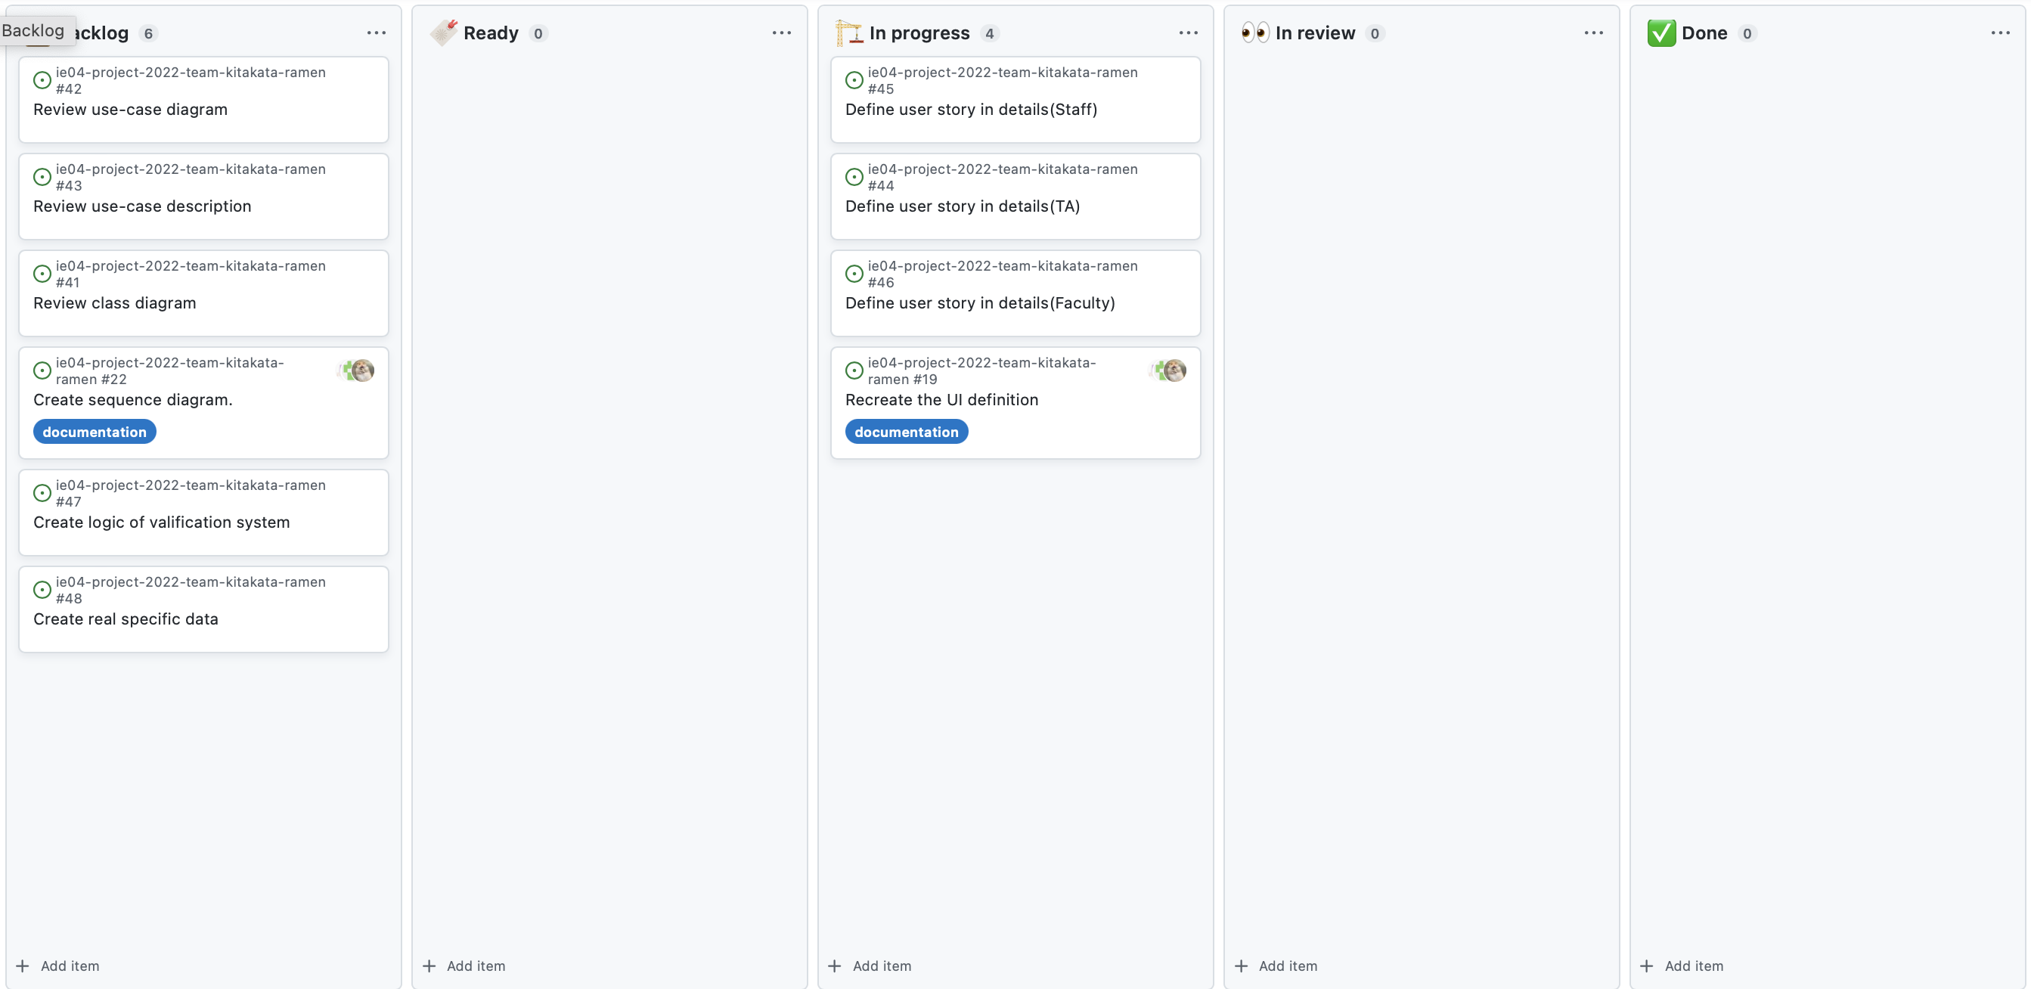
Phase Task Board

Slide 5
Issues & Risks (*if any)
Problem
Cause
Possible Solution
Deadline

