Slide 1
Project: TA report system
IE04 Weekly Progress Report
2022/11/29
Team: kitakata-ramen
Notes:
Let's startnnn

Slide 2
Activities of Previous Week ①
Task | Member | Status | Work Hours
Define User-story in detail. | Yuda | 100% | 2h
Recreate UI definition. | Kurihara | 100% | 2h
Recreate class diagrams | Tamura | 100% | 3h
Review User-story, UI and class diagrams. | Tamura, Kurihara, Yuda | 100% | 4.5h
Create filter button for “TAs list” screen by html. | Tamura Kurihara | 100% | 4h
Create “Create new Report” button for “Report List” screen by html | Kurihara | 100% | 2h
Create database by PostgresSQL. | Nhan | 100% | 2h
Linking database to app. | Nhan | 50% | 2h
Create MySQL database. | Tamura | 100% | 3h
Ready: 10%
In progress: 10~90%
In review: 90%
Done: 100%

Slide 3
Activities of Previous Week ②
Task | Member | Status | Work Hours
Convert use-case diagram to the astah file | Tamura | 90% | 0.5h
Convert use-case description to the astah file. | Tamura | 90% | 0.5h
Create verify button (for staff) in Report List by html | Kurihara | 90% | 0.5h
Create lock icon by html | Kurihara | 90% | 0.5h
Preparate weekly Reports | Yuda | 100% | 3.5h
 |  | Total time: | h

Slide 4
Plan for This Week
Task | Member | Work Hours
Commonize css and js implementation for the html file. | Yuda | 2h
Discussion of the function of validation. | Everyone | 1h
Create of the function of validation. | Undecided | 3h
Create report details screen by html | Tamura | 2h
Create sequence diagrams. | Tamura | 3h
Insert test data to database | Yuda | 2h
Create “new Record” button for “Report detail” screen by html. | Kurihara | 2h
 | Total time: | 15h
以下のタスク、既に手をつけていたら「Activities of Previous week」へ、手をつけてなければ「Plan for this week」へ
Go to "Activities of Previous week" if you have already started the following tasks, or "Plan for this week" if not.
Kurihara
*Create verify button (for staff) in Report List by html.
*Create “Create new Report” button for “Report List” screen by html
*Create lock icon by html
Nhan
*Create authority table by MySQL.
*Create account table by MySQL
*Add Login feature with backend.

Slide 5
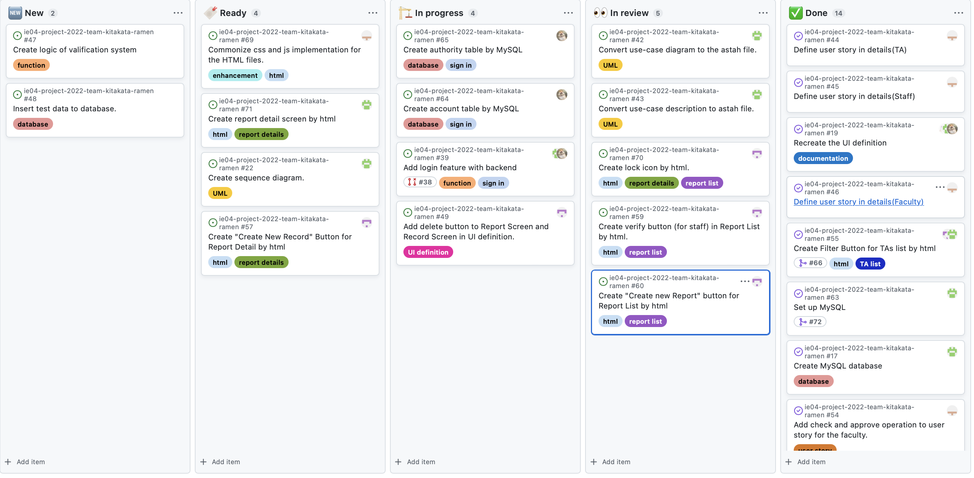
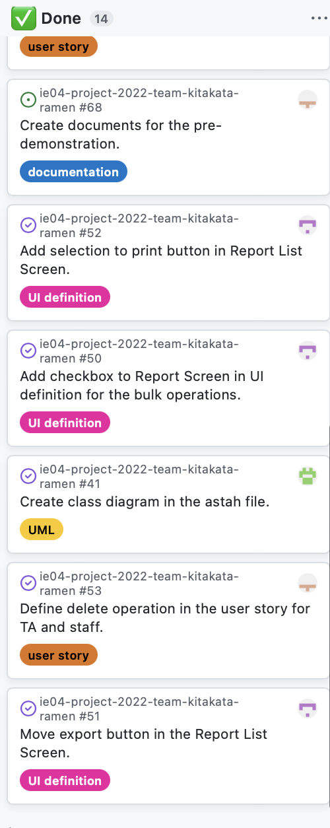
Phase Task Board

Slide 6
Issues & Risks (*if any)
Problem
We haven't been able to review it with all of them.
Cause
Didn't report of progress to member who can't join meeting.
Didn't join meeting.
Possible Solution
To report of progress to member who can't join meeting.
Encourage participation in meetings

