Slide 1
Module 1: The Danger
Instructor Materials
CyberOps Associate v1.0
Notes:
Cisco Networking Academy Program
CyberOps Associate v1.0
Module 1: The Danger

Slide 2
Instructor Materials – Module 1 Planning Guide
This PowerPoint deck is divided in two parts:
Instructor Planning Guide
Information to help you become familiar with the module
Teaching aids
Instructor Class Presentation
Optional slides that you can use in the classroom
Begins on slide # 8
Note: Remove the Planning Guide from this presentation before sharing with anyone.
For additional help and resources go to the Instructor Home Page and Course Resources for this course. You also can visit the professional development site on www.netacad.com, the official Cisco Networking Academy Facebook page, or Instructor Only FB group.
Notes:
2

Slide 3
What to Expect in this Module
To facilitate learning, the following features within the GUI may be included in this module:
Feature | Description
Videos | Expose learners to new skills and concepts.
Hands-On Labs | Labs designed for working with physical equipment.
Class Activities | These are found on the Instructor Resources page. Class Activities are designed to facilitate learning, class discussion, and collaboration.
Module Quizzes | Self-assessments that integrate concepts and skills learned throughout the series of topics presented in the module.
Module Summary | Briefly recaps module content.

Slide 4
Check Your Understanding
Check Your Understanding activities are designed to let students quickly determine if they understand the content and can proceed, or if they need to review.
Check Your Understanding activities do not affect student grades.
There are no separate slides for these activities in the PPT. They are listed in the notes area of the slide that appears before these activities.
Notes:
4

Slide 5
Module 1: Activities
What activities are associated with this module?
Page # | Activity Type | Activity Name | Optional?
1.0.6 | Class Activity | Top Hacker Shows Us How It’s Done | Recommended
1.1.4 | Video | Anatomy of an Attack | Recommended
1.2.3 | Lab | Learning the Details of Attacks | Recommended
1.3.4 | Lab | Visualizing the Black Hats | Recommended
Notes:
5

Slide 6
Module 1: Best Practices
Prior to teaching Module 1, the instructor should:
Review the activities and assessments for this module.
Try to include as many questions as possible to keep students engaged during classroom presentation.
Topic 1.1
Ask the participants to share any instances of cyberattacks that they may know of.
Ask the participants if they have ever been advised by their mentors to not open any unsolicited mails. Ask them if they know the reason behind this advice.
How can malware pose a threat to a nation?
Notes:
6

Slide 7
Module 1: Best Practices (Contd.)
Topic 1.2
Ask the participants to share their understanding of IoT.
Divide the class into groups and ask the participants to debate on pros and cons of IoT.
Ask the participants to research on the steps that can be taken to contain threat actors.
Topic 1.3
Ask the participants to share their views on how leaking of medical or personal data can pose an issue to an individual.
How can leaking of confidential information pose issues for an organization or a nation?
Notes:
7

Slide 8
Module 1: The Danger
CyberOps Associate v1.0
Notes:
Cisco Networking Academy Program
CyberOps Associate v1.0
Module 1: The Danger
In-Session Activities / Explanations:
Time: 5 mins
Instructor Notes:
Welcome the audience in a warm and cordial manner. Ensure that everyone is set up with the required resources.
Introduce yourself briefly and invite participants to introduce self with name, dept. and role, if deemed all right.
To set the context of the course, mention to the participants that the CyberOps Associate v1.0 course covers knowledge and skills needed to successfully handle the tasks, duties, and responsibilities of an associate-level Security Analyst working in a Security Operations Center (SOC).
Introduce the topic and encourage learners to come up with a list of expectations from the session.
Mention to the participants that there will be a number of tools and resources made available to them that will help them during the course of journey towards developing their CyberOps skills and preparing for job opportunities
Read out the Objectives and briefly describe each.
Key Points: NA

Slide 9
Module Objectives
Module Title: The Danger
Module Objective: Explain why networks and data are attacked.
Topic Title | Topic Objective
War Stories | Explain why networks and data are attacked.
Threat Actors | Explain the motivations of the threat actors behind specific security incidents.
Threat Impact | Explain the potential impact of network security attacks.
Notes:
9
CyberOps Associate v1.0
1 – The Danger
1.0 – Introduction
1.0.3 – What Will I Learn in this Module?
1.0.4 – Class Activity - Top Hacker Shows Us How It’s Done

Slide 10
1.1 War Stories
Notes:
Source:
1 – The Danger
1.1 – War Stories
In-Session Activities / Explanations:
Time: 15 mins
Instructor Notes:
Explain to the participants why networks and data are attacked.
Check whether the students faced any issue while installing the CyberOps Workstation Virtual Machine.
Explain to them the video on "Anatomy of an Attack."
Key Points: Evil twin hotspots, Network and Data Attack

Slide 11

The Danger Hijacked People
Hackers can set up open “rogue” wireless hotspots posing as a genuine wireless network.
Rogue wireless hotspots are also known as “evil twin” hotspots.
Notes:
1 – The Danger
1.1 – War Stories
1.1.1 – Hijacked People

Slide 12

The Danger Ransomed Companies
Employees of an organization are often lured into opening attachments that install ransomware on the employees’ computers.
This ransomware, when installed, begins the process of gathering and encrypting corporate data.
The goal of the attackers is financial gain, because they hold the company’s data for ransom until they are paid.
Notes:
1 – The Danger
1.1 – War Stories
1.1.2 – Ransomed Companies

Slide 13
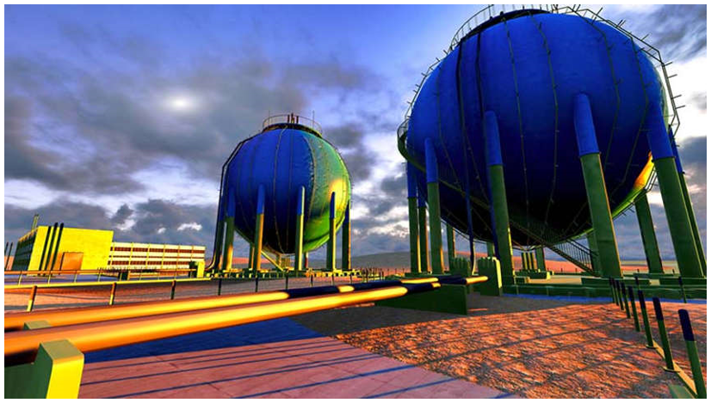
The Danger Targeted Nations
Some of today’s malware is so sophisticated and expensive to create that security experts believe only a nation state or group of nations could possibly have the influence and funding to create it.
Such malware can be targeted to attack a nation’s vulnerable infrastructure, such as the water system or power grid.
One such malware was the Stuxnet worm that infected USB drives and infiltrated Windows operating systems. It then targeted Step 7 software that was developed by Siemens for their Programmable Logic Controllers (PLCs).
Notes:
1 – The Danger
1.1 – War Stories
1.1.3 – Targeted Nations

Slide 14
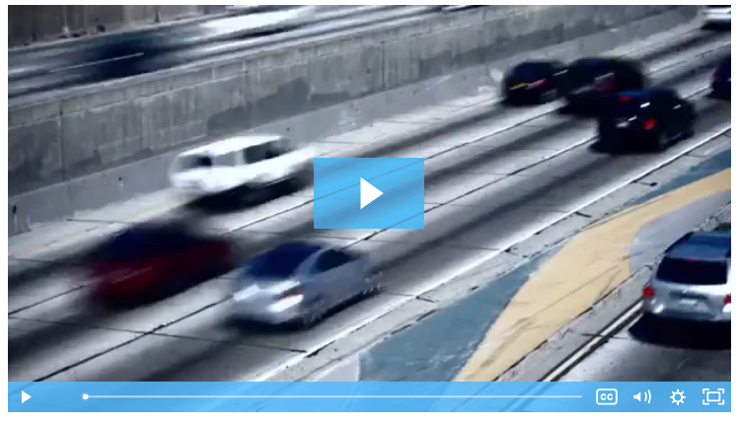
The Danger Video - Anatomy of an Attack
Watch this video to view details of a complex attack.
Notes:
1 – The Danger
1.1 – War Stories
1.1.4 – Video - Anatomy of an Attack

Slide 15
The Danger Lab - Installing the Virtual Machine
In this lab, you will complete the following objectives:
Install VirtualBox on your personal computer
Download and install the CyberOps Workstation Virtual Machine (VM).
Notes:
1 – The Danger
1.1 – War Stories
1.1.5 – Lab - Installing the Virtual Machine

Slide 16
The Danger Lab - Cybersecurity Case Studies
In this lab, you will analyze the given cases and answer questions about them.
Notes:
1 – The Danger
1.1 – War Stories
1.1.6 – Lab - Cybersecurity Case Studies

Slide 17
1.2 Threat Actors
Notes:
1 – The Danger
1.2 – Threat Actors
In-Session Activities / Explanations:
Time: 10 mins
Instructor Notes:
Introduce the topic and explain the learners about threat actors.
Discuss with the learners about cyberattacks. Ask the learners what they understand of the term.
Ensure that the learners know about IoT. Ask them to quote examples from our day-to-day lives when IoT is used.
Key Points: Threat actors, IoT

Slide 18
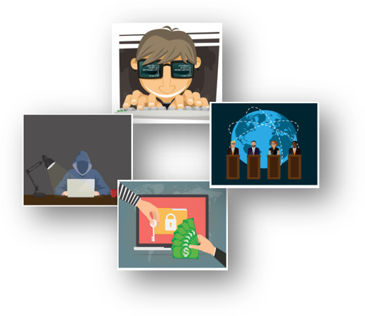
Threat Actors Threat Actors
Threat actors are individuals or groups of individuals who perform cyberattacks. They include, but are not limited to:
Amateurs
Hacktivists
Organized crime groups
State-sponsored groups
Terrorist groups
Cyberattacks are intentional malicious acts meant to negatively impact another individual or organization.
Notes:
1 – The Danger
1.2 – Threat Actors
1.2.1 – Threat Actors

Slide 19
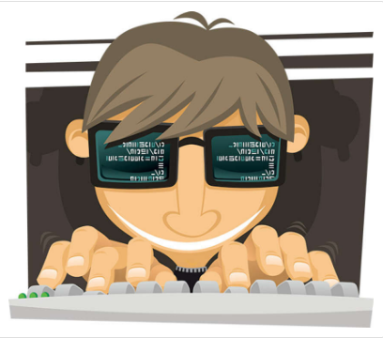
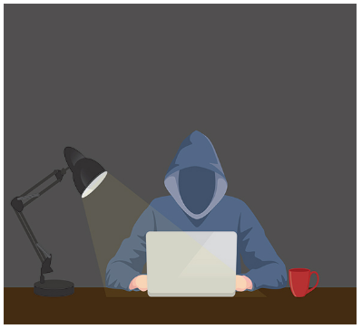
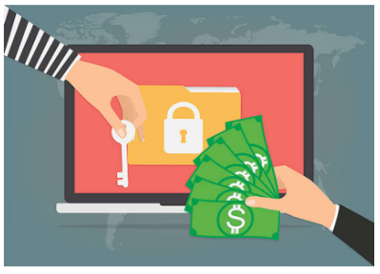

Threat Actors Threat Actors (Contd.)
Amateurs
They are also known as script kiddies and have little or no skill.
They often use existing tools or instructions found on the internet to launch attacks.
Even though they use basic tools, the results can still be devastating.
Hacktivists
These are hackers who publicly protest against a variety of political and social ideas.
They post articles and videos, leaking sensitive information, and disrupting web services with illegitimate traffic in Distributed Denial of Service (DDoS) attacks.
Financial Gain
Much of the hacking activity that consistently threatens our security is motivated by financial gain.
Cybercriminals want to gain access to bank accounts, personal data, and anything else they can leverage to generate cash flow.
Trade Secrets and Global Politics
At times, nation states hack other countries, or interfere with their internal politics.
Often, they may be interested in using cyberspace for industrial espionage.
The theft of intellectual property can give a country a significant advantage in international trade.
Notes:
1 – The Danger
1.2 – Threat Actors
1.2.1 – Threat Actors

Slide 20
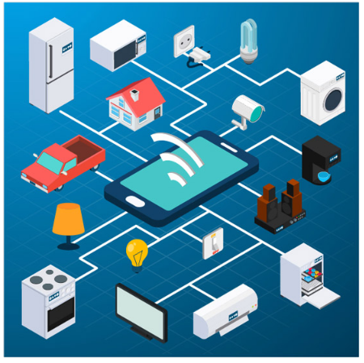
Threat Actors How Secure is the Internet of Things?
The Internet of Things (IoT) helps individuals connect things to improve their quality of life.
Many devices on the internet are not updated with the latest firmware. Some older devices were not even developed to be updated with patches. These two situations create opportunity for threat actors and security risks for the owners of these devices.
Notes:
1 – The Danger
1.2 – Threat Actors
1.2.2 – How Secure is the Internet of Things?

Slide 21
Threat Actors Lab - Learning the Details of Attacks
In this lab, you will research and analyze IoT application vulnerabilities.
Notes:
1 – The Danger
1.2 – Threat Actors
1.2.3 – Lab - Learning the Details of Attacks

Slide 22
1.3 Threat Impact
Notes:
1 – The Danger
1.3 – Threat Impact
In-Session Activities / Explanations:
Time: 10 mins
Instructor Notes:
Give a brief introduction to the learners about threat impact.
Explain to the learners about PII, PHI, PSI.
Encourage the learners to discuss the impact of cyberattacks on the economy, politics, and national security.
At the end of the topic, encourage the learners to perform the lab.
Key Points: PII, PHI, and PSI, National Security

Slide 23

Threat Impact PII, PHI, and PSI
Personally Identifiable Information (PII) is any information that can be used to positively identify an individual, for example, name, social security number, birthdate, credit card numbers etc.
Cybercriminals aim to obtain these lists of PII that can then be sold on the dark web. Stolen PII can be used to create fake financial accounts, such as credit cards and short-term loans.
The medical community creates and maintains Electronic Medical Records (EMRs) that contain Protected Health Information (PHI), a subset of PII.
Personal Security Information (PSI), another type of PII, includes usernames, passwords, and other security-related information that individuals use to access information or services on the network.
Notes:
1 – The Danger
1.3 – Threat Impact
1.3.1 – PII, PHI, and PSI

Slide 24
Threat Impact Lost Competitive Advantage
The loss of intellectual property to competitors is a serious concern.
An additional major concern is the loss of trust that comes when a company is unable to protect its customers’ personal data.
The loss of competitive advantage may come from this loss of trust rather than another company or country stealing trade secrets.
Notes:
1 – The Danger
1.3 – Threat Impact
1.3.2 – Lost Competitive Advantage

Slide 25
Threat Impact Politics and National Security
It is not just businesses that get hacked.
State-supported hacker warriors can cause disruption and destruction of vital services and resources within an enemy nation.
The internet has become essential as a medium for commercial and financial activities. Disruption of these activities can devastate a nation’s economy.
Notes:
1 – The Danger
1.3 – Threat Impact
1.3.3 – Politics and National Security

Slide 26
Threat Impact Lab - Visualizing the Black Hats
In this lab, you will research and analyze cybersecurity incidents to create scenarios highlighting how organizations can prevent or mitigate an attack.
Notes:
1 – The Danger
1.3 – Threat Impact
1.3.4 – Lab - Visualizing the Black Hats

Slide 27
1.4 The Danger Summary
Notes:
1 – The Danger
1.4 – The Danger Summary
In-Session Activities / Explanations:
Time: 5 mins
Instructor Notes:
Summarise the main points of the module
Take the learners through the new terms that they have learned in this module.
Ask them to complete the module quiz present in section 1.4.2.
Key Points: NA

Slide 28
The Danger Summary What Did I Learn in this Module?
Threat actors can hijack banking sessions and other personal information by using “evil twin” hotspots.
Threat actors include, but are not limited to, amateurs, hacktivists, organized crime groups, state sponsored, and terrorist groups.
As the Internet of Things (IoT) expands, webcams, routers, and other devices in our homes are also under attack.
Personally Identifiable Information (PII) is any information that can be used to positively identify an individual.
The medical community creates and maintains Electronic Medical Records (EMRs) that contain Protected Health Information (PHI), a subset of PII.
Personal Security Information (PSI) includes usernames, passwords, and other security-related information that individuals use to access information or services on the network.
Notes:
1 – The Danger
1.4 – The Danger Summary
1.4.1 – What Did I Learn in this Module?
1.4.2 – Module 1: The Danger Quiz

Slide 29
Module 1 New Terms and Commands
Evil twin hotspots Programmable Logic Controllers (PLCs) Threat Actors Hacktivists Cyberattacks Distributed Denial of Service (DDoS) | Internet of Things (IoT) Personally Identifiable Information (PII) Protected Health Information (PHI) Electronic Medical Records (EMRs) | Health Insurance Portability and Accountability Act (HIPAA) General Data Protection Regulation (GDPR Personal security information (PSI) Cyberwarfare
Notes:
1 – The Danger
New Terms and Commands

