Slide 1
Module 11: Network Communication Devices
Instructor Materials
CyberOps Associate v1.0
Notes:
Cisco Networking Academy Program
CyberOps Associate v1.0
Module 11: Network Communication Devices

Slide 2
Instructor Materials – Module 11 Planning Guide
This PowerPoint deck is divided in two parts:
Instructor Planning Guide
Information to help you become familiar with the module
Teaching aids
Instructor Class Presentation
Optional slides that you can use in the classroom
Begins on slide # 8
Note: Remove the Planning Guide from this presentation before sharing with anyone.
For additional help and resources go to the Instructor Home Page and Course Resources for this course. You also can visit the professional development site on www.netacad.com, the official Cisco Networking Academy Facebook page, or Instructor Only FB group.
Notes:
2

Slide 3
What to Expect in this Module
To facilitate learning, the following features within the GUI may be included in this module:
Feature | Description
Animations | Expose learners to new skills and concepts.
Videos | Expose learners to new skills and concepts.
Check Your Understanding(CYU) | Per topic online quiz to help learners gauge content understanding.
Module Quizzes | Self-assessments that integrate concepts and skills learned throughout the series of topics presented in the module.
Module Summary | Briefly recaps module content.

Slide 4
Check Your Understanding
Check Your Understanding activities are designed to let students quickly determine if they understand the content and can proceed, or if they need to review.
Check Your Understanding activities do not affect student grades.
There are no separate slides for these activities in the PPT. They are listed in the notes area of the slide that appears before these activities.
Notes:
4

Slide 5
Module 11: Activities
What activities are associated with this module?
Page # | Activity Type | Activity Name | Optional?
11.1.2 | Video | End Devices | Recommended
11.1.4 | Check Your Understanding | Match Layer 2 and Layer 3 Addressing | Recommended
11.1.8 | Video | Static and Dynamic Routing | Recommended
11.1.11 | Video | MAC Address Tables on Connected Switches | Recommended
11.2.1 | Video | Wireless Communications | Recommended
11.2.7 | Check Your Understanding | Steps in the Client and AP Process | Recommended
11.2.9 | Check Your Understanding | Identify the LAN Device | Recommended
Notes:
5

Slide 6
Module 11: Best Practices
Prior to teaching Module 11, the instructor should:
Review the activities and assessments for this module.
Try to include as many questions as possible to keep students engaged during classroom presentation.
Topic 11.1
Ask the class to name some network devices and then describe the devices to them.
Explain the packet forwarding decision process to the participants.
Ask the participants to share their understanding of hubs, bridges and LAN switches.
Describe the switching operation to the class.
Brief the class on VLANs and STP.
Notes:
6

Slide 7
Module 11: Best Practices (Contd.)
Topic 11.2
Ask the class to list some differences between Wireless LAN and Wired LAN.
Explain the fields of 802.11 frame structure to the class.
Talk over CSMA/CA in the class.
Describe the wireless client and AP association.
Discuss the passive and active disorder mode.
Ask the participants to share their knowledge of the AP, LWAP, and WLC.
Notes:
7

Slide 8
Module 11: Network Communication Devices
CyberOps Associate v1.0
Notes:
Cisco Networking Academy Program
CyberOps Associate v1.0
Module 11: Network Communication Devices
In-Session Activities / Explanations:
Time: 5 min
Instructor Notes:
Welcome the audience in a warm and cordial manner. Ensure that everyone is set up with the required resources.
Introduce the topic and encourage learners to come up with a list of expectations from the session. Collate topics on the white board or Desktop while using learner’s inputs to interpret them in words.
To set the context of the module, describe the basic operation of network infrastructures, including wired and wireless networks.
Read out the Objectives and briefly describe each.
Key Points: NA

Slide 9
Module Objectives
Module Title: Network Communication Devices
Module Objective: Explain how network devices enable wired and wireless network communication.
Topic Title | Topic Objective
Network Devices | Explain how network devices enable network communication.
Wireless Communications | Explain how wireless devices enable network communication.
Notes:
9
CyberOps Associate v1.0
11 – Network Communication Devices
11.0 – Introduction
11.0.2 – What Will I Learn in this Module?

Slide 10
11.1 Network Devices
Notes:
Source:
11 – Network Communication Devices
11.1 – Network Devices
In-Session Activities / Explanations:
Time: 40 min
Instructor Notes:
Introduce the topic and discuss the network devices.
Explain the end devices and routers to the learners.
Discuss the packet forwarding decision process and distinguish the process between IPv4 and IPv6 packets.
Describe hubs, bridges and LAN switches to the learners.
Ensure the learners have knowledge of the switching operation.
Talk over VLANs and STP and their significance.
By the end of the topic, brief the leaners on multilayer switching.
Key Points: Routers, Switches, Packet Forwarding Process, VLAN, STP, Multilayer Switching

Slide 11
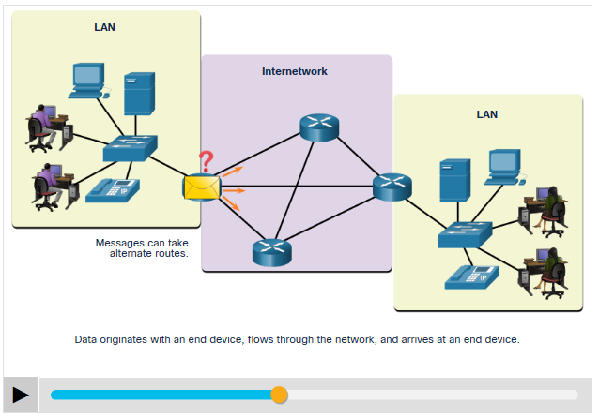
Network Communication Devices End Devices
The most familiar network devices are end devices. An end device is either the source or destination of a message transmitted over the network.
To distinguish one end device from another, each end device on a network has an address.
When an end device initiates communication, it uses the address of the destination end device to specify where to deliver the message.
Data originates with an end device, flows through the network, and arrives at an end device.
Notes:
11 – Network Communication Devices
11.1 – Network Devices
11.1.1 – End Devices

Slide 12
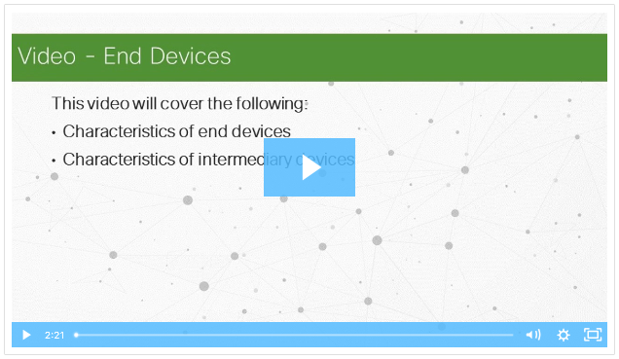
Network Communication Devices Video - End Devices
Watch the video to learn more about end devices.
Notes:
11 – Network Communication Devices
11.1 – Network Devices
11.1.2 – Video - End Devices

Slide 13
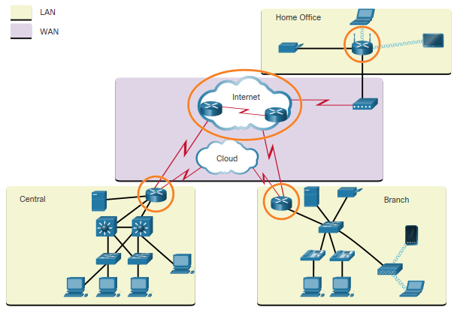
Network Communication Devices Routers
Routers are devices that operate at the OSI network layer (Layer 3).
As shown in the figure, routers are used to interconnect remote sites. They use the process of routing to forward data packets between networks.
The routing process uses network routing tables, protocols, and algorithms to determine the most efficient path for forwarding an IP packet.
Routers gather routing information and update other routers about changes in the network.
The Router Connection
Notes:
11 – Network Communication Devices
11.1 – Network Devices
11.1.3 – Routers

Slide 14
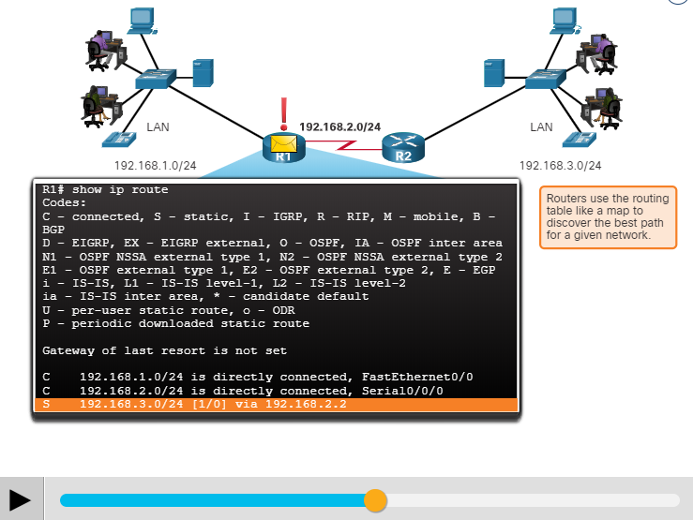
Network Communication Devices Routers (Contd.)
Routers have two primary functions: path determination and packet forwarding.
To perform path determination, each router builds and maintains a routing table which is a database of known networks and how to reach them.
The routing table can be built manually and contain static routes or can be built using a dynamic routing protocol.
Packet forwarding is accomplished by using a switching function.
Switching is the process used by a router to accept a packet on one interface and forward it out of another interface.
A primary aim of the switching function is to encapsulate packets in the appropriate data link frame type for the outgoing data link.
Notes:
11 – Network Communication Devices
11.1 – Network Devices
11.1.3 – Routers

Slide 15
Network Communication Devices Routers (Contd.)
After the router has determined the exit interface using path determination, the router must encapsulate the packet into the data link frame of the outgoing interface.
When a packet received from one network and destined for another network, the router performs the following three major steps:
It de-encapsulates the Layer 2 frame header and trailer to expose the Layer 3 packet.
It examines the destination IP address of the IP packet to find the best path in the routing table.
If the router finds a path to the destination, it encapsulates the Layer 3 packet into a new Layer 2 frame and forwards that frame out the exit interface.
Notes:
11 – Network Communication Devices
11.1 – Network Devices
11.1.3 – Routers

Slide 16
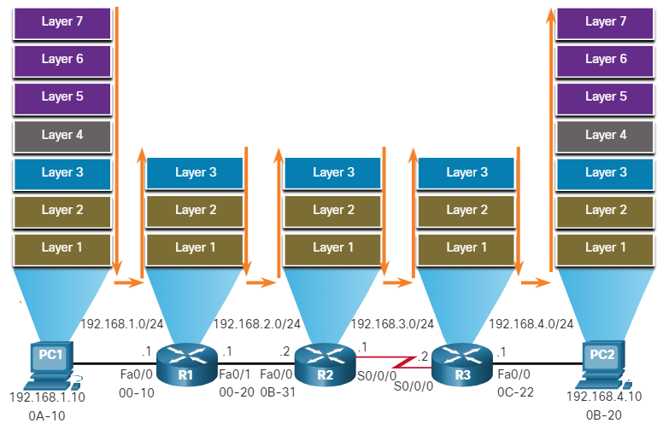
Network Communication Devices Routers (Contd.)
As shown in the figure, devices have Layer 3 IPv4 addresses, while Ethernet interfaces have Layer 2 data link addresses. The MAC addresses are shortened to simplify the illustration.
As a packet travels from the source device to the final destination device, the Layer 3 IP addresses do not change as the Layer 3 PDU does not change.
The Layer 2 data link addresses change at every router on the path to the destination, as the packet is de-encapsulated and re-encapsulated in a new Layer 2 frame.
Encapsulating and De-Encapsulating Packets
Notes:
11 – Network Communication Devices
11.1 – Network Devices
11.1.3 – Routers
11.1.4 – Check Your Understanding - Match Layer 2 and Layer 3 Addressing

Slide 17
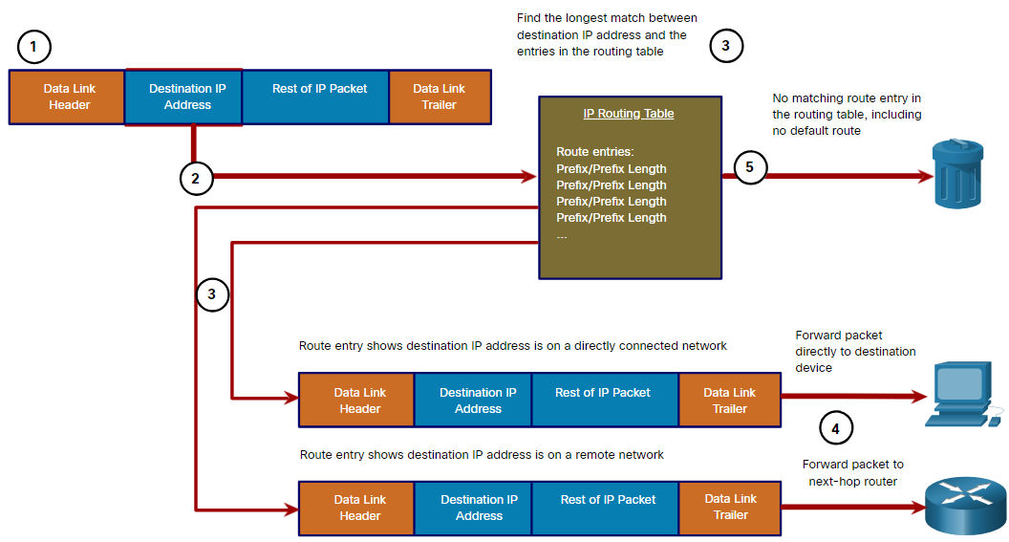
Network Communication Devices Packet Forwarding Decision Process
Now, router must determine how to encapsulate the packet and forward it out the correct egress interface. The following steps describe the packet forwarding process shown in the figure:
The data link frame with an encapsulated IP packet arrives on the ingress interface.
The router examines the destination IP address in the packet header and consults its IP routing table.
The router finds the longest matching prefix in the routing table.
The router encapsulates the packet in a data link frame and forwards it out the egress interface.
The destination could be a device connected to the network or a next-hop router.
If there is no matching route entry the packet is dropped.
Notes:
11 – Network Communication Devices
11.1 – Network Devices
11.1.5 – Packet Forwarding Decision Process

Slide 18
Network Communication Devices Packet Forwarding Decision Process (Contd.)
The three actions a router can perform with a packet, after the best path is determined:
Forwards the Packet to a Device on a Directly Connected Network
Forwards the Packet to a Next-Hop Router
Drops the Packet - No Match in Routing Table
Forwards the Packet to a Device on a Directly Connected Network
If the route entry indicates that the egress interface is a directly connected network, this means that the destination IP address of the packet belongs to a device on the directly connected network.
The packet can be forwarded directly to the destination device, an end device on an Ethernet LAN, which means the packet must be encapsulated in an Ethernet frame.
To encapsulate the packet in the Ethernet frame, the router needs to determine the destination MAC address associated with the destination IP address of the packet.
Notes:
11 – Network Communication Devices
11.1 – Network Devices
11.1.5 – Packet Forwarding Decision Process

Slide 19
Network Communication Devices Packet Forwarding Decision Process (Contd.)
The process varies based on whether the packet is an IPv4 or IPv6 packet.
IPv4 packet:
The router checks its ARP table for the destination IPv4 address and an associated Ethernet MAC address.
If there is no match, the router sends an ARP Request and the destination device will return an ARP Reply with its MAC address.
The router can now forward the IPv4 packet in an Ethernet frame with the proper destination MAC address.
IPv6 packet:
The router checks its neighbor cache for the destination IPv6 address and an associated Ethernet MAC address.
If there is no match, the router sends an ICMPv6 Neighbor Solicitation (NS) message and the destination device will return an ICMPv6 Neighbor Advertisement (NA) message with its MAC address.
The router can now forward the IPv6 packet in an Ethernet frame with the proper destination MAC address.
Notes:
11 – Network Communication Devices
11.1 – Network Devices
11.1.5 – Packet Forwarding Decision Process

Slide 20
Network Communication Devices Packet Forwarding Decision Process (Contd.)
Forwards the Packet to a Next-Hop Router
If the route entry indicates that the destination IP address is on a remote network, this means the destination IP address of the packet belongs to a device on network that is not directly connected.
Therefore, the packet must be forwarded to another router, specifically a next-hop router. The next-hop address is indicated in the route entry.
If the forwarding router and the next-hop router are on an Ethernet network, a similar process (ARP and ICMPv6 Neighbor Discovery) will occur for determining the destination MAC address of the packet. The difference is that the router will search for the IP address of the next-hop router in its ARP table or neighbor cache, instead of the destination IP address.
Drops the Packet - No Match in Routing Table
If there is no match between the destination IP address and a prefix in the routing table, and if there is no default route, the packet will be dropped.
Notes:
11 – Network Communication Devices
11.1 – Network Devices
11.1.5 – Packet Forwarding Decision Process

Slide 21
Network Communication Devices Routing Information
The routing table stores the following information:
Directly connected routes - These routes come from the active router interfaces. Routers add a directly connected route when an interface is configured with an IP address and is activated.
Remote routes - These are remote networks connected to other routers.
A routing table is a data file in RAM that is used to store route information about directly connected and remote networks.
The routing table contains network or next hop associations. These associations tell a router that a particular destination can be optimally reached by sending the packet to a specific router that represents the next hop on the way to the final destination.
The next hop association can also be the outgoing or exit interface to the next destination.
Notes:
11 – Network Communication Devices
11.1 – Network Devices
11.1.6 – Routing Information

Slide 22
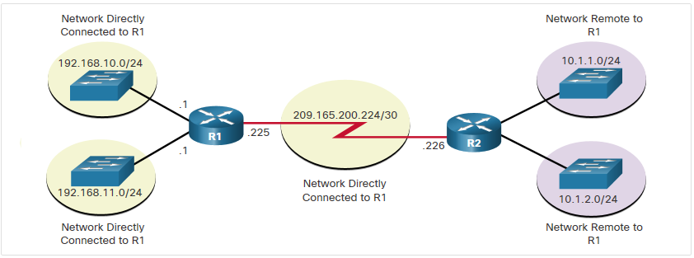
Network Communication Devices Routing Information (Contd.)
Directly Connected and Remote Network Routes
The figure identifies the directly connected networks and remote networks of router R1.
Notes:
11 – Network Communication Devices
11.1 – Network Devices
11.1.6 – Routing Information

Slide 23
Network Communication Devices Routing Information (Contd.)
The destination network entries in the routing table can be added in several ways:
Local Route interfaces – These are added when an interface is configured and active. This entry is only displayed in IOS 15 or newer for IPv4 routes, and all IOS releases for IPv6 routes.
Directly connected interfaces – These are added to the routing table when an interface is configured and active.
Static routes – These are added when a route is manually configured and the exit interface is active.
Dynamic routing protocol – This is added when routing protocols that dynamically learn about the network, such as EIGRP or OSPF, are implemented and networks are identified.
Dynamic routing protocols exchange network reachability information between routers and dynamically adapt to network changes.
Notes:
11 – Network Communication Devices
11.1 – Network Devices
11.1.6 – Routing Information

Slide 24
Network Communication Devices Routing Information (Contd.)
One of the first dynamic routing protocols was RIP. RIPv1 was released in 1988.
To address the needs of larger networks, two advanced routing protocols Open Shortest Path First (OSPF) and Intermediate System-to-Intermediate System (IS-IS) were developed.
Cisco developed the Interior Gateway Routing Protocol (IGRP) and Enhanced IGRP (EIGRP) which also scales well in larger network implementations.
The Border Gateway Protocol (BGP) is now used between Internet Service Providers (ISPs) and their larger private clients to exchange routing information.
The following table classifies the protocols:
Protocol | Interior Gateway Protocols |  |  |  | Exterior Gateway Protocols
 | Distance Vector |  | Link State |  | Path Vector
IPv4 | RIPv2 | EIGRP | OSPFv2 | IS-IS | BGP-4
IPv6 | RIPng | EIGRP for IPv6 | OSPFv3 | IS-IS for IPv6 | BGP-MP
Notes:
11 – Network Communication Devices
11.1 – Network Devices
11.1.6 – Routing Information

Slide 25
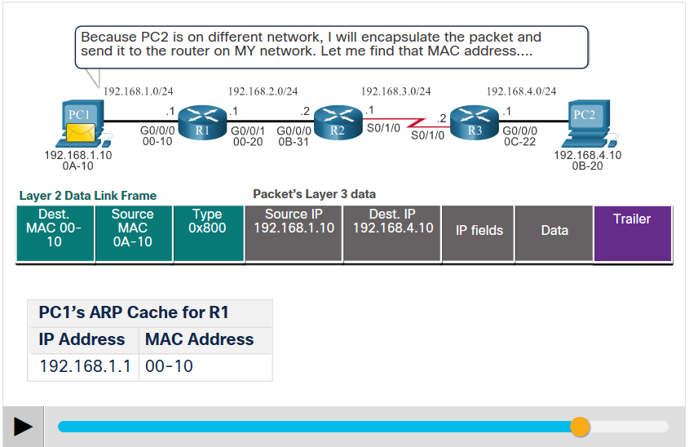
Network Communication Devices End-to-End Packet Forwarding
The primary responsibility of the packet forwarding function is to encapsulate packets in the appropriate data link frame type for the outgoing interface. The process of packet forwarding is described through the following example.
PC1 Sends Packet to PC2
In the first animation, PC1 sends a packet to PC2.
Note that if an ARP entry does not exist in the ARP table for the default gateway of 192.168.1.1, PC1 sends an ARP request.
Router R1 then return an ARP reply.
Notes:
11 – Network Communication Devices
11.1 – Network Devices
11.1.7 – End-to-End Packet Forwarding

Slide 26
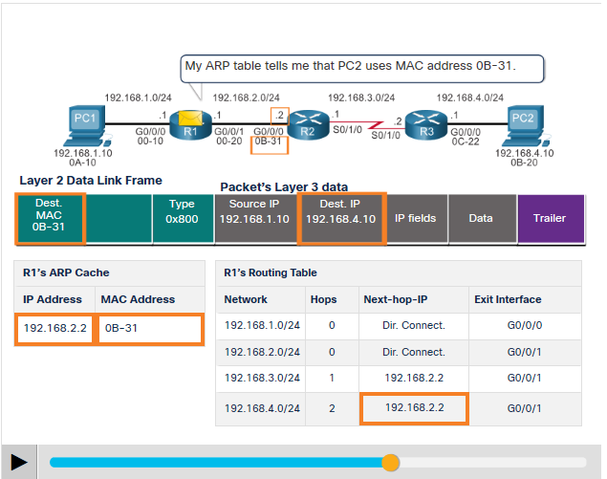
Network Communication Devices End-to-End Packet Forwarding (Contd.)
R1 Forwards the Packet to PC2
R1 now forwards the packet to PC2.
Because the exit interface is on an Ethernet network, R1 must resolve the next-hop IPv4 address with a destination MAC address using its ARP table.
If an ARP entry does not exist in the ARP table for the next-hop interface of 192.168.2.2, R1 sends an ARP request.
R2 would then return an ARP Reply.
Notes:
11 – Network Communication Devices
11.1 – Network Devices
11.1.7 – End-to-End Packet Forwarding

Slide 27
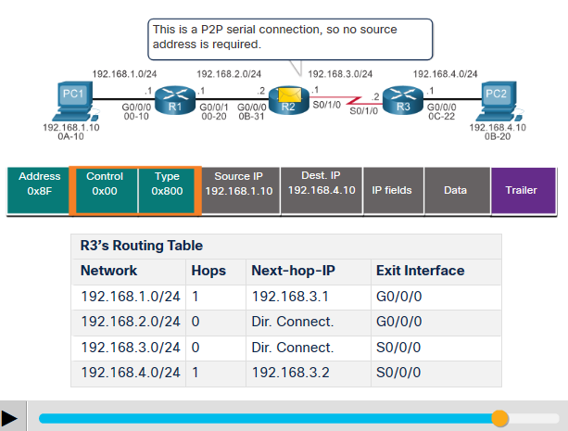
Network Communication Devices End-to-End Packet Forwarding (Contd.)
R2 Forwards the Packet to R3
R2 now forwards the packet to R3.
As the exit interface is not an Ethernet network, R2 does not have to resolve the next-hop IPv4 address with a destination MAC address.
When the interface is a point-to-point (P2P) serial connection, the router encapsulates the IPv4 packet into the proper data link frame format used by the exit interface.
As there are no MAC addresses on serial interfaces, R2 sets the data link destination address to an equivalent of a broadcast.
Notes:
11 – Network Communication Devices
11.1 – Network Devices
11.1.7 – End-to-End Packet Forwarding

Slide 28
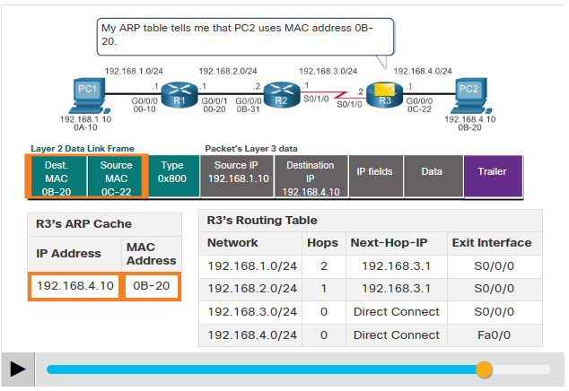
Network Communication Devices End-to-End Packet Forwarding (Contd.)
R3 Forwards the Packet to PC2
R3 now forwards the packet to PC2.
As the destination IPv4 address is on a directly connected Ethernet network, R3 must resolve the destination IPv4 address of the packet with its associated MAC address.
If the entry is not in the ARP table, R3 sends an ARP request out of its FastEthernet 0/0 interface.
PC2 would then return an ARP reply with its MAC address.
Notes:
11 – Network Communication Devices
11.1 – Network Devices
11.1.7 – End-to-End Packet Forwarding

Slide 29
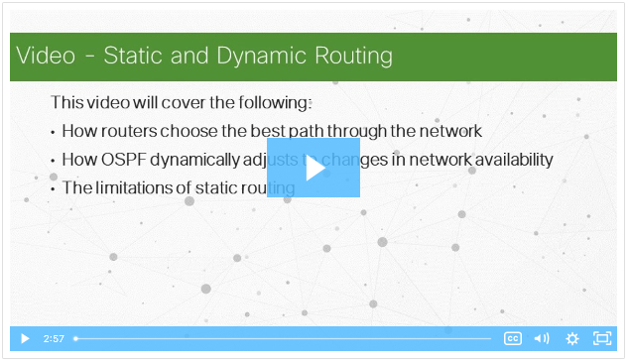
Network Communication Devices Video - Static and Dynamic Routing
Play the video to learn about static and dynamic routing.
Notes:
11 – Network Communication Devices
11.1 – Network Devices
11.1.8 – Video - Static and Dynamic Routing

Slide 30
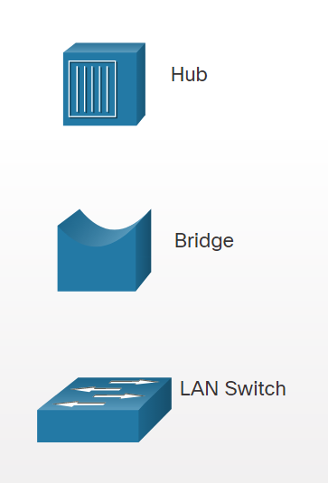
Network Communication Devices Hubs, Bridges, LAN Switches
The topology icons for hubs, bridges, and LAN switches are shown in the figure.
An Ethernet hub acts as a multiport repeater that receives an incoming electrical signal (data) on a port. It then immediately forwards a regenerated signal out all other ports. Hubs use physical layer processing to forward data.
Bridges have two interfaces and are connected between hubs to divide the network into multiple collision domains. Each collision domain can have only one sender at a time.
LAN switches are multiport bridges that connect devices into a star topology. Switches also segment a LAN into separate collision domains, one for each switch port. A switch makes forwarding decisions based on Ethernet MAC addresses.
Notes:
11 – Network Communication Devices
11.1 – Network Devices
11.1.9 – Hubs, Bridges, LAN Switches

Slide 31
Network Communication Devices Switching Operation
Switches use MAC addresses to direct network communications through the switch, to the appropriate port, and toward the destination.
A switch is made up of integrated circuits and the accompanying software that controls the data paths through the switch.
For a switch to know the port to transmit a frame, it must first learn the devices existing on each port. As the switch learns the relationship of ports to devices, it builds a table called a MAC address table, or content addressable memory (CAM) table which is a special type of memory used in high-speed searching applications.
LAN switches determine how to handle incoming data frames by maintaining the MAC address table.
The switch uses the information in the MAC address table to send frames destined for a specific device out of the port to which the device is connected.
Notes:
11 – Network Communication Devices
11.1 – Network Devices
11.1.10 – Switching Operation

Slide 32
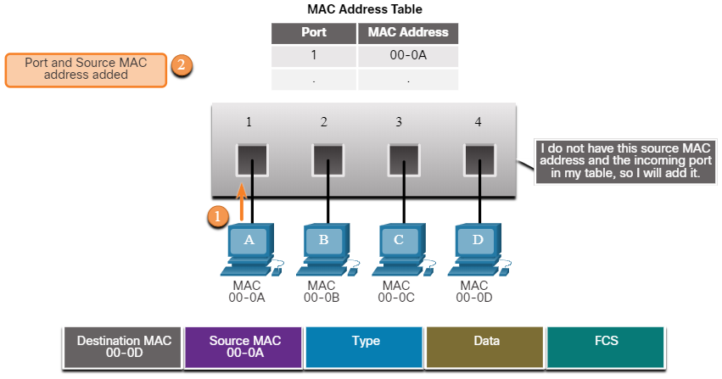
Network Communication Devices Switching Operation (Contd.)
The following two-step process is performed on every Ethernet frame that enters a switch.
Learn – Examining the Source MAC Address
Every frame that enters a switch is checked for new MAC address information by examining the frame’s source MAC address and the port number where the frame entered the switch.
If the source MAC address is not in the table, it is added to the MAC address table along with the incoming port number.
If the source MAC address does exist in the table, the switch updates the refresh timer for that entry. By default, most Ethernet switches keep an entry in the table for five minutes.
Note: If the source MAC address does exist in the table but on a different port, the switch treats this as a new entry. The entry is replaced using the same MAC address, but with the more current port number.
Notes:
11 – Network Communication Devices
11.1 – Network Devices
11.1.10 – Switching Operation

Slide 33
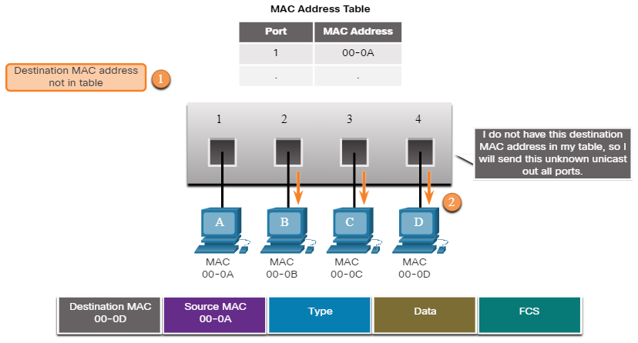
Network Communication Devices Switching Operation (Contd.)
Forward – Examining the Destination MAC Address
If the destination MAC address is a unicast address, the switch will look for a match between the destination MAC address of the frame and an entry in its MAC address table.
If the destination MAC address is in the table, it will forward the frame out the specified port.
If the destination MAC address is not in the table, the switch will forward the frame out all ports except the incoming port. This is called an unknown unicast.
Note: If the destination MAC address is a broadcast or a multicast, the frame is also flooded out all ports except the incoming port.
Notes:
11 – Network Communication Devices
11.1 – Network Devices
11.1.10 – Switching Operation

Slide 34
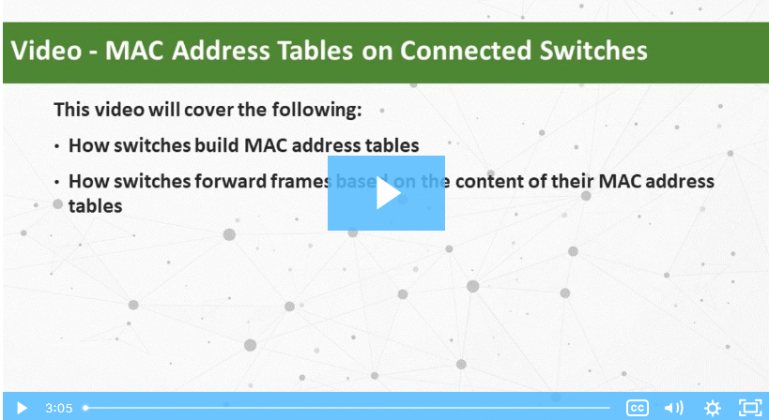
Network Communication Devices Video - MAC Address Tables on Connected Switches
A switch can have multiple MAC addresses associated with a single port. This is common when the switch is connected to another switch. The switch will have a separate MAC address table entry for each frame received with a different source MAC address.
Play the video to see a demonstration of how two connected switches build their MAC address tables.
Notes:
11 – Network Communication Devices
11.1 – Network Devices
11.1.11 – Video - MAC Address Tables on Connected Switches

Slide 35
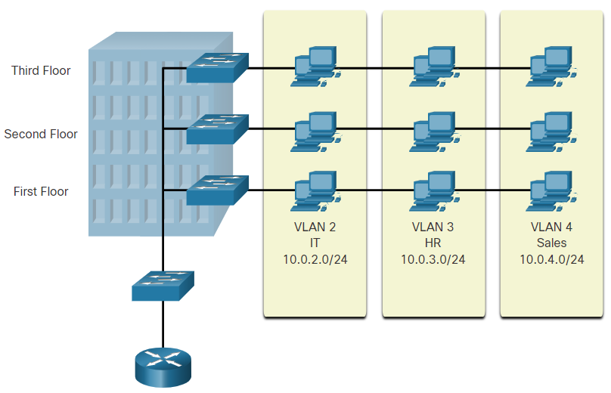
Network Communication Devices VLANs
VLANs provide a way to group devices within a LAN.
It provides segmentation and organizational flexibility within a switched internetwork.
It allows an administrator to segment networks based on factors such as function, project team, or application, without regard for the physical location of the user or device.
It creates a logical broadcast domain that can span multiple physical LAN segments.
It prevent users on different VLANs from snooping on each other’s traffic.
Notes:
11 – Network Communication Devices
11.1 – Network Devices
11.1.12 – VLANs

Slide 36
Network Communication Devices STP
The Spanning Tree Protocol is used to maintain one loop-free path in the Layer 2 network, at any time.
Loops and duplicate frames have severe consequences for a switched network. STP was developed to address these issues.
It ensures that there is one logical path between all destinations on the network by blocking redundant paths.
A port is considered blocked when user data is prevented from entering or leaving that port. This does not include bridge protocol data unit (BPDU) frames that are used by STP to prevent loops.
If the path is ever needed to compensate for a network cable or switch failure, STP recalculates the paths and unblocks the necessary ports to allow the redundant path to become active.
Notes:
11 – Network Communication Devices
11.1 – Network Devices
11.1.13 – STP

Slide 37
Network Communication Devices Multilayer Switching
Multilayer switches (Layer 3 switches) perform Layer 2 switching and also forward frames based on Layer 3 and 4 information.
All Cisco Catalyst multilayer switches support the following types of Layer 3 interfaces:
Routed port - A pure Layer 3 interface similar to a physical interface on a Cisco IOS router.
Switch virtual interface (SVI) - A virtual VLAN interface for inter-VLAN routing. In other words, SVIs are the virtual-routed VLAN interfaces.
Notes:
11 – Network Communication Devices
11.1 – Network Devices
11.1.14 – Multilayer Switching

Slide 38
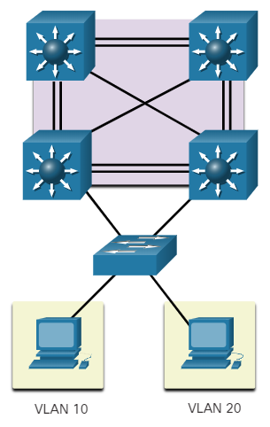
Network Communication Devices Multilayer Switching (Contd.)
Routed Ports
A routed port is a physical port that acts similarly to an interface on a router.
Unlike an access port, a routed port is not associated with a particular VLAN. It behaves like a regular router interface.
Also, as Layer 2 functionality has been removed, Layer 2 protocols, such as STP, do not function on a routed interface.
Some protocols, such as LACP and EtherChannel, do function at Layer 3. Unlike Cisco IOS routers, routed ports on a Cisco IOS switch do not support sub interfaces.
Notes:
11 – Network Communication Devices
11.1 – Network Devices
11.1.14 – Multilayer Switching

Slide 39
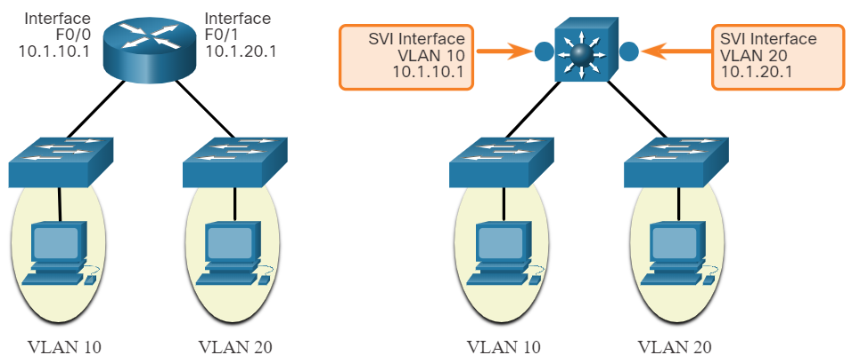
Network Communication Devices Multilayer Switching (Contd.)
Switch Virtual Interface
An SVI is a virtual interface that is configured within a multilayer switch. Unlike the basic Layer 2 switches, a multilayer switch can have multiple SVIs. An SVI can be created for any VLAN that exists on the switch.
An SVI is considered to be virtual as there is no physical port dedicated to the interface. It can perform the same functions for the VLAN as a router interface and can be configured in much the same way as a router interface.
The SVI for the VLAN provides Layer 3 processing for packets to or from all switch ports associated with that VLAN.
Notes:
11 – Network Communication Devices
11.1 – Network Devices
11.1.14 – Multilayer Switching

Slide 40
11.2 Wireless Communications
Notes:
Source:
11 – Network Communication Devices
11.2 – Wireless Communications
In-Session Activities / Explanations:
Time: 20 min
Instructor Notes:
Give a brief introduction to the topic and explain the difference between Wireless LAN and Wired LAN.
Brief the learners on various fields of 802.11 frame structure.
Ensure the learners know of CSMA/CA.
Ensure the learners understand the wireless client and AP association.
Discuss the passive and active disorder mode with the learners.
Explain the wireless devices such as AP, LWAP, and WLC to the learners.
By the end of the topic, encourage the leaners to perform the given activities.
Key Points: WLAN, 802.11 Frame Structure, CSMA/CA, Passive and Active Discover Mode, AP,WLC, LWAP, AP Association

Slide 41
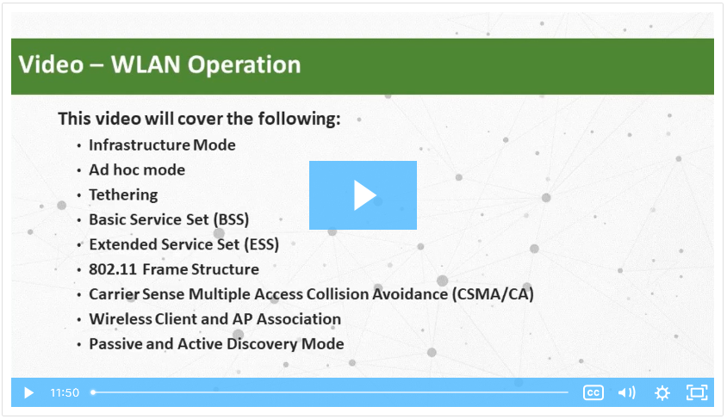
Wireless Communications
Video - Wireless Communications
Watch the video to learn about Wireless LAN (WLAN) operation.
Notes:
11 – Network Communication Devices
11.2 – Wireless Communications
11.2.1 – Video - Wireless Communications

Slide 42
Wireless Communications
Wireless versus Wired LANs
WLANs use Radio Frequencies (RF) instead of cables at the physical layer and MAC sublayer of the data link layer.
The IEEE has adopted the 802 LAN/MAN portfolio of computer network architecture standards which includes two dominant working groups 802.3 Ethernet, which defined Ethernet for wired LANs and 802.11 which defined Ethernet for WLANs.
WLANs also differ from wired LANs as follows:
WLANs connect clients to the network through a wireless access point (AP) or wireless router, instead of an Ethernet switch.
WLANs connect mobile devices that are often battery powered, as opposed to plugged-in LAN devices. Wireless NICs tend to reduce the battery life of a mobile device.
WLANs support hosts that contend for access on the RF media (frequency bands).
WLANs use a different frame format than wired Ethernet LANs. WLANs require additional information in the Layer 2 header of the frame.
WLANs raise more privacy issues because radio frequencies can reach outside the facility.
Notes:
11 – Network Communication Devices
11.2 – Wireless Communications
11.2.2 – Wireless versus Wired LANs

Slide 43
Wireless Communications
Wireless versus Wired LANs (Contd.)
The difference between WLAN and Wired LAN is summarized in the following table.
Characteristic | 802.11 Wireless LAN | 802.3 Wired Ethernet LANs
Physical Layer | Radio frequency (RF) | Physical cables
Media Access | Collision avoidance | Collision detection
Availability | Anyone with a wireless NIC in range of an access point | Physical cable connection required
Signal Interference | Yes | Minimal
Regulation | Different regulations by country | IEEE standard dictates
Notes:
11 – Network Communication Devices
11.2 – Wireless Communications
11.2.2 – Wireless versus Wired LANs

Slide 44
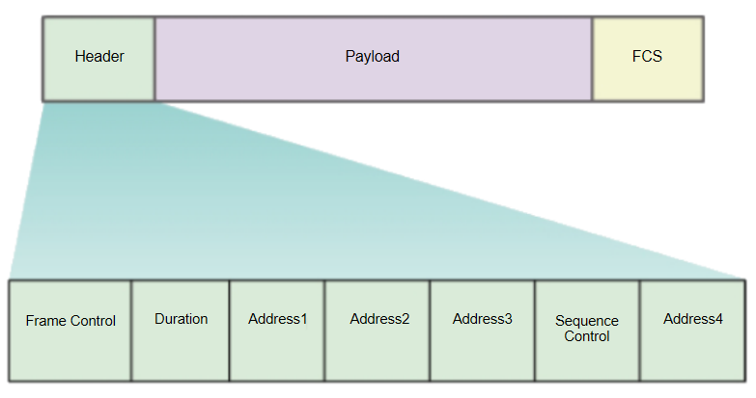
Wireless Communications
802.11 Frame Structure
All 802.11 wireless frames contain the following fields:
Frame Control – This identifies the type of wireless frame and contains subfields for protocol version, frame type, address type, power management, and security settings.
Duration – This is used to indicate the remaining duration needed to receive the next frame transmission.
Address1 – This contains the MAC address of the receiving wireless device or AP.
Address2 – This contains the MAC address of the transmitting wireless device or AP.
Notes:
11 – Network Communication Devices
11.2 – Wireless Communications
11.2.3 – 802.11 Frame Structure

Slide 45
Wireless Communications
802.11 Frame Structure (Contd.)
Address3 - This contains the MAC address of the destination, such as the router interface with AP attached.
Sequence Control – This contains information to control sequencing and fragmented frames.
Address4 - This is usually missing as it is used only in ad hoc mode.
Payload – This contains the data for transmission.
FCS – This is used for Layer 2 error control.
Notes:
11 – Network Communication Devices
11.2 – Wireless Communications
11.2.3 – 802.11 Frame Structure

Slide 46
Wireless Communications
CSMA/CA
WLANs are half-duplex, shared media configurations.
Half-duplex means that only one client can transmit or receive at any given moment.
Shared media means that wireless clients can all transmit and receive on the same radio channel.
This creates a problem because a wireless client cannot hear while it is sending, which makes it impossible to detect a collision.
To resolve this problem, WLANs use Carrier Sense Multiple Access with Collision Avoidance (CSMA/CA) method to determine how and when to send data on the network.
Notes:
11 – Network Communication Devices
11.2 – Wireless Communications
11.2.4 – CSMA/CA

Slide 47
Wireless Communications
CSMA/CA (Contd.)
A wireless client does the following:
Listens to the channel to see if it is idle. The channel is also called the carrier.
Sends a Ready To Send (RTS) message to the AP to request dedicated access to the network.
Receives a Clear To Send (CTS) message from the AP granting access to send.
If the wireless client does not receive a CTS message, it waits a random amount of time before restarting the process.
After it receives the CTS, it transmits the data.
All transmissions are acknowledged.
Notes:
11 – Network Communication Devices
11.2 – Wireless Communications
11.2.4 – CSMA/CA

Slide 48
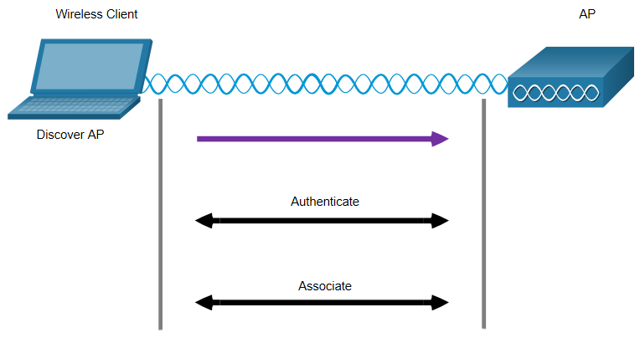
Wireless Communications
Wireless Client and AP Association
For wireless devices to communicate over a network, they must first associate with an AP or wireless router.
An important part of the 802.11 process is discovering a WLAN and subsequently connecting to it.
Wireless devices complete the following three stage process, as shown in the figure:
Discover a wireless AP
Authenticate with AP
Associate with AP
Notes:
11 – Network Communication Devices
11.2 – Wireless Communications
11.2.5 – Wireless Client and AP Association

Slide 49
Wireless Communications
Wireless Client and AP Association (Contd.)
In order to have a successful association, a wireless client and an AP must agree on specific parameters. Parameters must then be configured on the AP and subsequently on the client. The configurable wireless parameters include:
SSID -The SSID name appears in the list of available wireless networks on a client.
Password – This is required from the wireless client to authenticate to the AP.
Network mode - This refers to the 802.11a/b/g/n/ac/ad WLAN standards.
Security mode - This refers to the security parameter settings, such as WEP, WPA, or WPA2. Always enable the highest security level supported.
Channel settings - This refers to the frequency bands used to transmit wireless data.
Notes:
11 – Network Communication Devices
11.2 – Wireless Communications
11.2.5 – Wireless Client and AP Association

Slide 50
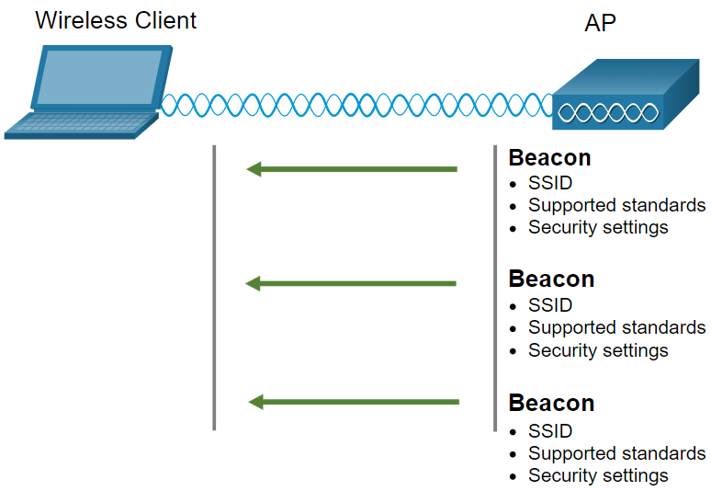
Wireless Communications
Passive and Active Discover Mode
Wireless devices must discover and connect to an AP or wireless router. Wireless clients connect to the AP using a scanning (probing) process such as passive and active.
Passive Mode
In this mode, the AP openly advertises its service by periodically sending broadcast beacon frames containing the SSID, supported standards, and security settings.
The primary purpose of the beacon is to allow wireless clients to learn which networks and APs are available in a given area.
This allows the wireless clients to choose which network and AP to use.
Notes:
11 – Network Communication Devices
11.2 – Wireless Communications
11.2.6 – Passive and Active Discover Mode

Slide 51
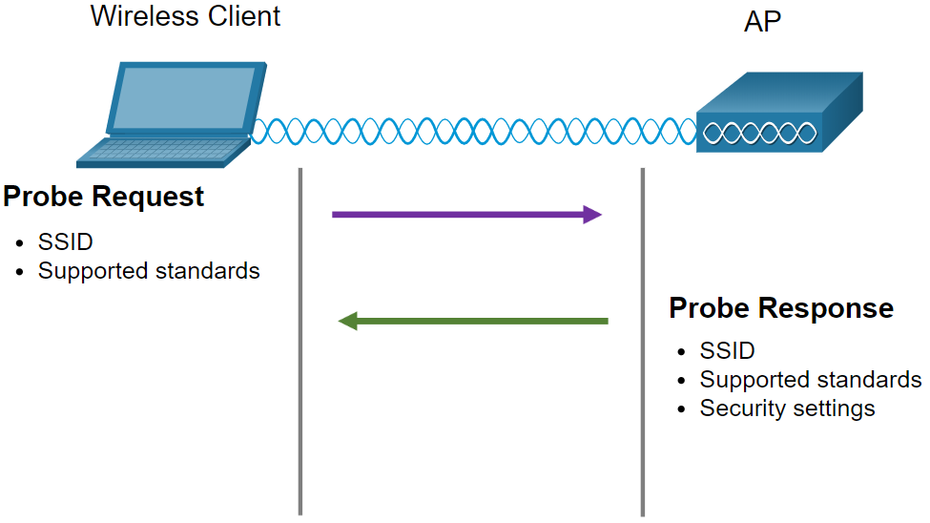
Wireless Communications
Passive and Active Discover Mode (Contd.)
Active Mode
In this mode, wireless clients must know the name of the SSID.
The wireless client initiates the process by broadcasting a probe request frame on multiple channels includes the SSID name and standards supported.
APs configured with the SSID will send a probe response that includes the SSID, supported standards, and security settings.
Active mode may be required if an AP is configured to not broadcast beacon frames.
A wireless client could also send a probe request without a SSID name to discover nearby WLAN networks. APs configured to broadcast beacon frames would respond to the wireless client with a probe response and provide the SSID name.
Notes:
11 – Network Communication Devices
11.2 – Wireless Communications
11.2.6 – Passive and Active Discover Mode
11.2.7 – Check Your Understanding – Steps in the Client and AP Process

Slide 52
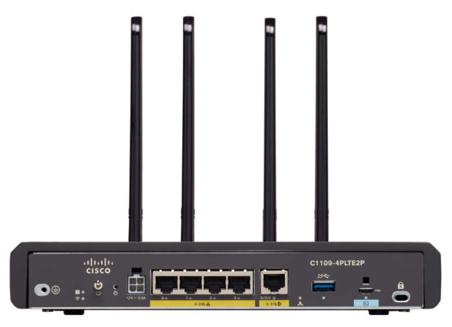
Wireless Communications
Wireless Devices - AP, LWAP, and WLC
A common wireless data implementation is enabling devices to connect wirelessly via a LAN.
In general, a wireless LAN requires wireless access points and clients that have wireless NICs.
Home and small business wireless routers integrate the functions of a router, switch, and access point into one device as shown in the figure.
In small networks, the wireless router may be the only AP as only a small area requires wireless coverage.
In larger networks, there can be many APs.
Notes:
11 – Network Communication Devices
11.2 – Wireless Communications
11.2.8 – Wireless Devices - AP, LWAP, and WLC

Slide 53
Wireless Communications
Wireless Devices - AP, LWAP, and WLC (Contd.)
All of the control and management functions of the APs on a network can be centralized into a Wireless LAN Controller (WLC).
When using a WLC, the APs no longer act autonomously, but instead act as lightweight APs (LWAPs).
LWAPs only forward data between the wireless LAN and the WLC.
All management functions, such as defining SSIDs and authentication are conducted on the centralized WLC rather than on each individual AP.
A major benefit of centralizing the AP management functions in the WLC is simplified configuration and monitoring of numerous access points, among many other benefits.
Notes:
11 – Network Communication Devices
11.2 – Wireless Communications
11.2.8 – Wireless Devices - AP, LWAP, and WLC
11.2.9 – Check Your Understanding - Identify the LAN Device

Slide 54
11.3 Network Communication Devices Summary
Notes:
Source:
11 – Network Communication Devices
11.3 – Network Communication Devices Summary
In-Session Activities / Explanations:
Time: 5 min
Instructor Notes:
Read out the summary points mentioned on the slide.
Discuss the same with the participants.
Ask if they have any questions or doubts.
Help the learners in completing the module quiz at section 11.3.2.
Key Points: NA

Slide 55
Network Communication Devices Summary
What Did I Learn in this Module?
End devices that are connected to a LAN connect to other LANs using an internetwork of intermediary devices such as routers and switches.
Routers are network layer (i.e., Layer 3) devices and use the process of routing to forward data packets between networks or sub networks.
Routers provide Path determination and Packet forwarding services.
Switches segment a LAN into separate collision domains, one for each switch port.
A switch makes forwarding decisions based on Ethernet MAC addresses that are contained in the Ethernet frame.
Switches are configured with the Spanning Tree Protocol (STP) to maintain a loop-free Layer 2 path by intentionally blocking redundant paths that could cause a loop.
Multilayer switches (also known as Layer 3 switches) not only perform Layer 2 switching, but also forward frames based on Layer 3 and 4 information.
Notes:
11 – Network Communication Devices
11.3 – Network Communication Devices Summary
11.3.1 – What Did I Learn in this Module?

Slide 56
Network Communication Devices Summary
What Did I Learn in this Module? (Contd.)
A Cisco Catalyst multilayer switch supports routed ports and switch virtual interfaces (SVIs).
Wireless networking devices connect to an Access Point (AP) or Wireless LAN Controller (WLC) suing the 802.11 standard.
The 802.11 frame format is similar to the Ethernet frame format, except that it contains additional fields.
WLAN devices use Carrier Sense Multiple Access with Collision Avoidance (CSMA/CA) as the method to determine how and when to send data on the network.
To connect to the WLAN, wireless devices complete a three-stage process to discover a wireless AP, to authenticate with the AP, and to associate with the AP.
APs can be configured autonomously (individually) or by using a WLC to simplify the configuration and monitoring of numerous access points.
Notes:
11 – Network Communication Devices
11.3 – Network Communication Devices Summary
11.3.1 – What Did I Learn in this Module?
11.3.2 – Module 11: Network Communication Devices Quiz

Slide 57
Module 11 New Terms and Commands
RIP Protocol Open Shortest Path First (OSPF) Intermediate System to Intermediate System (IS- IS) Interior Gateway Routing Protocol (IGRP) Enhanced IGRP (EIGRP) Border Gateway Protocol (BGP) Spanning Tree Protocol (STP) Bridge Protocol Data Unit (BPDU) | Switch Virtual Interface (SVI) Ready To Send (RTS) Clear To Send (CTS) Carrier Sense Multiple Access with Collision Avoidance (CSMA/CA) Passive and Active Discover Mode Access Point (AP) Wireless LAN Controller (WLC) Lightweight Aps (LWAPs)
Notes:
11 – Network Communication Devices
New Terms and Commands

