Slide 1
Module 12: Network Security Infrastructure
Instructor Materials
CyberOps Associate v1.0
Notes:
Cisco Networking Academy Program
CyberOps Associate v1.0
Module 12: Network Security Infrastructure

Slide 2
Instructor Materials – Module 12 Planning Guide
This PowerPoint deck is divided in two parts:
Instructor Planning Guide
Information to help you become familiar with the module
Teaching aids
Instructor Class Presentation
Optional slides that you can use in the classroom
Begins on slide # 9
Note: Remove the Planning Guide from this presentation before sharing with anyone.
For additional help and resources go to the Instructor Home Page and Course Resources for this course. You also can visit the professional development site on www.netacad.com, the official Cisco Networking Academy Facebook page, or Instructor Only FB group.
Notes:
2

Slide 3
What to Expect in this Module
To facilitate learning, the following features within the GUI may be included in this module:
Feature | Description
Animations | Expose learners to new skills and concepts.
Videos | Expose learners to new skills and concepts.
Check Your Understanding (CYU) | Per topic online quiz to help learners gauge content understanding.
PT Activity | Simulation and modeling activities designed to explore, acquire, reinforce, and expand skills.
Module Quizzes | Self-assessments that integrate concepts and skills learned throughout the series of topics presented in the module.
Module Summary | Briefly recaps module content.

Slide 4
Check Your Understanding
Check Your Understanding activities are designed to let students quickly determine if they understand the content and can proceed, or if they need to review.
Check Your Understanding activities do not affect student grades.
There are no separate slides for these activities in the PPT. They are listed in the notes area of the slide that appears before these activities.
Notes:
4

Slide 5
Module 12: Activities
What activities are associated with this module?
Page # | Activity Type | Activity Name | Optional?
12.1.6 | Video | Three-Layer Network Design | Recommended
12.1.8 | Check Your Understanding | Identify the Network Topology | Recommended
12.1.9 | Packet Tracer | Identify Packet Flow | Recommended
12.2.1 | Video | Security Devices | Recommended
12.2.4 | Check Your Understanding | Identify the Type of Firewall | Recommended
12.2.9 | Check Your Understanding | Compare IDS and IPS Characteristics | Recommended
12.3.1 | Video | Security Services | Recommended
12.3.4 | Packet Tracker | ACL Demonstration | Recommended
12.3.12 | Check Your Understanding | Identify the Network Security Device or Service | Recommended
Notes:
5

Slide 6
Module 12: Best Practices
Prior to teaching Module 12, the instructor should:
Review the activities and assessments for this module.
Try to include as many questions as possible to keep students engaged during classroom presentation.
Topic 12.1
Familiarize the learners with the important terms in network topology.
Demonstrate a basic topology with some of the key icons.
Reinforce the differences between the physical and logical topologies.
Ask the class to search the internet for “network topology diagrams” to see some more complex examples.
Explain the three-layer network design model via a video.
Notes:
6

Slide 7
Module 12: Best Practices (Contd.)
Topic 12.2
Ask the class what is the importance of a firewall and define its purpose.
Play an animation to demonstrate the operation of a firewall.
Explain firewalls and later ask the learners’ to list the benefits and limitations as per their understanding.
List the advantages and disadvantages of IPS and IDS.
Discuss the types of IPS.
Notes:
7

Slide 8
Module 12: Best Practices (Contd.)
Topic 12.3
Demonstrate a video to the learners to walk them through security services.
Reinforce the difference between Standard ACL and Extended ACL.
Create a Packet Tracer demonstration and refer it while explaining concepts related to ACL.
List the differences between TACACS and RADIUS protocols on the whiteboard (if, available) and explain them one by one.
Explain the concept of SNMP by illustrating its diagram on the whiteboard.
Ask the class if they are familiar with VPN.
Notes:
8

Slide 9
Module 12: Network Security Infrastructure
CyberOps Associate v1.0
Notes:
Cisco Networking Academy Program
CyberOps Associate v1.0
Module 12: Network Security Infrastructure
In-Session Activities / Explanations:
Time: 5 min
Instructor Notes:
Welcome the audience in a warm and cordial manner. Ensure that everyone is set up with the required resources.
Introduce the topic and encourage learners to come up with a list of expectations from the session. Collate topics on the white board or Desktop while using learner’s inputs to interpret them in words.
Interact with the learners to give an overview of network security infrastructure.
Read out the Objectives and briefly describe each.
Key Points: NA

Slide 10
Module Objectives
Module Title: Network Security Infrastructure
Module Objective: Explain how devices and services are used to enhance network security.
Topic Title | Topic Objective
Network Topologies | Explain how network designs influence the flow of traffic through the network.
Security Devices | Explain how specialized devices are used to enhance network security.
Security Services | Explain how network services enhance network security.
Notes:
10
CyberOps Associate v1.0
12 – Network Security Infrastructure
12.0 – Introduction
12.0.2 – What Will I Learn in this Module?

Slide 11
12.1 Network Topologies
Notes:
Source:
12 – Network Security Infrastructure
12.1– Network Topologies
In-Session Activities / Explanations:
Time: 20 min
Instructor Notes:
Explain the important terms or symbols used to represent different devices and connections within the network.
Describe the different types of topologies with their respective diagrams.
List the different types of networks.
Differentiate between LANs and WANs
Discuss the common security architectures with examples.
Ensure that the learners complete the “Check Your Understanding – Identify the Network Topology” in section 12.1.8.
Key Points: Topology diagrams, LANs and WANs, Three-Layer Network Design Model , Common Security Architectures.

Slide 12
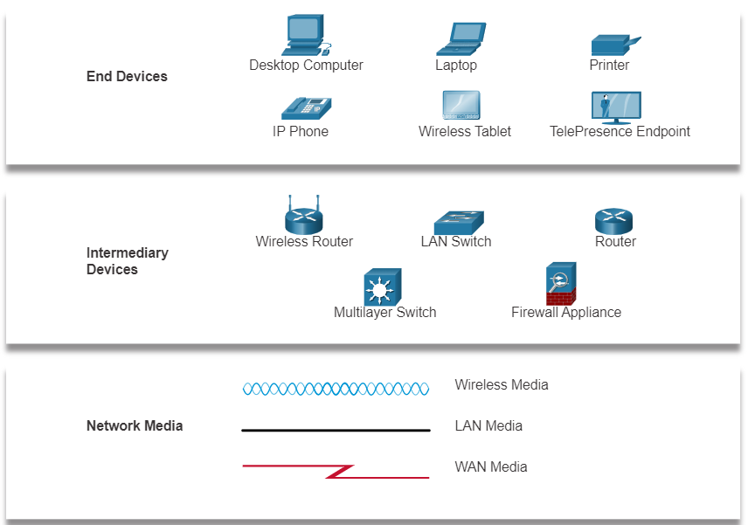
Network Security Infrastructure Network Representations
Network diagrams, often called topology diagrams, use symbols to represent different devices and connections within the network.
The important terminologies to be known include:
Network Interface Card (NIC)
Physical Port
Interface
Note: The terms port and interface are often used interchangeably.
Notes:
12 – Network Security Infrastructure
12.1– Network Topologies
12.1.1– Network Representations

Slide 13
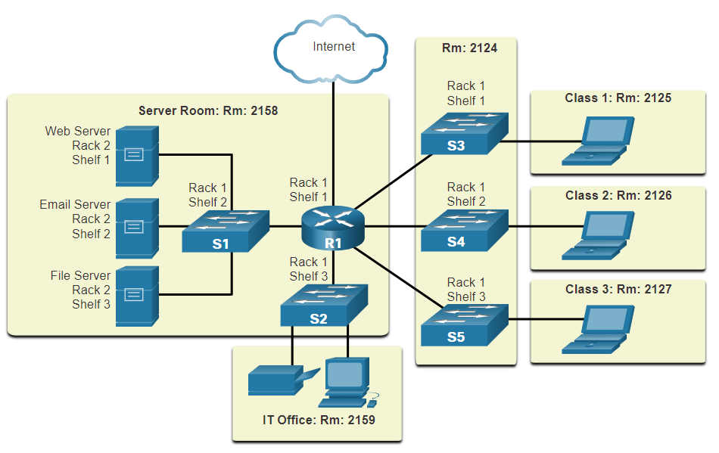
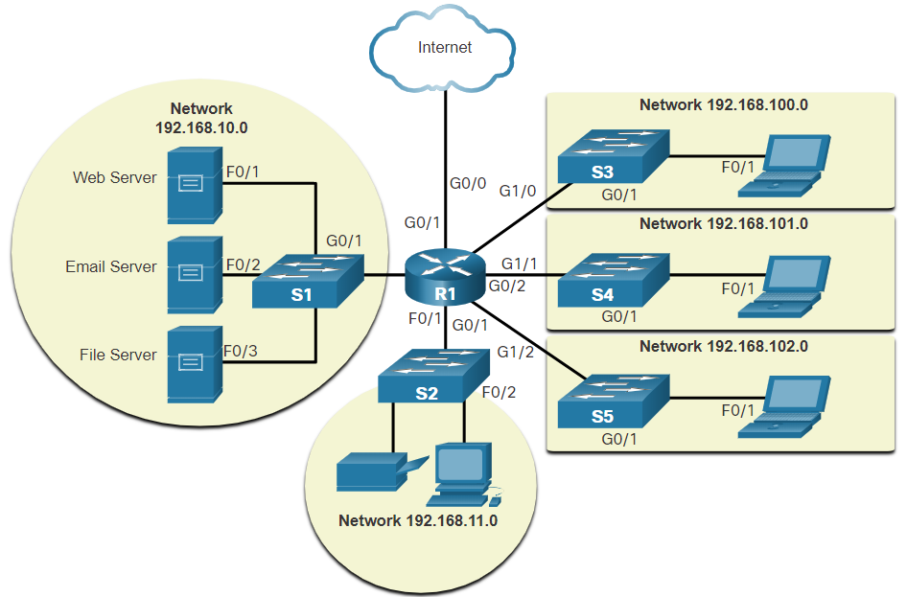
Network Security Infrastructure Topology Diagrams
Physical topology diagrams illustrate the physical location of intermediary devices and cable installation.
Logical topology diagrams illustrate devices, ports, and the addressing scheme of the network.
Notes:
12 – Network Security Infrastructure
12.1 – Network Topologies
12.1.2 – Topology Diagrams

Slide 14


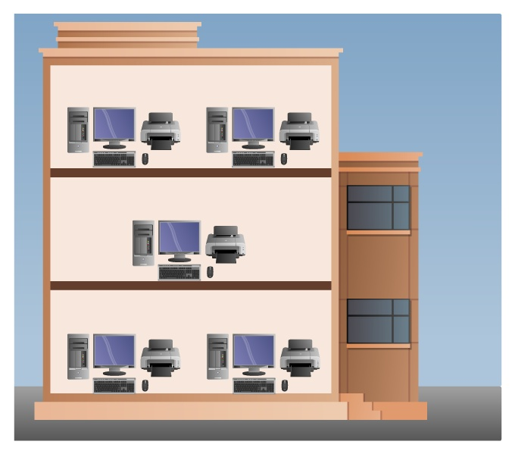
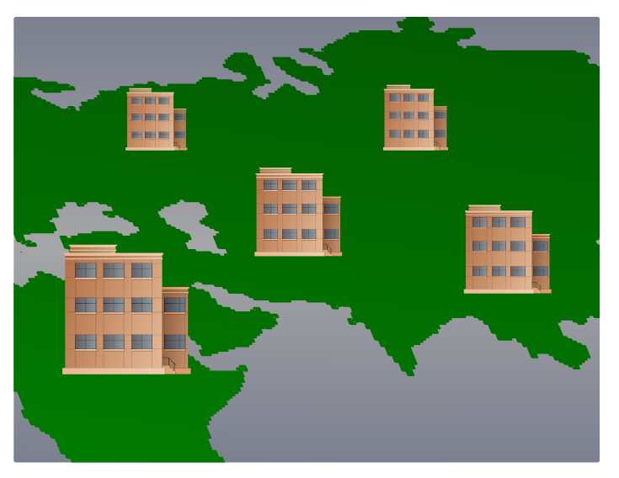
Network Security Infrastructure Networks of Many Sizes
Small Home Networks – connect a few computers to each other and the Internet.
Small Office and Home Office (SOHO) – enables computer within a home, office or remote office to connect to a corporate network, or access centralized, shared resources.
Medium to Large Networks – can have many locations with hundreds or thousands of interconnected computers.
World Wide Networks – connects hundreds of millions of computers world-wide – such as the internet.
Small Home SOHO
Medium/Large World Wide
Notes:
12 – Network Security Infrastructure
12.1– Network Topologies
12.1.3 – Networks of Many Sizes

Slide 15
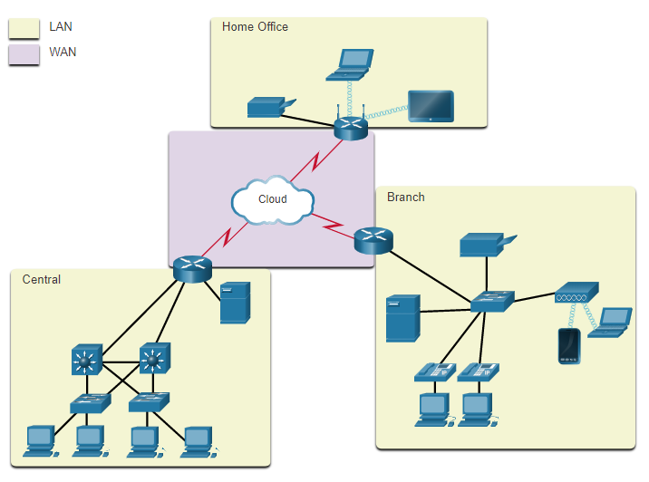
Network Topologies LANs and WANs
Network infrastructures vary greatly in terms of:
Size of the area covered
Number of users connected
Number and types of services available
Area of responsibility
The two most common types of network infrastructures are
Local Area Networks (LANs)
Wide Area Networks (WANs)
LANs connected to a WAN
Notes:
12 – Network Security Infrastructure
12.1 – Network Topologies
12.1.4 – LANs and WANs

Slide 16
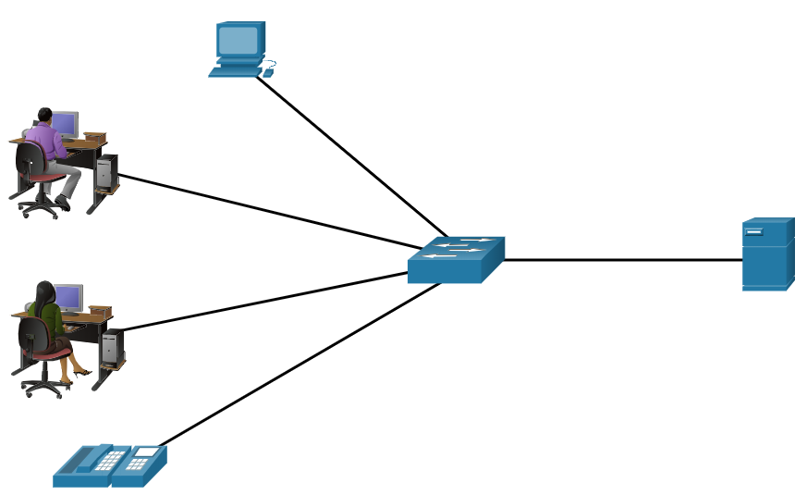
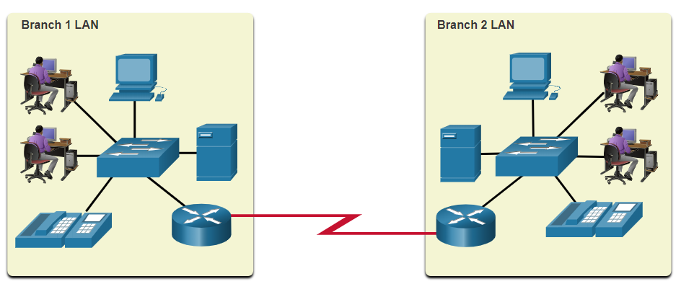
Network Topologies LANs and WANs (Contd.)
A LAN is a network infrastructure that spans a small geographical area.
A WAN is a network infrastructure that spans a wide geographical area.
LAN | WAN
Interconnect end devices in a limited area. | Interconnect LANs over wide geographical areas.
Administered by a single organization or individual. | Typically administered by multiple service providers.
Provide high-speed bandwidth to internal end devices and intermediary devices. | Typically provide slower speed links between LANs.
Notes:
12 – Network Security Infrastructure
12.1 – Network Topologies
12.1.4 – LANs and WANs

Slide 17
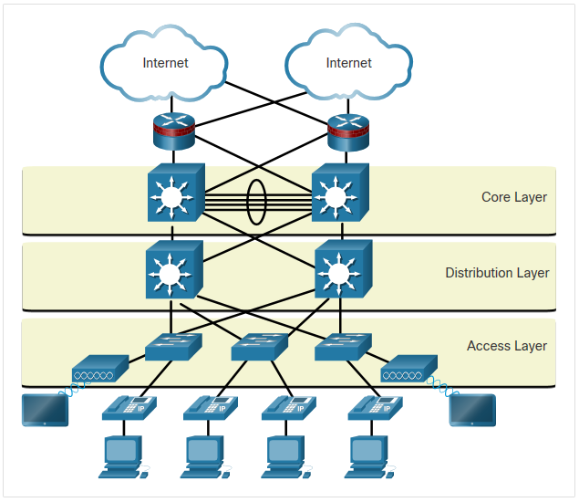
Network Security Infrastructure The Three-Layer Network Design Model
The campus wired LAN uses a hierarchical design model to separate the network topology into modular groups or layers.
The hierarchical LAN design includes three layers:
Access - Provides endpoints and users direct access to the network.
Distribution - Aggregates access layers and provides connectivity to services.
Core - Provides connectivity between distribution layers for large LAN environments.
Hierarchical Design Model
Notes:
12 – Network Security Infrastructure
12.1 – Network Topologies
12.1.5 – The Three-Layer Network Design Model

Slide 18
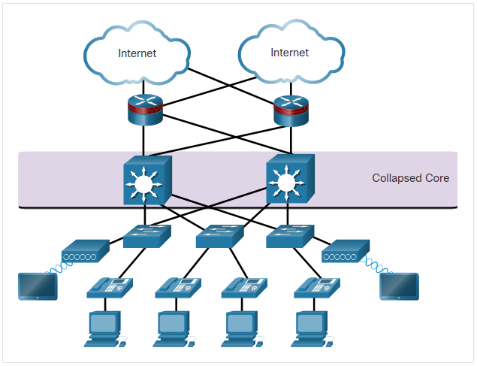
Network Security Infrastructure The Three-Layer Network Design Model (Contd.)
Although the hierarchical model has three layers, some smaller enterprise networks may implement a two-tier hierarchical design.
In this two-tier hierarchical design, the core and distribution layers are collapsed into one layer, thus reducing cost and complexity.
Collapsed Core
Notes:
12 – Network Security Infrastructure
12.1 – Network Topologies
12.1.5 – The Three-Layer Network Design Model

Slide 19
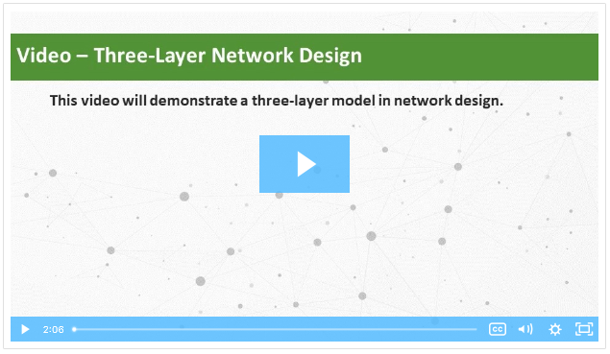
Network Security Infrastructure Video - Three-Layer Network Design
Play the video to view a demonstration of the three-layer network design model.
Notes:
12 – Network Security Infrastructure
12.1 – Network Topologies
12.1.6 – Video - Three-Layer Network Design

Slide 20
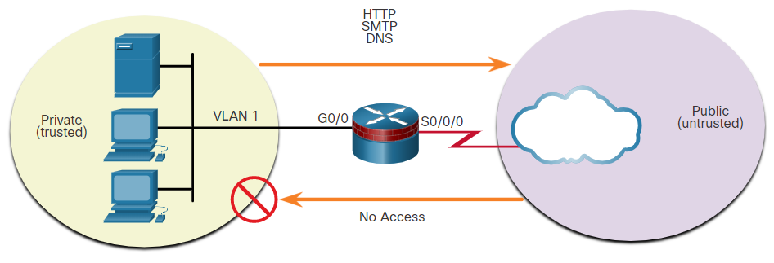
Network Security Infrastructure Common Security Architectures
Firewall design is primarily about device interfaces permitting or denying traffic based on the source, the destination, and the type of traffic.
The three firewall designs are:
Public and Private
The public network (or outside network) is untrusted, and the private network (or inside network) is trusted.
Notes:
12 – Network Security Infrastructure
12.1 – Network Topologies
12.1.7 – Common Security Architectures

Slide 21
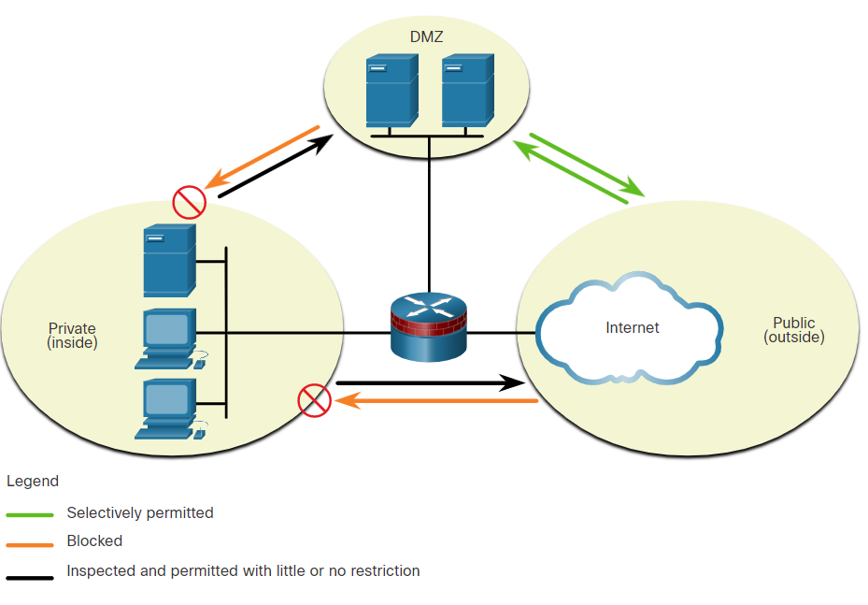
Network Security Infrastructure Common Security Architectures (Contd.)
Demilitarized Zone (DMZ)
A firewall design where there is typically one:
Inside interface connected to the private network
Outside interface connected to the public network
DMZ interface
Notes:
12 – Network Security Infrastructure
12.1 – Network Topologies
12.1.7 – Common Security Architectures

Slide 22
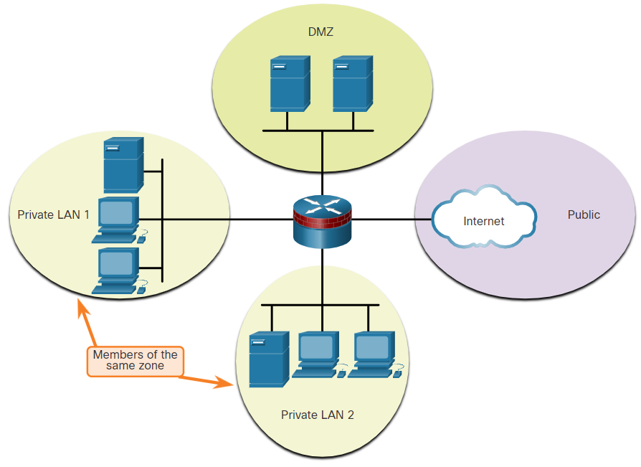
Network Security Infrastructure Common Security Architectures (Contd.)
Zone-based Policy Firewalls (ZPFs)
ZPFs use the concept of zones to provide additional flexibility.
A zone is a group of one or more interfaces that have similar functions or features.
Zones help to specify where a Cisco IOS firewall rule or policy should be applied.
Notes:
12 – Network Security Infrastructure
12.1 – Network Topologies
12.1.7 – Common Security Architectures
12.1.8 – Check your Understanding - Identify the Network Topology

Slide 23
Network Security Infrastructure Packet Tracer - Identify Packet Flow
In this Packet Tracer activity, you will observe the following:
Packet flow in a LAN and WAN topology.
Change in the packet flow path when there is a change in the network topology.
Notes:
12 – Network Security Infrastructure
12.1 – Network Topologies
12.1.9 – Packet Tracer - Identify Packet Flow

Slide 24
12.2 Security Devices
Notes:
Source:
12 – Network Security Infrastructure
12.2 – Security Devices
In-Session Activities / Explanations:
Time: 20 min
Instructor Notes:
Introduce the topic by demonstrating a video to the learners on security devices.
Explain the different types of firewalls with examples.
Describe the concepts of IPS and IDS.
Discuss examples of specialized security appliances.
Ensure that the learners complete the “Check Your Understanding – Identify the Type of Firewall” in section 12.2.4.
Key Points: Firewalls, Intrusion Detection and Prevention systems, Specialized Security Appliances

Slide 25
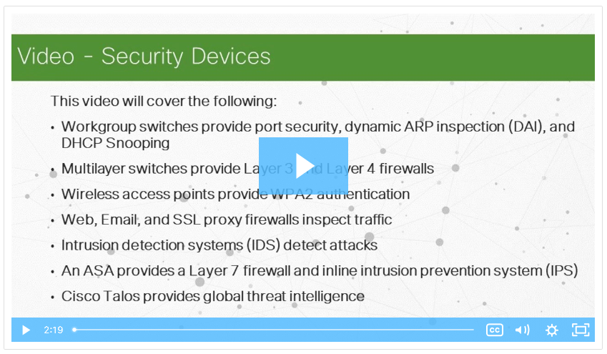
Security Devices Video - Security Devices
Play the video to learn more on security services.
Notes:
12 – Network Security Infrastructure
12.2 – Security Devices
12.2.1 – Video - Security Devices

Slide 26
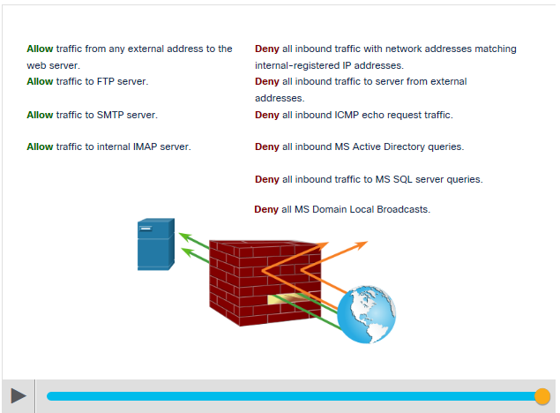
Security Devices Firewalls
A firewall is a system, or group of systems, that enforces an access control policy between networks.
Common Firewall Properties:
Resistant to network attacks
The only transit point between internal corporate networks and external networks because all traffic flows through the firewall
Enforce the access control policy
Play the animation in the figure to view a firewall in operation.
Notes:
12 – Network Security Infrastructure
12.2 – Security Devices
12.2.2 – Firewalls

Slide 27
Security Devices Firewalls (Contd.)
Following are the benefits and limitations of firewalls:
Firewall Benefits | Firewall Limitations
Prevent the exposure of sensitive hosts, resources, and applications to untrusted users. | A misconfigured firewall can have serious consequences for the network, such as becoming a single point of failure.
Sanitize protocol flow, which prevents the exploitation of protocol flaws. | The data from many applications cannot be passed over firewalls securely.
Block malicious data from servers and clients. | Users might proactively search for ways around the firewall to receive blocked material, which exposes the network to potential attack.
Reduce security management complexity. | Network performance can slow down.
 | Unauthorized traffic can be tunnelled or hidden as legitimate traffic through the firewall.
Notes:
12 – Network Security Infrastructure
12.2 – Security Devices
12.2.2 – Firewalls

Slide 28
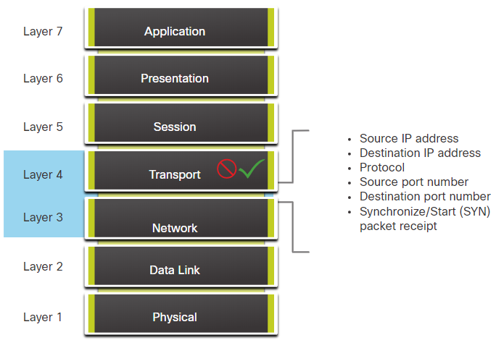
Security Devices Firewall Type Descriptions
The different types of firewalls are:
Packet Filtering (Stateless) Firewall
Packet Filtering firewalls are part of a router firewall, which permits or denies traffic based on Layer 3 and Layer 4 information.
They are stateless firewalls that use a simple policy table look-up that filters traffic based on specific criteria.
Notes:
12 – Network Security Infrastructure
12.2 – Security Devices
12.2.3 – Firewall Type Descriptions

Slide 29
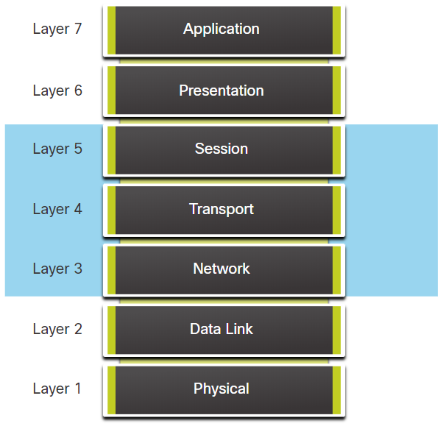
Security Devices Firewall Type Descriptions (Contd.)
Stateful Firewalls
Stateful firewalls are the most versatile and the most common firewall technologies in use.
These firewalls provide stateful packet filtering by using connection information maintained in a state table.
Notes:
12 – Network Security Infrastructure
12.2 – Security Devices
12.2.3 – Firewall Type Descriptions

Slide 30
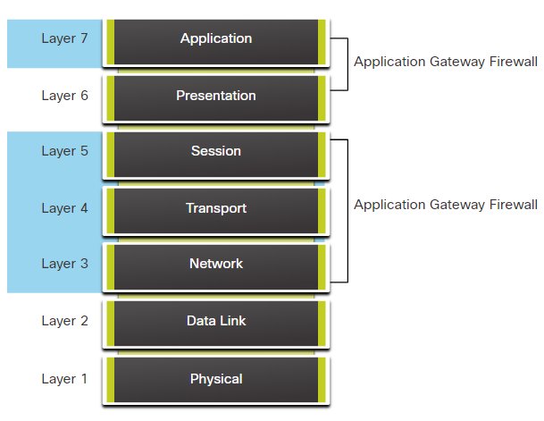
Security Devices Firewall Type Descriptions (Contd.)
Application gateway firewall (proxy firewall)
Application gateway firewall filters information at Layers 3, 4, 5, and 7 of the OSI reference model.
Most of the firewall control and filtering is done in the software.
Notes:
12 – Network Security Infrastructure
12.2 – Security Devices
12.2.3 – Firewall Type Descriptions

Slide 31
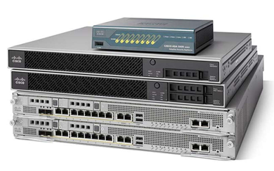
Security Devices Firewall Type Descriptions (Contd.)
Next-generation firewalls (NGFW)
NGFW go beyond stateful firewalls by providing:
Integrated intrusion prevention
Application awareness and control to see and block risky apps
Upgrade paths to include future information feeds
Techniques to address evolving security threats
Notes:
12 – Network Security Infrastructure
12.2 – Security Devices
12.2.3 – Firewall Type Descriptions

Slide 32
Security Devices Firewall Type Descriptions (Contd.)
Other methods of implementing firewalls include:
Host-based (server and personal) firewall - A PC or server with firewall software running on it.
Transparent firewall - Filters IP traffic between a pair of bridged interfaces.
Hybrid firewall - A combination of various firewall types.
Notes:
12 – Network Security Infrastructure
12.2 – Security Devices
12.2.3 – Firewall Type Descriptions
12.2.4 – Check Your Understanding - Identify the Type of Firewall

Slide 33
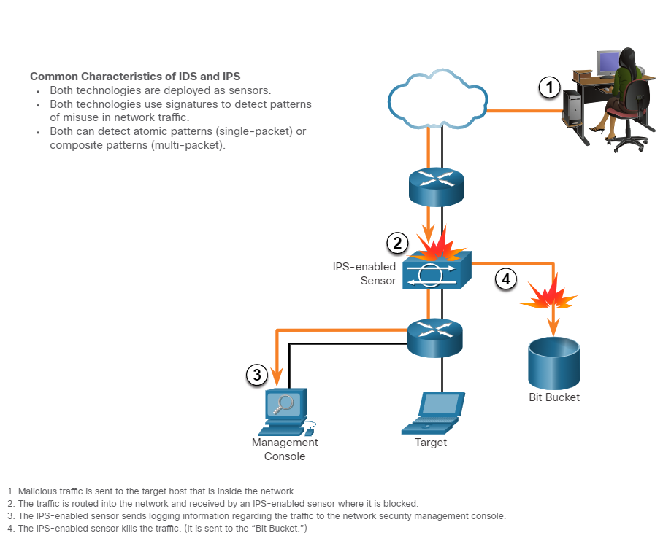
Security Devices Intrusion Prevention and Detection Devices
A networking architecture paradigm shift is required to defend against fast-moving and evolving attacks. This must include cost effective and prevention systems such as:
Intrusion Detection Systems (IDS)
Intrusion Prevention Systems (IPS)
The network architecture integrates these solutions into the entry and exit points of the network.
The figure shows how an IPS device handles malicious traffic.
Notes:
12 – Network Security Infrastructure
12.2 – Security Devices
12.2.5 – Intrusion Prevention and Detection Devices

Slide 34
Security Devices Advantages and Disadvantages of IDS and IPS
The table lists the advantages and disadvantages of IDS and IPS:
Solution | Advantages | Disadvantages
IDS | No Impact on network (latency, jitter) No Network impact if there is a sensor failure No network impact if there is sensor overload | Response action cannot stop trigger packets Correct tuning required for response actions More vulnerable to network security evasion techniques
IPS | Stops trigger packets Can use stream normalization techniques | Sensor issues might affect network traffic Sensor overloading impacts the network Some impact on network (latency, jitter)
Deployment Consideration:
IPS and IDS technologies can complement each other.
Deciding which implementation to use is based on the security goals of the organization as stated in their network security policy.
Notes:
12 – Network Security Infrastructure
12.2 – Security Devices
12.2.6 – Advantages and Disadvantages of IDS and IPS

Slide 35
Security Devices Types of IPS
There are two primary kinds of IPS :
Host-based IPS
Network-based IPS
Host-based IPS (HIPS)
HIPS is a software installed on a host to monitor and analyze suspicious activity.
Advantages | Disadvantages
Provides protection specific to a host operating system Provides operating system and application level protection Protects the host after the message is decrypted | Operating system dependent Must be installed on all hosts
Notes:
12 – Network Security Infrastructure
12.2 – Security Devices
12.2.7 – Types of IPS

Slide 36
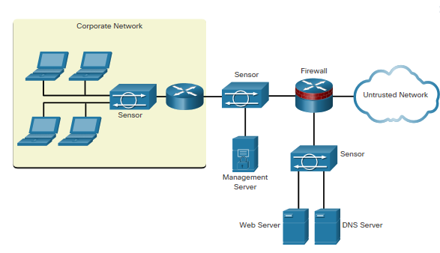
Security Devices Types of IPS (Contd.)
Network-based IPS
Network-based IPS are Implemented using a dedicated or non-dedicated IPS device.
Host-based IDS/IPS solutions are integrated with a network-based IPS implementation to ensure a robust security architecture.
Sensors detect malicious and unauthorized activity in real time and can take action when required.
Notes:
12 – Network Security Infrastructure
12.2 – Security Devices
12.2.7 – Types of IPS

Slide 37
Security Devices Specialized Security Appliances
Few examples of specialized security appliances.
Cisco Advanced Malware Protection (AMP) | Cisco Web Security Appliance (WSA) | Cisco Email Security Appliance (ESA)
An enterprise-class advanced malware analysis and protection solution | A secure web gateway that combines leading protections to help organizations address the growing challenges of securing and controlling web traffic | ESA/Cisco Cloud Email Security helps to mitigate email-based threats and the ESA defends mission-critical email systems
It provides comprehensive malware protection for organizations before, during, and after an attack | Protects the network by automatically blocking risky sites and testing unknown sites before allowing users to access them | Constantly updated by real-time feeds from Cisco Talos, which detects and correlates threats using a worldwide database monitoring system
 |  | Features: Global threat intelligence, Spam blocking, Advanced Malware Protection, Outbound Message Control
Notes:
12 – Network Security Infrastructure
12.2 – Security Devices
12.2.8 – Specialized Security Appliances
12.2.9 – Check Your Understanding - Compare IDS and IPS Characteristics

Slide 38
12.3 Security Services
Notes:
Source:
12 – Network Security Infrastructure
12.3 – Security Services
In-Session Activities / Explanations:
Time: 15 min
Instructor Notes:
In this topic, the leaners will get a knowledge of the different security services available.
List the important features of ACL
Discuss Simple Network Management Protocol (SNMP) with the help of an example.
Describe NetFlow
Briefly explain port mirroring
Discuss Syslog servers
Explain NTP
Ensure that the learners complete the “Check Your Understanding - Identify the Network Security Device or Service” in section 12.3.12.
Walk the learners through AAA servers
Describe VPN
Key Points: ACL, SNMP, NetFlow, Port Mirroring, Syslog Server, NTP, AAA, VPN

Slide 39
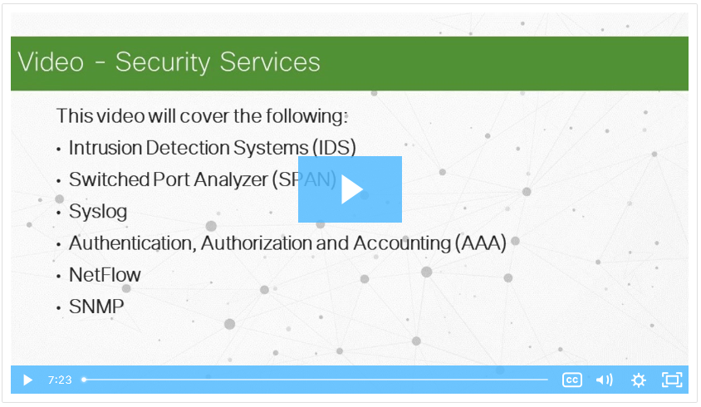
Security Services Video - Security Services
Watch the video to learn more on different security services.
Notes:
12 – Network Security Infrastructure
12.3 – Security Services
12.3.1 – Video - Security Services

Slide 40
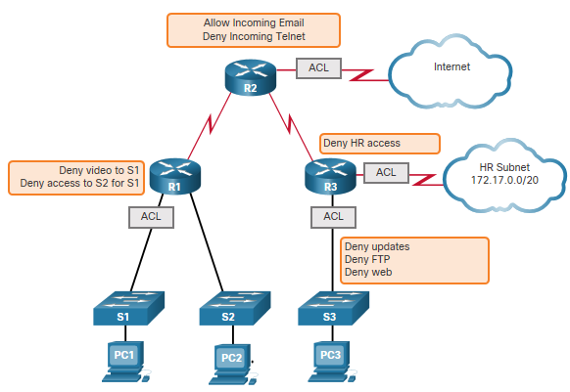
Security Services Traffic Control with ACLs
An Access Control List (ACL) is a series of commands that control whether a device forwards or drops packets based on information found in the packet header.
When configured, ACLs perform the following tasks:
Limit network traffic to increase network performance.
Provide traffic flow control.
Provide basic level of security for network access.
Filter traffic based on traffic type.
Screen hosts to permit or deny access to network services.
Sample Topology with ACLs applied to routers R1, R2, and R3.
Notes:
12 – Network Security Infrastructure
12.3 – Security Services
12.3.2 – Traffic Control with ACLs

Slide 41
Security Services ACLs: Important Features
The two types of Cisco IPv4 ACLs are:
Standard ACL - Used to permit or deny traffic only from source IPv4 addresses.
Extended ACL - Filters IPv4 packets based on several attributes that include:
Protocol type
Source IPv4 address
Destination IPv4 address
Source TCP or UDP ports
Destination TCP or UDP ports
Optional protocol type information for finer control
Standard and extended ACLs can be created using either a number or a name to identify the ACL and its list of statements.
Notes:
12 – Network Security Infrastructure
12.3 – Security Services
12.3.3 – ACLs: Important Features

Slide 42
Security Services Packet Tracer - ACL Demonstration
In this activity, you will observe the following:
How an ACL can be used to prevent a ping from reaching hosts on remote networks.
After removing the ACL from the configuration, the pings will be successful.
Notes:
12 – Network Security Infrastructure
12.3 – Security Services
12.3.4 – Packet Tracer - ACL Demonstration

Slide 43
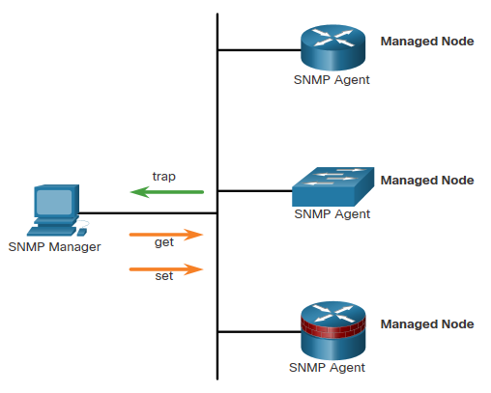
Security Services SNMP
Simple Network Management Protocol (SNMP) is an application layer protocol that provides a message format for communication between managers and agents.
It allows network administrators to perform the following:
Manage end devices such as servers, workstations, routers, switches, and security appliances, on an IP network.
Monitor and manage network performance.
Find and solve network problems.
Plan for network growth.
The SNMP system consists of two elements:
SNMP manager: Runs SNMP management software.
SNMP agents: Nodes being monitored and managed.
Notes:
12 – Network Security Infrastructure
12.3 – Security Services
12.3.5 – SNMP

Slide 44
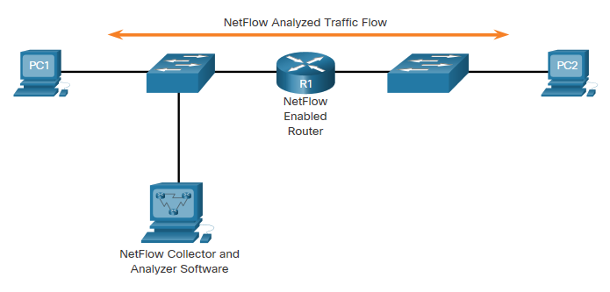
Security Services NetFlow
NetFlow is a Cisco IOS technology that provides statistics on packets flowing through a Cisco router or multilayer switch.
NetFlow provides data to enable:
network and security monitoring,
network planning
traffic analysis to include identification of network bottlenecks
IP accounting for billing purposes.
NetFlow can monitor application connection, tracking byte and packet counts for that individual application flow.
It then pushes the statistics over to an external server called a NetFlow collector.
PC 1 connects to PC 2 using HTTPS
Notes:
12 – Network Security Infrastructure
12.3 – Security Services
12.3.6 – NetFlow

Slide 45
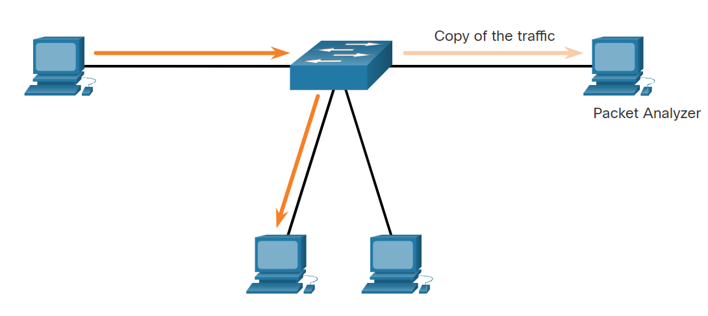
Security Services Port Mirroring
Port mirroring is a feature that allows a switch to make duplicate copies of traffic passing through a switch, and then sending it out a port with a network monitor attached.
Traffic Sniffing Using a Switch
Notes:
12 – Network Security Infrastructure
12.3 – Security Services
12.3.7 – Port Mirroring

Slide 46
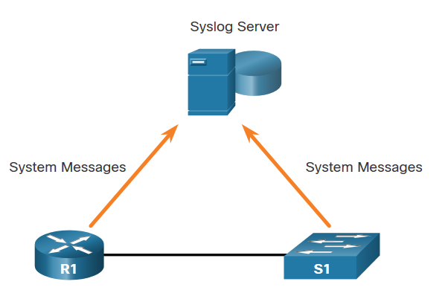
Security Services Syslog Servers
The most common method of accessing system messages is to use a protocol called syslog.
The Syslog protocol allows networking devices to send their system messages across the network to syslog servers.
It provides three primary functions:
The ability to gather logging information for monitoring and troubleshooting
The ability to select the type of logging information that is captured
The ability to specify the destination of captured syslog messages
Syslog
Notes:
12 – Network Security Infrastructure
12.3 – Security Services
12.3.8 – Syslog Servers

Slide 47
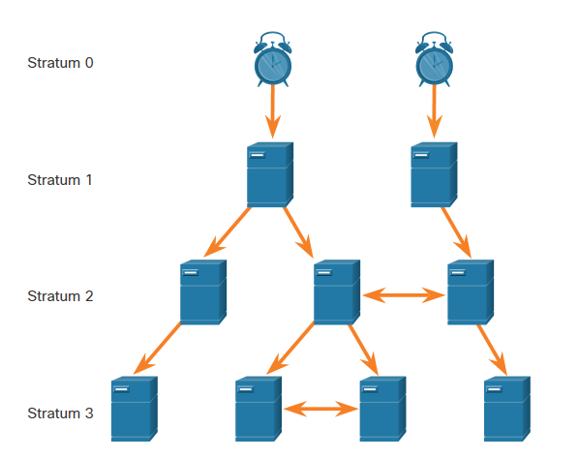
Security Services NTP
It is important to synchronize the time across all devices on the network. The date and time settings on a network device can be set using one of two methods:
Manual configuration of the date and time
Configuring the Network Time Protocol (NTP)
NTP networks use a hierarchical system of time sources, where each level in this system is called a stratum. NTP servers are arranged in three levels known as strata:
Stratum 0: An NTP network gets the time from authoritative time sources.
Stratum 1: Devices are directly connected to the authoritative time sources.
Stratum 2 and lower strata: Stratum 2 devices, such as NTP clients, synchronize their time using the NTP packets from stratum 1 servers.
NTP Stratum Levels
Notes:
12 – Network Security Infrastructure
12.3 – Security Services
12.3.9 – NTP

Slide 48
Security Services AAA Servers
The below table lists the three independent security functions provided by the AAA architectural framework.
Functions | Description
Authentication | Users and administrators must prove that they are who they say they are. Authentication can be established using username and password combinations, challenge and response questions, token cards, and other methods. AAA authentication provides a centralized way to control access to the network.
Authorization | After the user is authenticated, authorization services determine which resources the user can access and which operations the user is allowed to perform. An example is “User ‘student’ can access host serverXYZ using SSH only.”
Accounting | Accounting records what the user does, including what is accessed, the amount of time the resource is accessed, and any changes that were made. Accounting keeps track of how network resources are used. An example is "User ‘student’ accessed host serverXYZ using SSH for 15 minutes."
Notes:
12 – Network Security Infrastructure
12.3 – Security Services
12.3.10 – AAA Servers

Slide 49
Security Services AAA Servers (Contd.)
The below table lists the difference between Terminal Access Controller Access-Control System Plus (TACACS+) and Remote Authentication Dial-In User Service (RADIUS) protocols.
 | TACACS+ | RADIUS
Functionality | Separates AAA according to the AAA architecture, | Combines authentication and authorization but separates accounting,
Standard | Mostly Cisco supported | Open/RFC standard
Transport | TCP | UDP
Protocol CHAP | Bidirectional challenge and response as used in Challenge Handshake Authentication Protocol (CHAP) | Unidirectional challenge and response from the RADIUS security server to the RADIUS client
Confidentiality | Entire packet encrypted | Password encrypted
Customization | Provides authorization of router commands on per-user or per-group basis | No option to authorize router commands on a per-user or per-group basis
Accounting | Limited | Extensive
Notes:
12 – Network Security Infrastructure
12.3 – Security Services
12.3.10 – AAA Servers

Slide 50
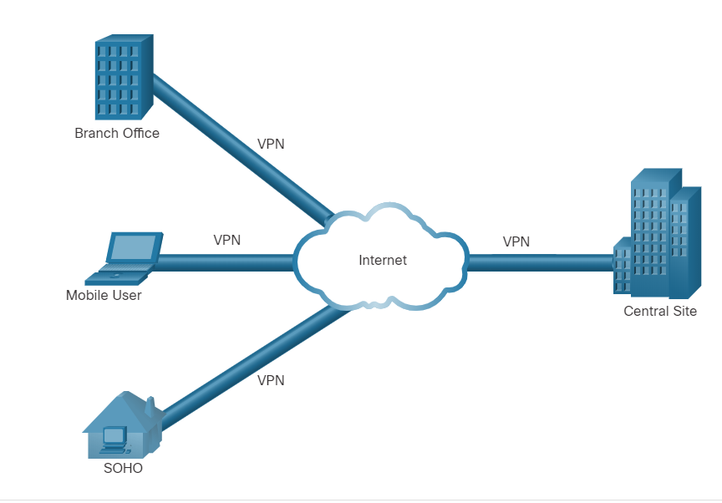
Security Services VPN
A VPN is a private network that is created over a public network (usually the internet).
A VPN uses virtual connections routed through the Internet from the organization to the remote site.
A VPN is a communications environment in which access is strictly controlled to permit peer connections within a defined community of interest.
Confidentiality is achieved by encrypting the traffic within the VPN.
In short, VPN connects two endpoints over a public network, to form a logical connection which can be made at Layer 2 or Layer 3.
Virtual Private Network
Notes:
12 – Network Security Infrastructure
12.3 – Security Services
12.3.11 – VPN
12.3.12 – Check Your Understanding - Identify the Network Security Device or Service

Slide 51
12.4 Network Security Infrastructure Summary
Notes:
Source:
12 – Network Security Infrastructure
12.4 – Network Security Infrastructure Summary
In-Session Activities / Explanations:
Time: 5 min
Instructor Notes:
Read out the summary points mentioned on the slide.
Discuss the same with the participants.
Ask if they have any questions or doubts.
At the end, ask the students to complete the module quiz.
Key Points: NA

Slide 52
Network Security Infrastructure Summary What Did I Learn in this Module?
Networks are typically represented as physical and logical topologies.
A physical topology represents physical connections and how end devices are connected whereas a logical topology refers to the standards and protocols that devices use to communicate.
The two most common types of network infrastructures are LANs and WANs.
The campus wired LAN design consists of hierarchical layers (access, distribution, core) with each layer assigned specific functions.
Common security architectures define the boundaries of traffic entering and leaving the network.
The different types of firewalls are Packet filtering firewalls, stateful inspection firewall, Application gateway firewalls, Next-generation firewalls.
Notes:
12 – Network Security Infrastructure
12.4 – Network Security Infrastructure Summary
12.4.1– What Did I Learn in this Module?

Slide 53
Network Security Infrastructure Summary What Did I Learn in this Module? (Contd.)
Intrusion prevention systems (IPS) and intrusion detection systems (IDS) are used to detect potential security risks and alert/stop unsafe traffic.
Specialized security appliances are available including Cisco Advanced Malware Protection (AMP), Cisco Web Security Appliance (WSA), and Cisco Email Security Appliance (WSA).
ACLs are a series of statements that control whether a device forwards or drops packets based on information found in the packet header.
SNMP enables network administrators to monitor and manage network performance, find and solve network problems, and plan for network growth.
NetFlow provides statistics on packets that are flowing through a Cisco router or multilayer switch.
Port mirroring is a feature that allows a switch to make duplicate copies of traffic that is passing through the switch, and then send it out a port that has a network monitor attached.
Notes:
12 – Network Security Infrastructure
12.4 – Network Security Infrastructure Summary
12.4.1– What Did I Learn in this Module?

Slide 54
Network Security Infrastructure Summary What Did I Learn in this Module? (Contd.)
Syslog servers compile and provide access to the system messages generated by networking devices.
NTP synchronizes the system time across all devices on the network to ensure accurate and consistent timestamping of system messages.
AAA is a framework for configuring user authentication, authorization, and accounting services. It typically uses a TACACS+ or RADIUS server for this purpose.
VPNs are private networks that are created between two endpoints across a public network.
Notes:
12 – Network Security Infrastructure
12.4 – Network Security Infrastructure Summary
12.4.1– What Did I Learn in this Module?
12.4.2 – Module 12: Network Security Infrastructure Quiz

Slide 55
Module 12 New Terms and Commands
Topology Diagram Demilitarized Zone (DMZ) Zone-based Policy Firewalls (ZPF) Packet Filtering Firewall Stateful Firewall Application gateway Firewall (Proxy Firewall) Next- Generation Firewall(NGFW) Host based Firewall Transparent Firewall Hybrid Firewall | Intrusion Detection Systems(IDS) Intrusion Prevention Systems(IPS) Cisco Advanced Malware Protection(AMP) Cisco Web Security Appliance (WSA) Cisco Cloud Web Security (CWS) Cisco Email Security Appliance (ESA) Access Control List (ACL) | Standard ACL Extended ACL Simple Network Management Protocol (SNMP) NetFlow Port Mirroring Syslog Server Network Time Protocol (NTP) Stratum TACACS+ RADIUS VPN
Notes:
12 – Network Security Infrastructure
New Terms and Commands

