Slide 1
Module 13: Attackers and Their Tools
Instructor Materials
CyberOps Associate v1.0
Notes:
Cisco Networking Academy Program
CyberOps Associate v1.0
Module 13: Attackers and Their Tools

Slide 2
Instructor Materials – Module 13 Planning Guide
This PowerPoint deck is divided in two parts:
Instructor Planning Guide
Information to help you become familiar with the module
Teaching aids
Instructor Class Presentation
Optional slides that you can use in the classroom
Begins on slide # 8
Note: Please remove the Planning Guide from this presentation before sharing with anyone.
For additional help and resources, go to the Instructor Home Page and Course Resources for this course. You also can visit the professional development site on www.netacad.com, the official Cisco Networking Academy Facebook page, or Instructor Only FB group.
Notes:
2

Slide 3
What to Expect in this Module
To facilitate learning, the following features within the GUI may be included in this module:
Feature | Description
Animations | Expose learners to new skills and concepts.
Interactive Activities | A variety of formats to help learners gauge content understanding.
Module Quizzes | Self-assessments that integrate concepts and skills learned throughout the series of topics presented in the module.
Module Summary | Briefly recaps module content.

Slide 4
Check Your Understanding
Check Your Understanding activities are designed to let students quickly determine if they understand the content and can proceed, or if they need to review.
Check Your Understanding activities do not affect student grades.
There are no separate slides for these activities in the PPT. They are listed in the notes area of the slide that appears before these activities.
Notes:
4

Slide 5
Module 13: Activities
What activities are associated with this module?
Page # | Activity Type | Activity Name | Optional?
13.2.4 | Check Your Understanding | Classify Cyber Attacks | Recommended
Notes:
5

Slide 6
Module 13: Best Practices
Prior to teaching Module 13, the instructor should:
Review the activities and assessments for this module.
Try to include as many questions as possible to keep students engaged during classroom presentation.
Topic 13.1
Ask the class:
What is network attack?
Discuss the importance of cybersecurity in an organization.
Discuss the term threat,vulnerability,risk.
Briefly explain four ways to manage risk.
Notes:
6

Slide 7
Module 13: Best Practices (Contd.)
Topic 13.1 (Contd.)
Ask the learners if any one of them have experienced bankruptcy or money deduction by an unknown source. If so, ask them the following questions:
How did the money deduction take place? What could be the reason?
Did you try tracking your information?
After asking these questions, explain to the learners the concept of cybercriminals.
Differentiate between IOC and IOA.
Topic 13.2
Ask students about various security tools and briefly explain each one of them
Ask students about various security attacks and briefly explain each one of them
Notes:
7

Slide 8
Module 13:Attackers and Their Tools
CyberOps Associate v1.0
Notes:
Cisco Networking Academy Program
CyberOps Associate v1.0
Module 13: Attackers and Their Tools
In-Session Activities / Explanations:
Time: 5 min
Instructor Notes:
Welcome the audience in a warm and cordial manner. Ensure that everyone is set up with the required resources.
Introduce yourself briefly and invite participants to introduce themselves with name, dept. and role, if deemed all right.
Introduce the topic and encourage learners to come up with a list of expectations from the session. Collate topics on the white board or Desktop while using learner’s inputs to interpret them in words.
Read out the Objectives and briefly describe each.
Key Points: NA

Slide 9
Module Objectives
Module Title: Attackers and Their Tools
Module Objective: Explain how networks are attacked.
Topic Title | Topic Objective
Who is Attacking our Network | Explain how network threats have evolved.
Threat Actor Tools | Describe the various types of attack tools used by Threat Actors.
Notes:
9
13 – Attackers and Their Tools
13.0.2 – What will I learn to do in this module?

Slide 10
13.1 Who is Attacking Our Network?
Notes:
13 – Attackers and Their Tools
13.1– Who is Attacking Our Network?
In-Session Activities / Explanations:
Time: 15 min
Instructor Notes:
This topic describes about network attackers and their attacking tools.
Ask the students the importance of cybersecurity.
Discuss Threat, Vulnerability and Risks with examples.
Briefly explain hacking and its types.
Explain the key performance of IOC and IOA
Key Points: Attack in network, Cybersecurity, Hackers, Threat Actors , Cybersecurity awareness, IOC, IOA

Slide 11

Attackers and Their Tools
Threat, Vulnerability, and Risk
Attackers wants to access our assets such as data and other intellectual property, servers, computers, smart phones, tablets, and so on.
Notes:
13 – Attackers and Their Tools
13.1 – Who is Attacking Our Network?
13.1.1 – Threat, Vulnerability, and Risk

Slide 12
Attackers and Their Tools
Threat, Vulnerability, and Risk (Contd.)
To understand network security, it is important to know the following terms:
TERM | EXPLANATION
Threat | A potential danger to an asset such as data or the network itself.
Vulnerability | A weakness in a system or its design that could be exploited by a threat.
Attack Surface | An attack surface is the total sum of the vulnerabilities in a given system that are accessible to an attacker. The attack surface describes different points where an attacker could get into a system, and where they could get data out of the system.
Exploit | The mechanism that is used to leverage a vulnerability to compromise an asset. Exploits may be remote or local. A remote exploit is one that works over the network without any prior access to the target system. In a local exploit, the threat actor has some type of user or administrative access to the end system. It does not necessarily mean that the attacker has physical access to the end system.
Risk | The likelihood that a particular threat will exploit a particular vulnerability of an asset and result in an undesirable consequence.
Notes:
13 – Attackers and Their Tools
13.1 – Who is Attacking Our Network?
13.1.1 – Threat, Vulnerability, and Risk

Slide 13
Attackers and Their Tools
Threat, Vulnerability, and Risk (Contd.)
Risk management is the process that balances the operational costs of providing protective measures with the gains achieved by protecting the asset.
Four ways to manage risk:
Risk Management Strategy | Explanation
Risk acceptance | When the cost of risk management options outweighs the cost of risk, the risk is accepted, and no action is taken.
Risk avoidance | This means avoiding any exposure to risk by eliminating the activity, thus resulting in losing any benefits from the activity.
Risk reduction | This reduces the exposure to risk. It is the most commonly used risk mitigation strategy. This strategy requires careful evaluation of the costs of loss, the mitigation strategy, and the benefits gained from the operation or activity that is at risk.
Risk transfer | Some or all of the risk is transferred to a willing third party such as insurance company.
Notes:
13– Attackers and Their Tools
13.1 – Who is Attacking Our Network?
13.1.1 – Threat, Vulnerability, and Risk

Slide 14
Attackers and Their Tools
Threat, Vulnerability, and Risk (Contd.)
Common network security terms:
Countermeasure – Actions taken to protect assets by mitigating a threat or reducing risk.
Impact - The potential damage to the organization that is caused by the threat
Note: A local exploit requires inside network access such as a user with an account on the network. It does not require an account on the network to exploit that network’s vulnerability.
Notes:
13– Attackers and Their Tools
13.1 – Who is Attacking Our Network?
13.1.1 – Threat, Vulnerability, and Risk

Slide 15
Attackers and Their Tools
Hacker vs. Threat Actor
‘Hacker’ is a common term used to describe a threat actor. Hacker has a variety of meanings that are as follows:
A clever programmer capable of developing new programs and making coding changes to existing programs to make them more efficient.
A network professional that uses sophisticated programming skills to ensure that networks are not vulnerable to attack.
An individual who run programs to prevent or corrupt data on servers.
Types of hackers:
White Hat hackers
Gray Hat hackers
Black Hat hackers
Notes:
13– Attackers and Their Tools
13.1 – Who is Attacking Our Network?
13.1.2 – Hacker vs. Threat Actor

Slide 16
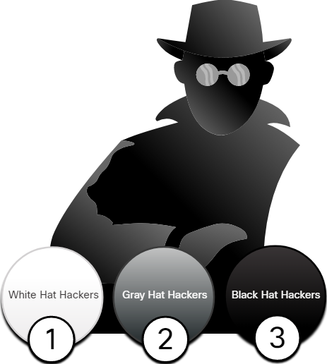
Attackers and Their Tools
Hacker vs. Threat Actor (Contd.)
White Hat Hackers:
White hat hackers are ethical hackers who use their programming skills for good, ethical, and legal purposes.
Gray Hat Hackers:
Grey hat hackers are individuals who commit crimes and unethical things, but not for personal gain or to cause damage.
Black Hat Hackers:
Black hat hackers are unethical criminals who violate computer and network security for personal gain.
Note: The term ‘threat actor’ is used when referring to individuals or groups that could be classified as gray or black hat hackers.
Notes:
13– Attackers and Their Tools
13.1 – Who is Attacking Our Network?
13.1.2 – Hacker vs. Threat Actor

Slide 17
Attackers and Their Tools
Evolution of Threat Actors
Hacking started in the 1960s with phone freaking, which refers to using various audio frequencies to manipulate phone systems.
In the early 1960’s, threat actors realized that by mimicking a tone using a whistle, they could exploit the phone switches to make free long-distance calls.
In the mid-1980’s, threat actors wrote ‘war dialing’ programs which dialed each telephone number in a given area in search of computers, bulletin board systems, and fax machines.
When a phone number was found, password-cracking programs were used to gain access.
Notes:
13– Attackers and Their Tools
13.1 – Who is Attacking Our Network?
13.1.3 – Evolution of Threat Actors

Slide 18
Attackers and Their Tools
Evolution of Threat Actors (Contd.)
Types of Threat Actors:
Script kiddies - It refers to teenagers or inexperienced threat actors running existing scripts, tools, and exploits, to cause harm, but typically not for profit.
Vulnerability brokers - It refers to grey hat hackers who attempt to discover exploits and report them to vendors, for prizes or rewards.
Hacktivists - It refers to grey hat hackers who rally and protest against different political and social ideas.
Cybercriminals - It refers to black hat hackers who are either self-employed or working for large cybercrime organizations.
State-sponsored - State-Sponsored hackers are threat actors who steal government secrets, gather intelligence, and sabotage networks of foreign governments, terrorist groups, and corporations.
Notes:
13– Attackers and Their Tools
13.1 – Who is Attacking Our Network?
13.1.3 – Evolution of Threat Actors

Slide 19

Attackers and Their Tools
Cybercriminals
Cybercriminals are threat actors who are motivated to make money using any necessary means.
At times, cybercriminals work independently or they are financed and sponsored by criminal organizations.
They steal billions of dollars from consumers and businesses every year.
They operate in underground economy and buy and sell personal information and intellectual property that they steal from victims.
They target small businesses and consumers, as well as large enterprises and industries.
Notes:
13– Attackers and Their Tools
13.1 – Who is Attacking Our Network?
13.1.4 – Cybercriminals

Slide 20
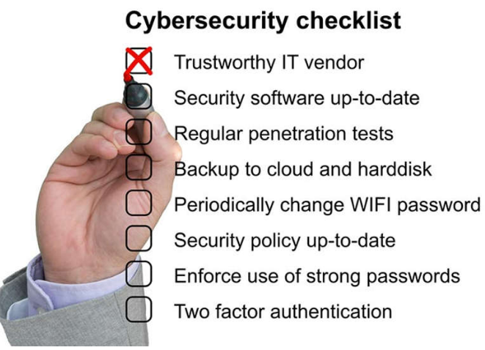
Attackers and Their Tools
Cybersecurity Tasks
Threat actors target the home users, small-to-medium sized businesses, as well as large public and private organizations.
Hence, Cybersecurity is a shared responsibility which all users must practice to make the internet and networks safer and more secure.
Organizations must take action and protect their assets, users, and customers. They must develop and practice cybersecurity tasks such as those mentioned in the figure.
Notes:
13– Attackers and Their Tools
13.1 – Who is Attacking Our Network?
13.1.5 – Cybersecurity Tasks

Slide 21
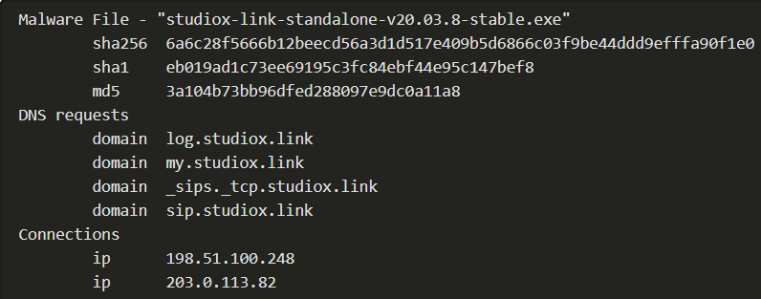
Attackers and Their Tools
Cyber Threat Indicators
Indicators Of Compromise (IOC)
IOCs are the evidence that an attack has occurred and each attack has unique identifiable attributes.
IOCs can be features that identify malware files, IP addresses of servers that are used in attacks, filenames, and characteristic changes made to end system software, among others.
IOCs help cybersecurity personnel identify what has happened in an attack and develop defenses against the attack.
Summary of the IOC for a piece of malware
Notes:
13– Attackers and Their Tools
13.1 – Who is Attacking Our Network?
13.1.6 – Cyber Threat Indicators

Slide 22
Attackers and Their Tools
Cyber Threat Indicators (Contd.)
Indicators of Attack (IOA)
IOA focus more on the motivation and strategies behind an attack and the attackers to gain access to assets.
IOAs helps to generate a proactive security approach that can be reused in multiple contexts and multiple attacks. Defending against a strategy can therefore prevent future attacks.
Notes:
13– Attackers and Their Tools
13.1 – Who is Attacking Our Network?
13.1.6 – Cyber Threat Indicators

Slide 23
Attackers and Their Tools
Threat Sharing and Building Cybersecurity Awareness
Governments are now actively promoting cybersecurity.
The US Cybersecurity Infrastructure and Security Agency (CISA) is leading efforts to automate the sharing of cybersecurity information with public and private organizations at no cost.
CISA use a system called Automated Indicator Sharing (AIS) which enables the sharing of attack indicators between the US government and the private sector as soon as threats are verified.
The European Union Agency for Cybersecurity (ENISA) delivers advice and solutions for the cybersecurity challenges of the EU member states.
The CISA and the National Cyber Security Alliance (NCSA) have an annual campaign in every October called National Cybersecurity Awareness Month (NCASM) to raise awareness about cybersecurity.
Notes:
13– Attackers and Their Tools
13.1 – Who is Attacking Our Network?
13.1.7 – Threat Sharing and Building Cybersecurity Awareness

Slide 24

Attackers and Their Tools
Threat Sharing and Building Cybersecurity Awareness (Contd.)
The theme for the NCASM for 2019 was Own IT. Secure IT. Protect IT.
Security topics provided through campaign:
Social media safety
Updating privacy settings
Awareness of device app security
Keeping software up-to-date
Safe online shopping
Wi-Fi safety
Protecting customer data
Notes:
13– Attackers and Their Tools
13.1 – Who is Attacking Our Network?
13.1.7 – Threat Sharing and Building Cybersecurity Awareness
13.1.8 - Check Your Understanding – What Color is my Hat?

Slide 25
13.2 Threat Actor Tools
Notes:
13 – Attackers and Their Tools
13.2 – Threat Actor Tools
In-Session Activities / Explanations:
Time: 7 min
Instructor Notes:
Introduce the topic and discuss various security tools and categories of attacks.
While discussing Introduction of Attack tools, please refer 13.2.1 on online course to view the bar graph.
Explain the evolution of security tools.
Ensure that the learners complete the “Check Your Understanding – Classify Cyber Attacks” in section 13.2.4.
Key Points: Attack tools, Introduction of security tools, Categories of attack

Slide 26
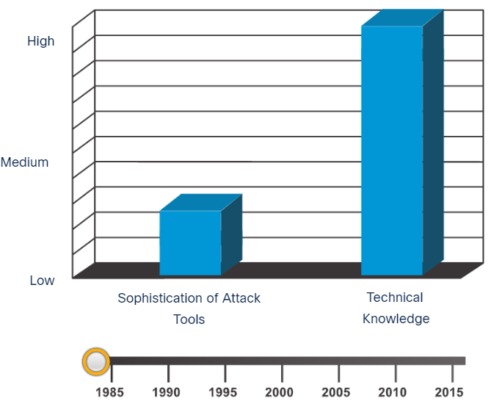
Threat Actor Tools
Introduction of Attack Tools
To exploit vulnerability, a threat actor must have a technique or tool.
Over the years, attack tools have become more sophisticated, and highly automated.
These new tools require less technical knowledge to implement.
In the figure, drag the white circle across the timeline to view the relationship between the sophistication of attack tools versus the technical knowledge required to use them.
Notes:
13 – Attackers and Their Tools
13.2 - Threat Actor Tools
13.2.1 - Introduction of Attack Tools

Slide 27
Threat Actor Tools
Evolution of Security Tools
Ethical hacking involves using many different types of tools to test the network and end devices.
To validate the security of a network and its systems, many network penetration testing tools have been developed and many of these tools can also be used by threat actors for exploitation.
Threat actors have also created various hacking tools. Cybersecurity personnel must also know how to use these tools when performing network penetration tests.
Note: Most of these tools are UNIX or Linux based; therefore, a security professional should have a strong UNIX and Linux background.
Notes:
13 – Attackers and Their Tools
13.2 - Threat Actor Tools
13.2.2 - Evolution of Security Tools

Slide 28
Threat Actor Tools
Evolution of Security Tools (Contd.)
The following table lists some of the categories of common network penetration testing tools.
Categories of Tools | Description
Password crackers | Used to crack or recover the password. Eg:John the Ripper, Ophcrack
Wireless hacking tools | Used to intentionally hack into a wireless network to detect security vulnerabilities. Eg:Aircrack-ng, Kismet
Network scanning and hacking tools | Used to probe network devices, servers, and hosts for open TCP or UDP ports. Eg: Nmap, SuperScan
Packet crafting tools | Used to probe and test a firewall’s robustness. Eg: Hping, Scapy
Packet sniffers | Used to capture and analyze packets within traditional Ethernet LANs or WLANs. Eg: Wireshark, Tcpdump
Rootkit detectors | It is a directory and file integrity checker used by white hats to detect installed root kits. Eg: AIDE, Netfilter
Fuzzers to search vulnerabilities | Used by threat actors when attempting to discover a computer system’s security vulnerabilities. Eg: Skipfish, Wapiti
Notes:
13 – Attackers and Their Tools
13.2 - Threat Actor Tools
13.2.2 - Evolution of Security Tools

Slide 29
Threat Actor Tools
Evolution of Security Tools (Contd.)
Categories of Tools | Description
Forensic tools | White hat hackers use these tools to sniff out any trace of evidence existing in a particular computer system. Eg: Sleuth Kit, Helix
Debuggers | Used by black hats to reverse engineer binary files when writing exploits and used by white hats when analyzing malware. Eg:GDB, WinDbg
Hacking operating systems | These are preloaded with tools and technologies optimized for hacking. Eg: Kali Linux, SELinux
Encryption tools | These tools use algorithm schemes to encode the data to prevent unauthorized access to the data. Eg: VeraCrypt, CipherShed
Vulnerability exploitation tools | These tools identify whether a remote host is vulnerable to a security attack. Eg: Metasploit, Core Impact
Vulnerability scanners | These tools scan a network or system to identify open ports. They can also be used to scan for known vulnerabilities and scan VMs, BYOD devices, and client databases. Eg:Nipper, Securia PSI
Notes:
13 – Attackers and Their Tools
13.2 - Threat Actor Tools
13.2.2 - Evolution of Security Tools

Slide 30
Threat Actor Tools
Categories of Attacks
Threat actors use the previously mentioned tools or a combination of tools to create various attacks.
It is important to understand that threat actors use a variety of security tools to carry out these attacks.
The following table displays common types of attacks.
Category of Attack | Description
Eavesdropping attack | An eavesdropping attack is when a threat actor captures and listens to network traffic. This is also called as sniffing or snooping.
Data modification attack | Data modification attacks occur when a threat actor has captured enterprise traffic and has altered the data in the packets without the knowledge of the sender or receiver.
IP address spoofing attack | An IP address spoofing attack is when a threat actor constructs an IP packet that appears to originate from a valid address inside the corporate intranet.
Notes:
13 – Attackers and Their Tools
13.2 - Threat Actor Tools
13.2.3 - Categories of Attacks

Slide 31
Threat Actor Tools
Categories of Attacks (Contd.)
Category of Attack | Description
Password-based attacks | Password-based attacks occur when a threat actor obtains the credentials for a valid user account.
Denial-of-service (DoS) attack | A DoS attack prevents normal use of a computer or network by valid users. This attack can block traffic, which results in a loss of access to network resources.
Man-in-the-middle attack (MiTM) | A MiTM attack occurs when threat actors have positioned themselves between a source and destination.
Compromised key attack | A compromised-key attack occurs when a threat actor obtains a secret key. A compromised key can be used to gain access to a secured communication without the sender or receiver.
Sniffer attack | A sniffer is an application or device that can read, monitor, and capture network data exchanges and read network packets. If the packets are not encrypted, a sniffer provides a full view of the data inside the packet.
Notes:
13 – Attackers and Their Tools
13.2 - Threat Actor Tools
13.2.3 – Categories of Attacks
13.2.4 – Check Your Understanding - Classify Cyber Attacks

Slide 32
13.3 Attackers and Their Tools Summary
Notes:
13 – Attackers and Their Tools
13.3 – Attackers and Their Tools Summary
In-Session Activities / Explanations:
Time: 5 min
Instructor Notes:
Read out the summary points mentioned on the slide.
Discuss the same with the participants.
Ask if they have any questions or doubts.
At the end, ask the students to complete the module quiz.
Key Points: NA

Slide 33
Attackers and Their Tools Summary What Did I Learn in this Module?
To understand network security, it is important to understand the terms such as threat, vulnerability, attack surface, exploit, and risk.
Risk management is the process of providing protective measures by protecting the asset.
Four common ways to manage risk are risk acceptance, risk avoidance, risk reduction, and risk transfer.
Hacker is a term used to describe a threat actor. White hat hackers are ethical hackers that use their skills for good, ethical, and legal purposes.
Grey hat hackers are individuals who commit crimes and do unethical things, but not for personal gain.
Black hat hackers are criminals who violate computer and network security for personal gain, or for malicious reasons, such as attacking networks.
Notes:
13 – Attackers and Their Tools
13.3 – Attackers and Their Tools Summary 13.3.1 – What Did I Learn In this Module?

Slide 34
Attackers and Their Tools Summary What Did I Learn in this Module? (Contd.)
Many network attacks can be prevented by sharing information about Indicators of Compromise (IOC). CISA and NCSA are examples of cybersecurity promoting organizations.
Attack tools have become more sophisticated, and highly automated.
Many of the tools are Linux or UNIX based and knowledge of these are useful to a cybersecurity professional.
Tools include password crackers, wireless hacking tools, network security scanning and hacking tools, packet crafting tools, packet crafting tools, packet sniffers, rootkit detectors, fuzzers to search vulnerabilities, forensic tools, debuggers, hacking operating systems, encryption tools, vulnerability exploitation tools, and vulnerability scanners.
Categories of attacks include eavesdropping attacks, data modification attacks, IP address spoofing attacks, password-based attacks, denial-of-service attacks, man-in the-middle attacks, compromised key attacks, and sniffer attacks.
Notes:
13 – Attackers and Their Tools
13.3 – Attackers and Their Tools Summary 13.3.1 – What Did I Learn In this Module?
13.3.2 – Quiz – Attackers and Their Tools Quiz

Slide 35
Module 13 New Terms and Commands
Indicators of Compromise (IOC) Indicators of Attack (IOA) Automated Indicator Sharing (AIS) Cybersecurity Infrastructure and Security Agency (CISA) | National Cyber Security Alliance (NCSA) National Cybersecurity Awareness Month (NCASM) European Union Agency for Cybersecurity (ENISA)
Notes:
13 – Attackers and Their Tools
New Terms and Commands

