Slide 1
Module 15: Network Monitoring and Tools
Instructor Materials
CyberOps Associate v1.0
Notes:
Cisco Networking Academy Program
CyberOps Associate v1.0
Module 15: Network Monitoring and Tools

Slide 2
Instructor Materials – Module 15 Planning Guide
This PowerPoint deck is divided in two parts:
Instructor Planning Guide
Information to help you become familiar with the module
Teaching aids
Instructor Class Presentation
Optional slides that you can use in the classroom
Begins on slide # 8
Note: Remove the Planning Guide from this presentation before sharing with anyone.
For additional help and resources go to the Instructor Home Page and Course Resources for this course. You also can visit the professional development site on www.netacad.com, the official Cisco Networking Academy Facebook page, or Instructor Only FB group.
Notes:
2

Slide 3
What to Expect in this Module
To facilitate learning, the following features within the GUI may be included in this module:
Feature | Description
Check Your Understanding(CYU) | Per topic online quiz to help learners gauge content understanding.
PT Activity | Simulation and modeling activities designed to explore, acquire, reinforce, and expand skills.
Class Activities | These are found on the Instructor Resources page. Class Activities are designed to facilitate learning, class discussion, and collaboration.
Module Quizzes | Self-assessments that integrate concepts and skills learned throughout the series of topics presented in the module.

Slide 4
Check Your Understanding
Check Your Understanding activities are designed to let students quickly determine if they understand the content and can proceed, or if they need to review.
Check Your Understanding activities do not affect student grades.
There are no separate slides for these activities in the PPT. They are listed in the notes area of the slide that appears before these activities.
Notes:
4

Slide 5
Module 15: Activities
What activities are associated with this module?
Page | Activity Type | Activity Name | Optional?
15.0.3 | Class Activity | What’s Going On? | Recommended
15.2.6 | Check Your Understanding | Identify the Network Monitoring Tool | Recommended
15.2.7 | PT Activity | Logging Network Activity | Recommended
Notes:
5

Slide 6
Module 15: Best Practices
Prior to teaching Module 15, the instructor should:
Review the activities and assessments for this module.
Try to include as many questions as possible to keep students engaged during classroom presentation.
Topic 15.1
Throw open ended questions to the learners:
What is the importance of keeping networks secured and protected?
What are the different tools or devices used for network protection?
Sketch a sample network with a TAP on the whiteboard to demonstrate to the learners an example of Network Tap.
Discuss about the importance of port mirroring technique.
Notes:
6

Slide 7
Module 15: Best Practices (Contd.)
Topic 15.2
List the tools used for Monitoring Network Security.
Differentiate between SIEM and SOAR.
Discuss SIEM Systems with the learners in class.
Define Netflow.
Assist the learners in the Packet Tracer activity in case they get stuck somewhere and give them the reasoning or explanation of the same.
Notes:
7

Slide 8
Module 15: Network Monitoring and Tools
CyberOps Associate v1.0
Notes:
Cisco Networking Academy Program
CyberOps Associate v1.0
Module 15: Network Monitoring and Tools
In-Session Activities / Explanations:
Time: 10 min
Instructor Notes:
Welcome the audience in a warm and cordial manner. Ensure that everyone is set up with the required resources.
Introduce yourself briefly and invite participants to introduce self with name, dept. and role, if deemed all right.
Introduce the topic and encourage learners to come up with a list of expectations from the session. Collate topics on the white board or Desktop while using learner’s inputs to interpret them in words.
Read out the Objectives and briefly describe each.
Key Points: NA

Slide 9
Module Objectives
Module Title: Network Monitoring and Tools
Module Objective: Explain network traffic monitoring.
Topic Title | Topic Objective
Introduction to Network Monitoring | Explain the importance of network monitoring.
Introduction to Network Monitoring Tools | Explain how network monitoring is conducted.
Notes:
9
15 – Network Monitoring and Tools
15.0 – Introduction
15.0.2 – What Will I Learn in this Module?
15.0.3 – Class Activity – What’s Going On?

Slide 10
15.1 Introduction to Network Monitoring
Notes:
Source:
15 – Network Monitoring and Tools
15.1 – Introduction to Network Monitoring
In-Session Activities / Explanations:
Time: 8 min
Instructor Notes:
Describe Network Security Topology
Explain the different tools and methods used for monitoring network traffic.
Describe the concept of Network Taps
Identify the different SPAN terms in the image on slide 15 and explain to the learners with their respective description.
Key Points: Network Security Topology, Network Monitoring Methods, Network Taps, Traffic Mirroring, SPAN.

Slide 11
Network Monitoring and Tools Network Security Topology
To mitigate threats, all networks must be secured and protected.
Network requires a security infrastructure consisting of firewalls, Intrusion Detection Systems (IDS), Intrusion Prevention Systems (IPS), and endpoint security software to protect.
These methods and technologies are used to introduce automated monitoring, creating security alerts, or automatically blocking offensive devices.
For large networks, an extra layer of protection is added.
Devices such as firewalls and IPS operate based on pre-configured rules and monitor traffic and compare it against the configured rules. If there is a match, the traffic is handled according to the rule.
An important part of the cybersecurity analyst is to review all alerts generated by network devices and determine the validity of the alerts.
Notes:
15 – Network Monitoring and Tools
15.1 – Introduction to Network Monitoring
15.1.1 – Network Security Topology

Slide 12
Network Monitoring and Tools Network Monitoring Methods
The day-to-day operations of a network consists of traffic flow, bandwidth usage, and resource access. These patterns identify normal network behavior.
To determine normal network behavior, network monitoring must be implemented.
The tools such as IDS, packet analyzers, SNMP, NetFlow, and others are used for network monitoring .
There are two common methods used to capture traffic and send it to network monitoring devices:
Network taps, sometimes known as Test Access Points (TAPs)
Traffic mirroring using Switch Port Analyzer (SPAN) or other port mirroring.
Notes:
15 – Network Monitoring and Tools
15.1 – Introduction to Network Monitoring
15.1.2 – Network Monitoring Methods

Slide 13
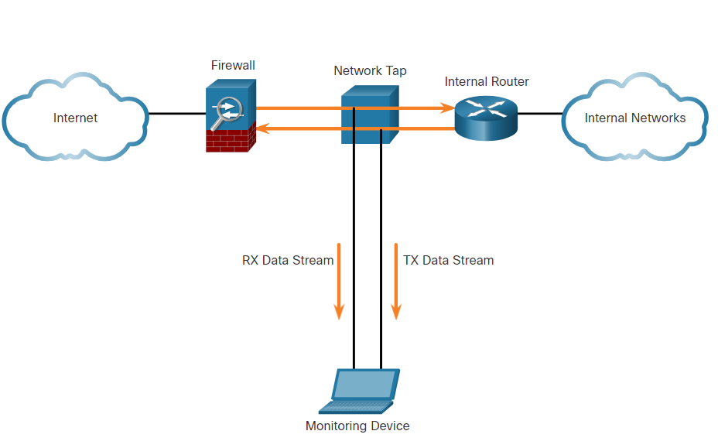
Network Monitoring and Tools Network Taps
A network tap is a passive splitting device implemented inline between a device of interest and the network.
A tap forwards all traffic, including physical layer errors, to an analysis device while allowing the traffic to reach its intended destination.
Here, the tap simultaneously sends both the transmit (TX) data stream from the internal router and the receive (RX) data stream to the internal router on separate, dedicated channels.
This ensures that all data arrives at the monitoring device in real time.
Taps are fail-safe, which means that the traffic between the firewall and internal router is not affected.
Implementing a TAP in a Sample Network
Notes:
15 – Network Monitoring and Tools
15.1 – Introduction to Network Monitoring
15.1.3 – Network Taps

Slide 14
Network Monitoring and Tools Traffic Mirroring and SPAN
Capturing data for network monitoring requires all traffic to be captured.
Special techniques such as port mirroring must be employed to bypass network segmentation imposed by network switches.
Port mirroring enables the switch to copy frames that are received on one or more ports to a Switch Port Analyzer (SPAN) port that is connected to an analysis device.
The table identifies and describes the SPAN terms.
SPAN Term | Description
Ingress traffic | Traffic that enters the switch
Egress traffic | Traffic that leaves the switch.
Source (SPAN) port | Source ports are monitored as traffic entering them is replicated (mirrored) to the destination ports.
Destination (SPAN) port | A port that mirrors source ports. Destination SPAN ports often connect to analysis devices such as a packet analyzer or an IDS.
Notes:
15 – Network Monitoring and Tools
15.1 – Introduction to Network Monitoring
15.1.4 – Traffic Mirroring and SPAN

Slide 15
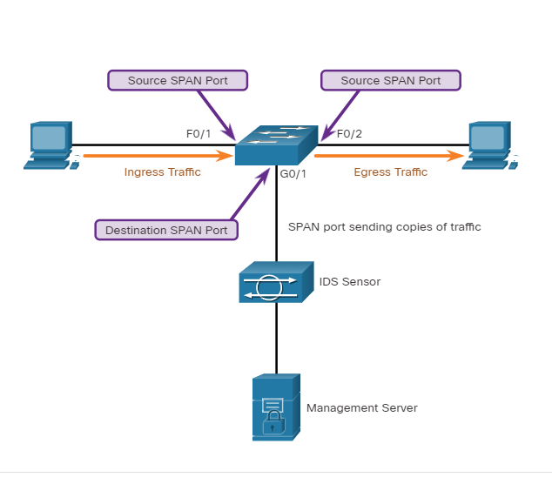
Network Monitoring and Tools Traffic Mirroring and SPAN (Contd.)
The association between source ports and a destination port is called a SPAN session.
In a single session, one or multiple ports can be monitored.
In few Cisco switches, session traffic can be copied to more than one destination port.
A source VLAN can be specified in which all ports in the source VLAN become sources of SPAN traffic.
Note: A variation of SPAN called Remote SPAN (RSPAN) enables a network administrator to use the flexibility of VLANs to monitor traffic on remote switches.
Switch interconnecting two hosts and mirroring traffic to an IDS and Network Management Server
Notes:
15 – Network Monitoring and Tools
15.1 – Introduction to Network Monitoring
15.1.4 – Traffic Mirroring and SPAN

Slide 16
15.2 Introduction to Network Monitoring Tools
Notes:
Source:
15 – Network Monitoring and Tools
15.2 – Introduction to Network Monitoring Tools
In-Session Activities / Explanations:
Time: 12 min
Instructor Notes:
This topic describes the different network monitoring tools.
List the tools used for monitoring Network Security.
List the essential functions and solutions of SIEM and SOAR respectively.
Ensure the learners complete the ‘Check Your Understanding – Identify the Network Monitoring Tool’ in section 15.2.6.
Key Points: Wireshark, Tcpdump, NetFlow, Security Information and Event Management Systems.

Slide 17
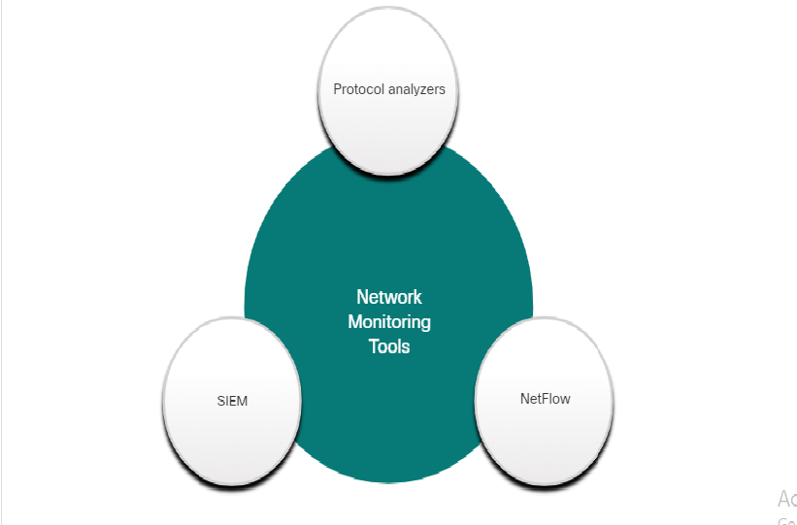
Introduction to Network Monitoring and Tools Network Security Monitoring Tools
Common tools that are used for network security monitoring include:
Network protocol analyzers such as Wireshark and Tcpdump
NetFlow
Security Information and Event Management Systems (SIEM)
It is common for security analysts to rely on log files and Simple Network Management Protocol (SNMP) for network behavior discovery.
Notes:
15 – Network Monitoring and Tools
15.2 – Introduction to Network Monitoring Tools
15.2.1 – Network Security Monitoring Tools

Slide 18
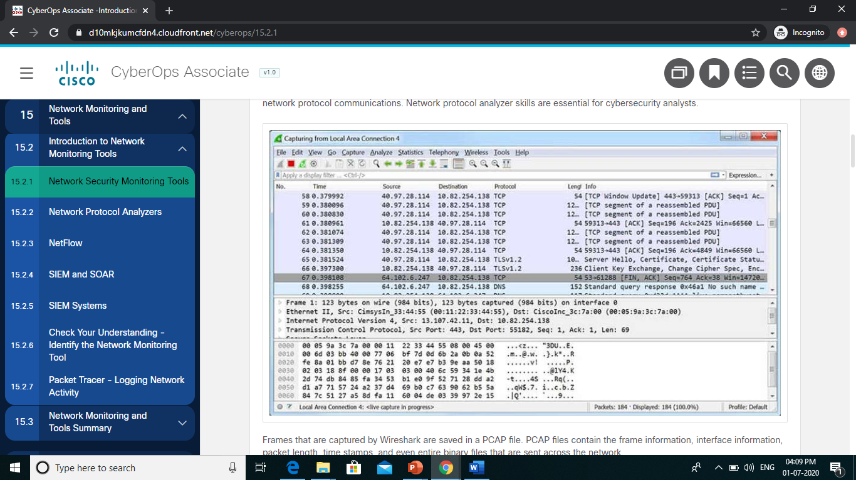
Introduction to Network Monitoring and Tools Network Protocol Analyzers
Network protocol analyzers (or ‘packet sniffer’ applications) are programs used to capture traffic.
Protocol analyzers display what is happening on the network through a graphical user interface.
Network protocol analyzers are not only used for security analysis but also used for network troubleshooting, software and protocol development, and education.
As shown in the figure, Wireshark is used in Windows, Linux, and Mac OS environments. It is a very useful tool for learning network protocol communications.
Notes:
15 – Network Monitoring and Tools
15.2 – Introduction to Network Monitoring Tools
15.2.2 – Network Protocol Analyzers

Slide 19
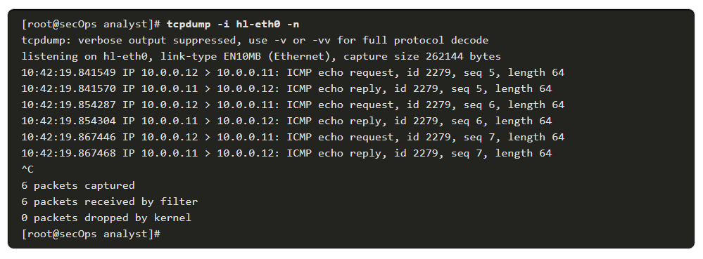
Introduction to Network Monitoring and Tools Network Protocol Analyzers (Contd.)
Frames captured by Wireshark are saved in a PCAP file that contains information regarding the frame, interface, packet length, time stamps, and all binary files sent across the network.
Wireshark can open files containing captured traffic from other software such as the tcpdump utility.
The example in the command output displays a sample tcpdump capture of ping packets.
Note: windump is a Microsoft Windows variant of tcpdump. tshark is a Wireshark command line tool that is similar to tcpdump.
Notes:
15 – Network Monitoring and Tools
15.2 – Introduction to Network Monitoring Tools
15.2.2 – Network Protocol Analyzers

Slide 20
Introduction to Network Monitoring and Tools NetFlow
NetFlow is a Cisco IOS technology that provides 24x7 statistics on packets that flow through a Cisco router or multilayer switch.
NetFlow is the standard for collecting IP operational data in IP networks.
NetFlow can be used for network and security monitoring, network planning, and traffic analysis. It provides a complete audit trail of basic information about every IP flow forwarded on a device.
Although NetFlow stores flow information in a local cache on the device, it should always be configured to forward data to a NetFlow collector which stores the NetFlow data.
Notes:
15 – Network Monitoring and Tools
15.2 – Introduction to Network Monitoring Tools
15.2.3 – NetFlow

Slide 21
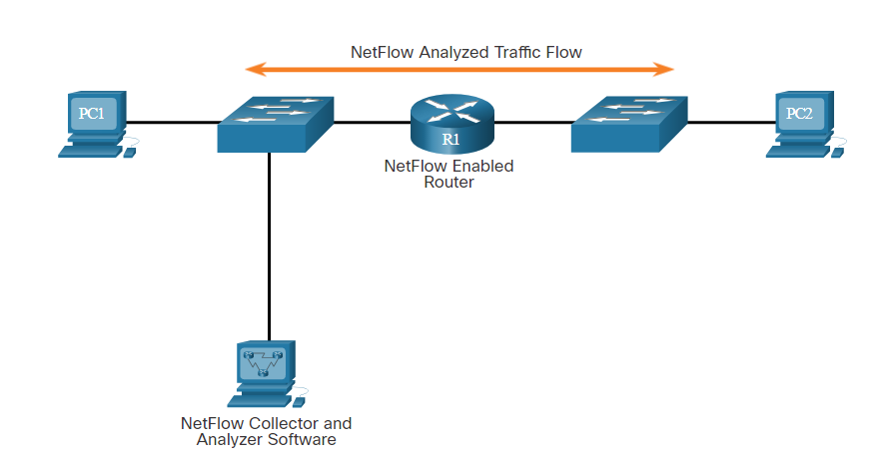
Introduction to Network Monitoring and Tools NetFlow (Contd.)
NetFlow can monitor application connection by tracking byte and packet counts for that individual application flow.
It pushes the statistics over to an external server called a NetFlow collector.
Cisco Stealthwatch collects NetFlow statistics to perform advanced functions including:
Flow stitching - It groups individual entries into flows.
Flow deduplication - It filters duplicate incoming entries from multiple NetFlow clients.
NAT stitching - It simplifies flows with NAT entries.
PC1 connected to PC2 using HTTPS
Notes:
15 – Network Monitoring and Tools
15.2 – Introduction to Network Monitoring Tools
15.2.3 – NetFlow

Slide 22
Introduction to Network Monitoring and Tools SIEM and SOAR
SIEM
Security Information Event Management (SIEM) is a technology used in enterprise organizations to provide real time reporting and long-term analysis of security events.
SIEM systems include the following essential functions:
Forensic analysis – The ability to search logs and event records from sources and provide complete information for forensic analysis.
Correlation – Examines logs and events from different systems or applications, speeding detection of and reaction to security threats.
Aggregation - Reduces the volume of event data by consolidating duplicate event records.
Reporting - Presents the correlated and aggregated event data in real-time monitoring and long-term summaries.
Notes:
15 – Network Monitoring and Tools
15.2 – Introduction to Network Monitoring Tools
15.2.4 – SIEM and SOAR

Slide 23
Introduction to Network Monitoring and Tools SIEM and SOAR (Contd.)
SIEM provides details on the source of suspicious activity:
User information such as username, authentication status, location.
Device information such as manufacturer, model, OS version, MAC address, network connection method, and location.
Posture information such as compliance of the device with the security policy and updated antivirus files and OS patches.
SOAR
Security Orchestration, Automation, and Response (SOAR) enhances SIEM.
SOAR helps security teams investigate security incidents and add enhanced data gathering and a number of functionalities that aid in security incident response.
Notes:
15 – Network Monitoring and Tools
15.2 – Introduction to Network Monitoring Tools
15.2.4 – SIEM and SOAR

Slide 24
Introduction to Network Monitoring and Tools SIEM and SOAR (Contd.)
SOAR solutions:
Provides case management tools that allow cybersecurity personnel to research and investigate incidents, frequently by integrating threat intelligence into the network security platform.
Use artificial intelligence to detect incidents that aid in incident analysis and response.
Automate complex incident response procedures and investigations, which are potentially labor intensive tasks performed by Security Operations Center (SOC) staff by executing run books.
Offers dashboards and reports to document incident response to improve SOC key performance indicators and can enhance network security for organizations.
SOAR helps analysts respond to the threat.
Notes:
15 – Network Monitoring and Tools
15.2 – Introduction to Network Monitoring Tools
15.2.4 – SIEM and SOAR

Slide 25
Introduction to Network Monitoring and Tools SIEM Systems
An open source product called Security Onion includes the ELK suite for SIEM functionality.
ELK is an acronym for three products from Elastic:
Elasticsearch - Document oriented full text search engine.
Logstash - Pipeline processing system that connects ‘inputs’ to ‘outputs’ with optional ‘filters’ in between.
Kibana - Browser based analytics and search dashboard for Elasticsearch.
Note: SolarWinds Security Event Manager and Splunk Enterprise Security are two popular proprietary SIEM systems used by SOCs.
Notes:
15 – Network Monitoring and Tools
15.2 – Introduction to Network Monitoring Tools
15.2.5 – SIEM Systems
15.2.6 – Check Your Understanding - Identify the Network Monitoring Too

Slide 26
Introduction to Network Monitoring and Tools Packet Tracer - Logging Network Activity
In this Packet tracer, you will do the following:
Intercept credentials using a sniffer device, while observing an FTP session. An exchange of Syslog messages will also be intercepted by a sniffer device.
Notes:
15 – Network Monitoring and Tools
15.2 – Introduction to Network Monitoring Tools
15.2.7 – Packet Tracer - Logging Network Activity

Slide 27
15.3 Network Monitoring and Tools Summary
Notes:
Source:
15 – Network Monitoring and Tools
15.3 – Network Monitoring and Tools Summary
In-Session Activities / Explanations:
Time: 3 min
Instructor Notes:
Summarise the main points of the module and take the learners through the new terms that they have learned in this module.
Ask them to complete the module quiz present in section 14.4.2.
Key Points: NA

Slide 28
Network Monitoring and Tools Summary What Did I Learn in this Module?
To mitigate threats, all networks should be secured and protected using a defense-in-depth approach.
This requires a security infrastructure that consists of firewalls, IDS, IPS, and endpoint security software.
A cybersecurity analyst needs to review all alerts that are generated by network devices and validate them.
Tools such as IDS, packet analyzers, SNMP, NetFlow, and others are used to determine normal network behavior.
Two common methods that are used to capture traffic and send it to network monitoring devices are network taps and traffic mirroring using Switch Port Analyzer (SPAN) or other port mirroring.
Notes:
15 – Network Monitoring and Tools
15.3 – Network Monitoring and Tools Summary
15.3.1 – What Did I Learn in this Module?

Slide 29
Network Monitoring and Tools Summary What Did I Learn in this Module? (Contd.)
Common tools that are used for network security monitoring include network protocol analyzers (Wireshark and Tcpdump), NetFlow, and SIEM.
Network protocol analyzers are programs that are used to capture traffic.
Netflow is a Cisco IOS feature that provides 24x7 statistics on packets that flow through a Cisco router or multilayer switch. It can be used for network and security monitoring, network planning, and traffic analysis.
SIEM is a technology that is used to provide real time reporting and long-term analysis of security events.
Notes:
15 – Network Monitoring and Tools
15.3 – Network Monitoring and Tools Summary
15.3.1 – What Did I Learn in this Module?
15.3.2 – Quiz – Network Monitoring and Tools Quiz

Slide 30
Module 15 New Terms and Commands
Wireshark tcpdump tshark windump Simple Network Management Protocol (SNMP) Security Information and Event Management Systems (SIEM) NATstitching | Intrusion Prevention Systems (IPS) Switch Port Analyzer (SPAN) NetScout Taps Egress traffic Ingress Traffic Intrusion Detection Device (IDS) Test Access Points (TAPs) Network Tap | Remote SPAN (RSPAN) Security Orchestration, Automation, and Response (SOAR) Security Operations Center (SOC) Security Onion Elastic Search Logstash Kibana (ELK) NetFlow
Notes:
Module 15: Network Monitoring and Tools
New Terms and Commands

